Slide 1
Impact of climate variables on Covid 19 cases

Slide 2
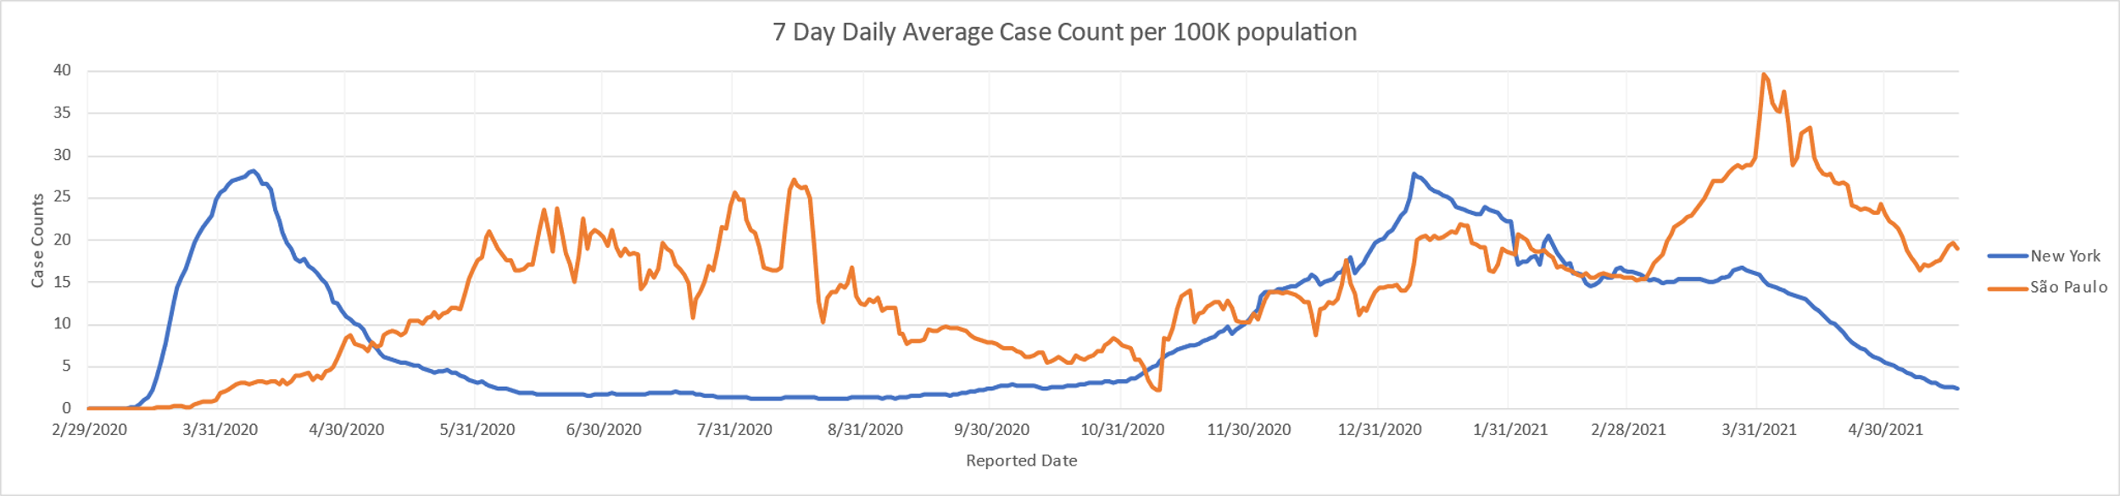
New Average case count per 100k trends
Converted the new covid cases to 7-day average per 100k to remove the anomalies.
New York

Slide 3
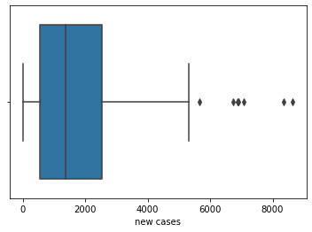
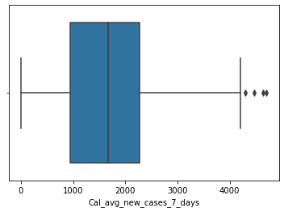
Outliers For new cases (old data set images)
Sau Paulo new case count
Sau Paulo average 7-day case count

Slide 4
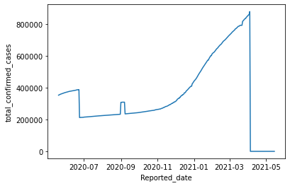
NYC_totalconfirmdataset (old data set images)

Slide 5
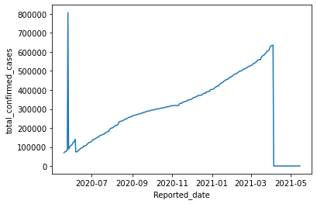
SP_totalconfirmdataset(old data set images)

Slide 6
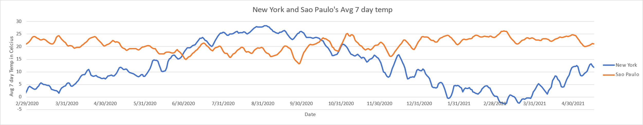

Slide 7
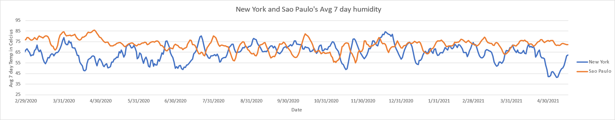

Slide 8
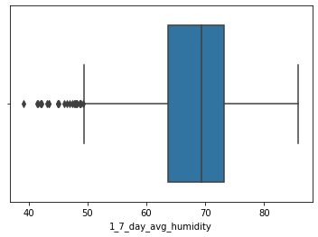
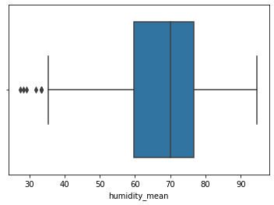
(old data set images)
New York average 7-day humidity
Sao Paulo average 7-day humidity

Slide 9
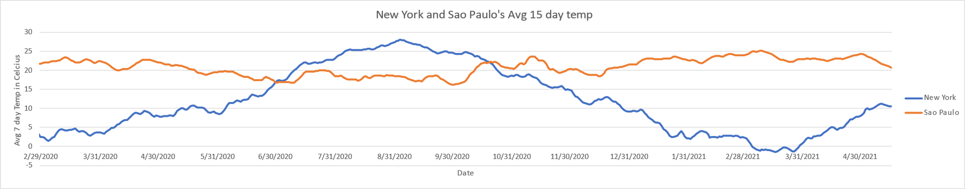

Slide 10
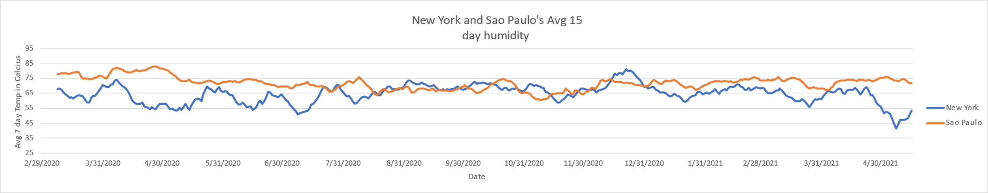

Slide 11
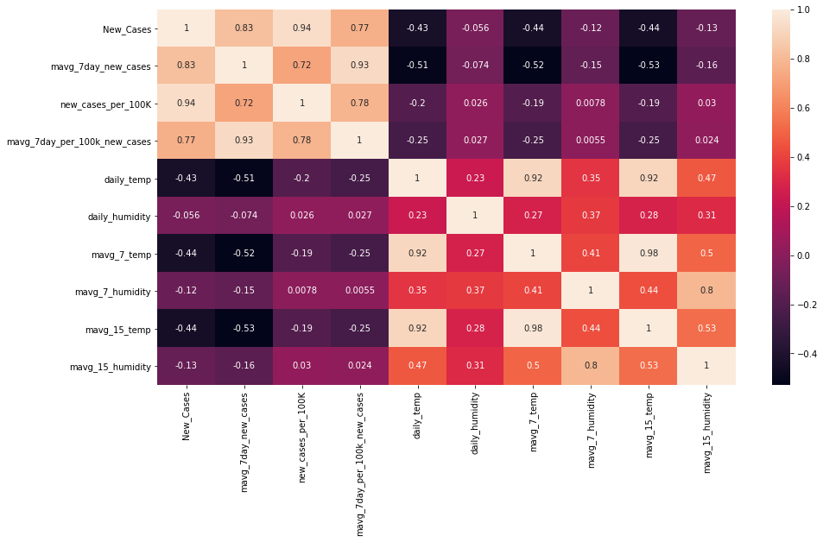
Correlation helps to understand relationship between variables
The heat map shows the correlation between average 7day covid cases per 100k with 15day average of temperature and humidity is low

Slide 12
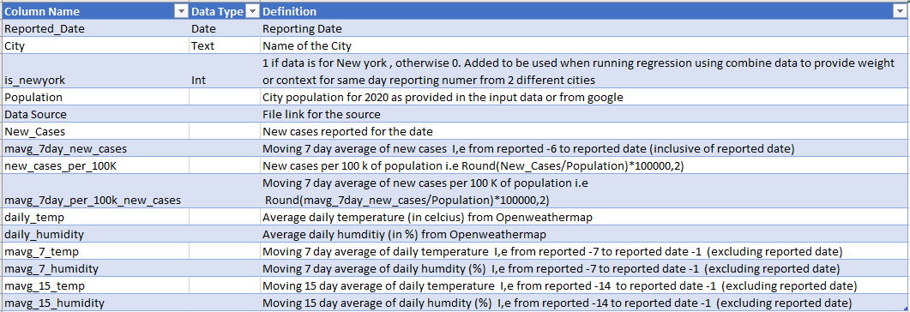
Data defnitions

Slide 13
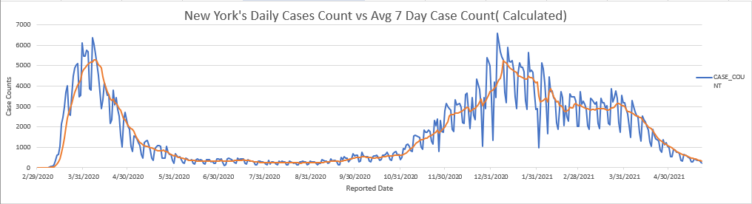

Slide 14
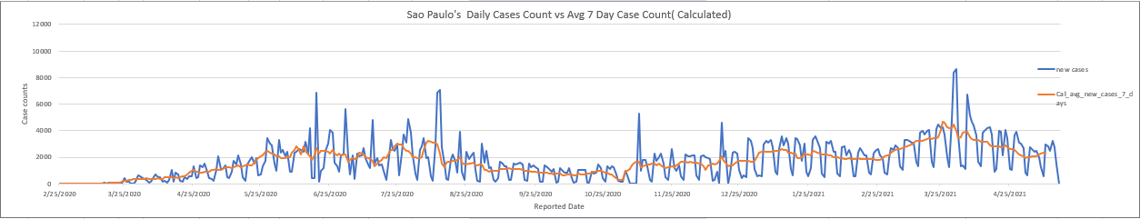

Slide 15
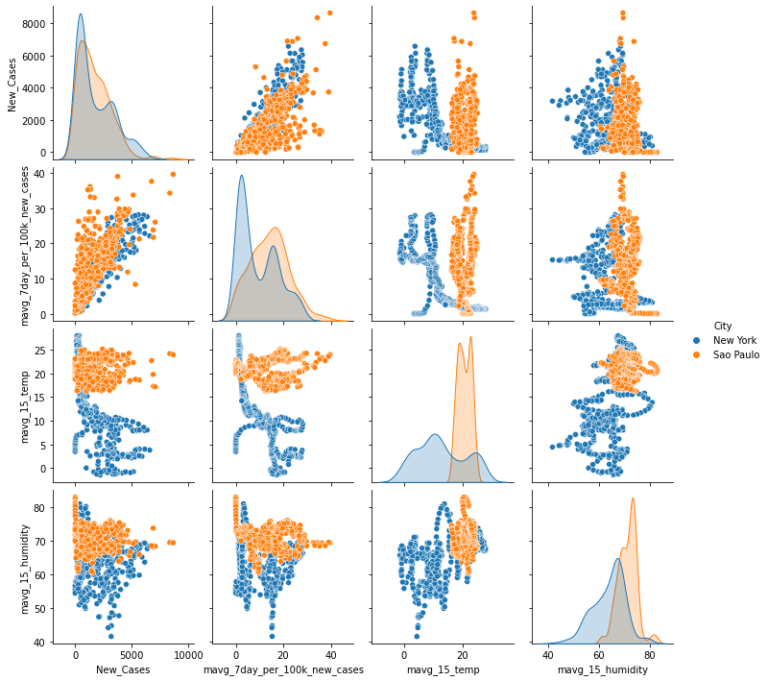
Pair plot to see relationship on the various columns in 2 cities i.e between Moving Average New Cases per 100k with Moving Avg 15 days Temperature and Humidity

Slide 16
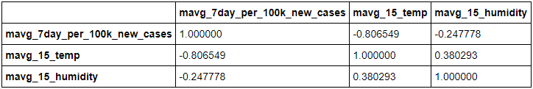
NYC_MovingAve_Correlation

Slide 17
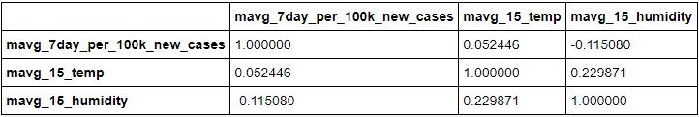
SP_MovingAve_Correlation

Slide 18
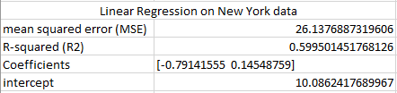

Slide 19
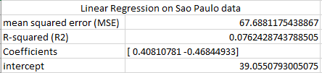
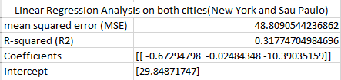

Slide 20
Any Questions ?

