Slide 1
Impact of climate variables on Covid 19 cases for New York City and Sao Paulo
(Does Covid spread faster in Colder and Drier weather?)
Presented by
Aisha Syed
Archana Narula
Maria Leon
Sushmitha Maddali
Kushal Sharma

Slide 2
Overview
The new novel Coronavirus known as Covid19 (SARS CoV-2), has caused one of the most serious health crises globally. Since its global spread last year, we've seen multiple news article around the impact of temperature and humidity on the speed of spread and whether or not virus thrive in colder temperature. A simple Google search using term "covid spread cold and dry weather news" will lead to multiple articles from credible sources (statistical and scientific) in favor or against.
Purpose
The purpose of this study is to analyze if colder and dryer weather have any impact on Covid-19 virus

Slide 3
Overview
Data Sources (Secondary Data)
Covid cases data
Seade Foundation Statistics Agency of the State of Sao Paulo ^{[1]}
NYC Department of Health and Mental Hygiene ^{[2]}
Weather data
OpenWeatherMap ^{[3]}
Project Scope
Limited to 2 cities
New York
Sao Paulo

Slide 4
Overview
Variables
Target
mavg_7day_per_100k_new_cases (7 days moving average of covid19 new cases for the city)
Weather data
mavg_15_temp (15 days moving average of temperature for the city)
mavg_15_humidity (15 days moving average of humidity for the city)
Limitations & Assumptions
Standalone Study (Considers all other parameters were constant like testing, lockdowns, vaccinations, etc)
Integrity of data sources (Data collections and reporting was reliable and neutral)
Notes:
Defining Variables: mentioning reason for the usage of moving average of variables
Assumptions need to be explained in details what does we mean testing, lockdowns and vaccinations, integrity of data

Slide 5
Exploratory Data Analysis
Initial data were loaded in python data structures
Some findings of initial data review
Weather data extarcted from openwheathermap was reliable
Covid data had descrepencies for both cities
Frequent changes in formats of recording data causing data jitters
New sources were identified
Repeated exploratory analysis in MS Excel
Data for covid19 from government websites was reliable
Actual metrices were decided based on new data

Slide 6
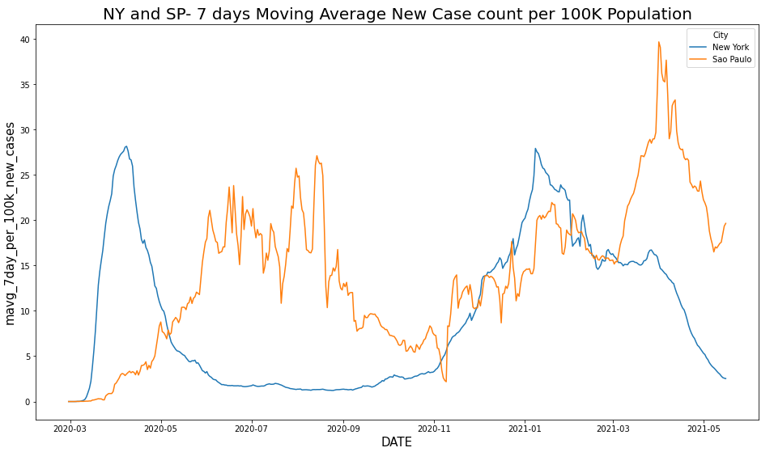
Data Analysis - Compare new cases
The period between May 2020 to Nov 2020, we can see that the weather is a variable that can directly impact the number of confirmed Covid Cases, especifically Cold weather.
ZoneA: As New York was going through a hotter weather, Sao Paulo was going through winter and an increase on the number of cases.
Zone B doesn't follow the same trend as Zone A, possibly as result of the vaccination rate in both cities. NYC higher vaccination rate than Sao Paulo in the same period.
Zone C: In this zone occurs a season transition for both cities; The temperatures are slightly similar. Therefore, the number of cases also follow the same tendency.
No. of cases per 100K population - 7 days avg
B
A
C

Slide 7
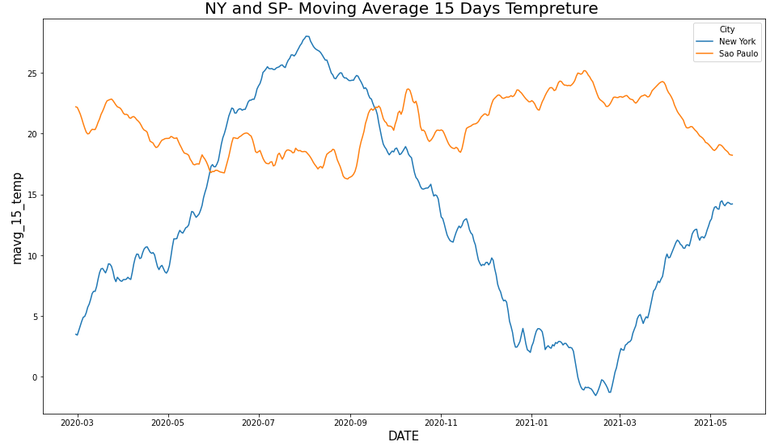
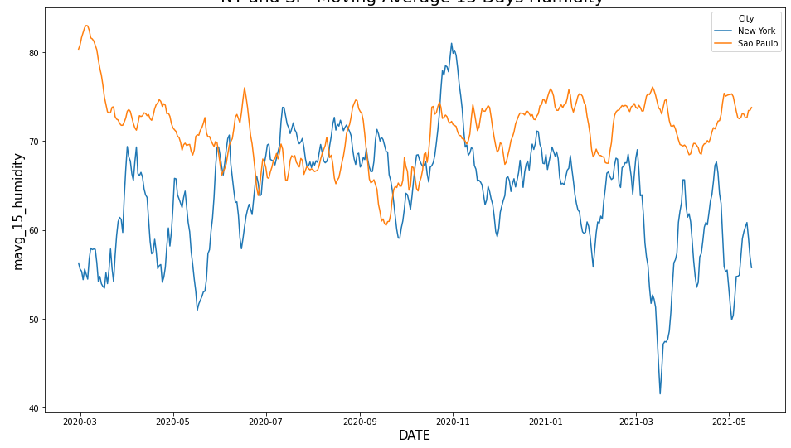
Data Analysis - Compare Weather
2. Temperature - 15 days avg
3. Humidity - 15 days avg
NY curve shows that there is a relation between weather and no. cases. Although, for Sao Paulo the 15 days temp avg is slightly linear. The reason of this discrepancy is possibly due to external factors as vaccination rate, lockdown restrictions, etc.
A
Considering the period selected on zone A, we can see that humidity is quite similar in both cities, Therefore, this parameter does not impact the number of confirmed cases.

Slide 8
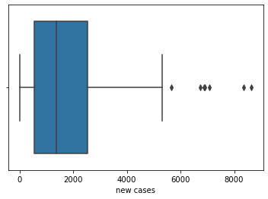
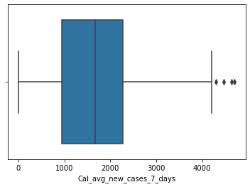
Data Exploration (Delete)
Outlier Detection (Sao Paulo)
New case Count
Case Count 7-day Average

Slide 9
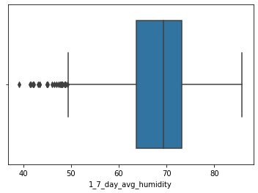
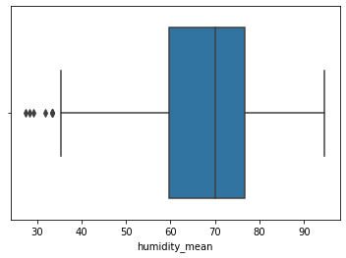
Data Exploration (Delete)
Outlier Detection (7-Day Average Humidity)
New York
Sao Paulo

Slide 10
Methodology
Variable Selection
15 days average temperature and humidity up to the day before as this is usually the virus incubation period
New cases per 100K to compare same size of population
Moving 7 days average of new cases per 100K to smooth out any reporting anomalies
Modeling
We ran correlations to validate the strength of the relationship between the variables.
We ran 3 different regressions , one for each city and one combined. For the combined, we added “is_New York flag” (1= NY, 0=SP)
Selected date range is from Feb 29,2020 to May 16,2021
We didn't split target into train and test due to time series impact and limited amount of data. Model is evaluated using actual y vs predicted y.

Slide 11
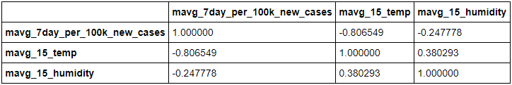
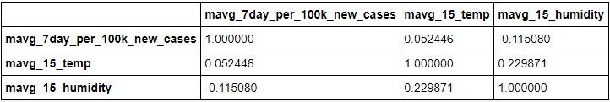
Combined Data - Correlation Analysis (merge1)
Correlation Data for both cities
New York
Sao Paulo

Slide 12
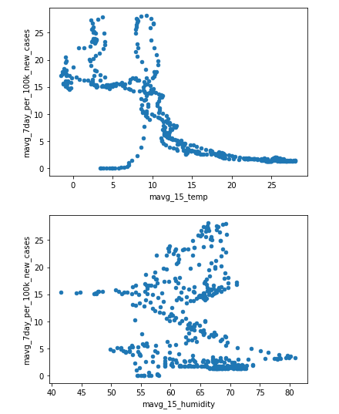
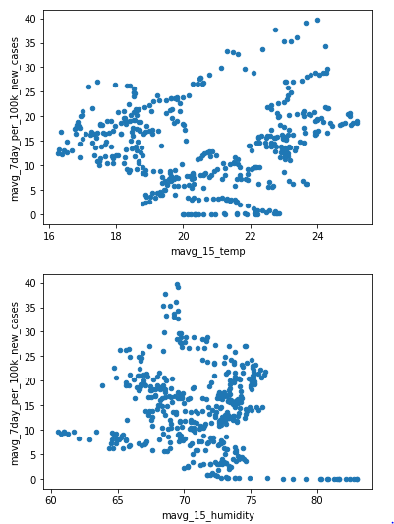
Combined Data - Correlation Analysis (merge2 option#1)
Temperature: The LR confirms that the no. of cases in SP do not follow a trend, especially when it is measured on a 15 days average period, while NY does. This confirms that the data makes sense.
Humidity: The LR shows that there is not impact on the number of cases when humidity is considered for the analysis.
Notes:
Might add pairplo and circle pair plot for aveg temp and new cases pairplot file name Images/pairplot.png. Decide if we should use individual pari lot for each city or the combined one from pairplot.png

Slide 13
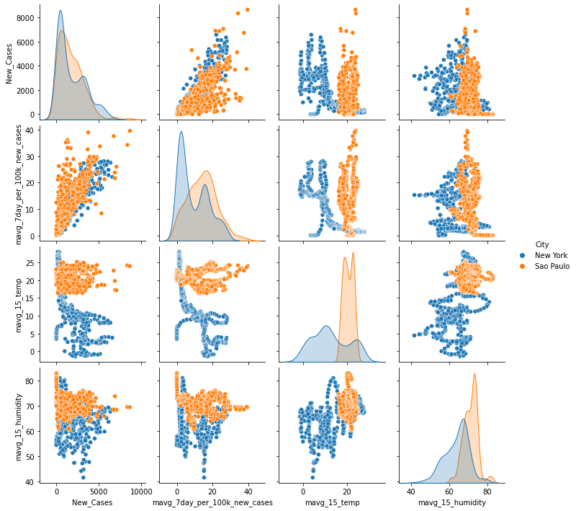
Analysis (Merge 2 Option#2)
Relationship of variables (Moving Average New Cases per 100k with Moving Avg 15 days Temperature and Humidity) for 2 cities

Slide 14
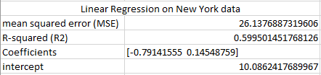
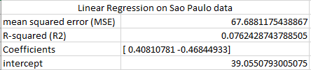
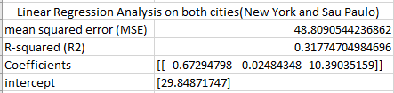
Modeling Outputs

Slide 15
Conclusion (Lucas Help)
Did we find any correlation between temperature and humidity or was our analysis inconclusive?
Notes:
Might add pairplo and circle pair plot for aveg temp and new cases pairplot file name Images/pairplot.png. Decide if we should use individual pari lot for each city or the combined one from pairplot.png

Slide 16
Recommendation to project expansion
Run 3 regression models excluding humidity
Remove impact of other variables e.g
Impact of vaccination rate
Impact of the positive cases related to brazilain mutant, which spread faster than the original.
Impact of Active cases in the city.
Run the analysis using additional city data with similar cities.
Add more cities with diverse conditions to understand the behaviour of Covid cases compare to different temperatures.
Use time series methodologies on the new cases variable before running the regression

Slide 17
Refrences
[1] Seade Foundation Statistics Agency of the State of São Paulo
https://saludata.saludcapital.gov.co/osb/index.php/datos-de-salud/enfermedades-trasmisibles/covid19/
[2] NYC Department of Health and Mental Hygiene
https://github.com/nychealth/coronavirus-data
[3] Open Weather Map
www.openweathermap.org
[4] Bogota Health Observatory
https://saludata.saludcapital.gov.co/osb/index.php/datos-de-salud/enfermedades-trasmisibles/covid19/
[5] wCota Github
https://github.com/wcota/covid19br

Slide 18
Project Team Profile
Aisha Syed https://www.linkedin.com/in/aisha-syed-27506a5/
Archana Narula
Maria Leon https://www.linkedin.com/in/marialeon2009/
Sushmitha Maddali https://www.linkedin.com/in/sushmitha-maddali
Kushal Sharma https://www.linkedin.com/in/kushca
Notes:
Might add pairplo and circle pair plot for aveg temp and new cases pairplot file name Images/pairplot.png. Decide if we should use individual pari lot for each city or the combined one from pairplot.png

Slide 19
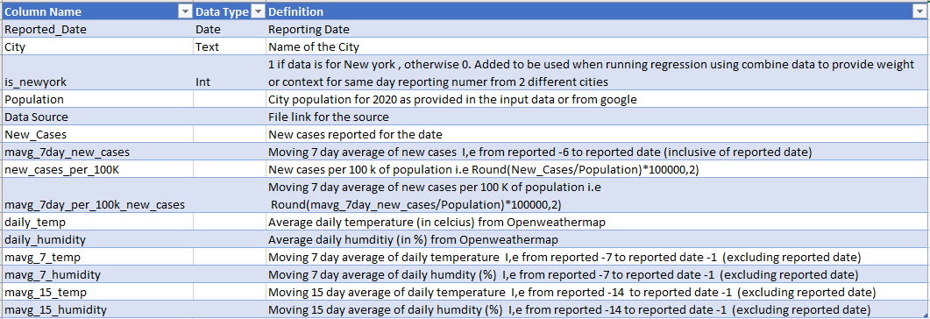
Data Definitions (Appendix#1)

Slide 20
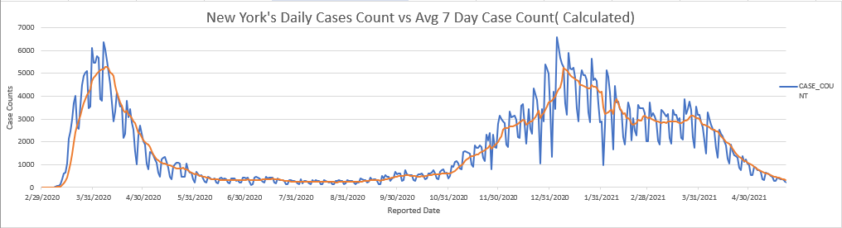
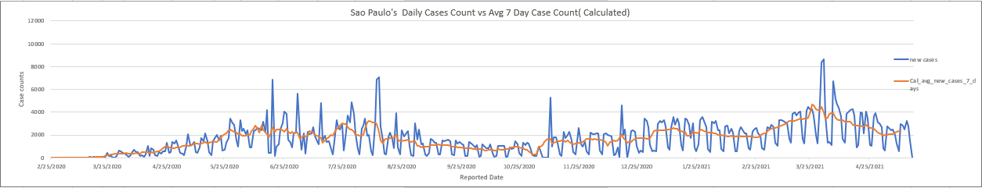
Data Exploration (appendix)
Daily vs 7 Day Average Case Counts

Slide 21
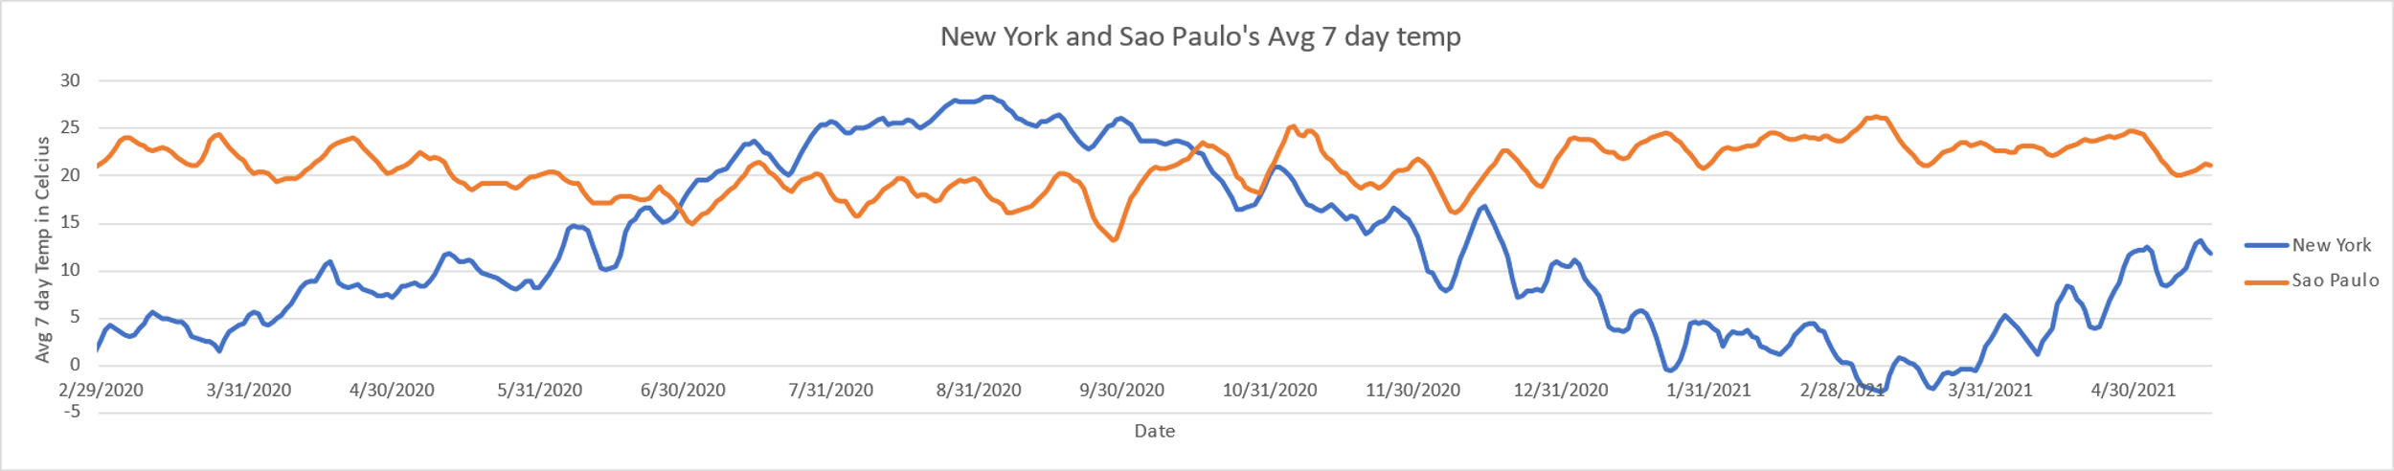
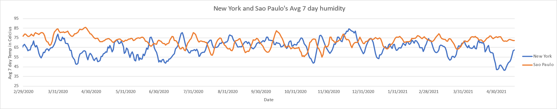
Data Exploration (appendix)
7 Day Averages for weather

Slide 22
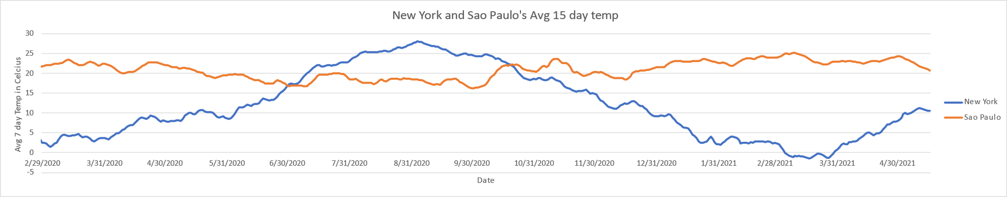
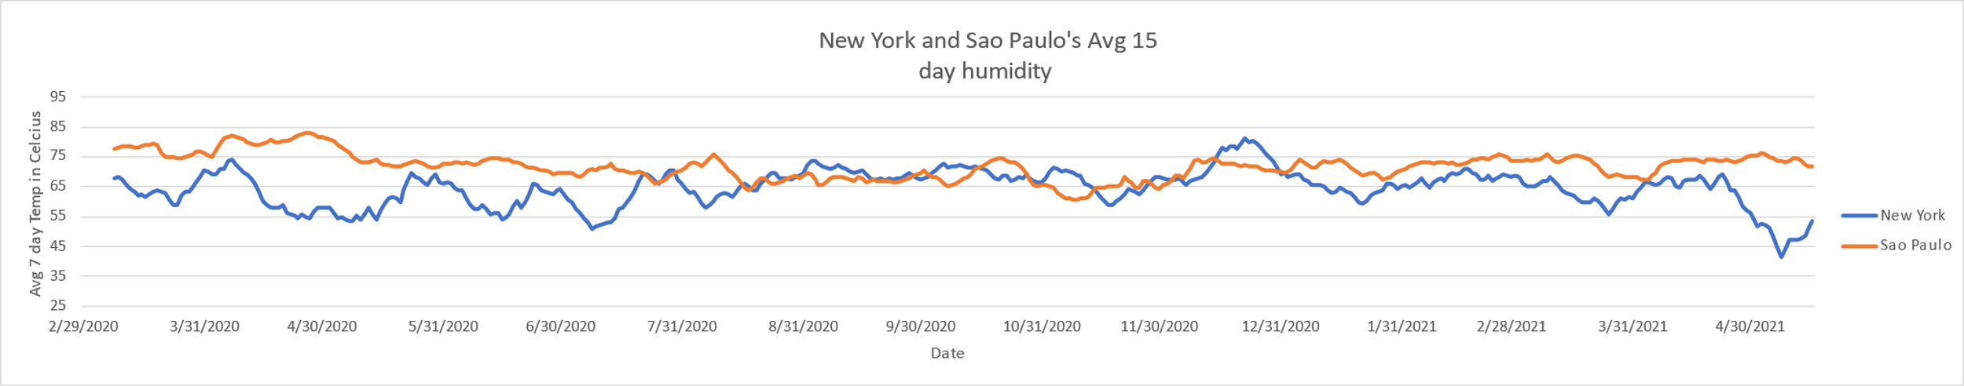
Data Exploration (appendix)
15 Day Averages for weather

Slide 23
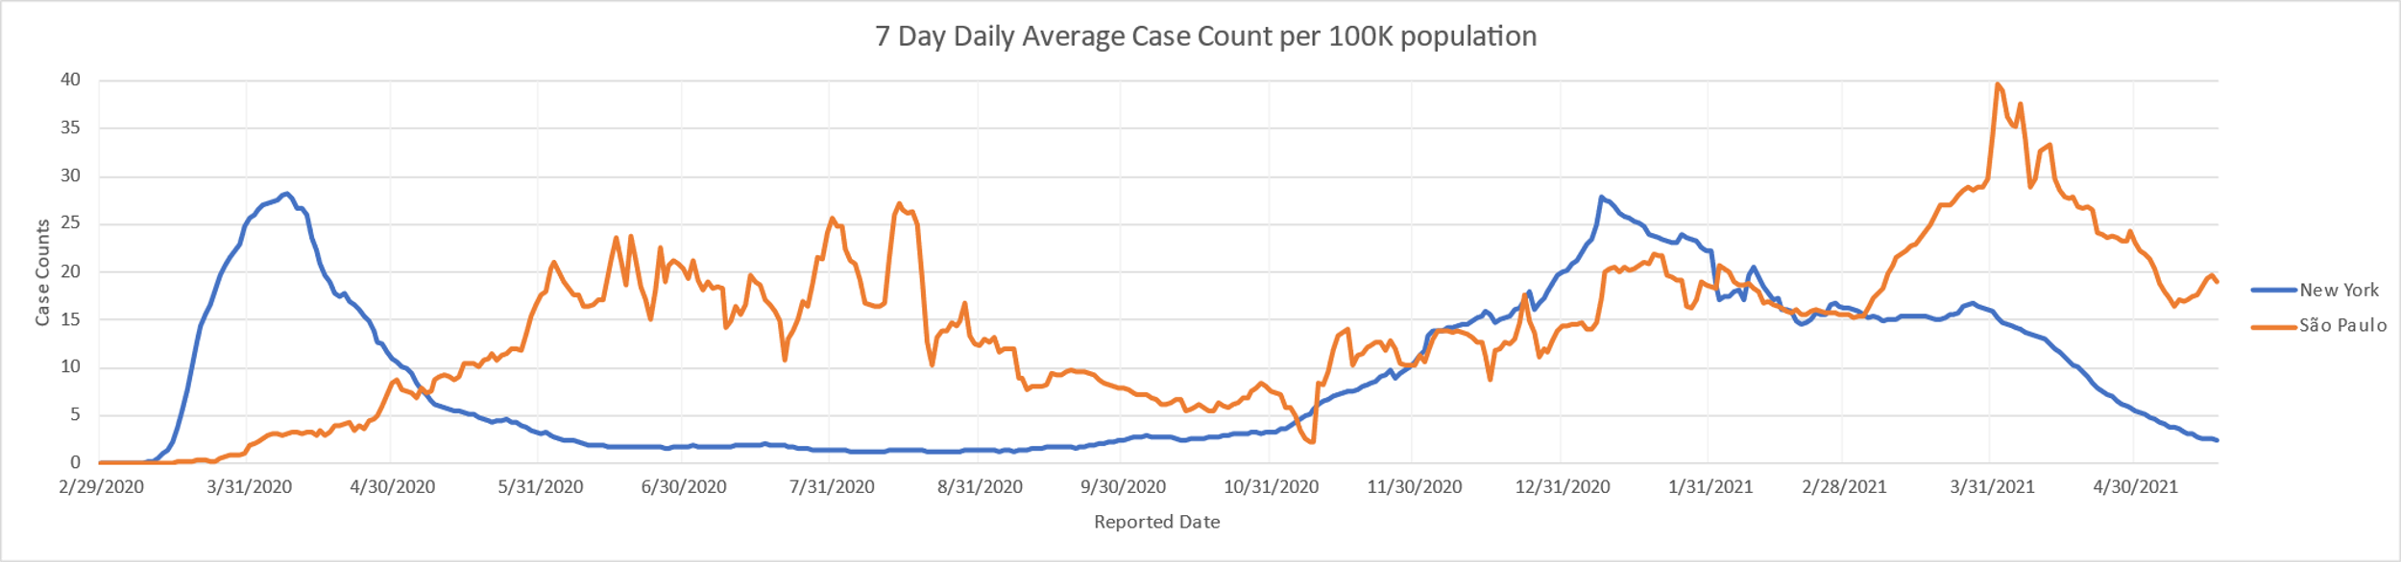
Data Exploration (appendix)
New Average case count per 100k trends
Converted the new covid cases to 7-day average per 100k to remove the anomalies.

Slide 24
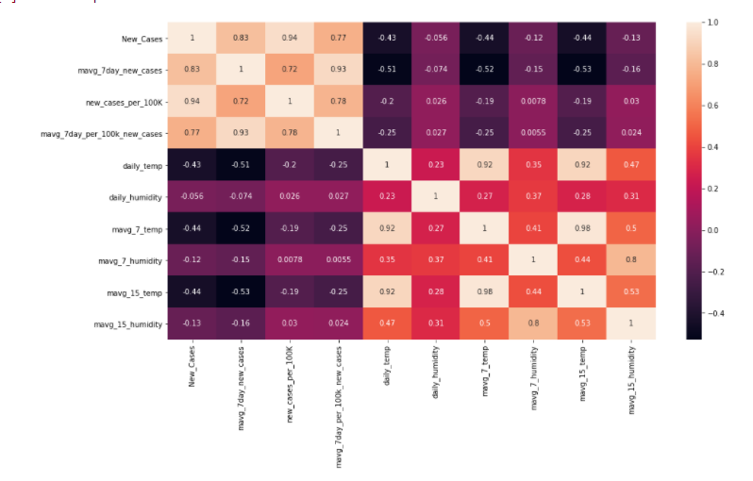
Combined Data - Correlation Analysis (Appendix)
Correlation Data for both cities
The dataset built for the analysis is consistent, as all of them follows the same correlation.
This can be seen through the color distribution for each parameters selected for the analysis.

Slide 25
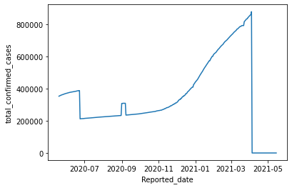
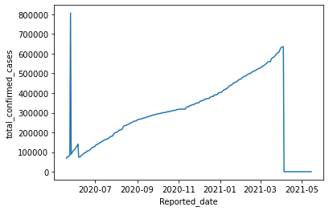
Data Exploration (Delete)
Total Confirmed Cases
New York
Sao Paulo

Slide 26
Assumptions and Constraints (Delete)
There are no extreme deviations in daily average weather parameters
(We have taken 7 day moving average to avoid high variations, nullifies this limitation)
Covid testing was available with similar opportunities to the residents of both cities
All or none Covid19 precautions were followed by residents of both of the cities. Lockdown restrictions were similar in both cities
Data sources selected has a similar reliability and integrity

Slide 27
Next steps for our project (DELETE)
Make adjustments based on feedback from the reviewers
Additional results interpretation (If required)
Conclusion (Suggestions: Add slides with regression results - 3 models from readme -compare them and provide which is the best out of the 3)
Recommendation for expansion of project idea (DONE ON MAY 31,2021)

