Slide 1
HOME4RENT.IE
SANDEEP SUKALE (10510089)
ARCHIS BENDRE (10504140)
MSc INFORMATION SYSTEMS WITH COMPTUING

Slide 2
ABSTRACT
Abstract:
The home4rent.ie web application is designed to fill in the gap between the students and landlords for student accommodation in Ireland. There is large number of students who come to Ireland from abroad for pursuing their higher studies such as master's or PHD. There is huge problem for students for finding an accommodation in Ireland. The web application allows students to login and search for the house according to their budget and location. It also provides a login to landlords wherein they can post their houses for rent. The visual studio code was used to code and design the web application, the data listing of the houses or apartments were used by scrapping the daft.ie website by using an application/software named as scrap storm. There were many challenges faced while designing the application and still there is a room for making it better. Improvements are in mind to integrate it with the backend database in the next version.
Keywords: (Student accommodation, web application,)

Slide 3
Introduction:
The paramount difficulty international students are facing after arriving Ireland is finding an optimal room for living. Unaffordable rent and lack of proper amenities are the main problems that are restricting students to obtain a proper room with ease. The proposed project home4rent.ie will be supporting students to acquire a satisfactory room.
Motivation:
There are no facilities for students for finding an apartments/room in Ireland that is the reason behind making this project by creating a web application to make the students life easier while finding accommodation.

Slide 4
Outline of Project:
Access of International Students
The project will be beneficial for international students, educational consultancies and landlords. Our system provides login access to each of these three users. Tenants (students) can access the website with the registered login id and password. Students will be having access to three separate search pages through which they can fulfil their requirements.
Normal searching for room’s availability. By inputting options such as location preferred, minimum and maximum rent, price and additional requirements vast number of rooms available will be listed on the webpage.
Additionally, a webpage will be available for registration of complaints in PRTB (Public Registration Tenancy Board). Our system administrators will act as an intermediate between tenants and PRTB. Based on the customer complaints, after performing proper investigation complaints will be forwarded to PRTB Office. A dedicated team will be recruited to perform these investigations.

Slide 5
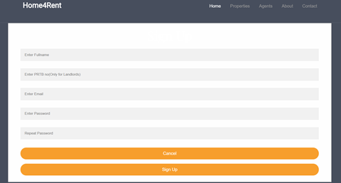
Landlords Access:
Landlords will be provided with a login id and password to login to the system. Landlords can update their room details. Different options of landlords are:
Adding a new room with rent details, location, details of other members (if the available room is an apartment), contact details, normal features and special features etc.
Updating an existing room detail.
PRTB number updating will be mandatory. Landlords with PRTB number can only complete the registration.

Slide 6
Access for Educational Agents
Even though educational agents are provided with separate login page, options will be similar to that of tenants. Majority of students are depending on educational agents for seeking a higher education. Our plan is to exploit this opportunity. Educational agents will be also benefitted by helping students to find the optimal rooms.
Initially we are planning to maintain alliance with educational agents from countries where the greatest number of international students are arriving to Ireland. Most number of overseas students arriving Ireland to seek education are from reputed listed companies. By collaborating with these agencies company will flourish further.

Slide 7
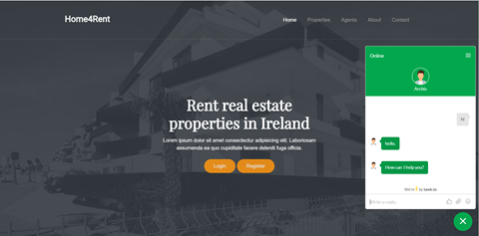
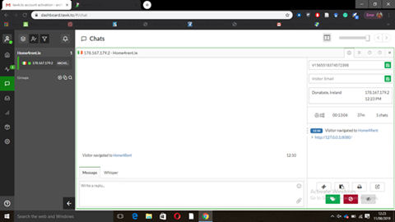
Additional Features
A chat box will be available for communication. After finding a suitable room tenants/educational agent can communicate with landlords. System administrators by collaborating with IT support team will be continuously monitoring and managing the chat box. Our dedicated team will be immediately contacting the landlords after receiving the request from users regarding a room. If the landlord is not available for communicating at the moment when student is requesting for help, based on the landlord availability we will reply the details to the users as soon as possible through phone call or messaging.

Slide 8
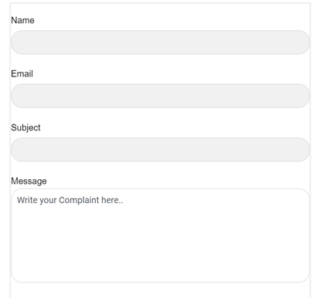
PRTB System
A PRTB complain register will be available for registering the customer complaints, in order to alert the PRTB regarding the difficulty's tenants are facing. Initially complaints will be checked manually and based on the authenticity of the complaints our supporting team will forward it to the PRTB. In the future we are planning to link the website completely to PRTB without the involvement of manual support. IT support team will be expanded to monitor and improve efficiency.

Slide 9
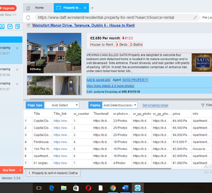
Technology stack:
Visual studio code
Scrape storm
Chat-box (tawk.to)
We have used scrape storm to fetch the data from daft.ie website in csv format. Then we have converted it into json from online editor. We faced some issues as images were not rendered completely by the software.

Slide 10
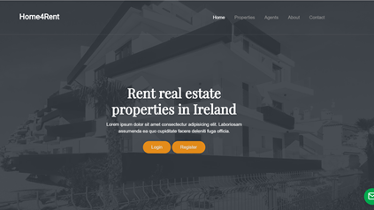
Web application design:

Slide 11
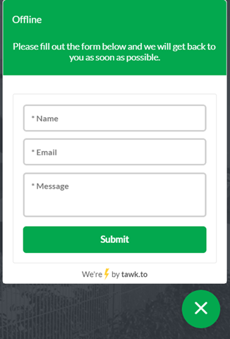
Offline chat box:

Slide 12
Limitations:
We do not have backend database; we are unable to store the data.
We have used Jquery filters for filtering the data from Json file.
Only two filters were used to filter the home listings data by “price” and “beds” but we were not able to use both the filters simultaneously.
After scraping the data, the links for few images were not scraped properly.

Slide 13
Conclusion:
This web application is designed to help overseas students coming to Ireland for their accommodation needs. There are improvements to be made for the project such as integrating it with the real time database. The idea is welcomed by fellow students in the community and they would like to have such kind of web application wherein they can find accommodation for themselves. We have taken the feedback and have plans to deliberately integrate those with our web application.

