Slide 1

Notes:
Welcome. Introduce yourself. Pause on the taglines.

Slide 2
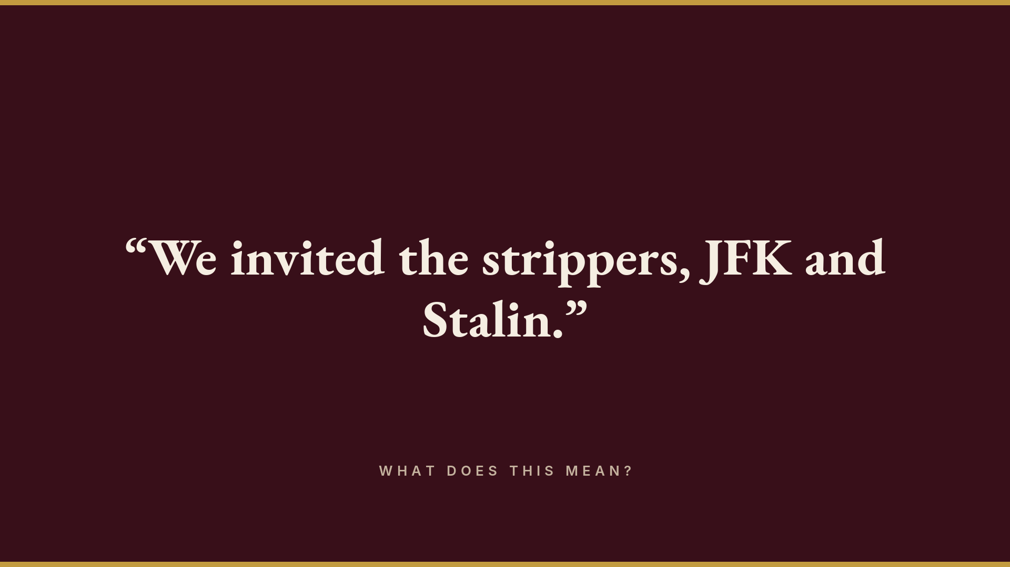
Notes:
Read the sentence. Pause. Ask the audience what it means.

Slide 3
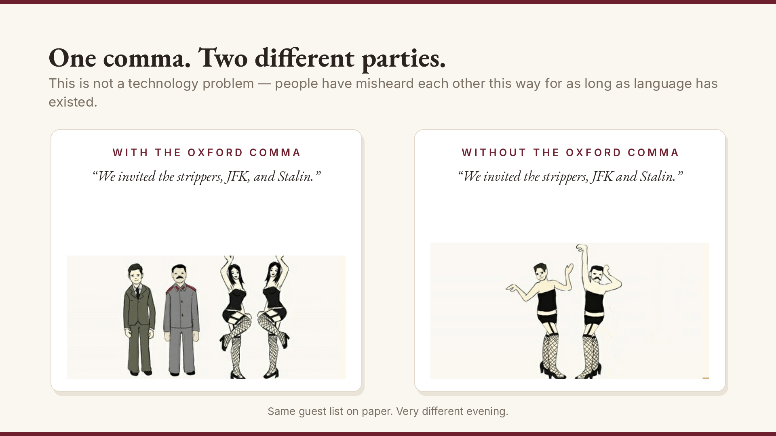
Notes:
One comma separates two entirely different parties. A language problem, not a technology problem.

Slide 4
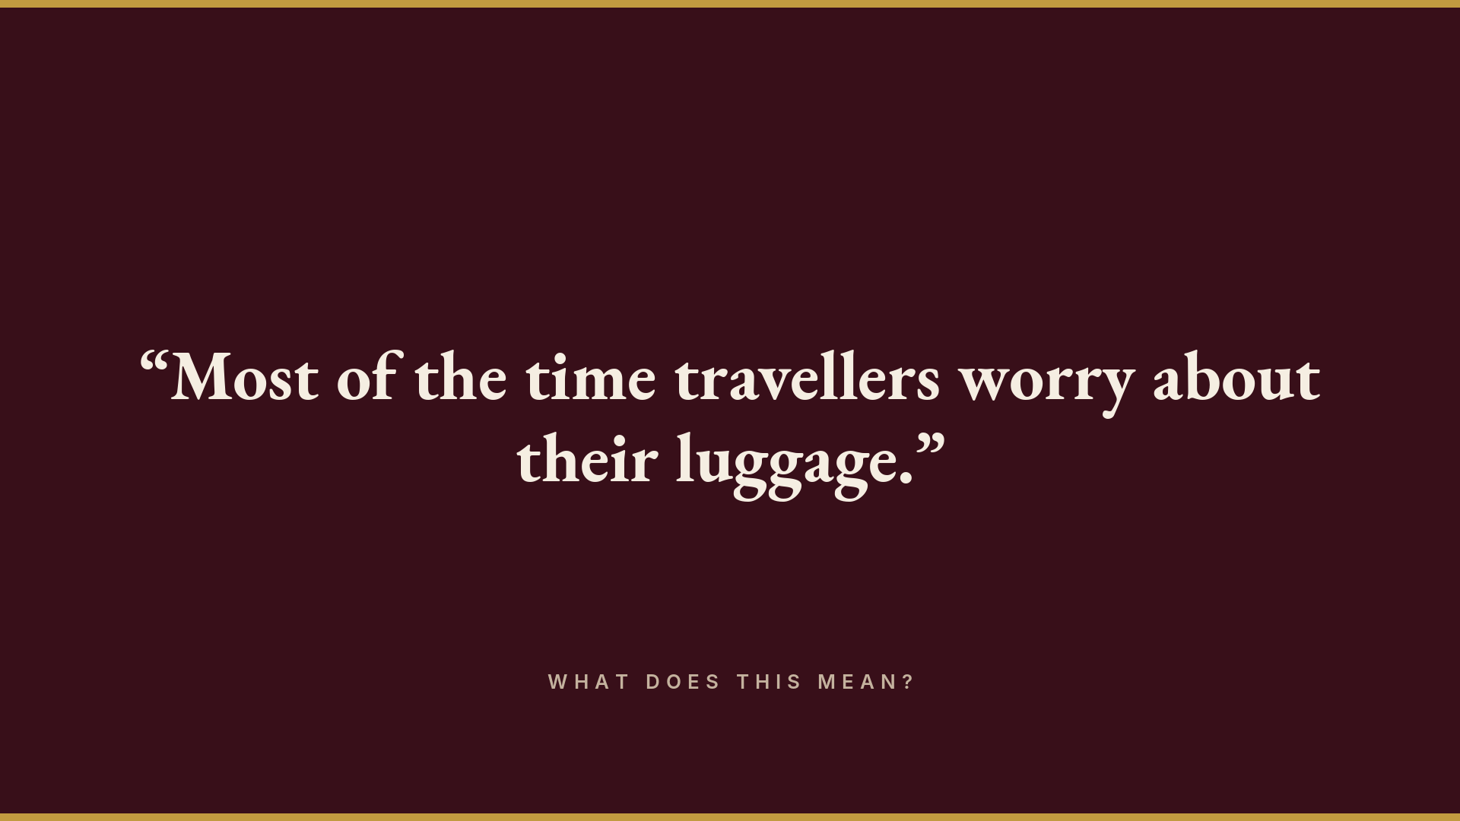
Notes:
Ask the audience what this means.

Slide 5
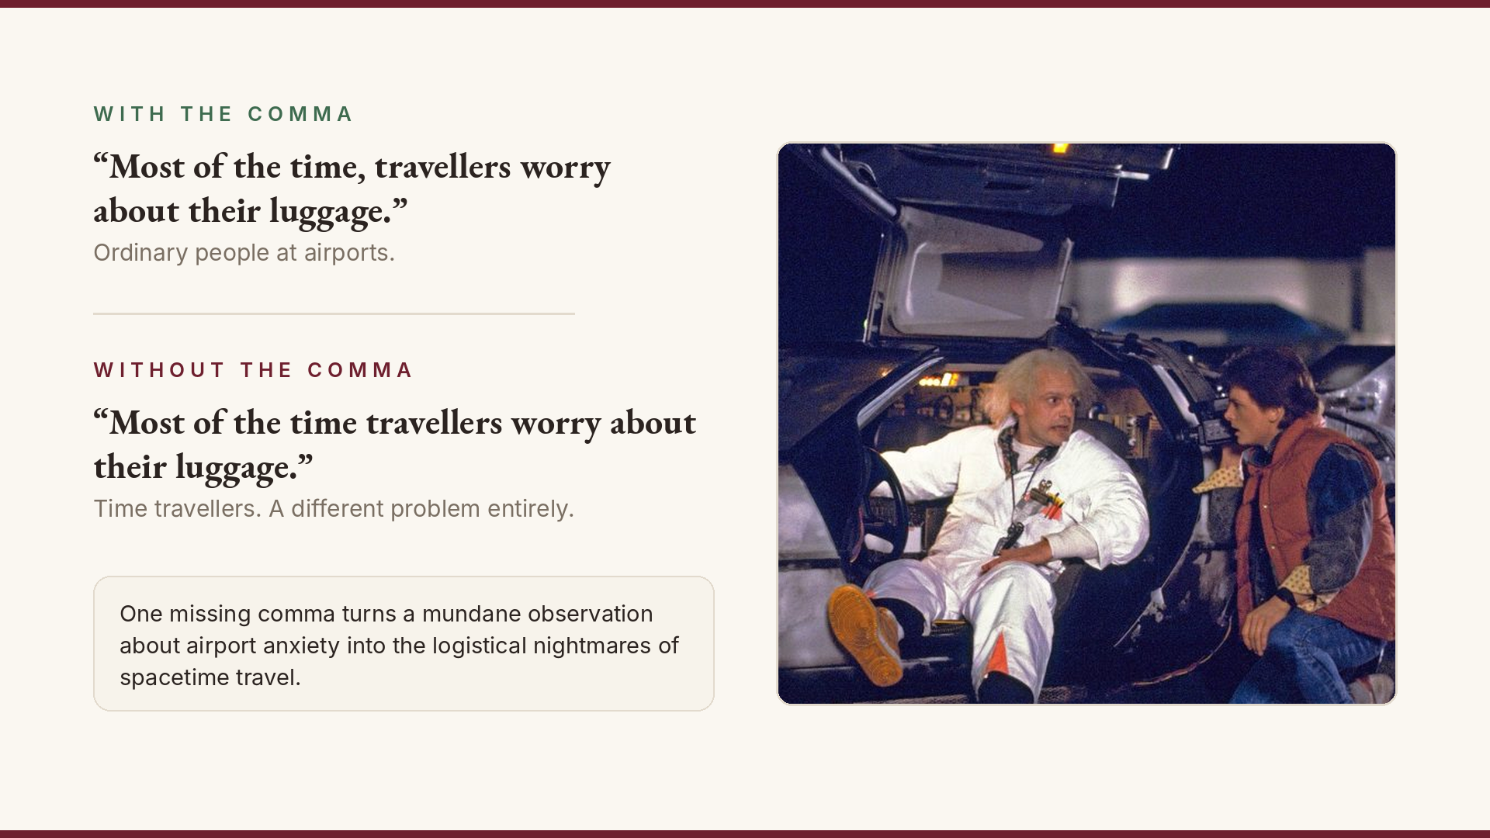
Notes:
Doc and Marty do the rest.

Slide 6
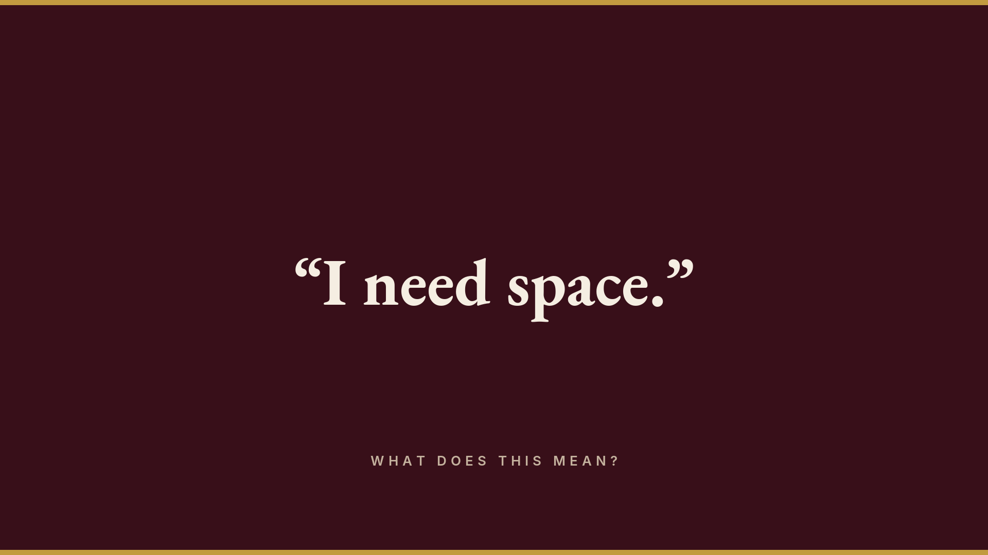
Notes:
Ask: who has been in this conversation?

Slide 7
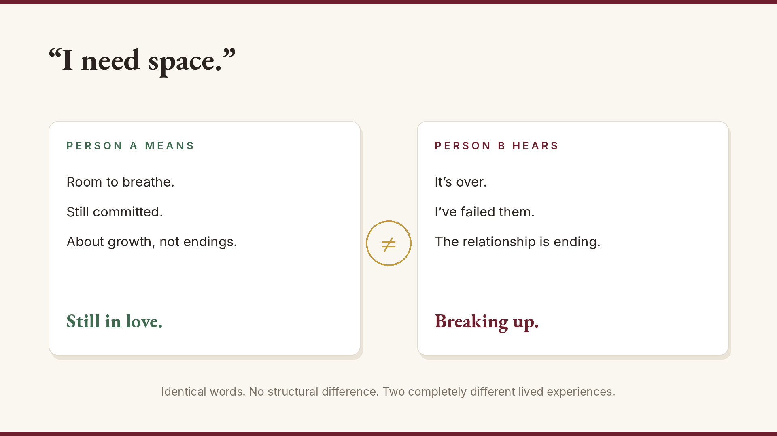
Notes:
Same words. No structural difference. Two completely different lived experiences. This is the nature of language.

Slide 8
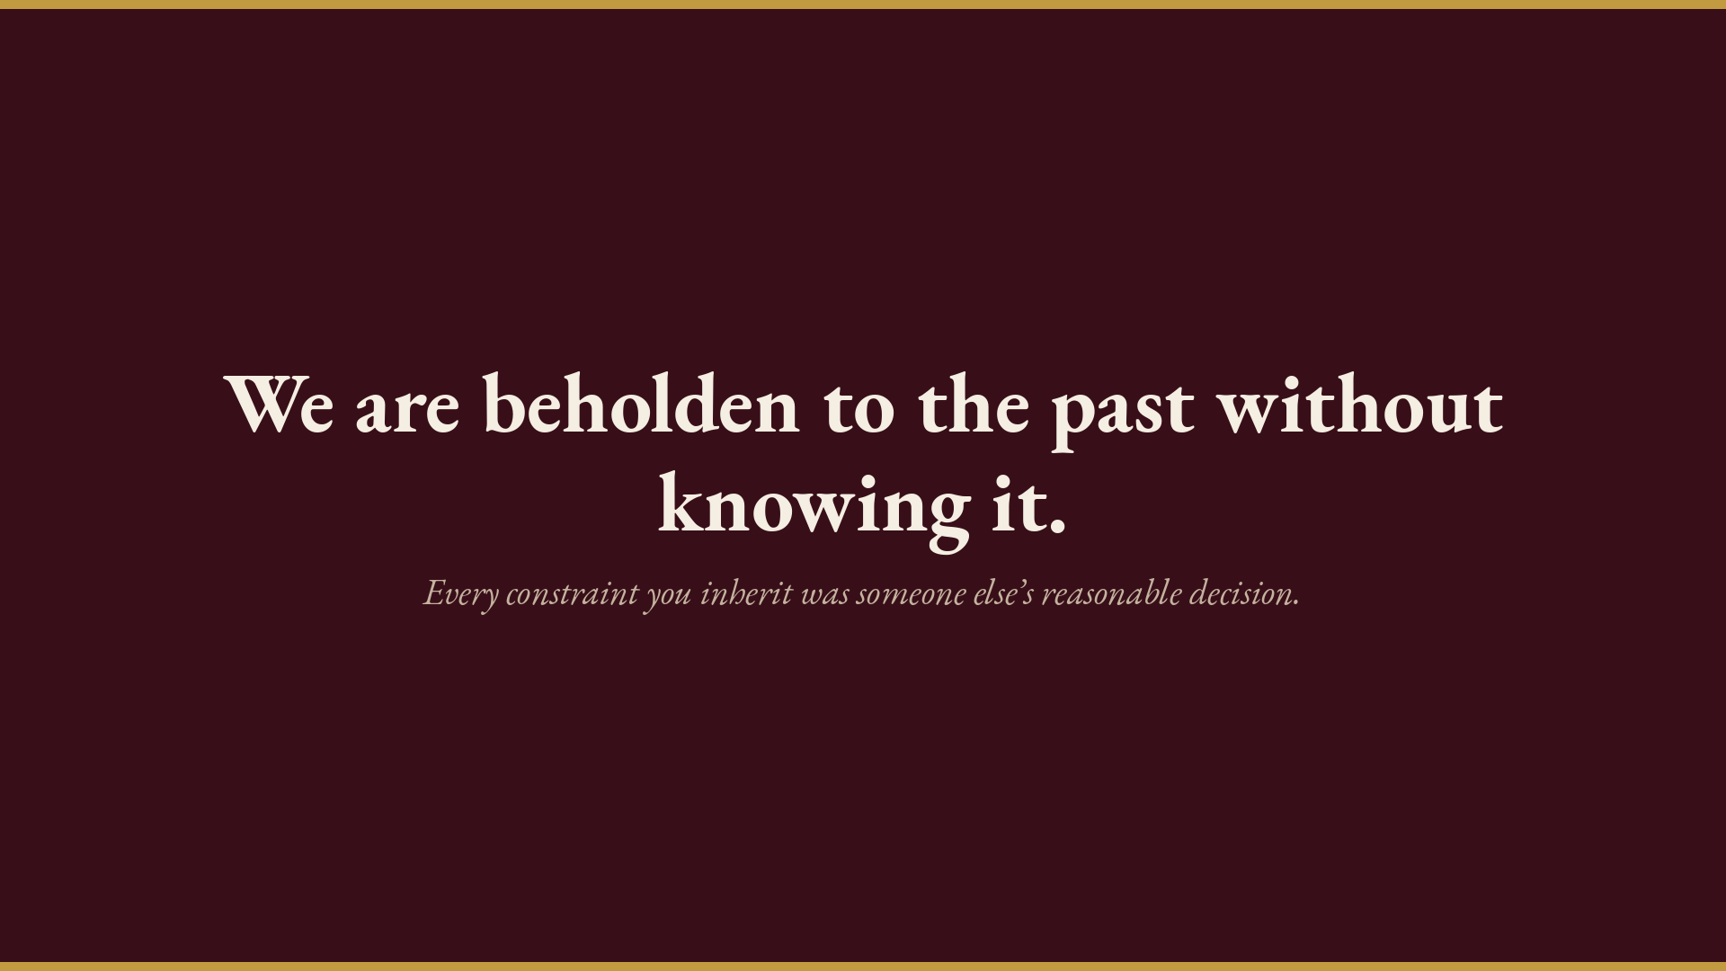
Notes:
We are beholden to the past without knowing it. Set up the horse-butt chain.

Slide 9
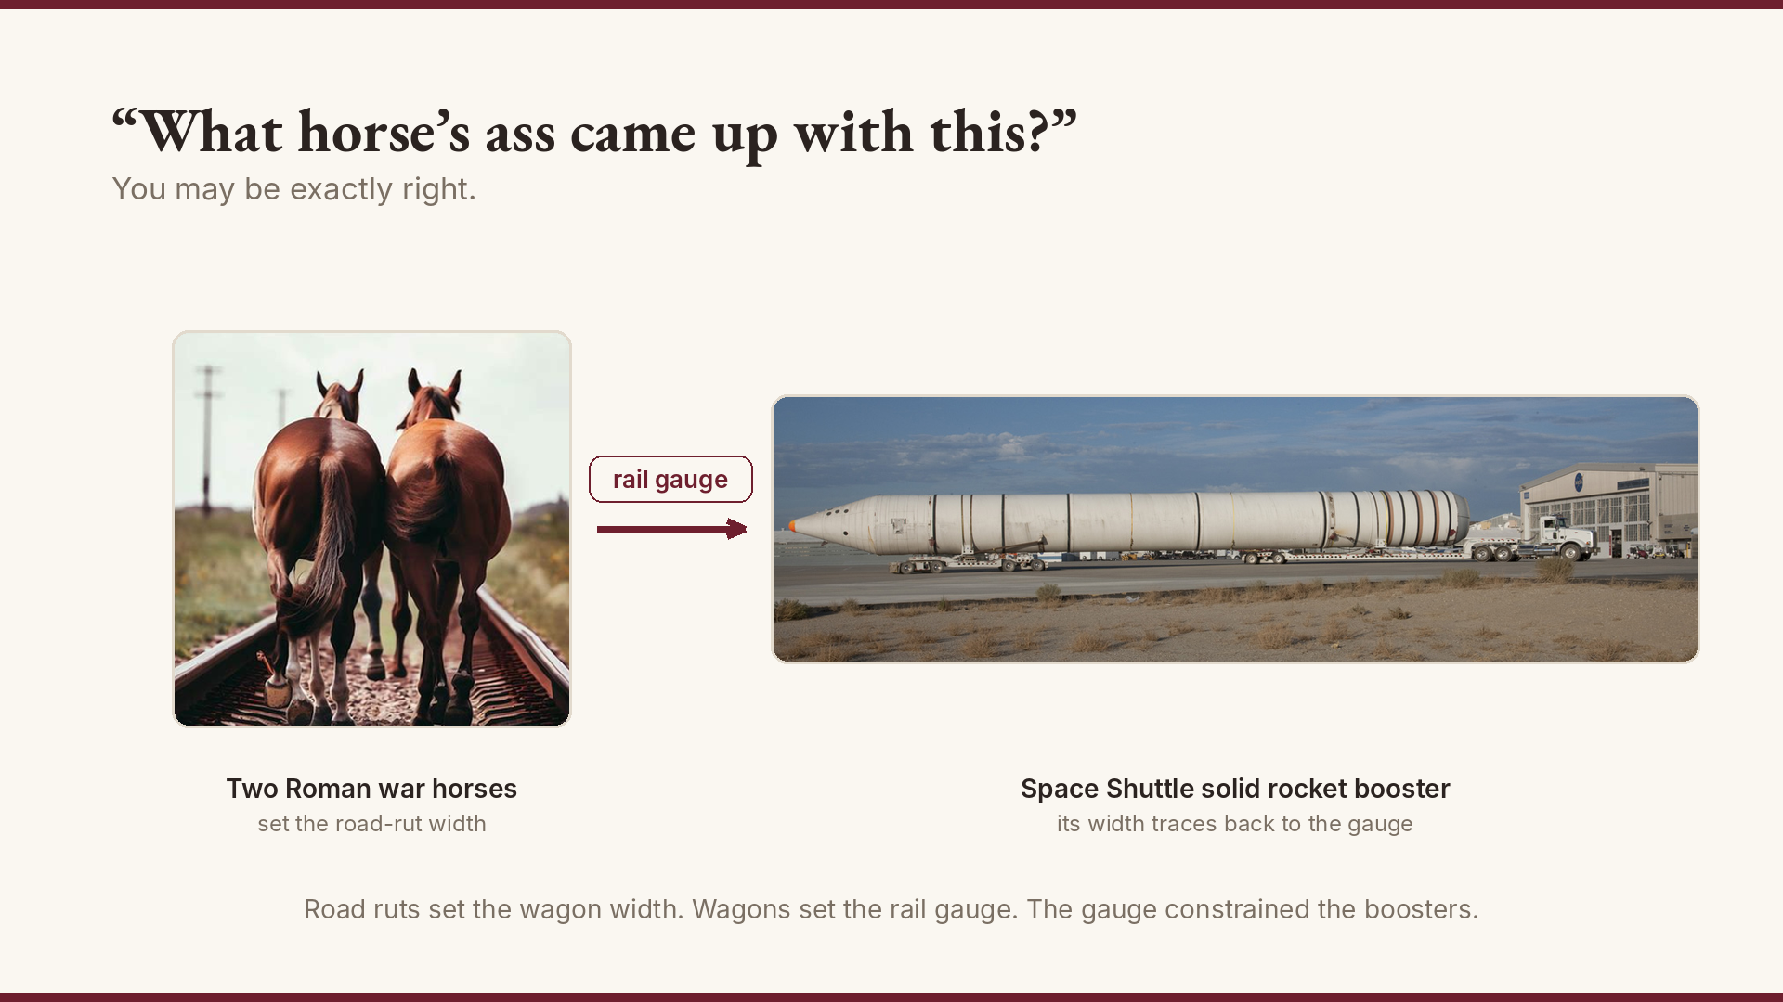
Notes:
Two Roman war horses determined road width. Road width determined rail gauge. Rail gauge constrained the Space Shuttle booster diameter. Let this sink in.

Slide 10
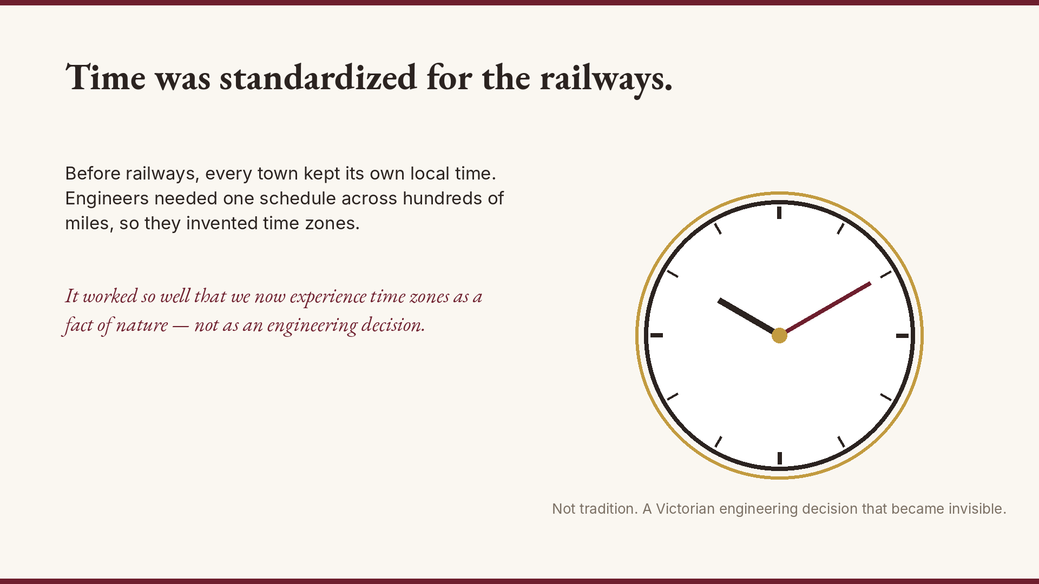
Notes:
We standardized time itself — not in ancient history, but during Victorian Industrialization, because railways needed schedules. Not tradition. An engineering decision that became invisible.

Slide 11
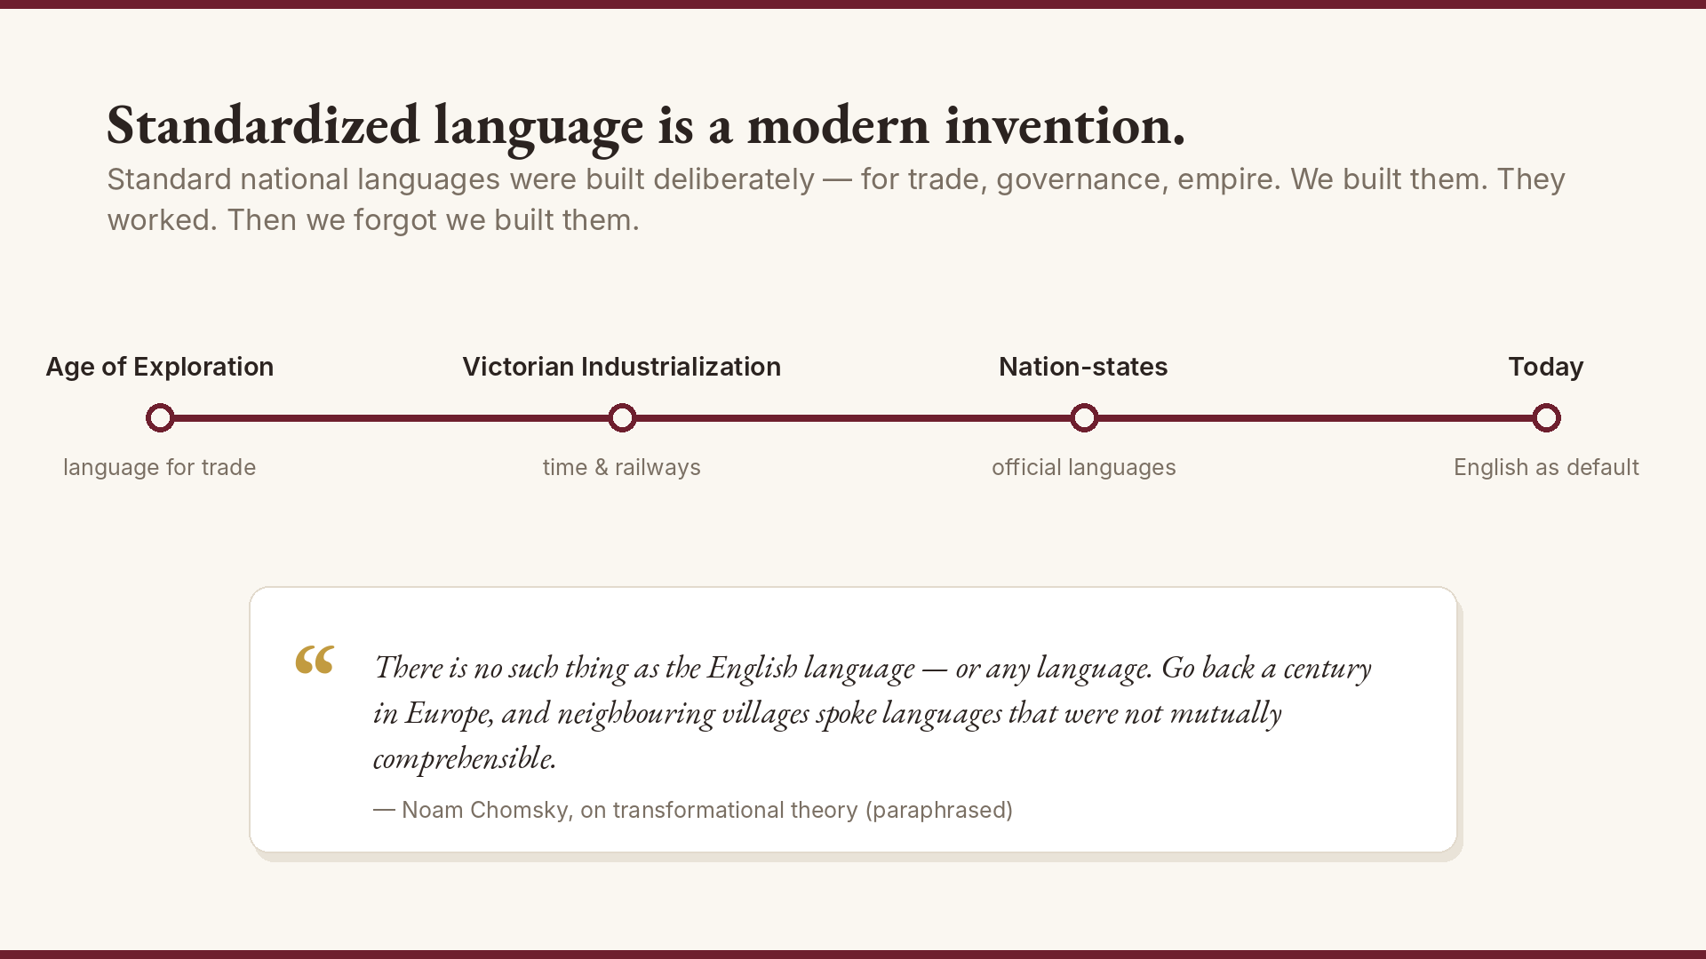
Notes:
Standardized language is a modern invention — built for the Age of Exploration, reinforced by Victorian Industrialization, then nation-states. We built it to unify people and nations. It worked. Then it became tradition.

Slide 12
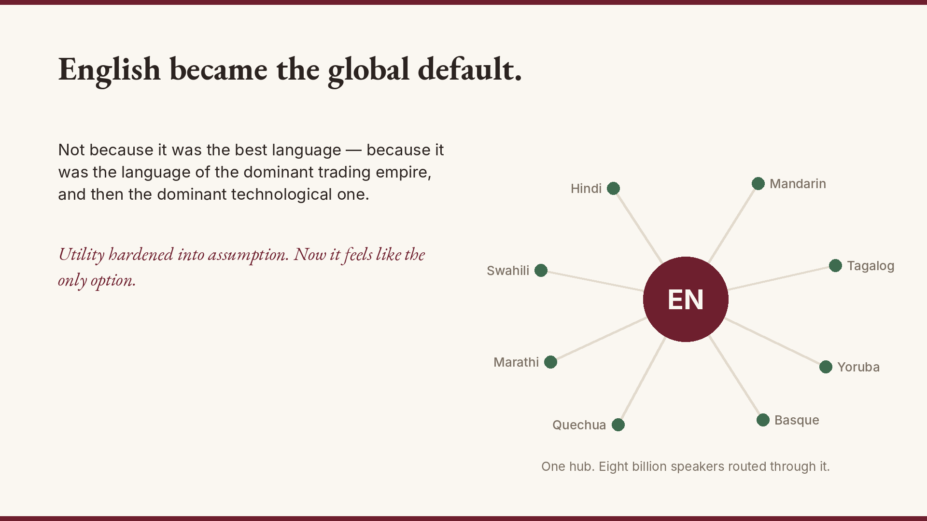
Notes:
English became the global default — not because it is the best language, but because it was the most useful trading language during the age of British empire and then American dominance. Utility hardened into assumption.

Slide 13
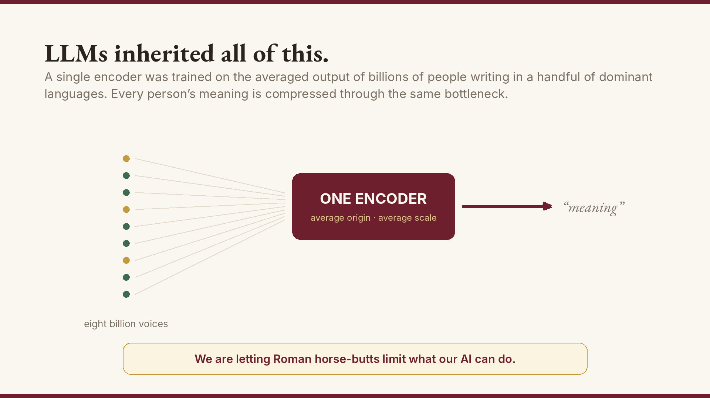
Notes:
And now LLMs have inherited the standardization as if it were nature. One encoder for eight billion people. We are letting Roman horse-butts limit what our AI can do.

Slide 14
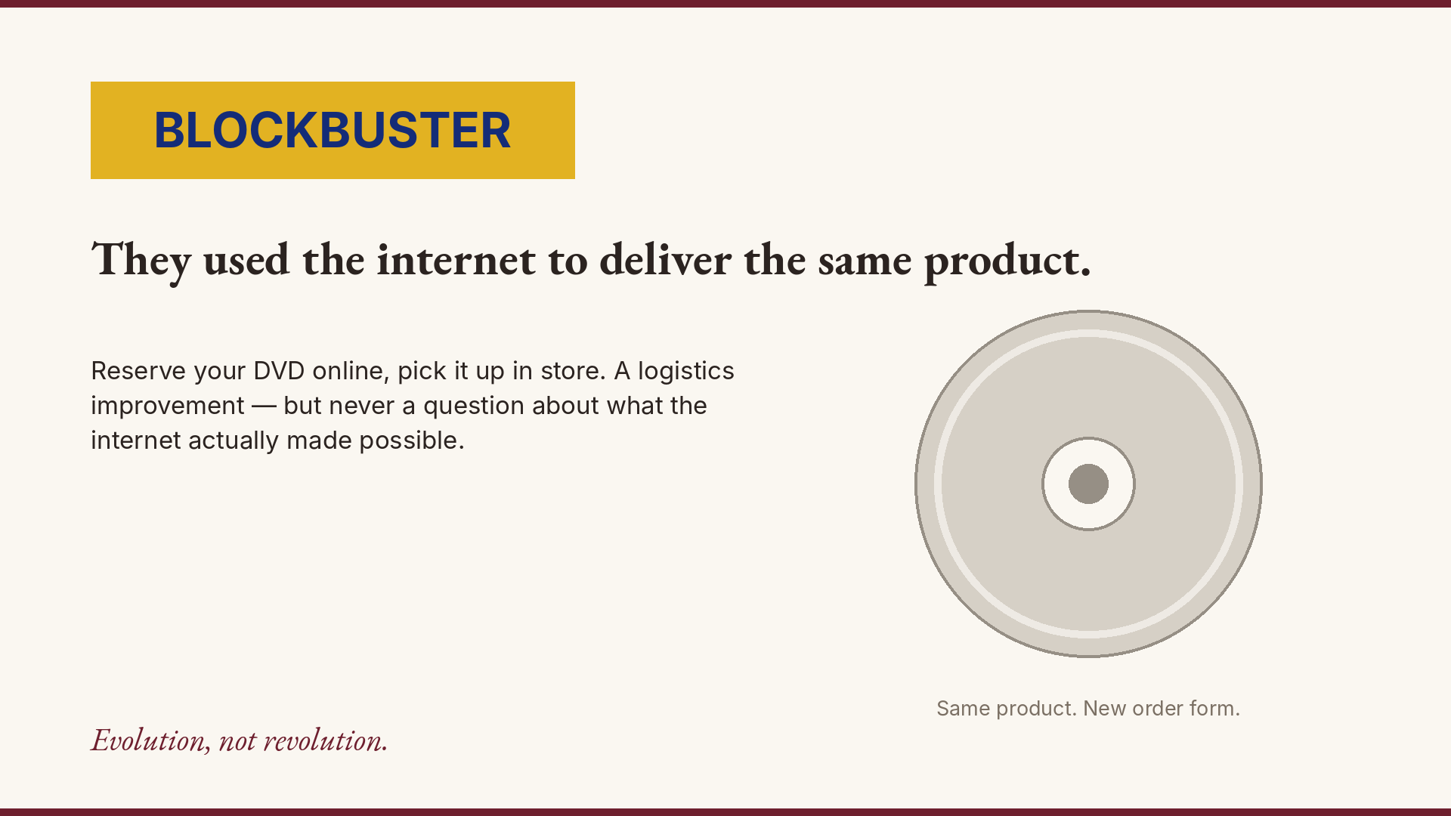
Notes:
Blockbuster saw the internet. They used it to do the old thing the old way — reserve DVDs online. Evolution, not revolution.

Slide 15
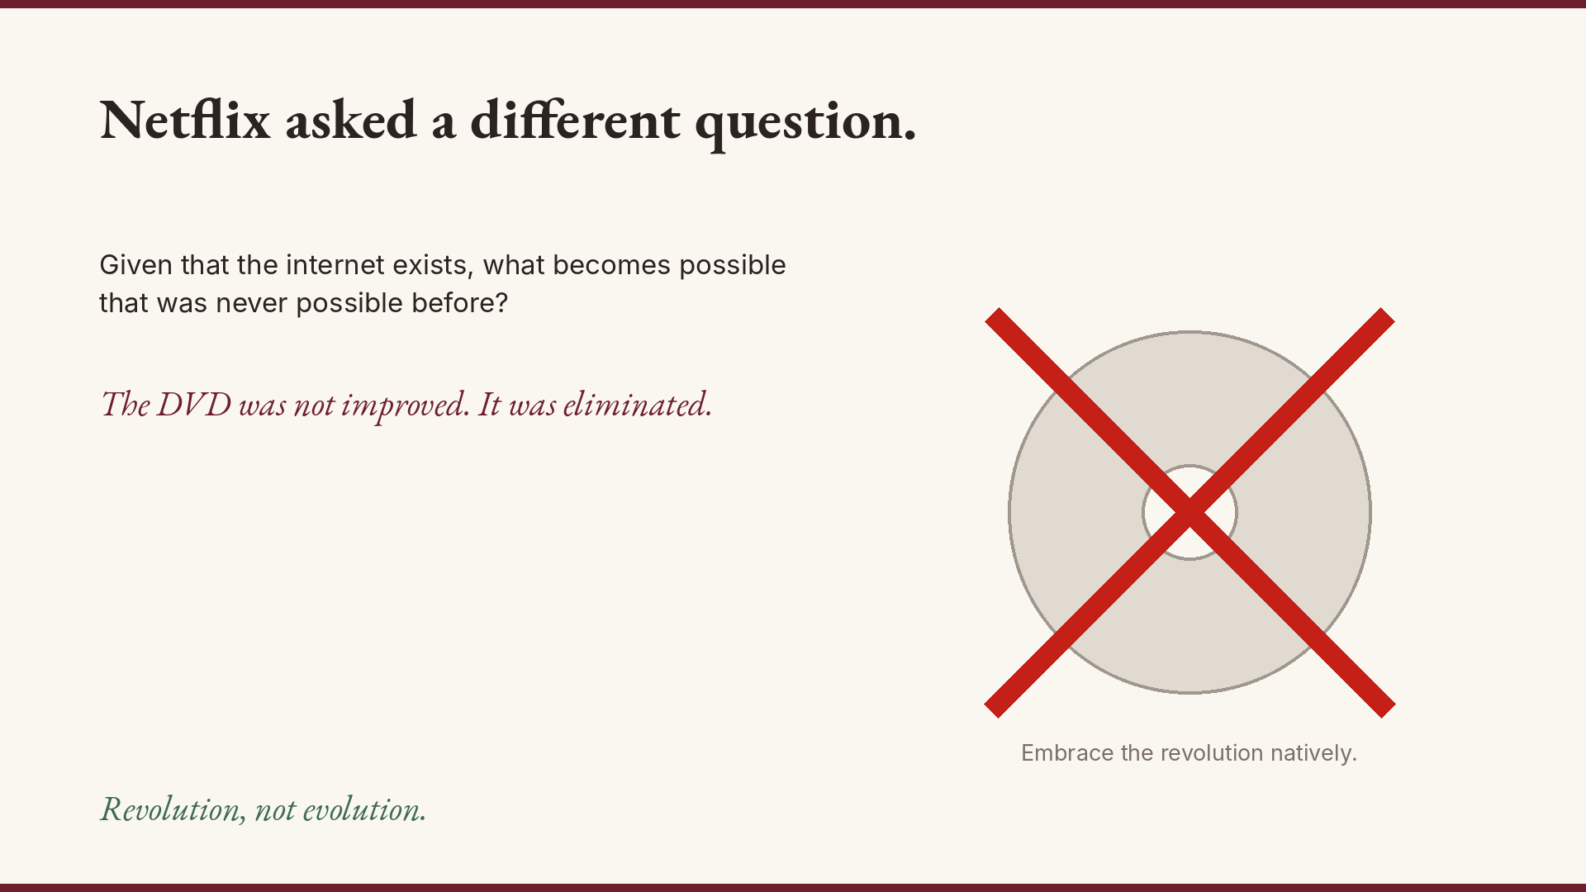
Notes:
Netflix asked a different question: given the internet exists, what becomes possible that was not possible before? They eliminated the DVD entirely. They embraced the revolution natively.

Slide 16
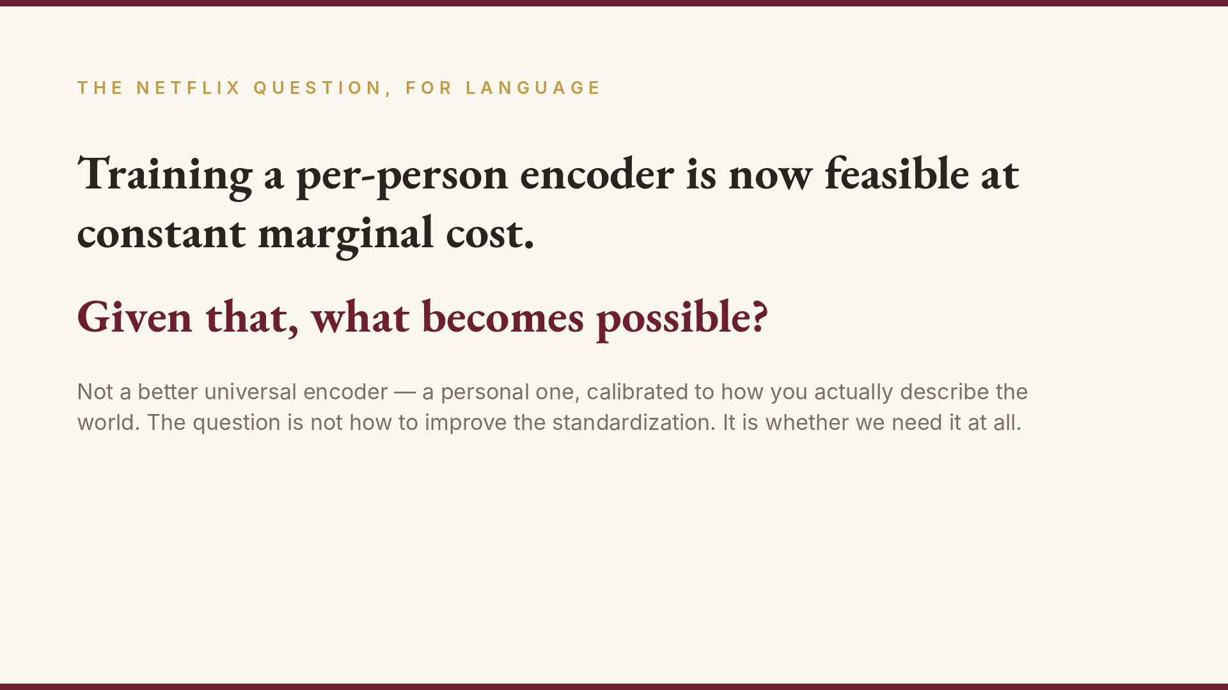
Notes:
WineTone asks the Netflix question for language. Given that training a per-person encoder is now possible and constant in cost, how much more cultural diversity, expression and understanding can we promote?

Slide 17
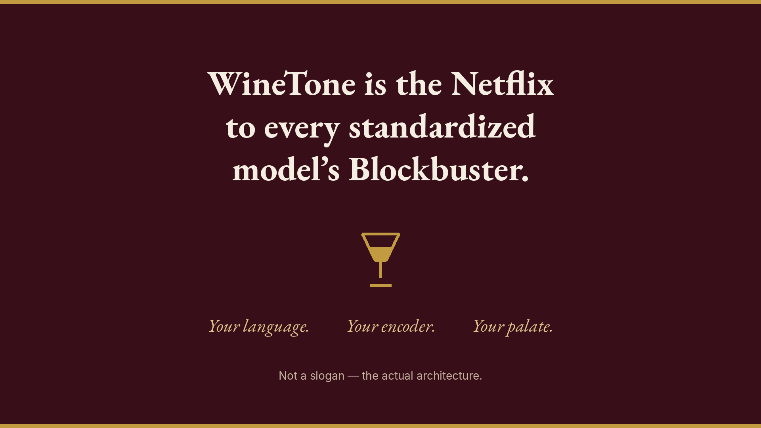
Notes:
WineTone is the Netflix to every standardized model Blockbuster. Your language. Your encoder. Your palate. Not a better standardization. A different paradigm entirely.

Slide 18
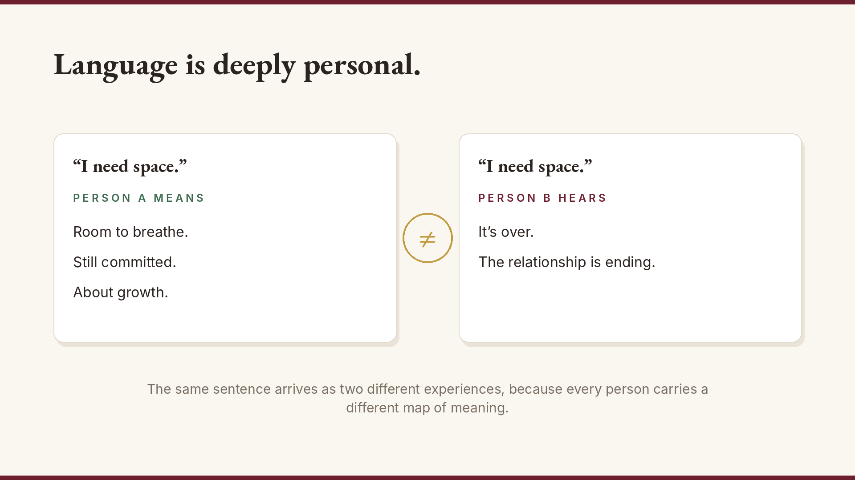
Notes:
Let this breathe. It sets up the expert data.

Slide 19
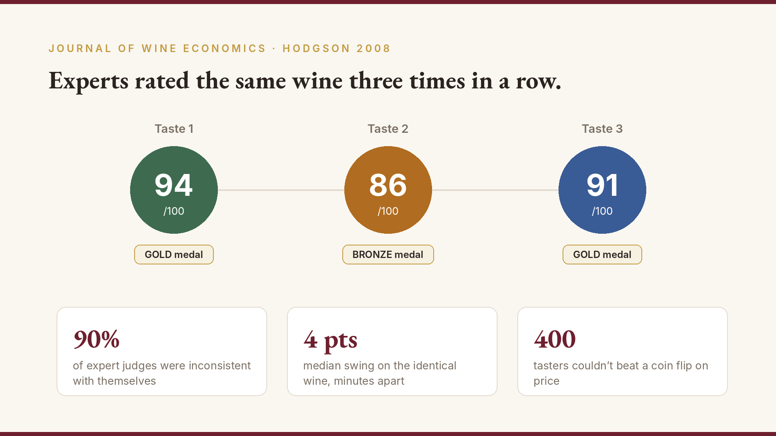
Notes:
Hodgson 2008. Same wine, three times. 90% of expert judges inconsistent.

Slide 20
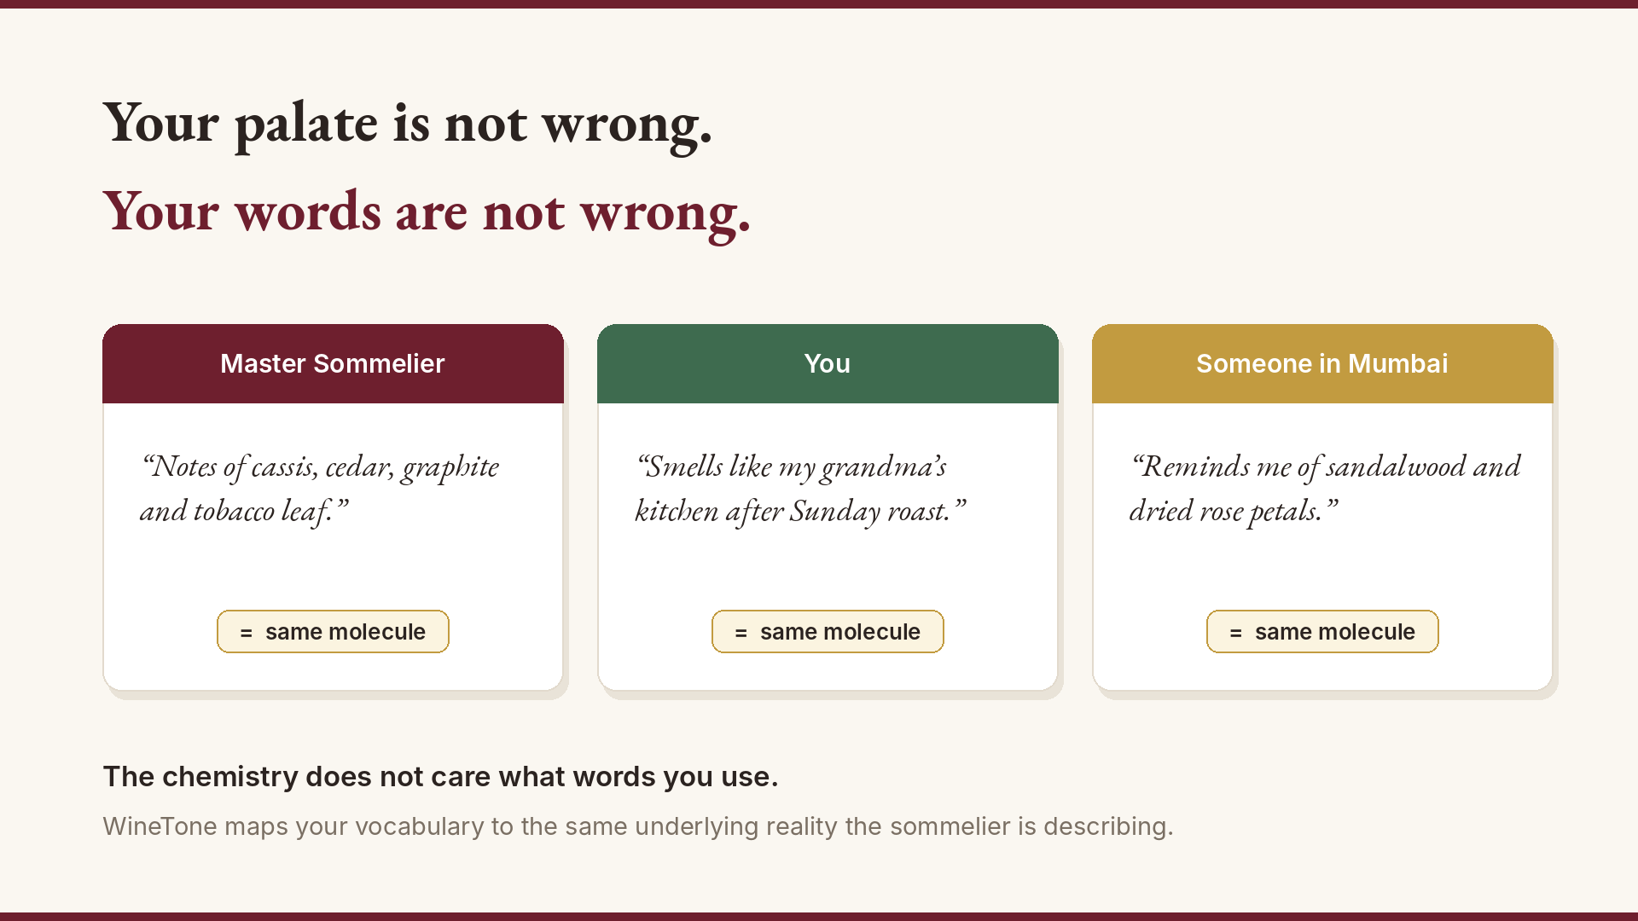
Notes:
Every vocabulary is equally valid. The chemistry is the anchor.

Slide 21
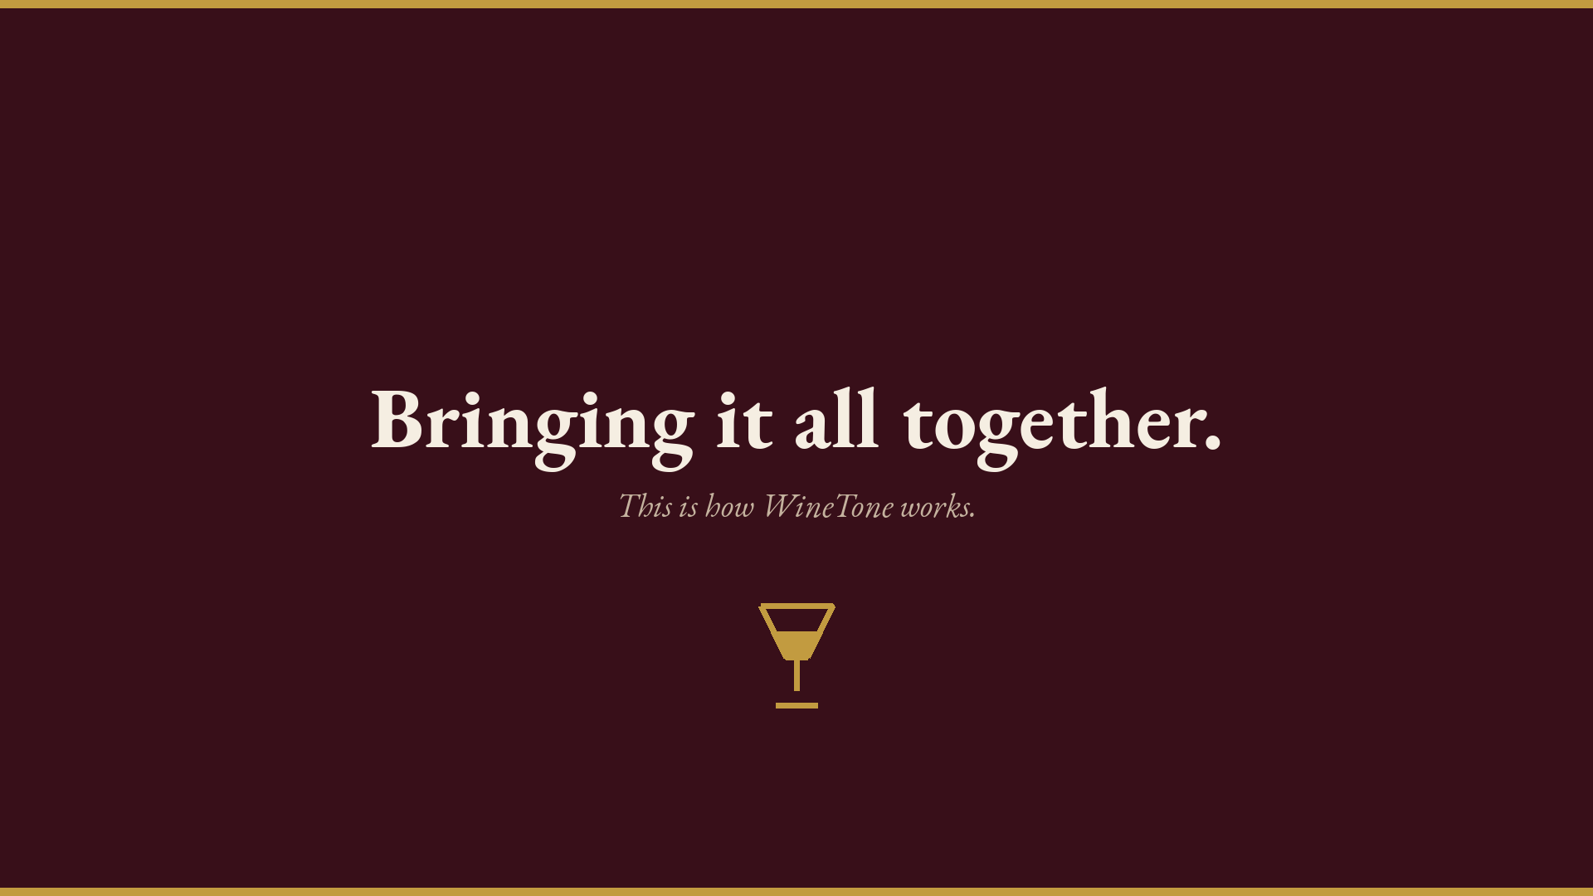
Notes:
Bringing it all together. Now show how WineTone actually works.

Slide 22
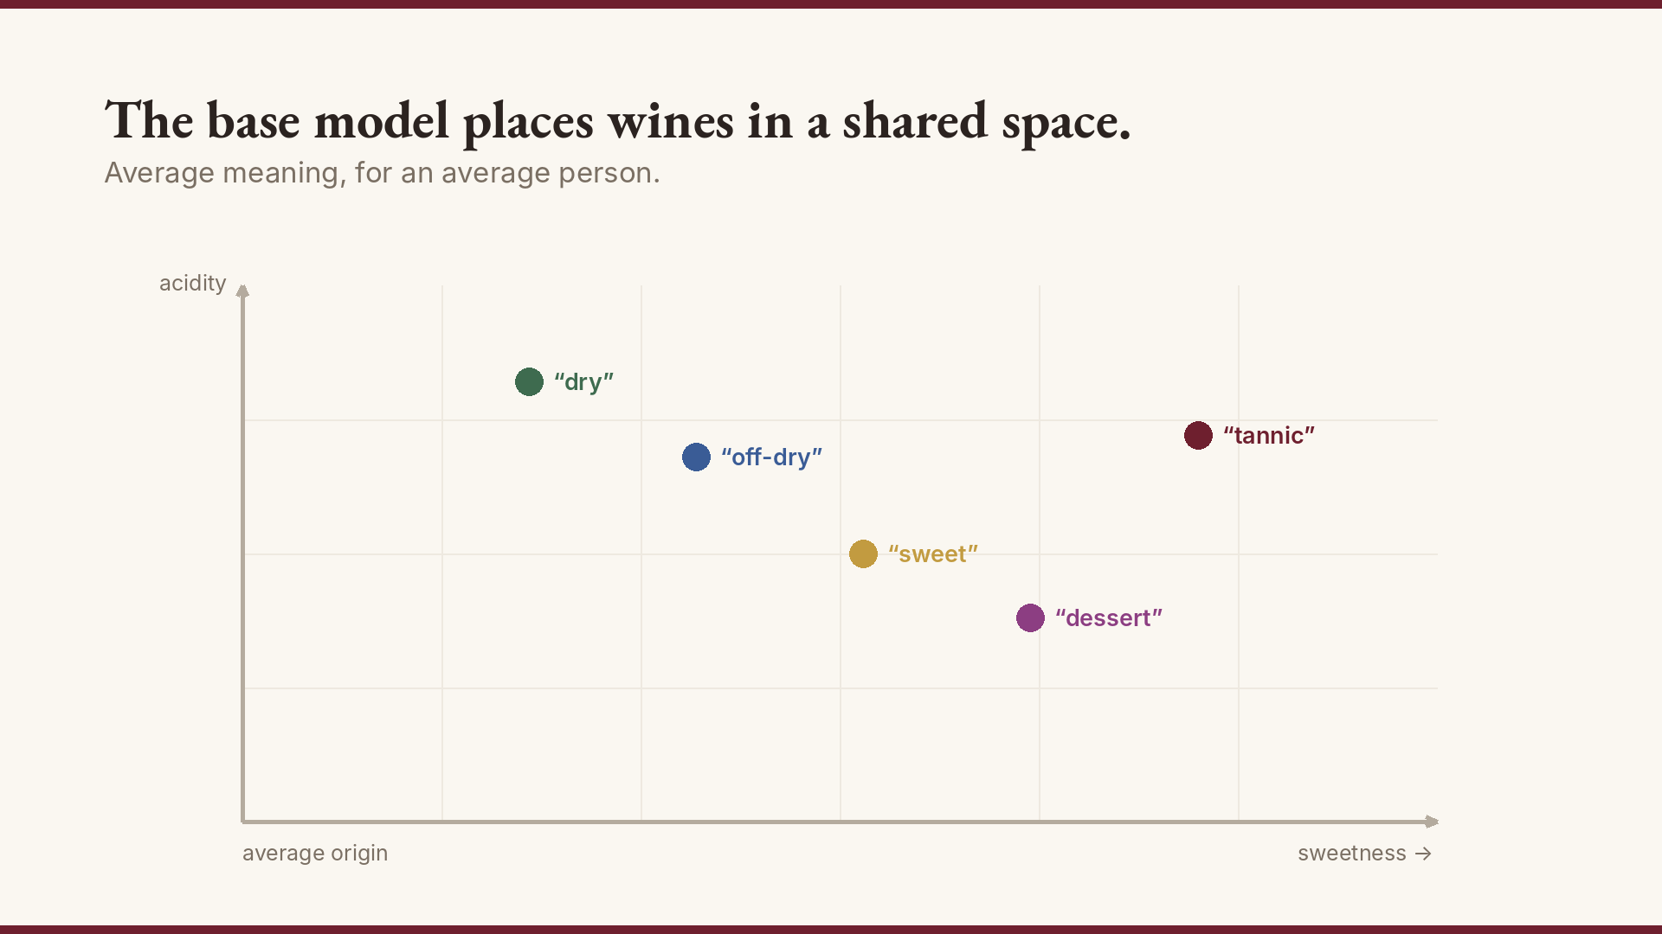
Notes:
The base model places all wines in a shared space. Average origin, average scale.

Slide 23
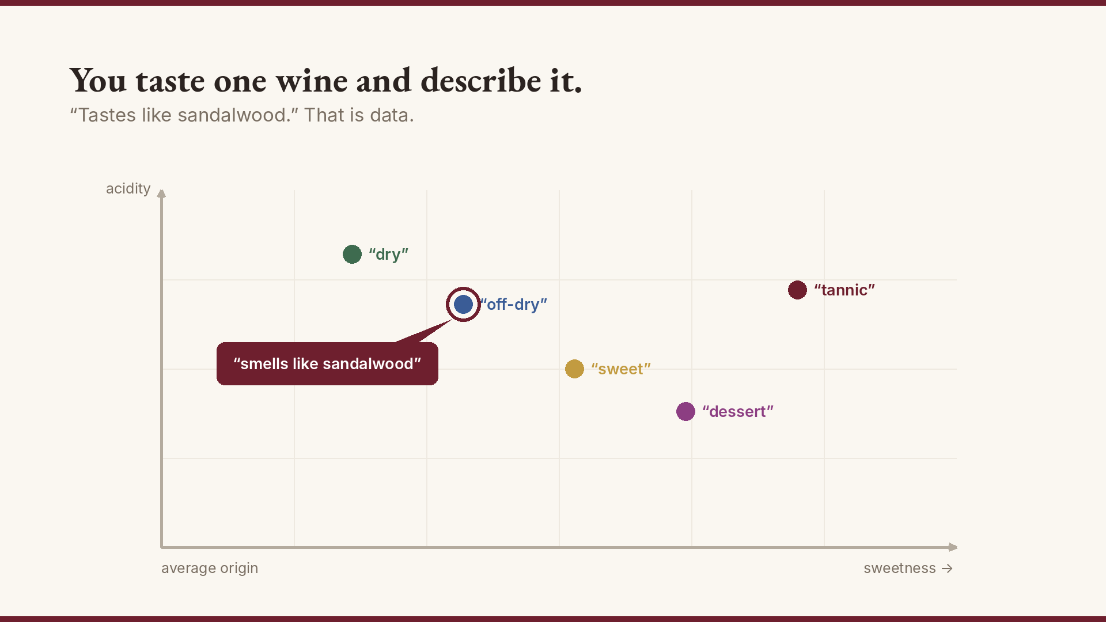
Notes:
You taste one wine and describe it in your words. That is data.

Slide 24
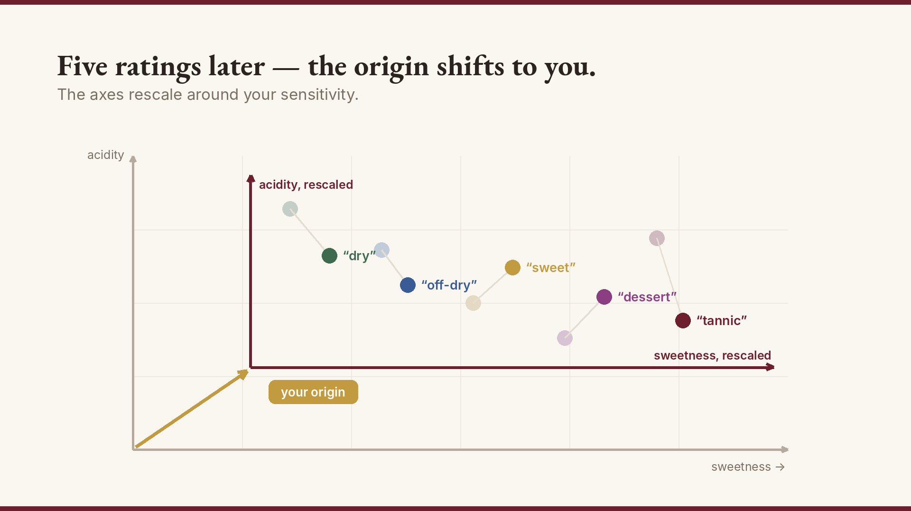
Notes:
Five ratings later — the origin shifts toward you. The axes rescale around your sensitivity.

Slide 25
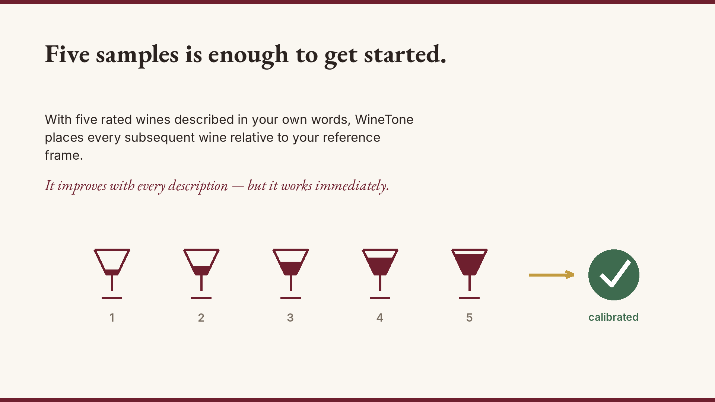
Notes:
Five samples. Your vocabulary. Your space. Every new wine placed relative to what you already know.

Slide 26
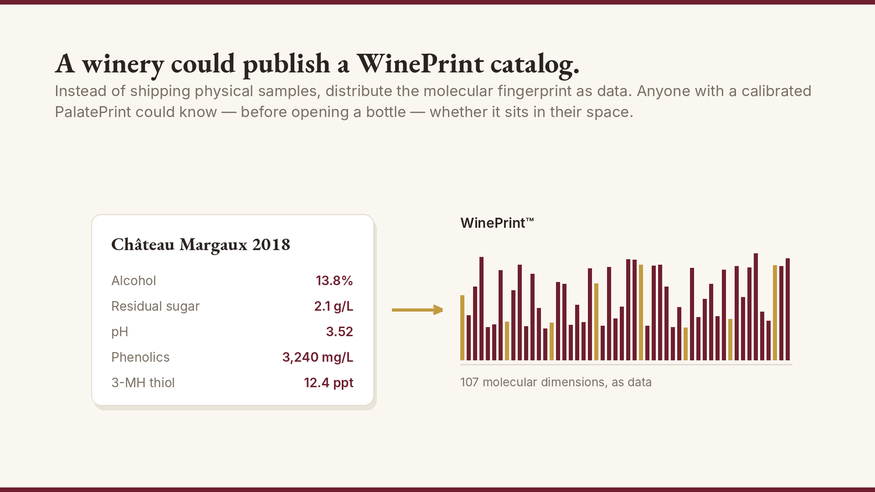
Notes:
A winery could publish a WinePrint catalog. No physical samples. Pure data.

Slide 27
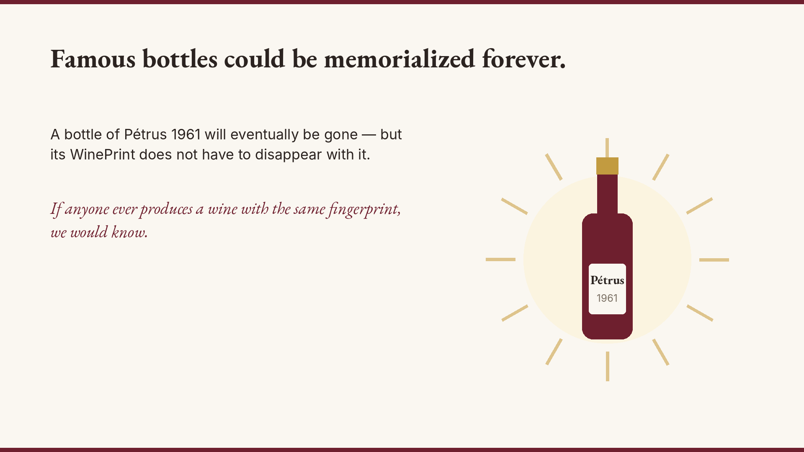
Notes:
Famous bottles memorialized. If we ever reproduce Pétrus 1961, we will know.

Slide 28
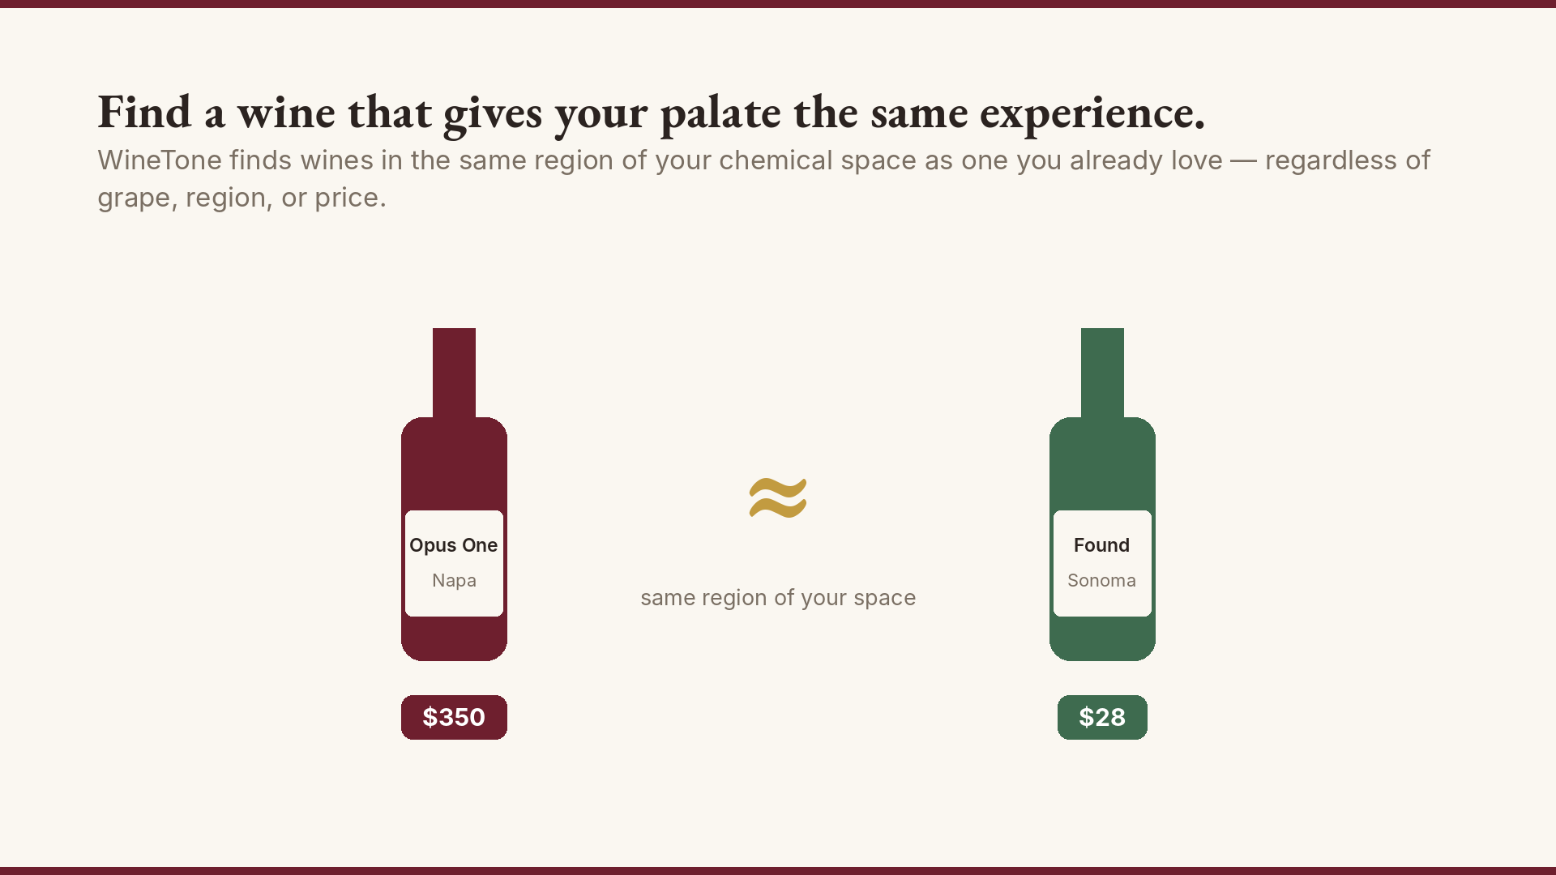
Notes:
Find a wine that gives your palate the same experience as another. Cross-price, cross-region.

Slide 29
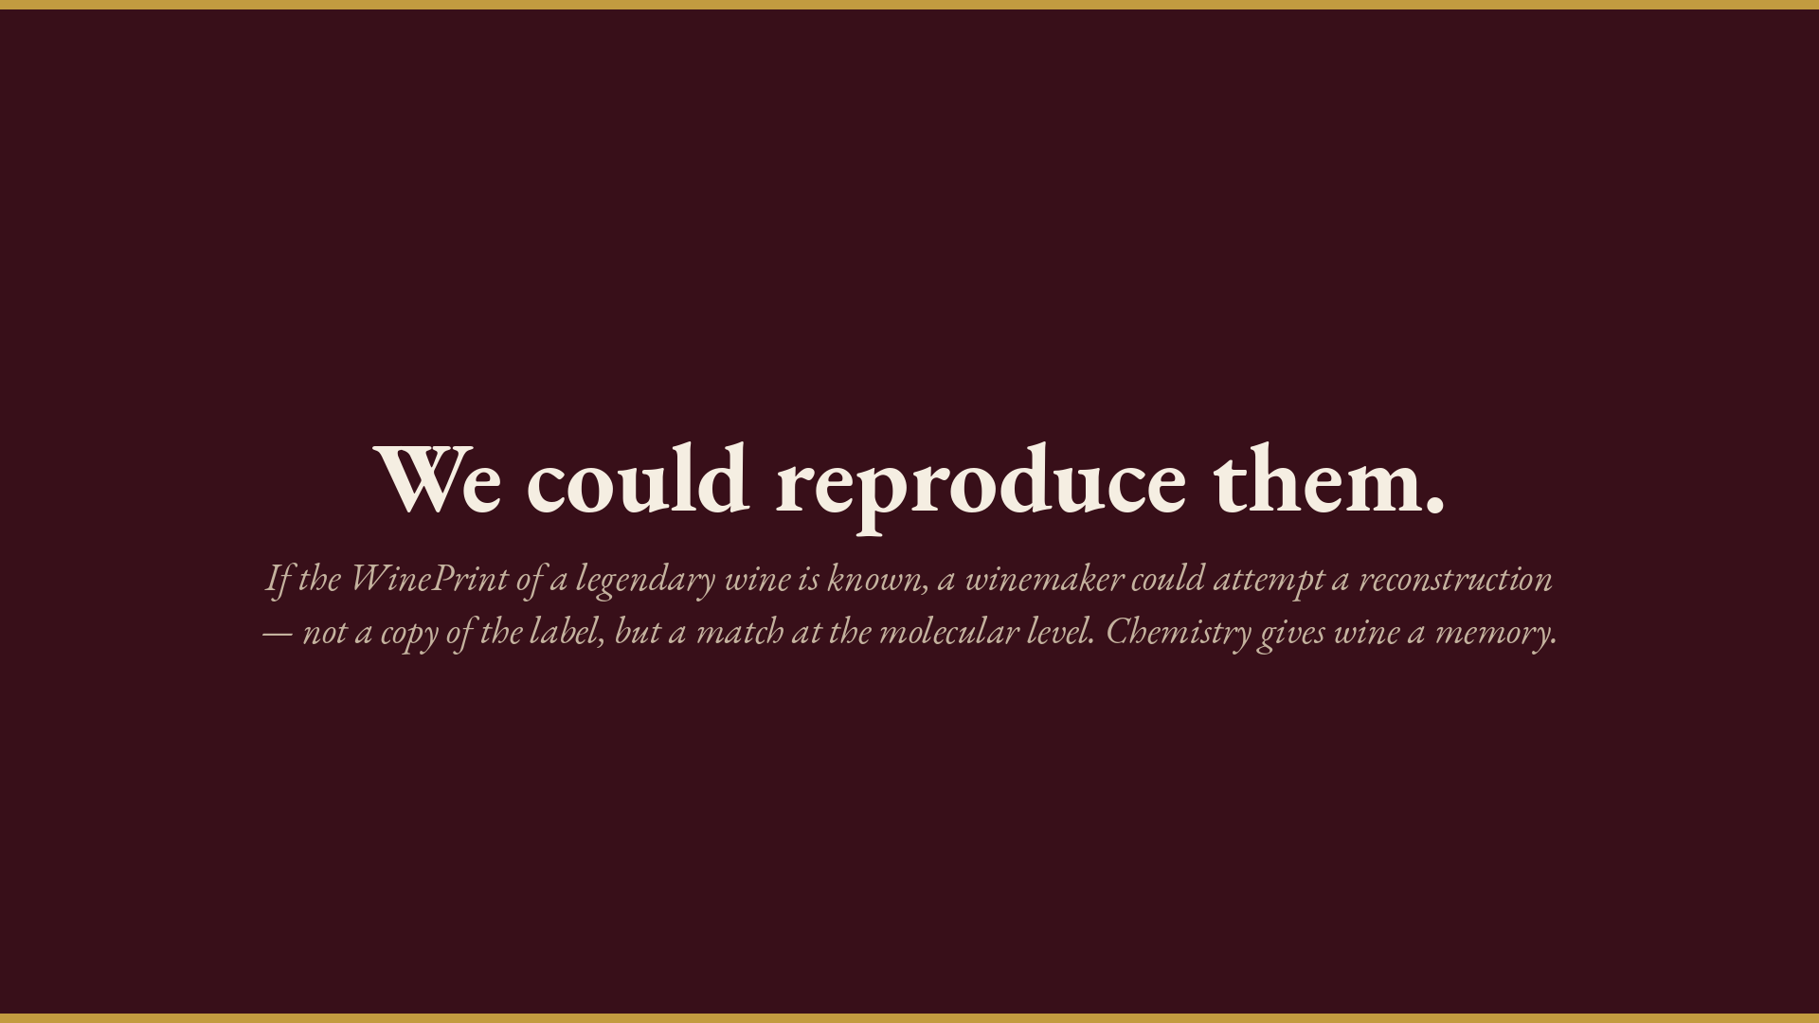
Notes:
We could reproduce them. Chemistry is the blueprint.

Slide 30

Notes:
Ask everyone to open tone.wine on their phone or laptop now. Give them 30 seconds while you pour.

Slide 31
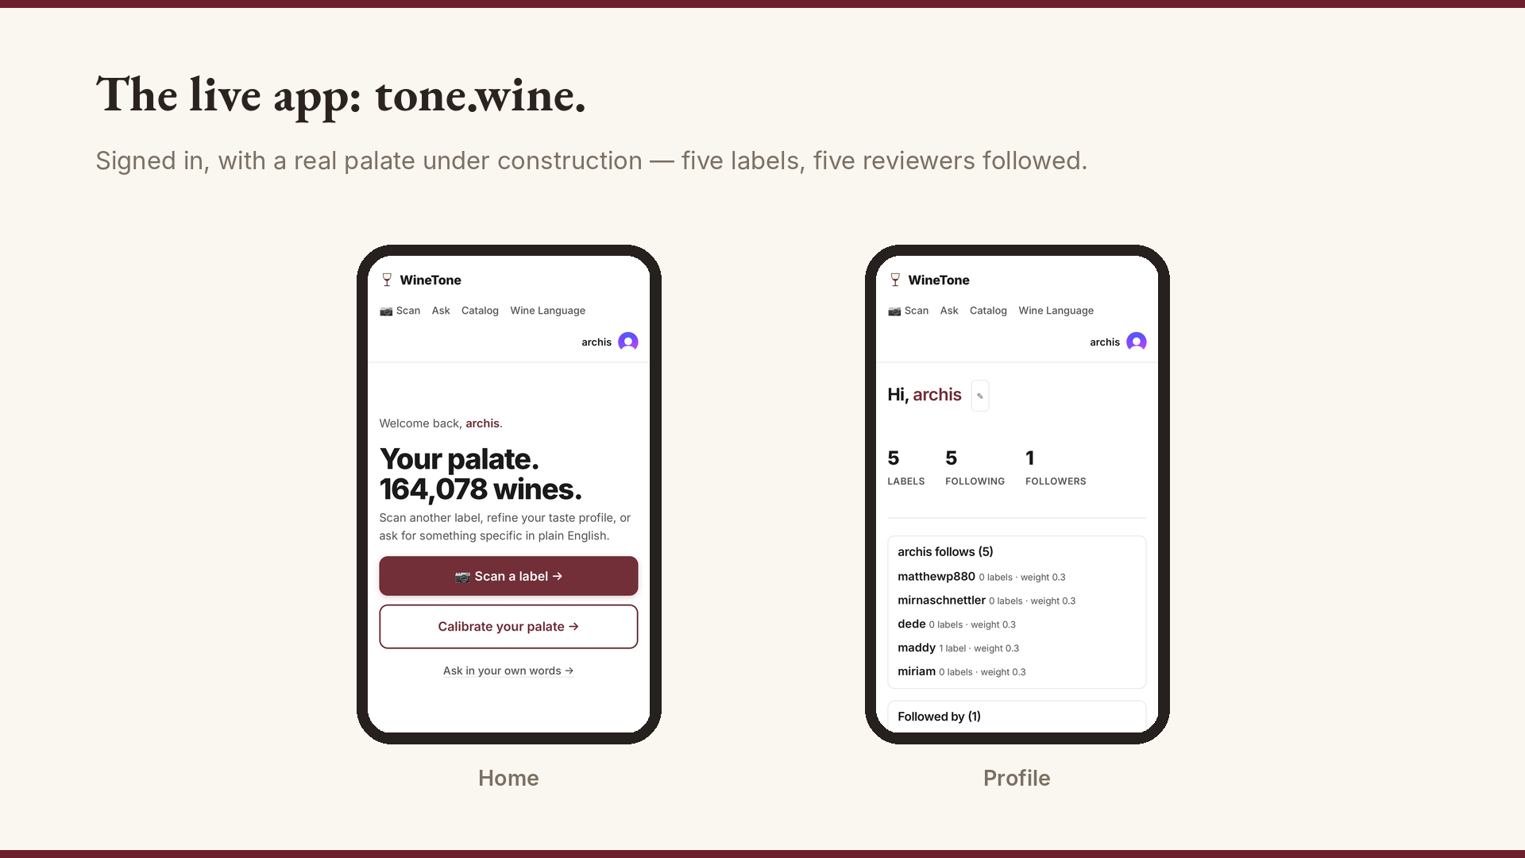
Notes:
The real app, signed in. Point at the wine count — 164,078 wines indexed.

Slide 32
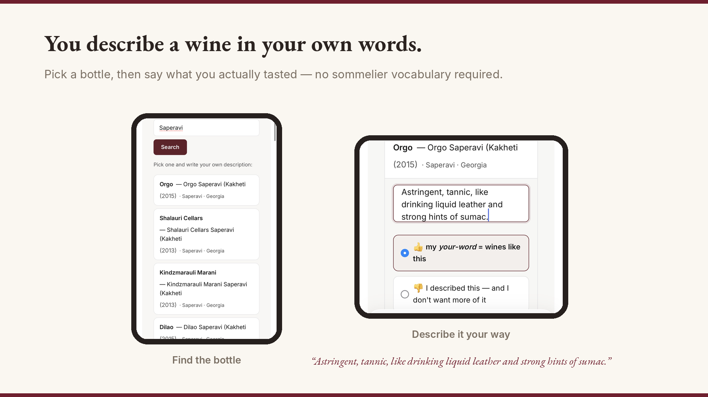
Notes:
Walk through describing the Orgo Saperavi. “Liquid leather and sumac” — nobody else's vocabulary. That is the point.

Slide 33
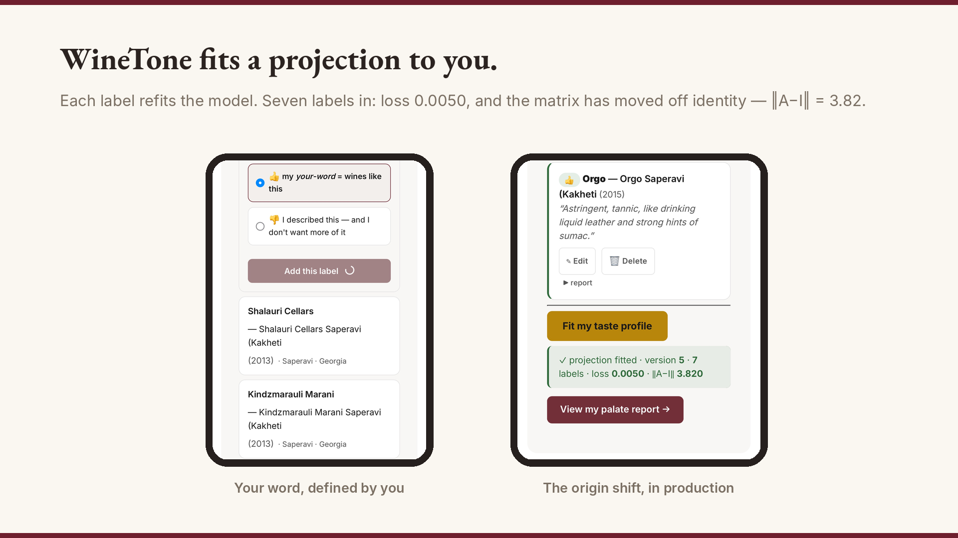
Notes:
This is slides 22–24 running in production. Seven labels, loss 0.0050, ‖A−I‖ = 3.82 — the matrix has genuinely moved off identity toward me.

Slide 34
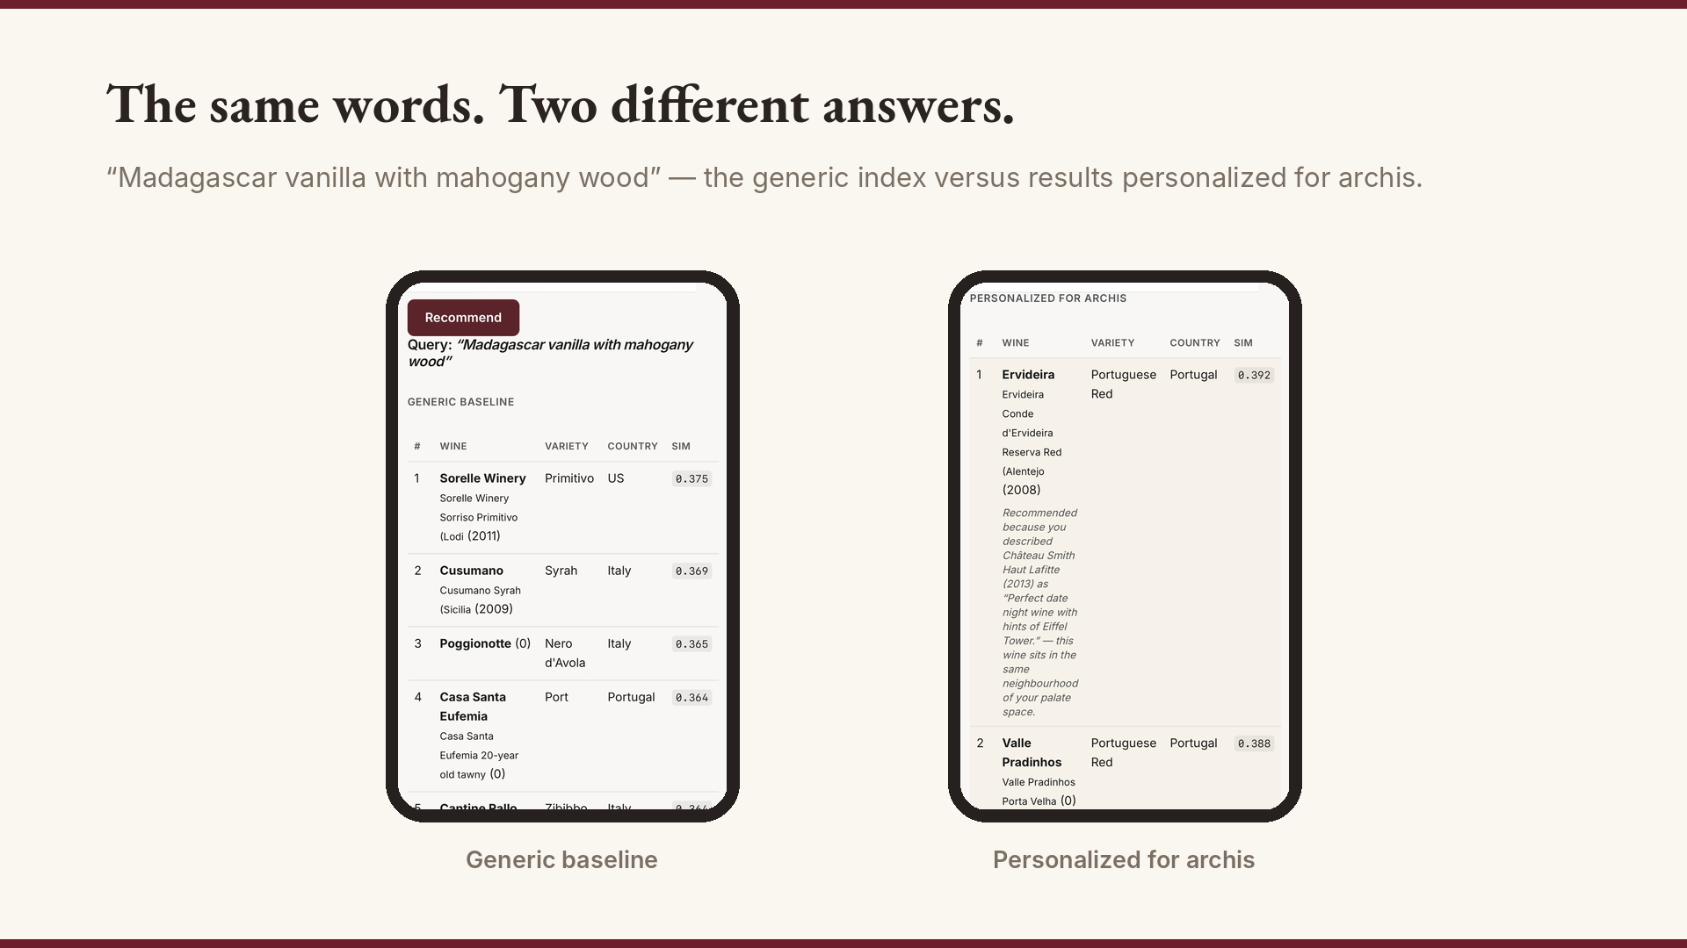
Notes:
The payoff. Same query, two answers — and the personalized side explains itself in my own past words. Invite the room to try it at tone.wine.

Slide 35
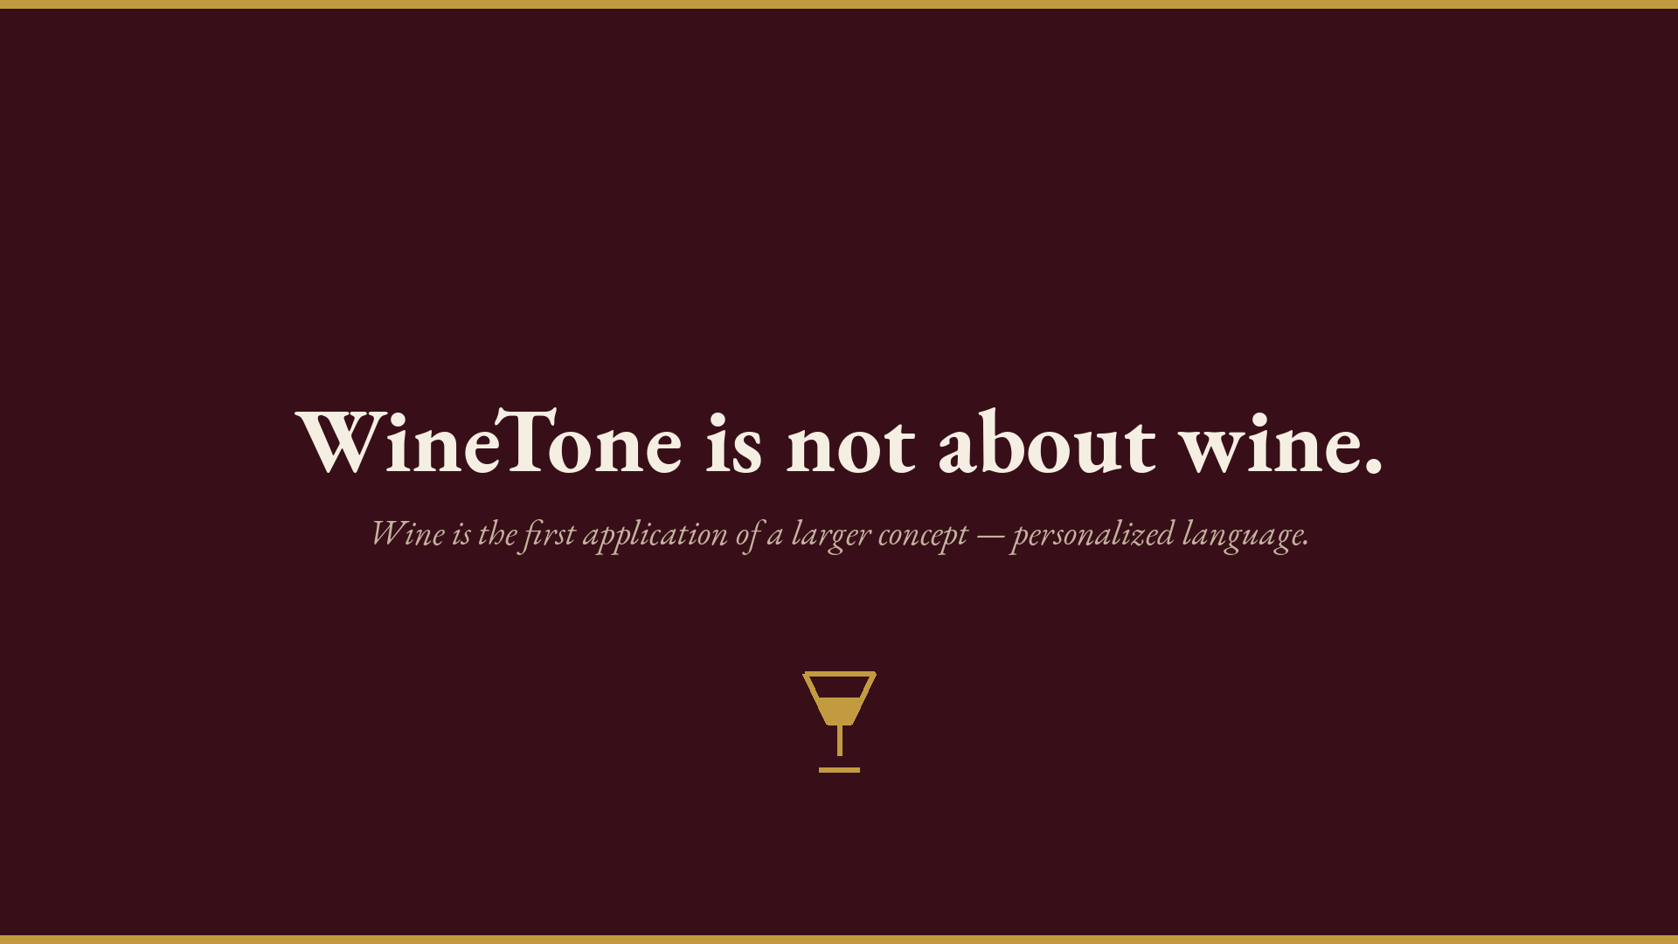
Notes:
The zoom-out. Pause and let it land: this was never about wine.

Slide 36
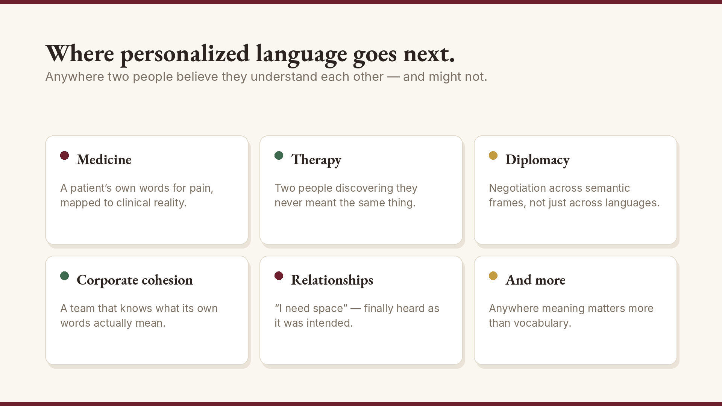
Notes:
Walk the domains briefly. End on relationships — the deck opened with “I need space.” Close the loop.

Slide 37
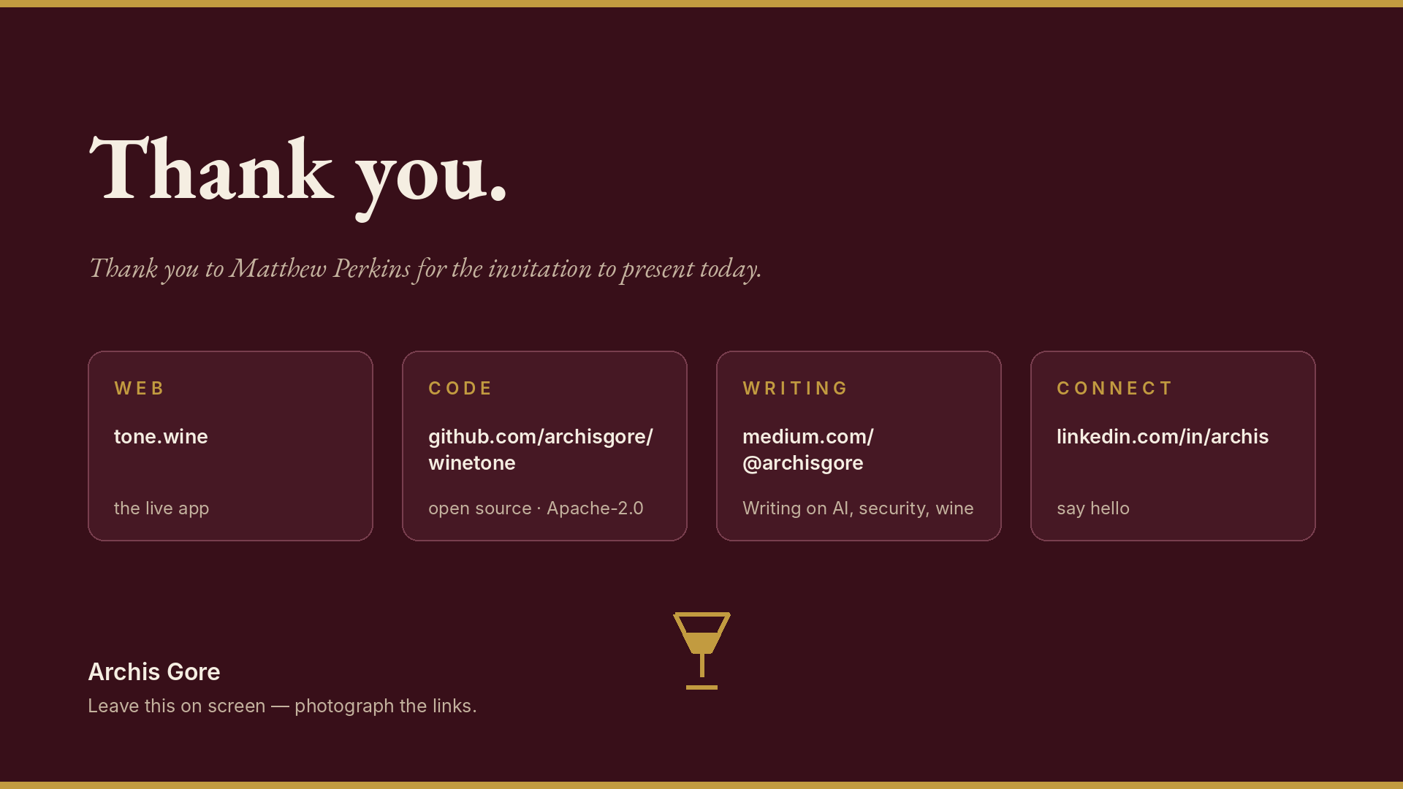
Notes:
Thank Matthew Perkins. Leave links on screen for people to photograph.

Slide 38
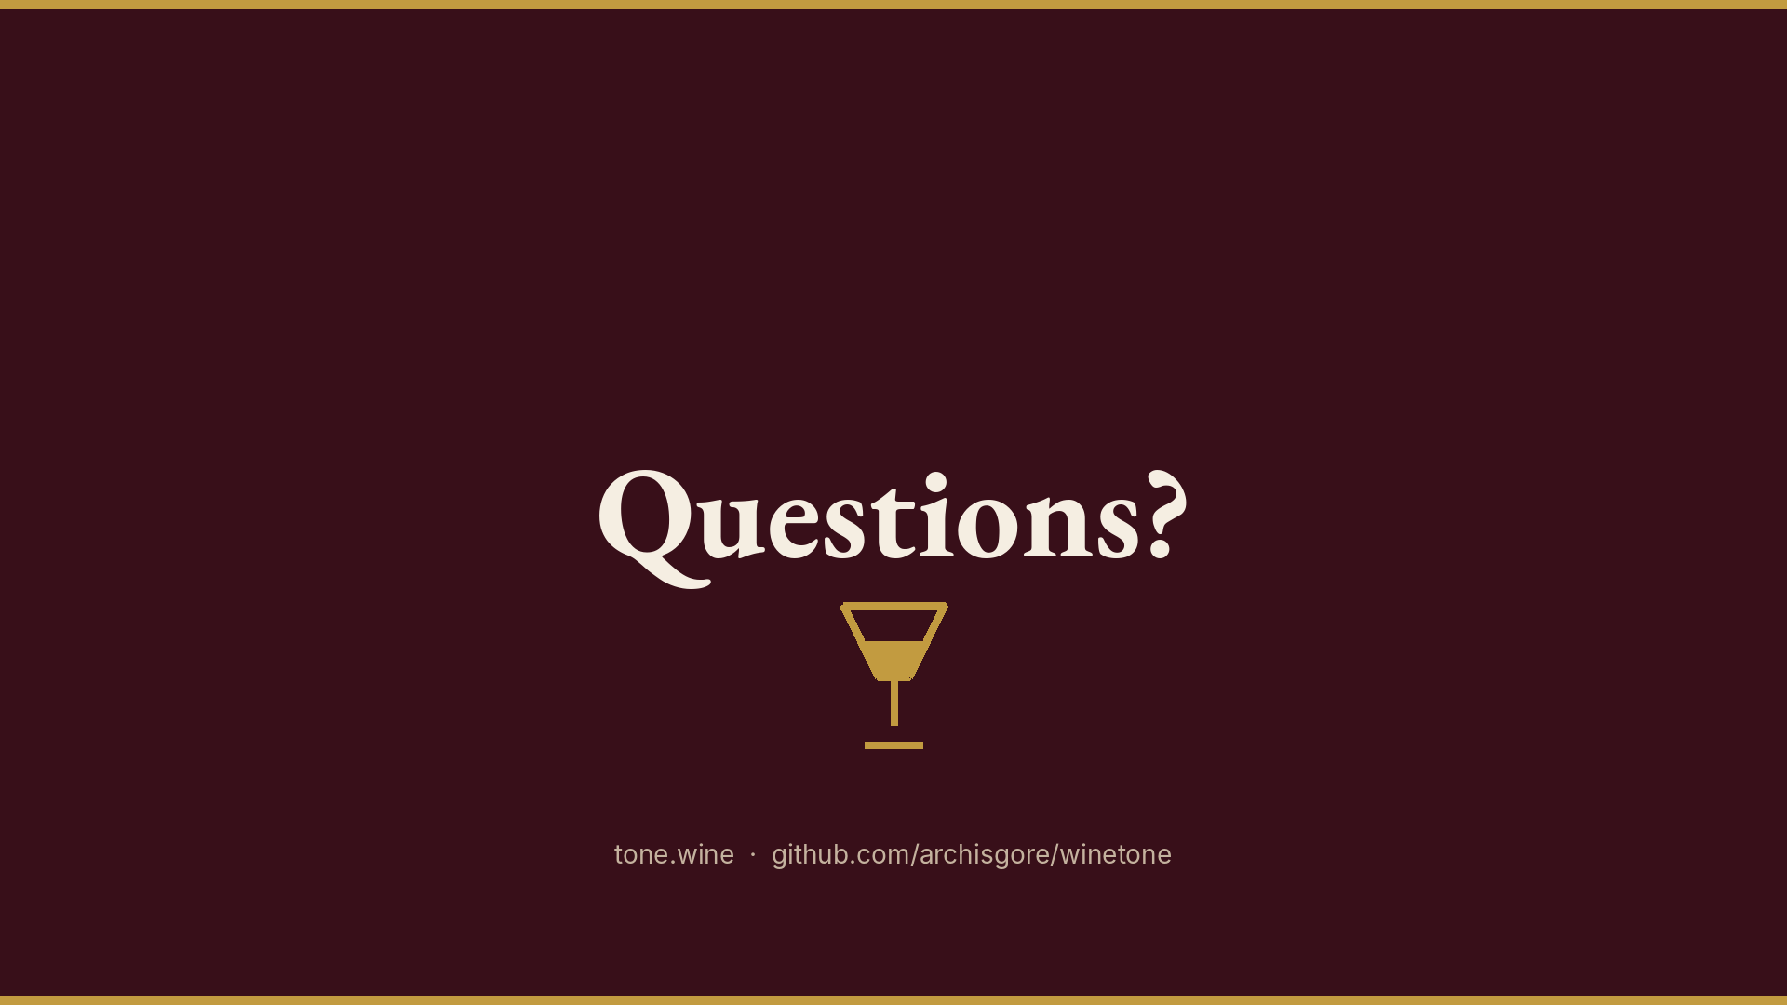
Notes:
Open floor. Keep the wine flowing.

