Slide 1

Lending Club Case Study
Detailed Analysis by
Samidh Bhagwat & Archishman Gantait

Slide 2

Business Objective
Perform EDA to understand how consumer attributes and loan attributes influence the tendency of default and identify driving factors behind loan default

Slide 3



Analysis Overview & Process
Data Exploration
Data Cleaning
Feature Analysis

Slide 4
Data Exploration
Data Overview - Understand the general structure of the dataset
Data Types and Conversion - Check the data types of each column
Unique Values and Cardinality - Identify unique values in categorical columns

Slide 5
Data Cleaning
Handling Missing Values
Identify columns with missing values and decide on an appropriate strategy
1
Handling Irrelevant or Redundant Features
Identify and remove irrelevant or redundant columns that do not contribute meaningful information to the analysis
2
Handling Data Types
Ensure that data types for each column are appropriate for the analysis.
3

Slide 6
Feature Analysis – Univariate Analysis
Univariate Analysis
Bi-variate Analysis

Slide 7
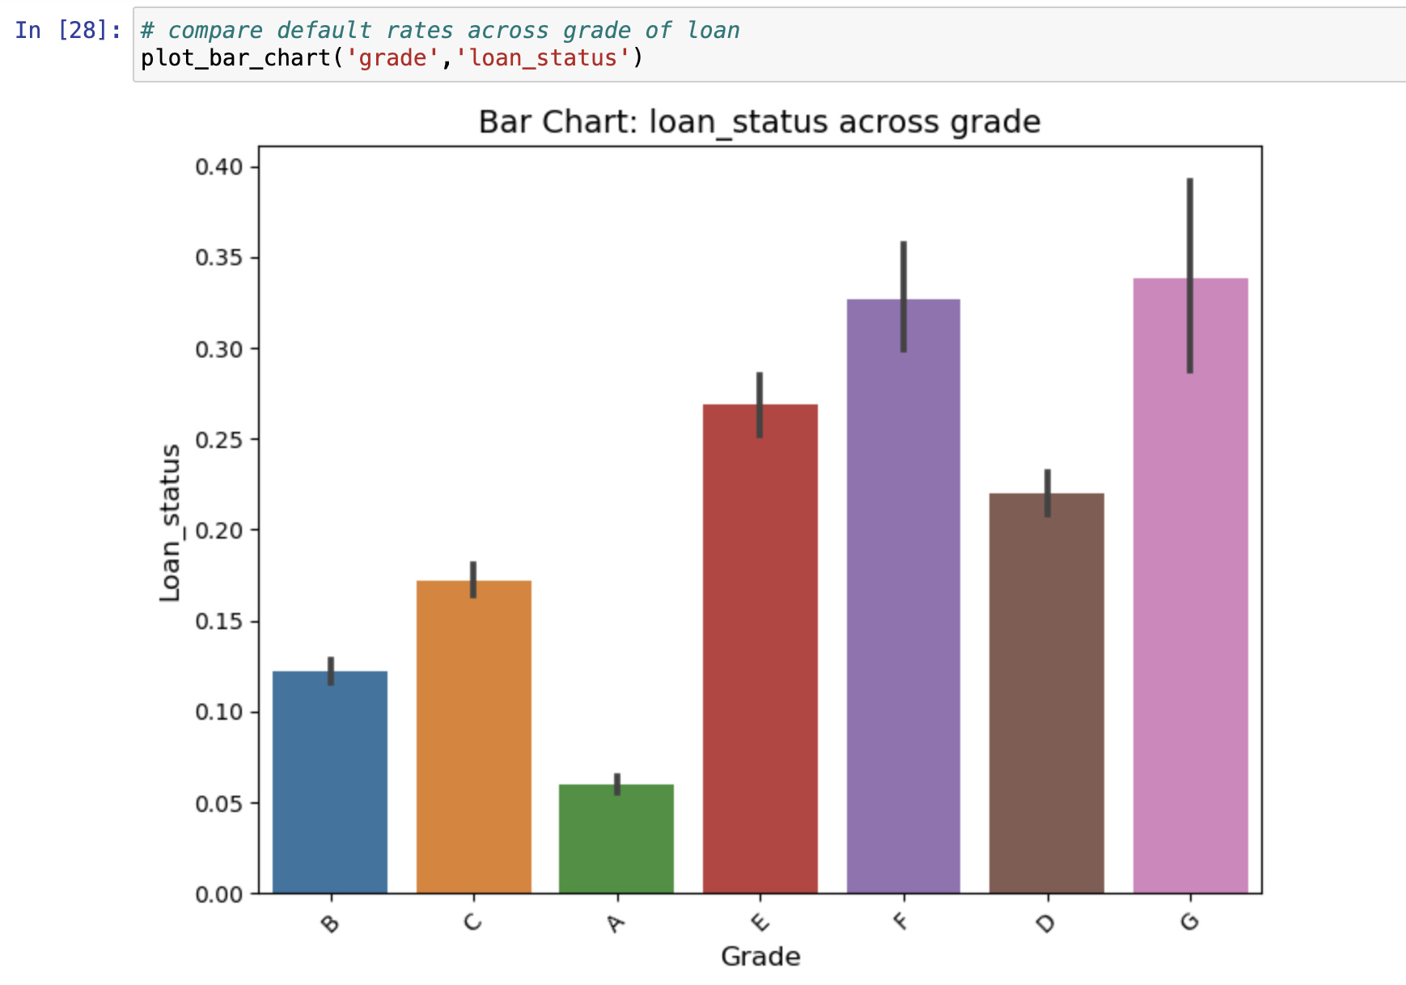
Grade - LC assigned loan grade
Grade “G”, lowest grade of loans have the highest rate of default.
Grade is decided as per the riskiness of the loan, as tagged by the Lending Club

Slide 8
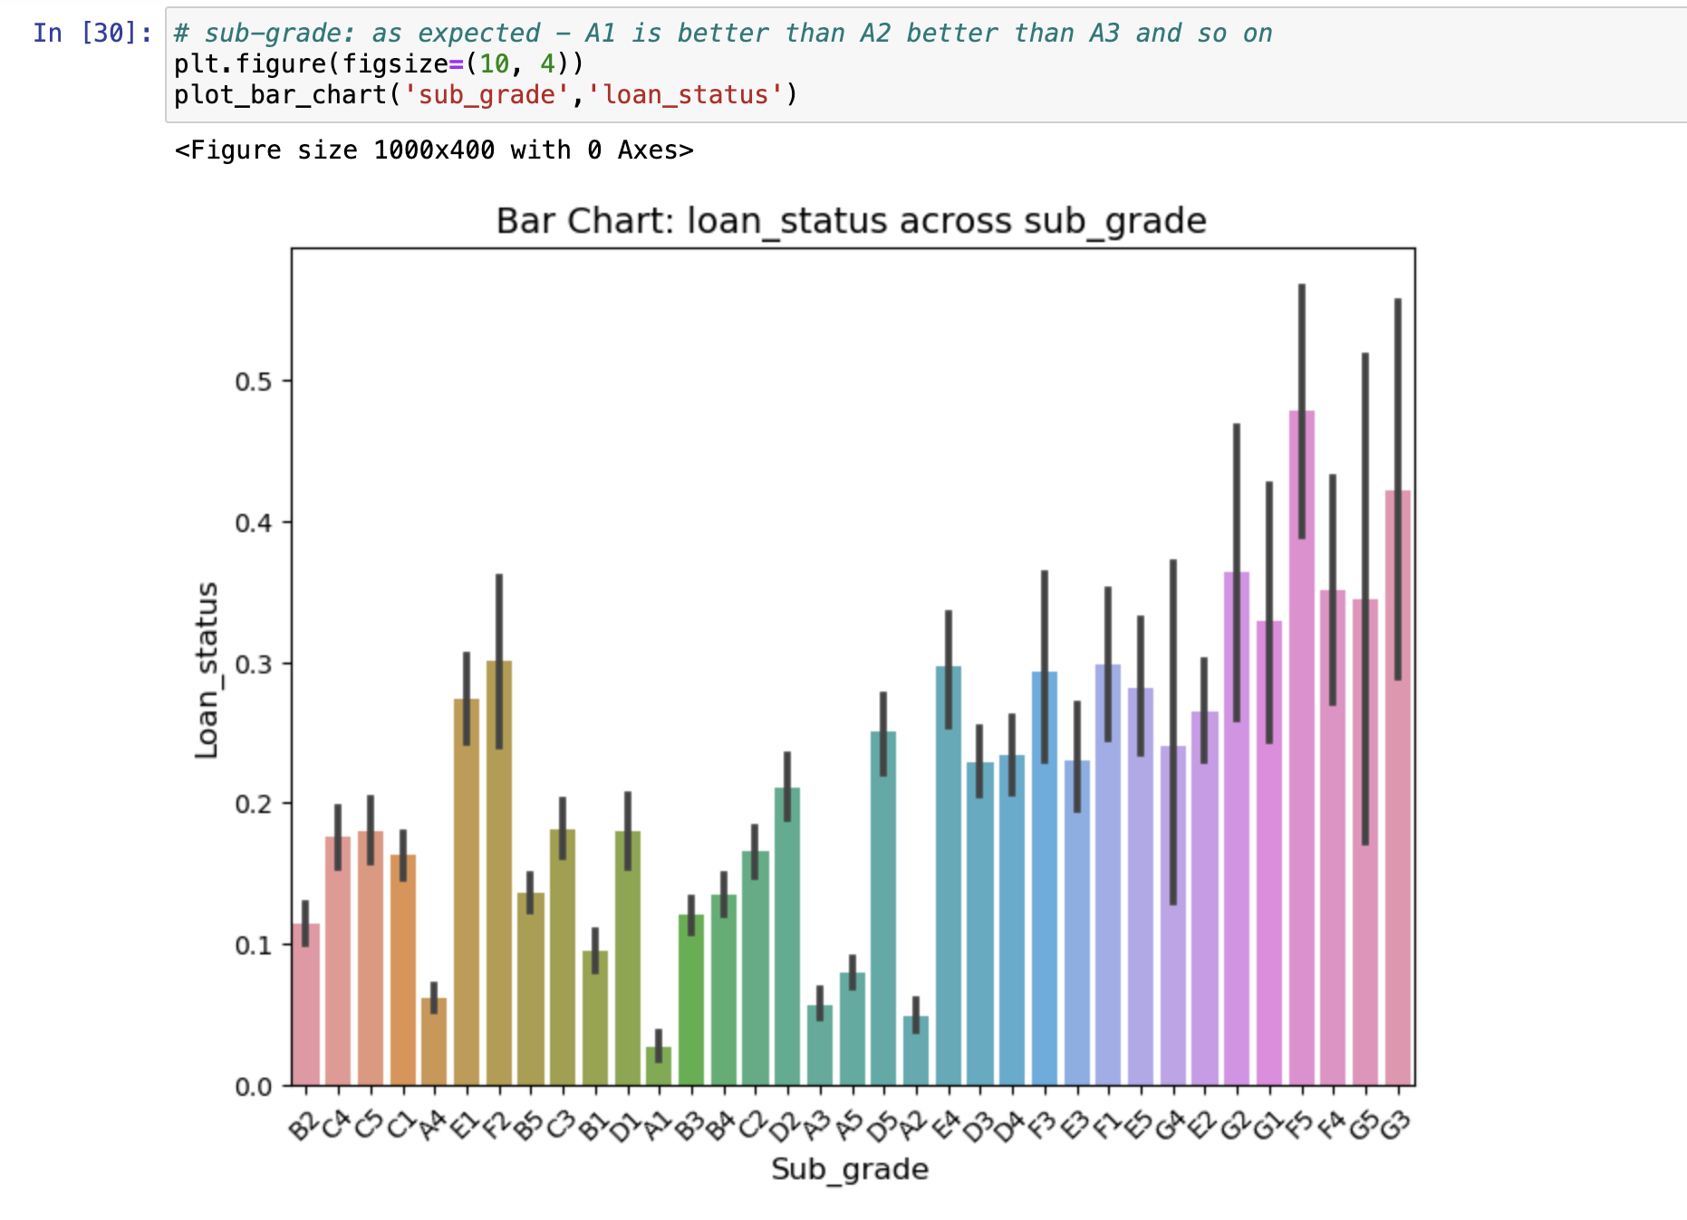
Sub_Grade - LC assigned loan Sub-grade
As we go down from A1 to A2 to A3, so on and so forth, the default rate increases
Sub-Grade is decided as per the riskiness of the loan, as tagged by the Lending Club

Slide 9
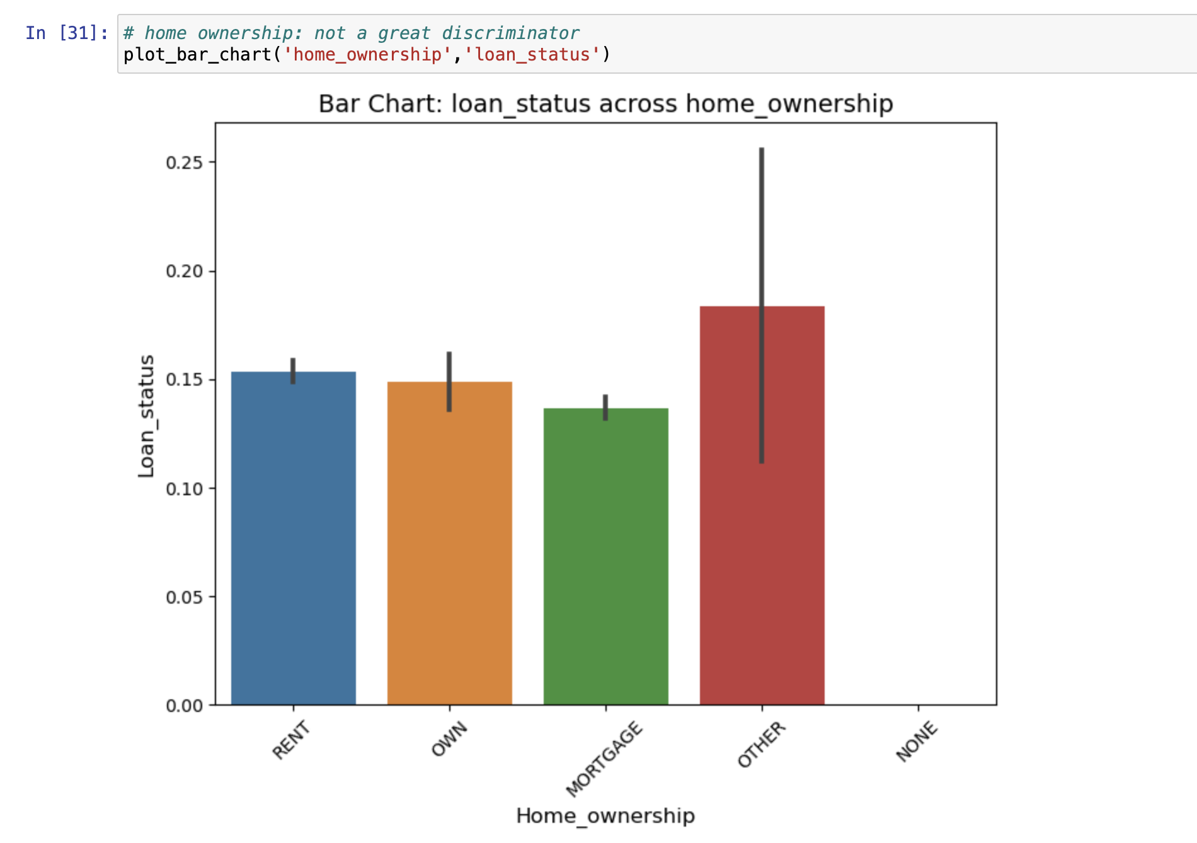
HOME OWNERSHIP - The home ownership status provided by the borrower during registration
Home Ownership doesn’t really have a lot of impact on the overall default rate

Slide 10
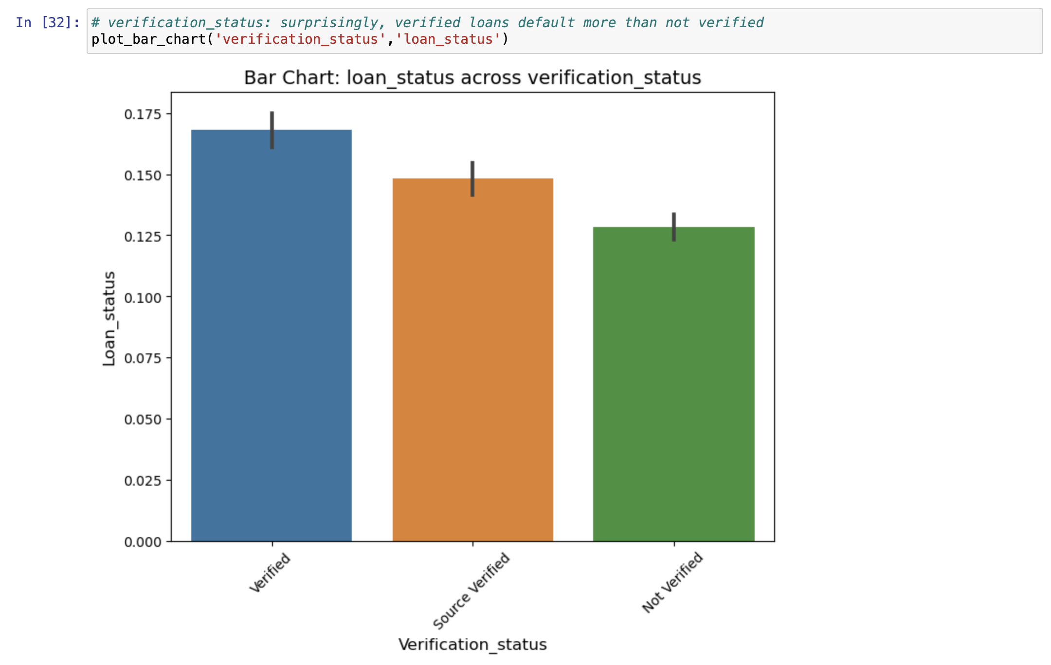
Verification Status - Indicates if income was verified by LC, not verified, or if the income source was verified
Verified loans have a higher default level

Slide 11
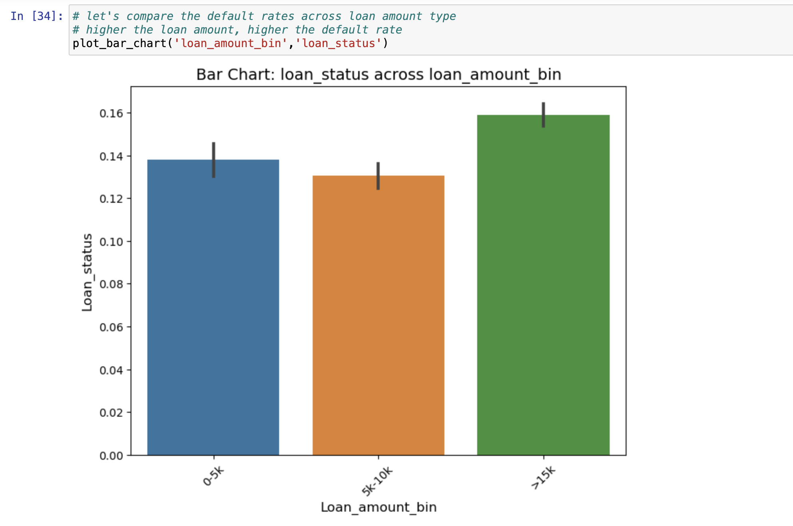
Loan Amount Bin – Derived variable to categorize loan amount into 3 segments.
Loan amount >15k has the highest default rate as compared to loans of lesser amount

Slide 12
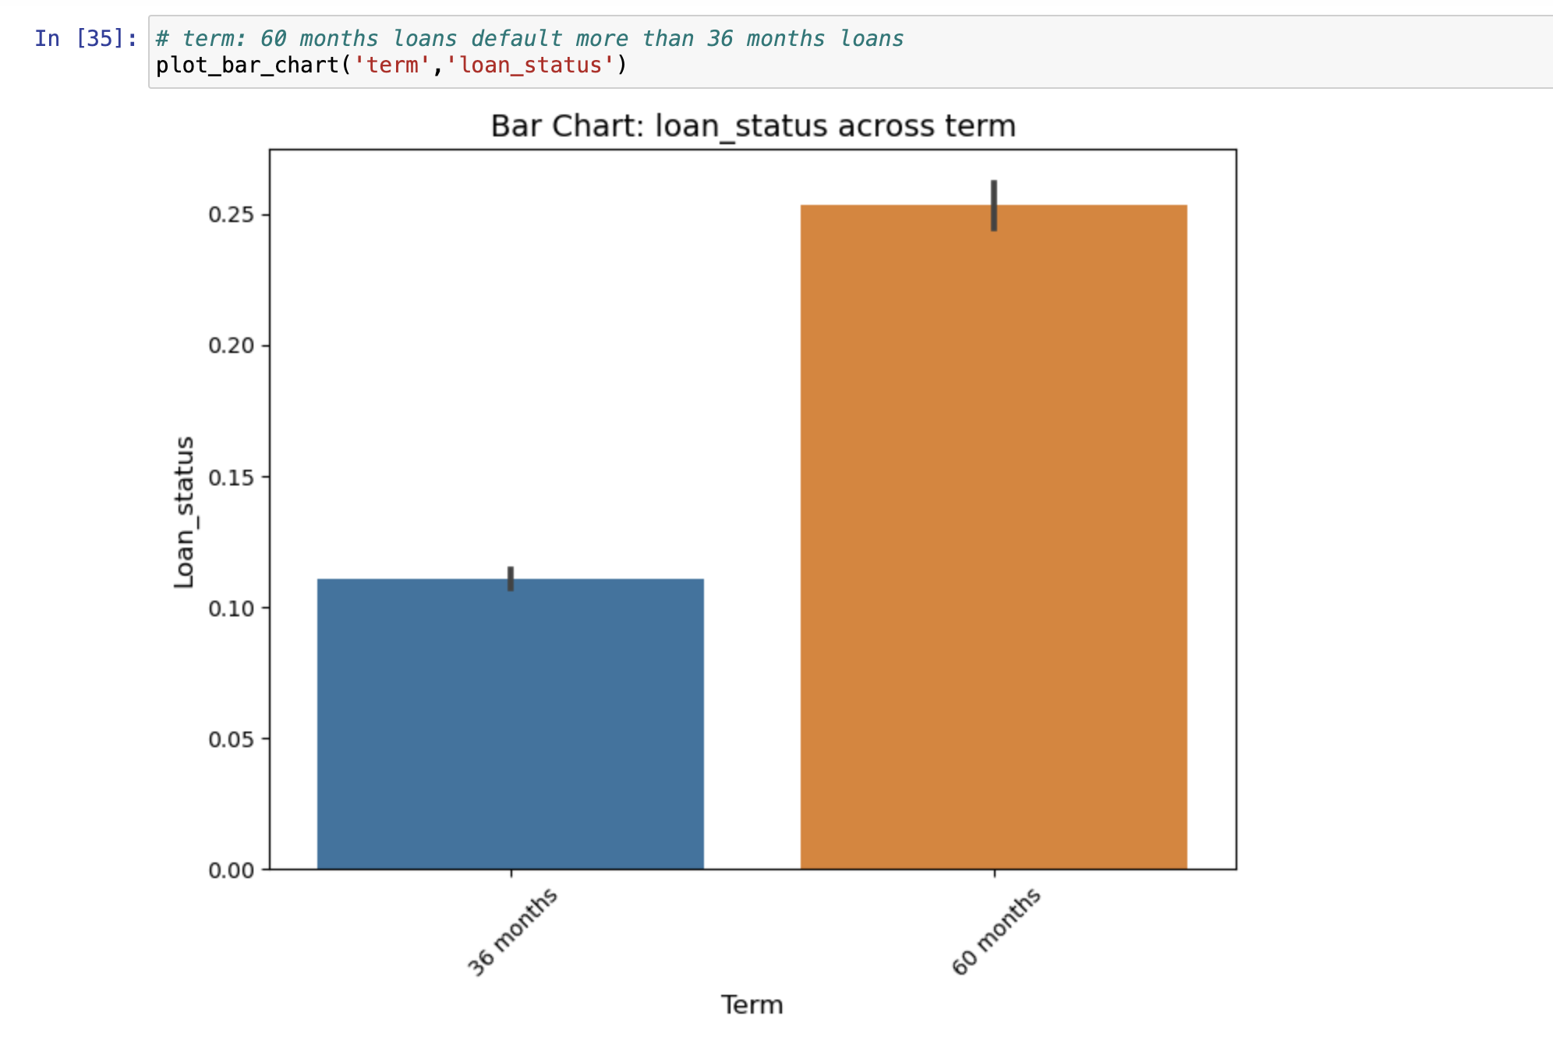
Term – Indicates the duration of Loan
Defaulters are higher when the term of loan is higher.

Slide 13
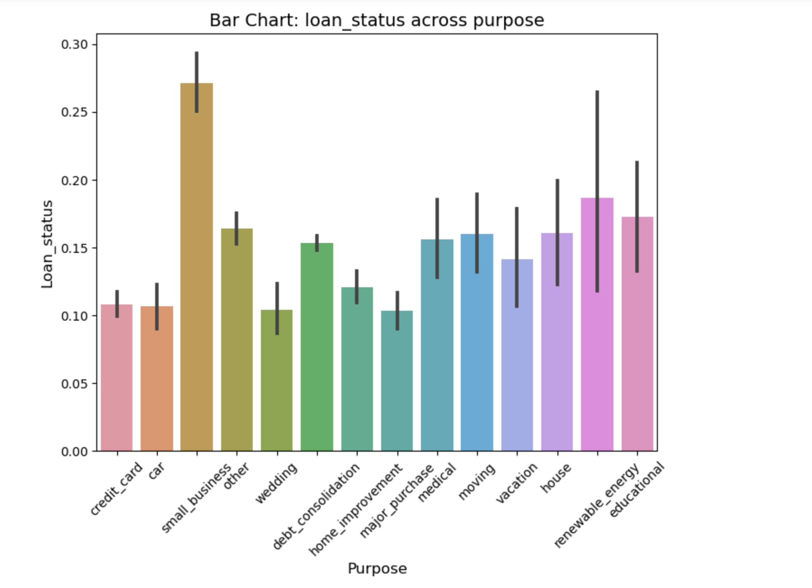
Purpose - LC assigned category , indicates purpose of loan
Approving Loan request for purpose like credit card , car , home improvement and wedding can be considered as much safer than others as there are less defaulters.

Slide 14
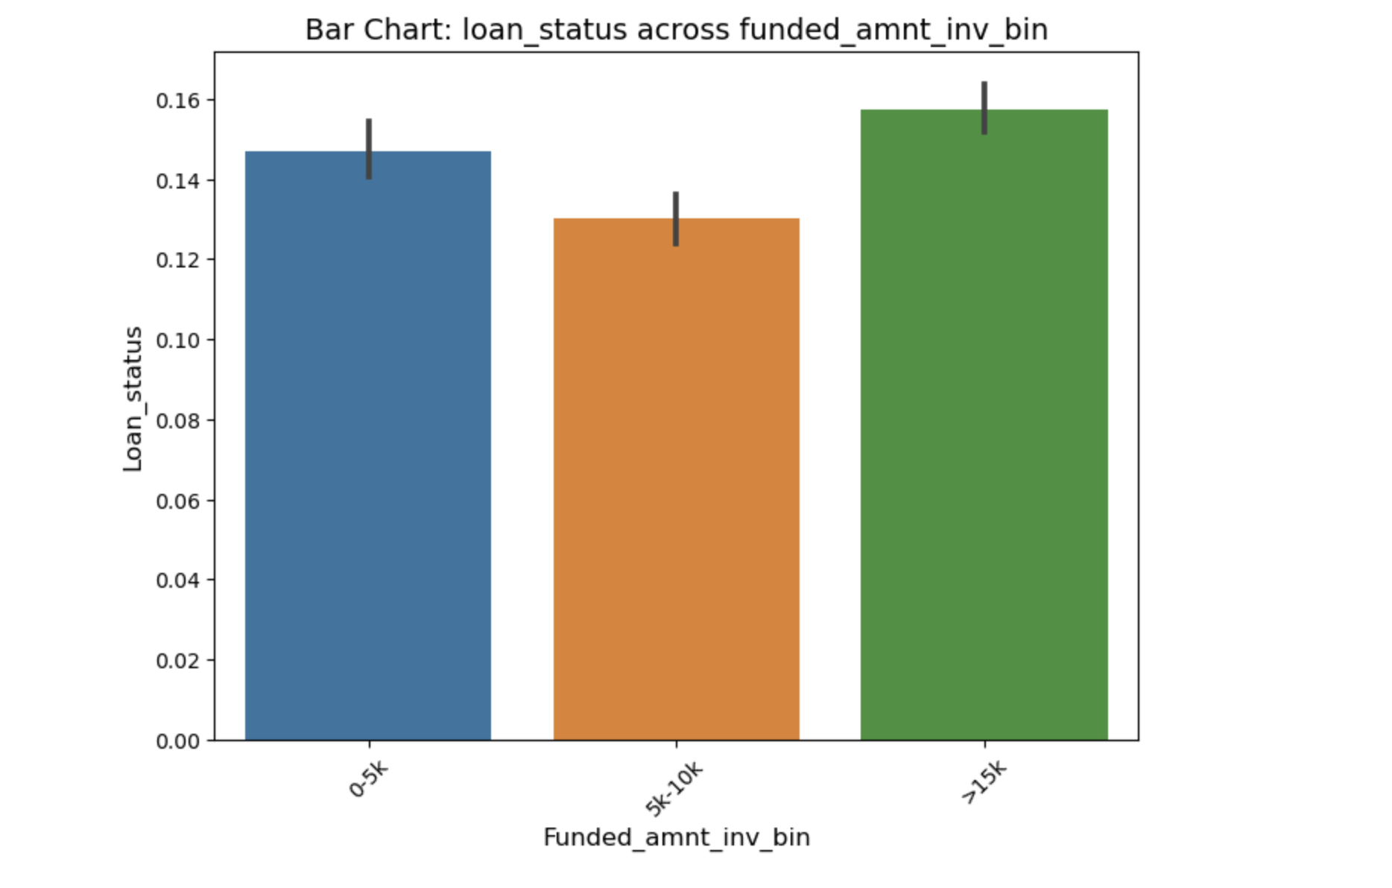
Funded_amnt_inv_bin : segment created based on the funded_amount i.e. amount committed by LC for a loan
The defaulters are more when funded amount is above 15k , however defaulters are less when funded amount id between 5k to 10k

Slide 15
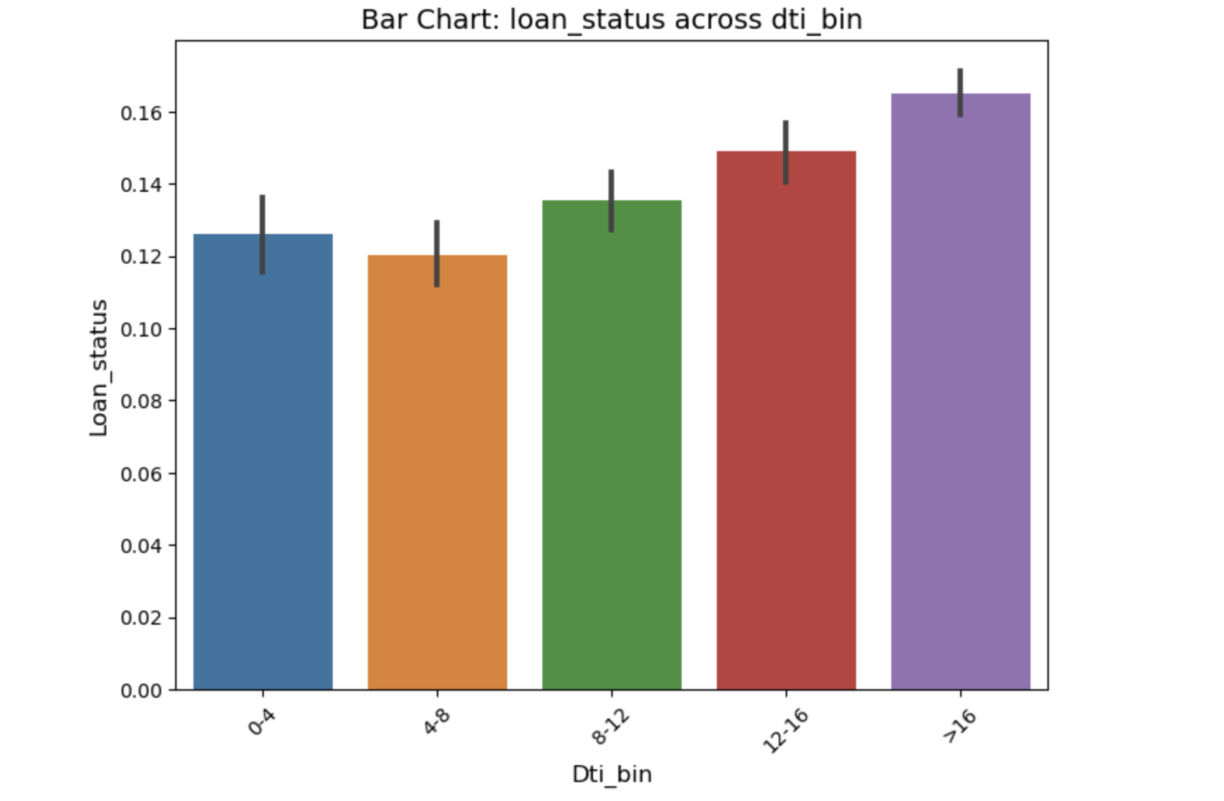
Dti_bin : segments created for LC defined Dti
Default rates are higher as the Dti increases , except for the 4-8 bracket , where defaulters are lower when compared with the previous segment of 0-4.

Slide 16
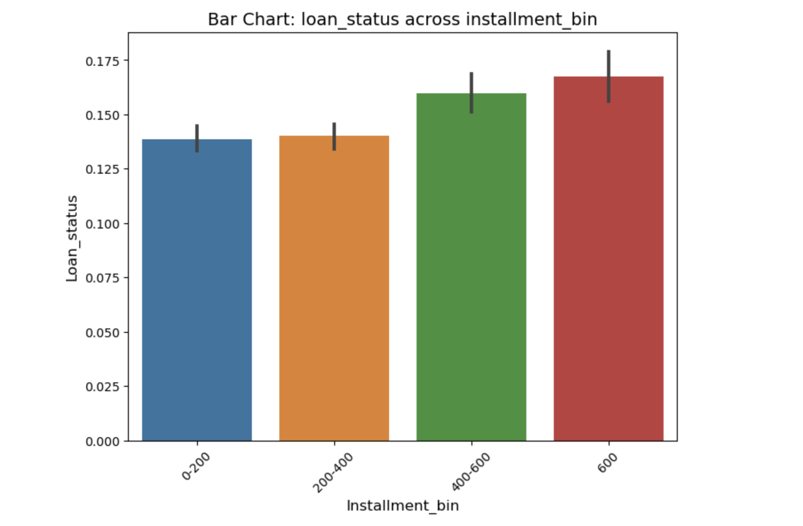
Installment_bin : created over the LC provided installment data
Defaulter rate is high when increasing installment value. Borrowers who choose lower installments are less likely to be defaulters.

Slide 17
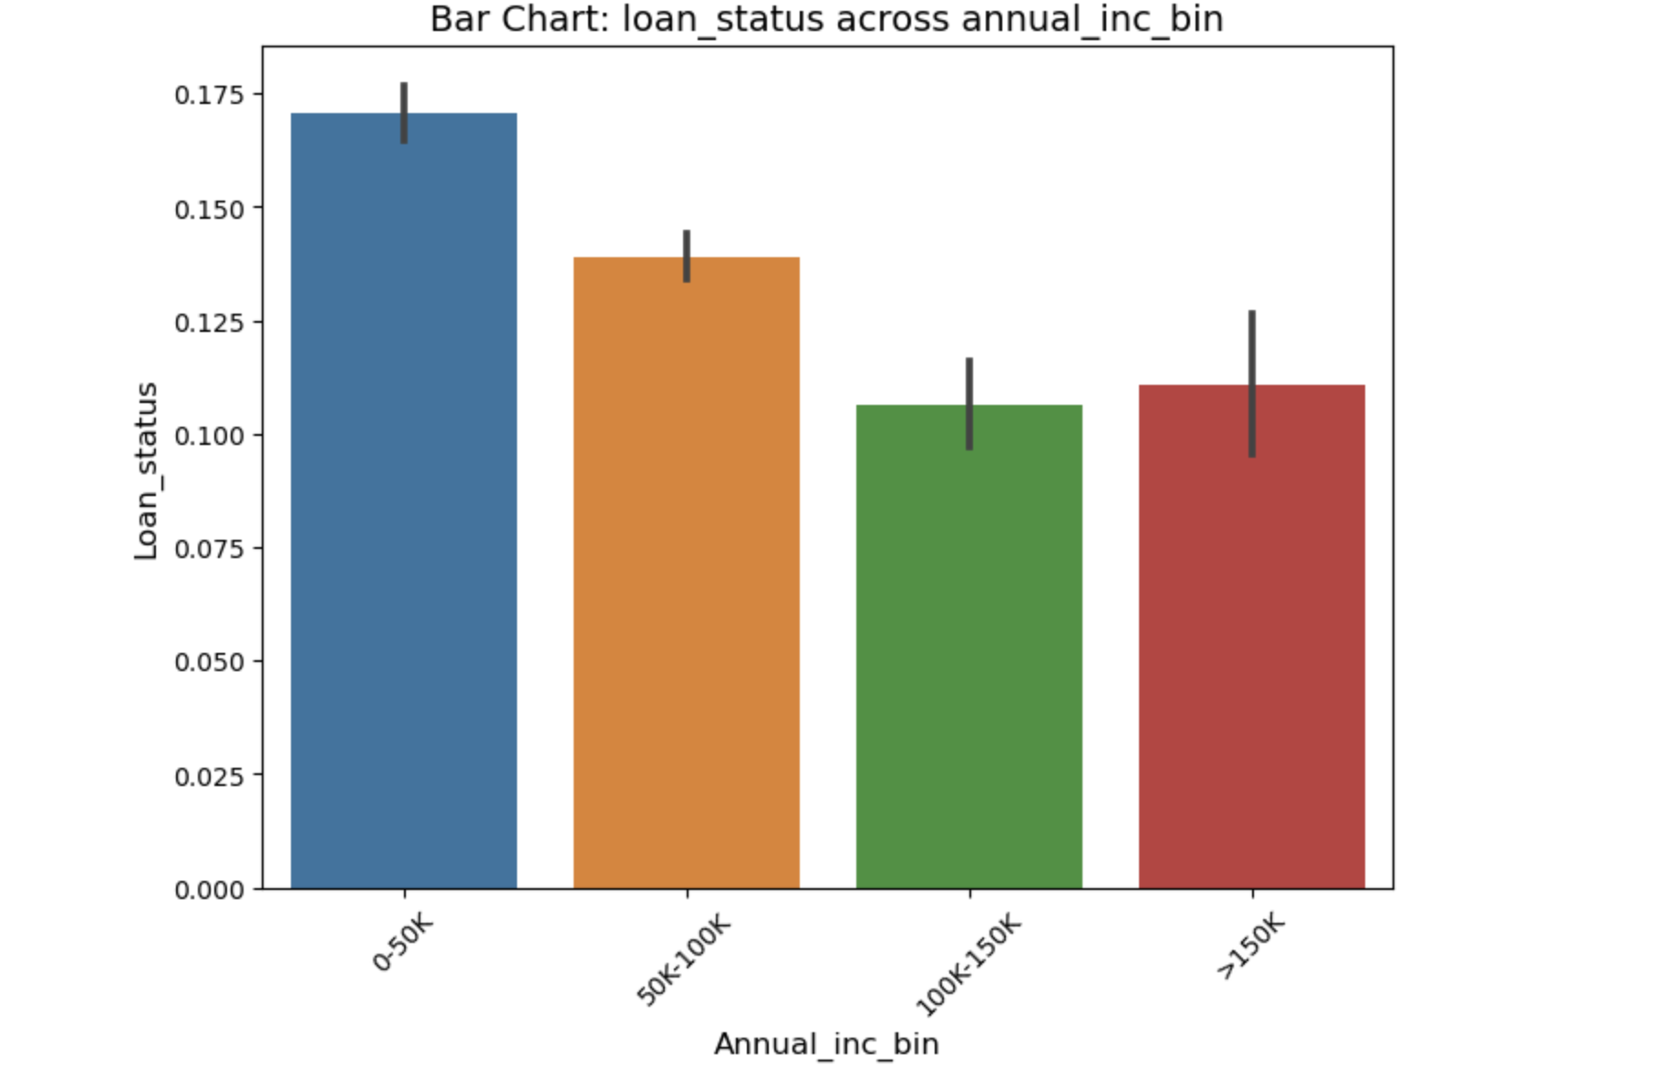
Annual_inc_bin : created over the LC provided annual_inc data
Defaulters tend to reduce with higher annual income upto a threshold of 150k . Post this the defaulters are likely to increase.

Slide 18
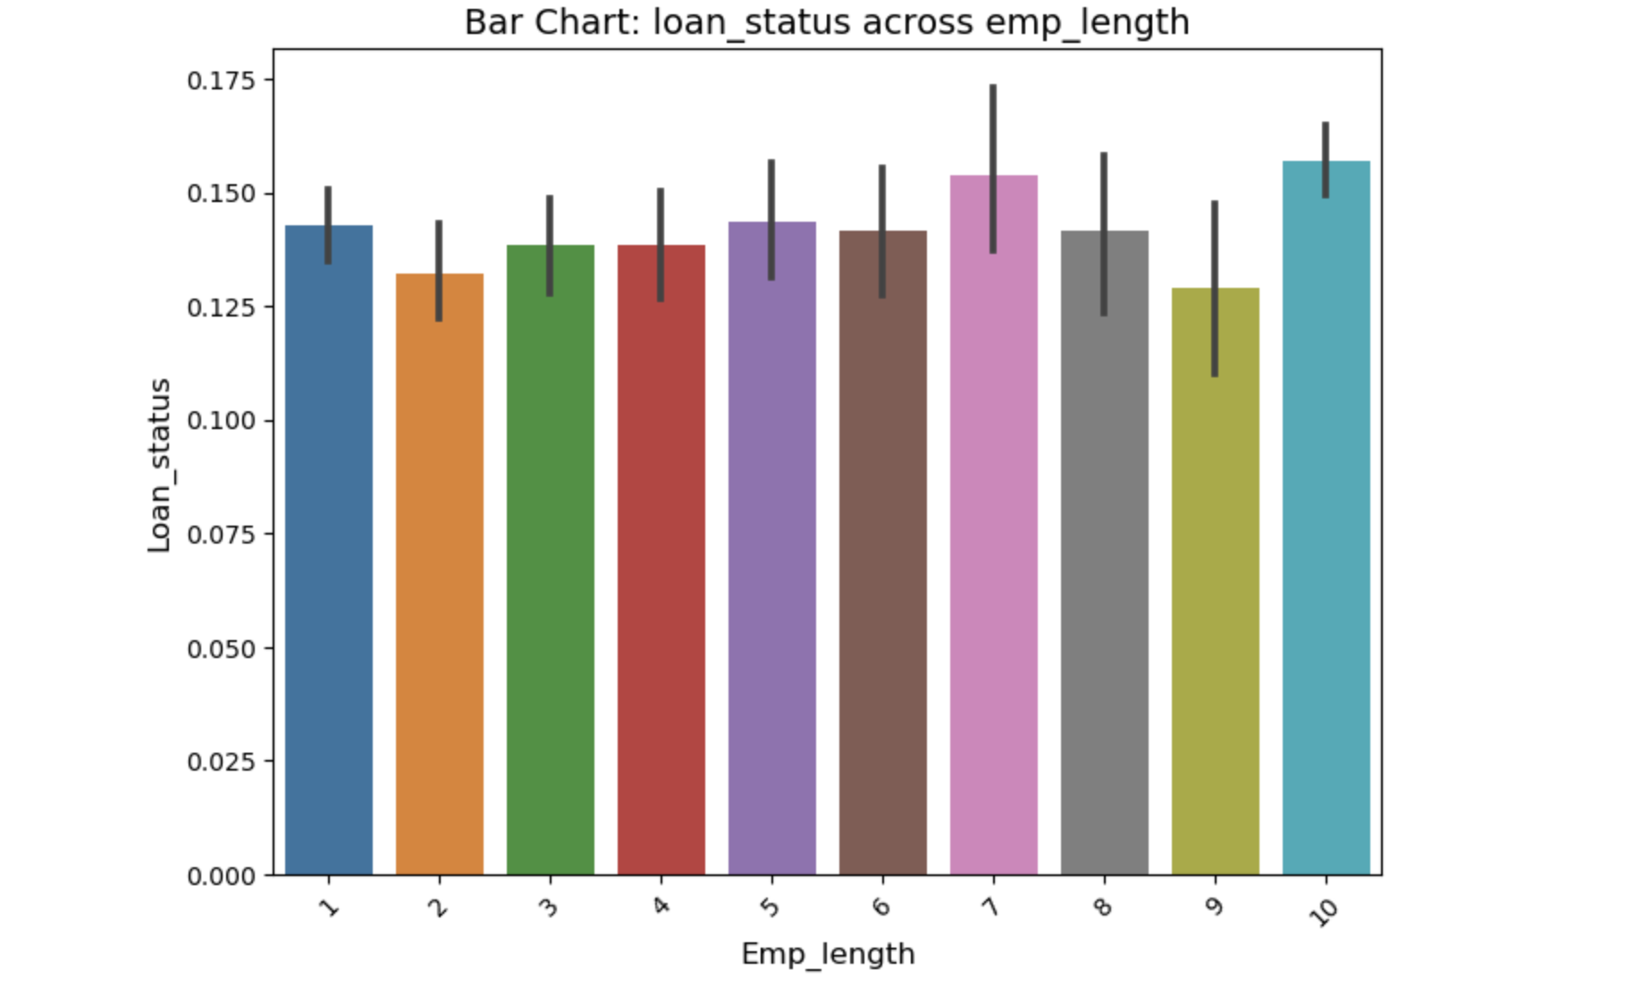
Emp_length : Employment length in years between 0 to 10
There is no such pattern in the data for decreasing or increasing years of employment. However borrowers with 7 or 10 years experience show higher defaulters rate.

