Slide 1

Lending Club Case Study
Detailed Analysis by
Samidh Bhagwat & Archishman Gantait

Slide 2

Business Objective
Perform EDA to understand how consumer attributes and loan attributes influence the tendency of default and identify driving factors behind loan default

Slide 3



Analysis Overview & Process
Data Exploration
Data Cleaning
Feature Analysis

Slide 4
Data Exploration
Data Overview - Understand the general structure of the dataset
Data Types and Conversion - Check the data types of each column
Unique Values and Cardinality - Identify unique values in categorical columns

Slide 5
Data Cleaning
Handling Missing Values
Identify columns with missing values and decide on an appropriate strategy
1
Handling Irrelevant or Redundant Features
Identify and remove irrelevant or redundant columns that do not contribute meaningful information to the analysis
2
Handling Data Types
Ensure that data types for each column are appropriate for the analysis.
3

Slide 6
Feature Analysis – Univariate Analysis
Univariate Analysis
Bi-variate Analysis

Slide 7
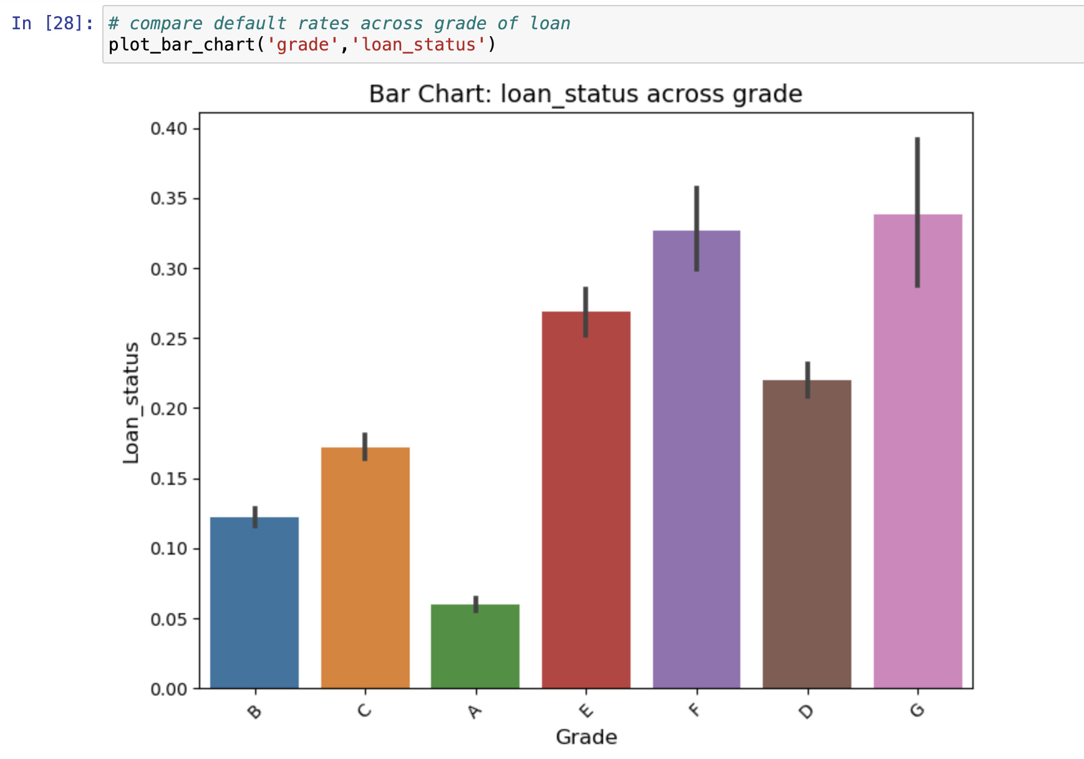
Grade - LC assigned loan grade
Grade “G”, lowest grade of loans have the highest rate of default.
Grade is decided as per the riskiness of the loan, as tagged by the Lending Club

Slide 8
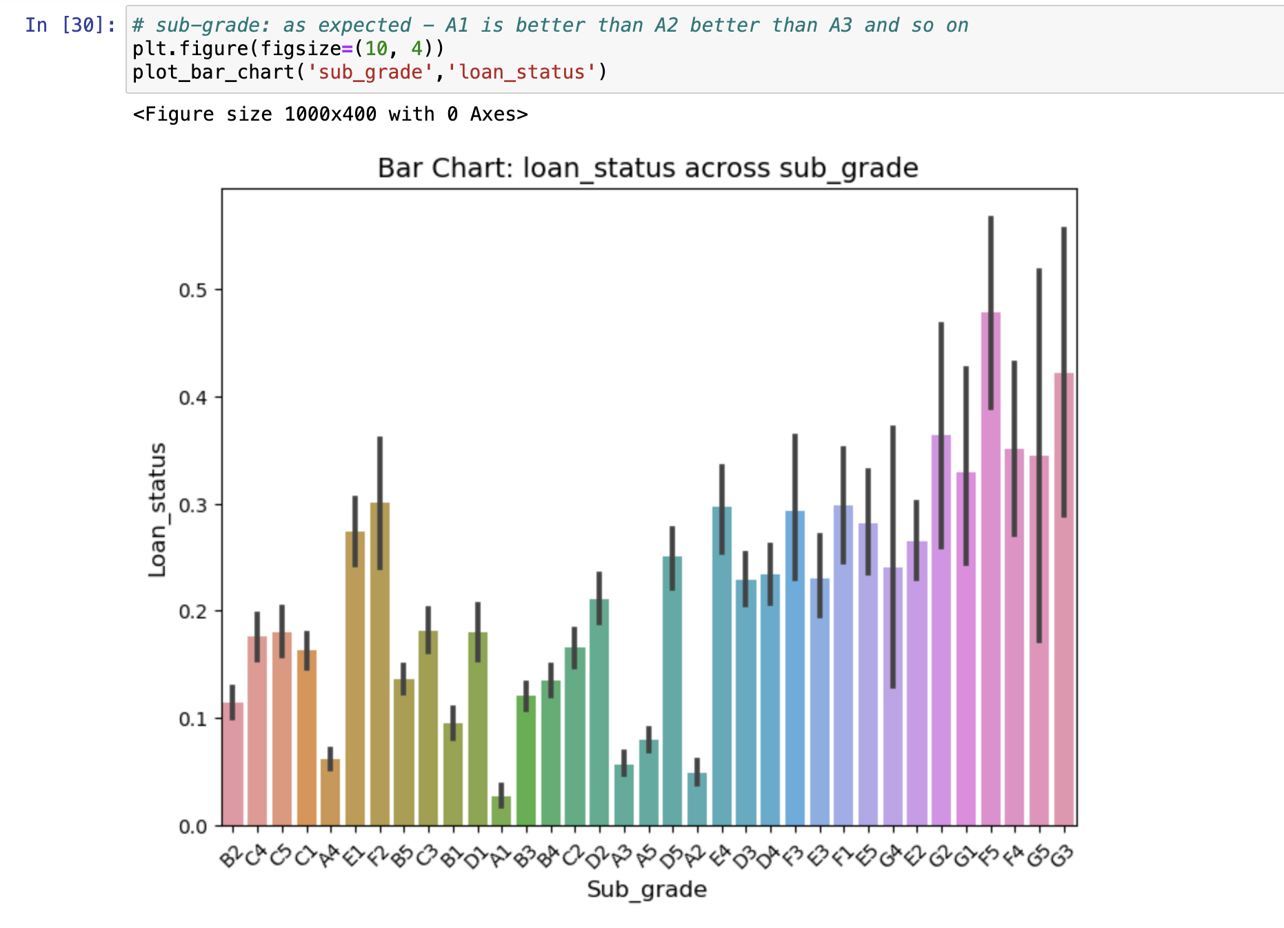
Sub_Grade - LC assigned loan Sub-grade
As we go down from A1 to A2 to A3, so on and so forth, the default rate increases
Sub-Grade is decided as per the riskiness of the loan, as tagged by the Lending Club

Slide 9
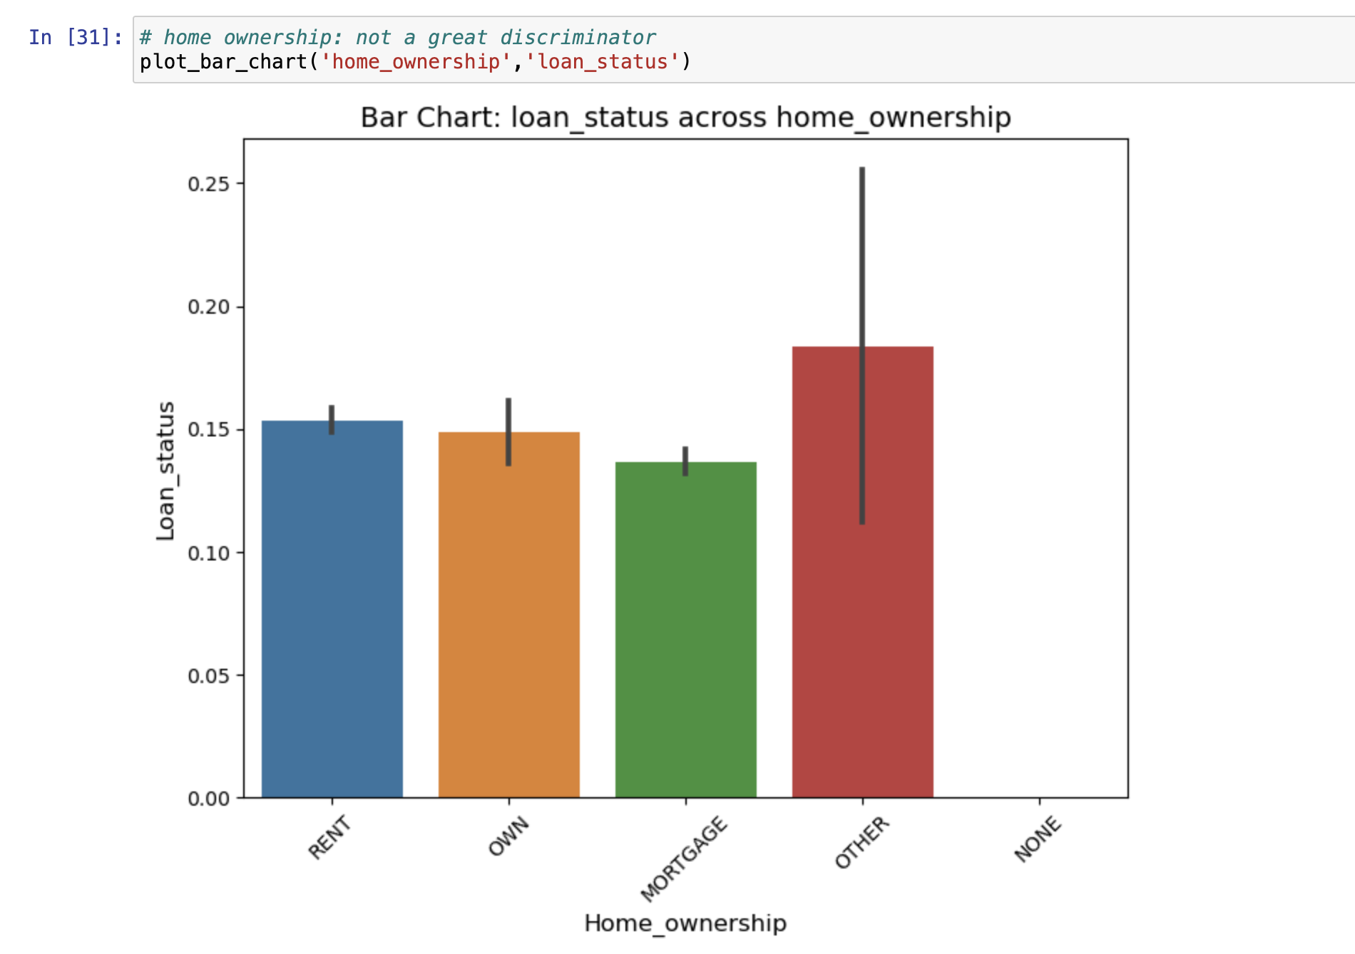
HOME OWNERSHIP - The home ownership status provided by the borrower during registration
Home Ownership doesn’t really have a lot of impact on the overall default rate

Slide 10
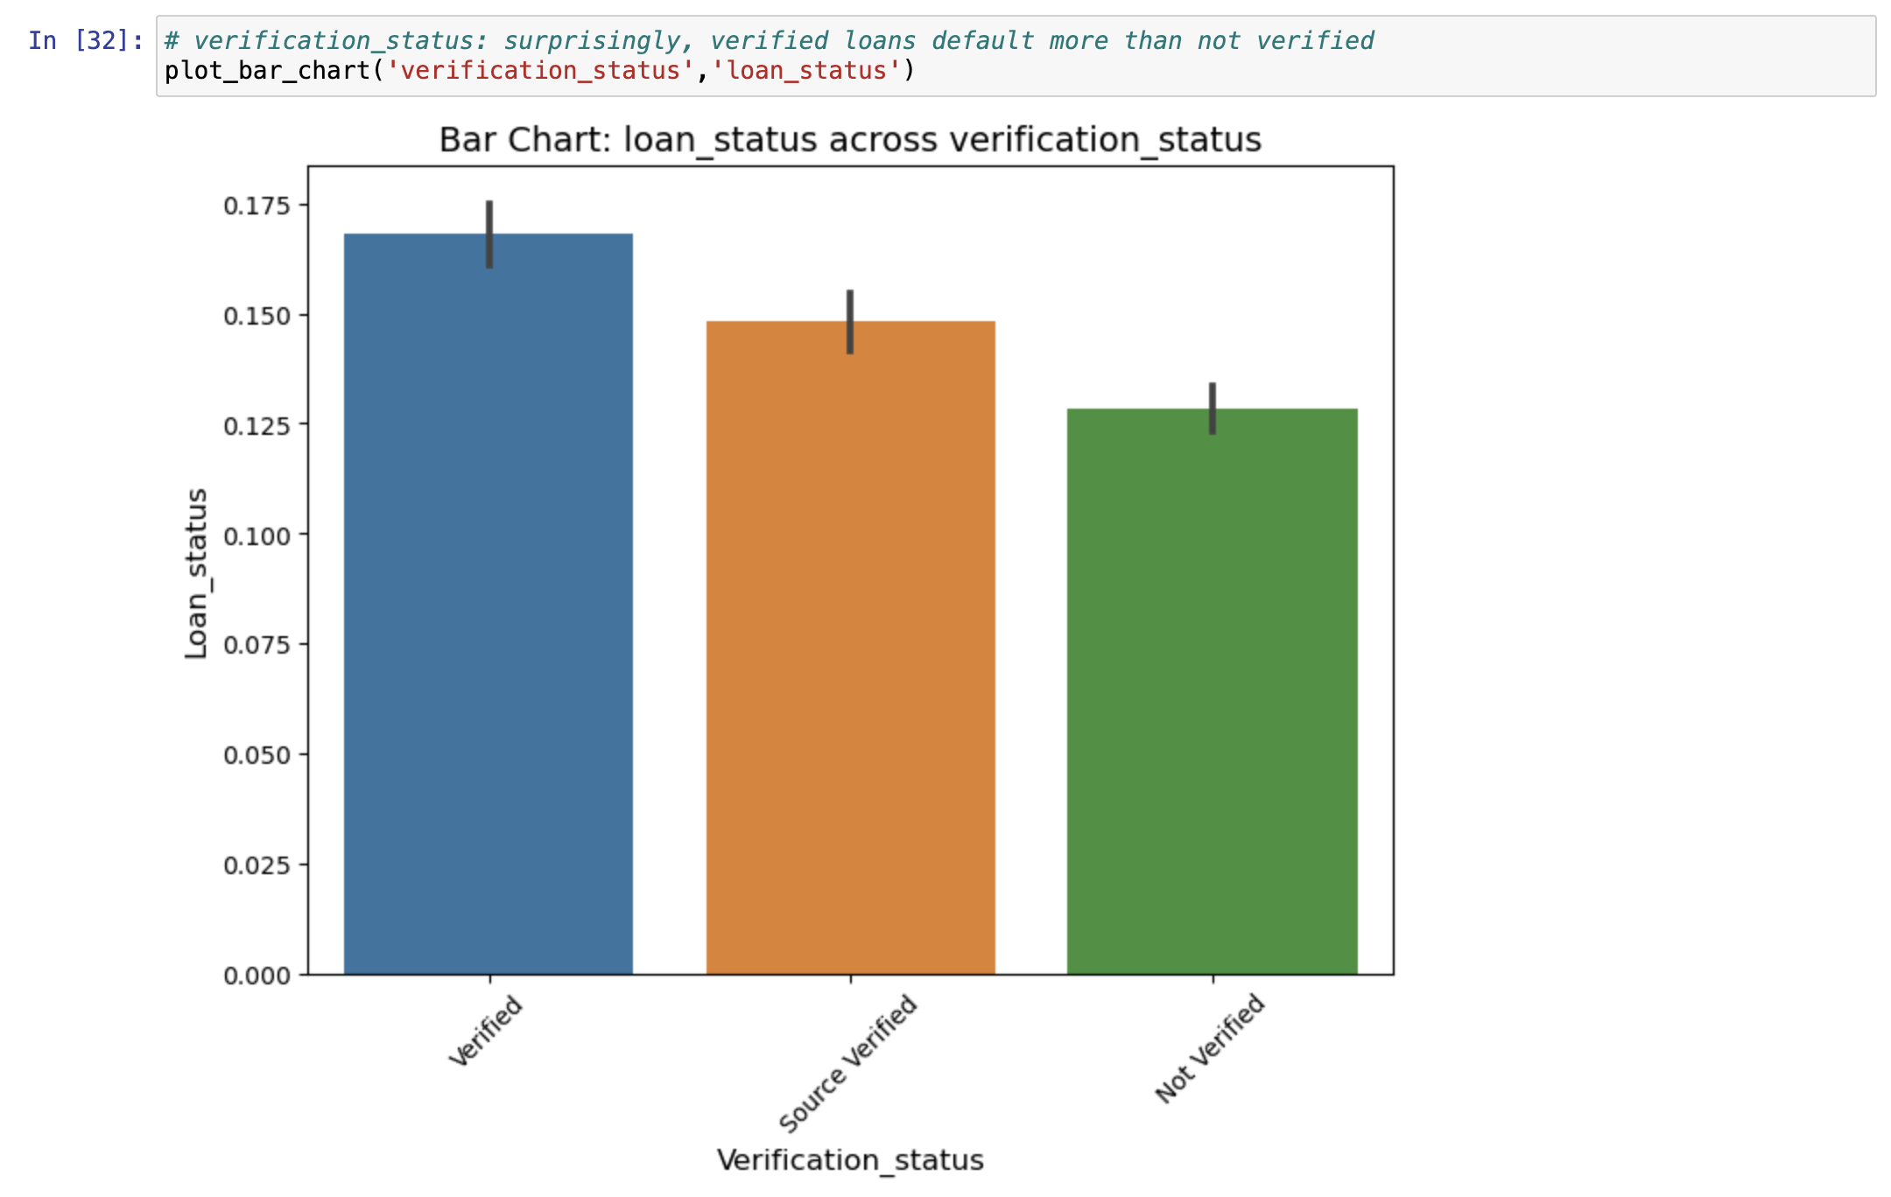
Verification Status - Indicates if income was verified by LC, not verified, or if the income source was verified
Verified loans have a higher default level

Slide 11
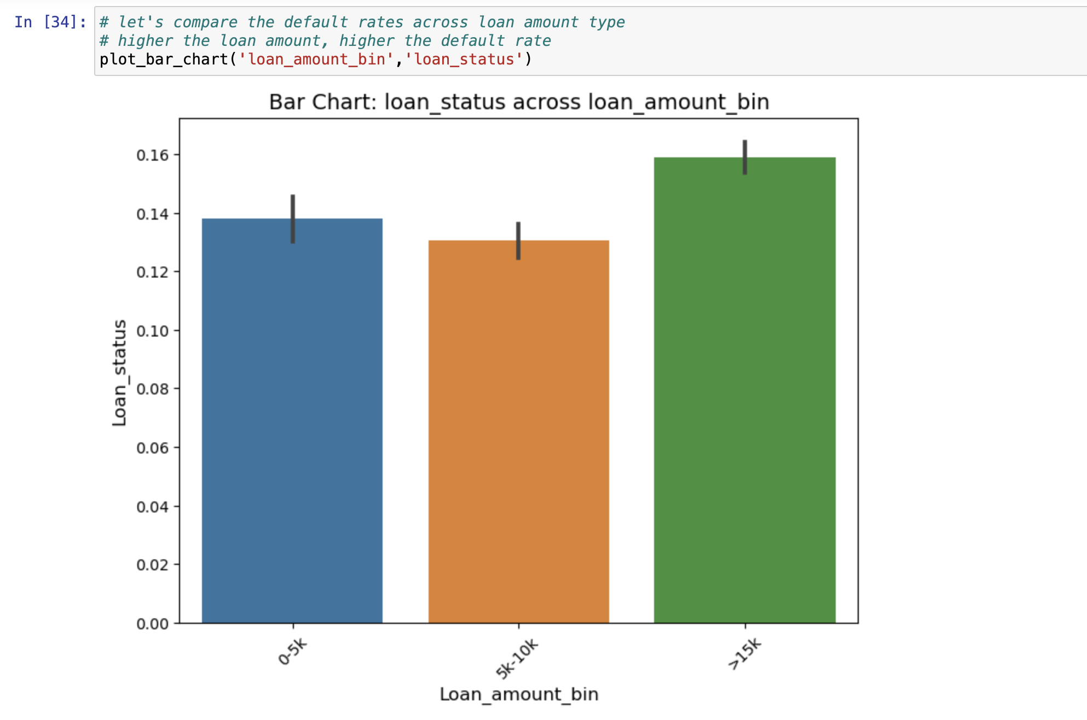
Loan Amount Bin – Derived variable to categorize loan amount into 3 segments.
Loan amount >15k has the highest default rate as compared to loans of lesser amount

Slide 12
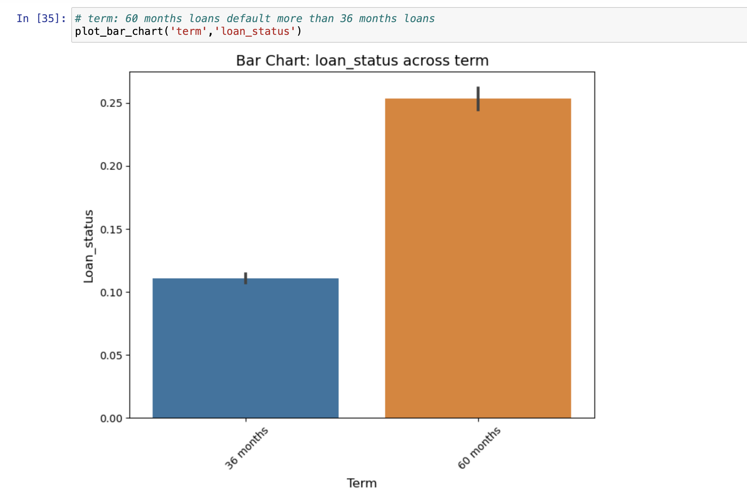
Term – Indicates the duration of Loan
Defaulters are higher when the term of loan is higher.

Slide 13
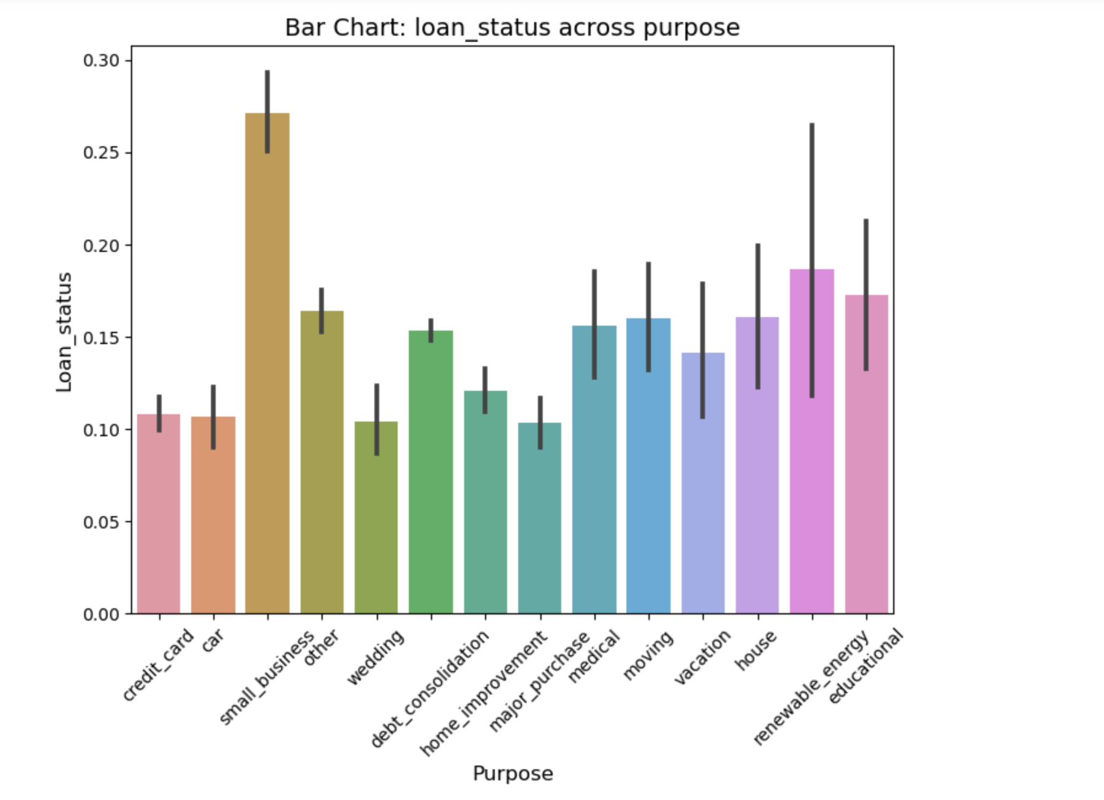
Purpose - LC assigned category , indicates purpose of loan
Approving Loan request for purpose like credit card , car , home improvement and wedding can be considered as much safer than others as there are less defaulters.

Slide 14
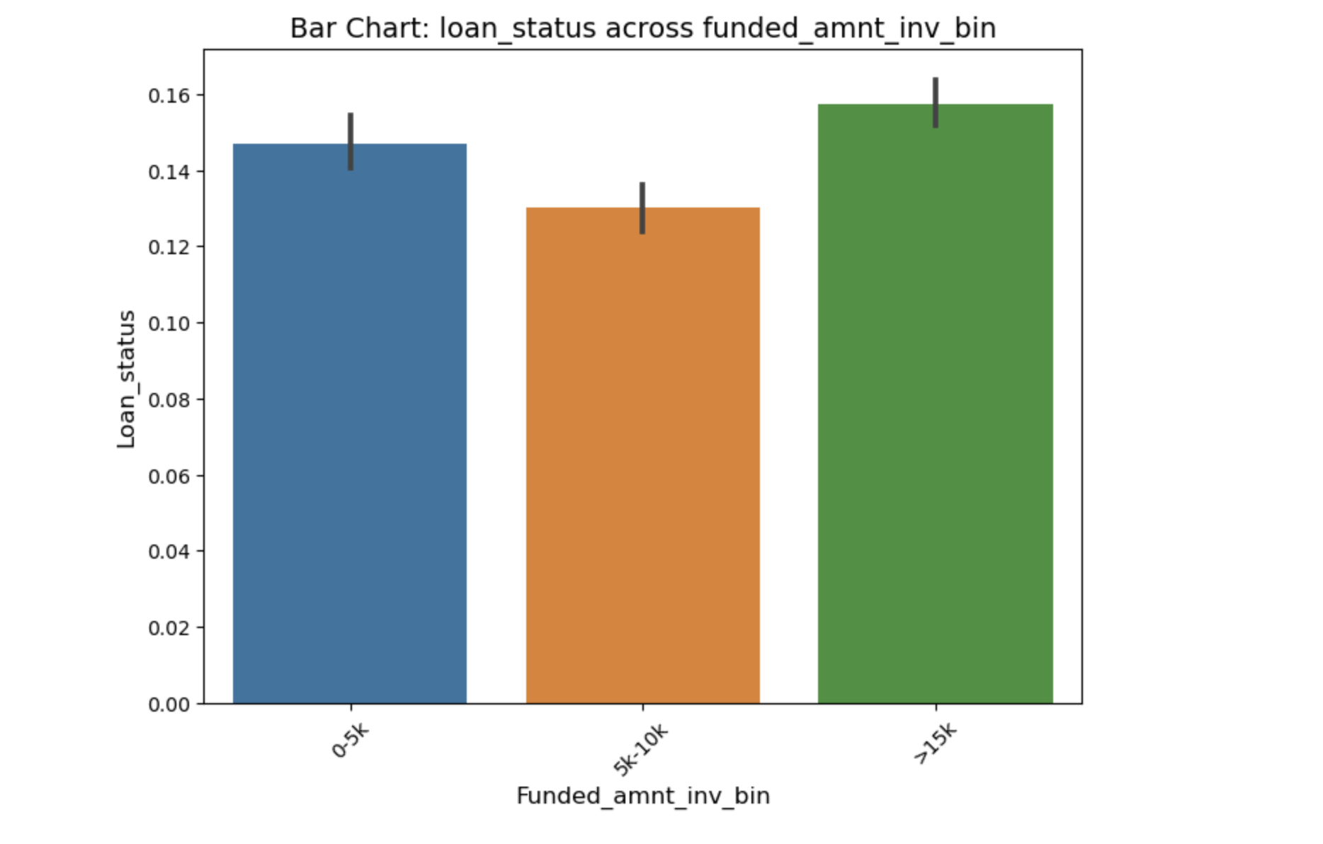
Funded_amnt_inv_bin : segment created based on the funded_amount i.e. amount committed by LC for a loan
The defaulters are more when funded amount is above 15k , however defaulters are less when funded amount id between 5k to 10k

Slide 15
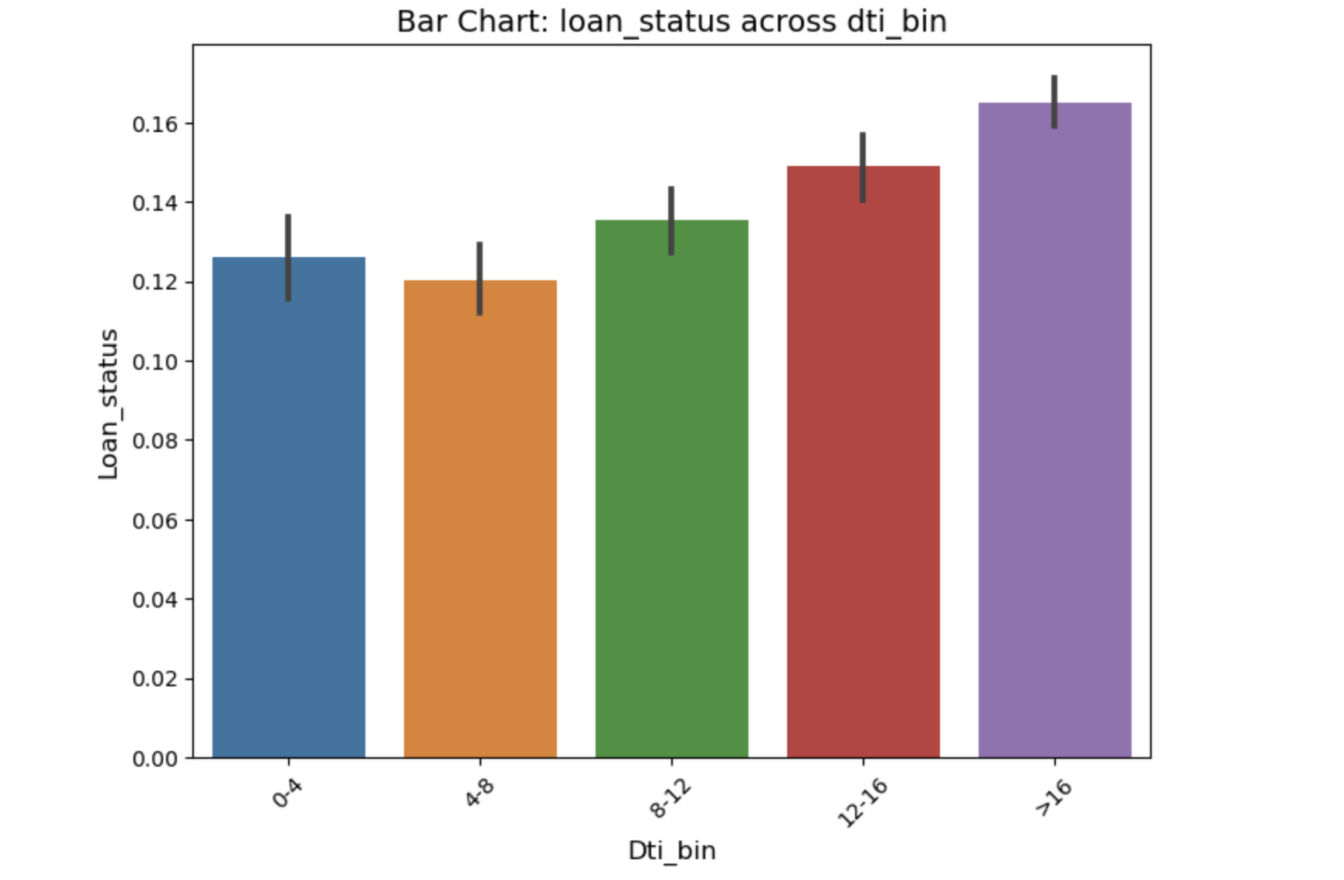
Dti_bin : segments created for LC defined Dti
Default rates are higher as the Dti increases , except for the 4-8 bracket , where defaulters are lower when compared with the previous segment of 0-4.

Slide 16
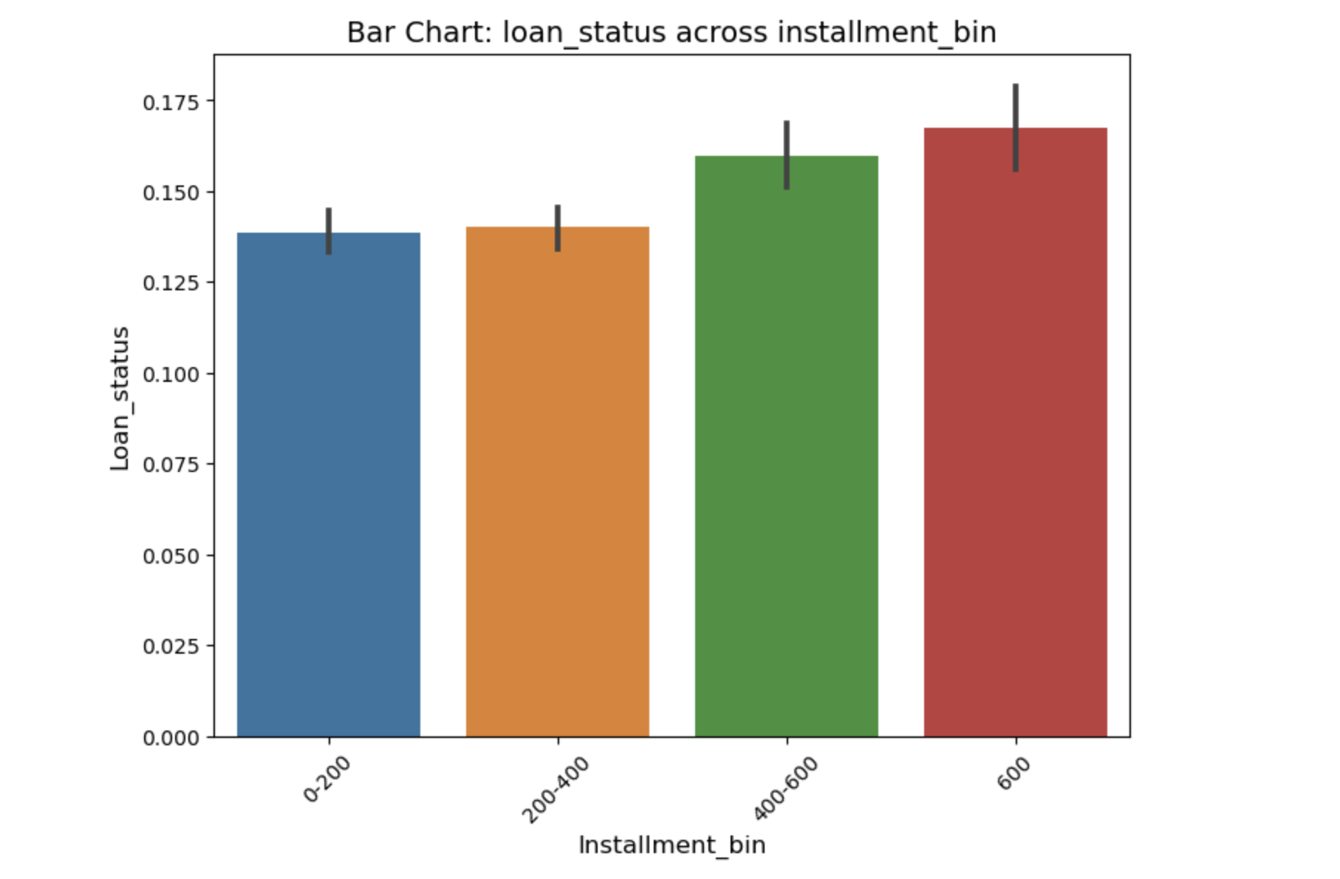
Installment_bin : created over the LC provided installment data
Defaulter rate is high when increasing installment value. Borrowers who choose lower installments are less likely to be defaulters.

Slide 17
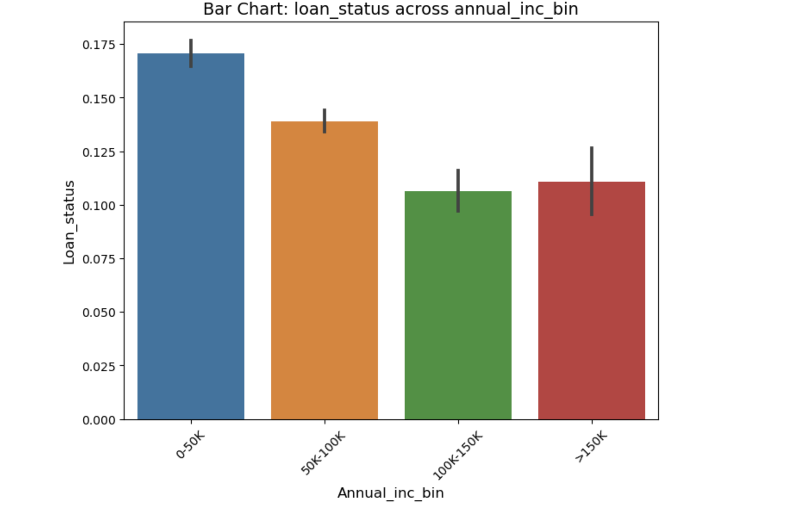
Annual_inc_bin : created over the LC provided annual_inc data
Defaulters tend to reduce with higher annual income upto a threshold of 150k . Post this the defaulters are likely to increase.

Slide 18
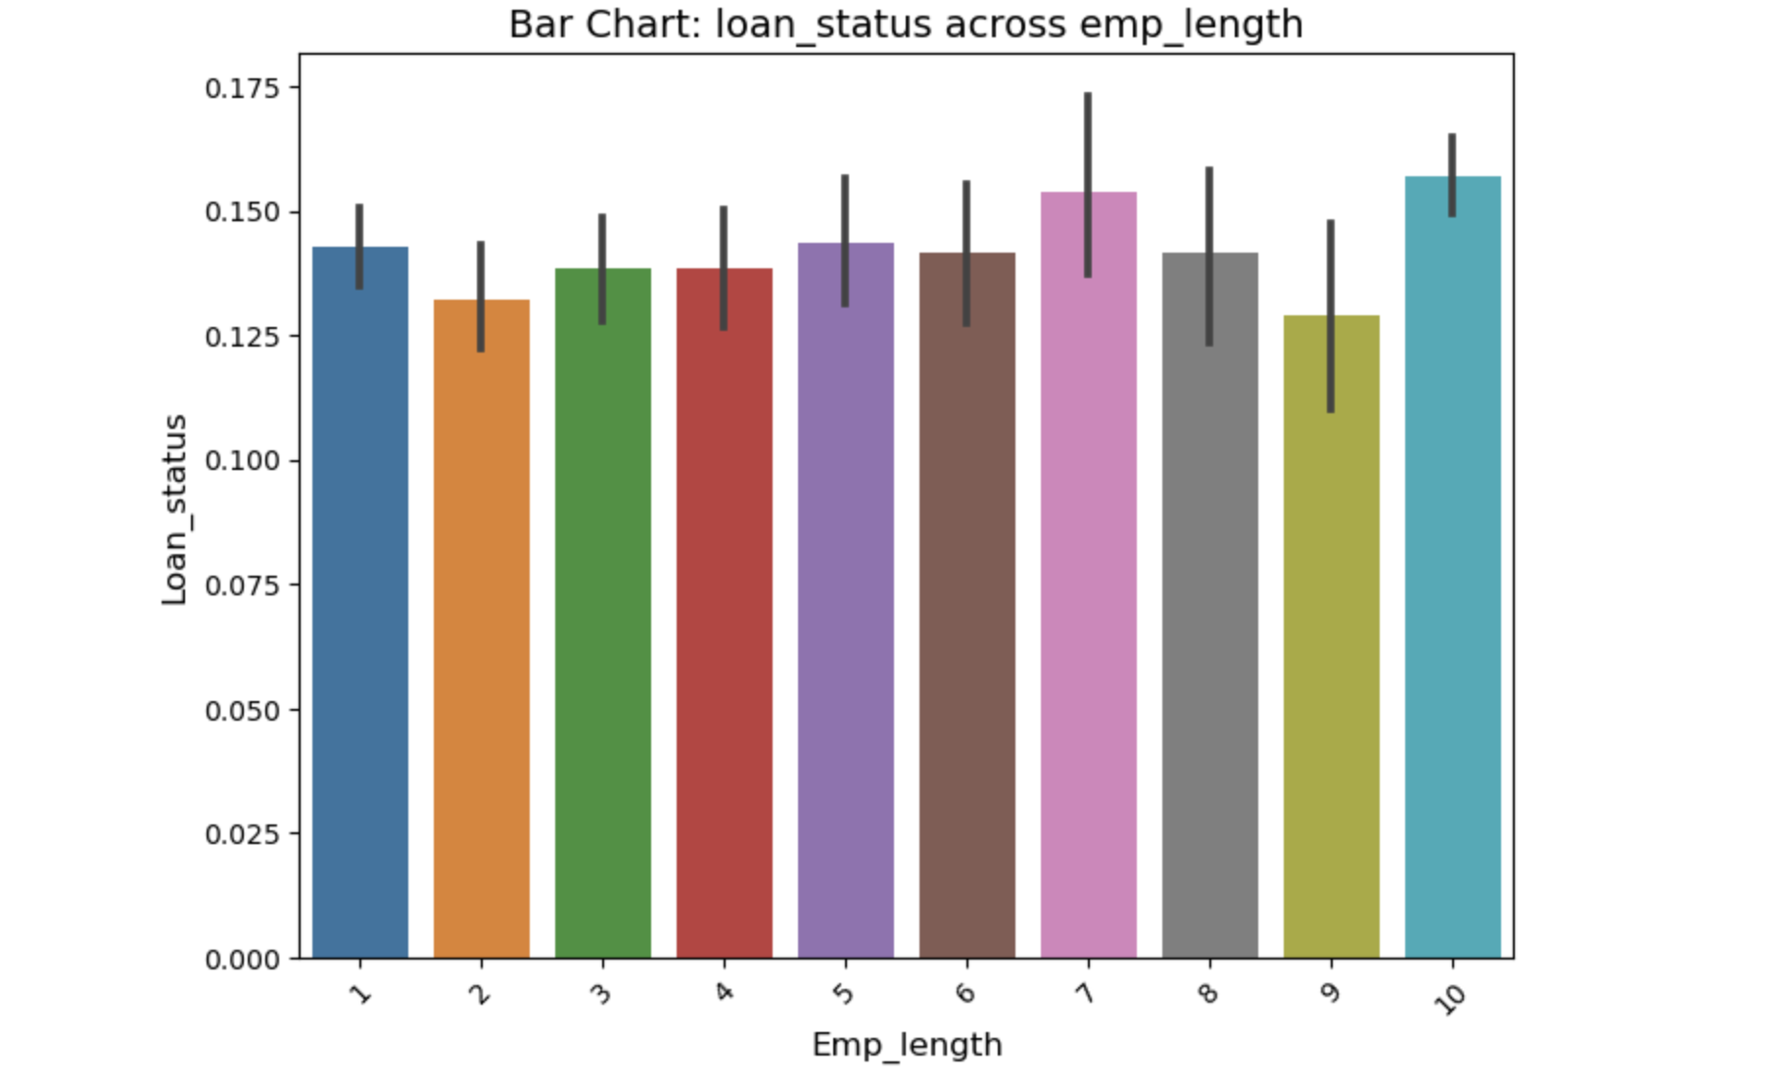
Emp_length : Employment length in years between 0 to 10
There is no such pattern in the data for decreasing or increasing years of employment. However borrowers with 7 or 10 years experience show higher defaulters rate.

Slide 19
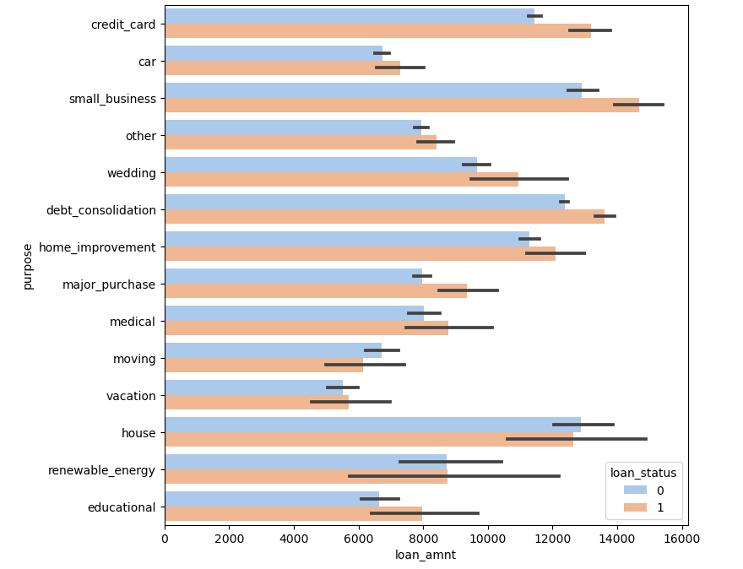
Correlation between purpose and loan_amnt
Except house purpose for all other purpose after a certain loan_amount limit all loan amounts are less likely to be repaid.
E.g. A loan amount above 13000 for small business has a risk of being repayed.

Slide 20
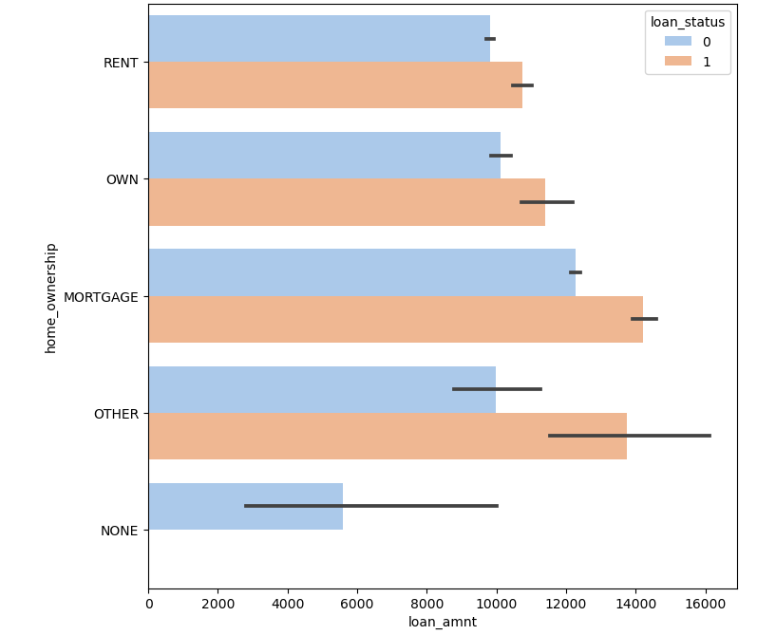
Correlation between loan_amount and home_ownership
Under home ownership category there are different types , and each type except none has a risk post a certain loan_amount.
E.g. It may not be safe to approve loan above 12000 for mortgage.
For none home_ownership there is no risk at all.

Slide 21
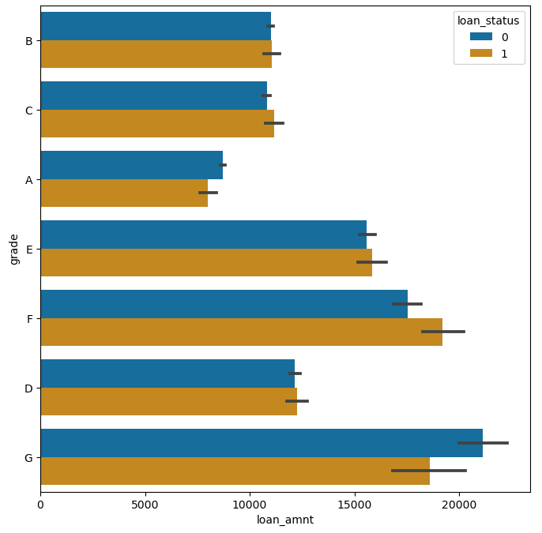
Correlation between grade and loan_amnt
We saw earlier that Grade G has higher risk of defaulters , however there is still a bracket of loan_amount that can be approved for grade G (18000 to 22000)

Slide 22
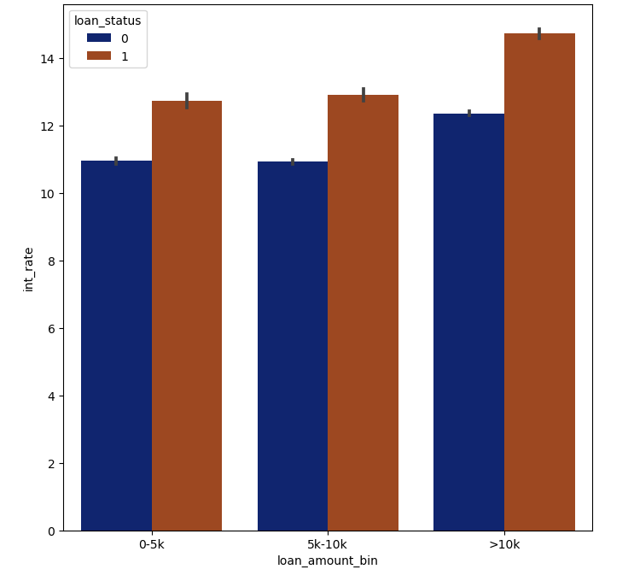
Correlation between int_rate and loan_amount_bin
For every segment of loan amount , higher interest rate has less deflaters.
E.g. interest rate above 11% for groups 0-5k and 5k to 10k can be considered safe.

Slide 23
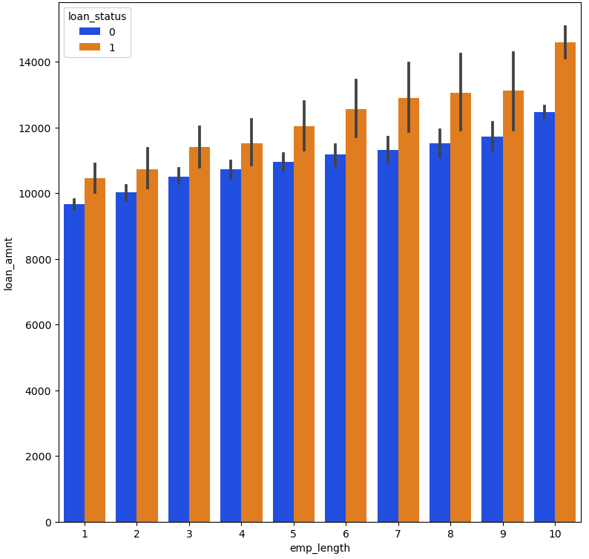
Correlation between loan_amnt and emp_length
For each employment length , there is a loan amount above which the risk of defaulters increases.
E.g. for emp_length 10 , above 12000 there is a risk of loan not being repaid on time.

Slide 24
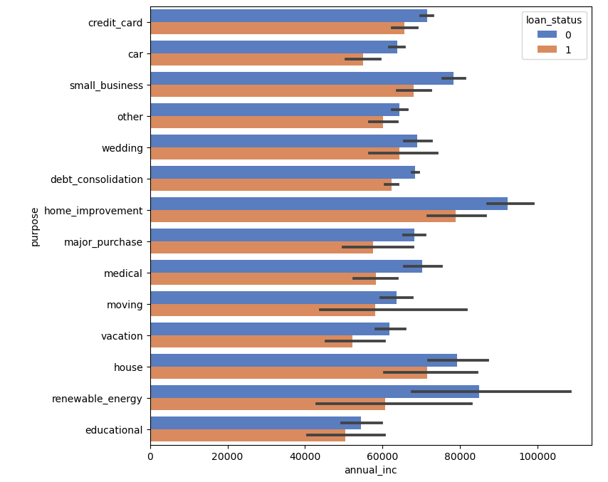
Correlation between purpose and annual_inc
For every purpose there a certain bracket for annual_inc where loan is getting repaid.
E.g. for purpose home_improvement , anything above 80000 can be approved.

Slide 25
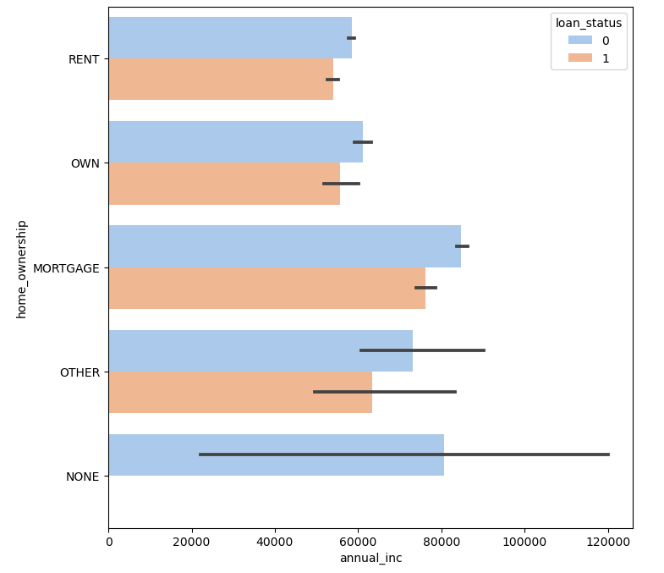
Correlation between home_ownership and annual income
Within the types in home_ownership , each type has a annual income post which it can be considered safe to approve loans.
E.g. any one applying for loan against mortgage with annual_inc above 80000 have more chnaces of repaying loan on time.

Slide 26
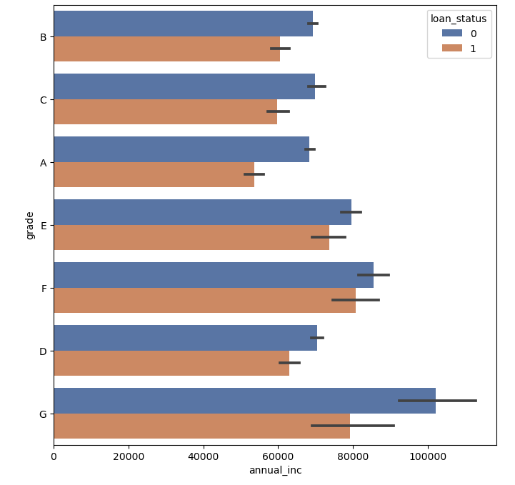
Correlation between grade and annual income
For each grade there are chances of loan being repaid when annual income exceeds a certain limit.
E.g. for grade G , above 80000 annual income people mostly repay loans.

Slide 27
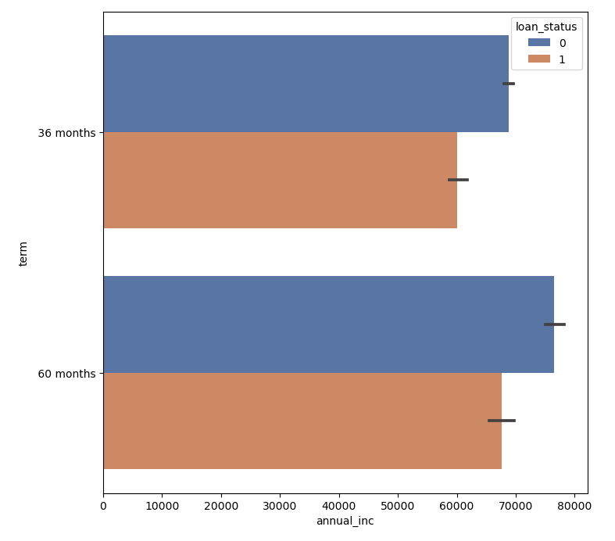
Correlation between annual_inc and term
For term 36 months , people with annual income above 60000 are more likely to repay loans.
For term 60 months , people with annual income above ~68k are more likely to repay loan.

Slide 28
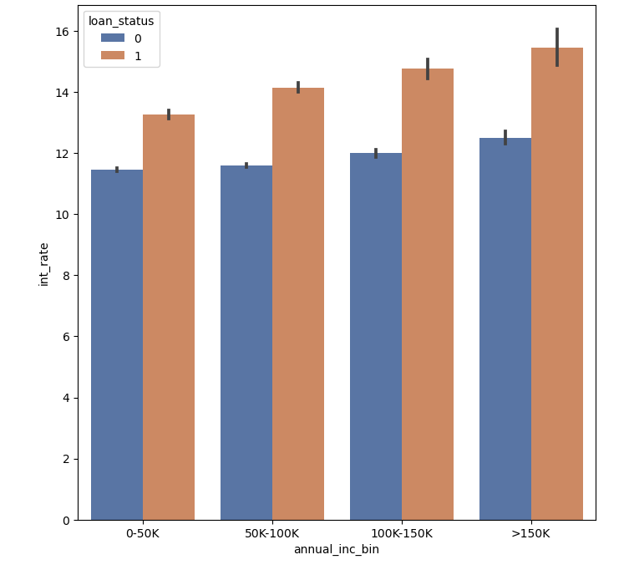
Correlation between int_rate and annual_inc_bin
For each annual income bracket , a higer interest rate has more defaulter.
Here for all the annual income range defined , interest rate over 12% has more default rate

