Slide 1

Lending Club Case Study
Detailed Analysis by
Samidh Bhagwat & Archishman Gantait

Slide 2

Business Objective
Perform EDA to understand how consumer attributes and loan attributes influence the tendency of default and identify driving factors behind loan default

Slide 3



Analysis Overview & Process
Data Exploration
Data Cleaning
Feature Analysis

Slide 4
Data Exploration
Data Overview - Understand the general structure of the dataset (Size, columns etc)
Data Types and Conversion - Check the data types of each column
Unique Values and Cardinality - Identify unique values in categorical columns

Slide 5
Data Cleaning
Handling Missing Values
Identify columns with missing values and decide on an appropriate strategy
1
Handling Irrelevant or Redundant Features
Identify and remove irrelevant or redundant columns that do not contribute meaningful information to the analysis
2
Handling Outliers
Outlier identification and treatment to ensure accuracy in the analysis
3

Slide 6
Feature Analysis – Univariate Analysis
Univariate Analysis
Bi-variate Analysis

Slide 7

Univariate analysis

Slide 8
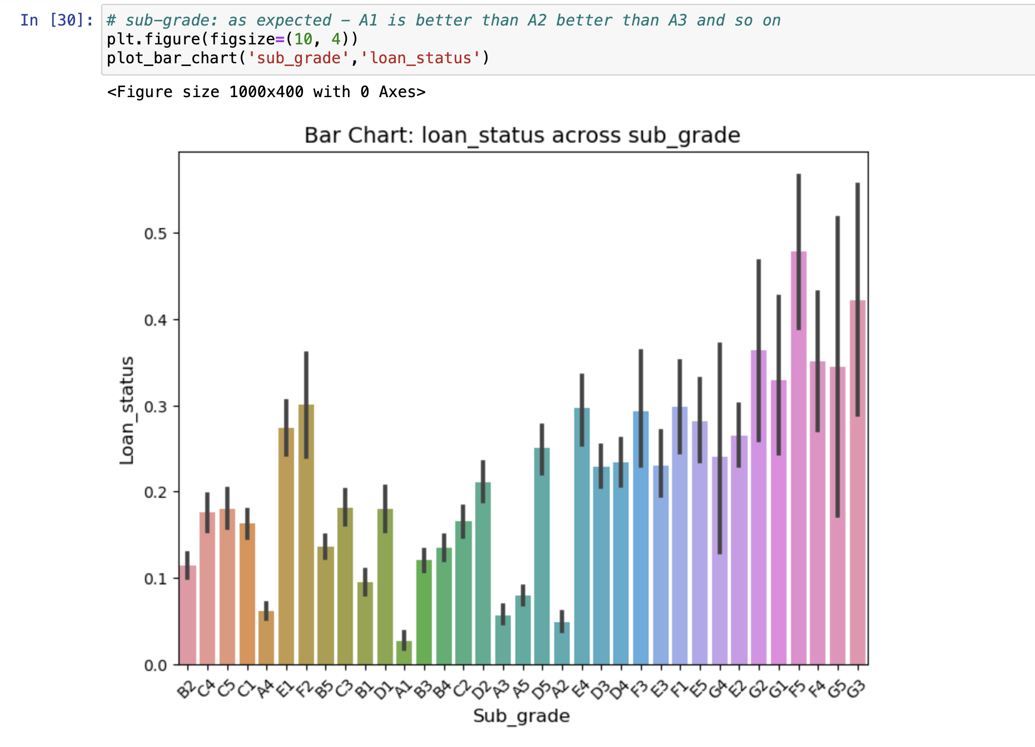
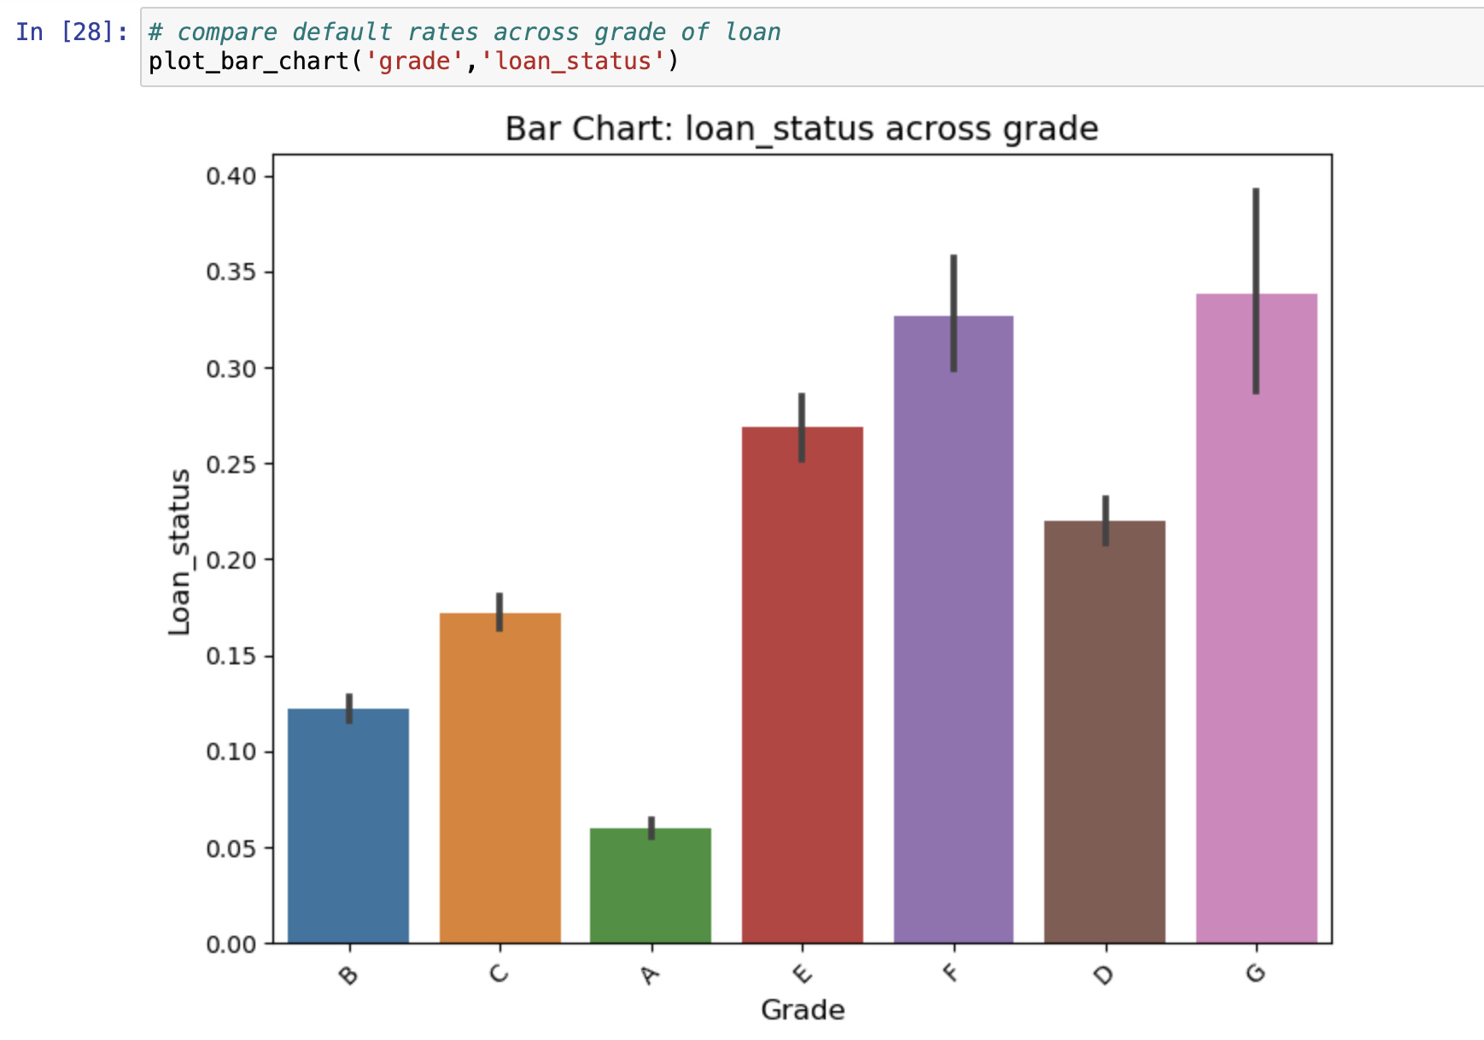
Grade & Sub Grade
Grade “G”, lowest grade of loans, as defined by LC have the highest rate of default.
As we go down from sub grade A1 to A2 to A3, so on and so forth, the default rate increases

Slide 9
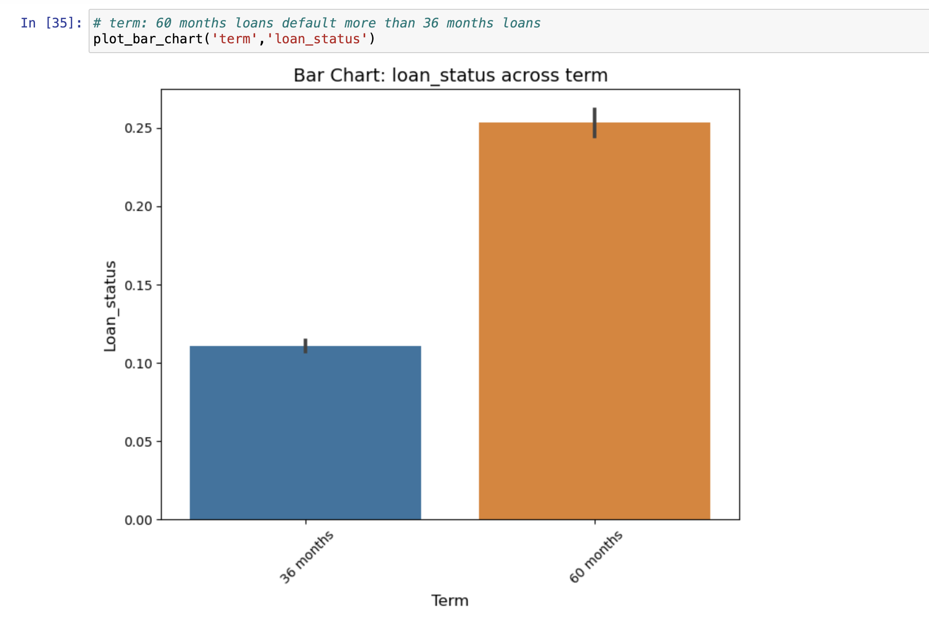
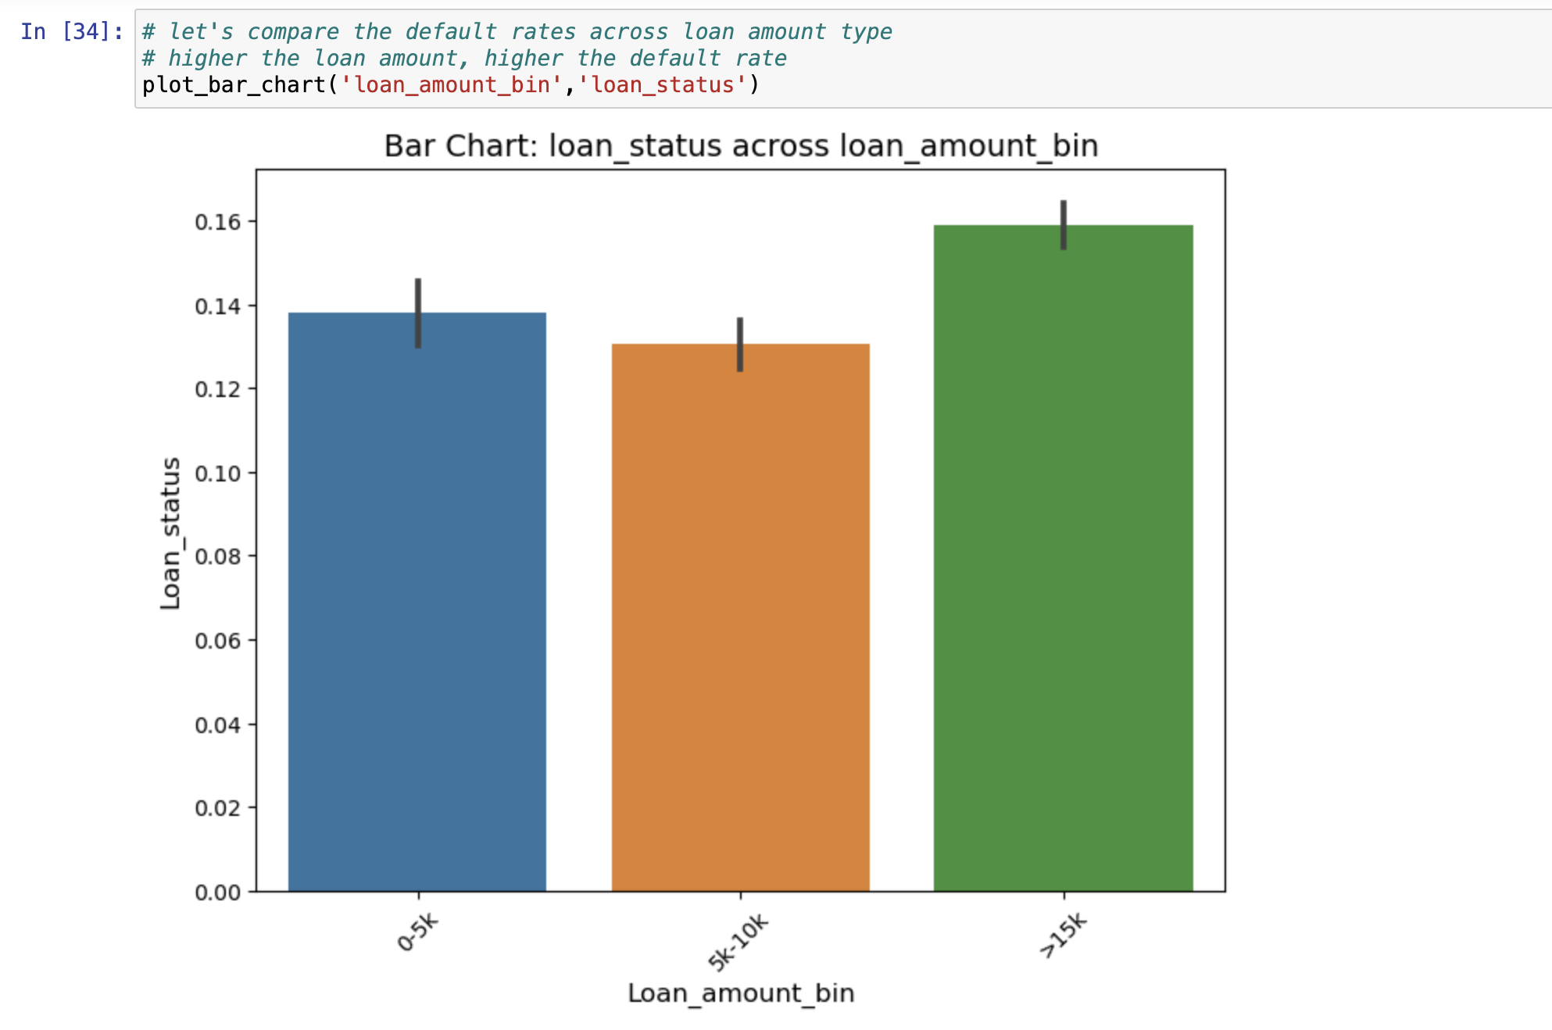
Loan Amount & Loan Term
Loan with amount >15k have the highest default rate while for 5k-10k, the defaults are the lowest
Defaults are higher when the term of loan is higher (60m)

Slide 10
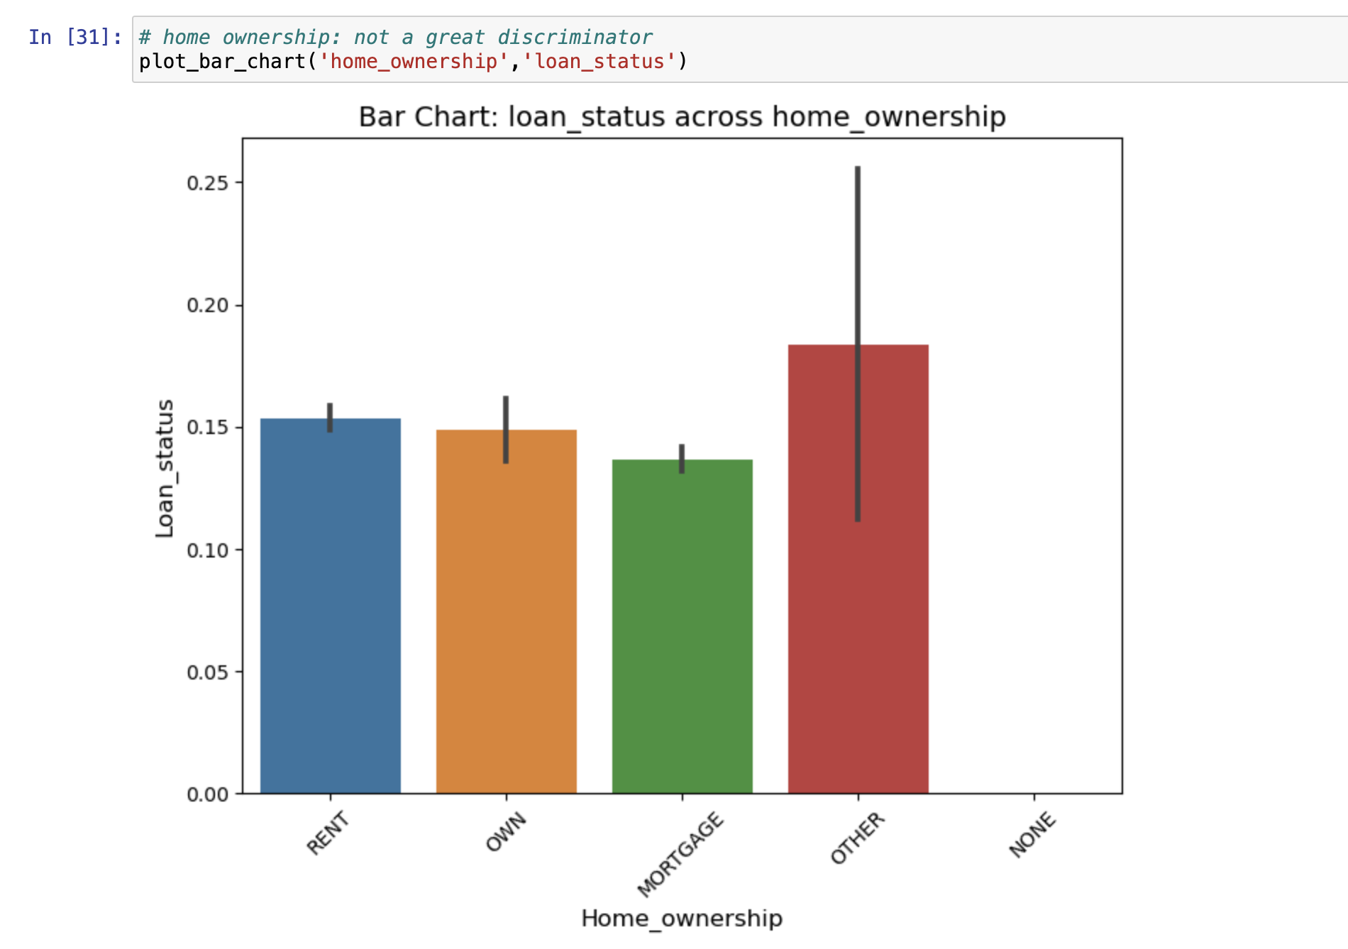
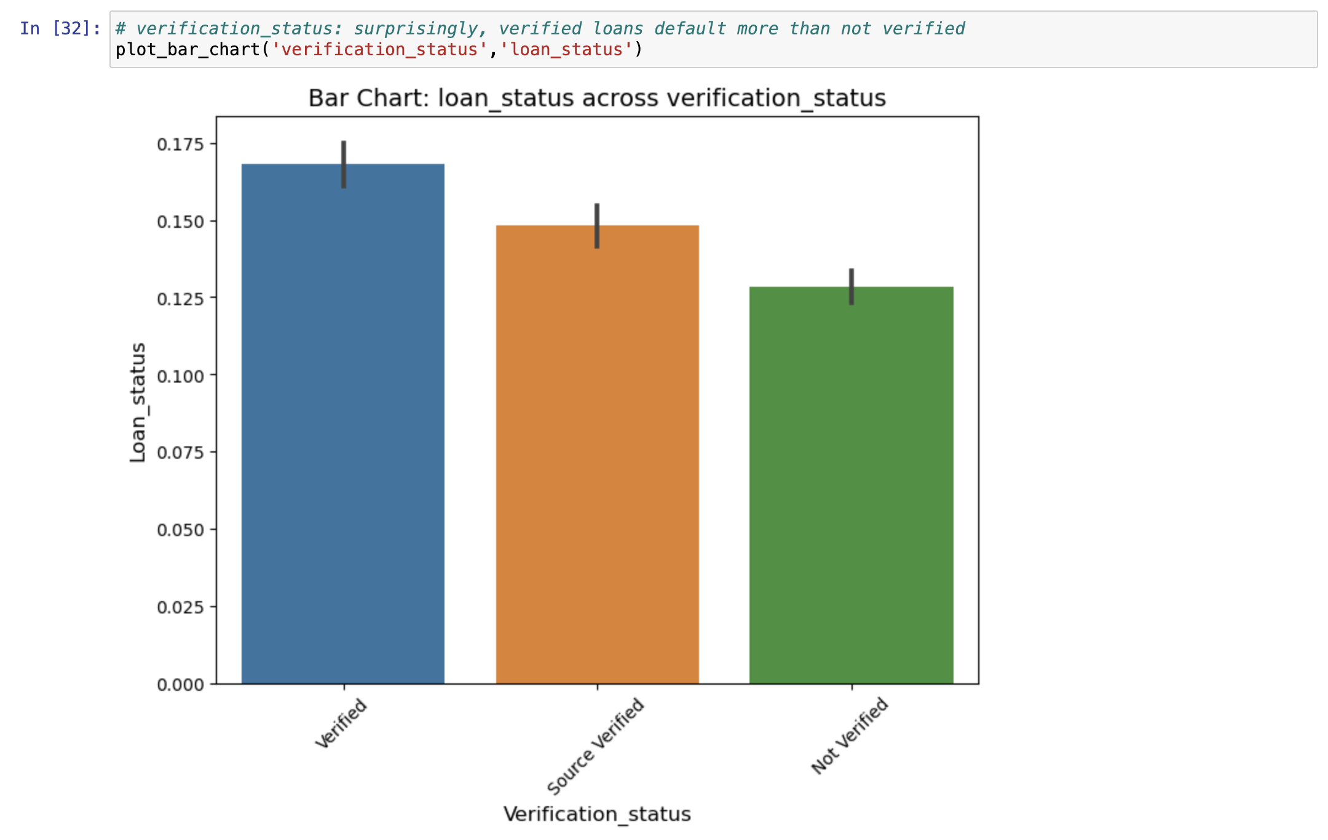
Home ownership & Verification status
Home Ownership doesn’t really have a lot of impact on the overall default rate. The rate seem to be uniform across
Verified loans have a higher default level as compared to Non-verified loans. The verification process needs to be re-evaluated

Slide 11
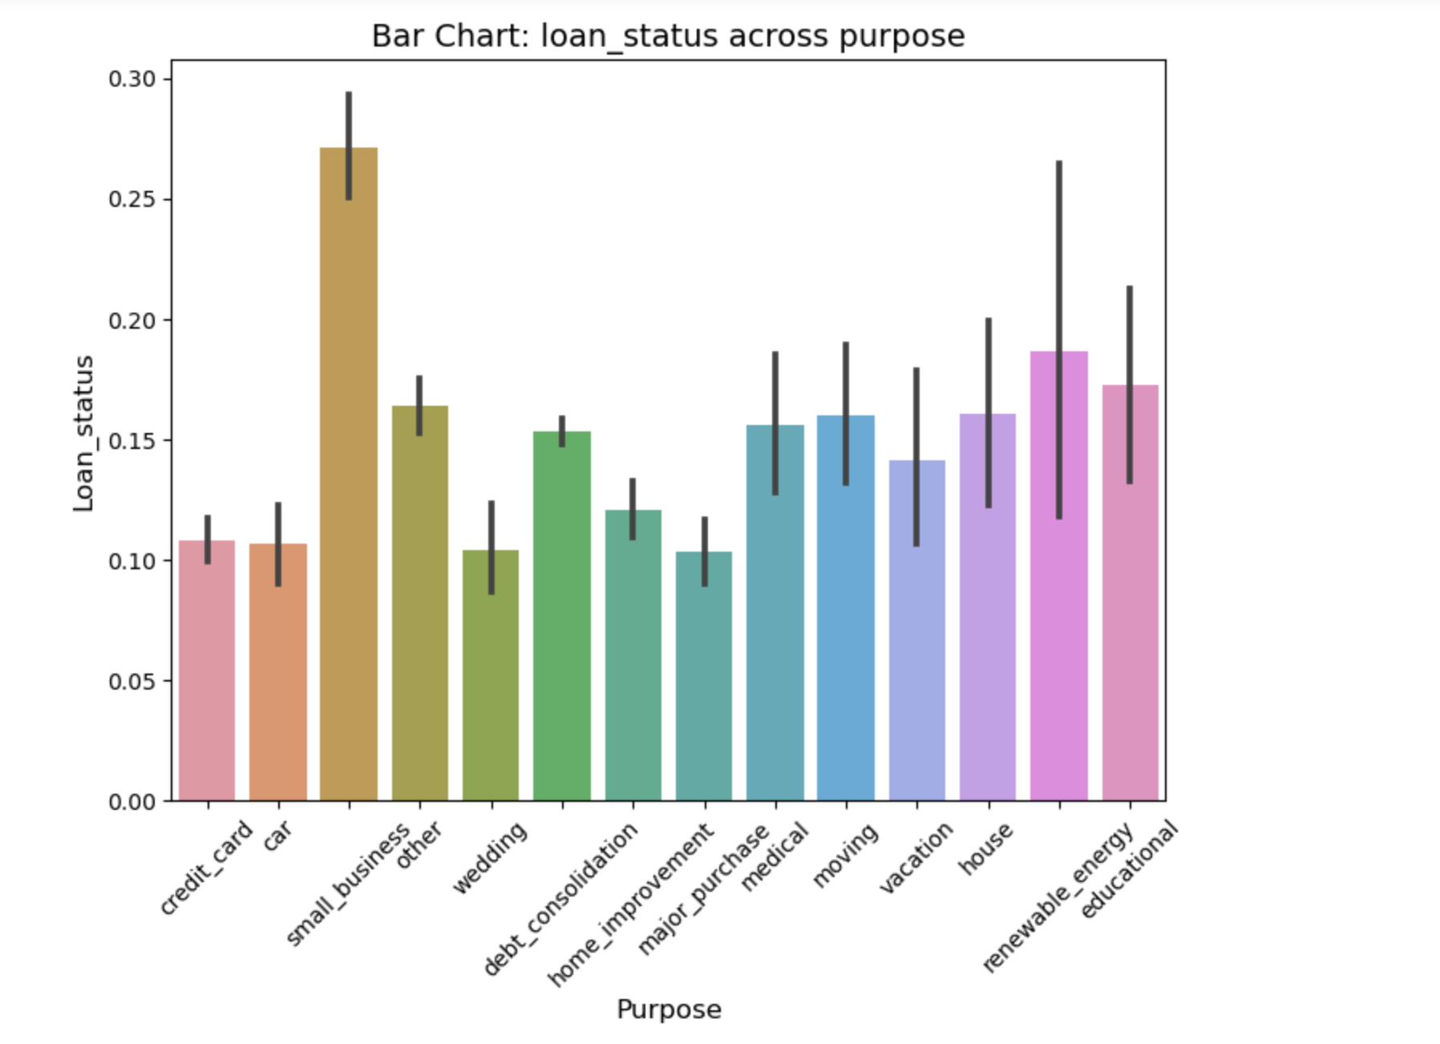
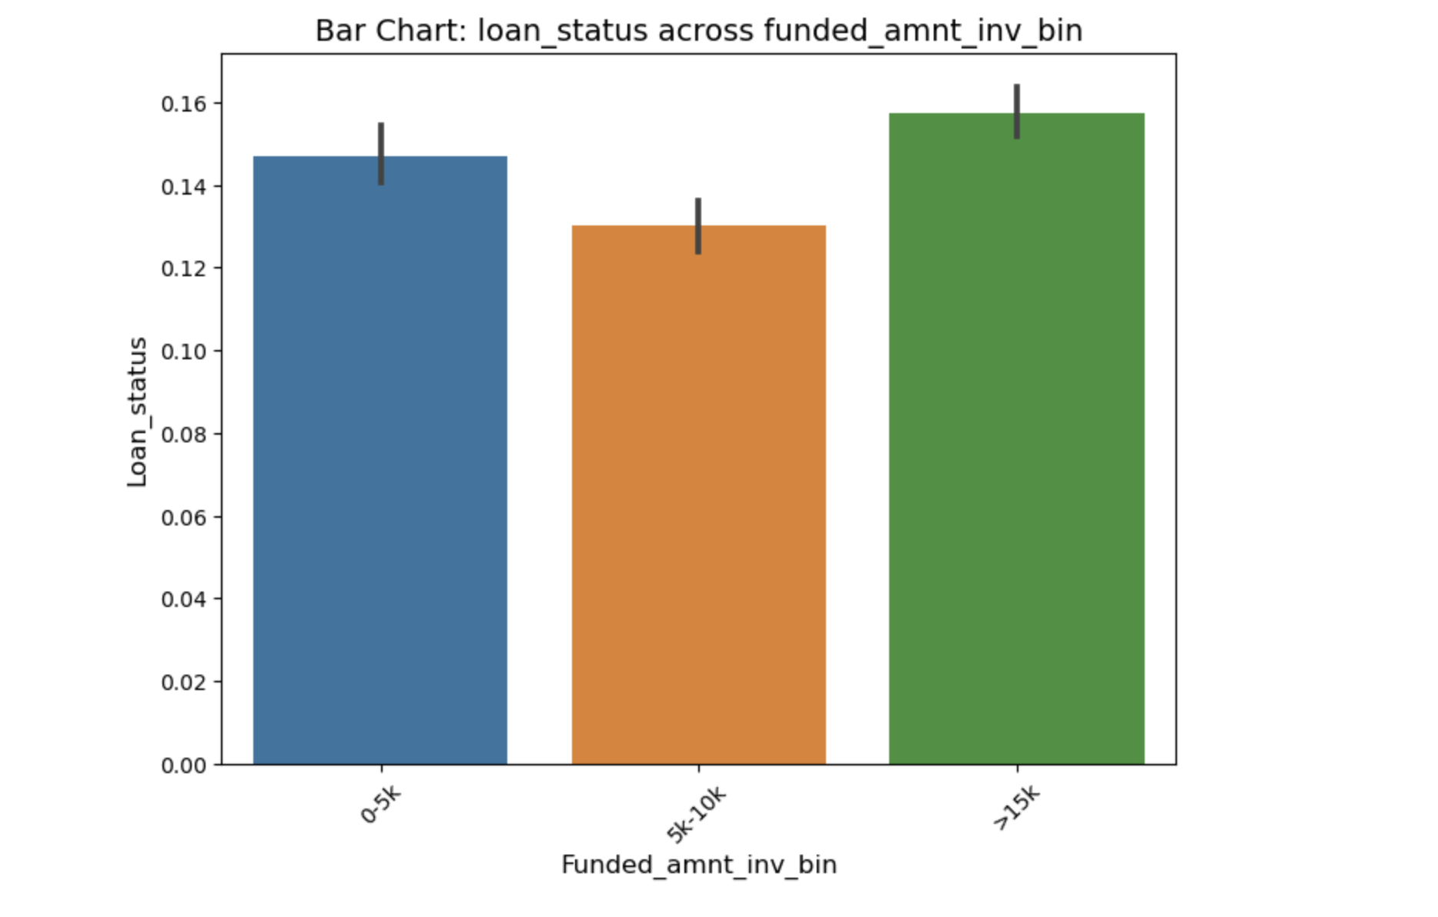
Purpose & funded amount
Approving Loan request for purpose like credit card, car, home improvement and wedding can be considered as much safer than others as there are less defaulters
The defaulters are more when funded amount is above 15k , however defaulters are less when funded amount id between 5k to 10k

Slide 12
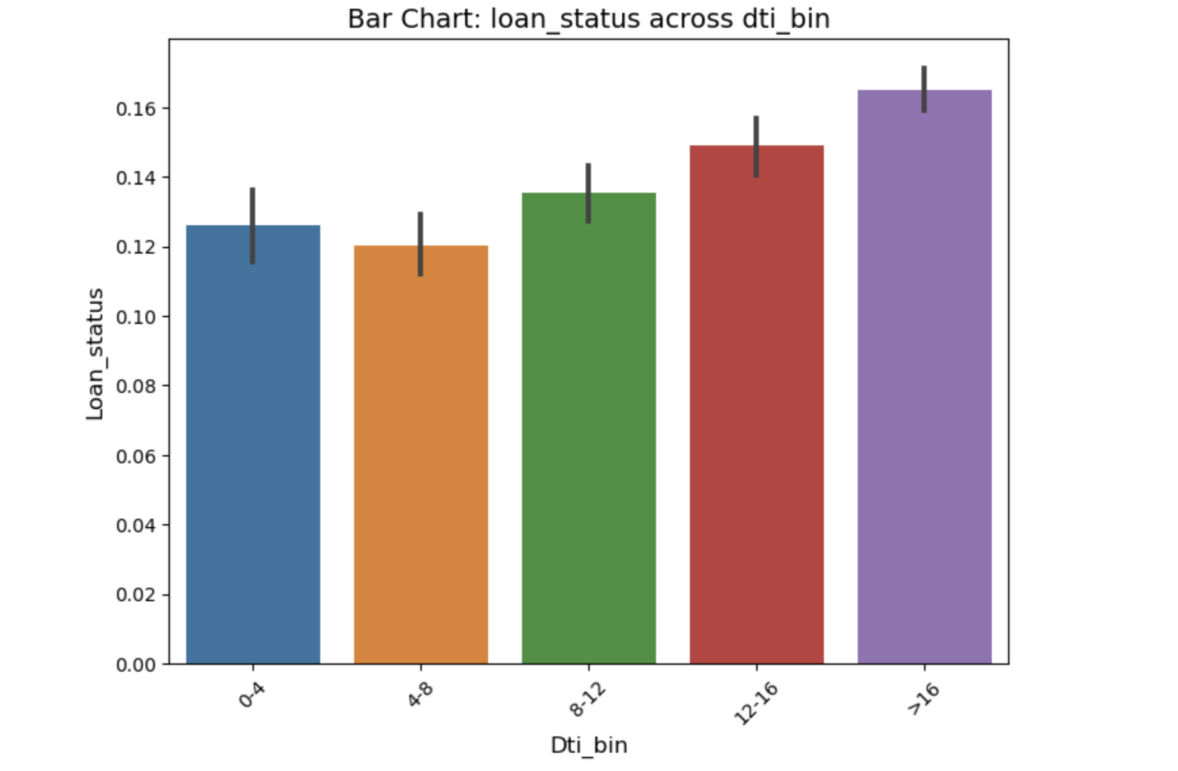
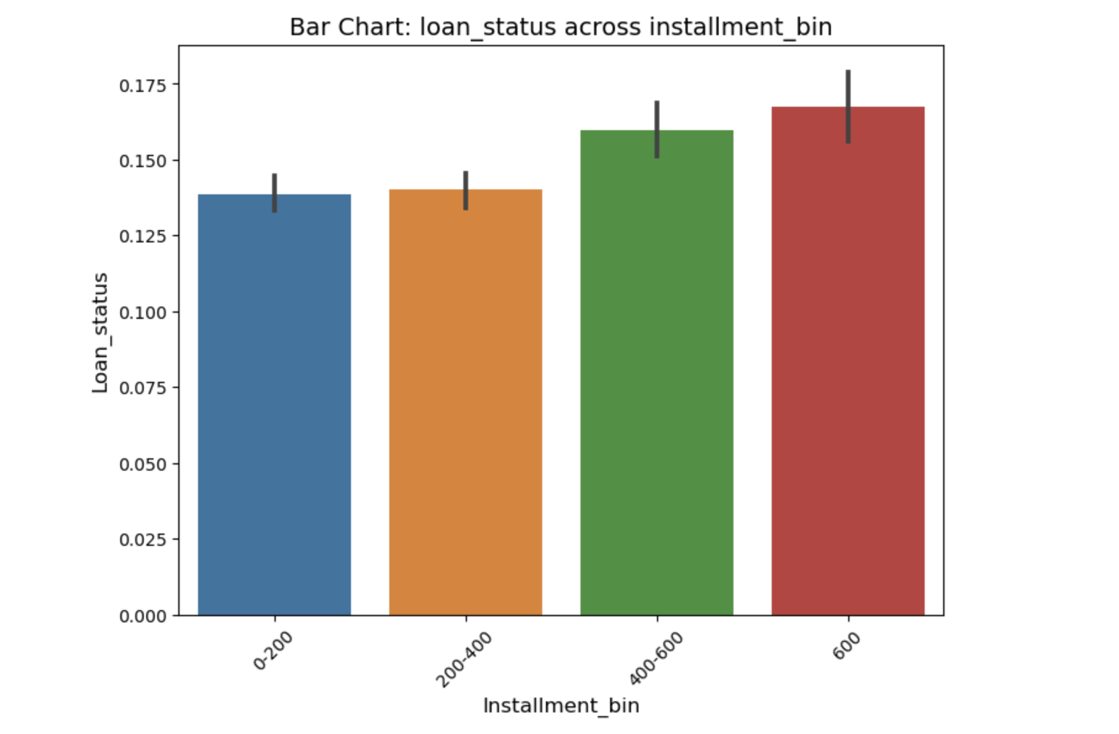
Debt to Income & Installment
Default rates are higher as the debt to income ratio increases , except for the 4-8 bracket , where defaulters are lower when compared with the previous segment of 0-4. A steady trend can be seen
Default rate is high when increasing installment value. Borrowers who choose lower installments are less likely to default

Slide 13
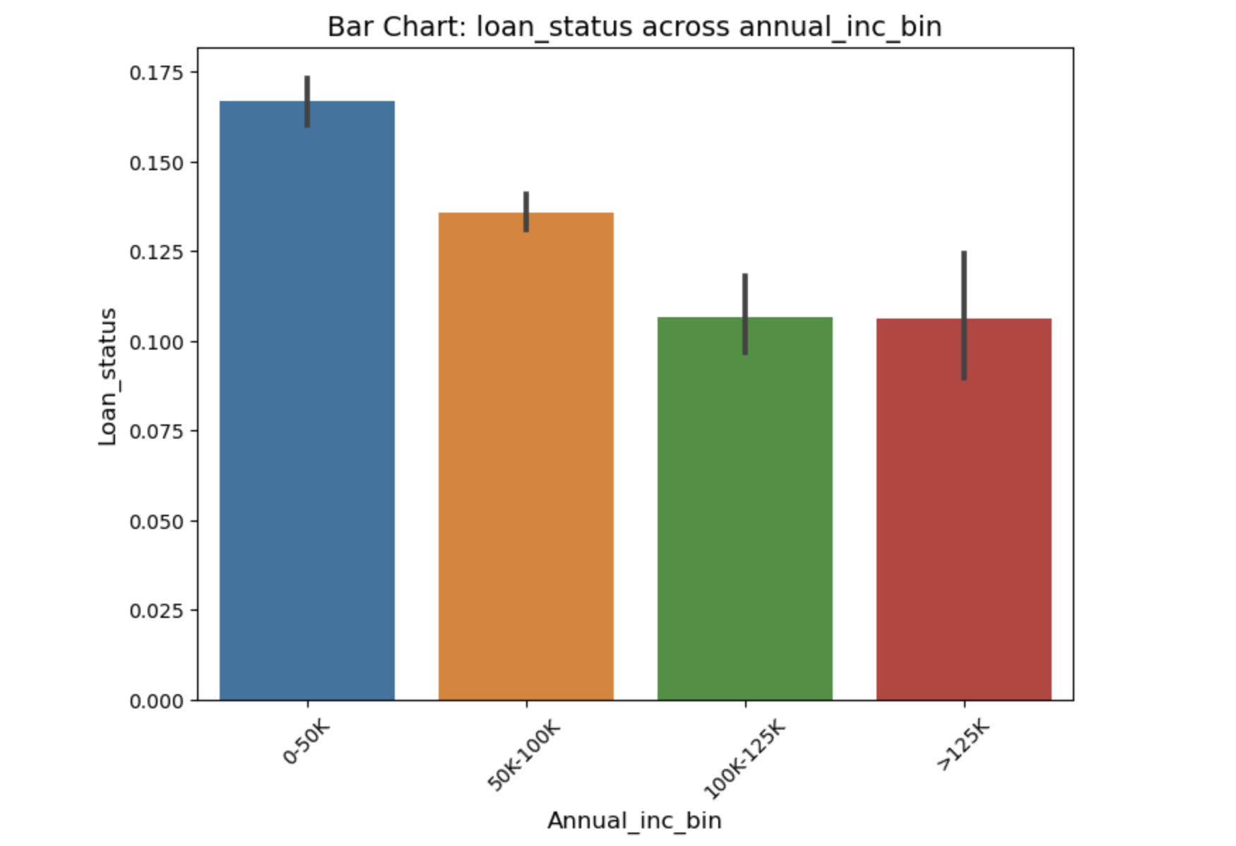
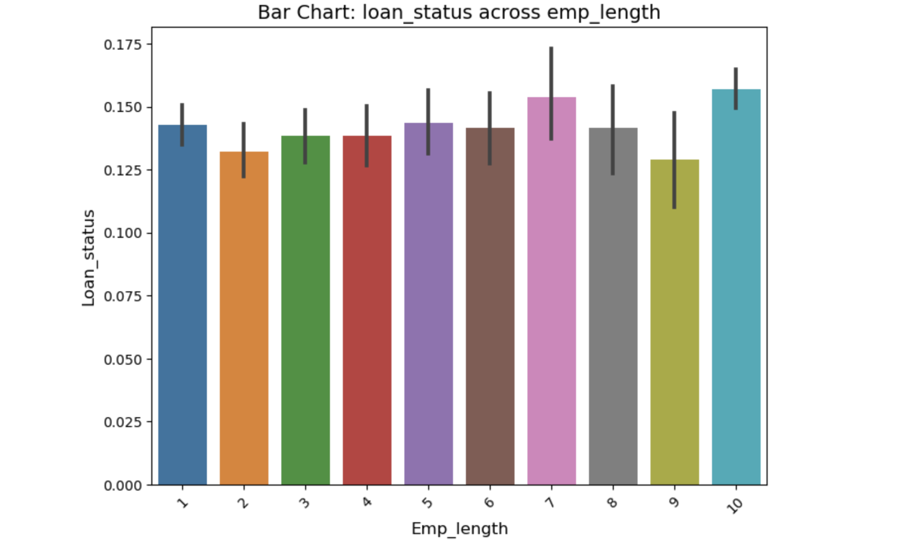
Annual income & Employee Length
Defaulters tend to reduce with higher annual income. Income >125k has the lowest default rate.
There is no such pattern in the data for decreasing or increasing years of employment. However, borrowers with 7- or 10-years experience show higher defaulters rate.

Slide 14

Bi -variate analysis

Slide 15
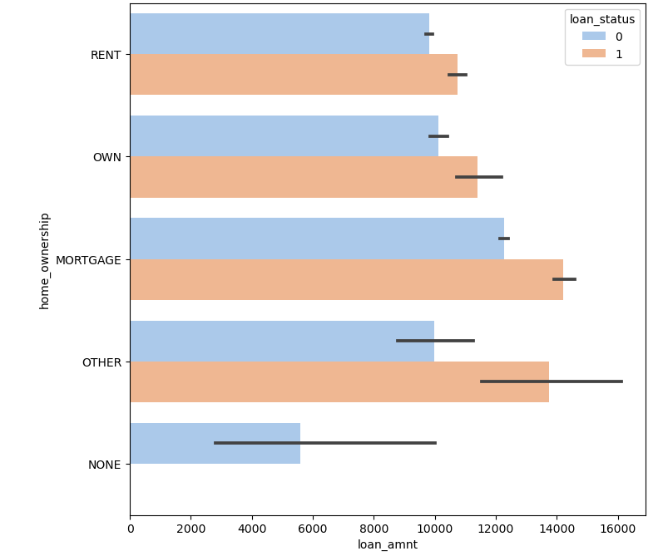
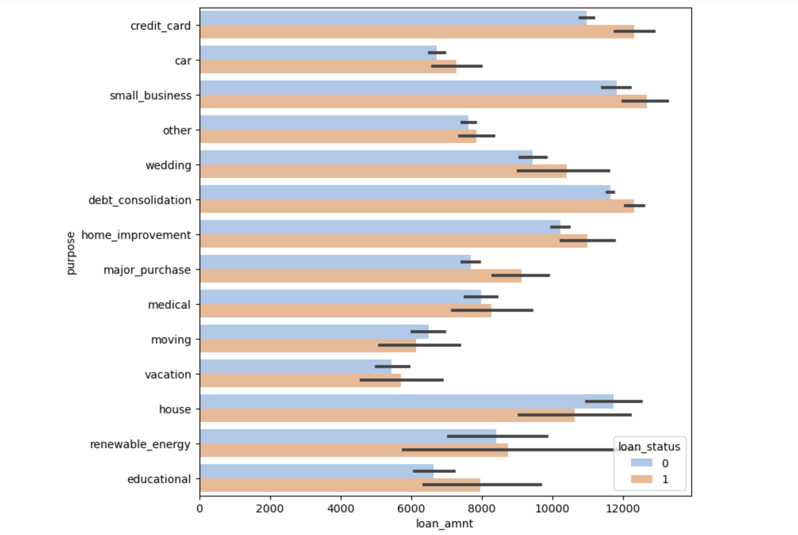
Bi-Variate analysis on Loan Amount with Purpose and Home Ownership
The loan amount for loans for Vacation, moving, medical are the lowest, however, they have the least default rate too, making them least risky for the organization.
Loans for small business have the biggest ticket size, suggesting a high revenue, however this high revenue comes with a highest rate of default
borrowers living in a mortgaged house have the highest loan ticket size, however this comes with the highest risk too .
As seen earlier, higher loan amount attracts higher risk

Slide 16
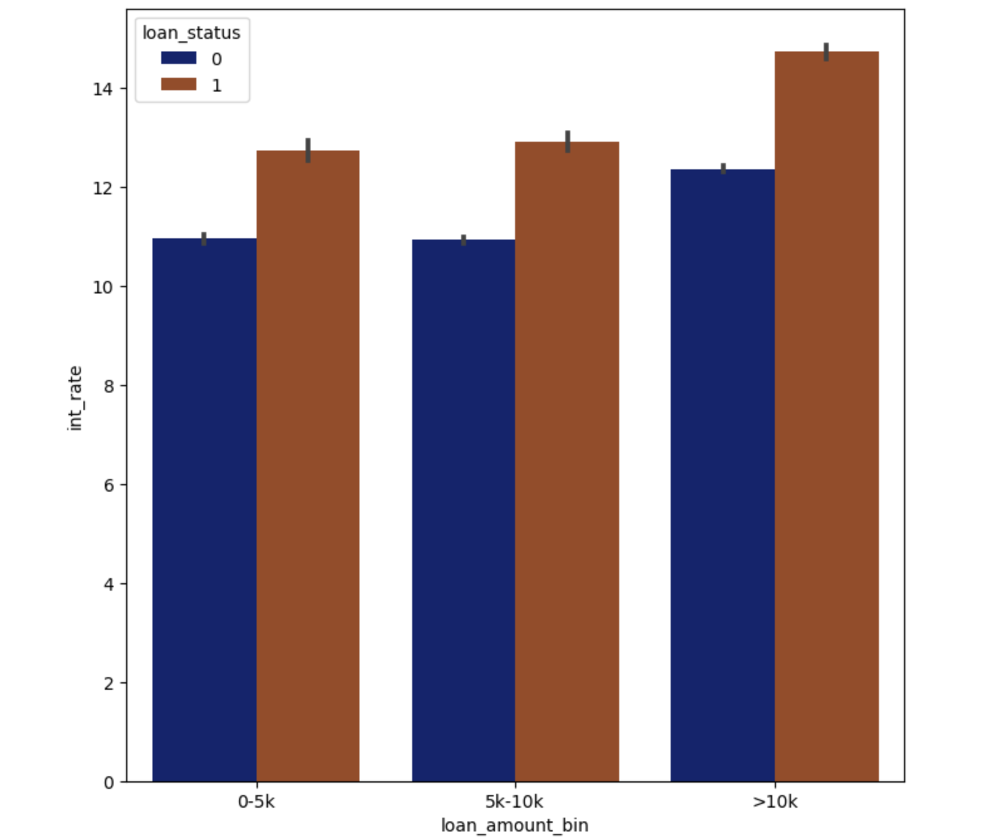
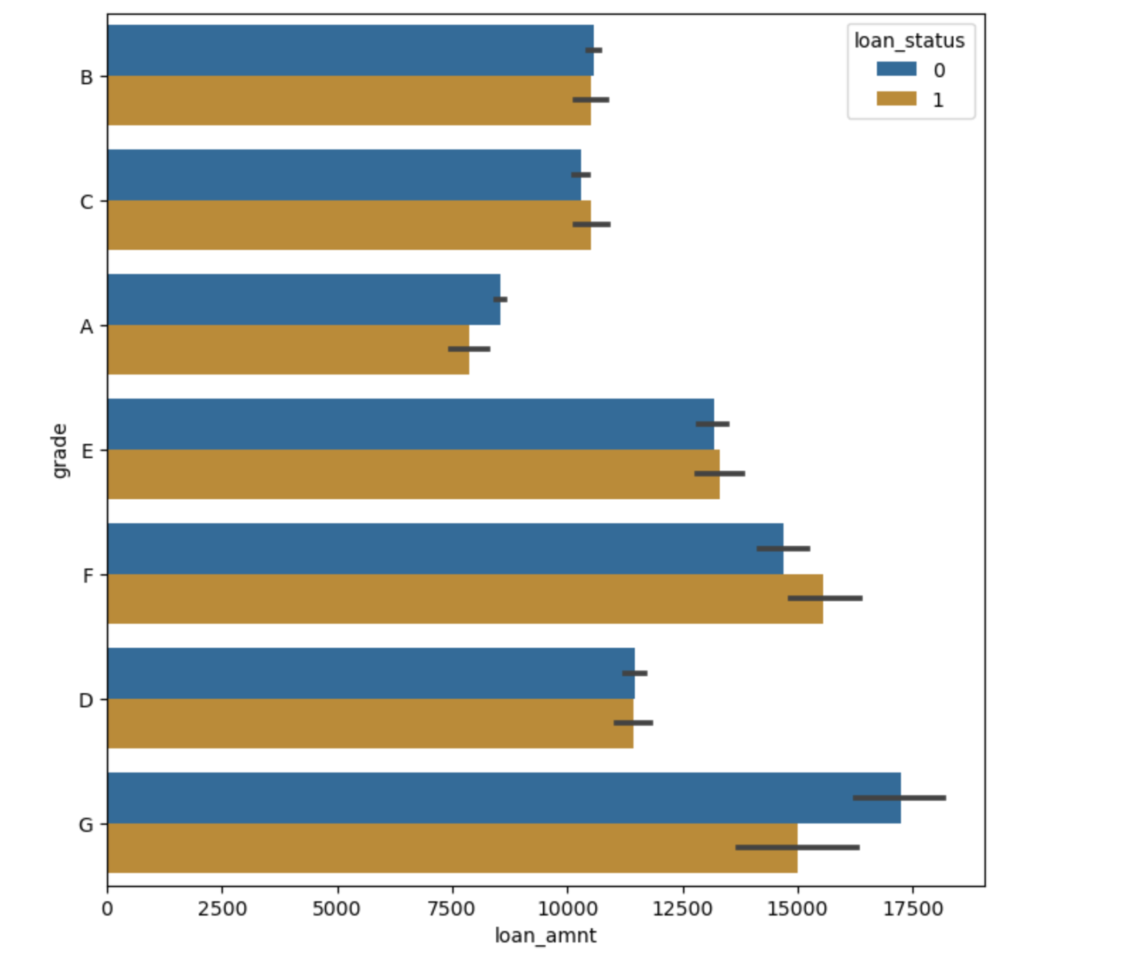
Bi-Variate analysis on Loan Amount with GRADE and Interest rate
We saw earlier that Grade G has higher risk of defaulters , however there is still a bracket of loan amount that can be approved for grade G
Grade F has the highest default rate, however the loan amount for these borrowers is significantly higher
Higher loan amount, >10k have interest rates between 12-15%.

Slide 17
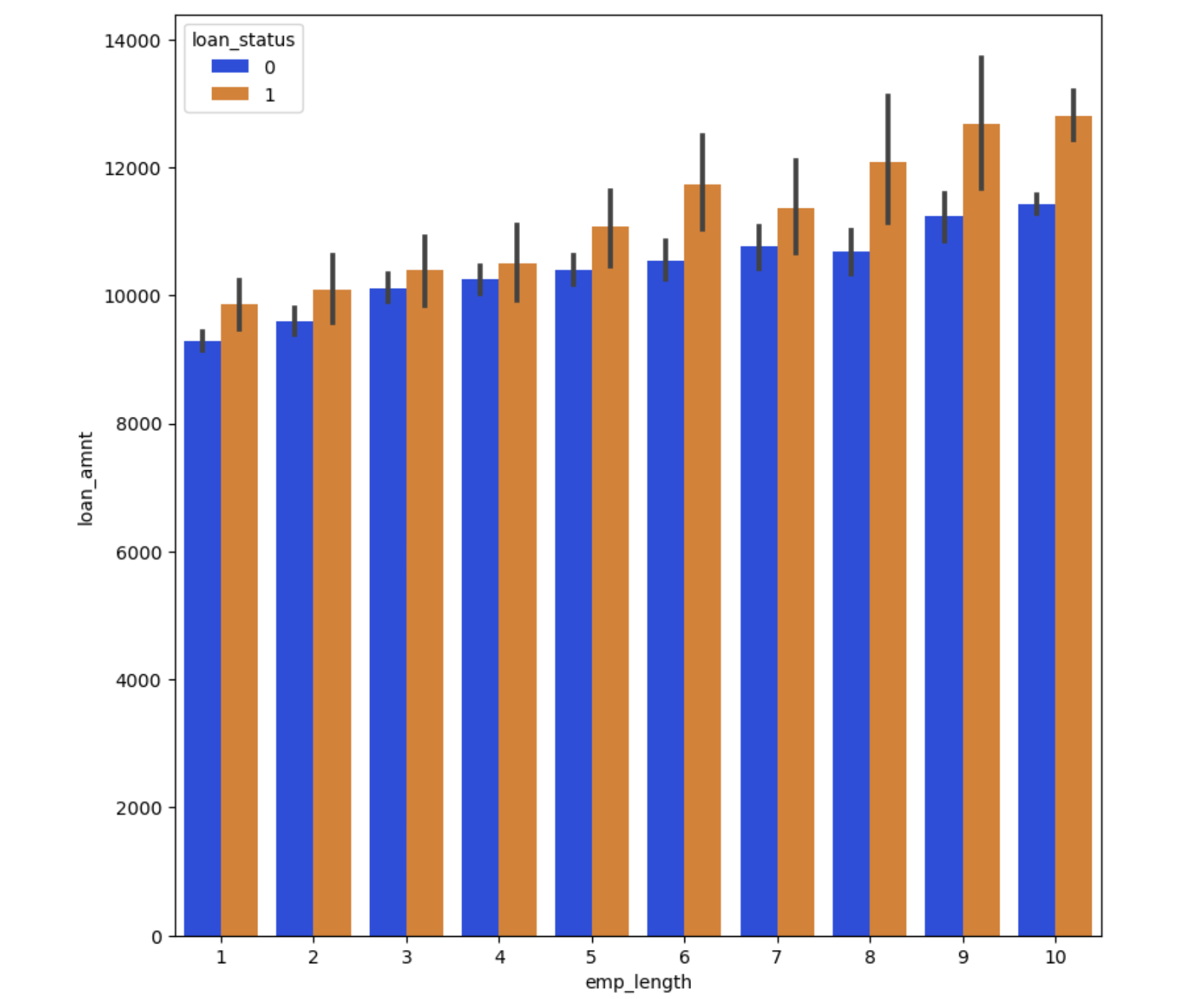
Bi-Variate analysis on Loan Amount with Employee length
For employees with longer work history, loan amount is higher, giving an impression of borrowers settled in their lives tend to have a higher loan eligibility
The default rate is proportionately higher for these high value loans.
E.g., for emp length 10 , above 12k there is a risk of loan not being repaid on time.

Slide 18
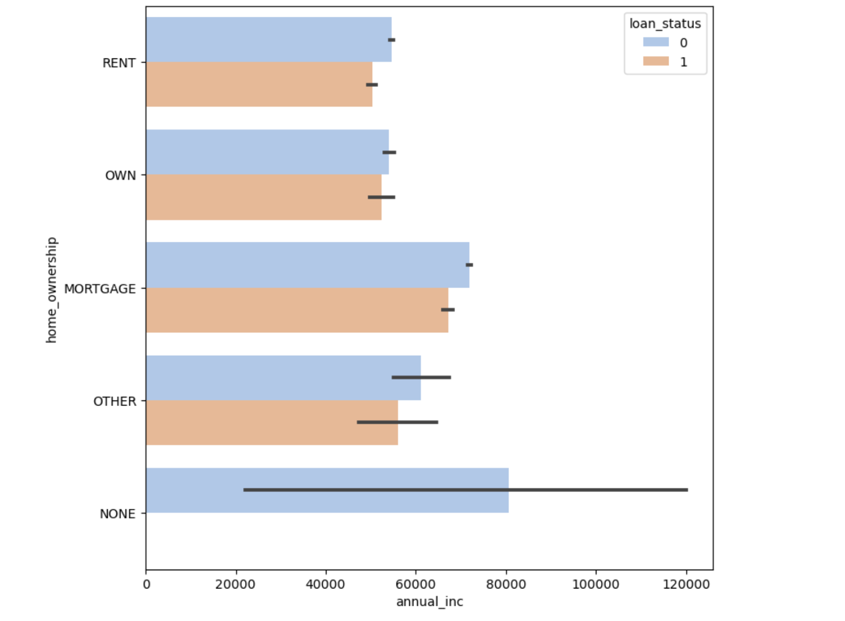
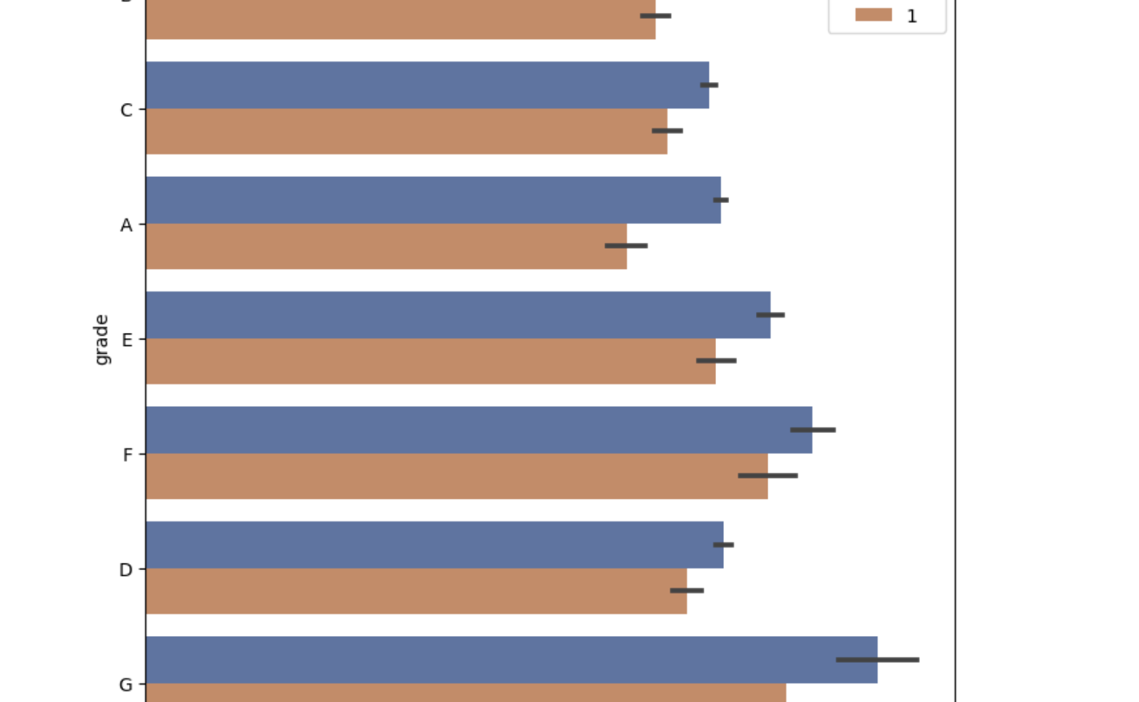
Bi-Variate analysis on Annual income with home ownership & Grade
Within the types in home ownership , each type has an annual income post which it can be considered safe to approve loans.
E.g. Any one applying for loan against mortgage with annual income above 80k have more chances of repaying loan on time.
For each grade there are chances of loan being repaid when annual income exceeds a certain limit.
E.g. for grade G , above 80k annual income people mostly repay loans.

Slide 19
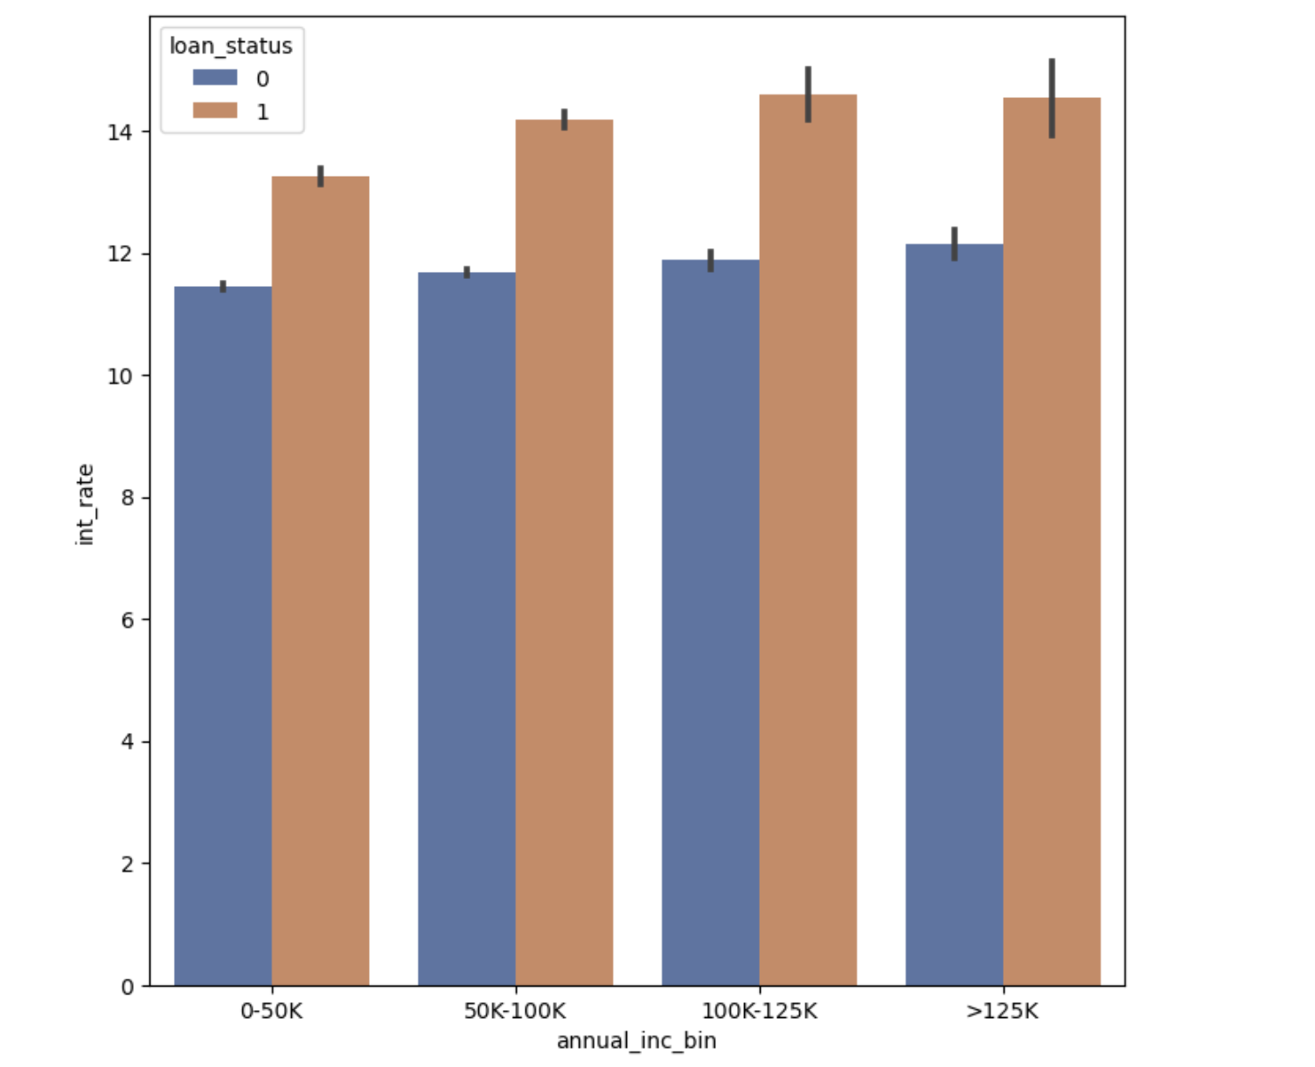
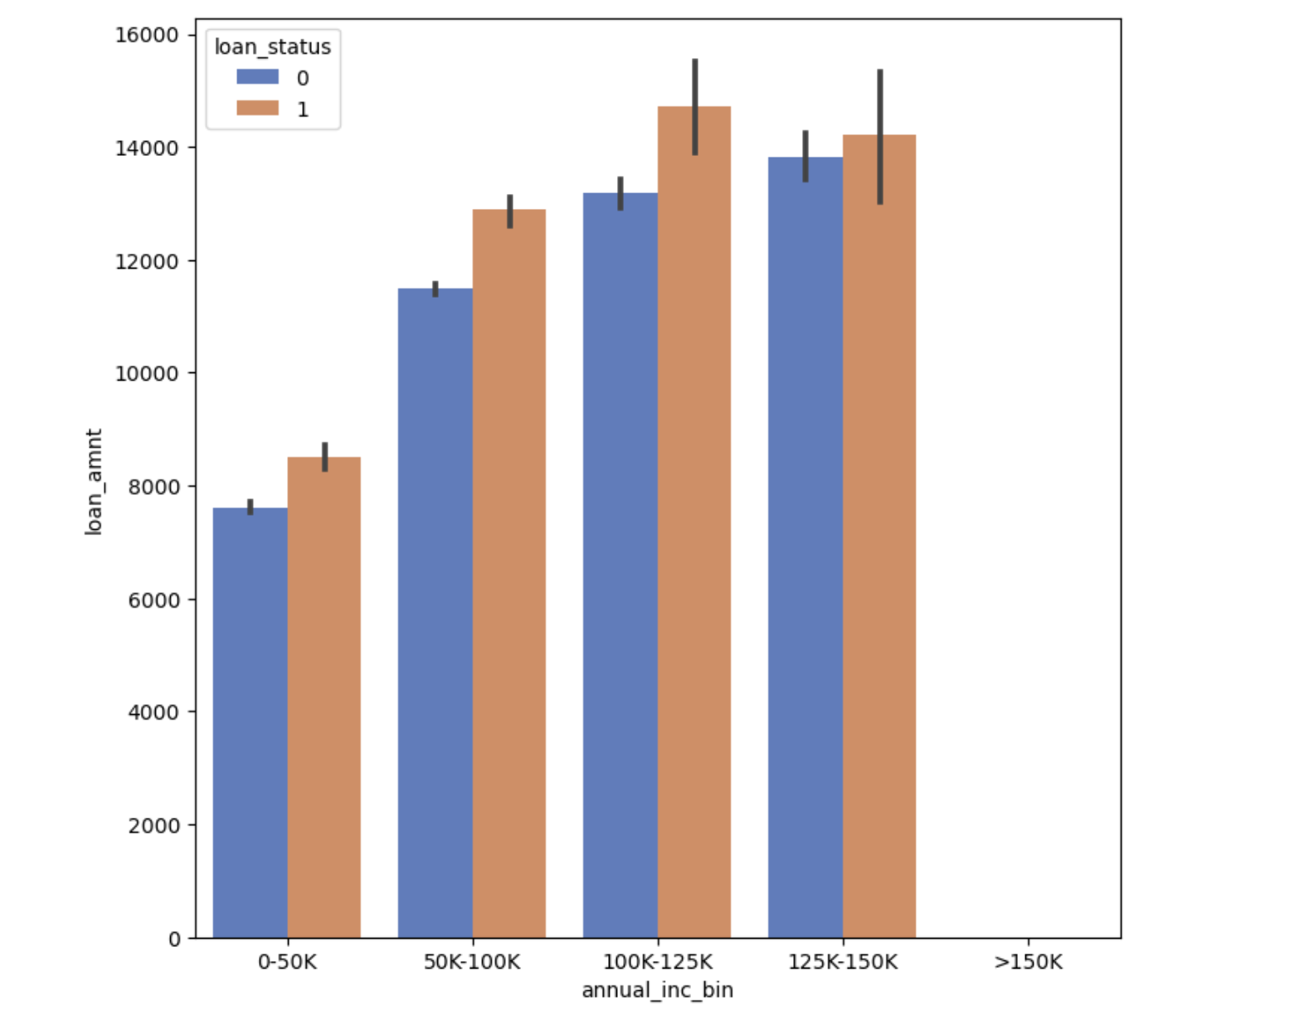
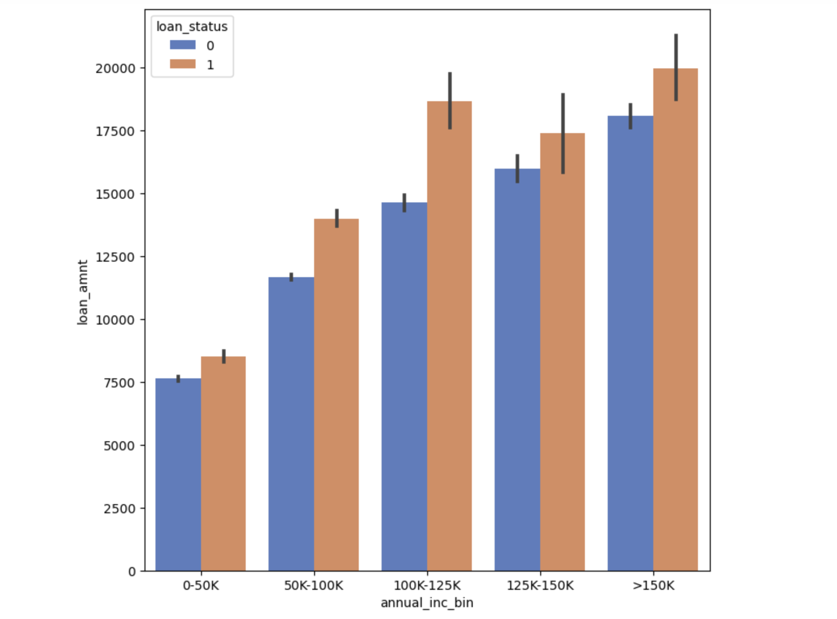
Bi-Variate analysis on Annual income with Interest rate , Loan Term & loan Amount
For term 36 months , borrowers with annual income above 60k are more likely to repay loans. For term 60 months , borrowers with annual income above ~68k are more likely to repay loan.
For each annual income bracket , a higher interest rate has more defaulter.
Here for all the annual income range defined , interest rate over 12% has more default rate
Borrowers with a higher income tend to get a higher loan as compared to the ones with a lower income
This signifying the correlation between income and approved loan amount
Borrowers with lower income tend to have a loan approved loan amount, in line with their income

Slide 20
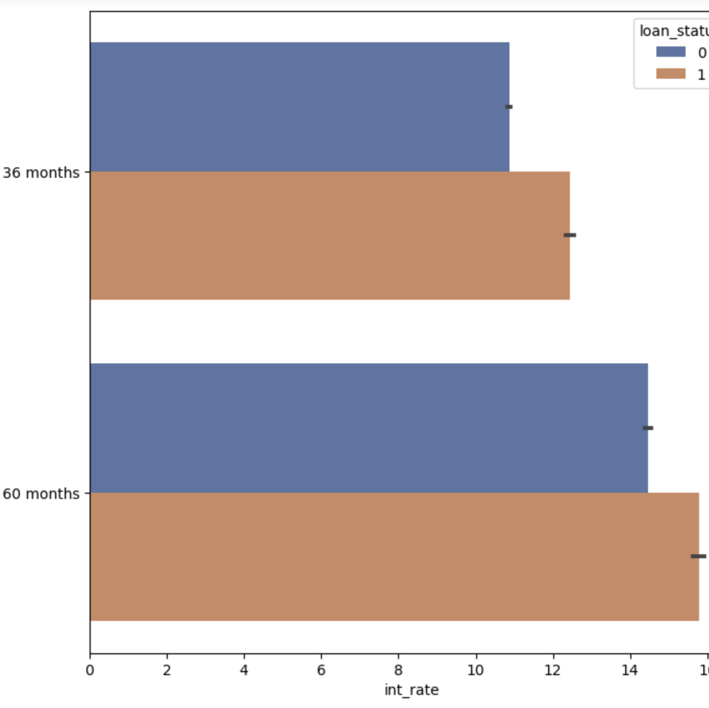
Bi-Variate analysis on Interest rate & Loan Term
For loans with higher term (60m), generally have higher rate of interest as compared to short tenure loans
The default rate for longer term loans with higher interest rate is higher which suggests these are risky loans and LC is cognizant of this

Slide 21

Overall Recommendations
Low Risk borrowers - Borrowers with higher credit rating (A,B) could be given loans as they have a less likelihood of default. These borrowers can be offered loans at a competitive rate.
Employment history – Borrowers with consistent employee history of >6-7 years could be less risky
Smaller loans should be approved for low graded borrowers
High risk borrowers should be given a short tenure loan
Verification process for the loans should be little more stringent
Applicants with higher income could be given more diversified loans

