Slide 1
CASE STUDY OF Paper - Predicting a Startup’s Acquisition Status Using Machine Learning Methods
Archi sisodia

Slide 2
Introduction
Keywords - Start-up, Mergers and Acquisitions (M&A), IPO, data analysis, machine learning, venture capital, true positive rate (TPR), false positive rate (FPR)
Success for a start-up is defined here as the event that gives a large sum of money to the company’s founders, investors and early employees, specifically through a process of M&A (Merger and Acquisition) or an IPO (Initial Public Offering).
The resulting algorithm takes in a startup’s financial statistics such as total funding dollars, funding dates, number of funding rounds, and headquarter location as inputs. The algorithm then predicts whether the startup has been closed, acquired, is operating, or has reached and IPO. The main challenge for this problem is dealing with an imbalanced dataset where one class is overrepresented, but under/oversampling cannot be used as a technique to balance the data. In order to address this, an ensemble-based technique that combines the results of a high precision anomaly detection algorithm (QDA) with a random forest classifier.

Slide 3
FEATURES
Data Mining problem Steps:
Selection of data to be processed by defining relevant tables from the entire structured CrunchBase database
Preprocessing, by cleaning, Selecting and Transforming data. At this stage we deal with missing values, outliers, discretization, and other common problems. An explorative analysis is made before further transformations
Experiment Setup, where evaluation metrics are defined, and the two major problems of the dataset - Sparsity and Imbalanced target classes, are dealt with. Both these problems are only addressed at this stage. Several machine learning algorithms are chosen to test a binary classifier to classify the observations as either successful or not-successful
Experiment Results, where we draw conclusions and interpret results.

Slide 4
Logistic Regression This is a multi-class classification problem (with only a small number of classes), so it initially seemed reasonable to apply a basic one-versus-all classification technique such as logistic regression to the problem.
Ensemble Technique The underlying challenge with the dataset is the over-representation of ‘Operating’ classes. Any model can obtain a high accuracy and recall by over-prediction ‘Operating’, but to the detriment of precision. An ensemble technique is used to attempt to address this. The general idea of the technique is to chain together two models that are trained with a specialized goal. The two models can be described as follows:
1. An anomaly detection model that can identify with high precision members of the over-represented class 2
2. A classification model that has accuracy when the input data is sampled from a more balanced distribution of classes

Slide 5
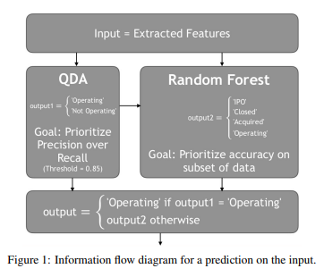

Slide 6
Conclusion and Future Work
The following are suggestions of where future work can take off from.
Better Model Tuning This two-step ensemble technique is not limited to using QDA and RF classifiers. We can explore how other models can be combined. Furthermore, RF models are high variance and dependent on the output of the QDA classifiers.
Better Comparisons to Other Techniques While this technique seems somewhat promising when compared to using QDA and RF alone, there are many other techniques to account for biased data such as Boosting. One area of further exploration would be to see how this technique compares to many others that specifically target biased data and whether there are situations where this technique would be prefered.

