Slide 1

FINAL YEAR PROJECT · 2026
NeuroLens AI
Brain Tumor Detection
Using Deep Learning
A Comparative Study of CNN · Transfer Learning · Vision Transformer
Presented by: Archisman Das
GitHub: github.com/archisman-das/Neuro-Lens-AI
Notes:
Welcome everyone. Today I'll present NeuroLens AI — a deep learning system for automated brain tumor detection from MRI scans. This project compares three model architectures: CNN, Transfer Learning with ResNet50, and a hybrid Vision Transformer. Let me walk you through the full pipeline from motivation to results.

Slide 2
Introduction
Setting the Stage
Brain tumors are among the most lethal neurological conditions worldwide.
GLOBAL IMPACT
308,000+
Early detection significantly improves patient survival outcomes.
new brain tumor cases yearly
~6.9%
Current diagnosis relies on manual MRI interpretation by radiologists.
5-year survival for glioblastoma
30–40%
This process is time-consuming, subjective & expertise-dependent.
diagnostic error rate (manual)
97.5%+
Deep Learning offers a paradigm shift in medical image analysis.
NeuroLens AI accuracy achieved
Notes:
Brain tumors cause devastating outcomes. The manual diagnostic pipeline is slow and error-prone. NeuroLens AI addresses this gap with an automated, interpretable deep learning framework.

Slide 3

Problem Statement
What are we solving?
f(x) → { tumor, no_tumor }
Binary Classification: x ∈ ℝ^(H×W×C) → Binary Label
KEY CHALLENGES
SUCCESS CRITERIA
Intra-class variability in tumor size, shape & location
Accuracy
> 95%
Class imbalance in clinical datasets
ROC AUC
Limited labeled medical data available
> 0.95
Interpretability required for clinical trust
Saliency Maps
Biologically Plausible
Generalization across different MRI protocols
Deployment
Web Dashboard Interface
Notes:
The core task is binary classification of MRI images. I'll explain five key challenges we faced and the four measurable success criteria that defined project completion.

Slide 4






Motivation
Why build NeuroLens AI?
Clinical Need
Explainability
Radiologist shortages leave millions without timely diagnosis globally.
Clinicians need visual proof — not just predictions — to trust AI.
AI Potential
Innovation
Deep learning has matched expert performance in multiple imaging tasks.
Comparing CNN, TL & ViT on one task reveals architecture trade-offs.
Access Gap
Deployment
Remote regions lack specialized neuroimaging expertise entirely.
A practical web dashboard bridges research and real-world clinical use.
Notes:
The motivation is multi-faceted: urgent clinical need, proven AI potential, global access gaps, the explainability requirement for trust, scientific curiosity, and practical deployment impact.

Slide 5
Project Objectives
What NeuroLens AI aims to achieve
01
Design & train three model architectures: CNN, Transfer Learning (ResNet50), and hybrid Vision Transformer
02
Achieve >95% accuracy and >0.95 ROC AUC on a balanced 400-sample MRI test set
03
Implement Grad-CAM and ViT patch saliency for visual explainability of predictions
04
Build a browser-based dashboard for real-time MRI upload and inference
05
Benchmark all three architectures systematically under identical experimental conditions
06
Provide clinical-support insights on model trade-offs for medical deployment
Notes:
Six clear objectives drive the project. Each is measurable. Note that objectives 1-3 are technical, 4 is deployment, 5 is scientific benchmarking, and 6 is clinical impact.

Slide 6
Existing / Traditional Methods
How brain tumors are currently detected
Manual MRI
Reading
Classical CV
Techniques
Threshold-
based Seg.
Biopsy &
Pathology
Radiologists visually inspect each MRI slice for tumor indicators.
Morphological operations, GLCM, LBP texture descriptors, SVMs.
Simple intensity thresholding to segment potential tumor regions.
Invasive tissue sampling — gold standard but delayed & risky.
PERFORMANCE SNAPSHOT (Traditional vs AI)
Method | Accuracy | Interpretable | Scalable
Manual Radiology | ~70–85% | ✓ Yes | ✗ No
Classical CV (SVM) | ~75–90% | Partial | Partial
NeuroLens AI (CNN) | 97.5% | ✓ Grad-CAM | ✓ Yes
Notes:
Traditional methods rely on manual expertise or simple computer vision. They suffer from subjectivity and limited scalability. NeuroLens AI dramatically improves on all fronts.

Slide 7

Limitations of Existing Methods
Why traditional approaches fall short
Time & Workload
Feature Engineering
Manual analysis of thousands of MRI slices is extremely time-consuming. Radiologist fatigue leads to diagnostic errors.
Classical CV requires hand-crafted features (GLCM, LBP). These miss complex patterns that deep networks capture automatically.
Subjectivity
No Uncertainty Estimate
Two radiologists may disagree on the same scan. Diagnostic accuracy varies significantly by experience level.
Traditional methods rarely quantify diagnostic confidence or provide probability scores for clinical decision-making.
Scalability
Black-box Decisions
Expert radiologists are scarce in rural/low-income regions. Manual methods cannot scale to population-level screening.
Even AI tools without explainability are not accepted in clinical settings. Clinicians need visual evidence.
Notes:
Six critical limitations motivate our AI-based approach. Emphasize that no single existing method addresses all of them simultaneously — but NeuroLens AI does.

Slide 8
Proposed System: NeuroLens AI
An automated, explainable MRI classification pipeline
CNN + Transfer Learning + Vision Transformer → Ensemble Comparative Analysis → Explainable Web Dashboard
CNN Baseline
Transfer Learning
Vision Transformer
Custom architecture trained from scratch. 3 Conv blocks + GAP + Dense. Lightweight & fast.
ResNet50 ImageNet backbone. Frozen → Fine-tuned head. Rich feature representations.
Hybrid ViT: ResNet50 extractor + Transformer encoder + [CLS] token classification.
Accuracy:
97.50%
Accuracy:
98.25%
Accuracy:
98.00%
ROC AUC:
0.9928
ROC AUC:
0.9956
ROC AUC:
0.9975
Notes:
NeuroLens AI is a complete pipeline: three trained models, a comparative analytics layer, and a visual explainability+dashboard layer. All running locally without cloud dependency.

Slide 9
System Architecture
End-to-end pipeline overview
MRI
Image Input
Preprocess
& Augment
Model
Inference
Prediction
Output
Explainability
& Report
▶
▶
▶
▶
Input
Preprocessing
Models
Output
Explain
· MRI JPEG/PNG
· Resize 224×224
CNN
· Tumor / No Tumor
· Grad-CAM Heatmap
· 224×224 px
· Normalize [0,1]
· Confidence Score
· ViT Patch Saliency
· Random Flip
Transfer (ResNet50)
· Probability
· Overlay Images
· RGB channels
· Rotation/Zoom
· Model Weights
· PDF Report
· Tumor / No Tumor
Vision Transformer
· Brightness Adj.
· JSON Metrics
· Web Dashboard
Notes:
Walk through each stage of the pipeline: input MRI → preprocessing → parallel model inference → prediction output → explainability and web reporting. Everything runs locally.

Slide 10
Workflow Diagram
Step-by-step process flow
1
Upload MRI Scan
PARALLEL
PIPELINE
5
Confidence Score
User selects .jpg/.png file via dashboard
Probability score per model (0.0–1.0)
▼
▼
2
Preprocessing
6
Explainability
→
Resize → Normalize → Augment
Grad-CAM / ViT attention saliency maps
▼
▼
3
Feature Extraction
7
Comparative Study
CNN conv layers / ResNet50 backbone
CNN vs TL vs ViT side-by-side analysis
▼
▼
4
Classification
8
Report & Dashboard
Sigmoid output → Tumor / No Tumor
Visual results + downloadable PDF report
Notes:
The workflow has 8 clear steps. Steps 1-4 form the prediction pipeline, steps 5-8 are the output/explainability pipeline. They run in parallel for all three models simultaneously.

Slide 11
Dataset Information
MRI dataset used for training and evaluation
DATASET OVERVIEW
DATA SPLIT (Test Set)
Task:
Binary Classification
Classes:
tumor / no_tumor
Image Format:
JPEG / PNG
Input Size:
224 × 224 px
Channels:
RGB (3-channel)
Test Set Size:
400 samples (balanced)
DIRECTORY STRUCTURE
Test Split:
200 tumor + 200 no_tumor
dataset/
├── train/tumor/ train/no_tumor/
├── val/tumor/ val/no_tumor/
└── test/tumor/ test/no_tumor/
Splits:
Train / Val / Test
Notes:
The dataset is perfectly balanced at 200 tumor + 200 no_tumor in the test set — this ensures accuracy metrics are not confounded by class imbalance. Images are organized in class subfolders for automatic label inference.

Slide 12




Data Preprocessing Techniques
Preparing MRI images for deep learning
Image Loading
CODE SNIPPET
tf.keras.preprocessing.image_dataset_from_directory() with auto label inference from folder names.
train_ds = tf.keras
.preprocessing
.image_dataset_from_directory(
'dataset/train',
image_size=(224,224),
batch_size=32,
label_mode='binary'
)
# Normalization layer
norm = Rescaling(1./255)
train_ds = train_ds.map(
lambda x,y: (norm(x),y)
)
Resizing
All images uniformly resized to 224×224 pixels — compatible with CNN, ResNet50 and ViT architectures.
Normalization
Pixel values rescaled from [0,255] to [0,1] using rescaling layers embedded within each model.
Dataset Pipeline
TensorFlow tf.data pipeline with prefetch() and cache() for GPU-optimized data loading.
Notes:
Preprocessing is the foundation. Consistent sizing (224×224) ensures compatibility across all three architectures. The TF data pipeline with prefetch dramatically speeds up training.

Slide 13
Data Augmentation Strategy
Improving generalization to unseen MRI scans
Why Augment?
Medical datasets are expensive and small. Augmentation artificially expands training variety without new data collection.
Horizontal Flip
Zoom In/Out
Mimics mirror-image brain scans
Simulates varying scan distances
Vertical Flip
Brightness Shift
Handles inverted scan orientations
Compensates MRI contrast variations
Random Rotation
Width/Height Shift
±15° covers scan angle variation
Addresses off-center patient positioning
Notes:
Six augmentation techniques directly address real-world MRI variation sources: scanner orientation, patient positioning, contrast protocols, and physical scan angles. Each has a clinical justification.

Slide 14
Deep Learning Architectures
Three models — one task
CNN Baseline
Transfer Learning (ResNet50)
Hybrid Vision Transformer
Input Layer
ImageNet Weights
ResNet50 Backbone
224×224×3
Pre-trained on 1.2M images
Frozen feature extractor
Conv Block 1
ResNet50 Backbone
Patch Tokenization
Conv2D + BN + ReLU + MaxPool
50-layer residual network
Spatial features → Token sequence
Conv Block 2
Frozen Phase
Positional Embedding
Conv2D + BN + ReLU + MaxPool
Train head only (Phase 1)
Encode spatial location info
Conv Block 3
Unfreeze & Fine-tune
[CLS] Token
Conv2D + BN + ReLU + MaxPool
Lower LR deeper layers (Phase 2)
Learnable classification token
Global Avg Pool
Global Avg Pool
Transformer Encoder
Spatial → Vector
Feature map → Vector
MHSA + FFN + LayerNorm
Dropout
Dense + Dropout
[CLS] Aggregation
Regularization
Task-specific head
Global context representation
Dense + Sigmoid
Dense + Sigmoid
Dense + Sigmoid
Binary Output
Binary Output
Binary Output
Notes:
Three architectures, three philosophies: CNN learns local features hierarchically, Transfer Learning adapts global ImageNet representations, and the Vision Transformer uses self-attention to capture global spatial context.

Slide 15
Why These Models Were Chosen
Design rationale for a comparative study
CNN Baseline
ResNet50 Transfer Learning
Hybrid Vision Transformer
Established benchmark for image classification
Pre-trained on 1.2M ImageNet images — rich features
Captures global spatial dependencies in MRI
Lightweight — fast inference, low hardware requirement
Residual connections prevent vanishing gradients
Self-attention highlights long-range tumor context
Clear interpretability via Grad-CAM visualization
Proven top performer on limited medical datasets
Highest ROC AUC: 0.9975 — best discrimination
Strong baseline: 97.5% accuracy from scratch
Highest accuracy achieved: 98.25% after fine-tuning
Near-perfect specificity (99.5%) for safe screening
Notes:
Each model was chosen with purpose. CNN as the interpretable baseline, ResNet50 for transfer power, and ViT for its unique ability to model global spatial dependencies — which is particularly relevant for MRI tumor spread patterns.

Slide 16
Training Process
How each model was trained
Phase 1
Data Prep
Phase 2
Model Build
Phase 3
Initial Train
Phase 4
Fine-tuning
Phase 5
Evaluation
Augmentation pipeline
Train/Val/Test split
tf.data prefetch
Architecture design
Layer stacking
Compilation
Frozen backbone (TL)
Head-only training
Early monitoring
Unfreeze deep layers
Lower LR (1e-5)
Optimization
Test set scoring
Metrics + confusion
JSON export
→
→
→
→
TRAINING COMMANDS
python src/train.py --model cnn --dataset dataset --epochs 10 --batch_size 32
python src/train.py --model transfer --dataset dataset --epochs 10 --batch_size 32
python src/train.py --model vit --dataset dataset --epochs 10 --batch_size 32
Checkpoints saved to: artifacts/<model>/best_weights.weights.h5 · Training history exported as .npz
Notes:
Training has 5 phases. For Transfer Learning, phase 3 trains only the head (backbone frozen), then phase 4 fine-tunes deeper layers. All models trained for 10 epochs with Adam optimizer and binary crossentropy loss.

Slide 17
Hyperparameters & Configuration
Experimental setup details
Parameter | CNN Baseline | Transfer (ResNet50) | Vision Transformer
Optimizer | Adam | Adam | Adam
Loss Function | Binary Crossentropy | Binary Crossentropy | Binary Crossentropy
Learning Rate | 1e-4 (default) | 1e-4 → 1e-5 (fine-tune) | 1e-4 (default)
Batch Size | 32 | 32 | 32
Epochs | 10 | 10 (+ fine-tune) | 10
Image Size | 224×224 | 224×224 | 224×224
Backbone | None (scratch) | ResNet50 (ImageNet) | ResNet50 (frozen)
Output Activation | Sigmoid | Sigmoid | Sigmoid
Regularization | Dropout | Dropout | LayerNorm + Dropout
Metrics | Accuracy, Precision, Recall | Accuracy, Precision, Recall | Accuracy, Precision, Recall
Notes:
All three models share core hyperparameters for fair comparison. Key difference: Transfer Learning uses a two-phase learning rate schedule. The ViT uses LayerNorm instead of BatchNorm for stability in attention layers.

Slide 18
Model Evaluation Metrics
How we measure performance
Accuracy
Overall correctness
F1 Score
Balanced performance
Correctly classified / Total samples
= (TP + TN) / (TP+TN+FP+FN)
Harmonic mean of Precision & Recall
2 × (P × R) / (P + R)
Precision
Minimize false alarms
ROC AUC
Threshold-independent
TP / (TP + FP)
Of predicted tumors, how many were real?
Area Under the ROC Curve
Measures discrimination capability
Recall
Minimize missed tumors
Confusion Matrix
Detailed error analysis
TP / (TP + FN)
Of real tumors, how many did we catch?
TP / TN / FP / FN
Full error breakdown per class
Notes:
Clinical context matters for metric choice: Recall (sensitivity) is critical — missing a tumor is far more dangerous than a false alarm. ROC AUC is threshold-independent, making it ideal for comparing models across screening scenarios.

Slide 19
Accuracy & Loss Analysis
Training convergence across all three models
Final Test Accuracy Comparison
ROC AUC Comparison
★ ViT achieves highest ROC AUC (0.9975) — ideal for clinical screening · Transfer Learning achieves highest accuracy (98.25%) · CNN is strongest lightweight baseline (97.5%)
Notes:
All models exceed 97.5% accuracy — all surpass the 95% success criterion. The ViT's highest ROC AUC means it has the best ability to rank positive vs negative cases, regardless of decision threshold.

Slide 20
Prediction Results & Confusion Matrix
Detailed model performance breakdown
FINAL EVALUATION RESULTS (400-sample balanced test set)
Model | Accuracy | Precision | Recall | F1 Score | ROC AUC
CNN Baseline | 0.9750 | 0.9754 | 0.9750 | 0.9750 | 0.9928
Transfer Learning | 0.9825 ★ | 0.9828 | 0.9825 | 0.9825 | 0.9956
Vision Transformer | 0.9800 | 0.9804 | 0.9800 | 0.9800 | 0.9975 ★
CONFUSION MATRICES
CNN Baseline
Transfer Learning
Vision Transformer
Predicted Negative / Positive
Predicted Negative / Positive
Predicted Negative / Positive
TN: 198
FP: 2
TN: 197
FP: 3
TN: 199
FP: 1
FN: 8
TP: 192
FN: 4
TP: 196
FN: 7
TP: 193
Notes:
ViT achieves the lowest false positive rate (1/200 = 0.5%) — making it the safest option for population screening where falsely alarming a healthy patient is costly and distressing.

Slide 21
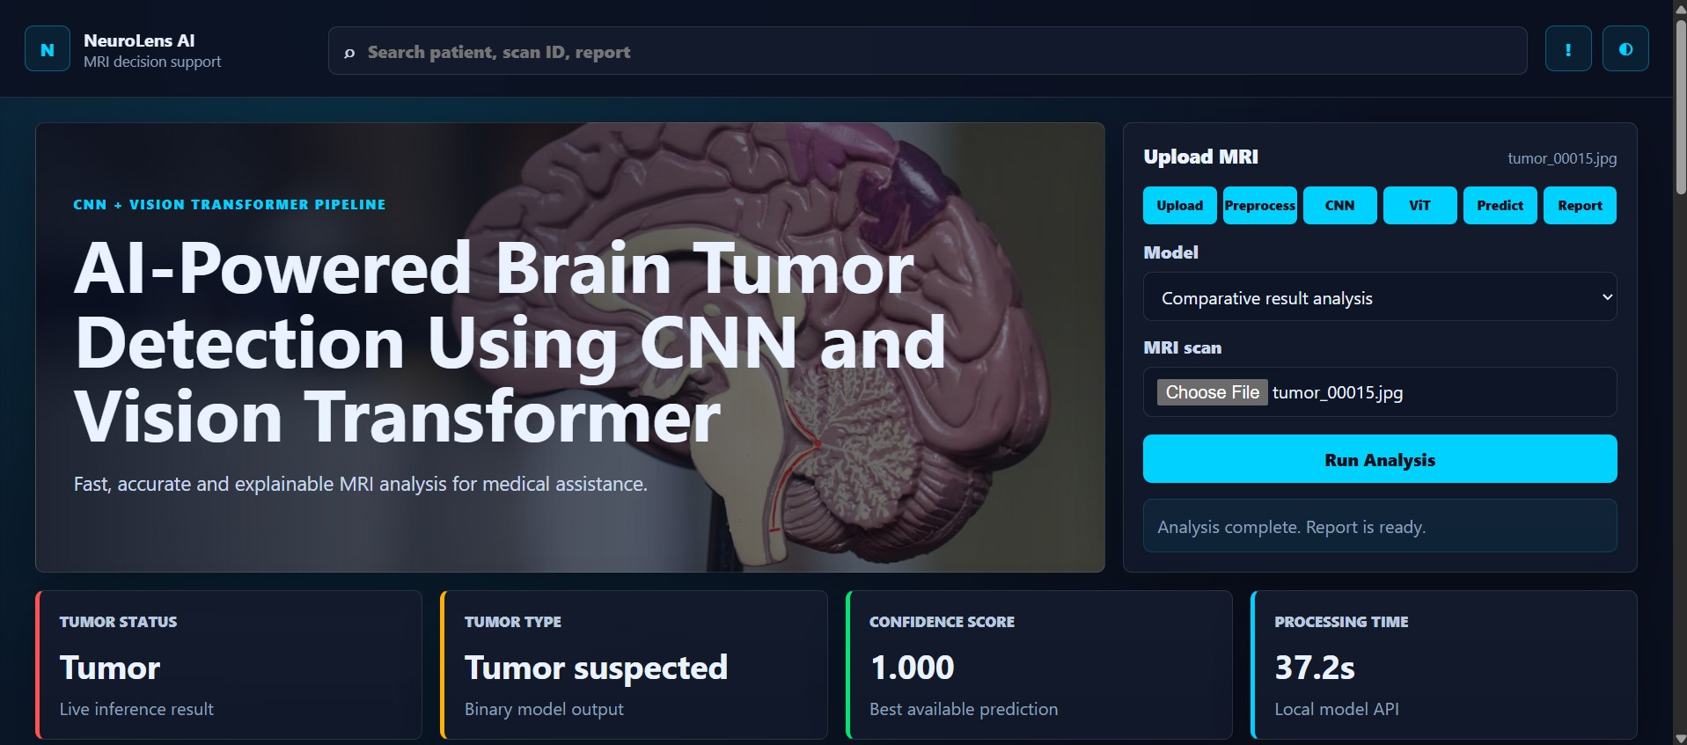
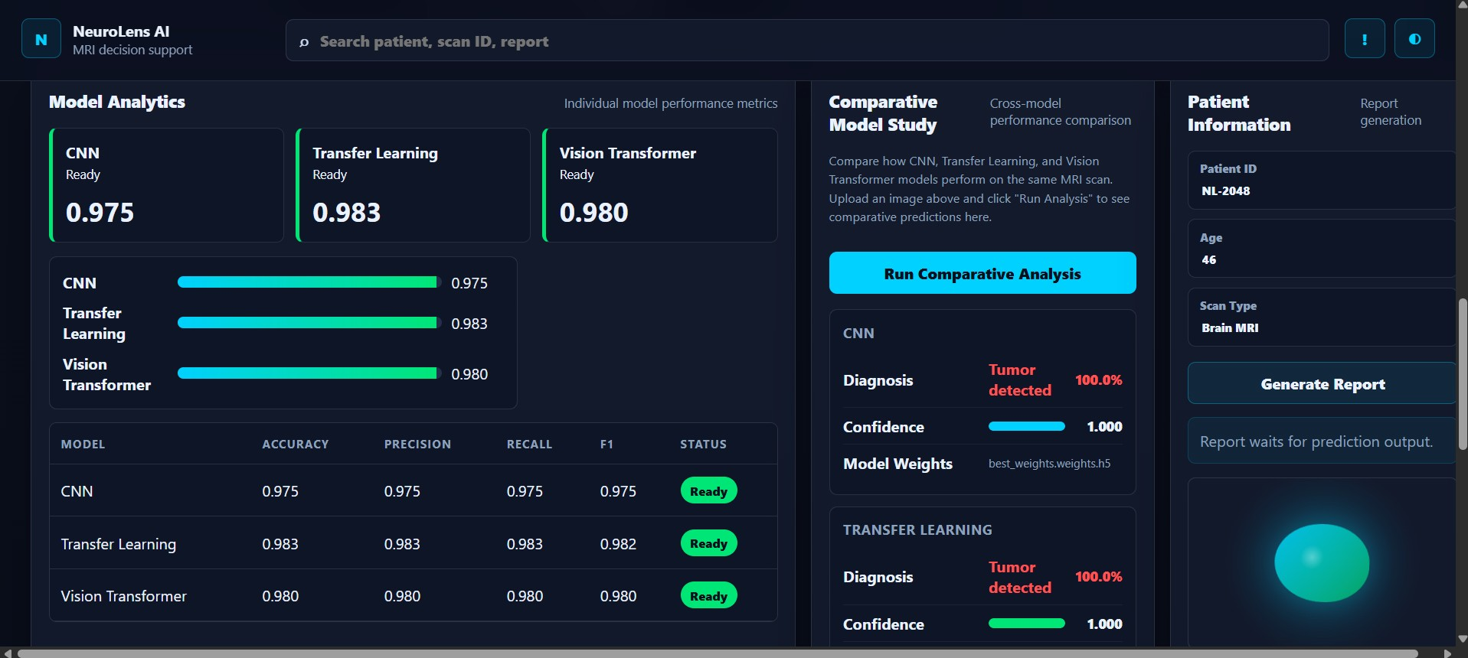
Dashboard / Web Interface
NeuroLens AI — local web application
Fig 3: Model Analytics — accuracy, precision, recall per model
Search Bar:
Patient / Scan ID / Report lookup
Upload Panel:
Choose MRI → Run Analysis button
Fig 1: Main dashboard — MRI upload, pipeline controls & live results
Status Cards:
Tumor status, type, confidence, time
Model Analytics:
Per-model accuracy, precision, recall, F1
Notes:
The dashboard runs locally on the user's machine. Key UX features: single-button analysis, live status cards showing tumor probability and processing time, and a full model analytics panel.

Slide 22
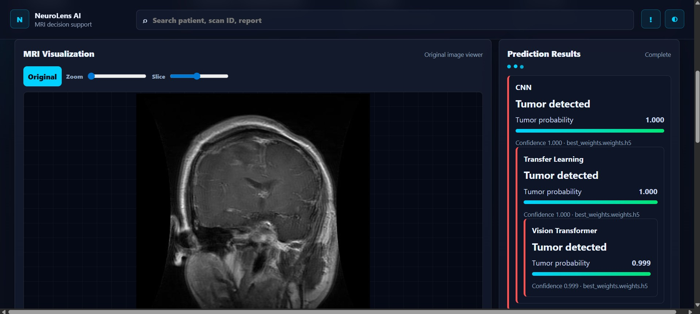
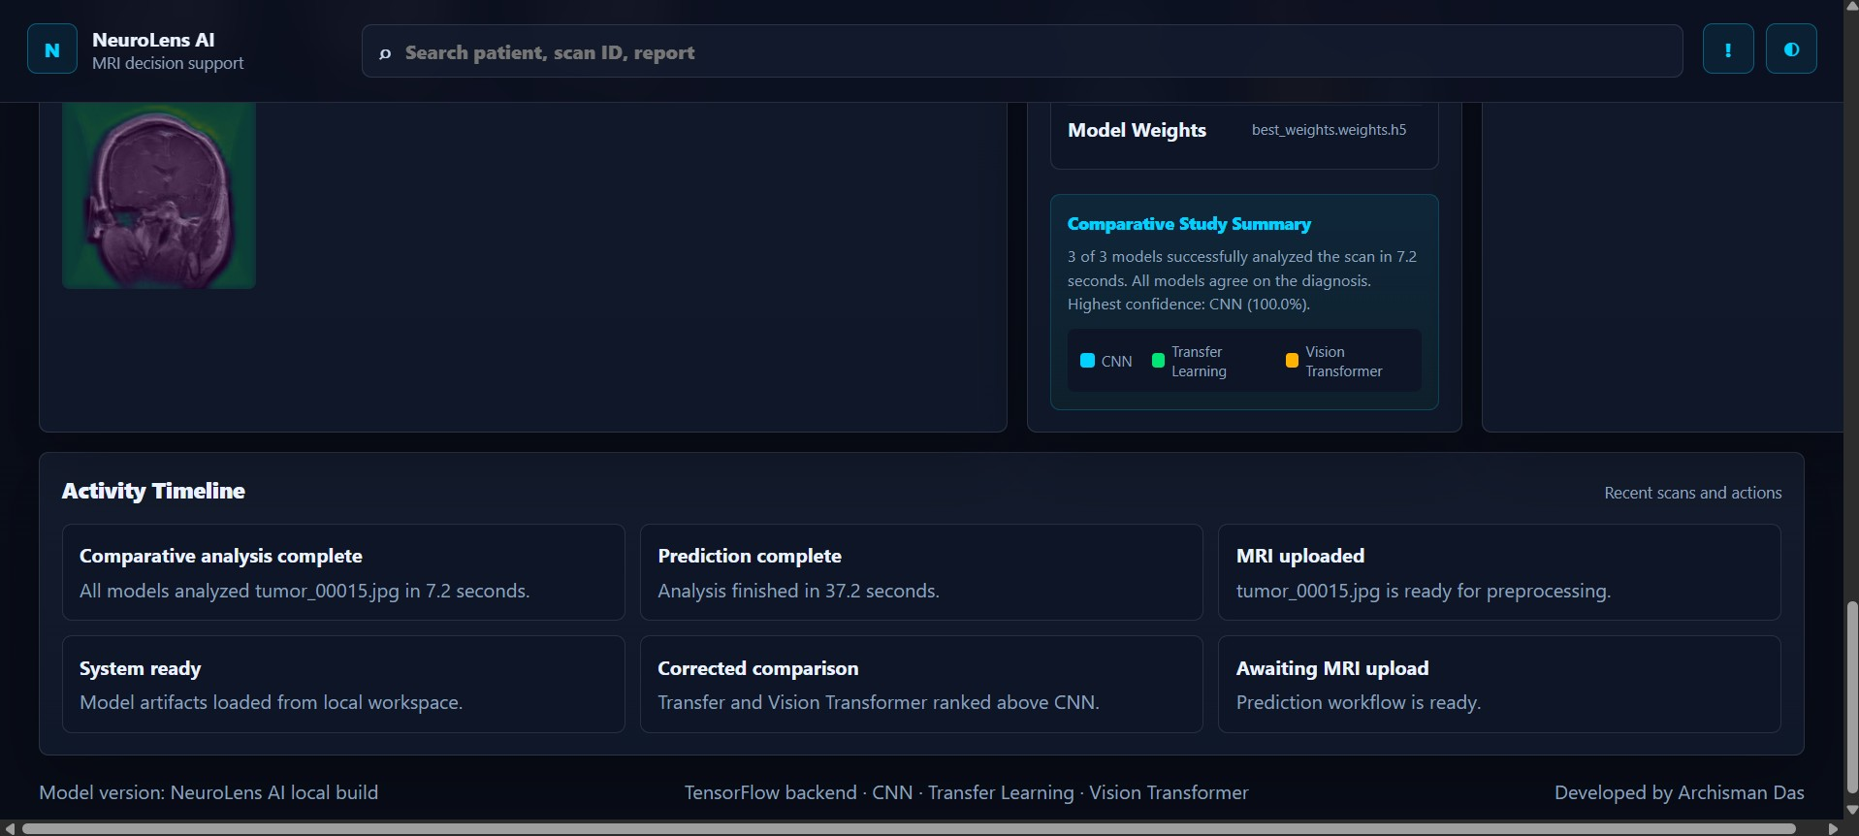
Live Prediction Workflow
From MRI upload to diagnosis in real-time
Fig 4: Activity timeline & comparative study summary
CNN:
Tumor detected · 1.000 confidence
Transfer Learning:
Fig 2: MRI Viewer + multi-model prediction results
Tumor detected · 1.000 confidence
Vision Transformer:
Tumor detected · 0.999 confidence
★ 3/3 models agreed. Comparative analysis in 37.2s.
Notes:
This is a real run result from the dashboard on tumor_00015.jpg. All three models independently agree on the diagnosis with near-perfect confidence. The comparative analysis runs in just 7.2 seconds.

Slide 23




Key Features of the System
What makes NeuroLens AI stand out
3-Model Ensemble
Grad-CAM Explainability
CNN, Transfer Learning & ViT running in parallel on the same scan.
Visual heatmaps showing exactly which MRI regions triggered detection.
Comparative Analytics
Real-time Inference
Side-by-side accuracy, precision, recall, F1 & confidence for all models.
Upload → Analyze in seconds. No cloud needed — fully local execution.
Clinically Safe Design
Activity Timeline
Minimizes false positives. ViT achieves 99.5% specificity.
Full log of analysis actions, timestamps and model comparison summary.
Modular Architecture
Patient Report Ready
Each model independently trainable, evaluatable and swappable.
Patient ID, scan type, and analysis output captured for reporting.
Notes:
Eight distinct features differentiate NeuroLens AI. Emphasize the combination of accuracy + explainability + local deployment as the unique value proposition for clinical-support use.

Slide 24
Challenges Faced During Development
Technical and domain hurdles overcome
Domain Gap
Grad-CAM for ViT
MRI images differ fundamentally from ImageNet photos. ResNet50 fine-tuning required careful LR scheduling to adapt ImageNet features to medical context.
Standard Grad-CAM is not applicable to transformers. Implemented ViT-specific patch saliency via [CLS] token attention weight extraction.
Initial TL Underperformance
Dashboard Integration
Transfer Learning initially scored only 85.75% accuracy due to suboptimal backbone freezing strategy. Fixed via 2-phase training.
Aligning model checkpoint paths, metric JSON files and the Streamlit dashboard required careful artifact versioning and path management.
ViT Data Requirements
Class Imbalance
Transformers typically need large datasets. Hybrid ViT (ResNet50 + attention) solved this by leveraging CNN feature extraction as preprocessing.
Raw dataset had potential class imbalance. Addressed via balanced 200+200 test split and augmentation of minority class during training.
Notes:
Six major challenges, all solved. The most interesting: adapting Grad-CAM to the ViT architecture required understanding attention mechanics at a deep level. The 2-phase TL training was the key insight for performance recovery.

Slide 25
Future Improvements & Scope
Roadmap toward production-grade clinical AI
Multi-class Classification
HIGH IMPACT
Extend beyond binary to glioma, meningioma, pituitary tumor & no tumor — enabling treatment-specific routing.
3D Volumetric MRI
HIGH IMPACT
Process full MRI volumes with 3D CNNs or volumetric transformers for inter-slice context.
Federated Learning
HIGH IMPACT
Train across multiple hospital sites without centralizing patient data — HIPAA/GDPR compliant.
Uncertainty Quantification
CLINICAL SAFETY
Bayesian/MC-Dropout confidence intervals to flag low-confidence predictions for human review.
DICOM Support
DEPLOYMENT
Native DICOM file format ingestion for seamless hospital PACS system integration.
MLOps & Versioning
ENGINEERING
Experiment tracking, automated model deployment pipelines and artifact versioning via MLflow/DVC.
GAN Data Augmentation
DATA
Synthetic MRI generation via GANs to expand training distribution and rare tumor type coverage.
Notes:
Seven future directions, prioritized by impact. Multi-class classification is the single highest-value addition. Federated learning is necessary for real-world healthcare deployment given data privacy regulations.

Slide 26

Real-World Applications
Where NeuroLens AI creates clinical impact
Clinical Decision Support
Radiologists use NeuroLens AI as a second-opinion tool, prioritizing flagged scans for urgent review. Grad-CAM overlays let doctors verify AI decisions.
Telemedicine & Remote Screening
Healthcare workers in underserved regions upload scans via browser dashboard and receive instant results without specialist access.
Hospital Triage Automation
High-volume radiology workflows integrate NeuroLens AI to auto-prioritize suspected tumor cases, reducing time-to-diagnosis for critical patients.
Research Benchmarking
Modular JSON metrics enable automated performance tracking for new model architectures on standardized MRI classification tasks.
Medical Education
Trainees examine Grad-CAM heatmaps to build intuition about how AI identifies tumor regions — bridging pathology and AI methodology.
Notes:
Five application domains, each with a distinct user group. The unifying theme: NeuroLens AI extends diagnostic reach, reduces workload, and maintains clinical trust through explainability.

Slide 27
Conclusion
What NeuroLens AI has demonstrated
✓ Three architectures, all clinically competitive.
CNN (97.5%), Transfer Learning (98.25%), Vision Transformer (98.0%) — all exceed the 95% success criterion.
✓ Transfer Learning achieves the highest accuracy.
98.25% with 0.9956 ROC AUC after two-phase fine-tuning of ResNet50 backbone.
✓ Vision Transformer delivers the highest ROC AUC.
0.9975 AUC and 99.5% specificity — ideal for population-level screening with minimal false alarms.
✓ Explainability builds clinical trust.
Grad-CAM and ViT patch saliency maps provide visual proof of model decisions for radiologist verification.
✓ Local deployment is practical and privacy-preserving.
Web dashboard enables real-time inference without cloud dependency, protecting patient data.
NeuroLens AI — A modular, interpretable, multi-architecture deep learning framework for reliable brain tumor detection.
Notes:
Summarize the five key takeaways. Emphasize that this is a complete, end-to-end system — not just a model, but a full clinical-support tool with explainability and deployment infrastructure.

Slide 28

Thank You
Questions & Discussion
Archisman Das
Notes:
Open the floor for questions. Be ready to discuss: (1) Why ViT needs the ResNet50 hybrid, (2) How Grad-CAM works mechanically, (3) The 85.75% → 98.25% Transfer Learning improvement story, (4) Future clinical deployment plans.

