Slide 1


Predicting Pollution from Traffic & Weather Patterns
Name: Archit Tiwari
AICTE Student ID: STU20241908F3EB1BEF AICTE Internship ID: INTERNSHIP_17513641056863b20937d78

Slide 2


Learning Objectives
Understand the relationship between traffic patterns, weather conditions, and air pollution levels (AQI).
Gain hands-on experience in data preprocessing and feature engineering .
Learn to visualize data and model predictions for better interpretation and communication.
Apply machine learning models (regression and classification) to predict environmental indicators.
Explore how ML can support preventive environmental management and smart city planning.
Source :
www.freepik.com/

Slide 3
Tools and Technology used
🛠
Programming Language: Python 🐍
Data Handling & Analysis: Pandas, NumPy
Data Visualization: Matplotlib, Seaborn
Machine Learning Models: Scikit-learn (Linear Regression, Random Forest, etc.)
Dataset Sources: Kaggle
Environment / IDE: Jupyter Notebook
Version Control (optional): Git & GitHub

Slide 4

Methodology
Problem Definition – Predict AQI levels using traffic and weather data.
Data Collection – Gather combined datasets (traffic, weather, pollution).
Preprocessing – Clean, merge, and engineer relevant features.
Exploratory Analysis – Visualize trends and correlations.
Modeling – Train ML models (Regression, Random Forest, LSTM).
Evaluation – Assess performance with RMSE, MAE, Accuracy.
Prediction & Visualization – Forecast AQI and present results via plots or a dashboard.

Slide 5

Problem Statement:
Air pollution poses a serious threat to human health and the environment, especially in urban areas where traffic congestion and unfavorable weather conditions worsen air quality. Most existing systems are reactive, reporting AQI only after pollution has already occurred. There is a need for a predictive system that can forecast pollution spikes in advance using traffic and weather data, enabling authorities and citizens to take preventive measures and reduce exposure to hazardous air conditions.

Slide 6

Solution:
This project develops a machine learning model that predicts upcoming air pollution levels by combining traffic congestion data (vehicle counts, speeds, peak hours) with weather conditions (temperature, humidity, wind speed, etc.). The model forecasts AQI or health risk categories, allowing authorities to issue early warnings and take preventive actions such as traffic regulation, industrial activity control, and timely public health advisories.
Github Link:https://github.com/archit-tiwari-26/Predicting-Pollution-from-Traffic-Weather-Patterns

Slide 7
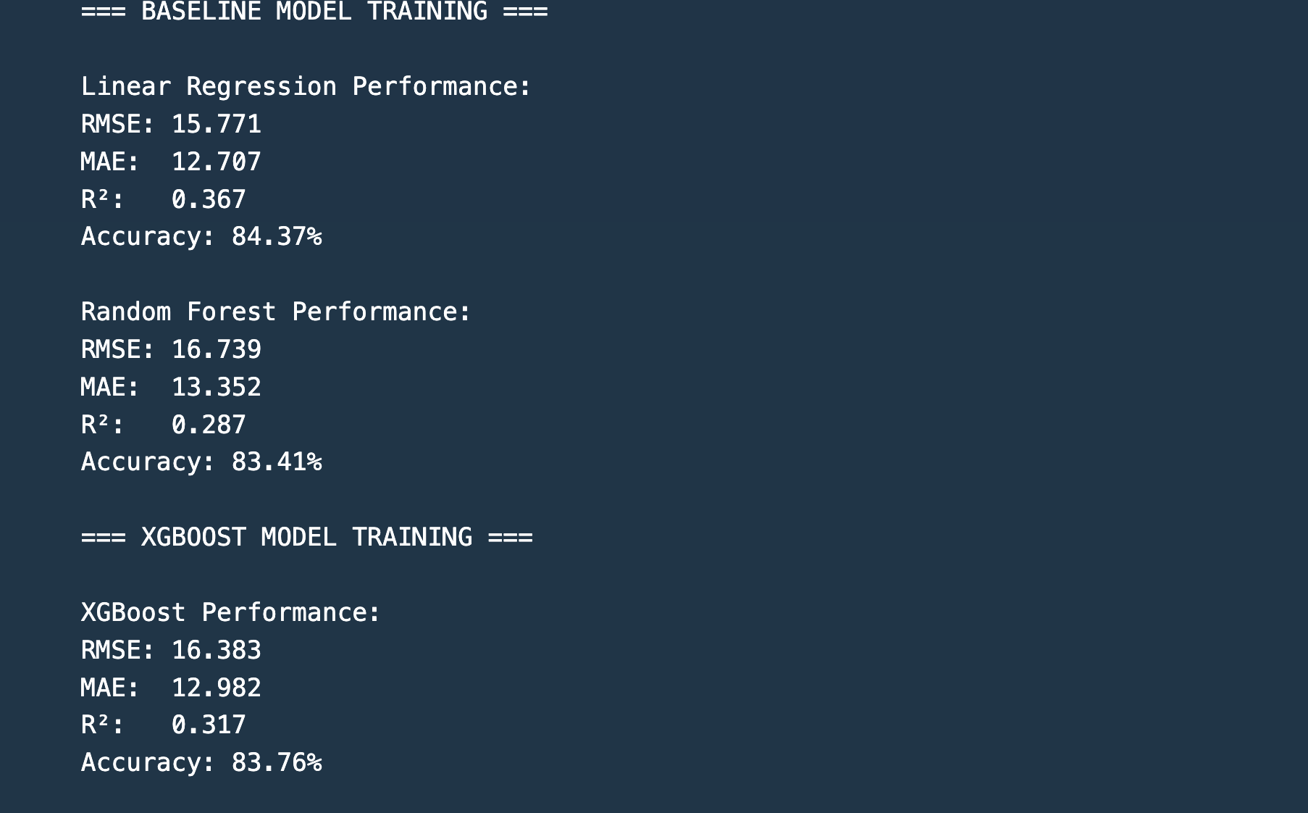
Screenshot of Output:

Slide 8

Conclusion:
This project demonstrates how machine learning can be applied to predict air quality by leveraging traffic and weather data. Unlike traditional reactive systems, the proposed solution enables early detection of pollution spikes, supporting preventive measures such as traffic management, industrial regulation, and public health advisories. By integrating real-world datasets with predictive modeling, the system provides a practical step toward smarter, healthier, and more sustainable urban living.

