Slide 1
StudySlot
Study-room bookings
DevOps capstone
Archit Kulkarni
24BCS10194 Section A
Notes:
Hi, I'm Archit Kulkarni, roll number 24BCS10194, Section A. This is StudySlot, a study-room booking app. I'll explain the setup briefly, then show the code, deployment and monitoring.
https://github.com/archit0k/Devops-HW/tree/main/project

Slide 2
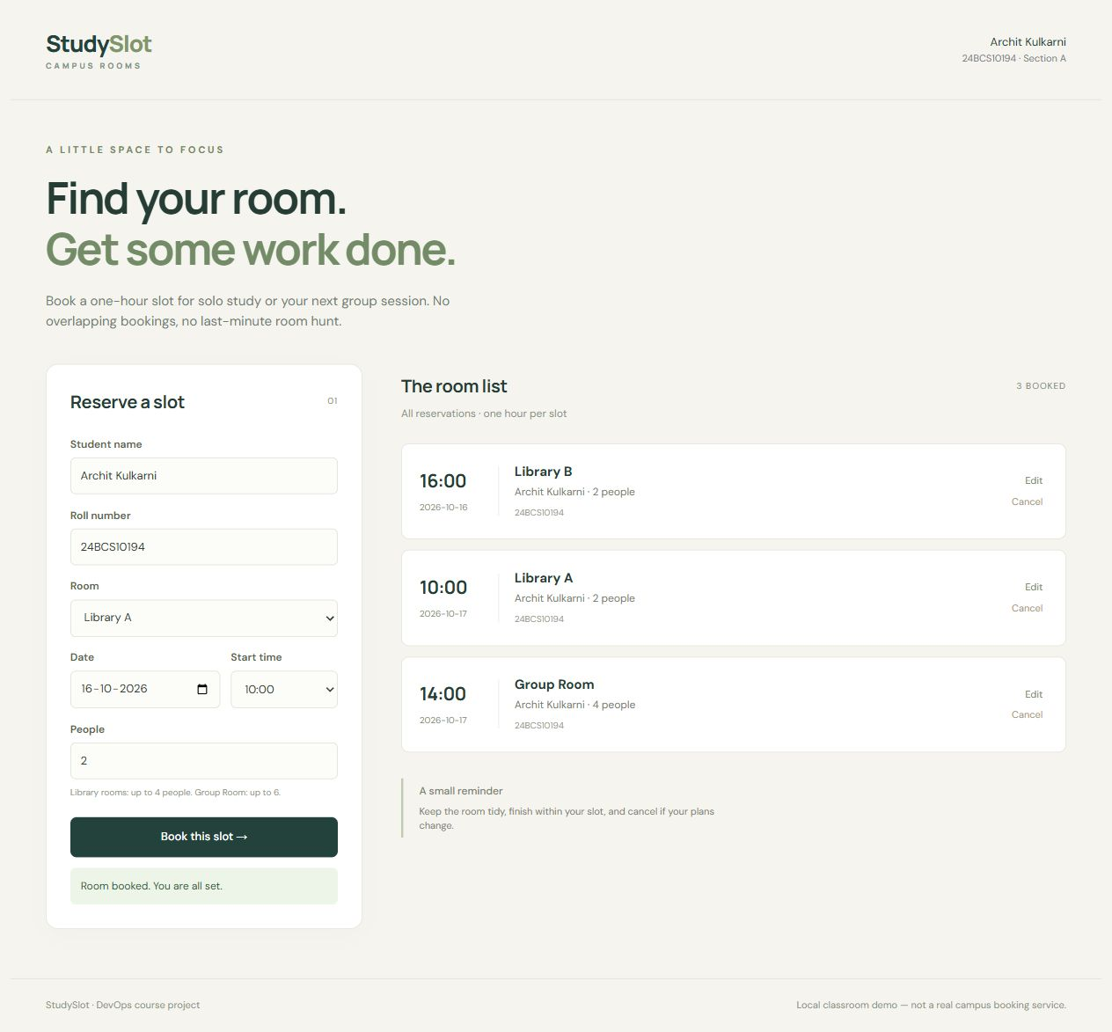
The booking app
A room for
one hour
Book an available slot.
Change or cancel it later.
Room-capacity checks
Duplicate-slot protection
Notes:
A student reserves one room for one hour, changes the booking or cancels it. Capacity and duplicate-slot validation give the app a concrete rule to test. Demo data only.
Project source: https://github.com/archit0k/Devops-HW/tree/main/project
Rubric: https://github.com/Nency-Ravaliya/devsecops-python/blob/main/GRADING.md
Screenshot: C:\Users\archi\Github Projects\Devops-HW\project\evidence\rehearsal-20261016\desktop-browser.jpg
Captured evidence is dated. It does not imply an always-on cloud service.

Slide 3
Application architecture
01
02
03
04
Browser
Ingress / Nginx
FastAPI
PostgreSQL
User interaction
localhost:3000
/ serves React
/api routes to backend
Validation and CRUD
Health and metrics
Bookings and constraints
Persistent volume
Monitoring
FastAPI /metrics Prometheus scrape Grafana dashboard
Notes:
The browser uses Ingress. The root route serves React through Nginx. API traffic goes to FastAPI and PostgreSQL. Prometheus scrapes FastAPI independently; Grafana queries Prometheus. PostgreSQL stays internal.
Project source: https://github.com/archit0k/Devops-HW/tree/main/project
Rubric: https://github.com/Nency-Ravaliya/devsecops-python/blob/main/GRADING.md

Slide 4
Stack and source
Interface
React, Vite, Nginx
project/frontend/
API and data
FastAPI, SQLAlchemy, Alembic, PostgreSQL
project/backend/
Packaging
Docker Compose, non-root application images
project/docker-compose.yml
Checks
Pytest, Ruff, Bandit, Gitleaks, Trivy
GitHub Actions workflow
Deployment
Terraform, EKS, Helm, Argo CD
project/terraform/ and helm/
Monitoring
Prometheus, Grafana, ServiceMonitor
project/monitoring/
Notes:
React/Vite is the UI. FastAPI handles the API. SQLAlchemy and Alembic manage PostgreSQL. Docker packages the app. GitHub Actions and Trivy check both images. Terraform, Helm, Kubernetes and Argo CD handle infrastructure and deployment.
Project source: https://github.com/archit0k/Devops-HW/tree/main/project
Rubric: https://github.com/Nency-Ravaliya/devsecops-python/blob/main/GRADING.md

Slide 5
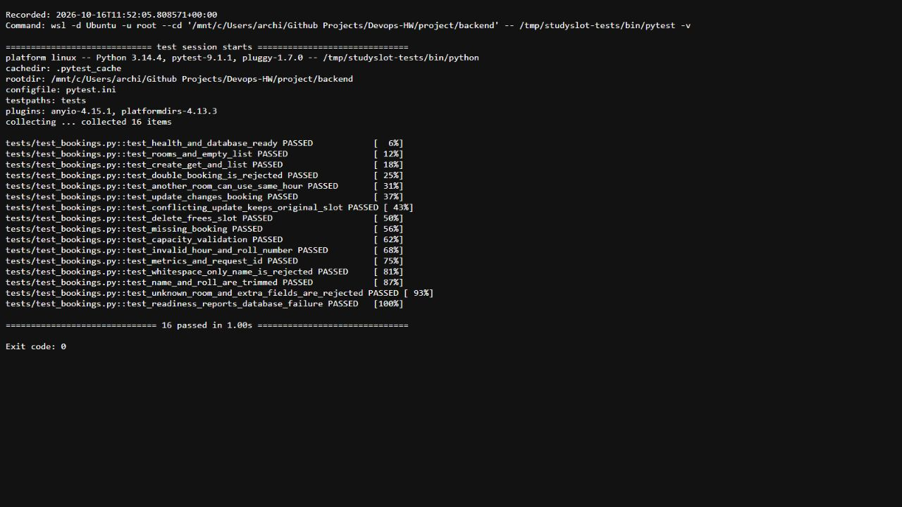
Tests and booking conflicts
16
API tests
Isolated test database
CRUD and validation
Real PostgreSQL race check
Concurrent booking requests: one 201, one 409
Notes:
Sixteen API tests use an isolated test database. A separate HTTP integration check uses actual PostgreSQL. Simultaneous POSTs for the same room/date/hour produce one 201 and one 409. The database constraint enforces this even under a race.
Project source: https://github.com/archit0k/Devops-HW/tree/main/project
Rubric: https://github.com/Nency-Ravaliya/devsecops-python/blob/main/GRADING.md
Screenshot: C:\Users\archi\Github Projects\Devops-HW\project\evidence\pytest-output.jpg
Captured evidence is dated. It does not imply an always-on cloud service.

Slide 6
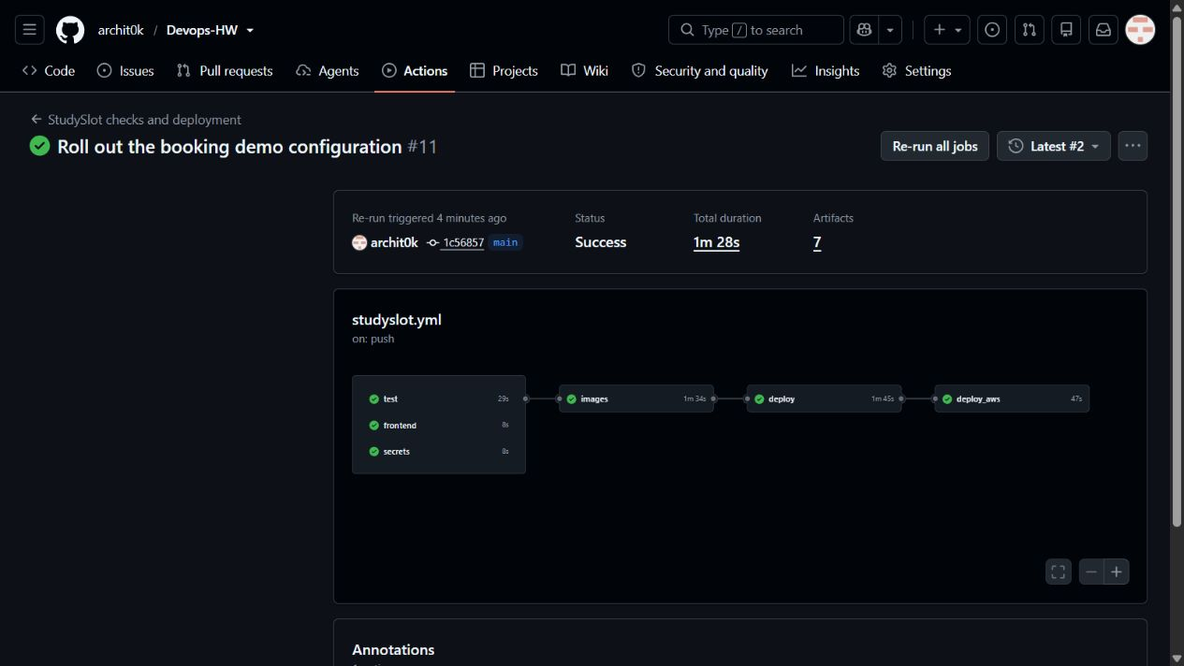
CI/CD and security gates
Tests and audits
Docker and Trivy
SHA images and Helm
A failed gate stops promotion. Cloud deployment runs only while the AWS lab is enabled.
Notes:
Each main push runs tests, frontend build, audits and a full-history secret scan. Trivy scans both runtime images. HIGH/CRITICAL findings block publication. Full commit-SHA image tags identify the checked builds. Kind verifies the exact images before optional EKS deployment. The pictured six-job run passed during the earlier temporary AWS lab.
Project source: https://github.com/archit0k/Devops-HW/tree/main/project
Rubric: https://github.com/Nency-Ravaliya/devsecops-python/blob/main/GRADING.md
Screenshot: C:\Users\archi\Github Projects\Devops-HW\project\evidence\pipeline-final.jpg
Captured evidence is dated. It does not imply an always-on cloud service.

Slide 7
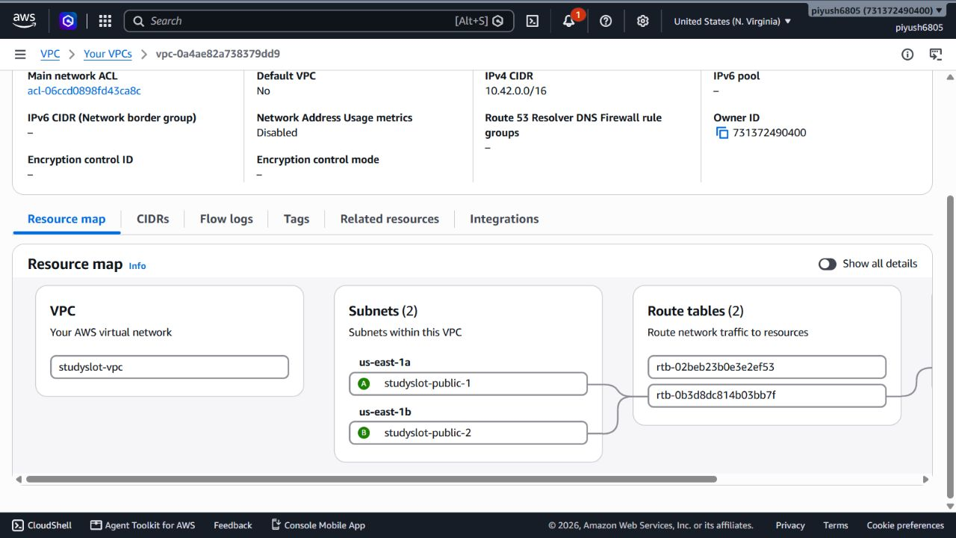
AWS infrastructure
2 zones
Two public subnets
One EKS cluster
Two worker nodes
Temporary OIDC access
Teardown after recording
us-east-1 VPC 10.42.0.0/16
Notes:
Terraform manages one VPC, two public subnets in separate availability zones, EKS 1.35 with two t3.medium workers and storage/identity/metrics add-ons. The fresh lab has 25 managed resources and reuses an existing GitHub OIDC provider. Short-lived access replaces permanent keys. No NAT gateway, RDS or public application LoadBalancer. The screenshot records a genuine temporary lab.
Project source: https://github.com/archit0k/Devops-HW/tree/main/project
Rubric: https://github.com/Nency-Ravaliya/devsecops-python/blob/main/GRADING.md
Screenshot: C:\Users\archi\Github Projects\Devops-HW\project\evidence\rehearsal-20261016\aws-vpc-map.jpg
Captured evidence is dated. It does not imply an always-on cloud service.

Slide 8
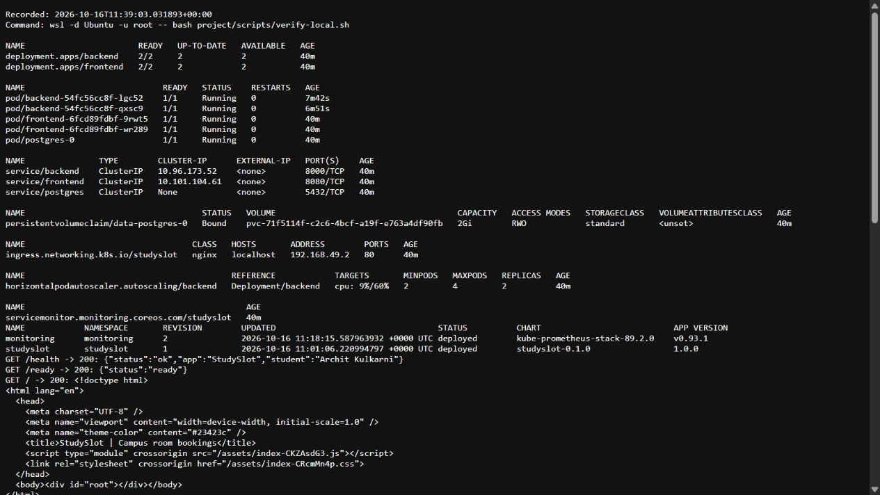
Kubernetes and Helm
Ready Pods
Internal Services
Bound database PVC
Notes:
The chart deploys two frontend replicas, backend HPA with a two-Pod minimum, internal Services, routing and a PostgreSQL PVC. Readiness probes keep unready Pods out of traffic. This pictured cluster is the local Minikube lab, separate from the AWS EKS checks.
Project source: https://github.com/archit0k/Devops-HW/tree/main/project
Rubric: https://github.com/Nency-Ravaliya/devsecops-python/blob/main/GRADING.md
Screenshot: C:\Users\archi\Github Projects\Devops-HW\project\evidence\kubernetes-pods-services.jpg
Captured evidence is dated. It does not imply an always-on cloud service.

Slide 9
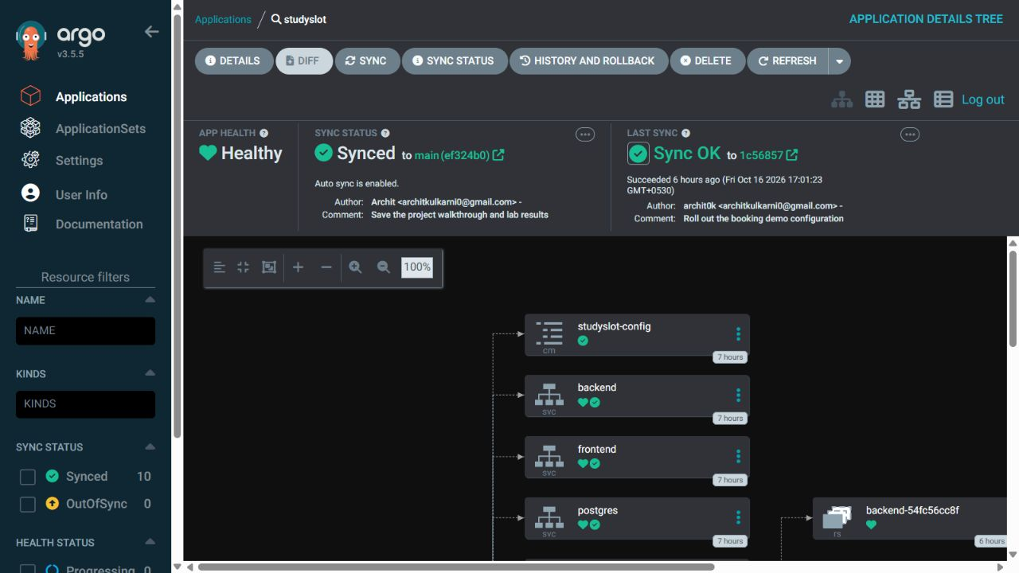
GitOps with Argo CD
Git change Configuration rollout Synced / Healthy
Notes:
Argo CD follows main, the Helm chart and pinned tested local image values. A demoRevision change updates the backend Pod annotation and causes an actual rollout. Automatic sync and self-healing reconcile the desired configuration. The HPA owns backend replica count.
Project source: https://github.com/archit0k/Devops-HW/tree/main/project
Rubric: https://github.com/Nency-Ravaliya/devsecops-python/blob/main/GRADING.md
Screenshot: C:\Users\archi\Github Projects\Devops-HW\project\evidence\rehearsal-20261016\argocd-synced.jpg
Captured evidence is dated. It does not imply an always-on cloud service.

Slide 10
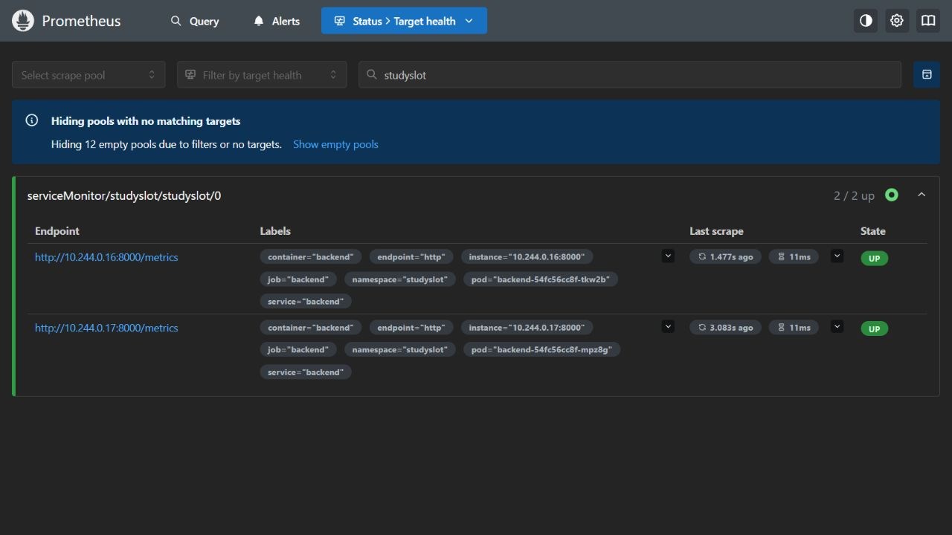
Prometheus targets
Backend targets UP through the ServiceMonitor
Notes:
FastAPI exposes application request counters and latency histograms. The ServiceMonitor selects backend Pods. All application scrape targets must be UP with no scrape errors. The HPA allows two to four replicas. Metrics Server separately supplies CPU readings for the HPA.
Project source: https://github.com/archit0k/Devops-HW/tree/main/project
Rubric: https://github.com/Nency-Ravaliya/devsecops-python/blob/main/GRADING.md
Screenshot: C:\Users\archi\Github Projects\Devops-HW\project\evidence\rehearsal-20261016\prometheus-targets.jpg
Captured evidence is dated. It does not imply an always-on cloud service.

Slide 11
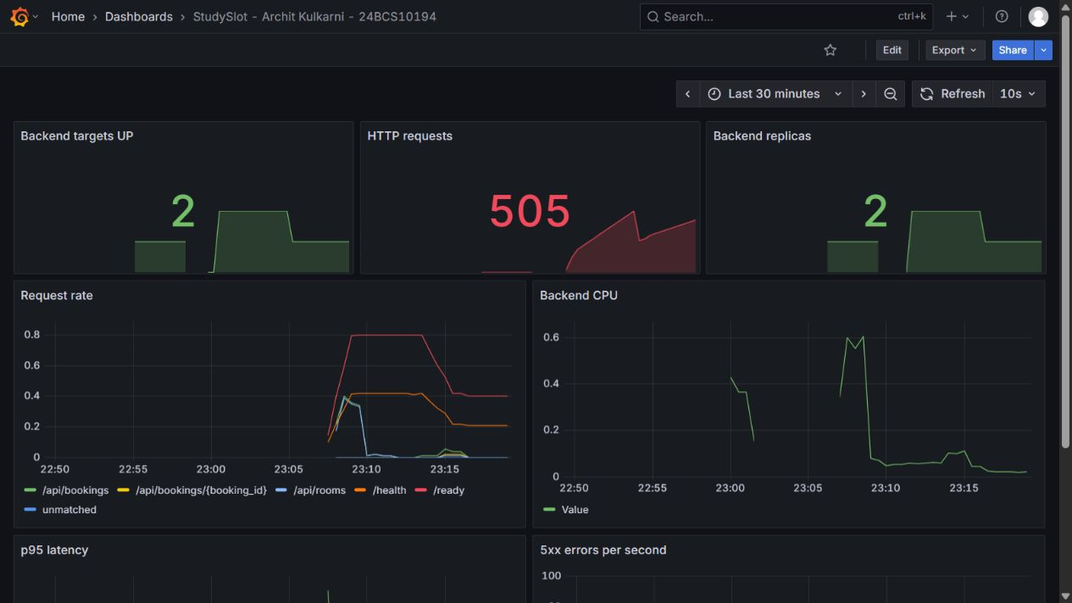
Application metrics in Grafana
Actual request activity and latency, collected from the running application
Notes:
The dashboard queries live Prometheus data: target health, HTTP requests/rate, backend replicas, CPU, p95 latency and errors. Real traffic populates the panels. A zero error rate is a valid measurement. Authentication remains enabled for this private local UI.
Project source: https://github.com/archit0k/Devops-HW/tree/main/project
Rubric: https://github.com/Nency-Ravaliya/devsecops-python/blob/main/GRADING.md
Screenshot: C:\Users\archi\Github Projects\Devops-HW\project\evidence\rehearsal-20261016\grafana-live.jpg
Captured evidence is dated. It does not imply an always-on cloud service.

Slide 12
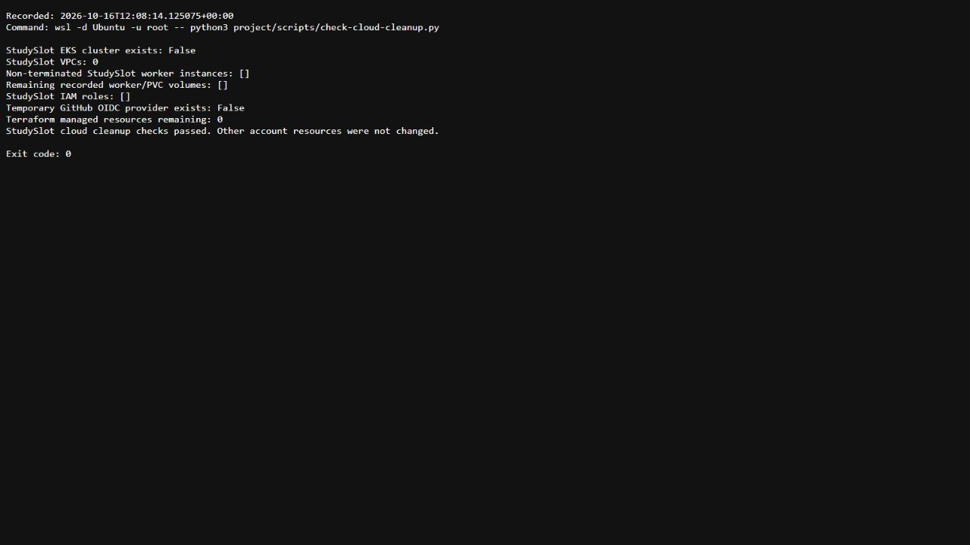
Learnings and cleanup
The database handles races
A unique room/date/hour key protects simultaneous requests.
Access stays small
Namespace deployment permissions include the required custom resource.
The lab has limits
Authentication, TLS, reliable backups and database HA remain production work.
Earlier lab: verified teardown
New lab: cleanup after recording
Notes:
Database constraints prevent booking races. Least-privilege deployment access needs an explicit Role for the custom ServiceMonitor resource. A Ready Pod does not prove routing and monitoring, so verify real HTTP requests. The temporary AWS lab is destroyed after recording. The classroom app still lacks authentication, TLS, automated backups and a highly available database.
Project source: https://github.com/archit0k/Devops-HW/tree/main/project
Rubric: https://github.com/Nency-Ravaliya/devsecops-python/blob/main/GRADING.md
Screenshot: C:\Users\archi\Github Projects\Devops-HW\project\evidence\cloud-cleanup-output.jpg
Captured evidence is dated. It does not imply an always-on cloud service.

