Slide 1
SUMMER INTERNSHIP PROJECT
Development of Advanced AI Applications using RAG and LLM APIs
RAG
retrieval
+ evidence
+ generation
A grounded knowledge-assistant prototype with retrieval evaluation and configurable LLM APIs
Master's Summer Internship | July 2026

Slide 2
PROBLEM
02
LLMs need evidence, not just fluent answers
The project makes source grounding, citation display, and insufficient-evidence refusal explicit parts of the application.
Without retrieval
With this RAG system
•
Stale or unsupported claims can sound credible
•
Documents are chunked and retrieved at query time
•
Private documents are absent from model parameters
•
Answers show inline citations and source excerpts
•
Users cannot inspect why an answer was given
•
Weak evidence produces a transparent refusal

Slide 3
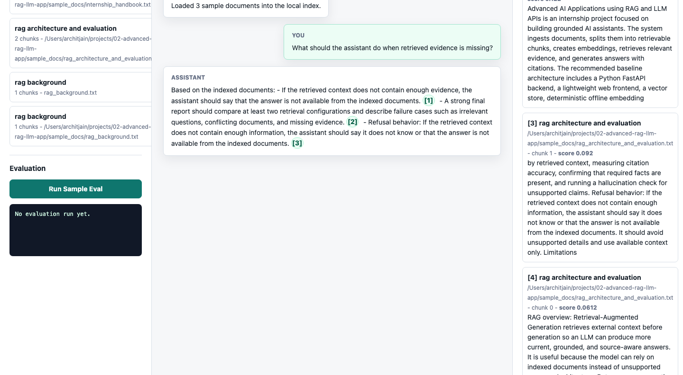
APPLICATION
03
The prototype is a working research assistant
Users ingest a corpus, ask a question, inspect evidence, and run the evaluation from one local interface.
User-facing controls
•
Upload or load a document corpus
•
Ask grounded questions
•
Inspect citations and latency
•
Run repeatable evaluation

Slide 4
ARCHITECTURE
04
Retrieval and generation stay independently testable
Persistent chunks and evidence diagnostics make each stage inspectable.
Documents
Chunks
Retrieve
Evidence gate
Provider
extract + normalize
hash embeddings + SQLite
vector + BM25 + RRF
answer or refuse
offline, OpenAI, Ollama
Citation validation attaches retrieved source, chunk position, score, and excerpt to each accepted answer.

Slide 5
EVALUATION
05
The evaluation tests real retrieval failure modes
41 labeled cases over 13 university AI research internship documents create a repeatable local benchmark.
Scenario coverage
Answer evaluation
required-fact recall • citation/refusal coverage • latency
30
answerable
3
ambiguous
Retrieval evaluation
3
conflicting
Recall@5 • MRR • nDCG@5 • abstention accuracy
5
unanswerable
41
13
29
total cases
source documents
indexed chunks

Slide 6
RESULTS
06
Hybrid retrieval wins the combined benchmark
Keyword-only ranking leads pure retrieval, but hybrid wins once evidence-gate abstention is included.
Hybrid combined score
0.9126
Hybrid Recall@5
1.0000
Hybrid abstention
0.8000

Slide 7
SAFETY
07
Evidence gating preserves answerable cases
The hybrid threshold is configurable and must be revalidated on a held-out dataset.
0.8000
1.0000
unanswerable-refusal accuracy
4 of 5 unsupported requests refused
answerable non-refusal rate
no answerable case rejected in this run
Decision rule: low hybrid score + low vector similarity + limited lexical overlap + weak keyword evidence.

Slide 8
LLM APIS
08
Generation providers remain replaceable
Offline mode keeps the project reproducible; remote models are explicit configuration, not hidden dependencies.
Offline extractive
OpenAI Responses API
Ollama
Deterministic baseline
No API key
Used for recorded results
Configurable GPT-5.6 model
Environment-loaded key
Bounded output tokens
Local HTTP endpoint
Model selected by config
No cloud requirement
OpenAI SDK integration uses the Responses API; a live request needs OPENAI_API_KEY and remains untested here because no credential was provided.

Slide 9
PLAN
09
A six-week engineering plan
Each phase leaves a demonstrable artifact rather than only a conceptual milestone.
1
2
3
4
5
6
Design
Ingest
Retrieve
Generate
Evaluate
Report
scope + architecture
loaders + chunks
hybrid baseline
providers + UI
tests + benchmark
analysis + demo

Slide 10
What the prototype demonstrates
•
An end-to-end RAG workflow that is locally runnable and inspectable
•
A reproducible 41-case evaluation with retrieval ablations
•
A clear path to API-backed generation once credentials and a held-out test set are available
Next: validate against held-out documents, add human claim-level review, and measure remote-provider cost and latency.
Advanced RAG and LLM API Assistant

