Slide 1
STUDYING THE INDUSTRIAL PATTERN USING HADOOP
By
- Archit Gupta
- Tanya Gupta

Slide 2
ABSTRACT
Energy Sector of United Kingdom using a very large dataset which represents the list of companies/industries persisting all over the world under different domains. This project is focused on processing such huge dataset using commodity hardware under HADOOP which is otherwise very hard to process using conventional software owing to the size of data.

Slide 3
INTRODUCTION
Big data is a popular term used to describe the exponential growth and availability of data, both structured, unstructured and Semi Structured. And big data may be as important to business – and society – as the Internet has become.

Slide 4
HADOOP - BIGDATA TOOL
Apache Hadoop is an open-source software framework written in Java for distributed storage and distributed processing of very large data sets on computer clusters built from commodity hardware.
Hadoop provides a reliable shared storage (HDFS) and analysis system (MapReduce).

Slide 5
ADVANTAGES OF HADOOP
Data Size and Data Diversity
Lifetime Data Availability
Cost Effective
Scalable

Slide 6
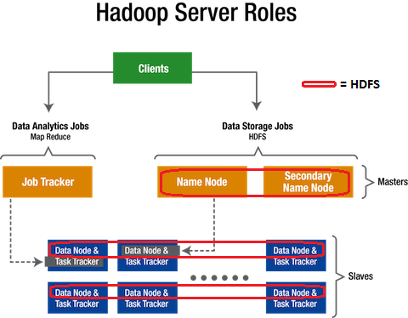
ARCHITECTURE OF HADOOP

Slide 7
PIG
Pig is a framework consisting of a high-level scripting language (Pig Latin) and a run-time environment that allows users to execute MapReduce on a Hadoop cluster. Like HiveQL in Hive, Pig Latin is a higher-level language that compiles to MapReduce.

Slide 8
CODE SNIPPLETS & SCREENSHOTS
# putting data on hdfs architecture
hadoop fs -put /home/cloudera/Desktop/Data.csv /user/cloudera/newdata.txt;
# showing Data file on host
http://localhost:50070/explorer.html#/ user/cloudera
# opening pig
pig -x local;

Slide 9
# Loading full data in a variable
variable = Load '/home/cloudera/Desktop/Data.csv' using PigStorage(',') as (CompanyName:chararray,CompanyNumber:int,RegAddressCareOf:chararray,RegAddressPOBox:chararray,RegAddressAddressLine1:chararray,RegAddressAddressLine2:chararray,RegAddressPostTown:chararray,RegAddressCounty:chararray,RegAddressCountry:chararray,RegAddressPostCode:chararray,CompanyCategory:chararray,CompanyStatus:chararray,CountryOfOrigin:chararray,DissolutionDate:chararray,IncorporationDate:chararray,AccountsAccountRefDay:int,AccountsAccountRefMonth:chararray,AccountsNextDueDate:chararray,AccountsLastMadeUpDate:chararray,AccountsAccountCategory:chararray,ReturnsNextDueDate:chararray,ReturnsLastMadeUpDate:chararray,MortgagesNumMortCharges:int,MortgagesNumMortOutstanding:int,MortgagesNumMortPartSatisfied:chararray,MortgagesNumMortSatisfied:chararray,SICCodeSicText_1:chararray,SICCodeSicText_2:chararray,SICCodeSicText_3:chararray,SICCodeSicText_4:chararray,LimitedPartnershipsNumGenPartners:int,LimitedPartnershipsNumLimPartners:int,URI:chararray,PreviousName_1CONDATE:chararray,PreviousName_1CompanyName:chararray,PreviousName_2CONDATE:chararray,PreviousName_2CompanyName:chararray,PreviousName_3CONDATE:chararray,PreviousName_3CompanyName:chararray,PreviousName_4CONDATE:chararray,PreviousName_4CompanyName:chararray,PreviousName_5CONDATE:chararray,PreviousName_5CompanyName:chararray,PreviousName_6CONDATE:chararray,PreviousName_6CompanyName:chararray,PreviousName_7CONDATE:chararray,PreviousName_7CompanyName:chararray,PreviousName_8CONDATE:chararray,PreviousName_8CompanyName:chararray,PreviousName_9CONDATE:chararray,PreviousName_9CompanyName:chararray,PreviousName_10CONDATE:chararray,PreviousName_10CompanyName:chararray,ConfStmtNextDueDate:chararray,ConfStmtLastMadeUpDate:chararray);

Slide 10
# loading csv file into a variable
var = Load '/home/cloudera/Desktop/data.csv' using PigStorage(',') as (Date:chararray,name:chararray,SIC1:chararra y,SIC2:chararray,SIC3:chararray,SIC4:chararra y,address1:chararray,address2:chararray,adder ss3:chararray,address4:chararray,address5:cha rarray);
# displaying the variable
dump var;
#filter global data for different SIC codes
fillglobal = filter var by (SIC1 == '05101 - Deep coal mines' or SIC2 == '05101 - Deep coal mines' or SIC3 == '05101 - Deep coal mines' or SIC4 == '05101 - Deep coal mines');

Slide 11
#counting the filtered out dates
countglobal = foreach (group fillglobal all) generate COUNT(fillglobal);
#display count
Dump countgobal;
#filter uk data
filluk = filter var by (SIC1 == '05101 - Deep coal mines' or SIC2 == '05101 - Deep coal mines' or SIC3 == '05101 - Deep coal mines' or SIC4 == '05101 - Deep coal mines') and (address1 == 'UNITED KINGDOM' or address2 == 'UNITED KINGDOM' or address3 == 'UNITED KINGDOM' or address4 == 'UNITED KINGDOM' or address5 == 'UNITED KINGDOM');

Slide 12
#counting the filtered out dates
countuk = foreach (group filluk all) generate COUNT(filluk);
#display count
Dump countuk;
# converting the dates into datetime format
convertuk = foreach filluk generate ToDate(Date, 'dd-mm-yyyy') as (ukDate:datetime);

Slide 13
# displaying the dates
dump convertuk;
# filtering the dates in a particular range > year 2005
fillukdate = filter convertuk1 by ukDate >= (datetime)ToDate('2005-01-01', 'yyyy-mm-dd');
# displaying the filtered out dates
dump filldate;

Slide 14
# counting the filtered out dates
counteruk = foreach (group fillukdate all) generate COUNT(fillukdate);
# displaying the count
dump counteruk;

Slide 15

Open Cloudera CDH for Analyzing Big Data
Cloudera is a commodity software for Hadoop which works on linux for
which a software emulator – VMWare is used.

Slide 16
DATA RESULTS
Energy Sectors | Number of Industries (Global) | Number of Industries (United Kingdom)
Coal | 145 | 16
Crude | 2061 | 295
Natural Gas | 967 | 162
Uranium & Thorium | 14 | 3
Petroleum & Natural Gas | 3935 | 719
Industrial Gases | 52 | 6
Nuclear Fuel | 11 | 2
Wholesale of Petroleum | 510 | 107

Slide 17
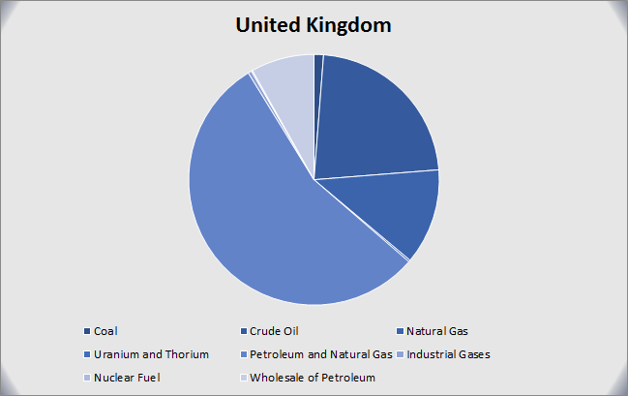

Slide 18
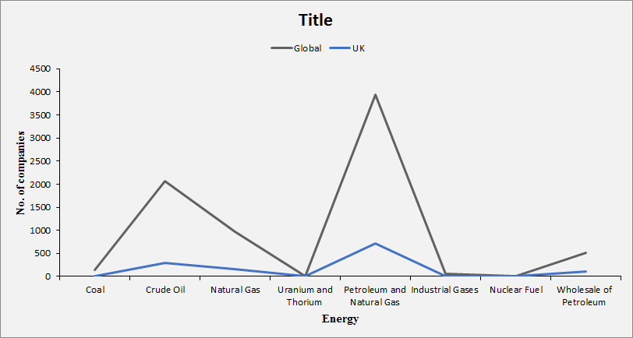

Slide 19
Variation since 20th Century
Energy Sectors | Number of Industries (United Kingdom)
 | 1900-2000 | 2000-2005 | 2005-2010 | 2010-2015 | 2015-2018
COAL | 3 | 0 | 0 | 4 | 9
CRUDE | 19 | 13 | 18 | 34 | 256
NATURAL GAS | 8 | 3 | 10 | 18 | 144
NUCLEAR FUEL | 0 | 0 | 2 | 0 | 4
PETROLEUM | 25 | 21 | 31 | 79 | 759

Slide 20
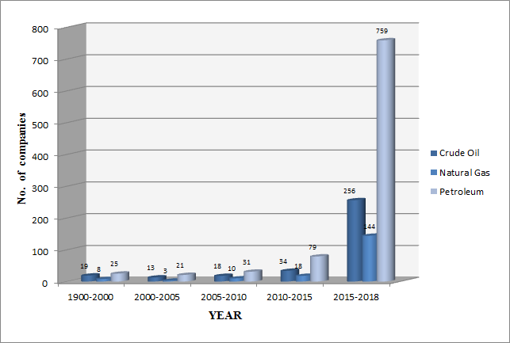

Slide 21
ANALYSIS
As we saw in previous analysis, the United Kingdom is richly endowed with energy resources. Historically, the country relied on coal mining and only tentatively ventured into nuclear energy in the mid-1950s. In the 1960s, the U.K. turned to the oil and natural gas buried below the North Sea. Although the country's natural resources are decreasing, the production of primary energy still accounts for 10% of Britain's Gross Domestic Product (GDP), a much higher share than in the majority of industrialized countries.

Slide 22
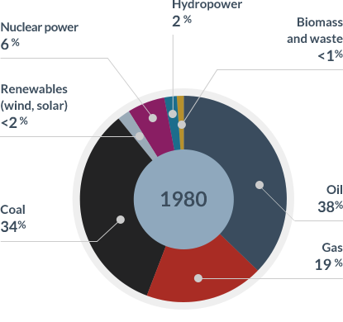

Slide 23
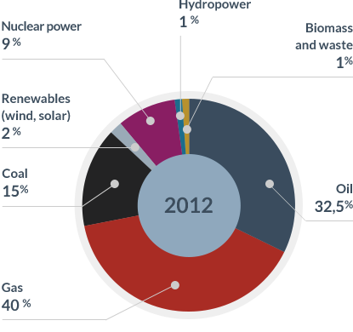

Slide 24
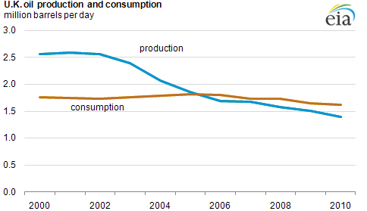

Slide 25
CONCLUSION
The United Kingdom is the largest producer of oil and second-largest producer of natural gas in the European Union which can also be seen from our results. Due to steadily declining production since the early 2000s, the U.K. became a net importer of natural gas and oil. This decline can be verified by the slow growth of industries in the petroleum sector in recent years which would have been drastic if the oil supplies would have been surplus.

Slide 26
Despite decreasing production, the U.K. remains one of the European Union's leading petroleum exporters which we signified in our previous analysis. The U.K. has also invested in renewable energy. Continued delays in delivering nuclear and a lack of investors willing to come forward to fund new large gas generating plant could provide opportunities for a range of renewable energy technologies to be deployed at scale if the policy is supportive. If we move to a renewable world, then this will have a mix of large- and small-scale projects. This means that more companies will be able to enter the market creating more competition from the likes of renewable energy companies. A lot of future investment can come from new market entrants, such as farmers, businesses, and communities investing in on-site and local renewable energy generation.

Slide 27
FUTURE ENHANCEMENT
The United Kingdom needs to gradually shift to renewable sources of energy which gives need to adopt following strategies–
Replace coal with natural gas, which can import in the form of liquefied natural gas- Through this strategy, the country will succeed and its environmental objectives.
Increasing the role of nuclear power and renewable energy sources in the future energy mix which will significantly reduce the need to exploit coal & petroleum.

Slide 28
REFERENCES
Apache Hive. Available at http://hive.apache.org
Oracle and FSN, "Mastering Big Data: CFO Strategies to Transform Insight into Opportunity".
"IBM What is big data? – Bringing big data to the enterprise". www.ibm.com.
"Big Data for Good" (PDF). ODBMS.org. 5 June 2012.
Data Set - https://data.gov.uk/dataset/basic-company-data
Final Output of Data - http://download.companieshouse.gov.uk/en_output.html
Detailed view of dataset - http://webarchive.nationalarchives.gov.uk/20140711134125/http://www.companieshouse.gov.uk/toolsToHelp/pdf/freeDataProductDataset.pdf
https://www.planete-energies.com/en/medias/saga-energies/history-energy-united-kingdom
https://www.eia.gov/todayinenergy/detail.php?id=3170
https://www.r-e-a.net/blog/overview-of-the-uks-renewable-energy-growth-08-06-2016

Slide 29
https://www.lynda.com/Hadoop-tutorials/Data-Analysis-Hadoop/460439-2.html
https://www.3pillarglobal.com/insights/analyze-big-data-hadoop-technologies
http://www.informit.com/articles/article.aspx?p=2008905
https://hortonworks.com/hadoop-tutorial/how-to-analyze-machine-and-sensor-data/
https://www.sas.com/en_in/insights/big-data/hadoop.html
https://dzone.com/articles/data-analysis-using-apache-hive-and-apache-pig
https://www.udemy.com/learn-how-to-analyse-hadoop-data-using-apache-pig/
https://www.dezyre.com/article/difference-between-pig-and-hive...hadoop.../79
https://www.ironsidegroup.com/2015/12/01/hadoop-ecosystkey-components/
https://blog.eduonix.com/bigdata-and-hadoop/learn-process-data-using-apache-pig-hadoop-platform/
https://www.energy-uk.org.uk/energy-industry.html
https://www.energy-uk.org.uk/energy-industry/the-energy-market.html
https://en.wikipedia.org/wiki/Electricity_sector_in_the_United_Kingdom
https://www.theguardian.com/business/energy-industry
https://www.brightnetwork.co.uk/career-path-guides/energy.../growth-jobs-energy/

Slide 30
[1] D. P. Acharjya, Kauser Ahmed P, “A Survey on Big Data Analytics: Challenges, Open Research Issues and Tools”, (IJACSA) International Journal of Advanced Computer Science and Applications, Vol. 7, No. 2, 2016.
[2] Ramesh Sharda, Daniel Adomako Asamoah and Natraj Ponna, “Research and Pedagogy in Business Analytics: Opportunities and Illustrative Examples”, Journal of Computing and Information Technology - CIT 21, 2013, 3, 171–183 doi:10.2498/cit.1002194.
[3] Anurag K. Srivastava, Sukumar Kamalasadan, Daxa Patel, Sandhya Sankar Khalid S. Al‐Olimat” Electricity markets: an overview and comparative study”, International Journal Of Energy Sector Management, volume 5, issue 2.
[4] Dr. D.K. Subramanian, Dr. T.V. Ramachandra,” Energy Utilisation in Karnataka -Part II: Industries Sector (IISc.)”, Humanity Development Library Version - 2.0.
[5] Athanasios Kolios and George Read, “A Political, Economic, Social, Technology, Legal and Environmental (PESTLE) Approach for Risk Identification of the Tidal Industry in the United Kingdom”, Energies 2013, 6, 5023-5045.

Slide 31
THANK YOU

