Slide 1
Bankruptcy Prediction
MGMT 571: Final Project
Team 512MB
Archita Ray
Rahul Chowdary Kunku
Sai Mona Duvvapu

Slide 2
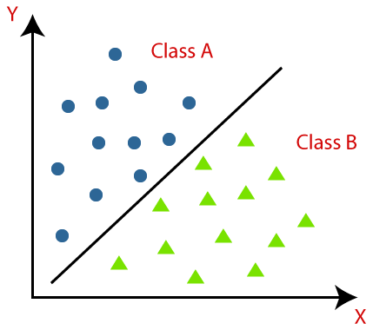
About the Dataset
64 Independent Variables
1 Dependent Variable
1 Training Dataset
1 Test Dataset
Output: EventProbability
The estimated probability that an observation or data point belongs to the positive class.

Slide 3

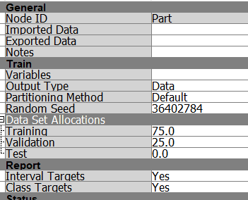


Initial Approach: Neural Network
Data Partition
Results

Slide 4
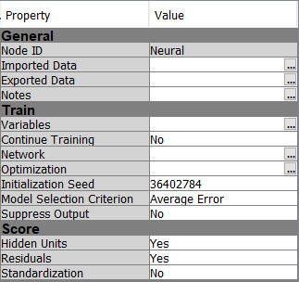
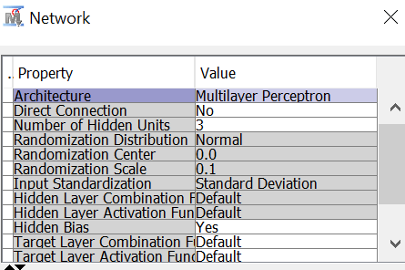
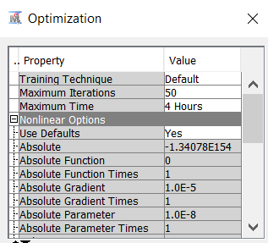
Initial Approach: Neural Network

Slide 5
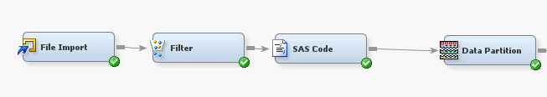
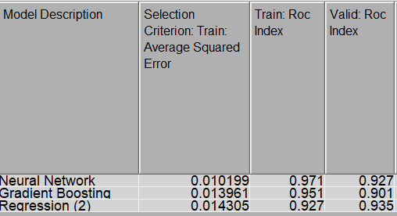
Learnings along the way: Preprocessing
Results
Filtering out data that’s 3 standard deviations away from the mean for all variables did well with Train data
However, the model failed to get a reasonable AUC for the public test data

Slide 6
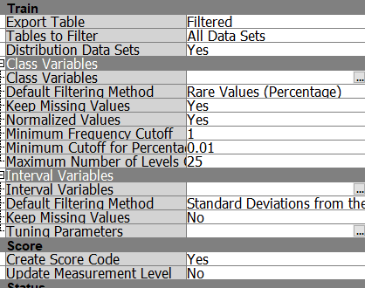
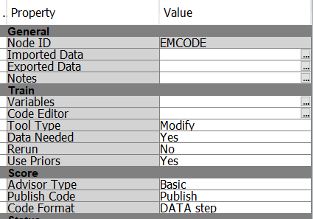
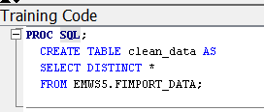
Learnings along the way: Preprocessing

Slide 7
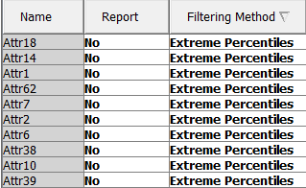
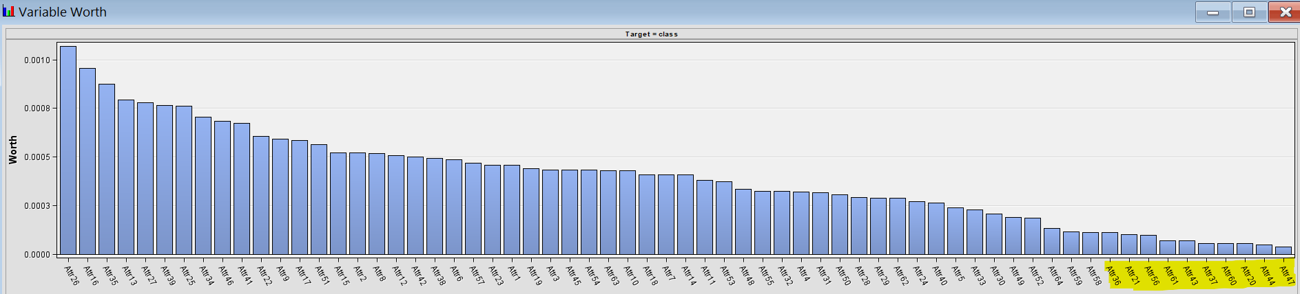
Learnings along the way: Preprocessing
Method 1
Filtered variables due to high kurtosis and skewness
Method 2 Lowest worth

Slide 8
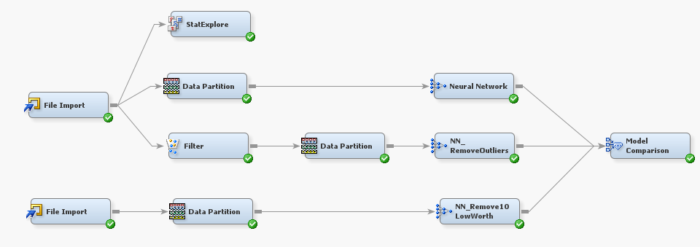
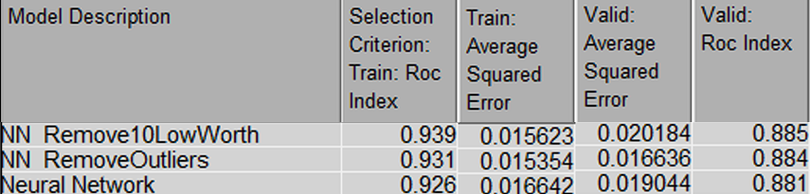
Learnings along the way: Preprocessing
Changes in Data Partition
Filtering extreme percentile for 10 variables
Rejecting 10 variables with lowest worth
No significant effect on valid ROC
Submissions based on better train ROC did not do any better with public test data
Results

Slide 9

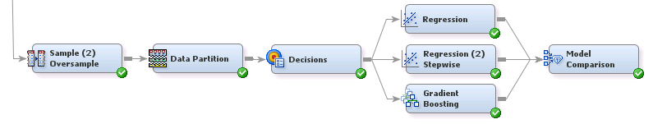
Learnings along the way: Oversampling

Slide 10
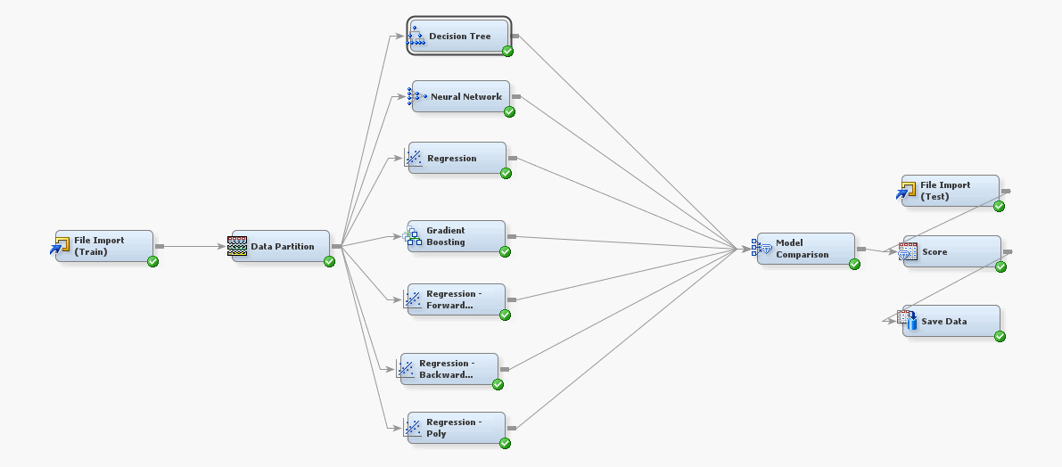
Our second-best model
Data split – 60:40

Slide 11
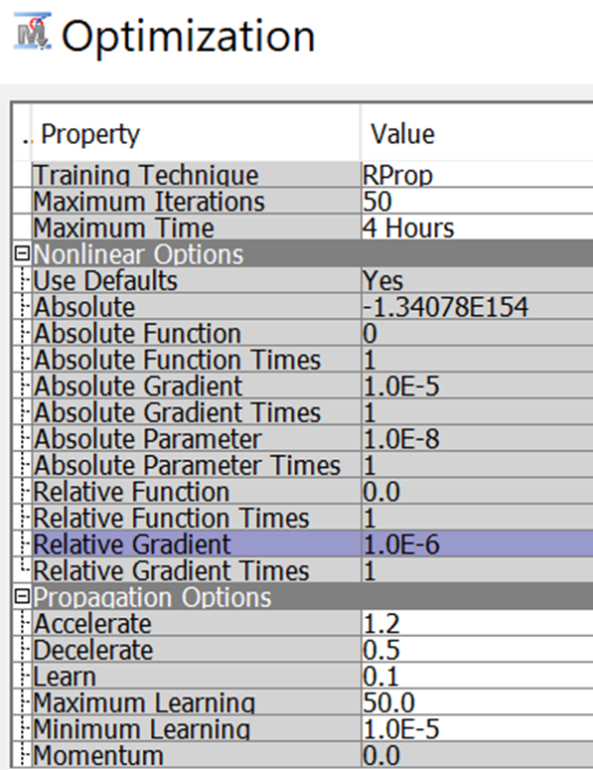
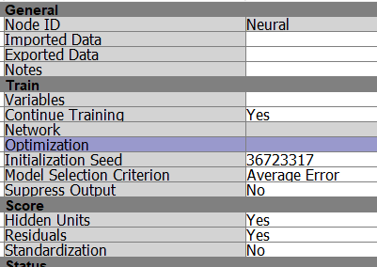
Our second-best model
Neural Network

Slide 12
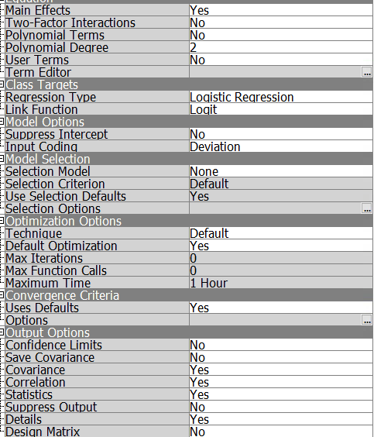
Our second-best model
Logistic Regression

Slide 13
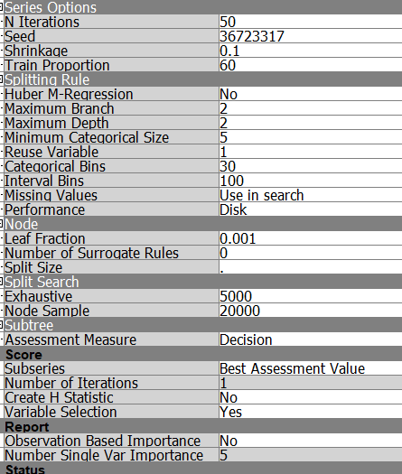
Our second-best model
Gradient Boosting

Slide 14
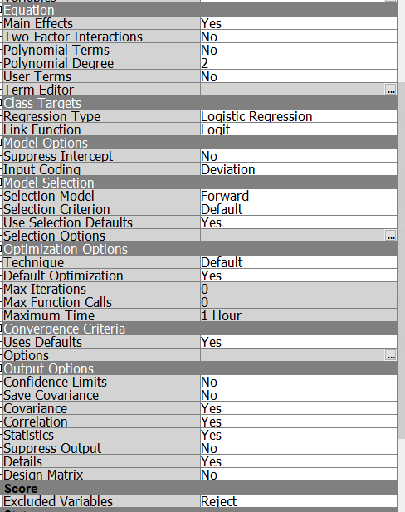
Our second-best model
Forward Regression

Slide 15
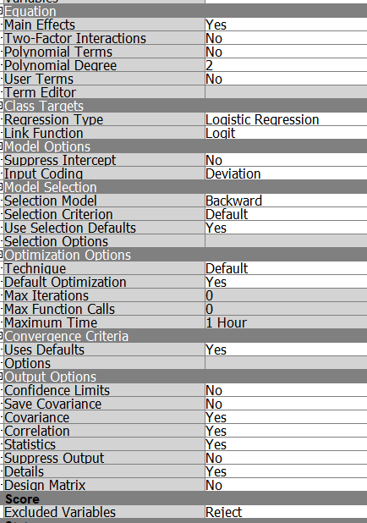
Our second-best model
Backward Regression

Slide 16
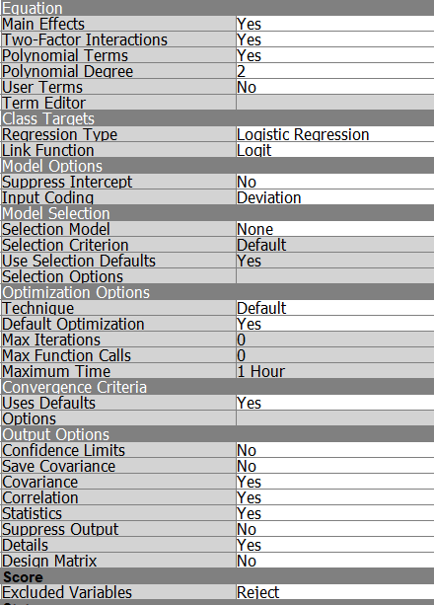
Our second-best model
Polynomial Regression

Slide 17
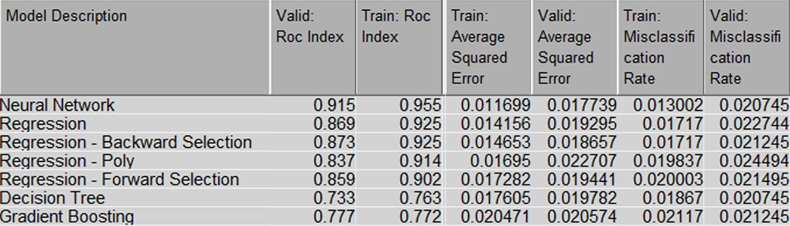
Our second-best model- Results

Slide 18
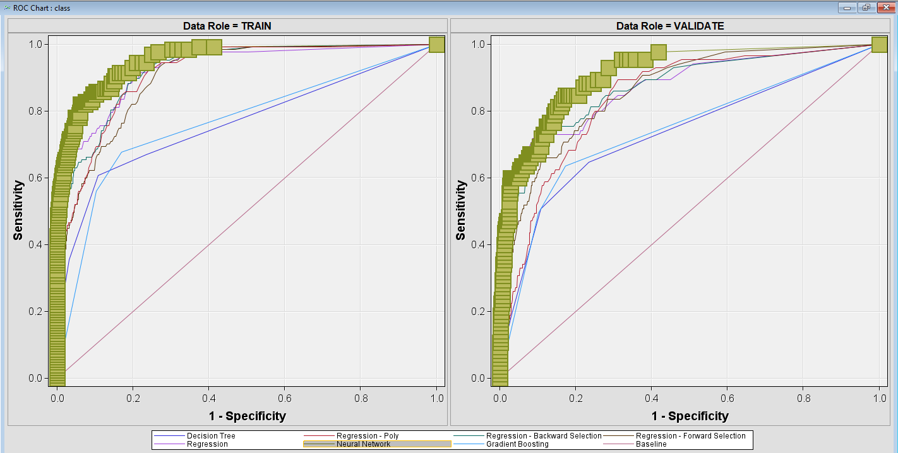
Our second-best model- Results

Slide 19
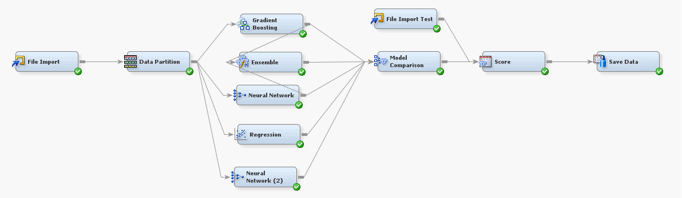
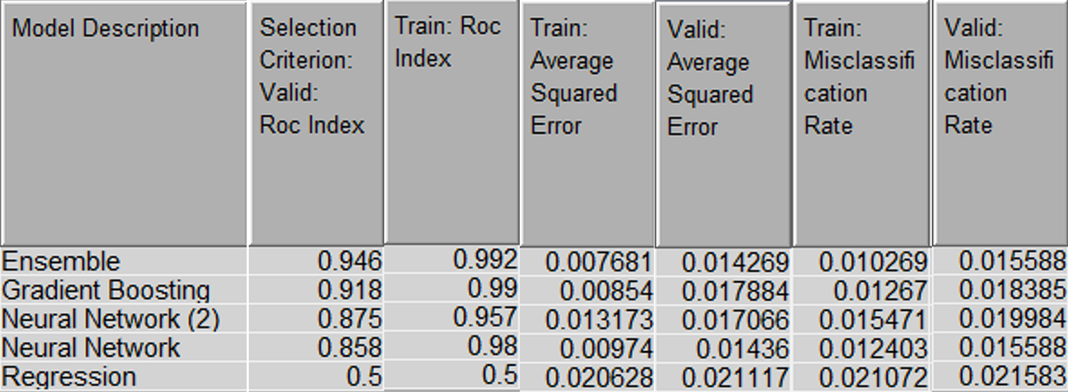
Our best model
Model Comparison
Results

Slide 20
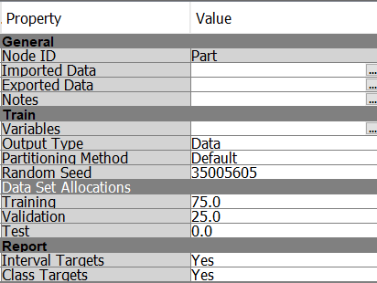
Our best model
Data Partition
Gradient Boosting
Neural Network
Ensemble

Slide 21
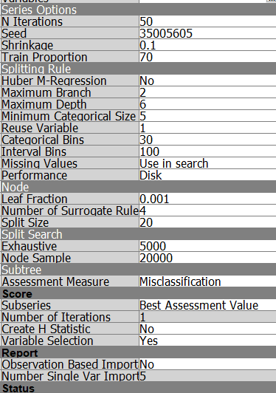
Our best model
Data Partition
Gradient Boosting
Neural Network
Ensemble

Slide 22
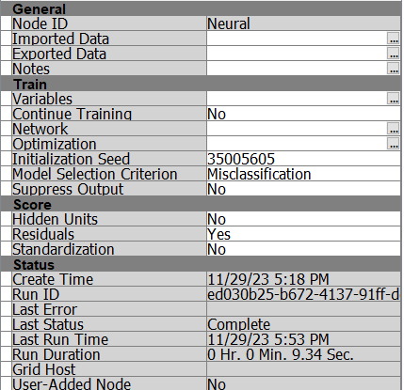
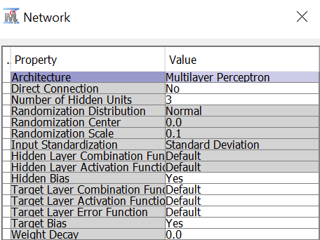
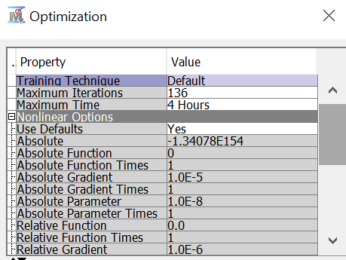
Our best model
Data Partition
Gradient Boosting
Neural Network
Ensemble

Slide 23
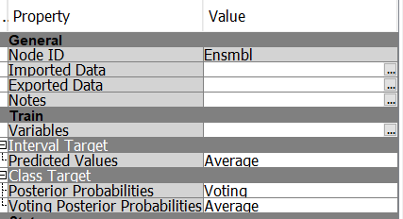
Our best model
Data Partition
Gradient Boosting
Neural Network
Ensemble

Slide 24
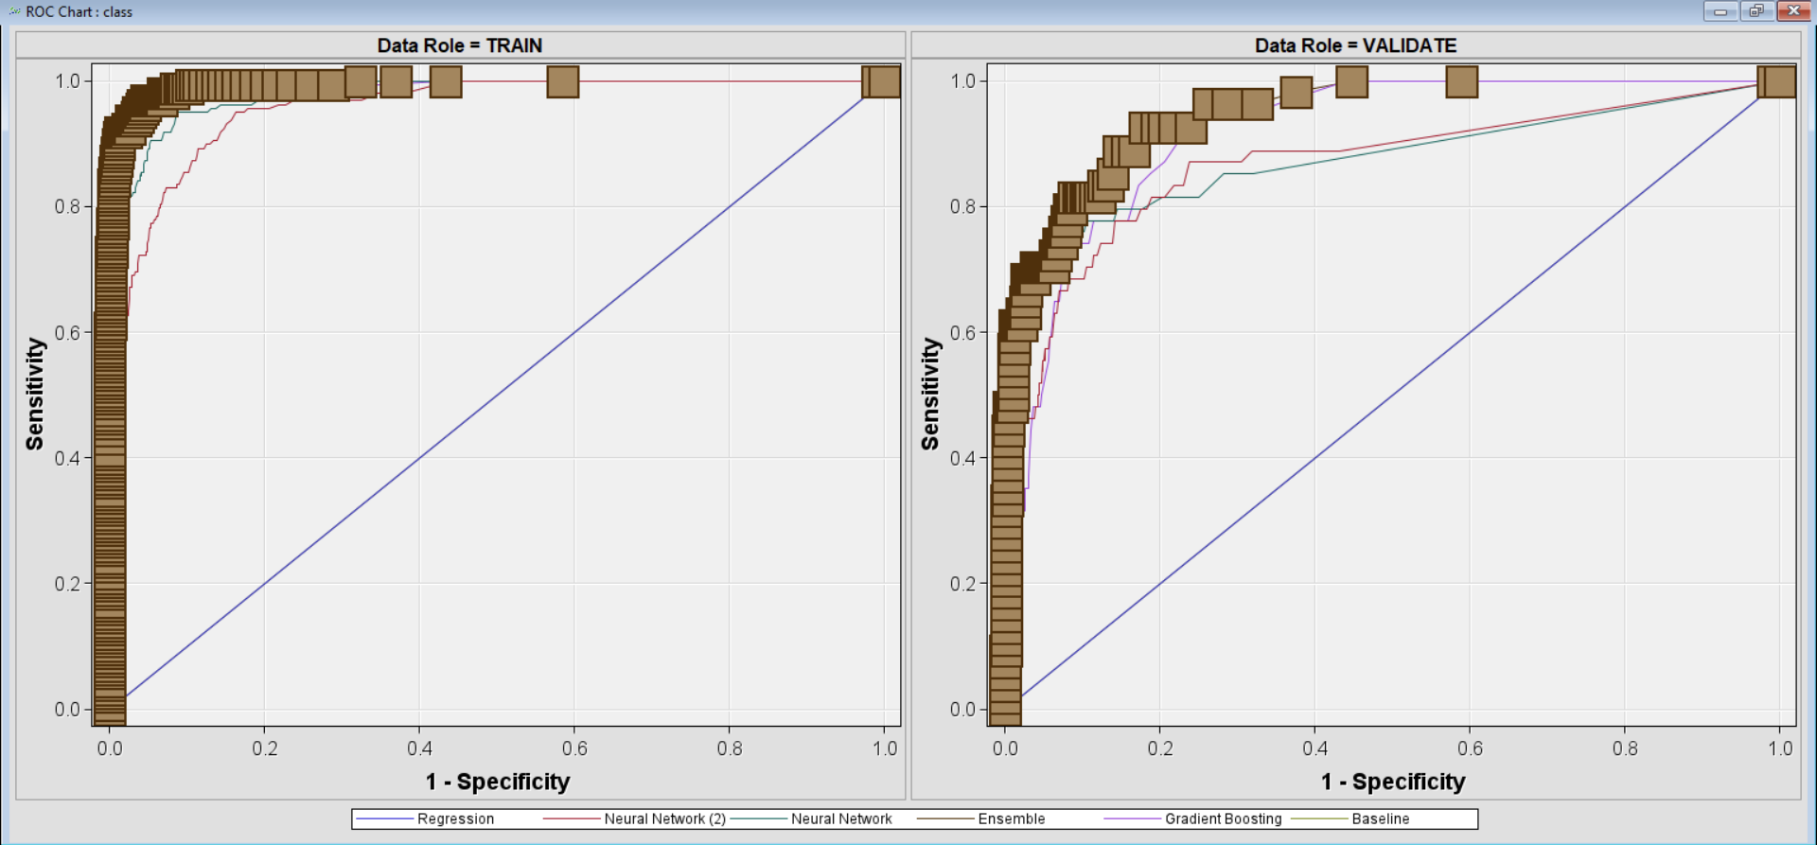
Our best model

Slide 25
Takeaways
Right combination of properties, algorithms is key
Various metrics need to be evaluated before assuming the goodness of the model
Finding the balance between a model that's too simple (underfitting) and one that's too complex (overfitting) is critical

Slide 26
THANK YOU

