Slide 1
GREEN-A-THON
TEAM NAME: CONNECT TECH
TEAM MEMBERS: KOPAL AGRAWAL
ARCHITAA PANDEY
KAVYA SINGH
BANSTHALI UNIVERSITY

Slide 2
Android Application Development
Our project is the development of an android application.
This application is built on Android Studio with the help of coding tools such as java , xml and sqlLite.
Xml is for the development of the front end of the application,java is used for coding the backend of the application and sqlLite is used for managing the database.

Slide 3
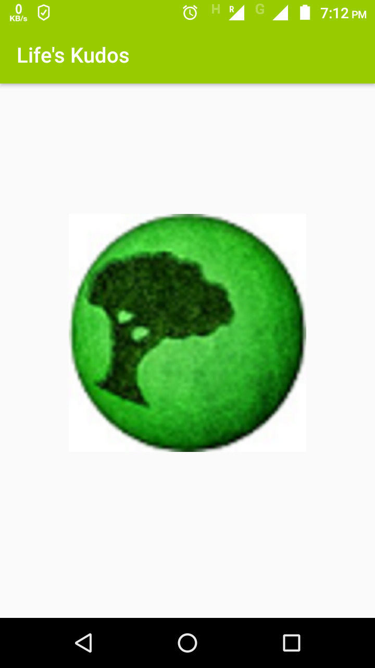
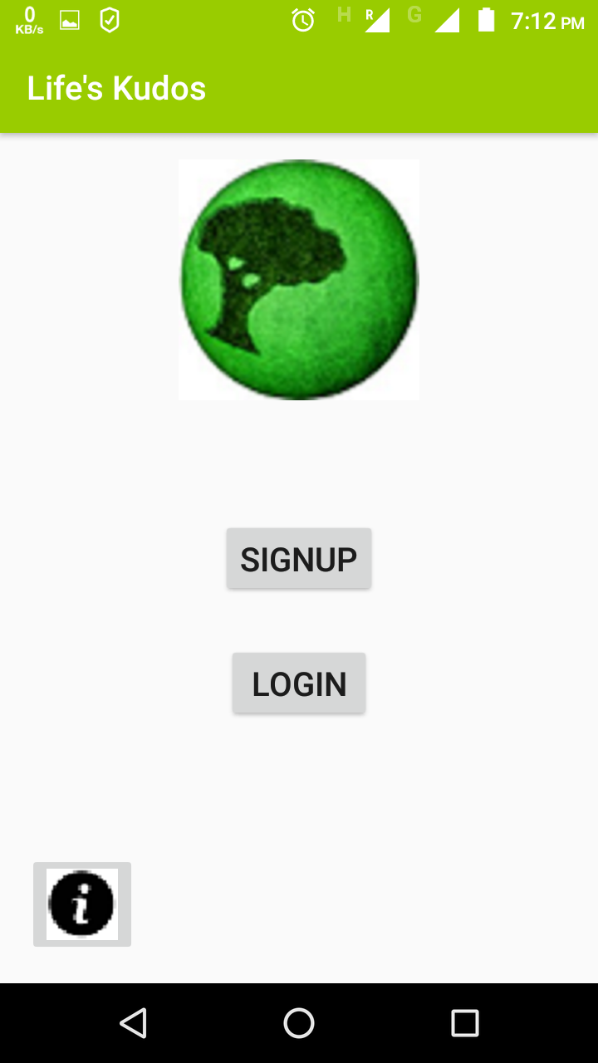
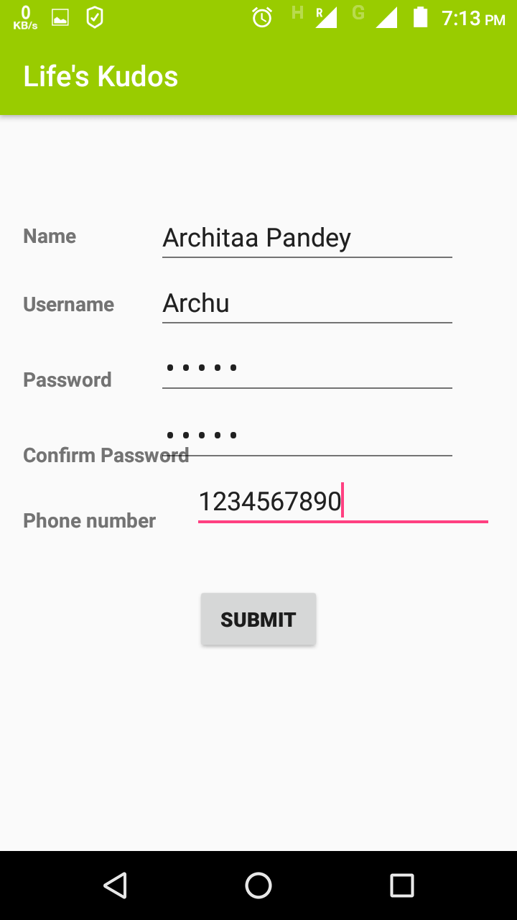
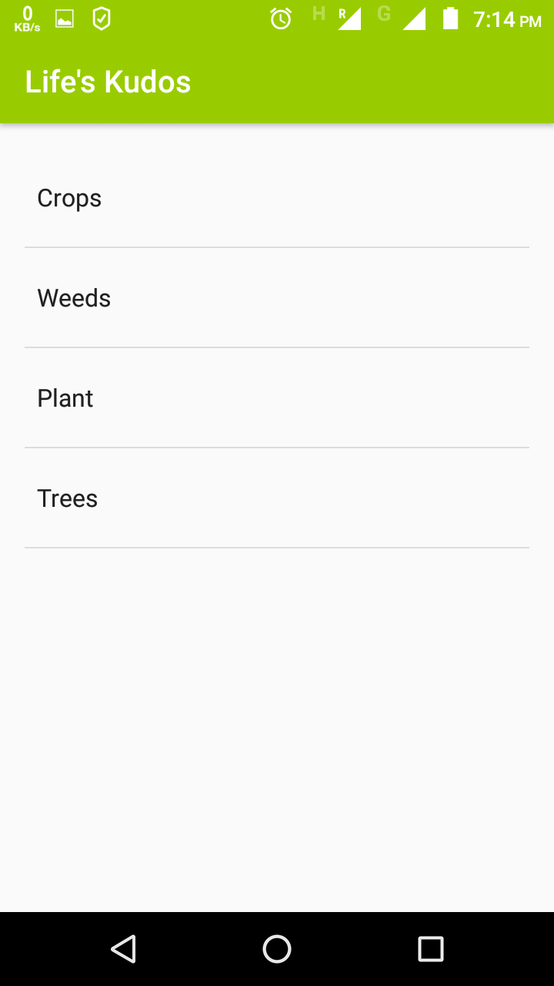
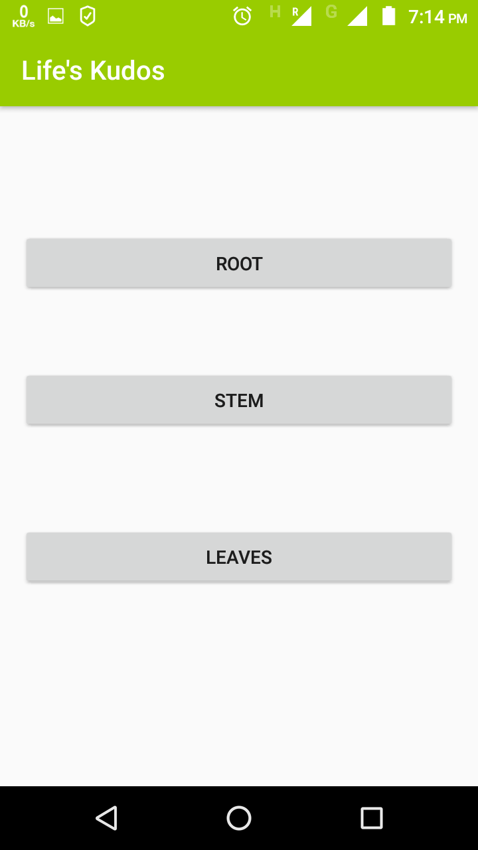
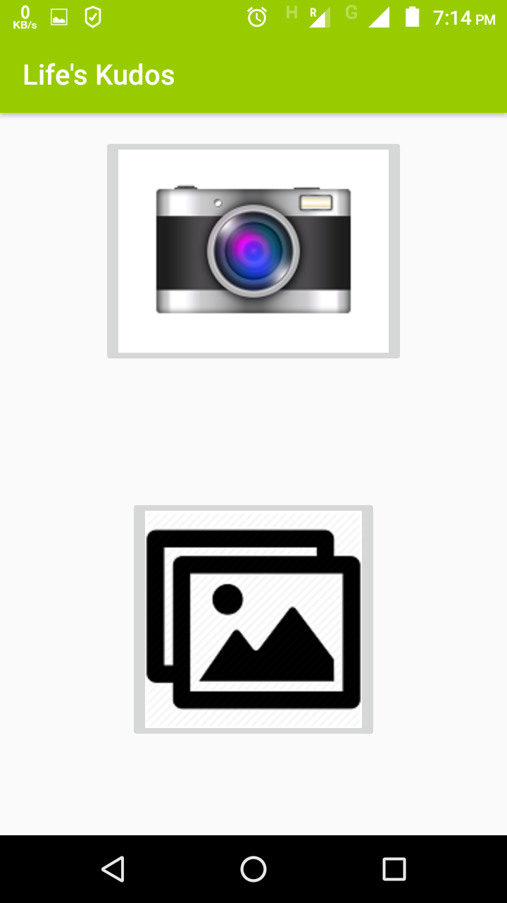
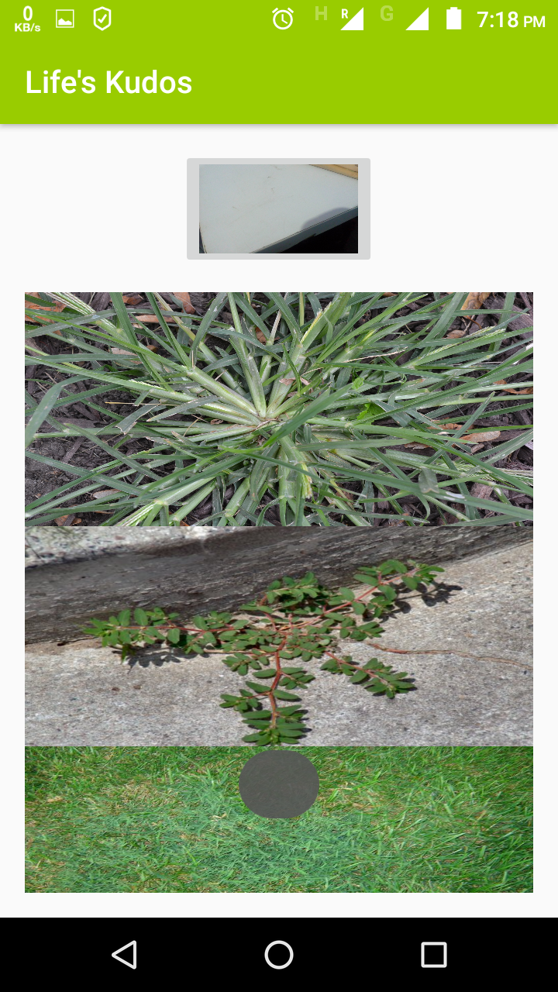
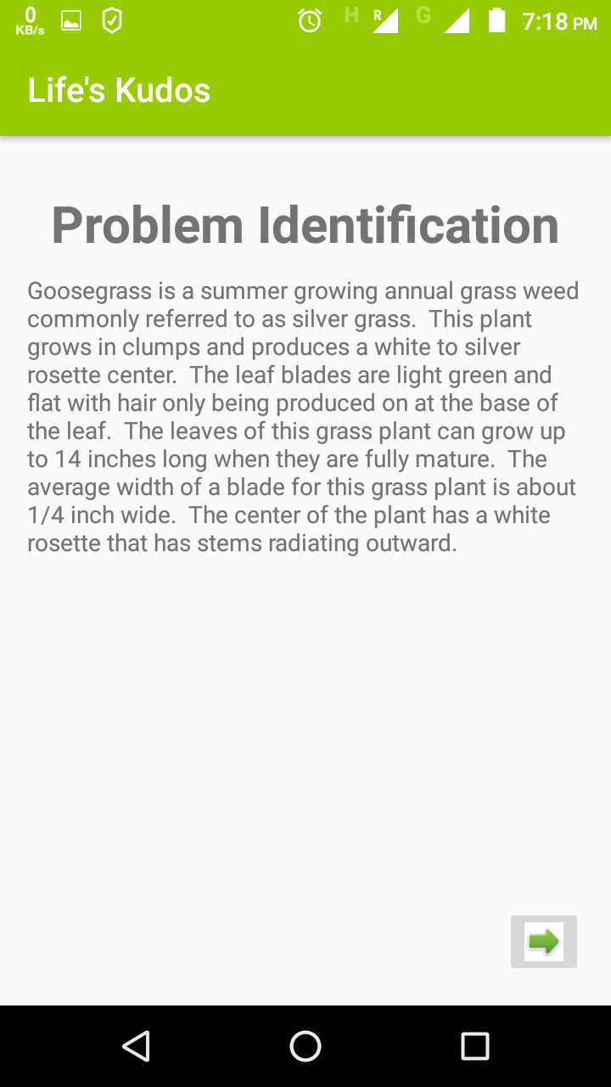
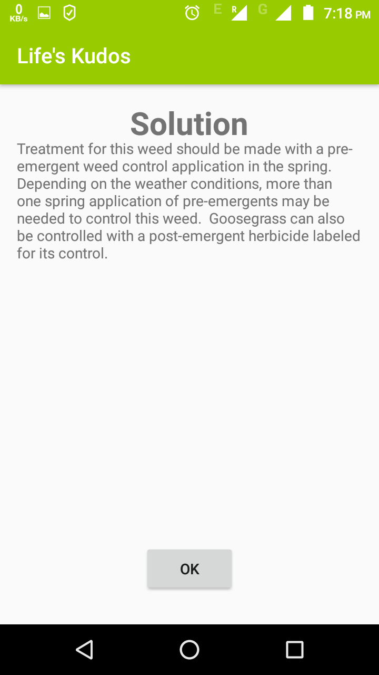
PROTOTYPE- Our app- Life’s Kudos
Some of the interfaces of our application are shown above.
The concept of this presentation is having a user interface where user creates their account and categorize their problem according to our given categories.
According to their category their image is matched with our database and solution along with the problem is given to them to implement it easily.

Slide 4
PROBLEM
In rural areas, we come across the problem of farmers committing suicide due to the damage done to their crop by diseases, pest, nutrient deficiency, etc.
The major reason of damage or the problem originate due to the absence of knowledge in the farmers regarding different agricultural problems their harvest face.
We have studied the different types of diseases or damage in the agricultural land of farmers that’s impossible to remember each one of them.
There is always a news regarding farmer committing suicide due to unknown damage to their crops or fields.
Even now if we will visit a village, we will find 90% of fields being affected by one or the other disease which the farmers are not aware about.

Slide 5
Affected Community
As the disease is spread over the whole field which lead to the destruction of the harvest. Thus, farmers(25% of the population) and their family are most affected by this problem . All their investments and labour are wasted.
As the harvest is damaged due to the problem, it leads to affecting even the mediators who are waiting for the harvest and will also affect the whole market and prices of the products will rise . This adversely affects the common man.
More than 50% of the population depends upon agriculture directly.

Slide 6
Initiation of our idea
We recently visited museums of Forest Research Institute , Dehradun; where we got to know how the trees get affected over forests that affects livelihood of farmers.
We started analysing from there and reached to the conclusion that most of the farmers are uneducated and they are not provided with the proper information regarding cure and control of diseases affecting plants , trees and crops. This unawareness leads to ignorance of performance at cultivation land .Thus decrementing the overall expected growth or damaging the cultivation in mass.
Giving access to the farmers in a handy way , about the information regarding problems and their cures can greatly help in rectifying the issues. Thus leading to the development of farmers and the entire nation where “JAI JAWAAN JAI KISAAN” means a lot.

Slide 7
Idea derivation
As already discussed this idea had came to our minds after visiting FRI.
Since no one has developed any such application for the disease management of the agricultural area,it would be an opportunity for us to develop this application.
As we already know that no such technology exists till date to retrieve the solution of a plant disease other than google which comes out to be a great headache for the farmers to use, again giving us an advantage over other applications.
Thus, turning out our idea to be original and user friendly.

Slide 8
State of art or conventional ?
Our idea focuses on general development and is brought into action by an android application that is user friendly and can be easily accessed by the farmers and help them to a great extent. It is a state of art.
Farmers can put their image of affected area of plants, trees, weeds, crops via camera or gallery and our application provides them with facility of comparing their images with the images present in our databases ,this will lead them to the problem and possible ways to cure it.
Our application can be extended by Image Processing where the application can directly link the farmer’s pictures with the problems and their efficient solution

Slide 9
Discussion of idea
The main aspect of idea revolves around helping the farmers to secure their agricultural product.
Giving the farmers a handy tool to work and providing them the appropriate knowledge for their problem and respective solutions.
Since farmers are not much literate and occupy approximately 25% of the population, it is necessary for them to have accurate knowledge regarding their harvest.
Our idea is to help not only farmers but also the food market by preventing the food shortage circumstances in the near future.

Slide 10
As we know there is a whole chain connected rigorously ; farmers with mediators, mediators with market and market with common people.
Affects on one will be reflected on others.
Our idea aims at preventing the farmers to beg around for help to their sahabs.Thus enhancing their self esteem and morale.
The idea is to make them self dependent and capable enough to solve their daily routine agricultural problem.

Slide 11
PROJECT DETAILS
Our idea is based on the concept of finding solution to the given agricultural problem related to diseases,pest damage,nutrients deficiency of the farmers.
Our idea follows the method of comparing the images of crops,plants,trees,etc provided by the farmer either through camera or gallery, then comparing that image with the existing images of the database.
The comparison can be done by the farmer itself as both the given image and the one provided by the database are arranged in a parallel manner.

Slide 12
when extending this application into a real one this comparison can be made through image processing ,directly by the application.
As 51% of the population is involved in agriculture ,thus giving us a large scale of audience.
Building an application and connecting it with the database is much feasibile when compared with this mass audience.
Implementation of this application would be much easier , as the device which solves most of your life problem will be easily compelling and more accepted by you than a normal application.
Developing this application requires a handful of good programmers ,thus reducing the production cost and will not eve require much marketing.
The timeline required for this application is basically a maximum of two to three months to build this application and one week for the farmers to learn the implementation.

Slide 13
The challenge for the application can be to make the smartphones available to each and every farmer so that they can use this app.
It may be possible that landlords, due to somehow a lost in their position due to this application, will discourage farmers to use the application by threatning them.
Challenge of making the knowledge available to the farmers about the application.
Our revenue model is same as that of an application model. The number of downloads will increase the revenue of our application.
As most of the applications available nowadays are more complex, solving the whole environment, physical and any other conditions available, thus confusing the farmers whereas our application is much easier to understand and use.
Our idea is making efforts in improving not only the agricultural area of the farmers but also their economic conditions. The economic condition of the local people is also improved because of the regular availability of the food in the market . Thus having both social and economic impact on the system.

Slide 14
S.W.O.T Analysis of the project
The strengths of our project is our vast audience and the reliable and handy application system for the farmers.
Presently there is no such technique which with such ease provide the farmers with the solution and problem of their crop,plant,weeds,trees.
Since it is an android application which will work on only smartphones, thus having a prerequisite of its use.
As there is no such application available and the problem is general and widely faced , thus giving us a great opportunity to showcase our application and make it utilisable.
Having a vast data it is quite necessary to manage it efficiently and provides the correct information after image comparison.

Slide 15
Probable Outcomes
It has been estimated that after the use of our application , the amount of loss of agricultural food will be reduced in a huge amount.
It is also believed that the solution provided by our application will remove not only the problem of the agriculture but will also help to improve the yield of that particular crop,plant,trees,etc.
Increase in the yield will automatically improve the economic condition of the farmers.
It will also help in improving their social reputation.

Slide 16
Future Aspects
The application is currently asking the farmers to select the appropriate image from the images provided by our application by showing the farmers the image provided by them in parallel with the image of the database and then thus providing the appropriate solution to that problem
But this technique can be improved by introducing imge processing in the application which will compare both the images automatically and will provide the appropriate result.
This time the application supports only one language but can be easily converted to support all the languages thus converting it into a multilingual device making it much more easier.
The application can be linked to the google when developed for real thus providing the details automatically by searching through the category.

Slide 17
THANK YOU

