Slide 1

Drug-OverDose-Prediction
DubsTech Datathon
Archita Vasuki, Neha Rachapali

Slide 2
GOALS
Application to develop a predictive model to forecast future drug overdose death rates for each demographic group.
User Experience
Personalized Predictions User uploads CSV files containing keyword performance data (future enhancement - Data Input: User inputs CSV file and gets predicted output based on this)
Analysis: The tool is trained on the historical dataset provided to run and regression and predict the risk of drug overdose

Slide 3
ASSUMPTIONS
Deaths per 100,000 resident population, age-adjusted and Deaths per 100,000 resident population, crude as "Deaths per 100,000 resident population" is the same metric and combined since there was negligible difference between the estimation of death rates.
In the STUB_LABEL attribute, we have assumed that if the record does not contain “not Hispanic or latino”, that the person is Hispanic or latino
In the records with Female: Not Hispanic or Latino: Black, we have used as native black person
If records do not have gender specified, assumed as unknown

Slide 4
Modelling process
Data Cleaning
Pre-processing
Modelling
Prediction
Model Deployment

Slide 5
Data cleaning
Remove rows with null values
Drop indicator and flag columns

Slide 6
Data pre-processing
Create the Gender column
Creating are you hispanic latino column
Creating individual race and gender columns
Replace values in the 'Panel’, ’Unit’ column with one-word representations
Perform one-hot encoding on 'STUB_LABEL' column
Convert all boolean columns to integer columns with 1 and 0
Change column names to lowercase and replace spaces with underscores

Slide 7
Data modelling
Performed Exploratory Data Analysis to understand descriptive statistics
Built a model with multiple predictors and target variable estimate.
Divide the data into training and testing sets to evaluate model performance.
Create and train the Random Forest model
Create and train the Gradient Boosting Regressor
Make predictions on the test set
Evaluate the model
Create and fit the logistic regression model

Slide 8
Model evaluation
Metric | Random Forest Regressor | Gradient Boosting Regressor | Linear Regression
Root Mean Squared Error | 1.33 | 12.98 | 14.03
R-Squared | 0.96 | 0.96 | 0.96

Slide 9
clustering
Features selected for clustering:
'hispanic_latino_flag', 'hispanic_latino_race',
'white', 'native_black', 'black_american', 'american_indian',
'asian_pacific_islander', 'asian', 'native_hawaiian',
'panel_any_opioid', 'panel_heroin', 'panel_methadone',
'panel_natural_opioids', 'panel_other_synthetic', 'unit_age_adjusted',
'unit_crude', 'age_15-24_years', 'age_25-34_years', 'age_35-44_years',
'age_45-54_years', 'age_55-64_years', 'age_65-74_years',
'age_75-84_years', 'age_85_years_and_over', 'age_under_15_years',
'gender_female', 'gender_male'

Slide 10
clustering
Handle categorical variables using one-hot encoding
Standardize the features
Convert the scaled data back to a DataFrame
Set the number of clusters using elbow method to determine the optimal number
Apply K-Means clustering
Group data by clusters and calculate summary statistics

Slide 11
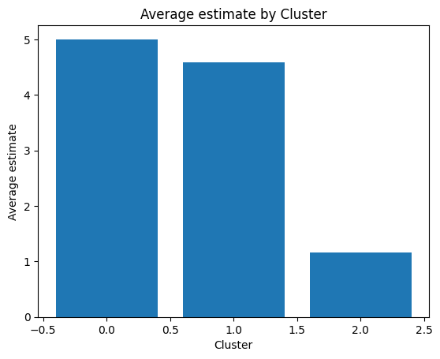
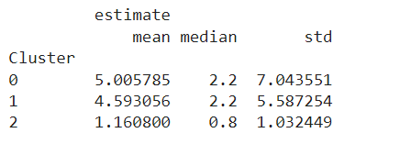
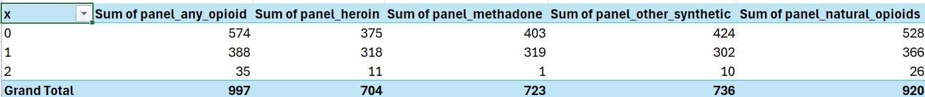
OPTIMAL CLUSTERS

Slide 12
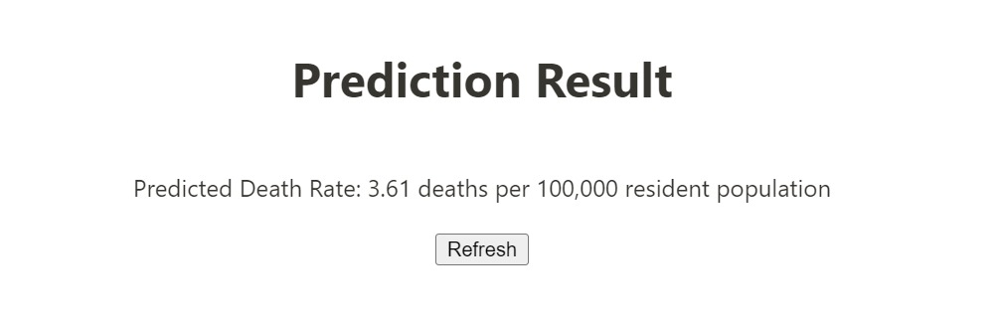
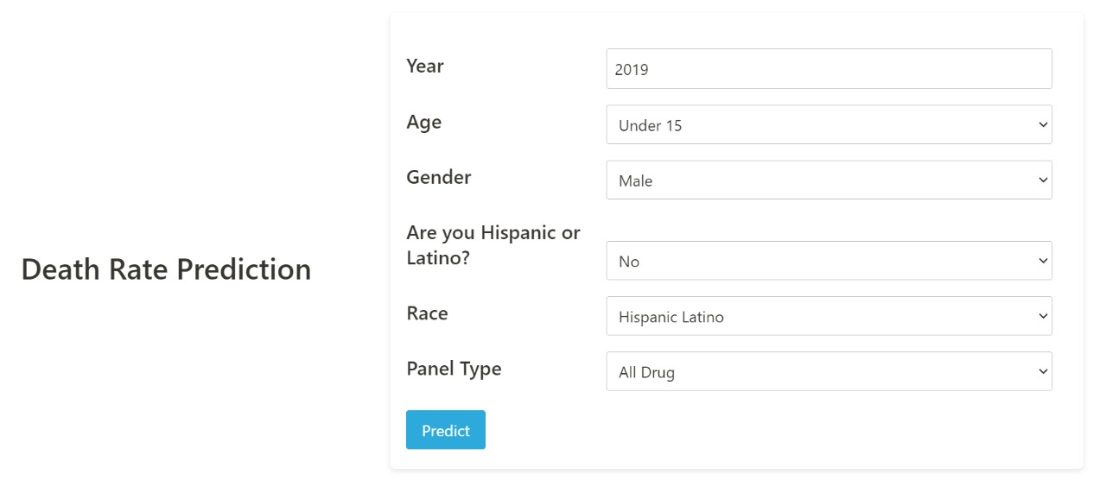
Final model
Use Case 1
Model Prediction
Predicted for the year 2019, Under 15 age, Male Gender, Hispanic/Latino and all drugs death rate

Slide 14
Thank you

