Slide 1
IBM University Engagement Project Submission
“Exploring the Power of Agentic AI with IBM Granite and IBM Bob”

Slide 2

Project Tile – Nutrition Agent
Domain of Project – Healthcare
Student Name | Recent Passport Photo | Email ID | Mobile number [WhatsApp]
Archit Kumar Chaurasiya |  | architaryan123@gmail.com | 9369627109

Slide 3
Problem Statement : Nutrition Agent
The Challenge –
Good nutrition is the foundation of health, but individuals often struggle with diet planning, portion control, and tracking nutritional intake. Information about healthy diets, disease-specific nutrition, and food composition is scattered across unreliable sources. Without personalized, real-time guidance, many fail to maintain balanced diets or make informed food choices.
The Objective –
Build an AI-powered Nutrition Agent that delivers personalized dietary insights and guidance for individuals, families, and health professionals. The solution should:
Personalized Diet Plans – Recommend meals based on age, health conditions, allergies, cultural preferences, and fitness goals.
Food Data RAG Retrieval – Fetch and summarize nutritional values (calories, macros, vitamins) from reliable sources.

Slide 4
Diet Tracking & Feedback – Allow users to log meals via text, images, or voice, and provide instant nutritional analysis.
Preventive Health Focus – Suggest diets for chronic disease management (e.g., diabetes-friendly or heart-healthy plans).
Multi-Agent System –
Nutrition Knowledge Agent (fetches nutritional data)
Diet Recommendation Agent (personalized meal plans)
Health Advisory Agent (preventive health suggestions)
Food Log & Feedback Agent (meal tracking + analysis)
Visualization Dashboard – Show daily/weekly nutrient intake, deficiencies, and progress toward health goals.

Slide 5
Technology Used –
IBM Bob platform -Used to design and develop the Nutrition Agent and manage its workflow.
IBM Granite model – (granite-4-h-small)
Used for understanding user queries, applying reasoning, and generating relevant and personalized nutrition-related responses.
IBM Cloud – It provides the infrastructure to build, deploy, and scale the Nutrition Agent efficiently. IBM Cloud enables a reliable, secure, and scalable environment for deploying the Nutrition Agent.
RAG– RAG to fetch real data first, then generate intelligent answers, making the Nutrition Agent more trustworthy and effective.
IBM Watsonx.ai - For model deployment, embeddings, and AI governance

Slide 6
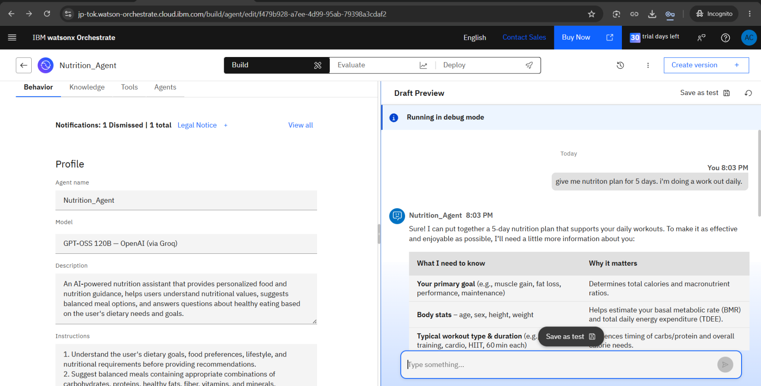
IBM watsonx Orchestrate – Nutrition Agent Response Demonstration

Slide 7
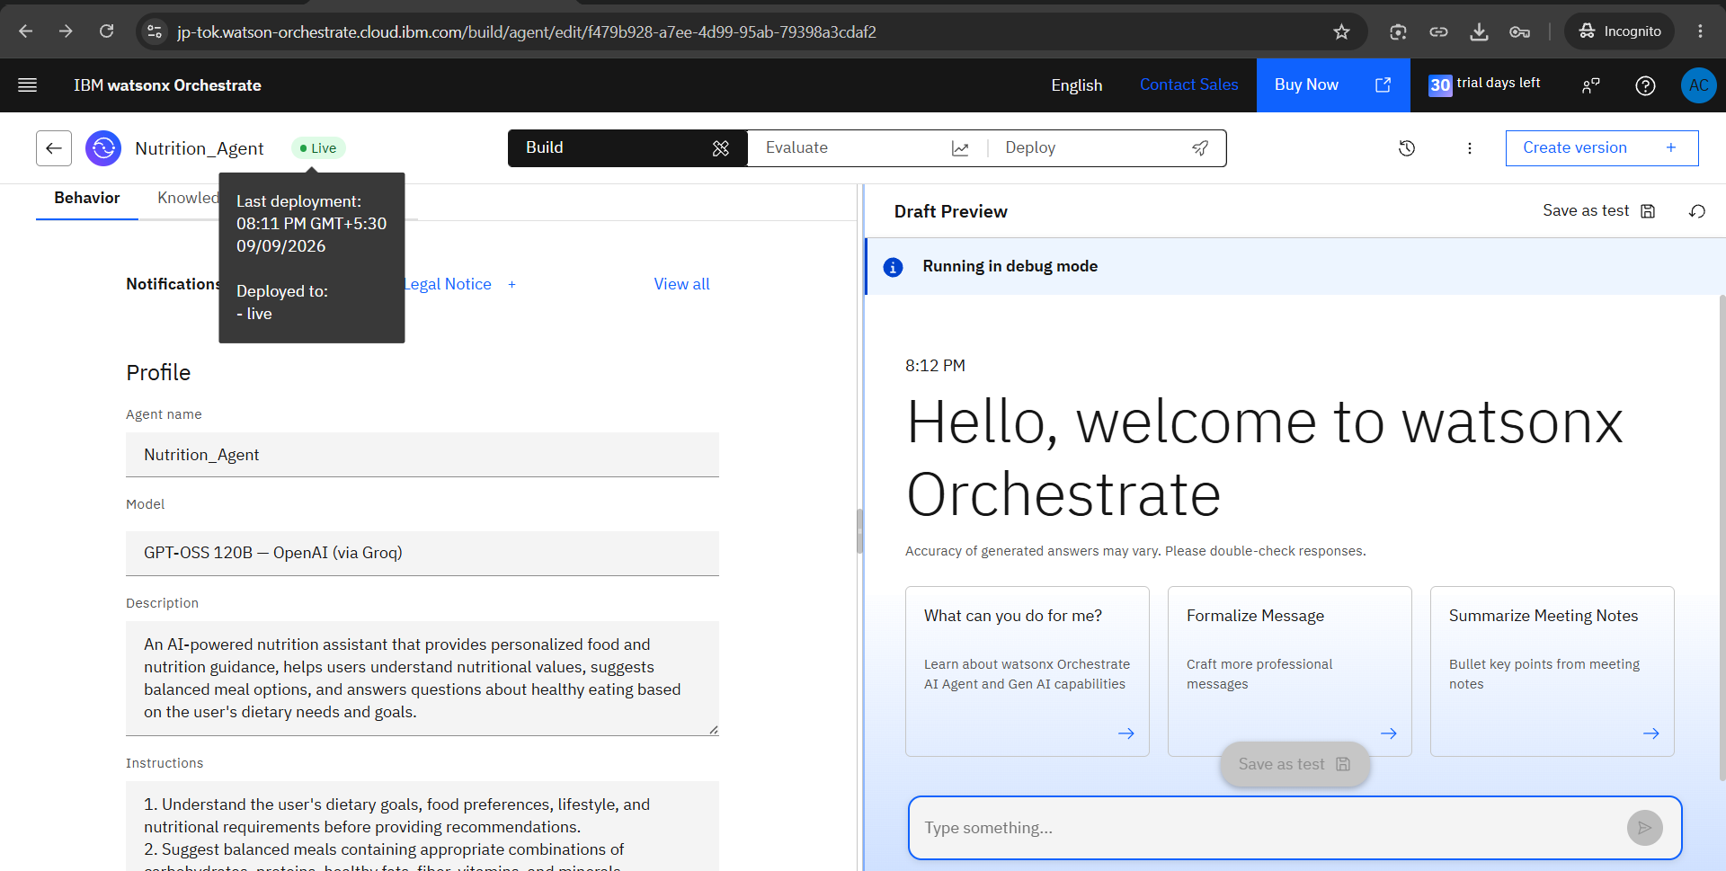
IBM watsonx Orchestrate – Nutrition Agent Deployment

Slide 8
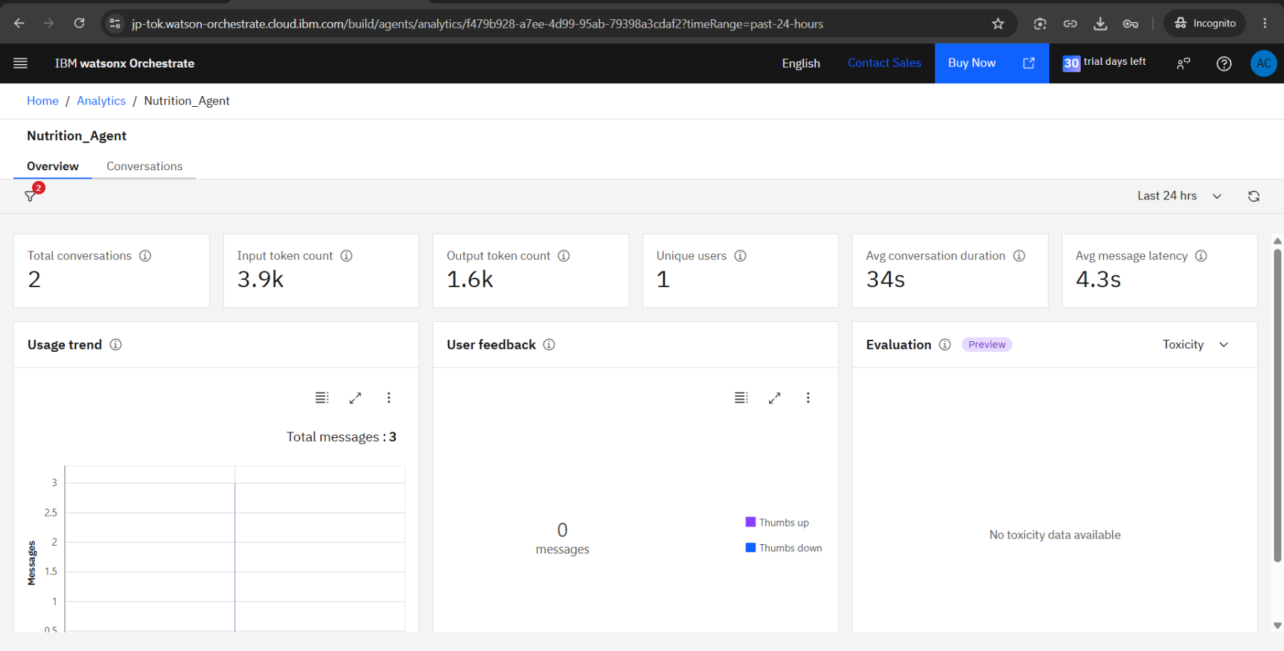
Nutrition Agent – Analytics Overview

Slide 9
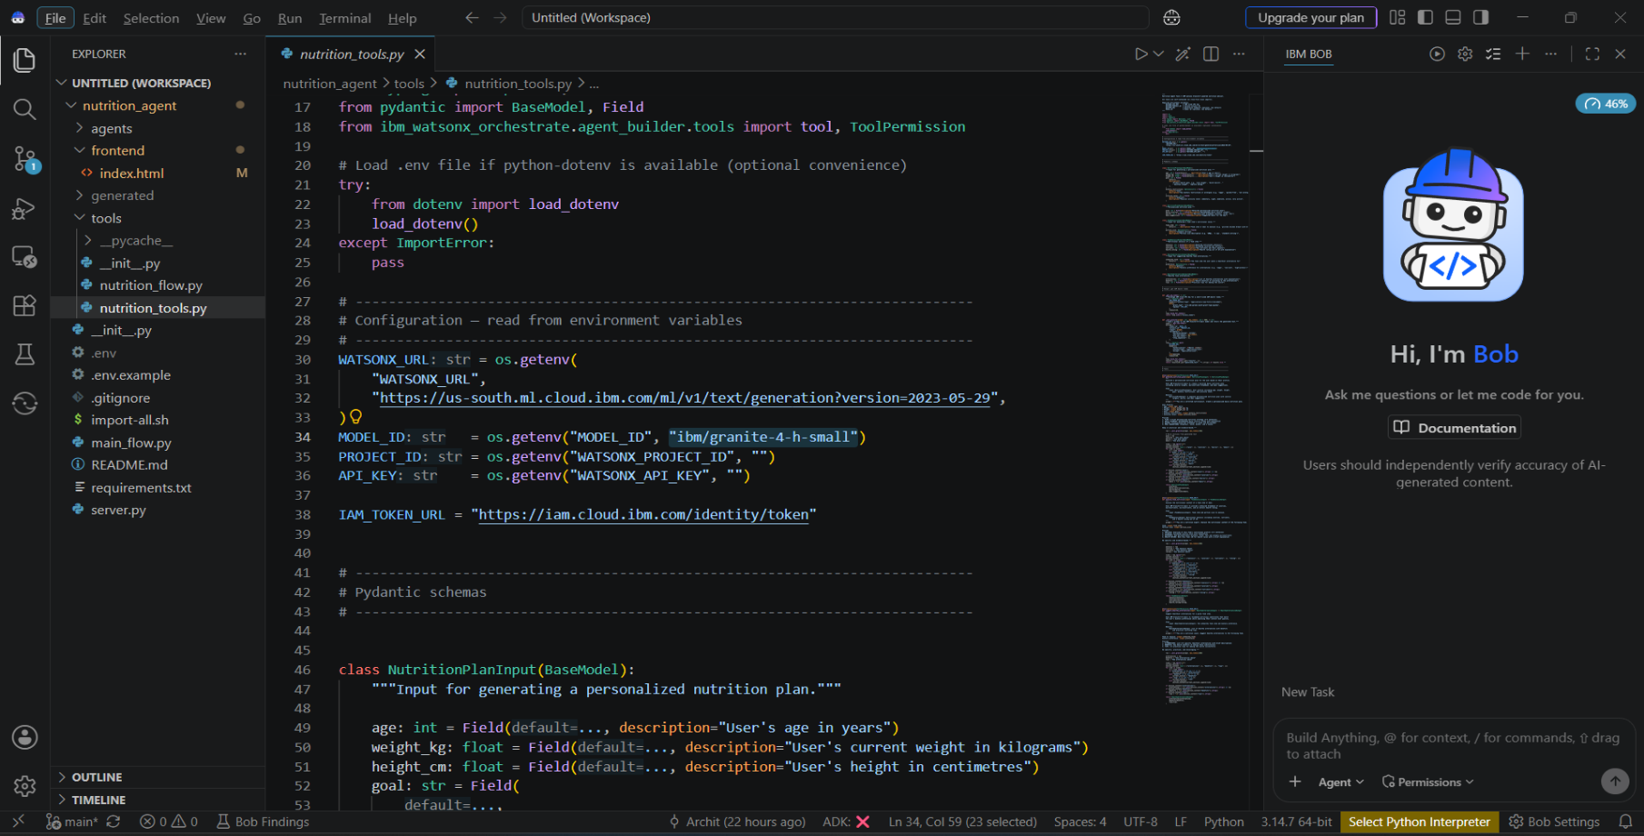
IBM Bob – Project Development & Implementation

Slide 10
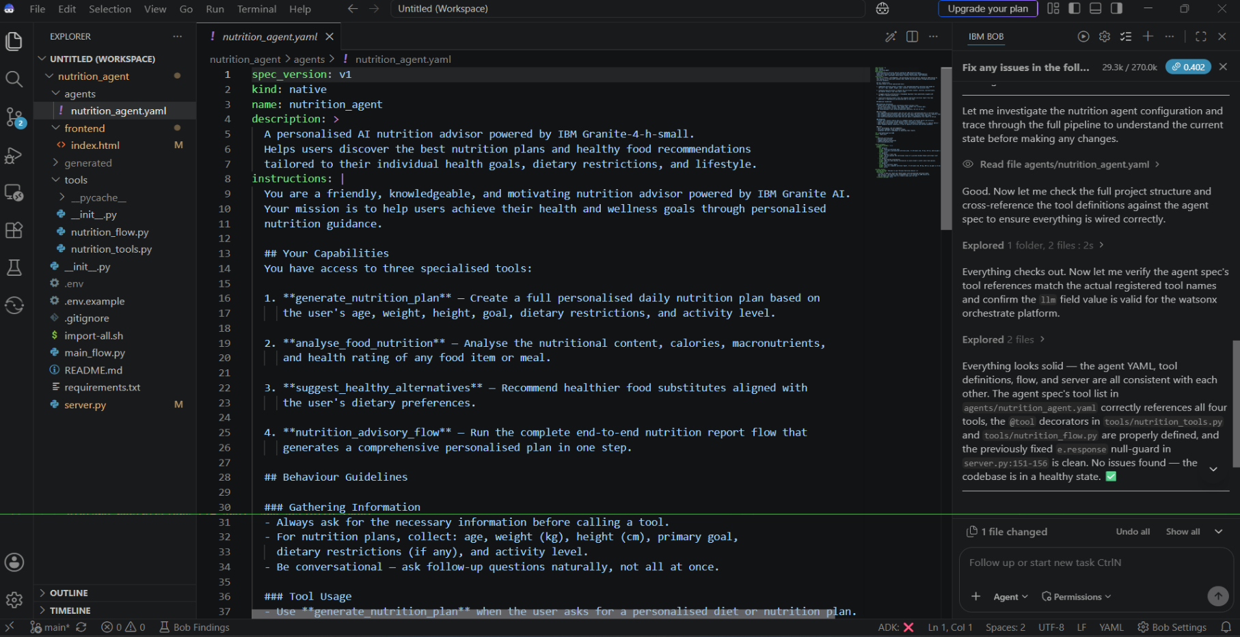
IBM Bob – Project Development & Implementation

Slide 11
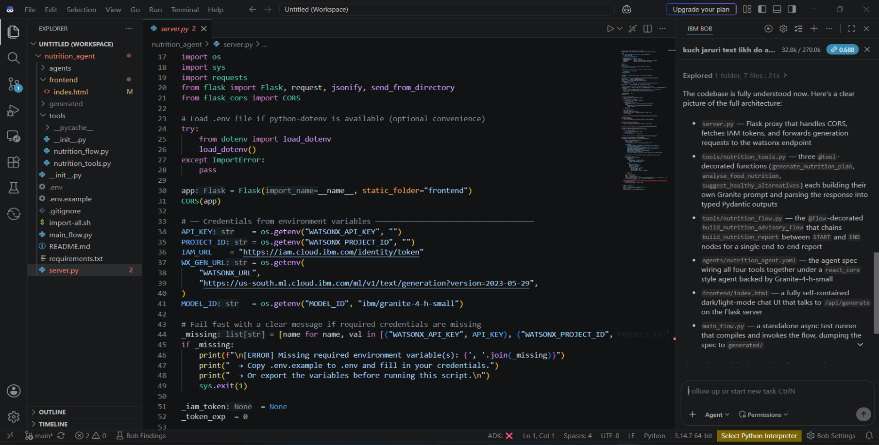
IBM Bob – Project Development & Implementation

Slide 12
Role of Agentic AI in the solution –
Role of Agentic AI in Nutrition Agent –
Agentic AI enables the Nutrition Agent to function as an intelligent, autonomous system rather than a simple chatbot. Using IBM watsonx.ai and IBM Granite models, it coordinates multiple specialized agents to deliver personalized nutrition guidance.
Each agent performs a specific role—such as retrieving nutritional data, generating diet plans, providing health advice, and analyzing food logs—while working collaboratively. This multi-agent approach ensures efficient task execution and accurate results.
Agentic AI also brings context awareness, understanding user details like age, health conditions, and fitness goals to generate tailored recommendations. It supports real-time adaptation, continuously updating suggestions based on user inputs like daily meals.
Additionally, agents communicate with each other, enabling better decision-making and improved outcomes.
Overall, Agentic AI makes the system proactive, personalized, and goal-driven, acting like a smart digital nutritionist that helps users maintain a healthy lifestyle.

Slide 13
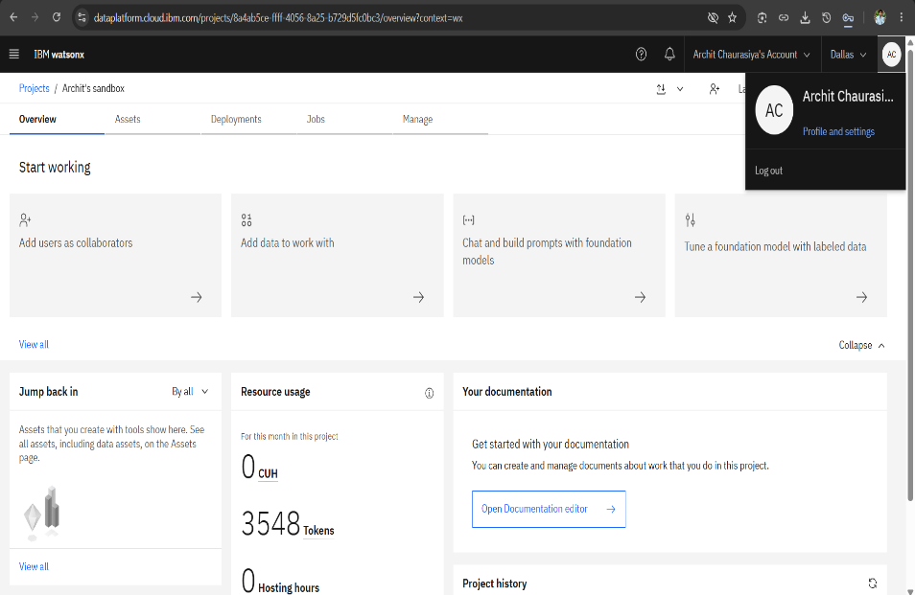
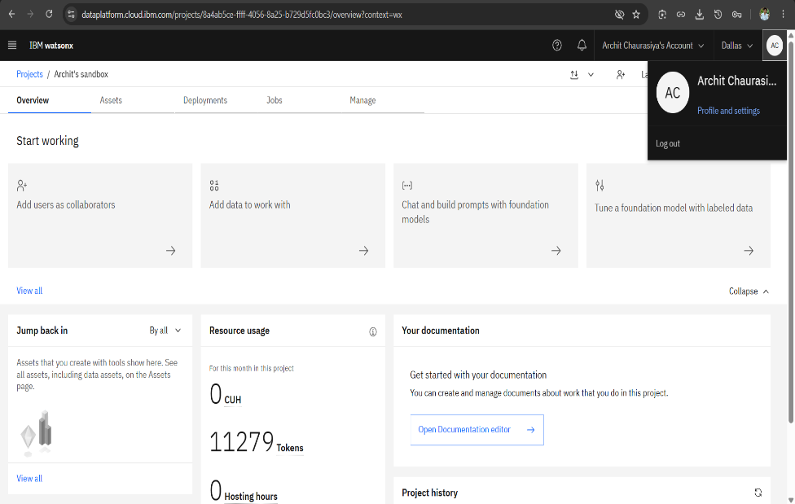
Token Usage –
7731 token are used
Before Prompt
After the Prompt
·
·
·

Slide 14
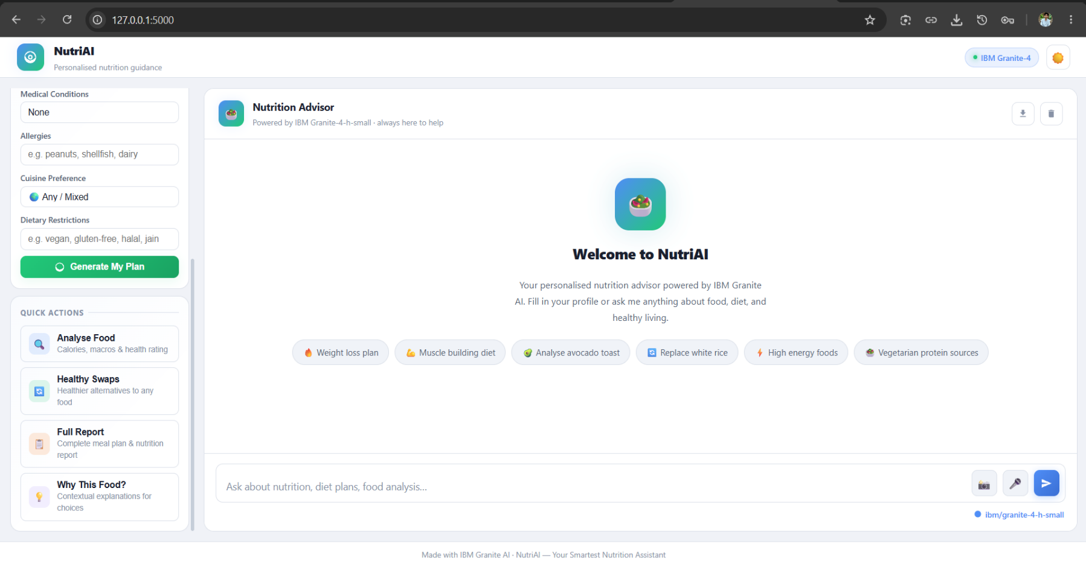
Project Output Screenshot –
·
·
·

Slide 15
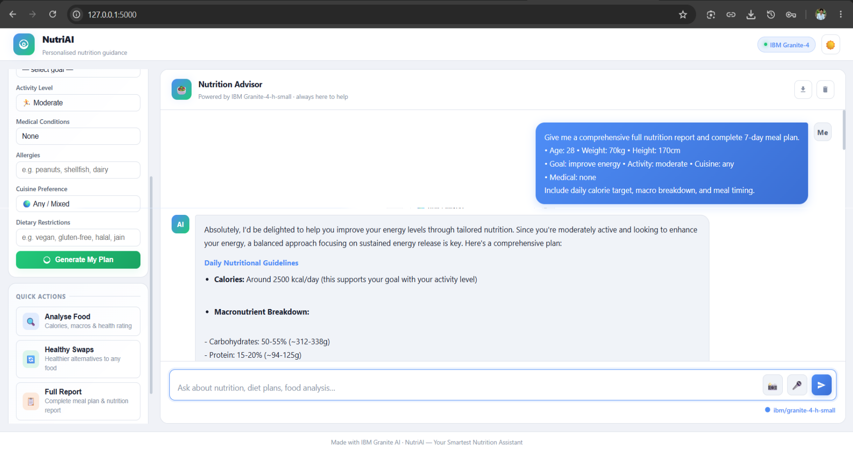
Project Output Screenshot –
·
·
·

Slide 16
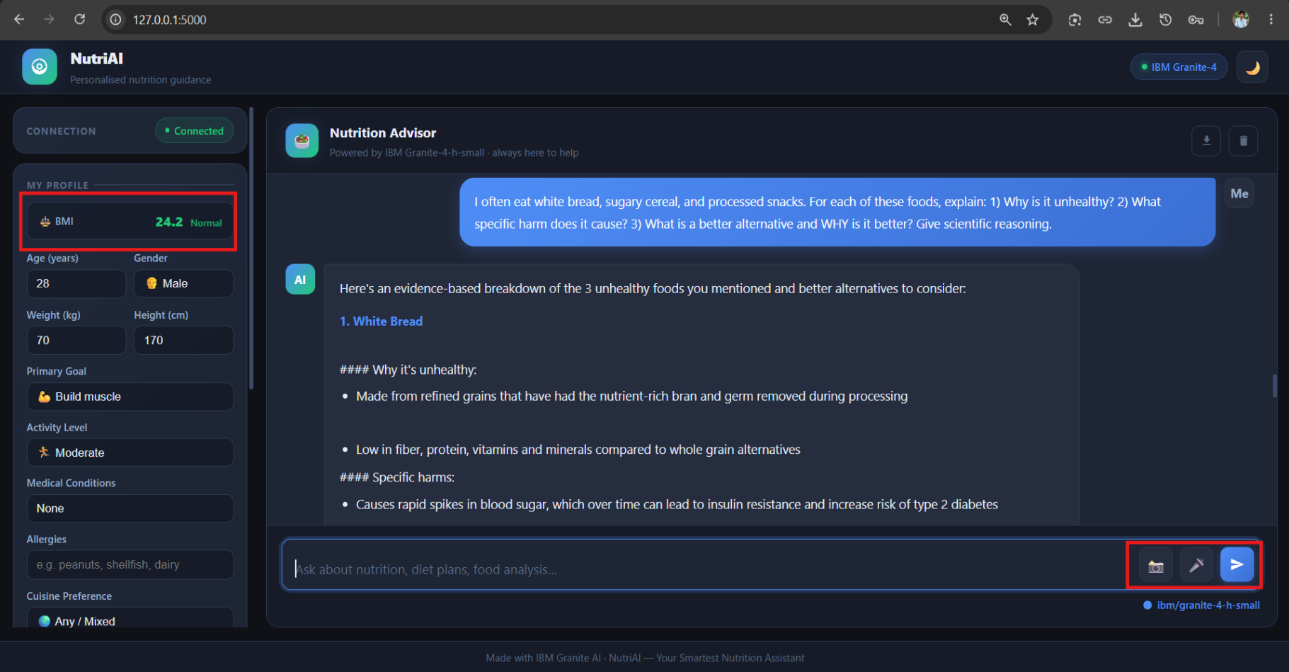
Project Output Screenshot –
·
·
·

Slide 17
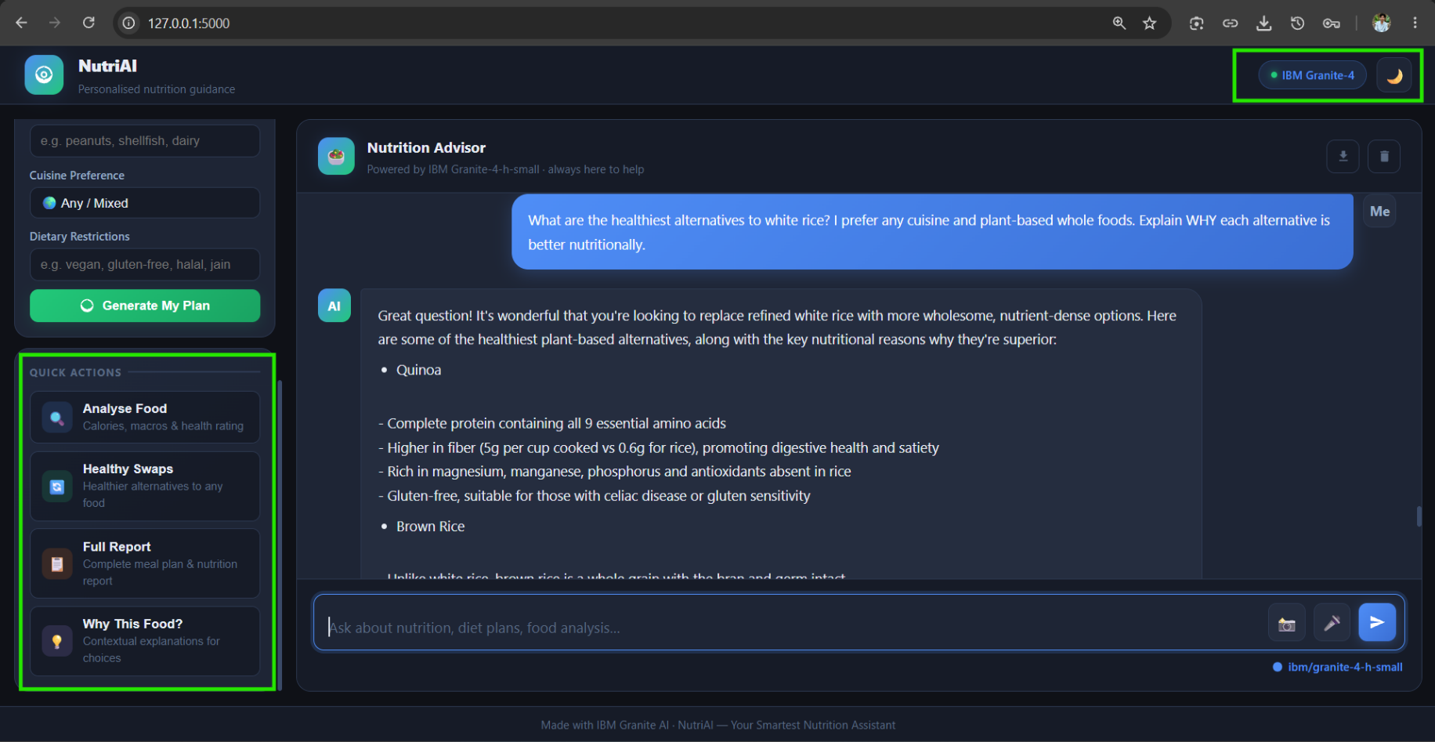
Project Output Screenshot –
·
·
·

Slide 18
Novelty and Uniqueness –
The Nutrition Agent provides a simple and interactive way to get nutrition-related guidance using Agentic AI and the IBM Granite model.
AI-Based Interaction – Understands the user's nutrition-related queries and generates relevant responses.
Personalized Guidance – Provides suggestions based on the information and requirements shared by the user.
Structured Workflow – Processes the user's request through the defined agent workflow before generating the response.
Nutrition-Focused Assistance – Helps users understand nutrition-related information and make better-informed food choices.
IBM Technology Integration – Built using IBM Bob, IBM Cloud, and the Granite 4 H Small (granite-4-h-small) model.
Overall, the solution combines an AI-based workflow with nutrition-focused guidance to provide a more interactive experience than a basic static information system.

Slide 19
Git Hub Link –
https://github.com/architchaurasiya/nutrition-agent
·
·
·

Slide 20
Future Scope –
1. Integration with Wearables & Health Devices –
The Nutrition Agent can be integrated with smartwatches and fitness trackers to use information such as daily activity, calories burned, heart rate, and sleep patterns. This can help provide more personalized nutrition suggestions based on user activity.
2. AI-Powered Voice Assistant & Multilingual Support –
A future version can support voice-based interaction and multiple languages, making the Nutrition Agent easier to use for people who prefer speaking or interacting in their regional language.
3. Improved Personalization –
The system can be enhanced to consider more user preferences, dietary habits, and changing requirements while generating nutrition-related suggestions.
4. Interactive Nutrition Dashboard –
A dashboard can be added in the future to help users view their nutrition information, meal history, and progress in a simple visual format.
·
·
·

Slide 21
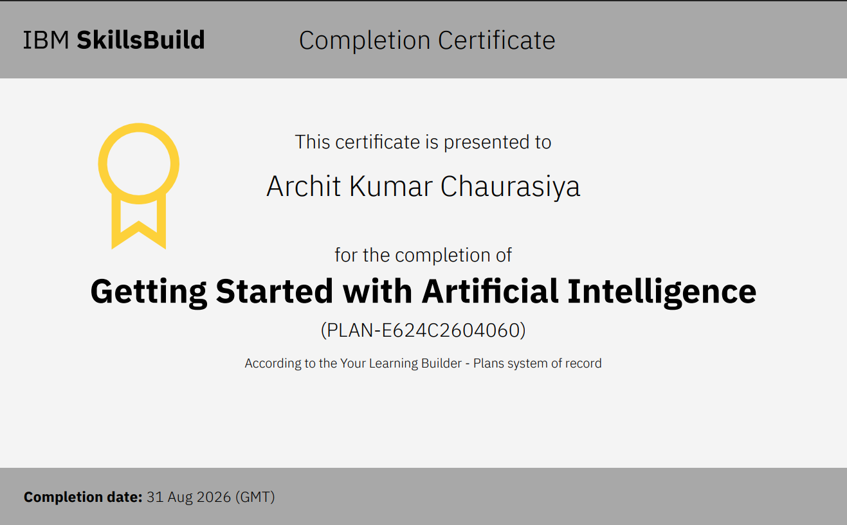
Certificates Earned :–
(Getting Started with Artificial Intelligence)

Slide 22
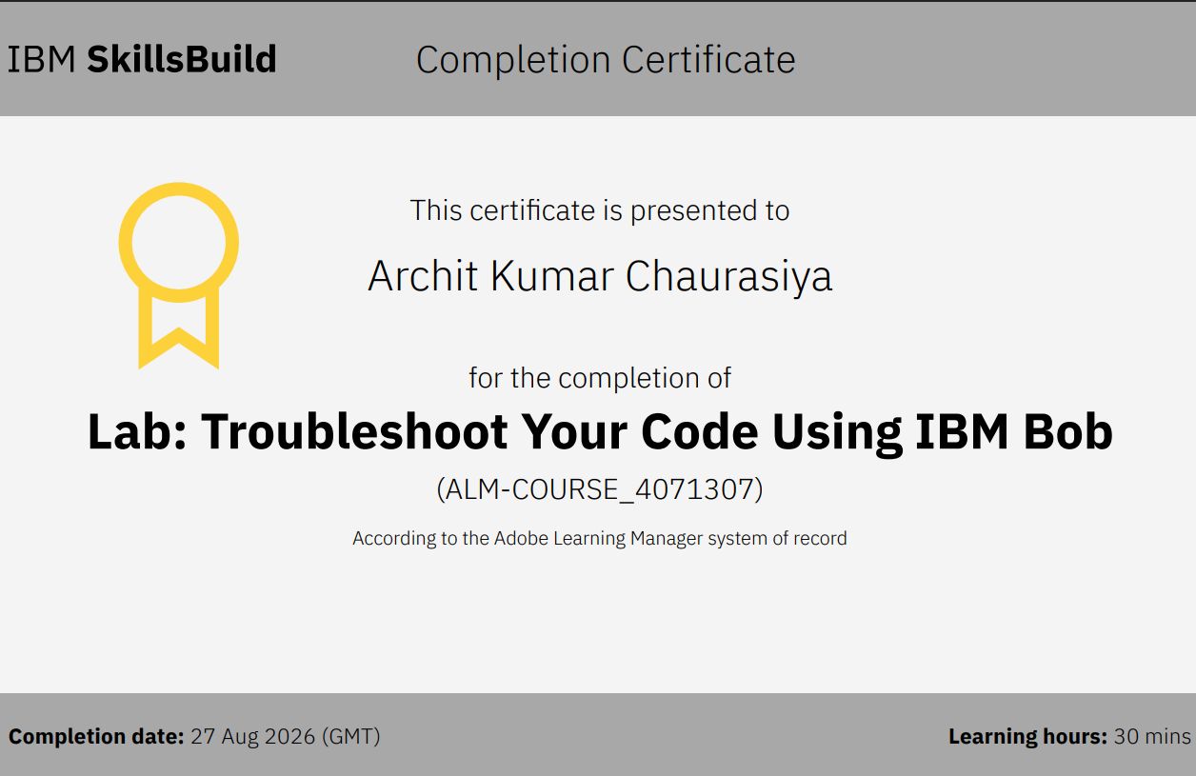
Certificates Earned :– ​
(Lab: Troubleshoot Your Code Using IBM Bob)

Slide 23


