Slide 1
AIML Summer Internship 2026 | IIHMF, MNNIT Allahabad
Employee Attrition
Prediction System
Predicting employee attrition risk using classification models and
deploying a live decision-support tool for HR teams
Archit Srivastava
Param Gupta
Adish Tripathi
B.Tech CSE, United College of Engineering & Research (UCER), Prayagraj

Slide 2
Project Team
AS
PG
AT
Archit Srivastava
Param Gupta
Adish Tripathi
Team Lead
Team Member
Team Member
B.Tech Computer Science & Engineering, United College of Engineering & Research (UCER), Prayagraj
Employee Attrition Prediction System | 2

Slide 3
Problem Statement
Organizations lose skilled employees every year, often without warning. Replacing them costs time, money, and institutional knowledge.
1,470
employee records analyzed
Goal: Using historical HR records, predict whether a given employee is likely to leave the organization — so HR can act before it happens, not after.
16.1%
A binary classification problem: Attrition = Yes / No
of employees left the company
Employee Attrition Prediction System | 3

Slide 4
Project Objectives
Clean & explore the HR dataset through thorough EDA
Engineer meaningful new features from raw HR fields
1
2
Balance the imbalanced target using SMOTE
Train & compare Logistic Regression, Decision Tree, Random Forest, XGBoost
3
4
Evaluate using Accuracy, Precision, Recall, F1, ROC-AUC
Deploy the best model as a live Streamlit web app
5
6
Employee Attrition Prediction System | 4

Slide 5
Dataset Description
IBM HR Analytics Employee Attrition Dataset
1,470
35
0
5.2 : 1
employee rows
attributes
missing values
class imbalance ratio
Key attribute groups:
Demographics — Age, Gender, MaritalStatus, DistanceFromHome
Compensation — MonthlyIncome, DailyRate, PercentSalaryHike, StockOptionLevel
Role & Org — Department, JobRole, JobLevel, BusinessTravel
Satisfaction — JobSatisfaction, EnvironmentSatisfaction, WorkLifeBalance
Tenure — YearsAtCompany, TotalWorkingYears, YearsSinceLastPromotion
Employee Attrition Prediction System | 5

Slide 6
Methodology — End-to-End Pipeline
Data
Collection
➜
Preprocessing
➜
EDA
➜
Feature
Engineering
➜
Model
Building
➜
Evaluation
➜
Deployment
Follows the standard supervised ML lifecycle, ending in a deployed, user-facing prediction tool.
Train/test split: 80% / 20%, stratified on Attrition
SMOTE applied only on the training set to avoid data leakage
Same preprocessing reused at inference time inside the Streamlit app
Employee Attrition Prediction System | 6

Slide 7
Data Preprocessing
✓
Dropped 4 constant columns
EmployeeCount, StandardHours, Over18, EmployeeNumber carry no predictive signal
✓
Verified data quality
Zero missing values, zero duplicate rows — no imputation needed
✓
Encoded the target
Attrition mapped to 1 (Yes) / 0 (No)
✓
Label-encoded 7 categorical fields
BusinessTravel, Department, EducationField, Gender, JobRole, MaritalStatus, OverTime
✓
Scaled all features
StandardScaler applied — required for Logistic Regression to converge well
Employee Attrition Prediction System | 7

Slide 8
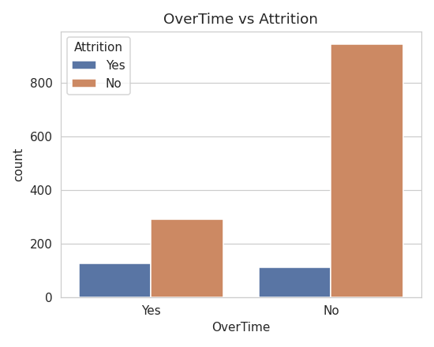
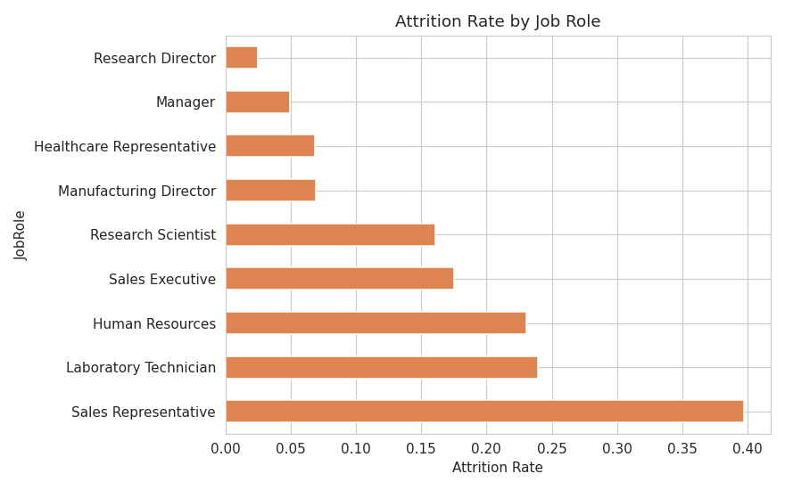
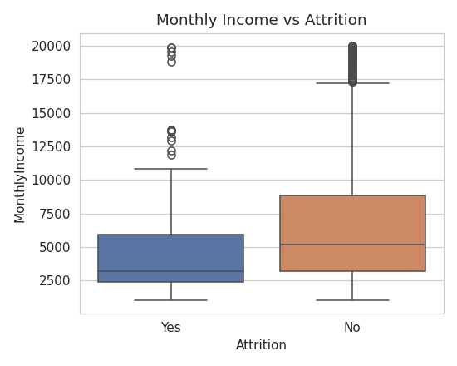
Exploratory Data Analysis — Key Insights
Employees who work OverTime leave at a much higher rate
Sales Representatives & Lab Technicians show the highest attrition by role
Leavers tend to have lower Monthly Income than those who stay
Employee Attrition Prediction System | 8

Slide 9
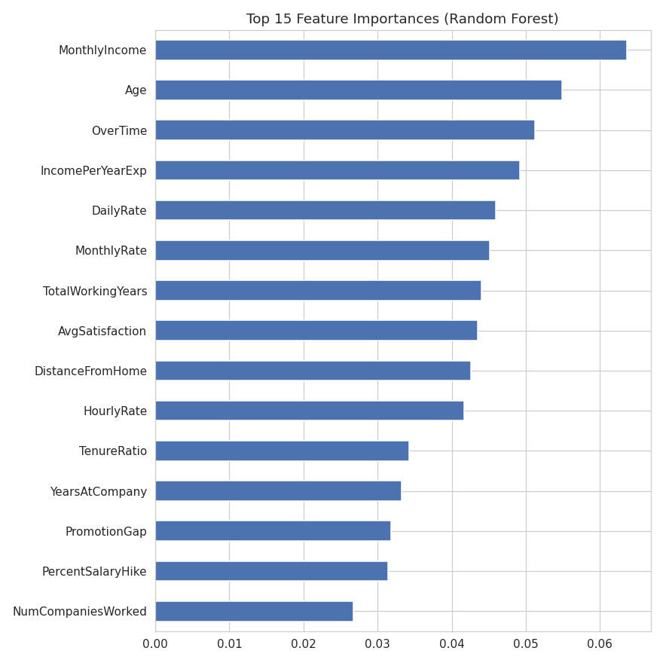
Feature Engineering
TenureRatio
IncomePerYearExp
PromotionGap
AvgSatisfaction
YearsAtCompany / (TotalWorkingYears + 1)
MonthlyIncome / (TotalWorkingYears + 1)
YearsAtCompany − YearsSinceLastPromotion
Mean of 4 satisfaction & work-life scores
Top 15 Feature Importances (Random Forest)
2 of 4 engineered features rank in the top 10 by importance:
IncomePerYearExp — rank #4
AvgSatisfaction — rank #8
Employee Attrition Prediction System | 9

Slide 10
Models Used
Logistic Regression ✅
Decision Tree
Linear, highly interpretable baseline. max_iter=1000. Deployed model.
Single tree, depth capped at 6. Fast, fully interpretable.
Random Forest
XGBoost
Bagged decision trees, tuned via 3-fold GridSearchCV, class_weight='balanced'.
Sequential gradient boosting. 300 estimators, depth 5, lr=0.05.
Class imbalance (16% positive) handled via SMOTE oversampling on the training set before all four models were trained.
Employee Attrition Prediction System | 10

Slide 11
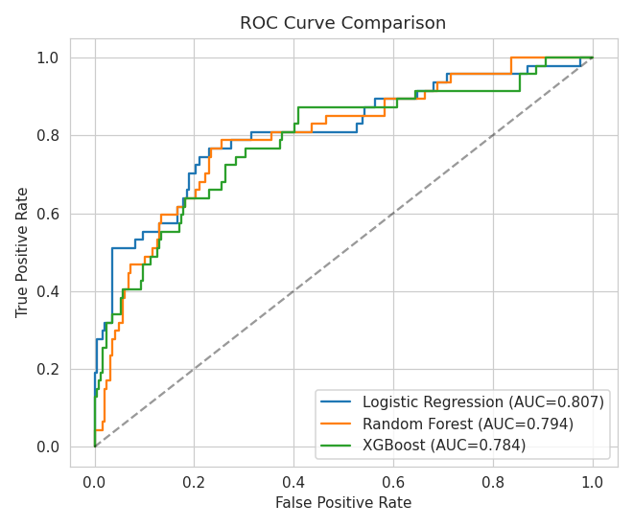
Results — Model Comparison
Model | Accuracy | Precision | Recall | F1 | ROC-AUC
Logistic Regression | 0.762 | 0.379 | 0.766 | 0.507 | 0.807
Decision Tree | 0.810 | 0.435 | 0.638 | 0.517 | 0.736
Random Forest | 0.847 | 0.538 | 0.298 | 0.384 | 0.794
XGBoost | 0.864 | 0.640 | 0.340 | 0.444 | 0.784
LR (class_weight, no SMOTE) | 0.752 | 0.362 | 0.723 | 0.482 | 0.813
Decision Tree edges out Logistic Regression on F1 (0.517 vs 0.507) — but they're within 0.02, so treated as tied. Logistic Regression wins the tie-break on ROC-AUC (0.807 vs 0.736) and is deployed.
ROC shown for the original 3-model run — see table for all 5 variants
Employee Attrition Prediction System | 11

Slide 12
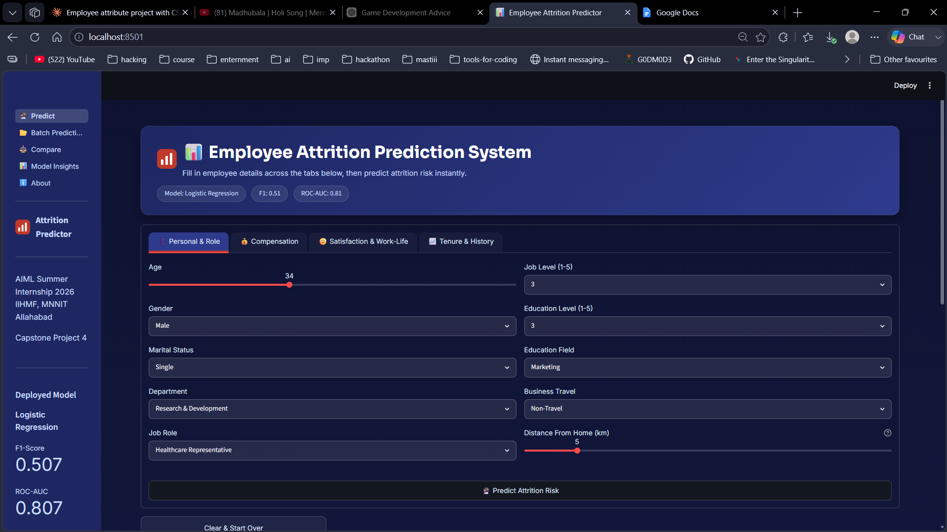
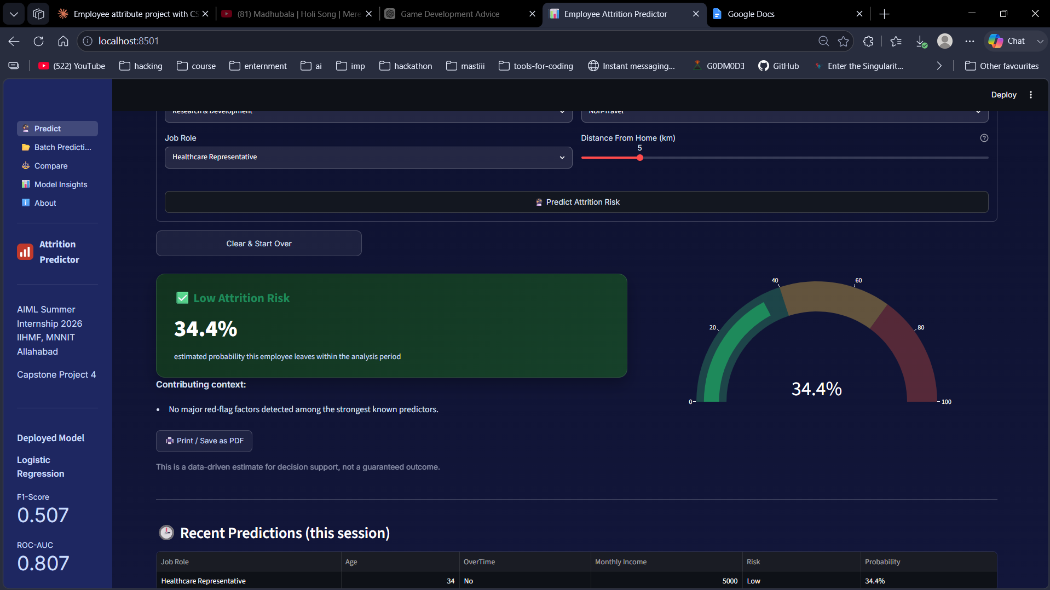
Live Demo — Streamlit App
Predict page — form (left) and live result with gauge (right). Also includes Batch Prediction, Compare, and Model Insights pages.
How it works:
Fill in employee attributes in the form
App re-creates the 4 engineered features
Same scaler & encoders from training are applied
Returns risk label + probability instantly
Employee Attrition Prediction System | 12

Slide 13
Conclusion
Built a complete pipeline: preprocessing → EDA → feature engineering → SMOTE balancing → 4-model training → evaluation → deployment.
OverTime, low relative income, frequent travel, and low satisfaction are the strongest attrition drivers.
Logistic Regression was deployed via a defensible tie-break rule (F1 within 0.02 → best ROC-AUC wins) — not just the top scorer on one metric.
Delivered as a 5-page Streamlit app (Predict, Batch Prediction, Compare, Model Insights, About), plus an optional custom FastAPI + HTML/CSS/JS deployment.
Employee Attrition Prediction System | 13

Slide 14
Future Scope
1
Add SHAP explainability so HR sees *why* an employee was flagged
2
Stack models to combine Logistic Regression's recall with tree-model precision
3
Collect longitudinal data for time-to-attrition survival modeling
4
Integrate into an HRIS with scheduled batch scoring & manager alerts
5
Audit for fairness across gender, age, and marital status
Employee Attrition Prediction System | 14

