Slide 1
CREDIT CARD FRAUD DETECTION
A Machine Learning Project under the supervision on Prof. Shweta Meena
By – ARCHIT GUPTA [2K19/MC/022]
CHAITANYA KUMAR [2K19/MC/033]
DATASET FROM KAGGLE.COM

Slide 2
WHAT CONSITUTES CREDIT CARD FRAUD?
Using the credit card number without possession of the actual card is also a form of credit card fraud.
Stealing a person’s identity in order to receive a credit card is another more threatening form of credit card fraud, because it works in conjunction with identity theft.
Credit card fraud is a problem that affects the entire consumer credit industry.
It is one of the fastest-growing types of fraud and one of the most difficult to prevent.

Slide 3
Machine learning Algorithms used:
We used 3 Supervised Learning Algorithms :
LOGISTIC REGRESSION
SUPPORT VECTOR MACHINE
RANDOM FOREST CLASSIFIER

Slide 4
BRIEF INTRODUCTION
LOGISTIC REGRESSION
Logistic regression is a statistical analysis method to predict a binary outcome, such as yes or no, based on prior observations of a data set.
Logistic Regression is used widely for solving Industry scale problems as it’s easy to implement and it generally doesn't give you discrete output and gives Probability associated with each output.
The logistic regression algorithm is robust to a small noise in the data and is not particularly affected by small cases of multi-collinearity.

Slide 5
SUPPORT VECTOR MACHINE
The objective of the support vector machine algorithm is to find a hyperplane in an N-dimensional space(N — the number of features) that distinctly classifies the data points.
Support vector machine is another simple algorithm that every machine learning expert should have in his/her arsenal.
Support vector machine is highly preferred by many as it produces significant accuracy with less computation power.

Slide 6
Random forest CLASSIFIER
Random forest builds decision trees on different samples and takes their majority vote for classification and average in case of regression.
One of the most important features of the Random Forest Algorithm is that it can handle the data set containing continuous variables as in the case of regression and categorical variables as in the case of classification. It performs better results for classification problems.
Random Forest Classifier is more of Accuracy focused algorithm and is best till it’s used with proper fit, else it gets overfat quickly.

Slide 7

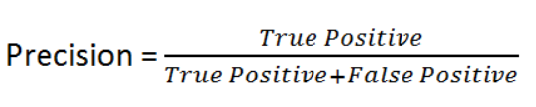

F1 SCORE
F1 Score is a better measure to use if we need to seek a balance between Precision and Recall AND there is an uneven class distribution (large number of Actual Negatives).

Slide 8
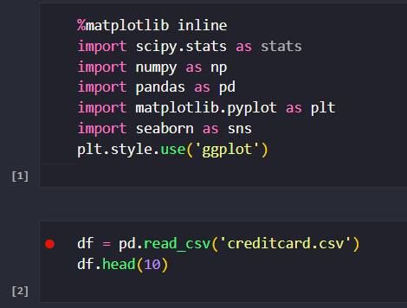
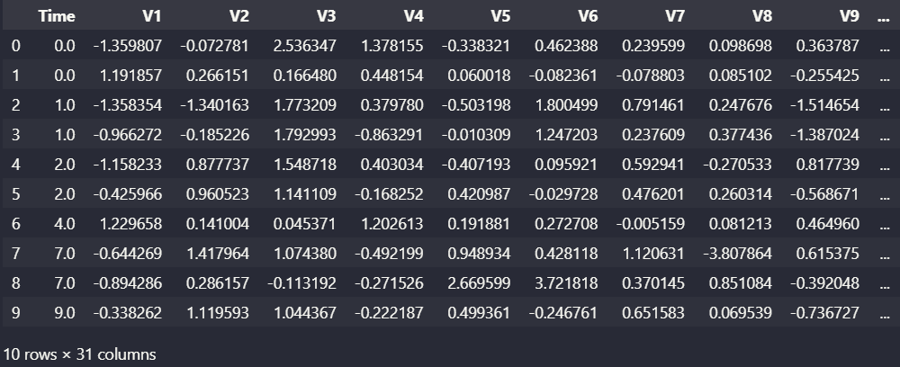
UPLOADING THE DATASET AND LIBRARIES

Slide 9
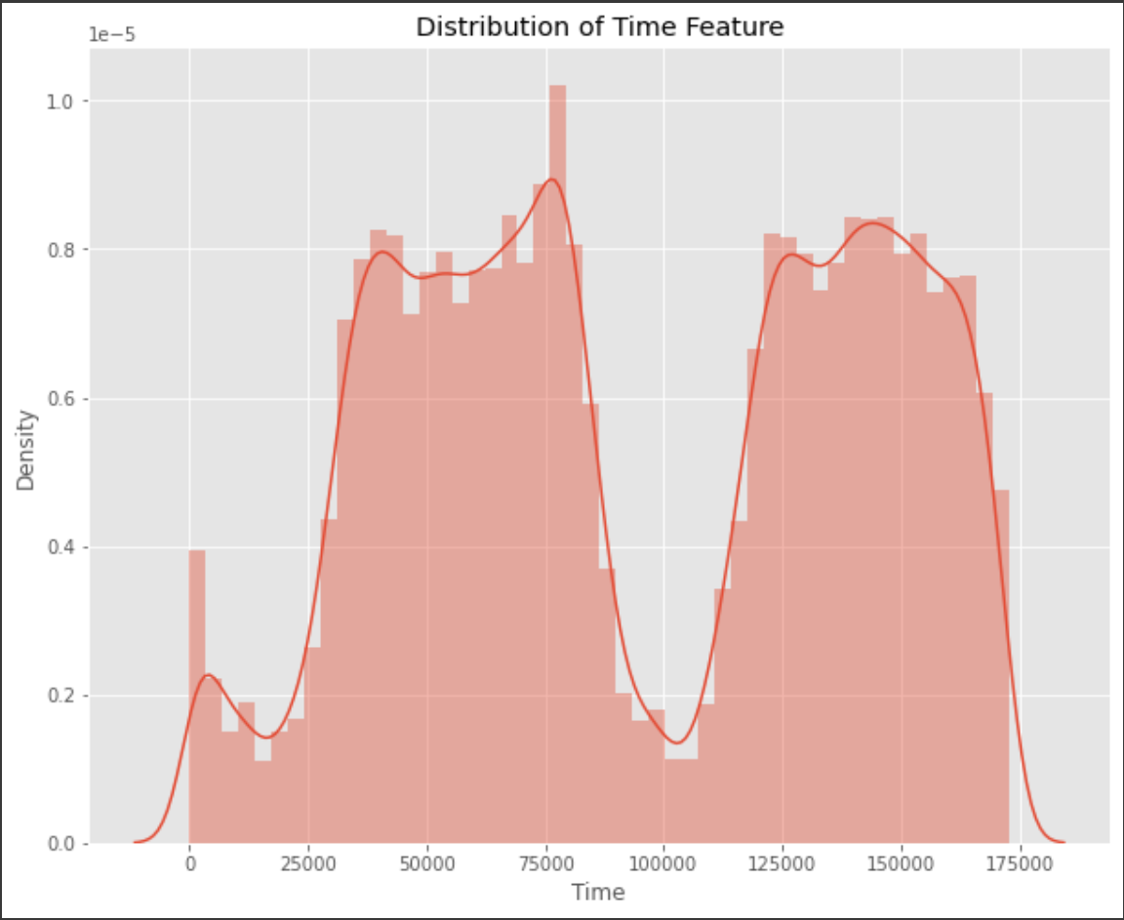
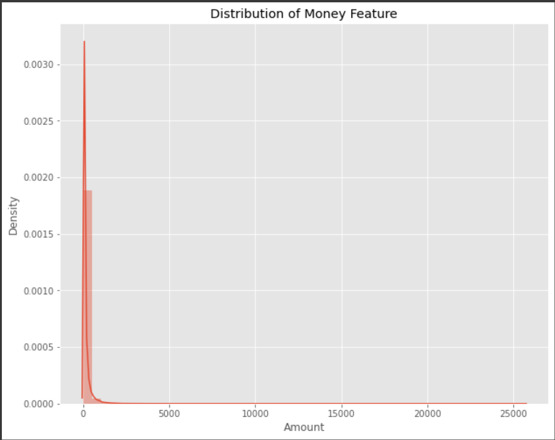
EDA AND VISUALIZATIONS
By seeing the distributions we have an idea how skewed are these features. There are techniques that can help the distributions be less skewed which will be implemented in this notebook in the future.

Slide 10
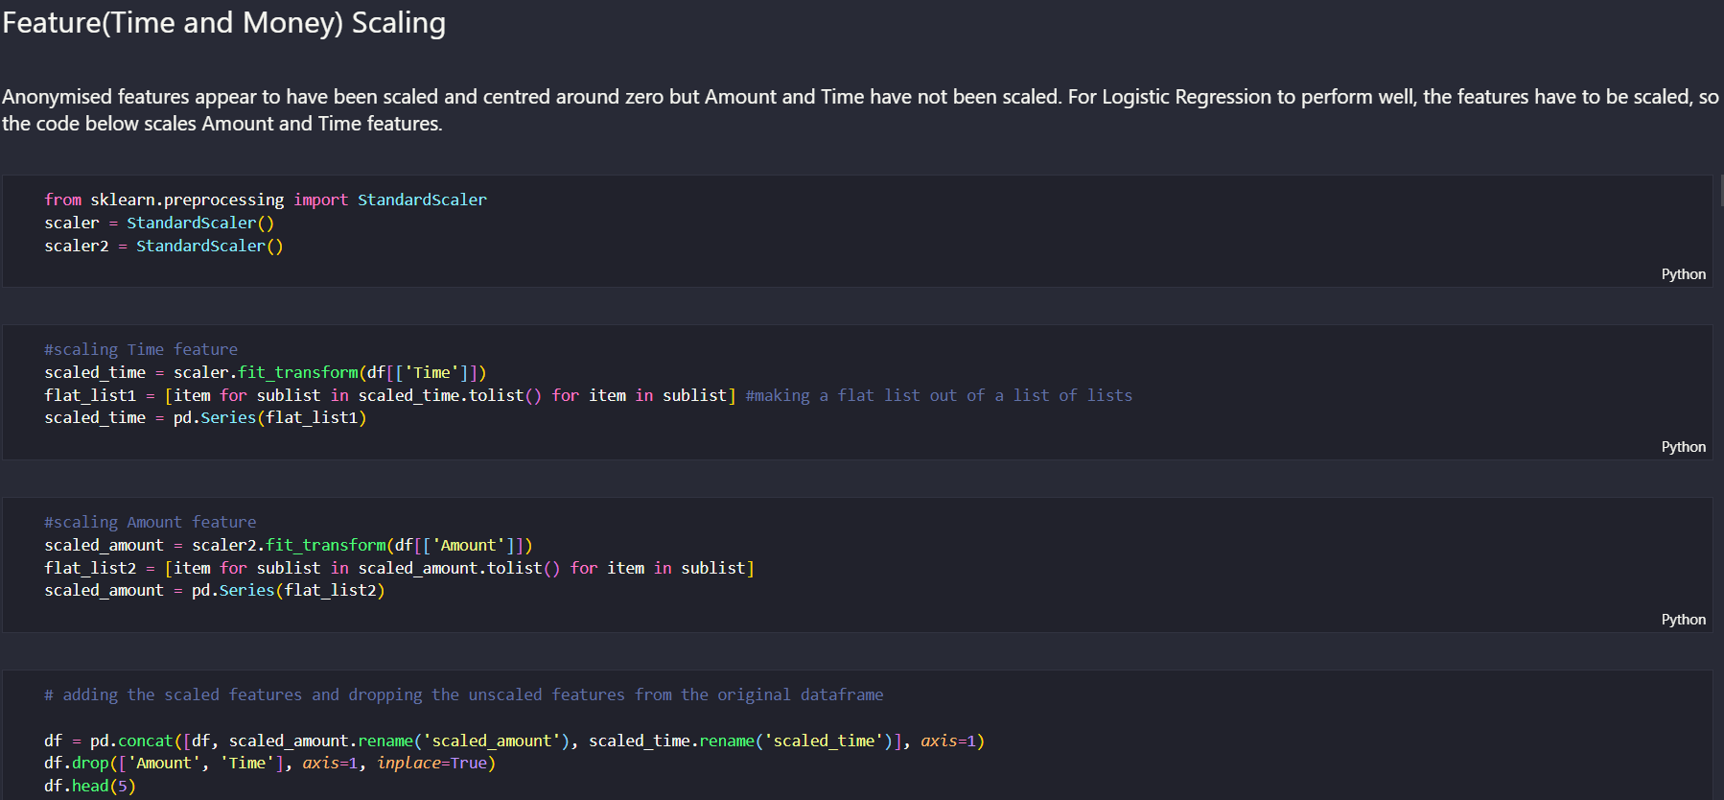
Scaling the data

Slide 11
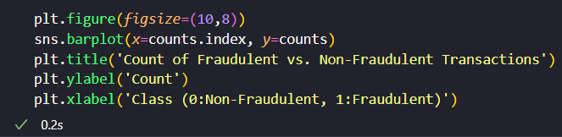
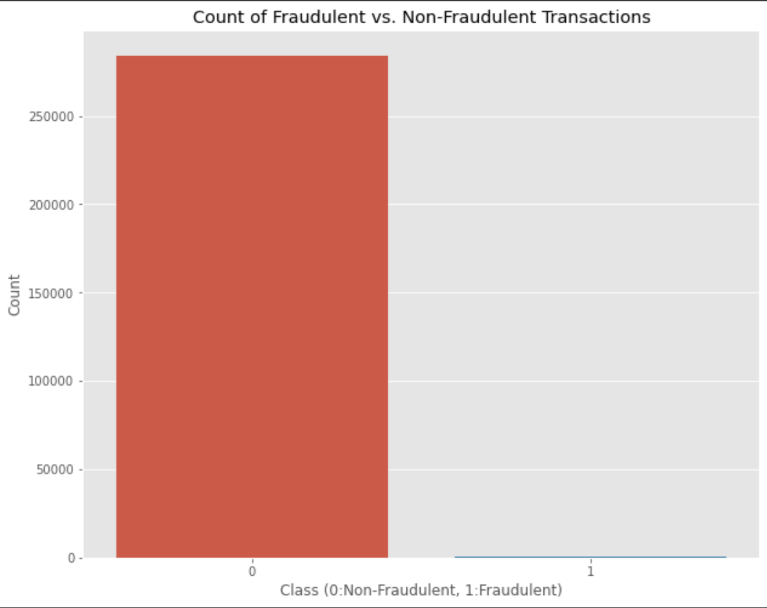
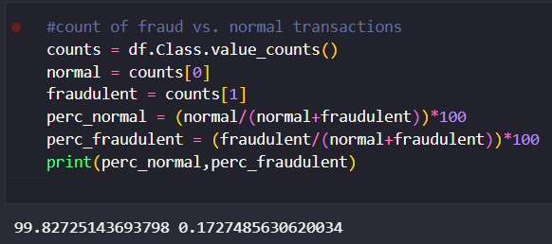
FRAUDULENT CASES
CODE FOR THE GRAPH:
Calculation of percentage of fraudulent cases:
Genuine Cases: 99.827%
Fraud Cases: 0.173%

Slide 12
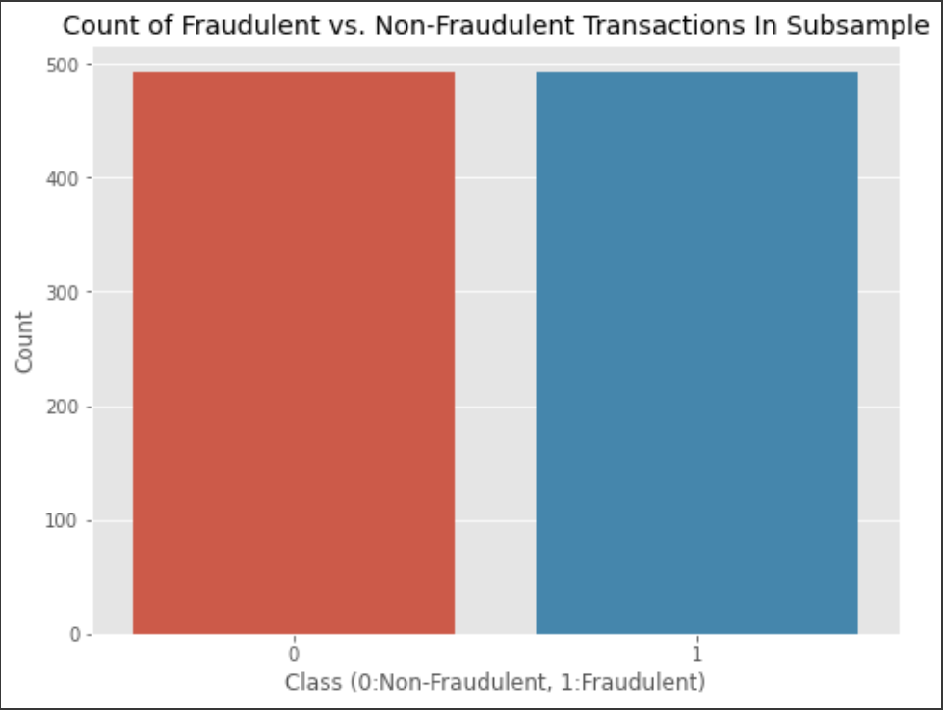
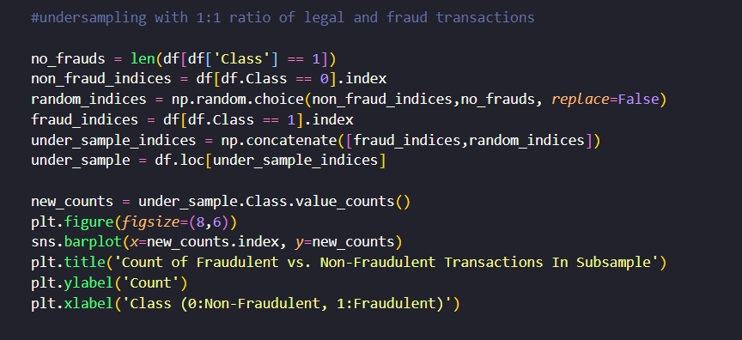
UNDERSAMPLING
The present dataset is highly imbalanced with the fraud cases forming an extremely small percentage of the whole. This poses a problem in training the algorithms. To deal with this problem, the technique of random undersampling - removal of samples from majority class, is used.
Here we have 1:1 undersampling

Slide 13
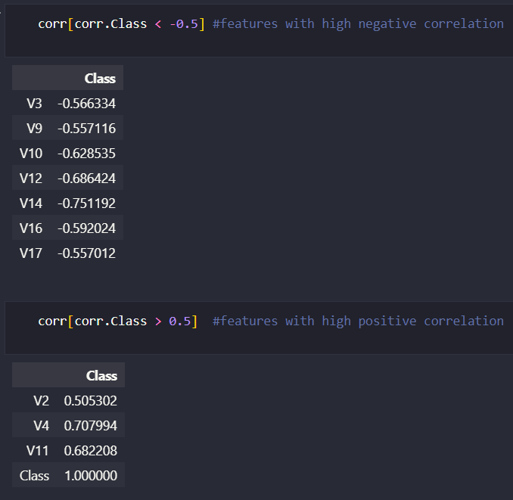
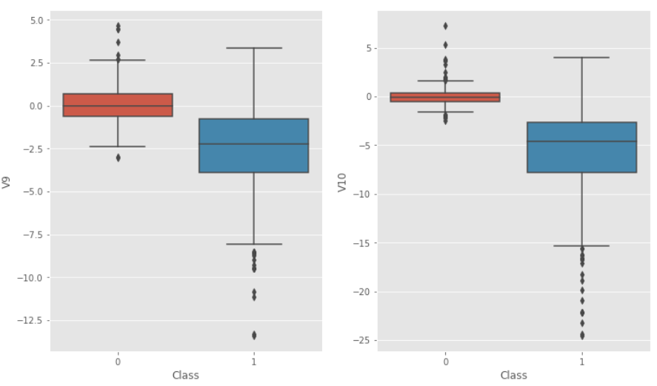
OUTLIER DETECTION
Now features with high negative correlation and high positive correlation are identified. We then remove the outliers that lies outside 2.5 times the inter quantile range in an attempt to eliminate the effect of outliers.

Slide 14
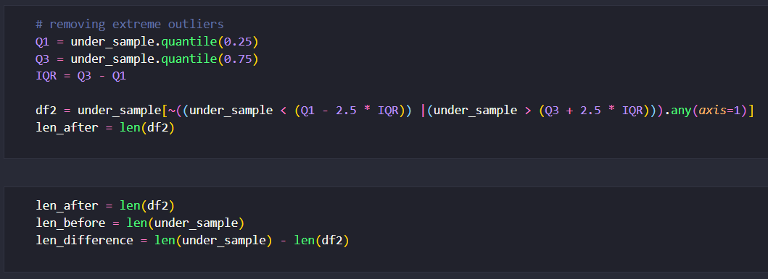
REMOVING EXTREME OUTLIERS

Slide 15
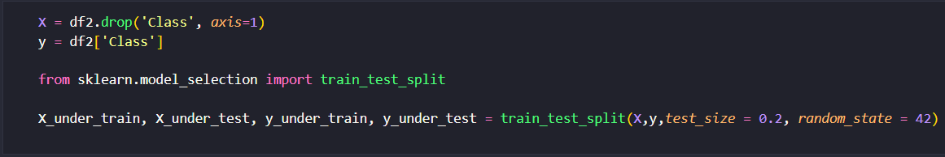
SPLITTING THE DATA

Slide 16
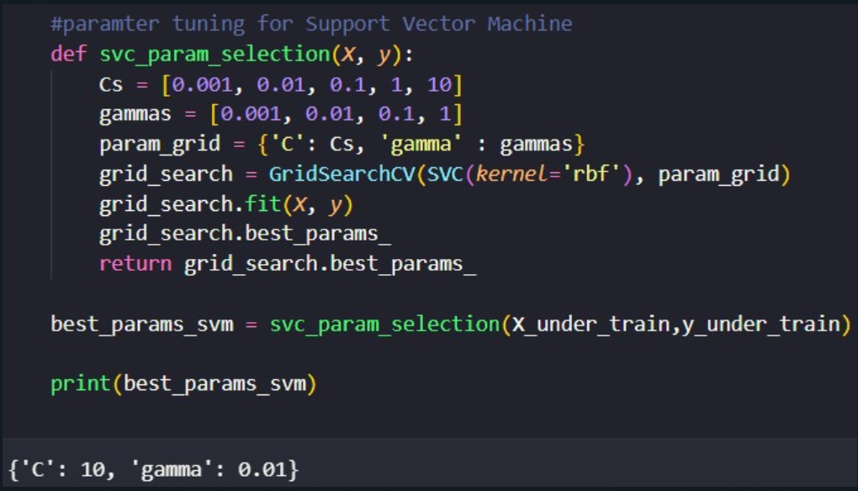
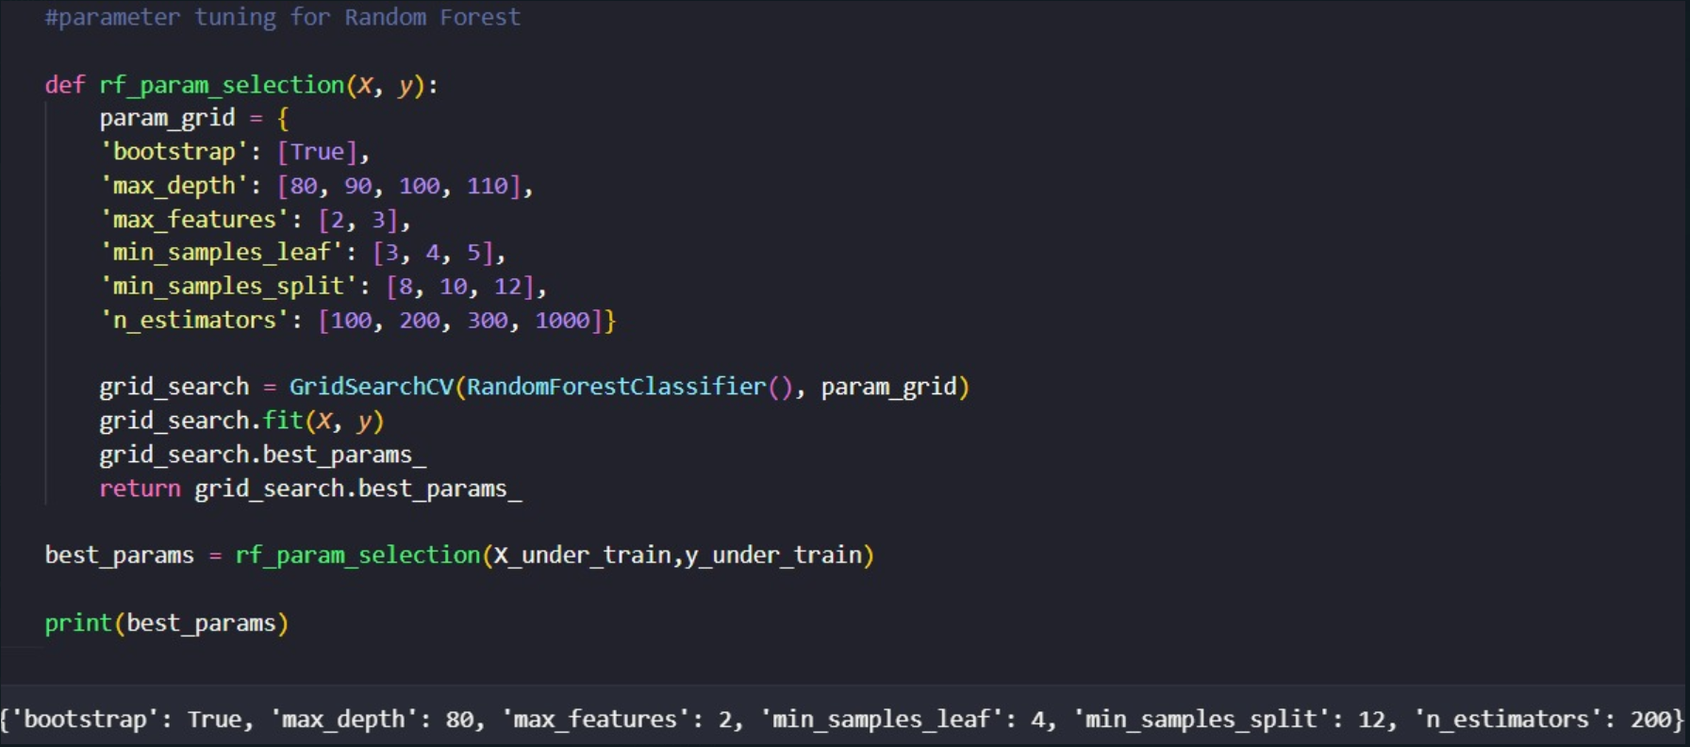
PARAMETER TUNING
Parameters which define the model architecture are referred to as hyperparameters and thus this process of searching for the ideal model architecture is referred to as hyperparameter tuning.
Grid Search
Grid search is arguably the most basic hyperparameter tuning method. With this technique, we simply build a model for each possible combination of all of the hyperparameter values provided, evaluating each model, and selecting the architecture which produces the best results.

Slide 17
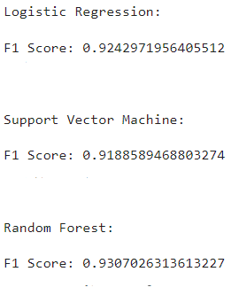
1:1 UNDERSAMPLING

Slide 18
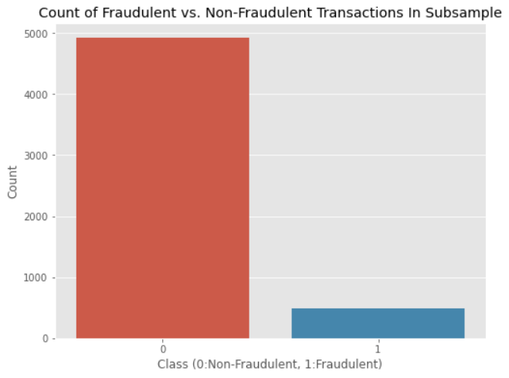
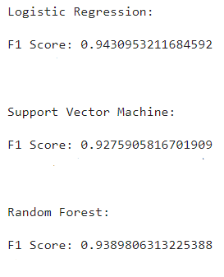
FOR 15% UNDERSAMPLING

Slide 19
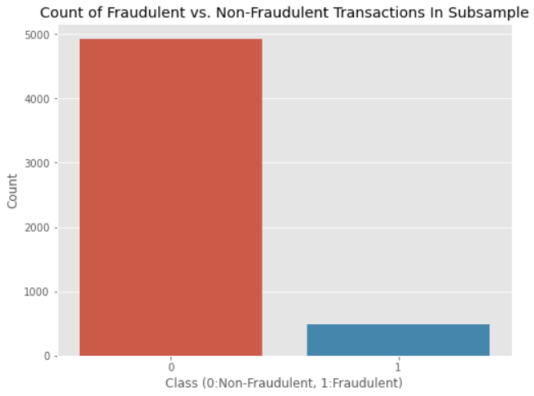
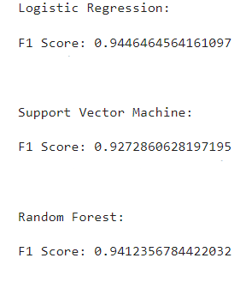
FOR 10% UNDERSAMPLING

Slide 20
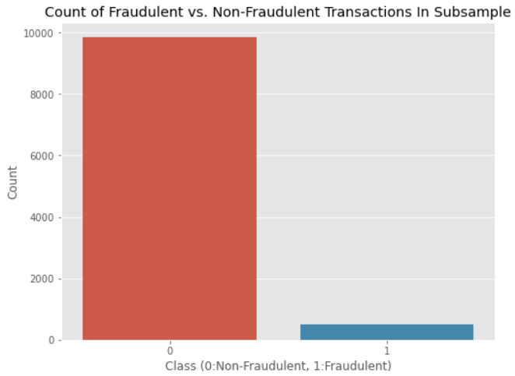
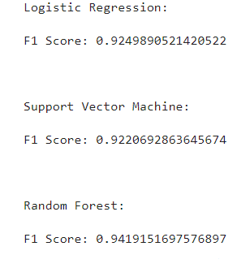
FOR 5% UNDERSAMPLING

Slide 21
RESULT
As we reduce the percentage of undersampling, the F1 score of Logistic Regression and Support Vector Machine show a downward trend whereas those of Random Forest show better performance.
The F-score of Random Forest is better than the other two with decreasing ratio of fraud cases. This is an important performance indicator as it shows that the system is correctly classifying frauds as well as minimising errors in incorrect classification, both of which are extremely relevant to the real world scenario.

