Slide 1
DIGITAL BANKING
SYSTEM
A source-grounded technical presentation
React + Spring Boot microservices
OTP/JWT security | PostgreSQL | Redis | Kafka
APEXBANK
Actual implementation, not a generic model
Notes:
Introduce the project as a working microservice prototype. Emphasize that this presentation follows the actual source code and also identifies limitations.

Slide 2
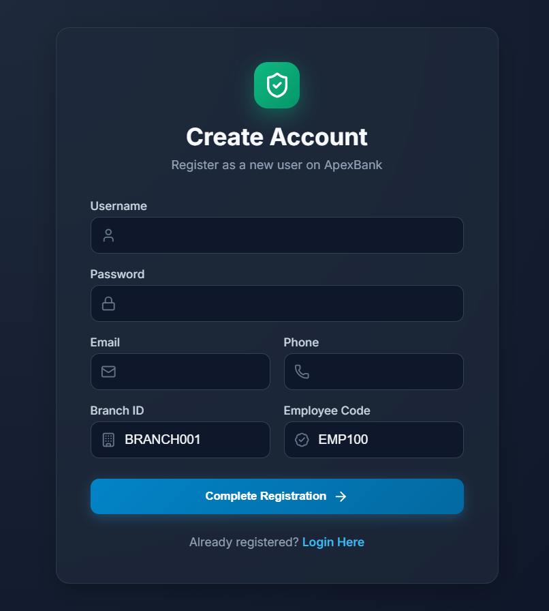
Real UI: Create Account
Captured from the running Vite frontend at /register
OBSERVED SCREEN
ApexBank registration form
Username and password
Email and phone
Branch ID and employee code
Routes to /user/register through gateway
This is the actual project UI, not a mock screenshot.
Notes:
This screenshot proves the frontend is running. The form fields come from the actual React page.

Slide 3
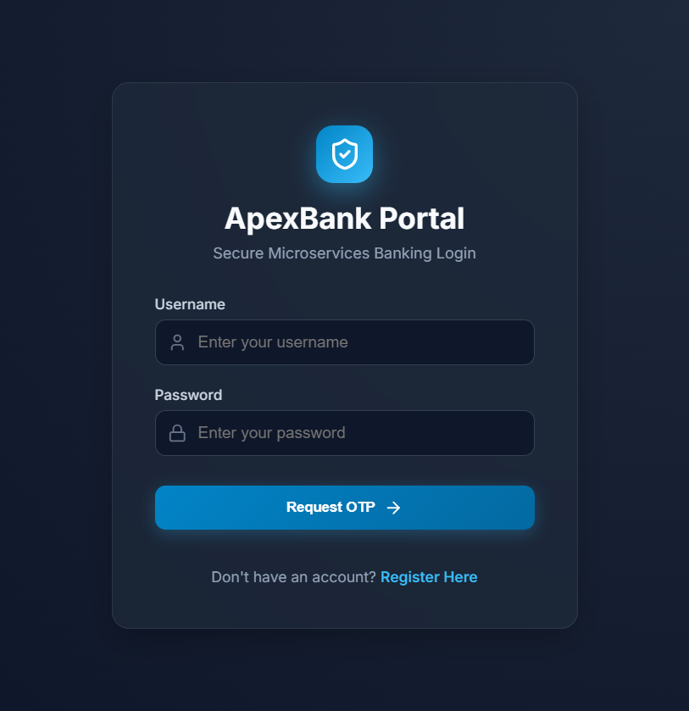
Real UI: Secure Login
Captured from the running Vite frontend at /login
OBSERVED SCREEN
ApexBank Portal
Username/password input
Request OTP action
Registration link
Login calls auth-service through gateway
Protected dashboard states require valid demo credentials.
Notes:
Explain that the frontend first requests an OTP. The next token step is handled by the auth service OAuth2 endpoint.

Slide 4
Actual Architecture
Separate Spring Boot applications, separate persistence boundaries
React / Vite
:5173
API Gateway
:8080
Eureka :8761
Config Server :8888
Auth Service
Customer Service
Account Service
Transaction Service
Redis: OTP / cache / locks
authdb
PostgreSQL
customerdb
PostgreSQL
accountdb
PostgreSQL
transactiondb
PostgreSQL
Kafka + Zookeeper: events
Synchronous service calls use OpenFeign/HTTP. Kafka is producer-only in the confirmed source path.
Notes:
Walk left to right. The gateway is the public entry point. The four business services own separate databases.

Slide 5
Services and Technology Map
The repository contains business services plus platform services
Auth
Users, roles, password, OTP, JWT
Spring Security, OAuth2, Redis, PostgreSQL
Customer
Profile and KYC
JPA, PostgreSQL, WebClient/Setu
Account
Account numbers and balances
JPA, Flyway, Redis locks, Kafka
Transaction
Transfer, history, audit, reversal
JPA, OpenFeign, Resilience4j, Kafka
Gateway
Routing, edge security, logging
Spring Cloud Gateway, JWT resource server
Eureka / Config
Discovery and configuration
Spring Cloud Netflix / Config Server
ROOT MODULES
auth-service | customer-service | account-service | transaction-service | api-gateway | eureka-server | config-server | frontend

Slide 6
Registration and Login Flow
Source path: frontend -> gateway -> auth-service
REGISTRATION
LOGIN + OTP
POST /api/auth/register
-> gateway rewrite: /user/register
-> UserController.register()
-> UserService.register()
-> BCrypt encode
-> UserRepository.save()
-> authdb
-> response: user id + username
POST /api/auth/login
-> LoginController.login()
-> BCrypt check
-> OtpService.generateOtp()
-> Redis, 30-minute TTL
-> SMS/email/local log
-> POST /oauth2/token
-> OtpAuthenticationProvider
-> signed JWT
Registration creates an auth user only; Customer and Account are separate later steps.

Slide 7
JWT and Authorization
The token carries identity and authorities across the services
TOKEN CREATION
TOKEN USAGE
OtpAuthenticationConverter
|
OtpAuthenticationProvider
|
AuthorizationServerConfig
|
JwkConfig: RSA 2048 key
|
JWT claims:
userId
authorities
standard OAuth2 claims
Axios interceptor
Authorization: Bearer <JWT>
|
Gateway validates JWT
|
Service SecurityFilterChain
|
JwtAuthenticationConverter
|
SecurityUtil.getUserId()
|
@PreAuthorize authorities
Important implementation detail: authorities are read from the custom authorities claim with no added prefix.

Slide 8
Customer and Account Creation
Ownership is established through JWT userId -> customerId -> account.customerId
CUSTOMER PROFILE
BANK ACCOUNT
POST /api/customers
-> CustomerController.create()
-> CustomerService.create()
-> SecurityUtil.getUserId()
-> prevent duplicate profile
-> CustomerRepository.save()
-> customerdb
POST /api/accounts
-> AccountController.create()
-> CREATE_ACCOUNT
-> AccountService.accountCreate()
-> CustomerClient
-> account_seq
-> AccountNumberGenerator
-> AccountRepository.save()
-> accountdb

Slide 9
Database Boundaries
Each service owns its persistence; cross-service links are logical IDs
authdb
customerdb
accountdb
transactiondb
users
roles / permissions
user_roles / role_permissions
customers
kyc_details
accounts
account_seq
transactions
transaction_audit
Logical references
auth.users.id --(userId)--> customer.Customer.userId
customer.Customer.id --(customerId)--> account.Account.customerId
account.Account.accountNumber --(string)--> transaction.Transaction.accountNumber

Slide 10
Money Transfer: Actual Execution
The happy path is implemented, but the commit is not distributed
1 Validate amount and account numbers
5 Load receiver and calculate target balances
2 Load sender through AccountClient
6 Direct sender update through internal endpoint
3 Verify sender belongs to JWT customer
7 Direct receiver update through internal endpoint
4 Check balance and blocked status
8 Save DEBIT + CREDIT + audit + Kafka attempt
Controller: TransactionController.transfer() Service: TransactionService.transfer()
Notes:
Point out that transaction-service @Transactional cannot roll back account-service writes.

Slide 11
Transfer Consistency: Honest Assessment
The most important technical limitation in the project
WHAT WORKS
WHAT IS NOT GUARANTEED
Sender ownership check
No distributed transaction
Positive amount and same-account checks
Direct controller write bypasses lock path
Insufficient balance check before write
Concurrent stale target balances can race
Debit and credit transaction rows
Compensation can fail
Best-effort compensation attempt
No client idempotency key for /transfer
Source comparison: TransactionService.transfer() vs AccountController.updateBalance() vs AccountService.updateBalance()

Slide 12
History, Audit, and Events
What is persisted after the banking operation
TRANSACTION HISTORY
AUDIT AND KAFKA
GET /api/transactions/me
-> AccountClient.getMyAccounts()
-> verify caller account numbers
-> TransactionRepository
-> order by createAt desc
Transfer creates:
DEBIT row for sender
CREDIT row for receiver
TransactionAuditService.log()
txnId, userId, action, IP, deviceId
Kafka producers:
account-created-topic
transaction-event
No Kafka consumers were found
in the confirmed source path.

Slide 13
Frontend-to-Backend Contract
The UI uses Axios and gateway paths; some field mismatches remain
FRONTEND FILES
VERIFY BEFORE DEMO
src/App.jsx
src/context/AuthContext.jsx
src/api/axiosClient.js
src/api/authApi.js
src/api/customerApi.js
src/api/accountApi.js
src/api/transactionApi.js
src/pages/LoginPage.jsx
src/pages/RegisterPage.jsx
src/pages/AccountsPage.jsx
src/pages/TransactionsPage.jsx
Account response: backend type vs UI accountType
KYC: aadharNumber vs aadhaarNumber
Transfer response: backend txnId vs UI fallback fields
Protected pages need valid seeded credentials

Slide 14
Live Demonstration Sequence
Use disposable data and show the source path as you operate the UI
1 Start Docker services + frontend
6 Create accounts with deposits
2 Show Eureka registrations
7 Show balances
3 Register user A and user B
8 Transfer small amount
4 Login: password -> OTP -> JWT
9 Show debit/credit history
5 Create customer profiles
10 Explain failure/consistency caveat
URLs: frontend http://localhost:5173 | gateway http://localhost:8080 | Eureka http://localhost:8761

Slide 15
Conclusion and Viva Position
A working prototype with clear production-hardening opportunities
SAY THIS CLEARLY
KNOW THESE CLASSES
"The project demonstrates a complete banking workflow using microservices, JWT/OTP security, separate databases, synchronous OpenFeign calls, and Kafka event publication. The happy-path transfer works, but it is not a distributed atomic transaction. The next engineering step is stronger idempotency, locking, recovery, key management, and integration testing."
LoginController
OtpService
AuthorizationServerConfig
JwkConfig
AccountService
AccountController
TransactionService
TransactionController
AccountClient
SecurityUtil
Thank you
Notes:
End by distinguishing confirmed implementation from future improvements. That honesty is a strength in a viva.

