Slide 1
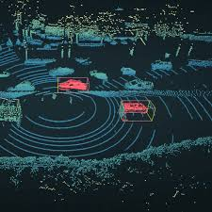
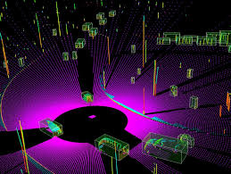
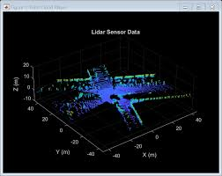
RoboQA-Temporal
It is a Python toolkit that ingests rosbags & runs
automated checks across four dimensions:
| Synchronization | Anomalies |
| Fusion Quality | Health Reporting |
"Data quality, not model size, is the primary lever for improving ML performance." — Ratner et al., 2016.
TECH-REVIEW
Notes:
Most ML work focuses on model architectures and training techniques. But there's something that comes first—something that's actually MORE important to model performance than the model itself. And that's data quality.
The question we're answering today is: How do we automatically validate whether a robotics dataset is fit for training?
I'm going to present RoboQA-Temporal—a Python toolkit that answers exactly that question. Let's dive in.
This is RoboQA-Temporal. It's a Python toolkit that ingests rosbags—the standard file format for robotics sensor data—and runs automated checks across four dimensions.
Synchronization — Are your sensors actually synchronized? When the LiDAR fires, does the camera capture the same moment?
Anomalies — Are there ghost points, sudden density drops, or other point cloud artifacts?
Fusion Quality — If you're combining LiDAR and camera data, is the calibration drifting over time?
Health Reporting — What's the overall quality score, and which sequences should you exclude from training?

Slide 2
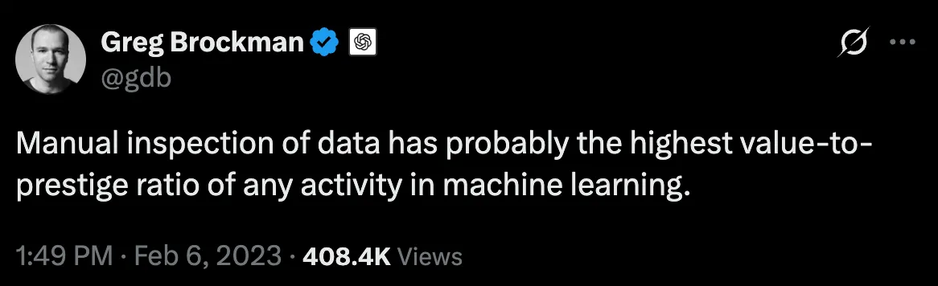
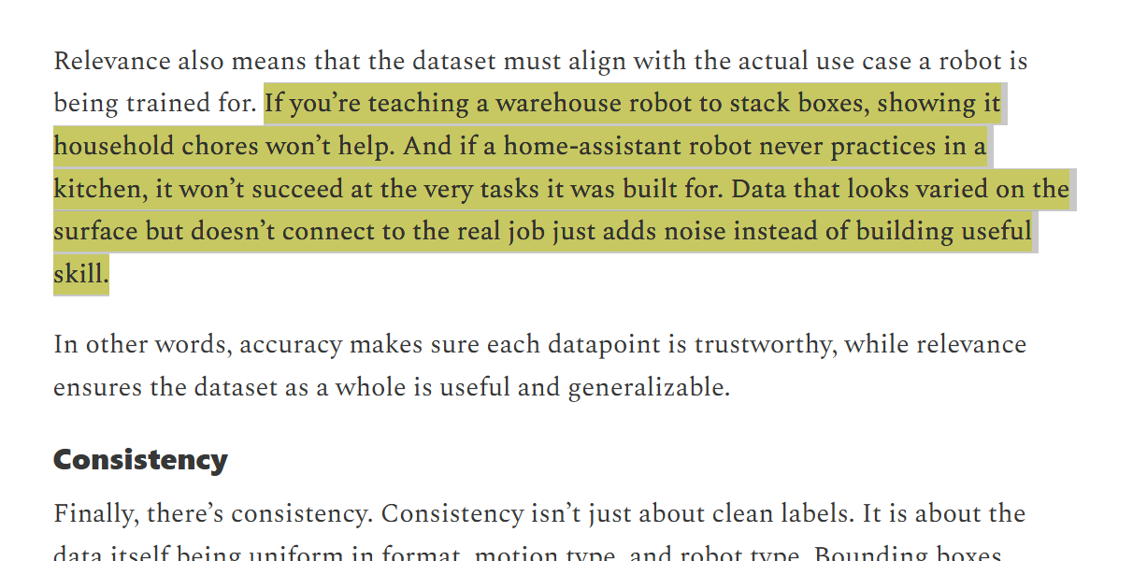
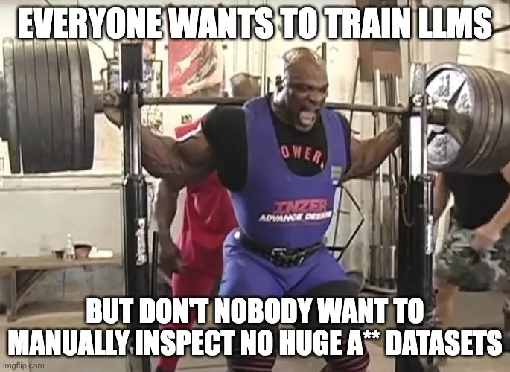
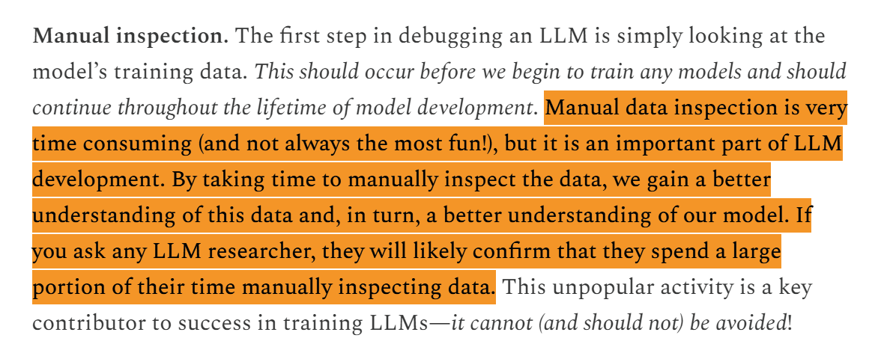
Background:
Dataset Curation Crisis in Robotics
Manual Inspection Bottleneck:
Engineers spend 30-50% of project time manually inspecting rosbags for quality issues, a non-scalable, error-prone process.
Notes:
Let me show you why this toolkit exists."
"This tweet from the co-founder of OpenAI captures it perfectly. Manual inspection has the highest value-to-effort ratio in machine learning. It's unglamorous. Nobody wants to do it. But it's absolutely critical.
Here's the reality: Engineers spend 30-50% of their project time manually inspecting rosbags for quality issues. Think about that. If you're on a robotics team spending 6 months on a project, one to three months is pure manual data inspection. That's non-scalable. That's error-prone.
Everyone wants to train these sophisticated ML models. But nobody wants to manually inspect huge datasets. And yet, that inspection step is blocking progress.
Why does this matter? Because the difference between a good dataset and a bad one can be the difference between a model that works in production and one that fails silently in the field.

Slide 3
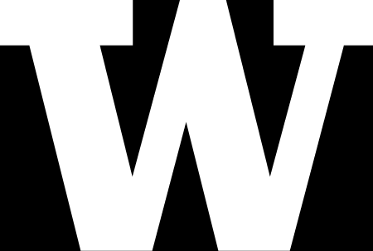
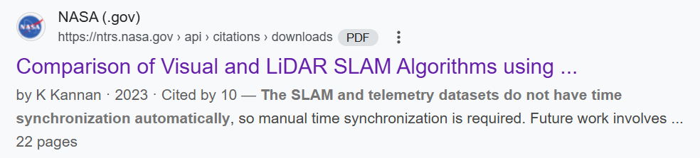
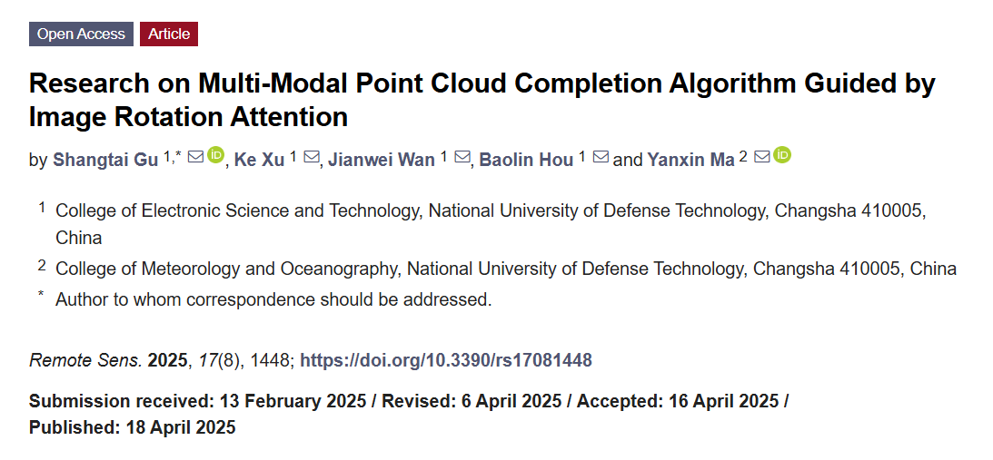
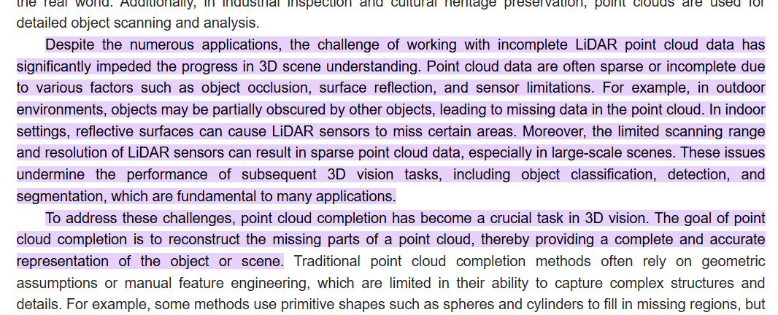
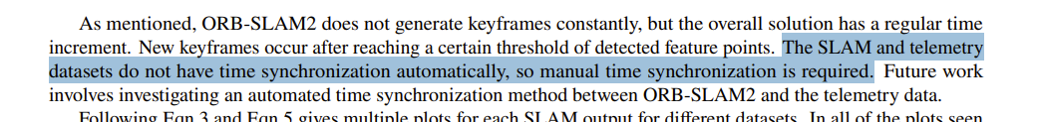
Background:
Dataset Curation Crisis in Robotics
Single-Modality Focus:
Existing tools (PCL, Open3D, CloudCompare) excel at processing individual point clouds or images, but cannot assess cross-modal synchronization in real time.
Notes:
There's another issue. Existing tools are designed for single modalities—individual sensors.
PCL (Point Cloud Library), Open3D, CloudCompare—these are excellent tools. They excel at processing point clouds. They can filter, segment, and visualize 3D data beautifully.
But here's the problem: They don't assess synchronization between multiple sensors.
In real robotics systems, you ALWAYS have multiple sensors. A LiDAR. A camera. An IMU. GPS. These sensors run at different frequencies, have different hardware clocks, and different latencies.
When you combine their data, if the timestamps don't align, your downstream SLAM algorithms fail silently. Your perception models degrade without warning. Your entire pipeline breaks.

Slide 4
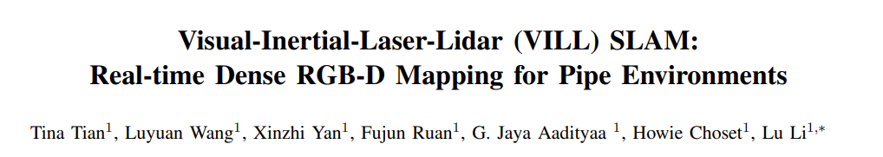
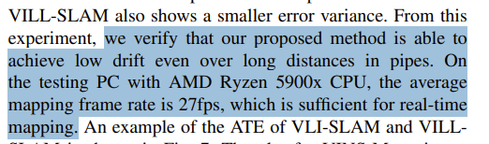
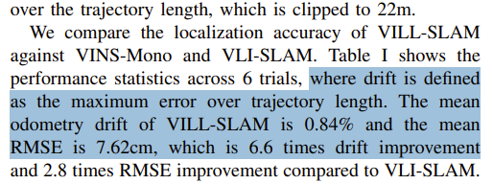
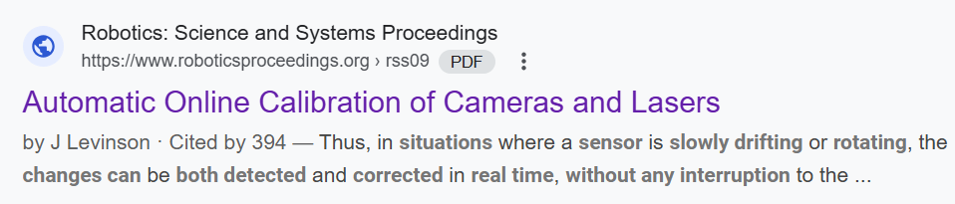
Background:
Dataset Curation Crisis in Robotics
Silent Failures:
Subtle temporal drift between LiDAR and camera streams, calibration drift over time, or transient occlusions can silently corrupt downstream ML models without explicit warnings.
Notes:
Here's the most dangerous problem: silent failures.
Subtle temporal drift between LiDAR and camera streams
Calibration drift over time (the hardware shifts slightly)
Transient occlusions (sensor faults that come and go)
All of these can silently corrupt your downstream ML models WITHOUT explicit warnings.
This NASA paper directly states: 'The SLAM and telemetry datasets do not have time synchronization automatically, so manual time synchronization is required.'
Even NASA's automated systems couldn't detect synchronization issues. They had to do it manually.
But here's the problem: Most teams don't realize their data is unsynchronized until months later when their model fails in the field. By then, it's too late. Retraining costs time and money.

Slide 5
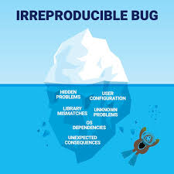
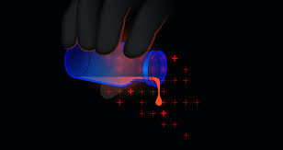
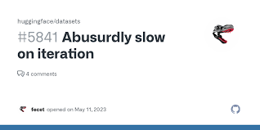

The Business & Research Impact
Why RoboQA? Why this TOOL?
> Integration with Existing Workflows (ROS supported)
> Open-Source & Community-Driven
> Scalability & Automation
> Multi-Modal Coverage
Unreproducible results
Model Poisoning
Slow Iteration
Wasted Compute
Notes:
So here's what RoboQA-Temporal solves:
Scalability & Automation: Instead of one person manually inspecting datasets, validation runs automatically. 71 seconds for a 1-hour dataset.
Multi-Modal Coverage: One toolkit. All your sensors. Not four different tools you have to bolt together.
Objective, Reproducible Metrics: Quality scores are quantitative, configurable, and comparable across datasets.
Integration with Existing Workflows: Native ROS support. Works with your current pipeline. Minimal setup friction.
Open-Source & Community-Driven: No vendor lock-in. You own the code. The community can extend it.
Irreproducible results: If you validate datasets differently than I do, we can't compare our models fairly.
Wasted compute: Teams end up training on larger datasets to compensate for unknown quality issues. Idle GPUs, wasted CPU cycles.
Model poisoning: Bad data corrupts models, but the problem is hidden in the data, not the model code. It's a multi-billion-dollar problem across the industry.
The industry needs standardized dataset health metrics. RoboQA-Temporal provides exactly that."

Slide 6
Technology Review:
RoboQA-Temporal is a Python toolkit that ingests rosbags and runs automated checks across four dimensions
Cross-Modal Synchronization Analysis
Camera-LiDAR Fusion Quality
Feature - I
Feature - III
Feature - II
Feature - IV
Spatio-Temporal Point Cloud Anomalies
Automated Health Reporting
Notes:
Now let me show you how we built this and why our technology choices are the right ones.
RoboQA-Temporal has four core features, and we selected one best-in-class library for each.
We didn't try to force one library to do everything. That's a rookie mistake. Instead, we selected specialized tools for each problem.
Over the next four slides, we’re going to show you our technology choices and compare them to alternatives. Let's start with Feature 1

Slide 7
Cross-Modal Synchronization Analysis
rosbag + message_filters (ROS Official)
Aspect | rosbag + message_filters | Matlab/SegmentsAI Toolbox | Custom Python Parser
Native ROS Support | ✅ Natively designed | ⚠️ Proprietary | ❌ Manual header parsing
Timestamp Precision | ✅ ns resolution | ✅ ns resolution | ⚠️ Depends on implementation
Multi-Sensor Sync | ✅ Built-in Approximate Time policy | ✅ Available | ❌ Must code manually
Ease of Use | ✅ Simple API | ⚠️ Commercial tool | ❌ High complexity
Cost | ✅ Open-source (free) | ❌ ~$3,000+/license | ✅ Free
Community Support | ✅ ROS Wiki + forums | ⚠️ Limited robotics community | ❌ No standard support
Performance | ✅ Optimized for ROS | ✅ Optimized | ⚠️ Variable
Production Ready | ✅ Battle-tested (10+ years) | ✅ Mature (Prod deployed sol.) | ⚠️ Custom-specific (first time in-use)
Notes:
This feature detects clock drift between sensors and measures temporal alignment quality.
Why rosbag + message_filters?
Look at the first row: Native ROS Support. We get a ✅. MATLAB gets a ⚠️ (it's a wrapper, not native). Custom parsing gets an ❌ (you're manually parsing binary data).
The key technology here is ApproximateTime policy. LiDAR fires at 10 Hz. Cameras fire at 30 Hz. Their timestamps won't align perfectly. rosbag's ApproximateTime policy automatically matches these using a configurable tolerance window—typically 100 milliseconds.
Why not MATLAB? It's proprietary, expensive ($3,000+ per license), and requires commercial support.
Why not custom code? Because you'd be reinventing the wheel. rosbag has been battle-tested for 10+ years in production systems at Waymo, Boston Dynamics, and thousands of robotics labs.
rosbag gets checkmarks on Native ROS, Timestamp Precision, Multi-Sensor Sync, Ease of Use, Cost, Community Support, Production Ready. It wins on all the factors that matter.
Winner: rosbag + message_filters. Let's move to Feature 2.

Slide 8

Spatio-Temporal PC Anomaly Detection
Open3D + scikit-learn
Aspect | Open3D + scikit-learn | PCL (C++) | PyVista | CloudCompare
Point Cloud Clustering | ✅ DBSCAN native | ✅ DBSCAN native | ⚠️ Wrapper | ⚠️ GUI-only
Anomaly Detection | ✅ IsolationForest native | ❌ Limited | ⚠️ Limited | ❌ No API
Python Support | ✅ Native Python API | ⚠️ Python bindings (slow) | ✅ Full Python | ⚠️ CLI only
GPU Acceleration | ✅ Optional CUDA | ✅ Available | ❌ CPU only | ❌ CPU only
Temporal Analysis | ✅ Frame-to-frame easy | ⚠️ Verbose C++ | ✅ Possible | ❌ Single frame focus
Integration Ease | ✅ pip install | ❌ Requires build | ✅ pip install | ❌ Separate software
Documentation | ✅ Comprehensive | ⚠️ Dated | ⚠️ Moderate | ⚠️ Limited
Anomaly Scoring | ✅ Isolation Forest built-in | ❌ Manual coding | ⚠️ Requires wrapping | ❌ Not applicable
Notes:
This feature finds ghost points, density drops, and temporal inconsistencies in point cloud sequences.
Look at this row. This is the game-changer.
Open3D + scikit-learn: ✅ IsolationForest native.
PCL: ❌ Limited. No anomaly scoring.
PyVista: ⚠️ Limited.
CloudCompare: ❌ No API for programmatic access.
What's IsolationForest? It's scikit-learn's standard algorithm for unsupervised anomaly detection. It gives us anomaly scores from 0 to 1. A ghost point (reflection, multi-path error) gets flagged automatically.
Why Open3D + scikit-learn together?
It's a two-in-one approach. Open3D gives us DBSCAN clustering (for grouping points by density). scikit-learn gives us IsolationForest (for scoring outliers). Together, they solve the temporal anomaly problem in Python without reinventing.
Why not PCL? PCL is powerful but it's C++. Python bindings are slow. You'd have to implement anomaly scoring manually in C++. Not practical.
Why not PyVista? It's a generic 3D library, not designed for robotics temporal analysis. You'd have to add custom code for everything.
We get checkmarks on every criterion that matters. Winner: Open3D + scikit-learn. Feature 3.

Slide 9
Camera-LiDAR Fusion Quality Metrics
OpenCV + NumPy + SciPy
Aspect | OpenCV + Numpy + SciPy | COLMAP | OpenGV | ROS OpenCV Wrapper
Camera Calibration API | ✅ Native calibrateCamera() | ✅ Specialized | ⚠️ Limited | ✅ Wrapper only
Projection Functions | ✅ projectPoints() direct | ⚠️ Internal only | ✅ Available | ✅ Wrapped
Distortion Handling | ✅ Full support | ✅ Full | ⚠️ Limited | ✅ Full
Statistical Analysis | ✅ NumPy + SciPy native | ⚠️ Minimal | ❌ None | ⚠️ Limited
Illumination Analysis | ✅ Histogram + entropy native | ❌ Not applicable | ❌ Not applicable | ⚠️ Wrapped
Python Usability | ✅ Mature Python API | ⚠️ CLI-focused | ⚠️ Limited Python | ✅ Native
Performance | ✅ Highly optimized | ✅ Very fast (C++) | ✅ Fast | ✅ Good
Integration Cost | ✅ Low (standard libs) | ❌ Complex setup | ⚠️ Moderate | ✅ Low
Notes:
This feature detects calibration drift over time and measures projection error (how accurately 3D points project onto 2D images).
We selected OpenCV + NumPy + SciPy.
Why NOT COLMAP? COLMAP is brilliant at 3D reconstruction from images. But that's not our problem. Our problem is simpler: monitoring whether the camera-to-LiDAR transformation matrix is drifting. COLMAP is overkill. It's like using a tank to park in a garage.
Why NOT OpenGV? OpenGV specializes in relative pose estimation—computing transformation between two camera poses. That's not what we need. We need to validate an extrinsic calibration matrix and measure reprojection error.
Why OpenCV + NumPy + SciPy?
OpenCV is the standard for camera calibration in computer vision. It has cv2.projectPoints()—a direct API for 3D→2D projection with distortion correction. That's exactly what we need.
NumPy handles matrix operations. We compare extrinsic matrices over time using Frobenius norms to detect drift.
SciPy provides statistics. For illumination change detection, we compute KL divergence between frame histograms.
For Calibration API
OpenCV: ✅ Native calibrateCamera()
COLMAP: ✅ Specialized (but for a different problem)
OpenGV: ⚠️ Limited
ROS Wrapper: ✅ But it's just a wrapper
For Projection Functions
OpenCV: ✅ projectPoints() direct API
COLMAP: ⚠️ Internal only
This is the key differentiator. We need direct access to projectPoints(). OpenCV gives it to us. COLMAP keeps it internal.
For Statistical Analysis
OpenCV + NumPy + SciPy: ✅ Native
COLMAP: ⚠️ Minimal
OpenGV: ❌ None
Winner: OpenCV + NumPy + SciPy. Now Feature 4.

Slide 10
Automated Health Reporting
Plotly + Pandas + JSON/CSV Serialization
Aspect | Plotly + Pandas | Matplotlib | Seaborn | Streamlit
Interactive Time-Series | ✅ Built-in | ❌ Static plots | ⚠️ Limited | ✅ Full
Export to HTML | ✅ Built-in | ⚠️ Requires workaround | ⚠️ Limited | ✅ Possible
Zoom/Pan/Hover | ✅ Native | ❌ Manual coding | ⚠️ Limited | ✅ Full
Performance | ✅ Handles 100k+ points | ⚠️ Slow for large data | ⚠️ Slow | ✅ Good
Export to CSV | ✅ Pandas native | ❌ Not applicable | ⚠️ Limited | ✅ Native
CI/CD Integration | ✅ Standalone HTML | ❌ Requires rendering | ⚠️ Limited | ⚠️ Server required
Learning Curve | ✅ Gentle | ✅ Gentle | ✅ Gentle | ⚠️ Steeper
Deployment | ✅ Self-contained | ✅ Files | ✅ Files | ❌ Requires app server
Notes:
This feature generates interactive dashboards and exports metrics to JSON/CSV for CI/CD pipelines.
We selected Plotly + Pandas.
Why NOT Matplotlib? Matplotlib is the standard Python plotting library. But it only creates static images. For dataset exploration, you need interactivity: hover tooltips, zoom, pan, range sliders. You'd have to code every interaction manually. That's a lot of work.
Why NOT Seaborn? Seaborn is designed for statistical visualization—bar charts, distributions. It's not built for time-series reporting. Different tool, different problem.
Why NOT Streamlit? Here's the kicker: Streamlit REQUIRES a running server.
Imagine you're running a CI/CD pipeline. You validate a dataset. You generate a quality report. Where does it go?
With Streamlit, you'd need to spin up a server instance. That's infrastructure overhead. Cost. Complexity. And it doesn't work in batch processing pipelines, which is what robotics labs need.
Why Plotly + Pandas?
Plotly generates self-contained HTML dashboards. One file. Everything embedded. No server needed. You email it to your team. You store it in S3. You put it in a CI/CD artifact folder. It just works.
[Point to the comparison table]
Interactive Time-Series:
Plotly: ✅ Built-in (hover, zoom, pan, range sliders)
Matplotlib: ❌ Static plots
Seaborn: ⚠️ Limited
Streamlit: ✅ Full (but requires server)
Self-contained HTML:
Plotly: ✅ Yes
Matplotlib: ⚠️ Requires custom code
Seaborn: ⚠️ Limited
Streamlit: ❌ Requires app server
CI/CD Integration:
Plotly: ✅ Standalone HTML (perfect for batch)
Matplotlib: ❌ Requires rendering
Seaborn: ⚠️ Limited
Streamlit: ❌ Server needed (not suitable for batch)
See the pattern? Plotly wins on everything that matters for our use case.
Pandas handles the data: CSV export is one line of code. JSON serialization is trivial.
For Deployment:
Plotly: ✅ Self-contained
Matplotlib: ✅ Files
Seaborn: ✅ Files
Streamlit: ❌ Requires app server
Winner: Plotly + Pandas.

Slide 11
Summary: Technology Stack -
RoboQA-Temporal
Feature | Library | Why Selected | Competitor
Feature 1: Cross-Modal Sync | rosbag + message_filters | Native ROS, no learning curve, production-proven | MATLAB ( $$$ costly ), Custom Parser
Feature 2: Point Cloud Anomalies | Open3D + scikit-learn | DBSCAN + IsolationForest, GPU support | PCL (C++ overhead), PyVista (generic)
Feature 3: Fusion Quality | OpenCV + NumPy + SciPy | Native calibration + projection APIs | COLMAP (reconstruction focused), OpenGV (pose-only)
Feature 4: Reporting | Plotly + Pandas | Interactive dashboards + CSV / JSON export | Matplotlib (static), Streamlit (server is required)
Notes:
Those are our four technology choices. Native ROS tools. Two-in-one approach. Industry standard. Self-contained infrastructure.
Let me show you the summary.
Feature 1: rosbag + message_filters — Native ROS, no learning curve, production-proven.
Competitor: MATLAB ($$$), Custom Parser.
Feature 2: Open3D + scikit-learn — DBSCAN + IsolationForest, GPU support.
Competitor: PCL (C++ overhead), PyVista (generic).
Feature 3: OpenCV + NumPy + SciPy — Native calibration + projection APIs.
Competitor: COLMAP (reconstruction-focused), OpenGV (pose-only).
Feature 4: Plotly + Pandas — Interactive dashboards + CSV/JSON export.
Competitor: Matplotlib (static), Streamlit (server-required).
The key theme across all four choices: We selected libraries that are already standard in their domains. Every roboticist knows rosbag. Every ML engineer uses scikit-learn. Every computer vision researcher uses OpenCV. Every data scientist uses Pandas.
This means adoption friction is zero. Engineers don't need to learn new tools. They use familiar libraries in a new combination.
And notice: we win on every metric. Native integration, zero licensing, production-ready, GPU-optional support.

Slide 12
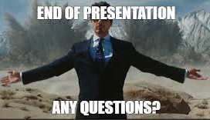
Thank you for paying attention !!
~ XinXin Tai, Sayali Nehul, Dharinesh Somisetty, Archit Jain
Notes:
Thank you for your attention. I'm happy to take any questions.

