Slide 1

MAJOR PROJECT – Mid Sem Evaluation
Presented by: Mentored by:
Archit Jindal (18103019) Dr. Rajneesh Rani
Navjot Singh (18103061) (Assistant Professor)

Slide 2
Contents:
Introduction
Applications/Scope
Methodology
Examples
Flow Diagram
Tech Stack

Slide 3
Introduction
The ability to recognize image features for generating textual description is very important for many tasks in computer vision.
So, we will make a Python project using Machine Learning which basically recognizes the image, interprets it and generate a corresponding text in Hindi which will be shown to the user.

Slide 4
Introduction (cont…)
Image captioning is the process of generating a textual description of an image that aims to describe the salient parts of the given image.
Here, in Image Captioning Bot, we are tackling this problem for Hindi language and hence generating captions in Hindi.
User will be able to upload the image manually from the system or from the webcam also.

Slide 5
Introduction (cont…)
It involves computer vision and natural language processing.
It also involves data pre-processing, data cleaning, and deep learning models like CNN, RNN, LSTM etc.
The model will be integrated with a website and user will be able to use in a feasible and easier way.

Slide 6
Applications/Scope
Image captioning has various applications such as: -
recommendations in editing applications
usage in virtual assistants, for image indexing, for visually impaired persons
for social media, and several other natural language processing applications.

Slide 7
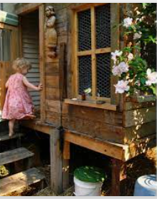
Methodology-
1) Dataset used : Flickr8k Dataset
It consists of around 8000 unique images and each image will be mapped to five different sentences which will describe the image.
Sample Captions:
1) A girl going into a wooden building.
2) A little girl climbing into wooden playhouse.

Slide 8
Methodology (Cont…)
Then, we pre-processed the caption data.
Then we took and the captions and using tokenizer to generate corresponding vocabulary and also dumped the tokenizer using pickle for further use.
Then, we performed a train-test split in 9:1 ratio.

Slide 9
Methodology (Cont…)
We used the instance of VGG16 model in our project.
We removed the last layer of VGG16 , as it was basically a classification layer.
Then, we extracted features from the images and dumped them using pickle for further use.

Slide 10
Methodology (Cont…)
Then, we trained the model for 20 epochs.
Then, using the test set, we generated some captions.
Then we re-trained the model for 30 epochs and again generated captions again. This time, results were better than the previous trained model.
Then, we save the model for further use.

Slide 11
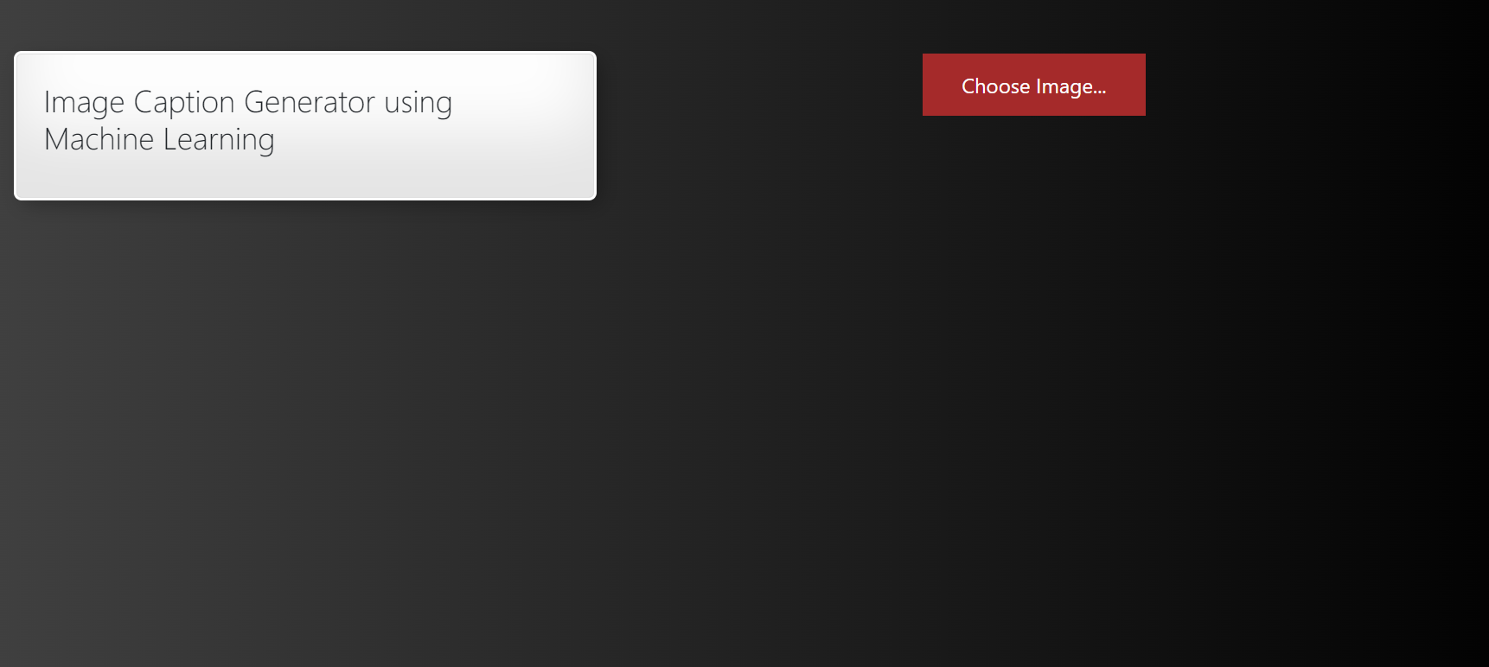
Image and Captions generated-
User Interface of our Image Captioning App

Slide 12
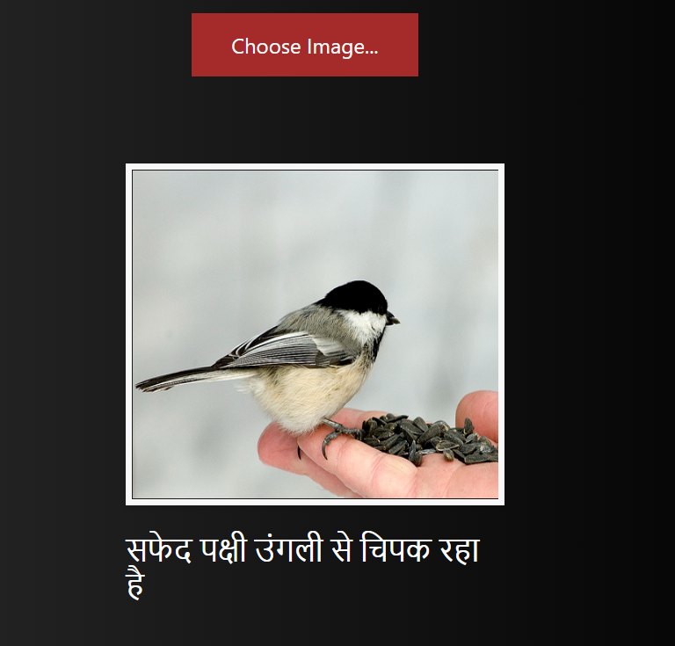
Image and Captions generated-
User Interface of our Image Captioning App

Slide 13
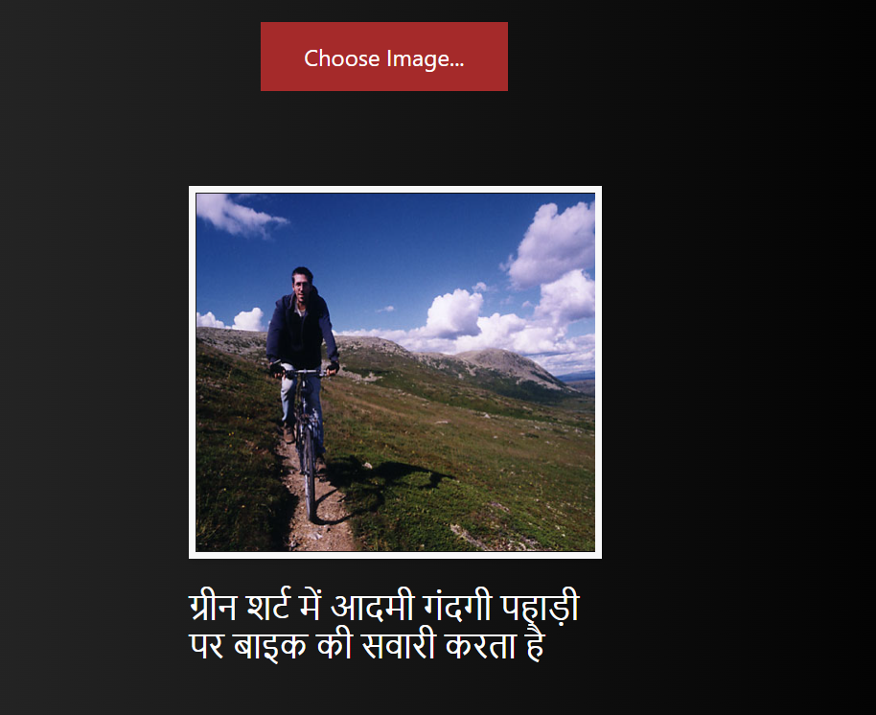
Image and Captions generated-
User Interface of our Image Captioning App

Slide 14
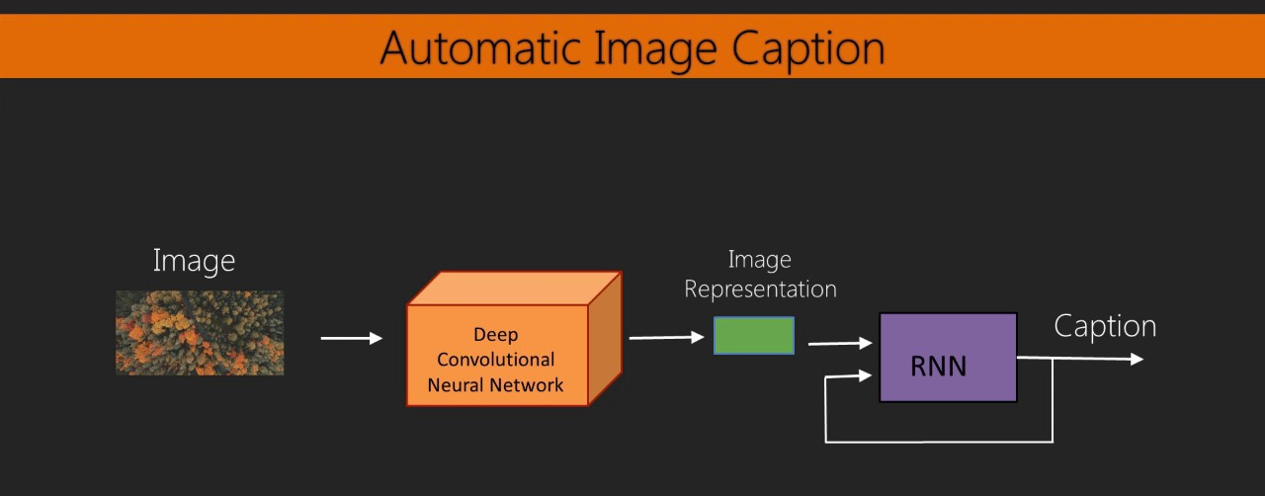

Slide 15
Further additions/trials to be done-
Try more methods of data cleaning, and check whether the performance of the model improves or not.
Try parameter tuning (like epochs and batch-size) and check the performance after the changes.

Slide 16
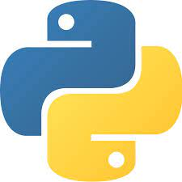
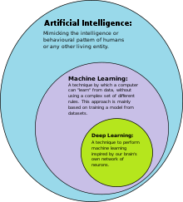
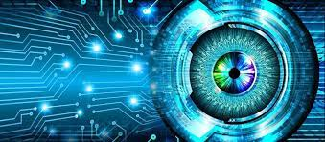
Tech Stack/Techniques-
Python Deep Learning Image Processing

Slide 17
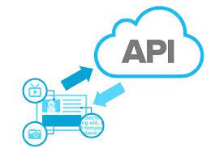

Tech Stack/Techniques-
API Calls TensorFlow

Slide 18

Tech Stack/Techniques -
Flask

Slide 19

Thank you !!

