Slide 1
HarAppan and Mesopotamian civilization
Name:-Shivangi Roll no.:-19
Class9th’B’

Slide 2
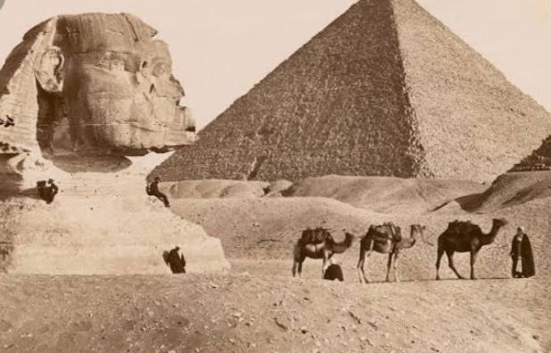
~Civilization~
A civilization is a complex human society, usually made up of different cities, with certain characteristics of cultural and technological development. In many parts of the world, early civilizations formed when people began coming together in urban settlements.The Romans usually wanted conquered people to live in towns. A civilization is generally an advanced stage of organization. That means it has laws, culture, a regular way of getting food and protecting the people.

Slide 3
~Harappan Civilization~
Indus civilization, also called Indus valley civilization or Harappan civilization, the earliest known urban culture of the Indian subcontinent. The nuclear dates of the civilization appear to be about 2500–1700 bce, though the southern sites may have lasted later Into the 2nd millennium bce.
The civilization was first identified in 1921 at Harappa in the Punjab region and then in 1922 at Mohenjo-daro (Mohenjodaro), near the Indus River in the Sindh (Sind) region. Both sites are in present-day Pakistan, in Punjab and Sindh provinces, respectively. The ruins of Mohenjo-daro were designated a UNESCO World Heritage site in 1980.

Slide 4
~Mesopotamian Civilization~
Mesopotamia is the region within the Tigris and Euphrates rivers located south of Anatolia and West of the Iranian plateau. It hosted the earliest large-scale civilizations, who bequeathed the earliest forms of organized government, religion, warfare, and literature. Mesopotamian civilizations flourished from the founding of the Sumerian Empire in 3100 BC to the fall of Babylon in 539 BC to the Achaemenid
In the narrow sense, Mesopotamia is the area between the Euphrates and Tigris rivers, north or northwest of the bottleneck at Baghdad, in modern Iraq; it is Al-Jazīrah (“The Island”) of the Arabs. South of this lies Babylonia, named after the city of Babylon. However, in the broader sense, the name Mesopotamia has come to be used for the area bounded on the northeast by the Zagros Mountains and on the southwest by the edge of the Arabian Plateau and stretching from the Persian Gulf in the southeast to the spurs of the Anti-Taurus Mountains in the northwest. .

Slide 5
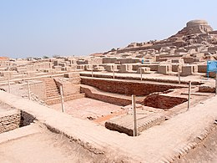
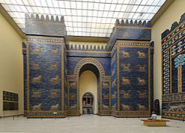
~Architecture~
Harappan architecture:-
Harappa architecture is the architecture of the Indus Valley Civilization, an ancient society of people who lived during circa 3300 BCE to 1300 BCE in the Indus Valley of modern-day India and Pakistan.
~Mesopotamian architecture:-
The architecture of Mesopotamia is ancient architecture of the region of the Tigris–Euphrates river system (also known as Mesopotamia), encompassing several distinct cultures and spanning a period from the 10th millennium BC, when the first permanent structures were built in the 6th century BC. Among the Mesopotamian architectural accomplishments are the development of urban planning, the courtyard house, and ziggurats. No architectural profession existed in Mesopotamia; however, scribes drafted and managed construction for the government, nobility, or royalty.

Slide 6
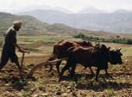
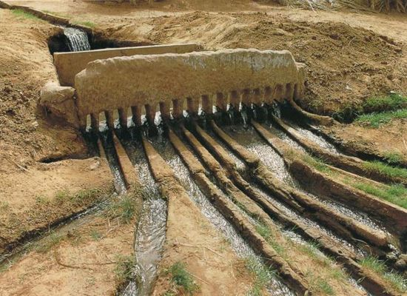
~Food &Farming~
~Food & Farming of Harappan Civilization:-
The first people of this civilization reached India from Africa in 40,000 BC. At first they were hunters and gatherers but in 4000 BC they became farmers. The Indus valley farmers grew wheat, grains, and animals on land. Cows, goats, and sheep gave milk and alternatives. They cooked on hearths and grounded grain into flour by rubbing a rounded stone across on top of a flat stone. Bread, and porridge were part of everybody’s diet. They mostly ate veggies and fresh or salted fish. The rich ate meat.
~Food & Farming of Mesopotamian civilization:-
The Mesopotamians farmed all kinds of things, but the most valuable food sources were the grains they grew. Barley was probably the most common of these. … The Mesopotamians had herds of livestock (cattle, goats, sheep) that could used for their meat, milk, and wool or hides.

Slide 7
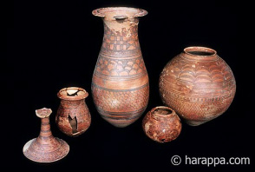
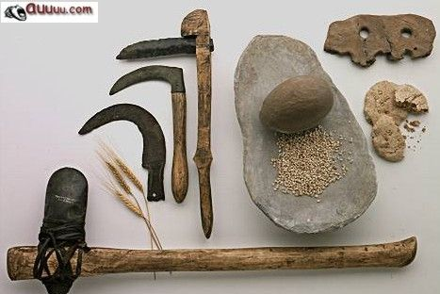
~Tools~
Tools of Harrapan Civilization:-
Tools were constructed from bronze and possibly copper and iron. Clay was both distributed in making tools and manufacturing. The civilizations developed a measuring system and tools for measurement.
~Tools of Mesopotamian civilization:-
The farmers of Mesopotamia were inventive. They made bronze hand tools, like hammers, sickles, axes, and hoes. Mesopotamians were probably the first to use the wheel. By 3000 BCE, they had invented the plow and plow seeder.

Slide 8
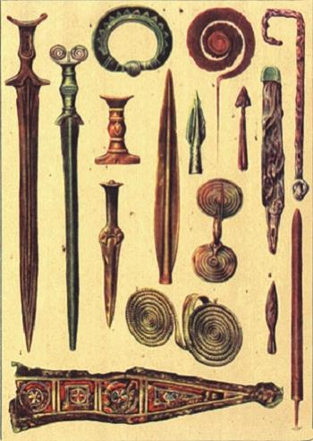
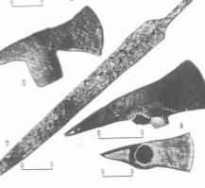
~Weapons~
Weapons of Mesopotamian civilization:-
Mesopotamian weapons used spears, maces, axes, adzes, and bows and arrows. They would carry daggers and swords, including sickle-shaped swords. To protect themselves, these foot soldiers would have body armor, round helmets, and small round shields. Charioteers were employed by ancient Mesopotamians as well.
Weapons of Harrapan Civilization:-
Weapons were constructed from bronze, also the weapons weren’t as developed as it was in the Mesopotamian society. Arrows were crafted and swords had not been developed at the time. Because the isolated geography, not many weapons were needed, and the people of the civilizations were peaceful, and didn’t want to encounter war.

