Slide 1
THE INDIAN CONSTITUTION PROTECTS THE RIGHTS OF CHILDREN,WOMEN MINORITIES AND WEAKER SECTIONS NAVNI VERMA Class – 9^{th(wandering minds)}

Slide 2
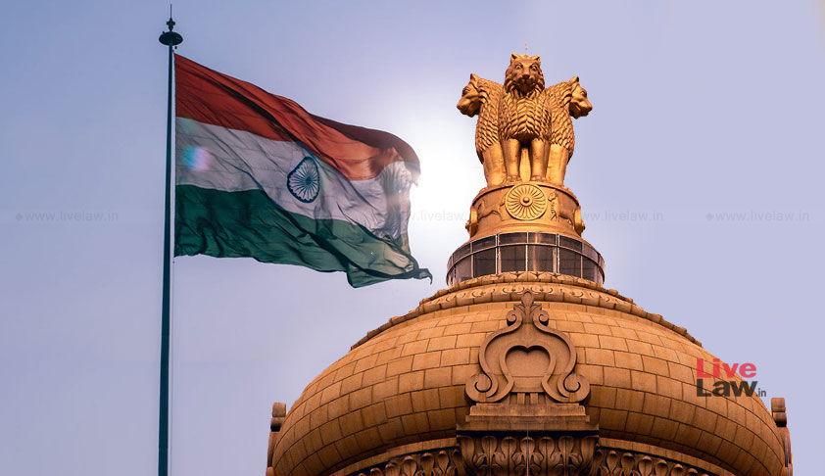
The Indian Constitution
The Constitution of India (Bharatiya Samvidhana) is the supreme law of india. The document lays down the Framework that demarcates fundamental political code, structure, procedures, powers, and duties of government institutions and sets out fundamental rights, directive principlesb ,and duties of citizens. It is the longest written constitution of any country.

Slide 3
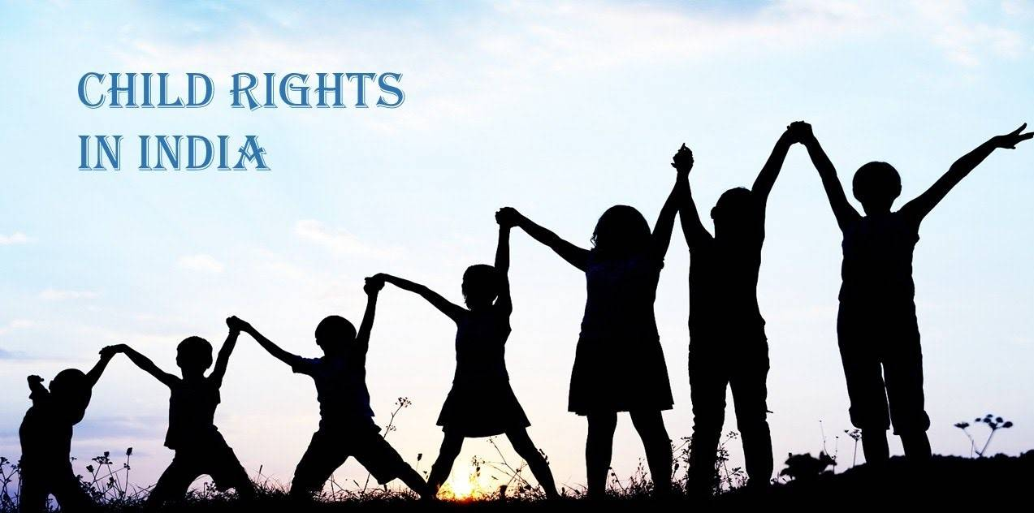
THE INDIAN CONSTITUTION PROTESTS THE RIGHTS OF CHILDREN

Slide 4
According to internationl law, a child means every human being below the age of 18years. This is a universally accepted definition of a child and comes from the United Nations Convection on the rights of the Child (UNCRC), an international legal instrument accepted and ratified by most countries.
India has always recognized the category of persond below the age of 18 years as distict legal entity. That is precisely why people can vote or get a driving license or enter or enter into into legal contracts only when they attain the age of 18years. Marriage of a girl below the age of 18 years and a boy below 21 yearsis restrained under the child marriage Restraint Act 1929, India changed its law on juvenile justice to ensure that every every person below the age of 18 years have to be treated as children.

Slide 5
CHILDREN RIGHTS
1. Right to free and complusary elementary education for all the children in 6-14 year age group (Article 21-A).
2. Right to be protced from any hazardous employment till the date of 14 years.(Article-24).
3. Right to be protected from being abused and forcrd by economic necessity to enter occupations unsuited to their age or strength.(Article 39)

Slide 6
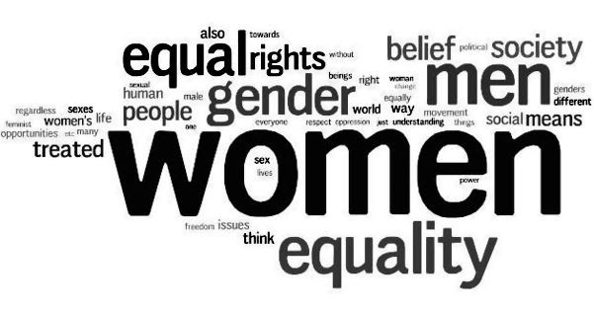
THE INDIAN CONSTITUTION PROTECTS THE RIGHTS OF WOMEN
The Constitution of India not only grants equality to women but also empowers the State to adopt measures of positive discrimination in favour of women for neutralising the cumulative socio economic, education and political disadvantages faced by them. Fundamental Rights, among others, ensure equality before the law and equal protection of law; probhits discrimination against any citizens on the grounds of religion ,race,caste,sexor place of birth, and guarantee equality of opportunity to all citizens in matters related to employment.

Slide 7

Article 14
Article 15
Article 15(3)
Article 16
Article 39(b)
Article 39(c))
And Article 42 of Constitution are of specific importance in the regard.

Slide 8
Constitutional Rights accorded to Minorities
Right of a minority to establish educational institutions – (a) Article – 30 – Article – 30(1) gives the linguistic or religious minorities the following two rights: (a) The right to establish, and (b) The right to administer educational institutions of their choice.
Article – 30(2) bars the state, while granting aid to educational institutions, from discriminating against any educational institution on the ground that it is under the management of a linguistic or a religious minority. It mandates that in granting aid to educational institutions, the state shall not discriminate against any educational institution on the ground that it is under the management of a minority, whether based on religion or language.

Slide 9
Rights of weaker Sections
Constitutional provisions like Article 14. 15 and 16 ensures that there is not discrimination against weaker section, and if possible, State can take help of positive discrimination to improve the politico-economic situation of weaker section of society. And on this basis reservation for weaker class like SC/ST , women etc is provided in public employment, educational institutions, and legislature at different levels.
Article 14: This ensures equality before law and equal protection of law. Article 15: This prohibits discrimination on any ground i.e. religion, race, caste, sex, place of birth. Article 21: No person shall be deprived of his life or personal liberty except the procedure established by law. Article 25: This ensures freedom of conscience and the right freely to profess, practice and propagate religion. Article 26: This ensures a right to manage religious institutions, religious affairs, subject to public order, morality and health.

Slide 10


