Slide 1
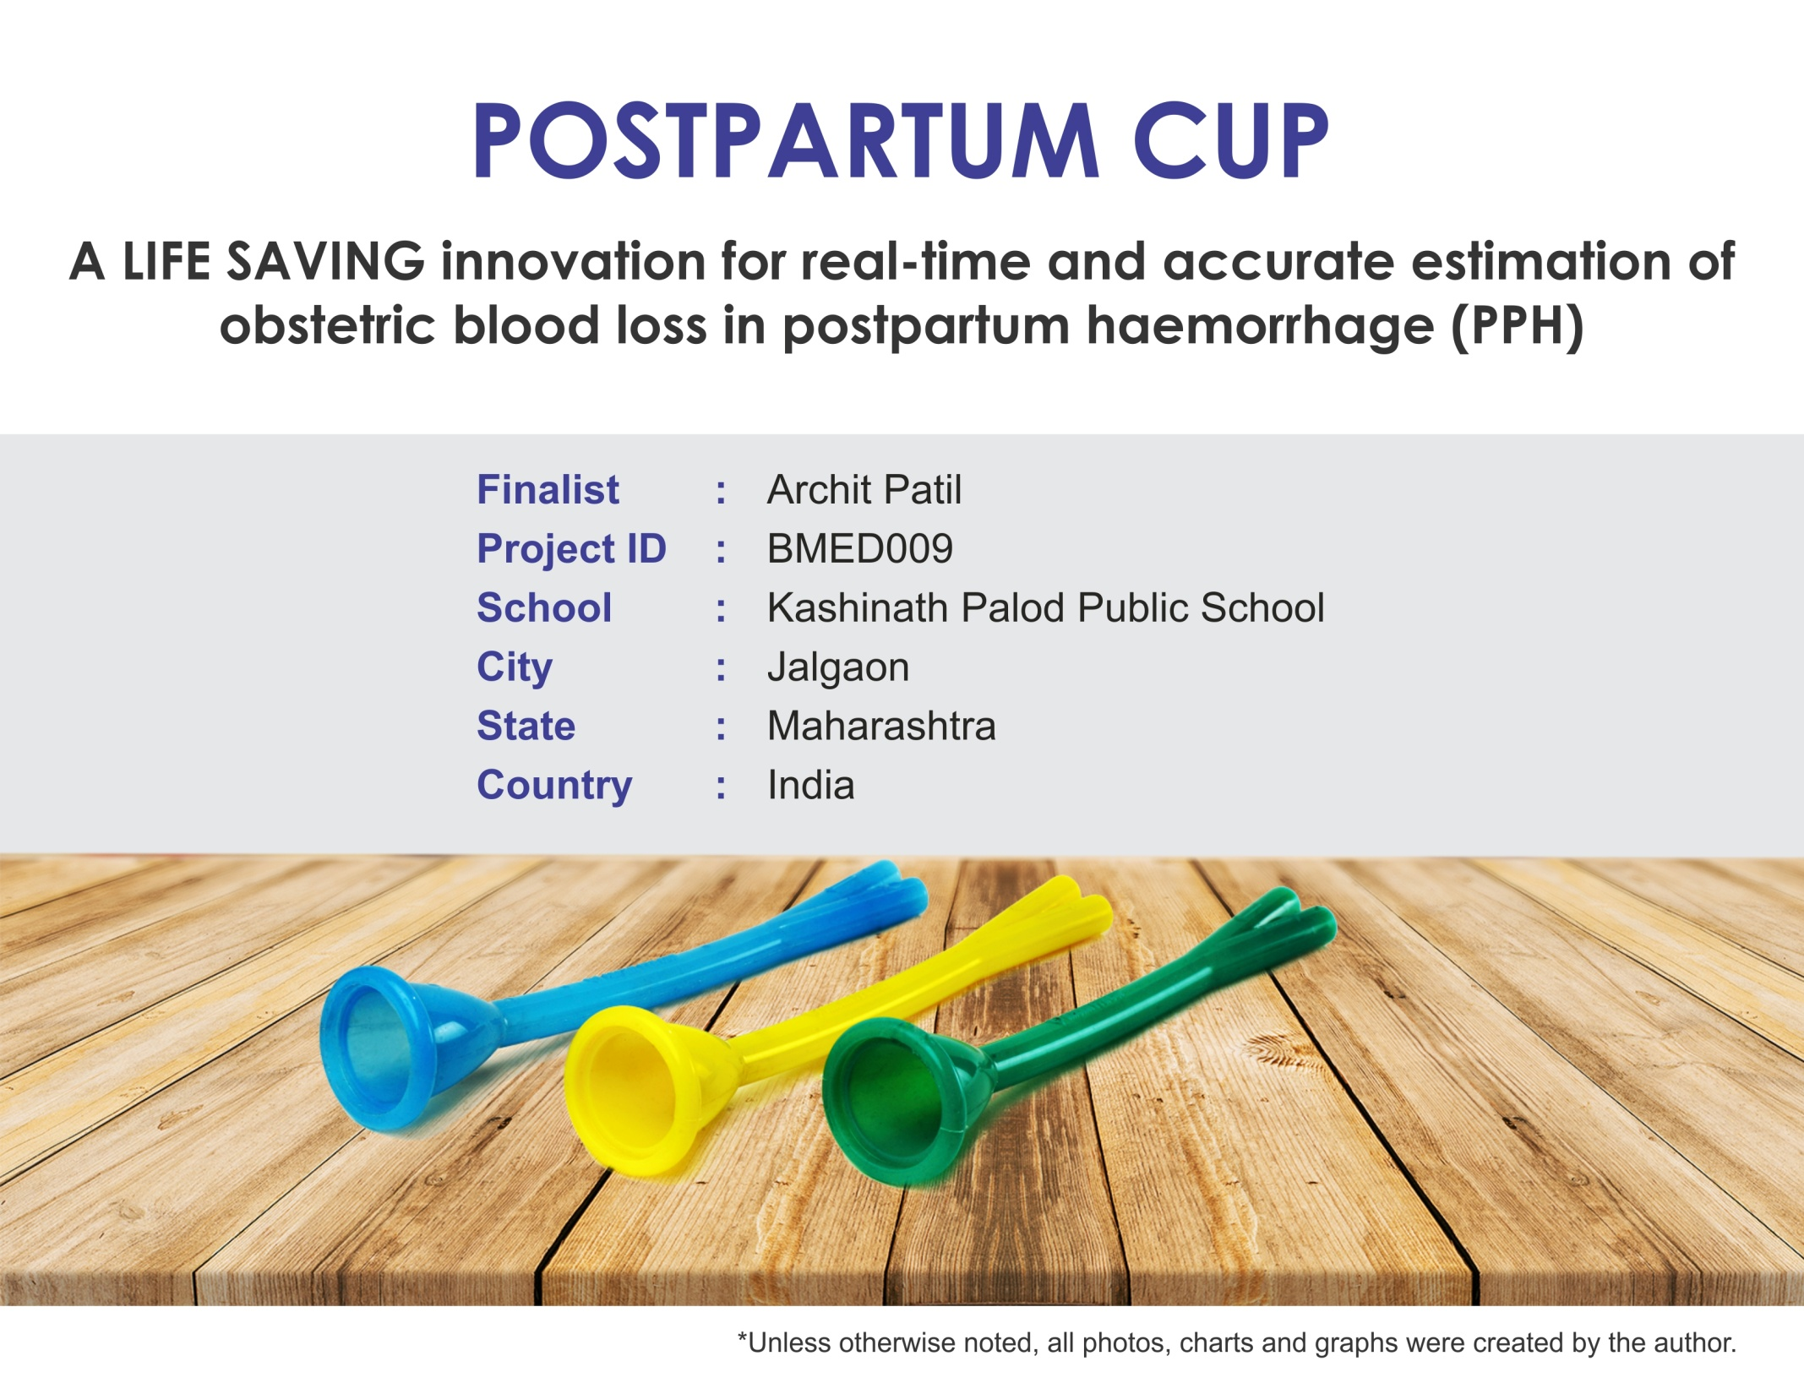

Slide 2
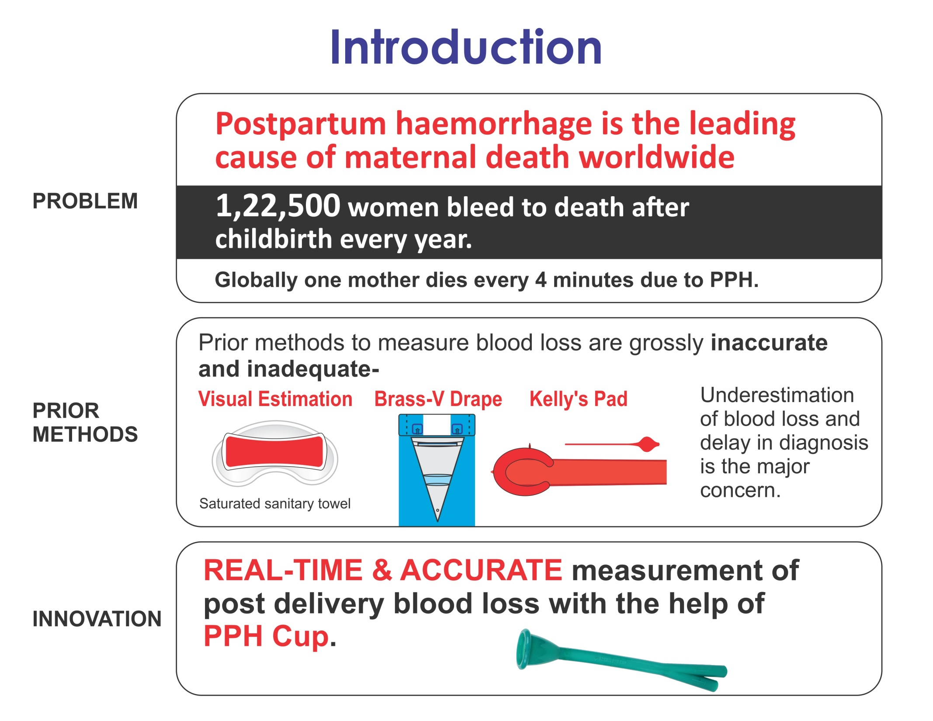

Slide 3
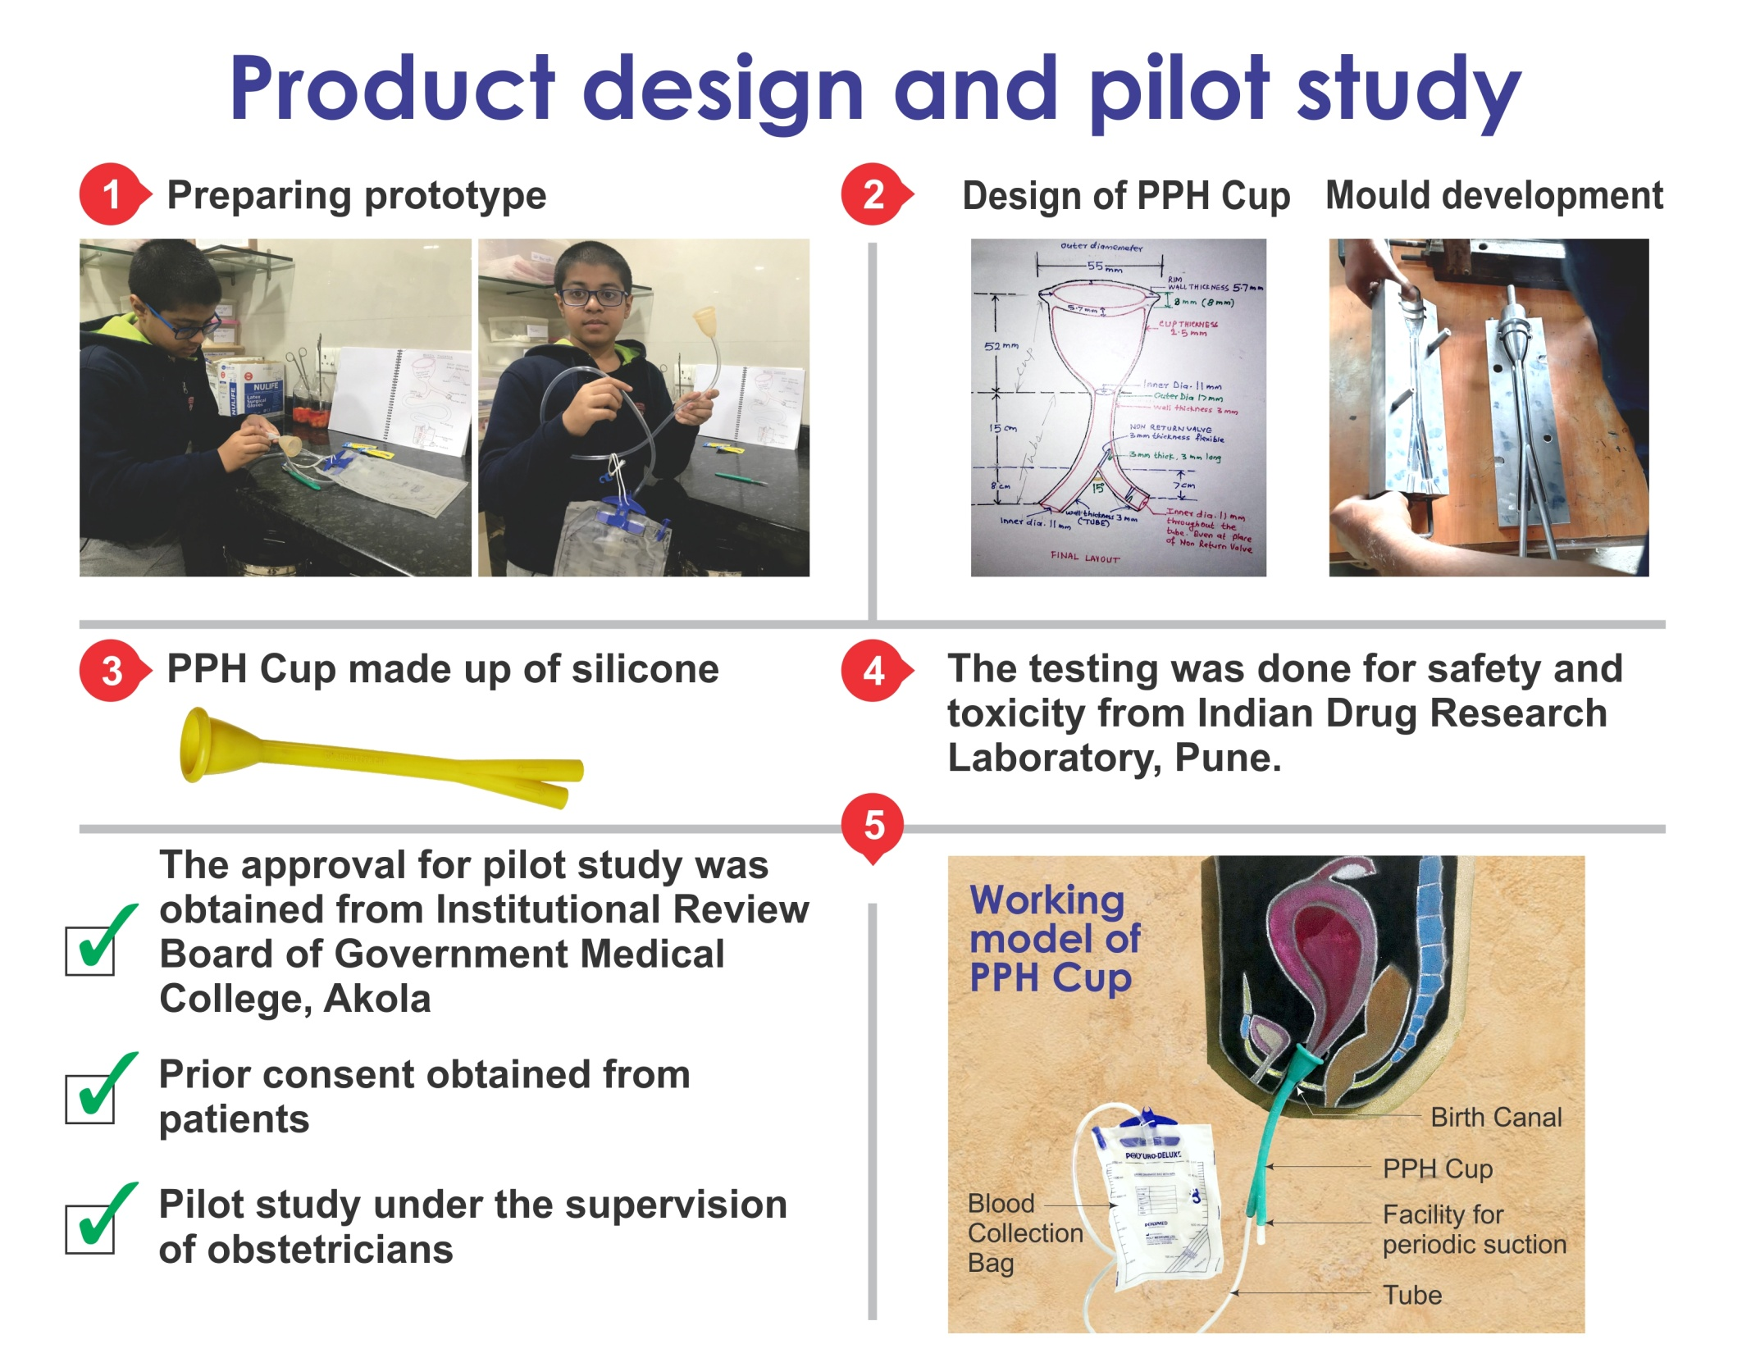
Notes:
Firstly,i prepared the prototype.The the pph cup was designed and the mould was developed.THen the pph cup was made up of silicone.It was tested for safety and toxicity from IDRL Pune.It was also approved by the USAFDA(USA food and drug association).The approval for the pilot study was obtained

Slide 4
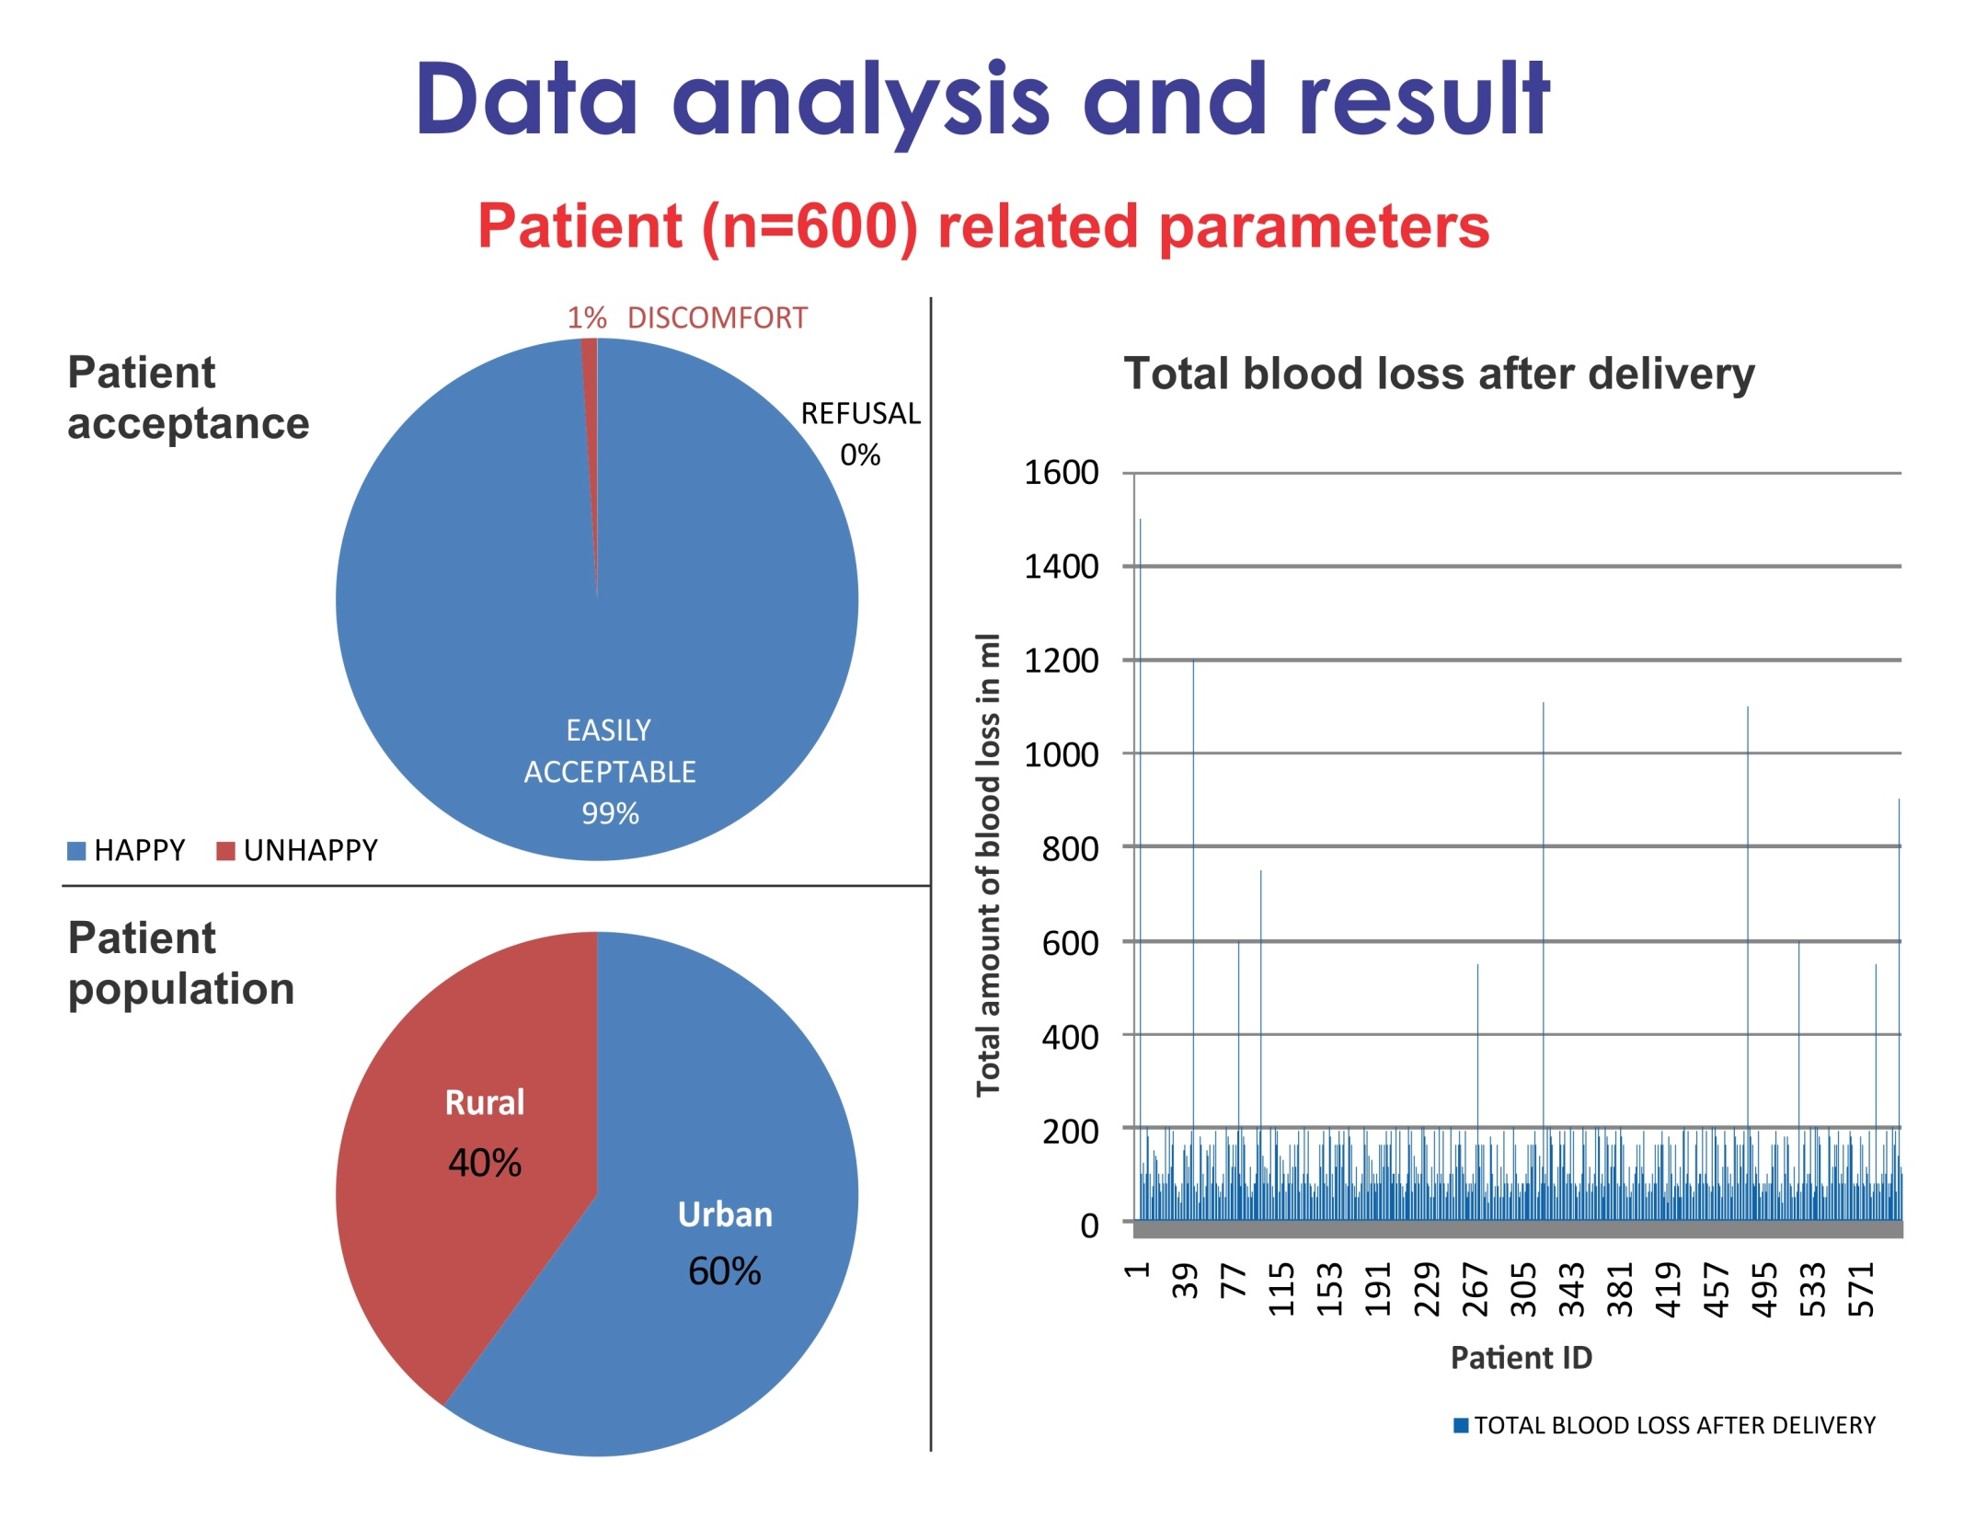

Slide 5
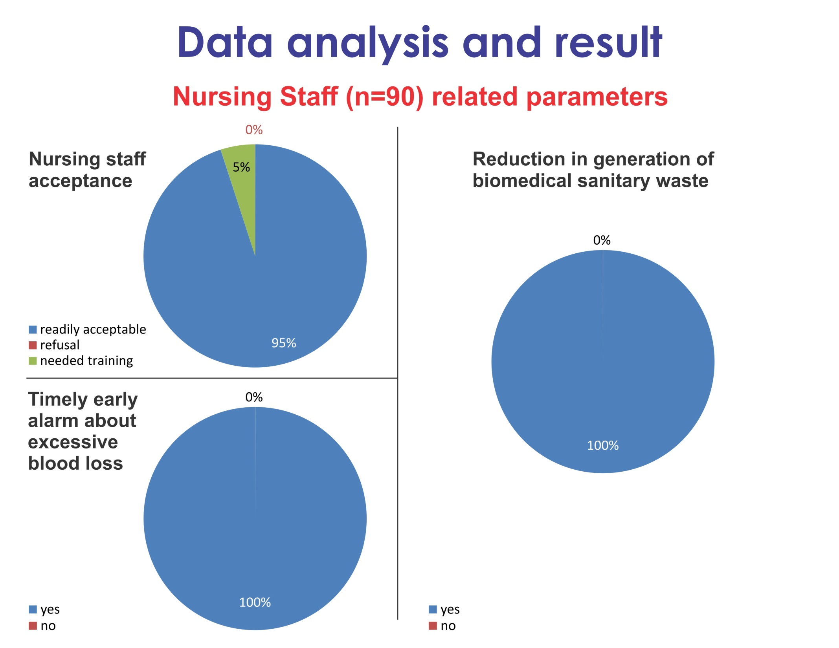
Notes:
The nursing staff accepts the pph cup readily and it gives timely alarm to the doctors and helps save the maternal life.It also reduced the production of nondegradable biomedical waste and helps the environment.

Slide 6
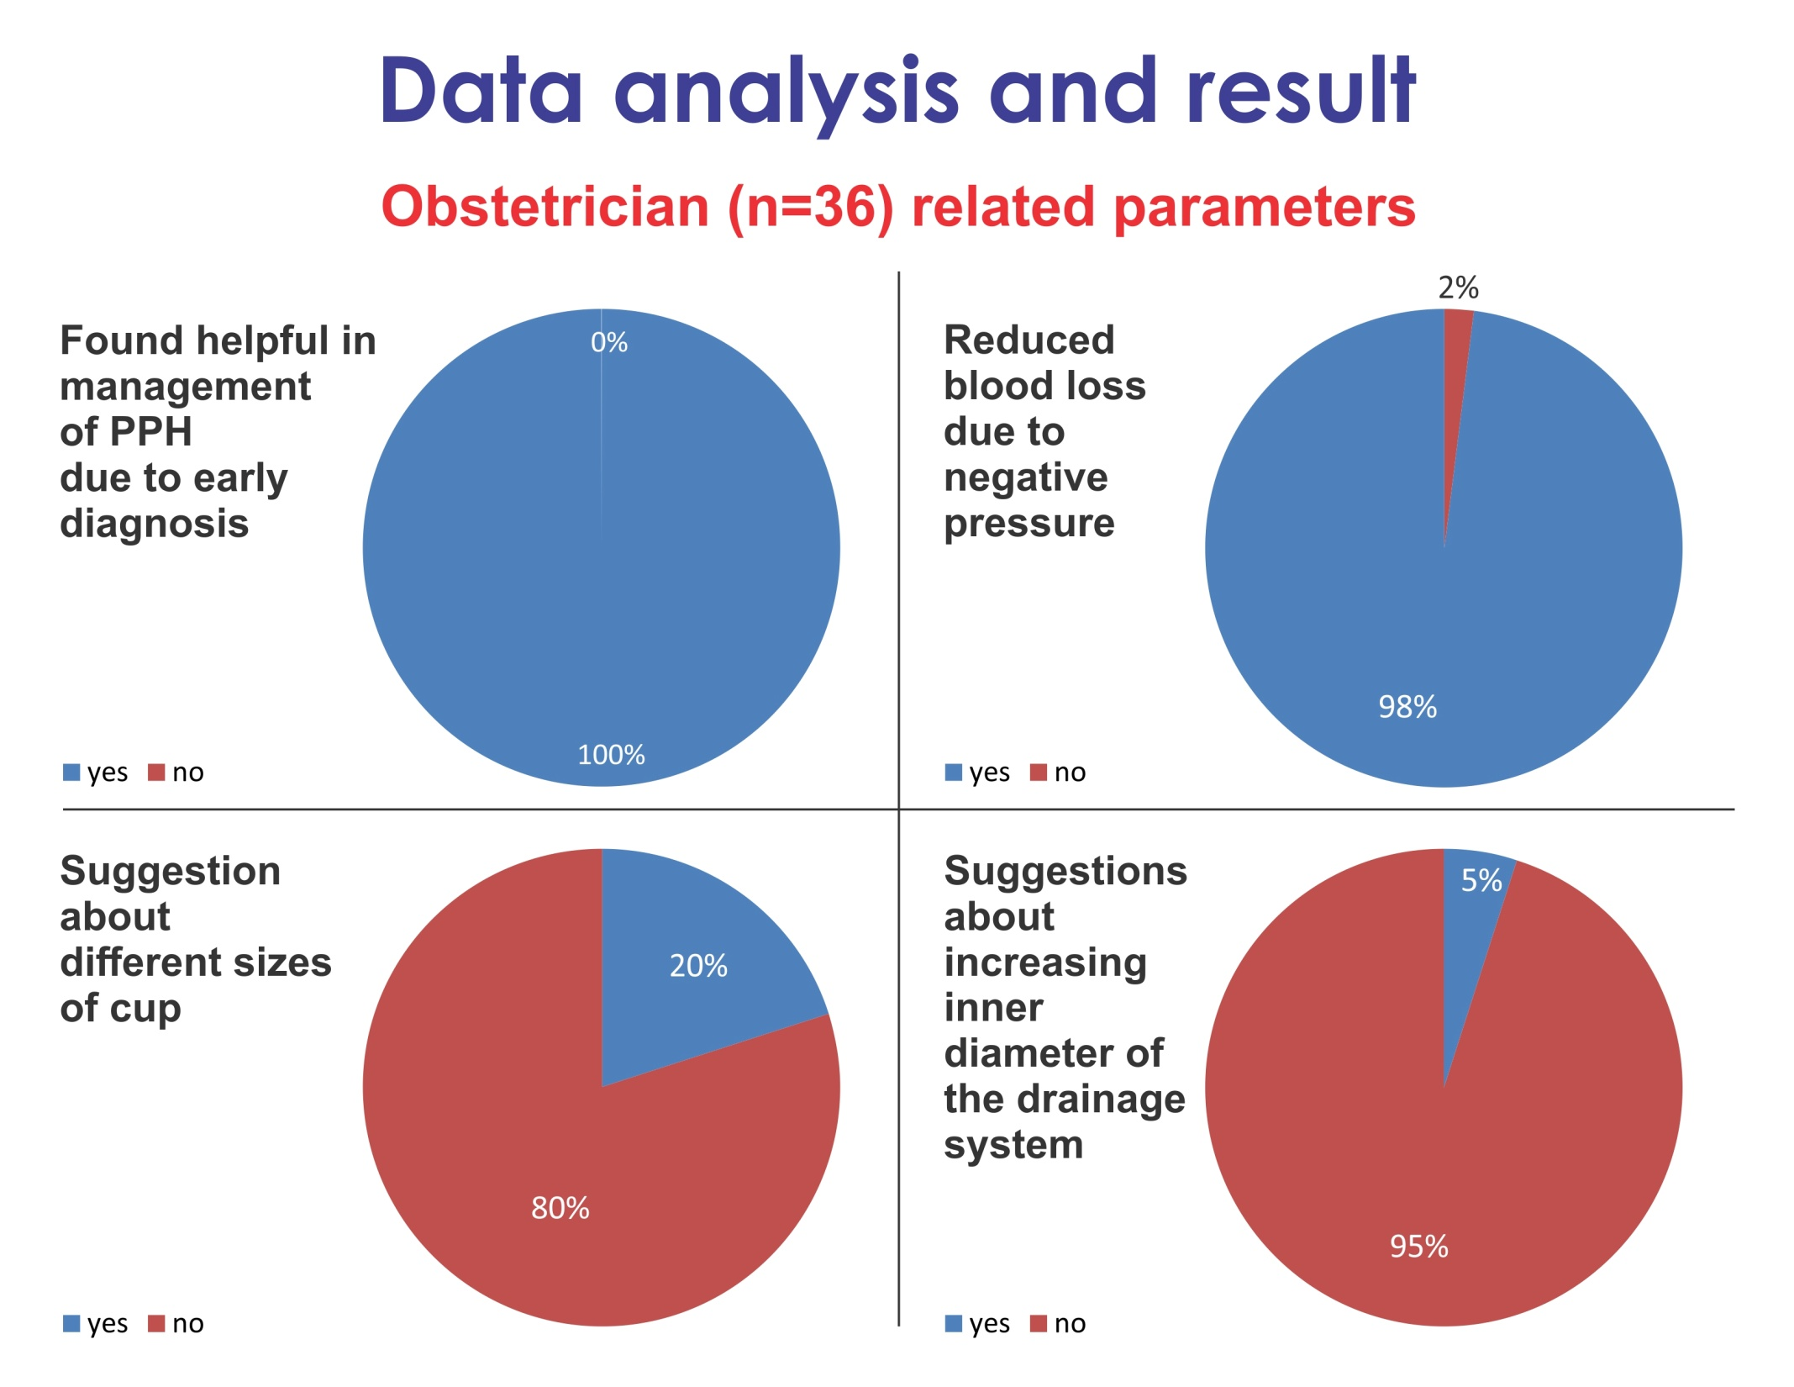
Notes:
Its has been shown to be helpful in helping with thebmanagement of pph,Some obstetricians have suggested about different sizes of pph cup and also suggested about inc

Slide 7
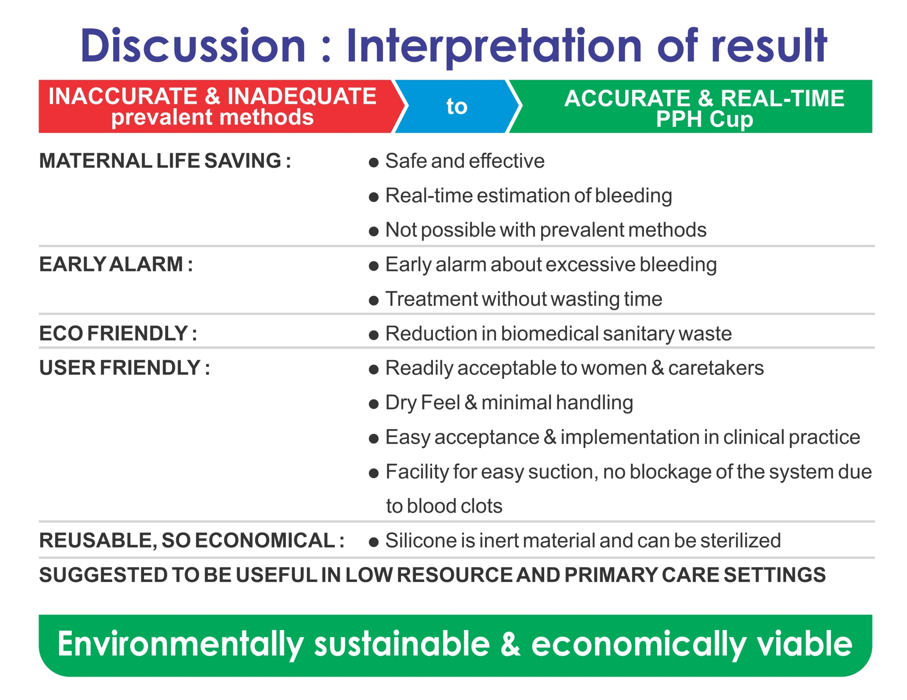

Slide 8
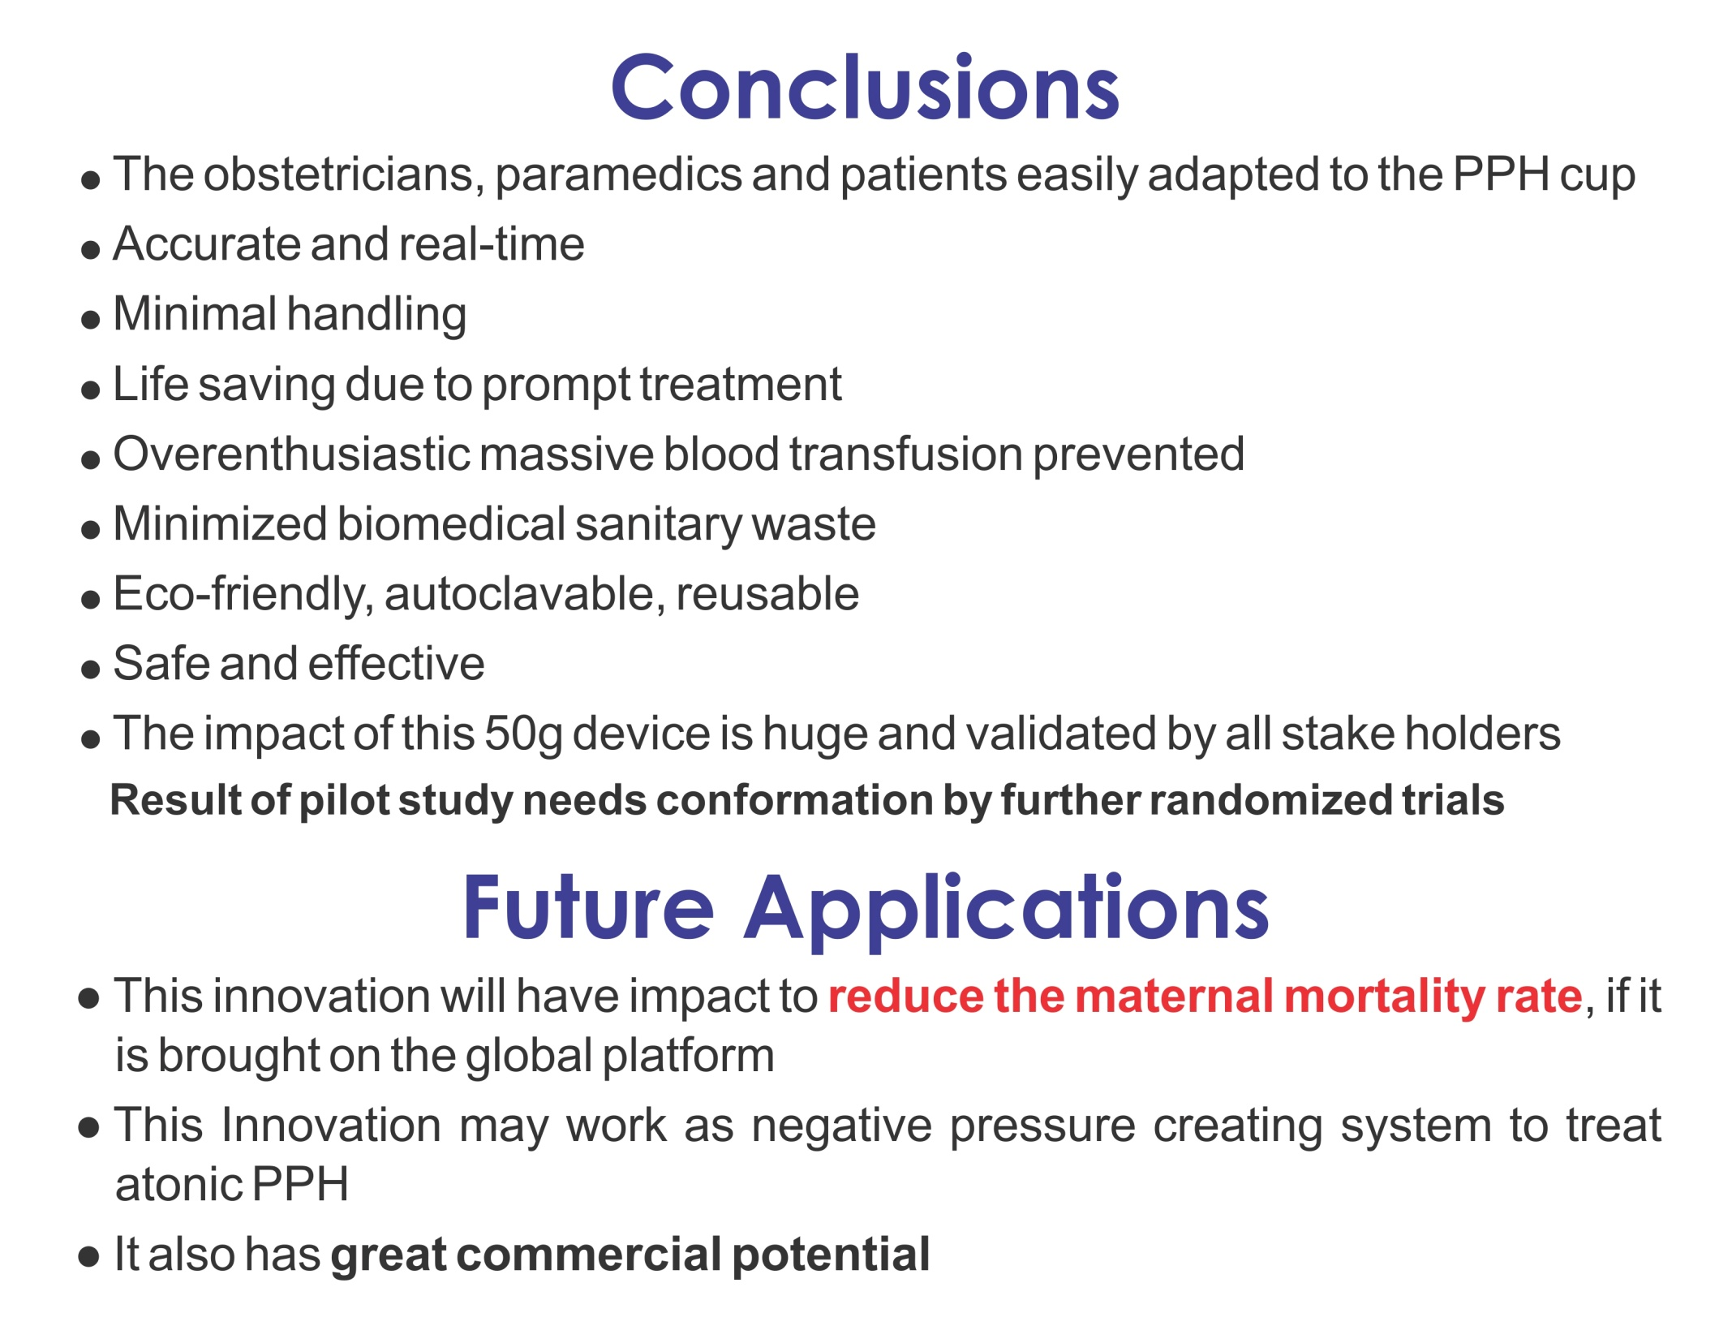

Slide 9
