Slide 1
Simple Expense Tracker
Capgemini Programming Assignment
Archit Sharma
June 2026

Slide 2
Problem Statement
Build a simple application to track expenses and generate spending insights.
Requirements:
• Add expenses
• Store data in a file
• Calculate totals and trends
• Identify highest and lowest spend categories

Slide 3
Approach & Design
• Java Swing desktop application
• CSV file storage
• Object-oriented design
• No database required
• Simple and easy-to-maintain architecture

Slide 4
Application Architecture
ExpenseTrackerApp (UI)
|
ExpenseManager (Business Logic)
|
FileHandler (CSV Storage)
|
expenses.csv

Slide 5
Project Structure
Expense.java - Expense model
ExpenseManager.java - Calculations and expense management
FileHandler.java - CSV read/write operations
ExpenseTrackerApp.java - User interface
expenses.csv - Persistent storage

Slide 6
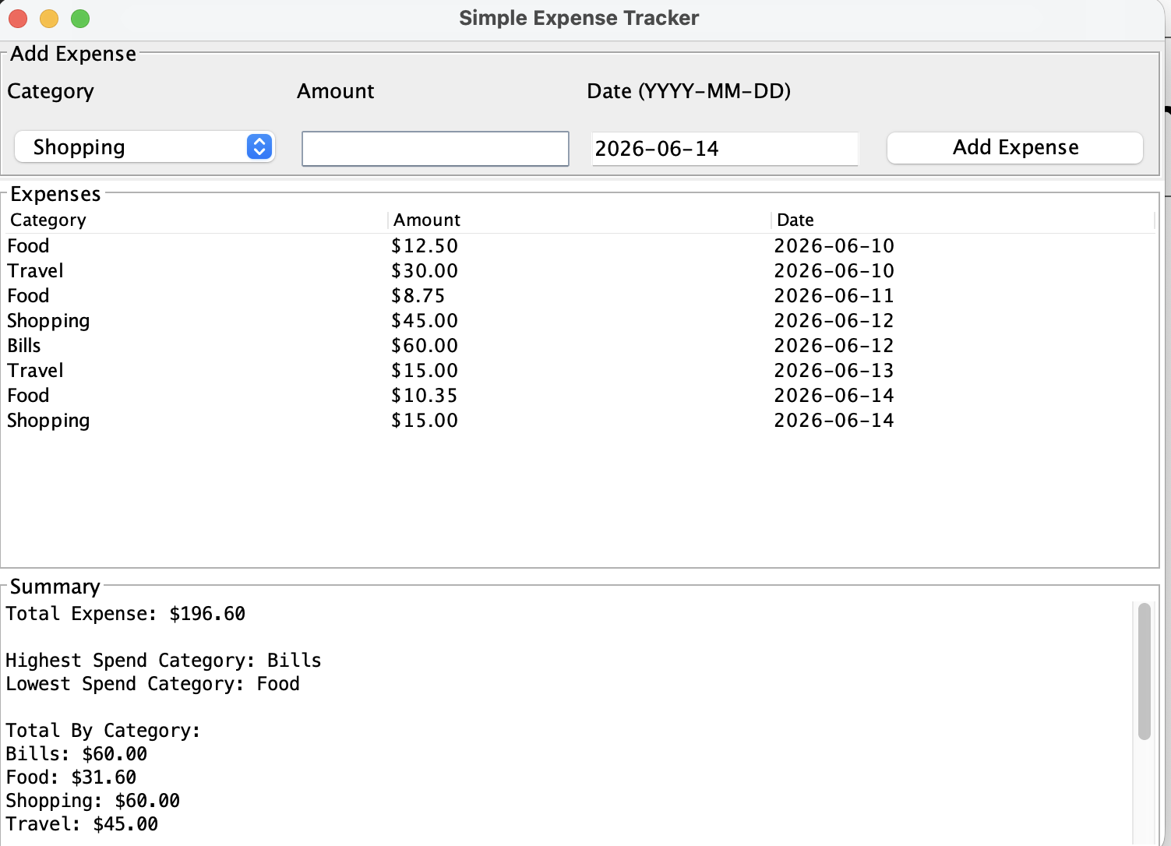
Features & Application Screenshot
Features:
• Add Expense
• View Expenses
• Total Expense
• Total by Category
• Expense Trend
• Highest and Lowest Spend Category

Slide 7
Testing & Verification
Test Case 1: Add valid expense → Appears in table
Test Case 2: Enter non-numeric amount → Validation message
Test Case 3: Enter negative amount → Validation message
Test Case 4: Restart application → Data persists in CSV

Slide 8
Future Improvements
• Edit/Delete expenses
• Charts and visual analytics
• Search and filtering
• Database integration
• Export reports

