Slide 1

MINI PROJECT
TOPIC : Spam Filter
stats
M.L.
process
K.N.N.
Problems
about
DESIGNED BY :
Archit Shukla , Ashwani Ponia

Slide 2

M.L.
SPAM FILTER
stats
K.N.N.
process
timeline
about
A Spam Filter is a Classifier built on Machine Learning techniques based on Data set made from data collected so far which will classify whether the e-mail is a spam or not.

Slide 3



Types of Learning
1
2
3
stats
Supervised
Un-Supervised
Semi-Supervised
M.L.
process
K.N.N
Problems
about

Slide 4
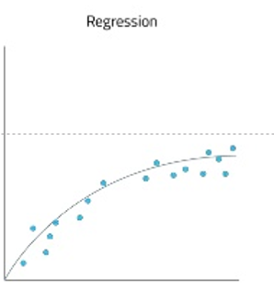
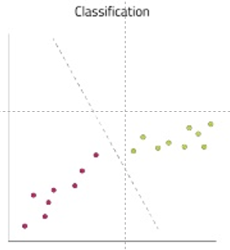
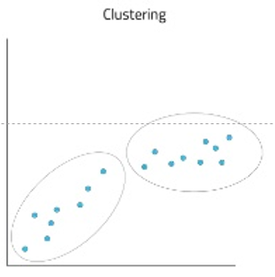
Types of M.L. Problems
stats
M.L.
process
K.N.N
Problems
about
Regression
Classification
Clustering

Slide 5
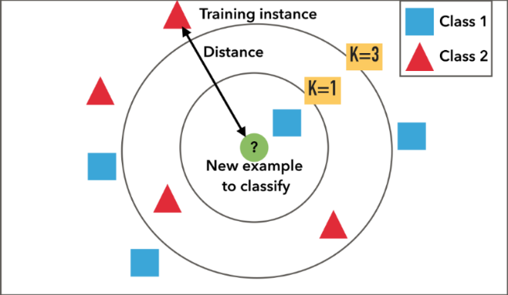
stats
K.N.N.
M.L.
process
Problems
about

Slide 6






File Creation
Predict
Train Model
Test Accuracy
stats
teams
history
process
timeline
about
Test Model
Result

Slide 8




stats
M.L.
process
K.N.N
Problems
about
4M
14B
66K

