Slide 1
Presentation
SkillMapper

Slide 2
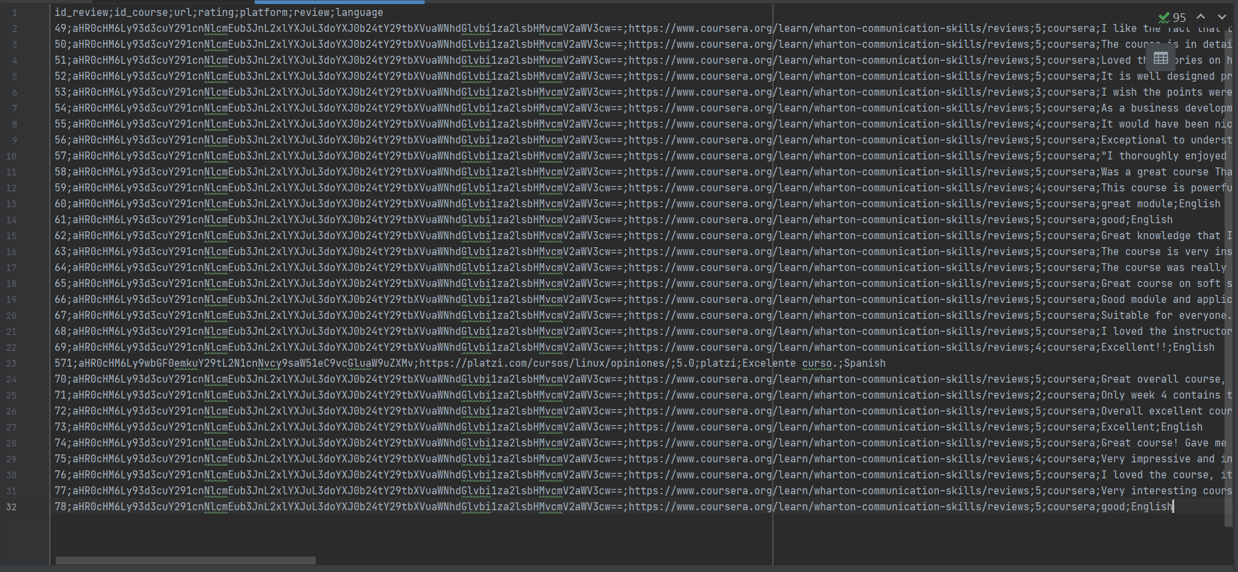

Slide 3
Issues to solve
Commodification of courses
Too many courses to pick from
Limited exposure to reviews
Too many reviews
Good reviews always on top
High search time
Comparing multiple courses
Caused by the 1st issue

Slide 4
Issues to solve
Commodification of courses
Too many courses to pick from
Limited exposure to reviews
Too many reviews
Good reviews always on top
High search time
Comparing multiple courses
Caused by the 1st issue
Something that takes into account all the courses
Something that takes into account all the reviews
Decision making should not take away too much time

Slide 5
Possible Approaches
Wordcloud and top-words
Sentiment Analysis
TF-IDF Approach
Cosine similarity using spaCy

Slide 6
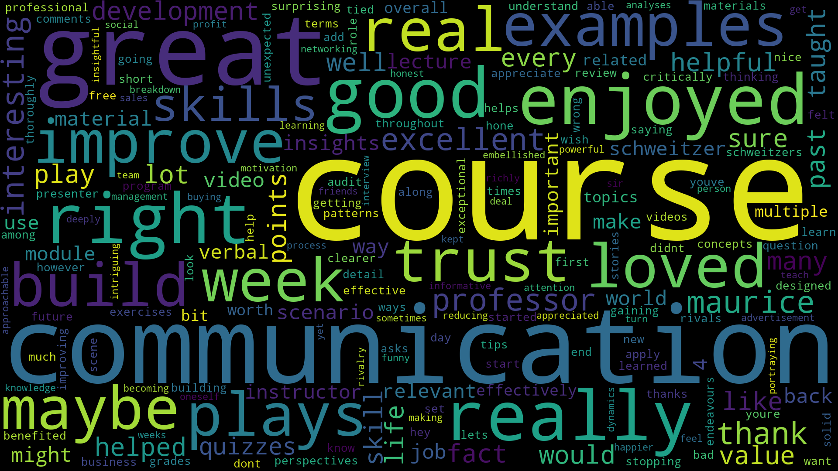
Wordcloud & Top-Words
word count
course 23
communication 12
great 10
enjoyed 4
right 4
good 4
really 4
plays 3
improve 3
loved 3
real 3
examples 3
week 3
maybe 3
build 3
trust 3
skills 3
professor 3
thank 3
maurice 3
interesting 3

Slide 7
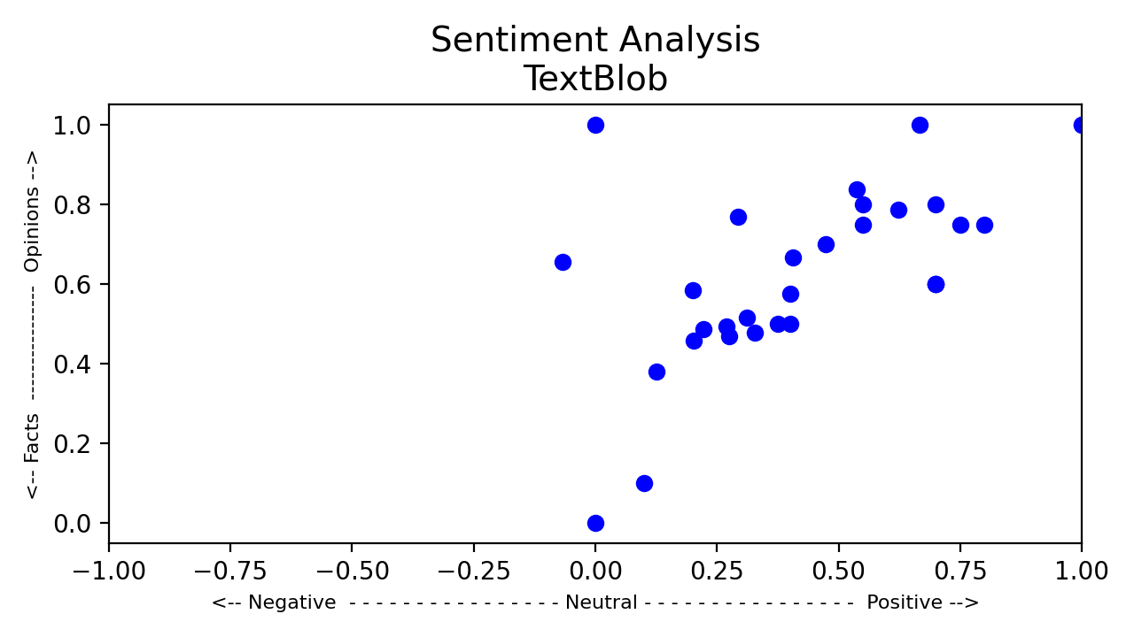
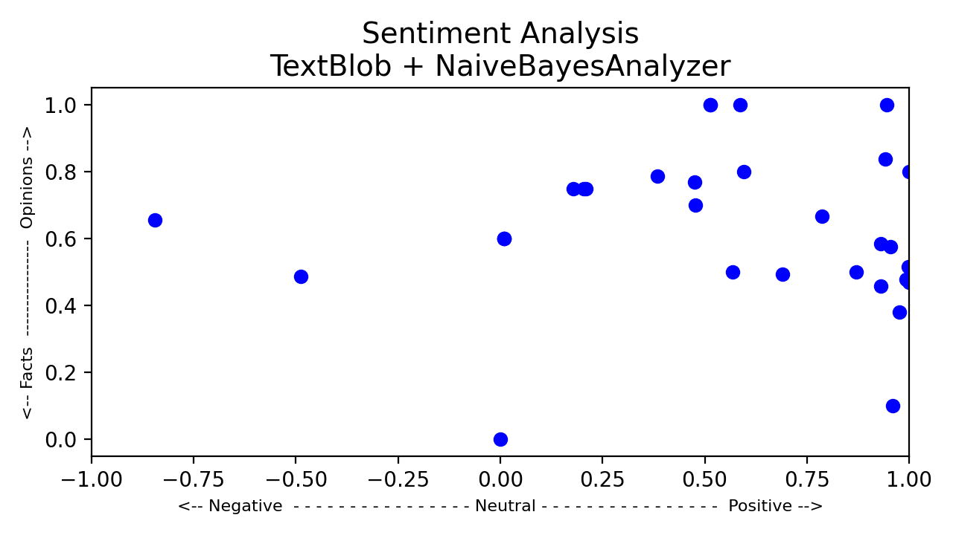
Sentiment Analysis
TextBlob (based on NLTK)
PatterAnalyzer
NaiveBayesAnalyzer
Possible for each course
Comparison between courses

Slide 8
TF-IDF Approach
Generally used for words
Can be possibly leveraged for reviews
TF-DF

Slide 9
TF-IDF Approach
Course α
Course 1
Course 2
Course M
. . .
review 1
review 2
review 3
.
.
.
review n
review 1
review 2
review 3
.
.
.
review n
review 1
review 2
review 3
.
.
.
review n
review 1
review 2
review 3
.
.
.
review n

Slide 10
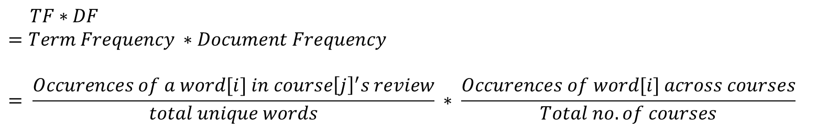
TF-IDF Approach
word count
course 23
communication 12
great 10
enjoyed 4
right 4
good 4
really 4
plays 3
improve 3
loved 3
real 3
examples 3
week 3
maybe 3
build 3
trust 3
skills 3
professor 3
thank 3
maurice 3
interesting 3
$$TF∗DF$$
$$=Term Frequency ∗Document Frequency$$
$$= \frac{Occurences of a word[i] in course{\left[j\right]}^{′}s review}{total unique words} ∗ \frac{Occurences of word[i] across courses}{Total no. of courses}$$
Course 1
Course 2
Course M
. . .
review 1
review 2
review 3
.
.
.
review n
review 1
review 2
review 3
.
.
.
review n
review 1
review 2
review 3
.
.
.
review n

Slide 11
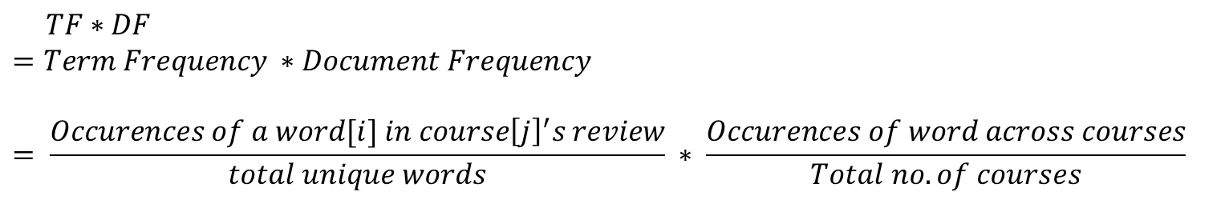
TF-DF Approach
W1 W2 . . . W_{N}
Course 1
Course 2
.
.
.
Course M
$$TF∗DF$$
$$=Term Frequency ∗Document Frequency$$
$$= \frac{Occurences of a word[i] in course{\left[j\right]}^{′}s review}{total unique words} ∗ \frac{Occurences of word across courses}{Total no. of courses}$$
Takes into account all reviews
Takes into account all courses

Slide 12
spaCy’s .similarity()
Based on cosine similarity
Returns value between [0, 1]
θ
nlp = spacy.load("en_core_web_sm")
doc_gold = nlp(course_gold_reviews)
doc1 = nlp(course1_reviews)
doc2 = nlp(course2_reviews)
doc3 = nlp(course3_reviews)
doc_gold.similarity(doc1)
doc_gold.similarity(doc2)
doc_gold.similarity(doc3)
return numpy.dot(self.vector, other.vector) / (self.vector_norm * other.vector_norm)

