Slide 1



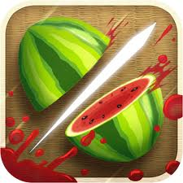




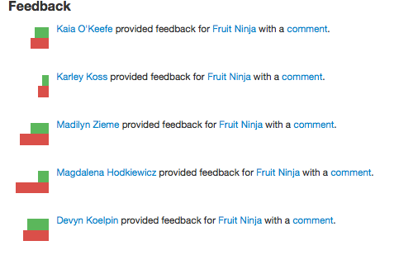
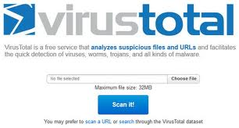
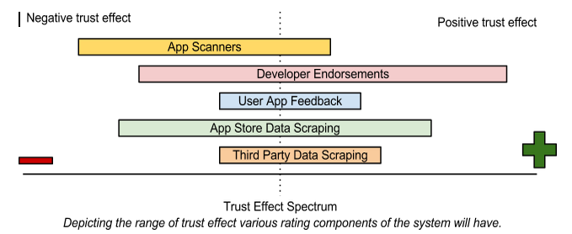
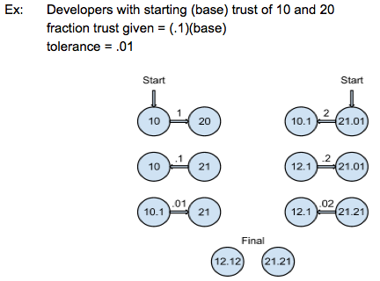
G O O D A P P
Acknowledgements
UCSB: Chandra Krintz, Tim Sherwood, Kyle Dewey
Microsoft: Greg Wroblewski and Dave Probert
UCSB Capstone 2012: Yulia Dubinina, TJ Koblentz, Jasper Fredrickson, Victor Moreira
Overview
Nowadays, with malware crawling everywhere, users are very concerned about protecting and securing their devices. GoodApp is a web application that creates a community for Mobile Smartphone Application users and developers. This community establishes a web of trust between its members, where developers are assigned a rating based on their activity in this trust network. These ratings give users valuable information about which developers have an established and trusted reputation in the community, and which developers should be avoided.
Developer Page
Application Page
GoodApp users can search for all the awesome (or not so awesome) developers who have registered with GoodApp. Information such as what apps were created by the developer and whether they are endorsed by others is collected and transformed into a convenient “trust rating”, so users can easily determine how trustworthy that developer is!
If you find an app you want to download from any of our supported app stores, but you don’t know whether to trust it, just look it up on GoodApp. You will find all the information about how trusted its developer is. and what other users have said about it. Also, we’ll let you know if it passed VirusTotal’s malware scanners.
This developer is trustworthy
Mary Smith
Endorsing Mary Smith will show that you trust her
Fruit Ninja
See how trusted the developer of this app is
Endorsements(2) >>
Developed by: Mary Smith
100.5
ENDORSE
100.5
>>
“Fruit Ninja” has passed the VirusTotal malware scanner
Company: Halfbrick Studios
Number of downloads: 50,000,000
Rating: 4 stars, (128,439)
Current Version: 1.6.2.10
Scan:
Find the developers apps and platforms
>>
1.0
1.1
1.2
1.6.2
After using this app tell others what you thought
About:
I enjoy programming during my free time, and I also enjoy creating Phone apps
Find the version you want to see reviews for
>>
REVIEW
Trust Rating
GoodApp uses five factors to determine a developers “trust rating”. (1) A developer’s apps are scanned for malware (using virustotal; left) and (2) reviewed by users, other app information is scraped from both (3) app stores and (4) third party code repositories, and (5) developers can endorse one another (which affects trust based on how trusted the endorser is). These five factors can have more or less weight on the overall rating, depending on if they affect the rating positively or negatively (see “Trust Effect Spectrum” for details; right). The trust rating of the developer is indicated on their profile page with a number for a rating and a colored ribbon based on how trustworthy they have proven to be.
Endorsements
Each developer can give a fraction of their trust to another developer’s score by endorsing that developer (giving endorsements does not decrease your own score). Each developer has a total amount of trust they can give through all endorsements which cannot exceed their own total trust rating. Referring to the diagram on the left : the example propagation between two nodes who trust one another . Developers with base trust of 10 and 20, fraction trust given = (.1)(base), tolerance = .01. the node which started with trust 10 has gained 0.1 of the other nodes overall trust (10 + .1( 21.21 ). The other node has gained 0.1 of the first’s overall trust (20 + .1( 12.12 ). The nodes do not gain trust less than the tolerance (in this case 0.01)
Citations
[1] Virus Total; [2] Fruit Ninja; [3 ]Android Store; [4] Windows Marketplace ; [5] Arch Linux; [6] UCSB; [7] Microsoft

