Slide 1
CSE 20 Discussion - Week 1
Definitions and Notation Practice

Slide 2
Administrative Stuff
This discussion is being recorded
Discussions are not mandatory
Homework 1 has been released - due Tuesday, October 5th at 11:00 pm PST
Can work in groups of up to 3 - Piazza “Search for Teammates” thread
Review quizzes due Friday (with late submission open until Sunday)
Submitted on Gradescope

Slide 3
When will you use what you learn in this course?
CSE 21 (Math for Algorithms/ Systems)
CSE 100 (Data Structures)
CSE 101 (Algorithms)
CSE 105 (Theory of Computability)
MATH 183 and other Statistics classes
Lots of applications (recall examples from lecture-- recommendation systems, bioinformatics, etc.)!

Slide 4
Agenda
Review and practice with some key definitions
Strings, sets, tuples
Different representations of sets
Roster method, set-builder
Practice with functions
Distance functions as an example
Practice with recursive definitions
Of both sets and functions

Slide 5
Datatypes
We will work with various types of data in this class - differentiating between them and using the correct notation for each is very important!
n-tuple: An ordered collection of n elements (repetition matters)
Set: An unordered collection of elements (repetition doesn’t matter)
String: A finite sequence of characters, where each character is an element of a predefined alphabet

Slide 6
n-Tuples
n-tuple: An ordered collection of n elements (repetition matters)
Contained in parentheses, with commas separating the elements, i.e. the 3-tuple (1,2,3)
Ordered: (1,2,3) is not equal to (3,2,1)
Repetition matters: (1,1,1) is not equal to (1,1)
Number of elements is part of the definition, i.e. fixed length
Motivating example: Movie ratings

Slide 7
Sets
Set: An unordered collection of n elements (repetition doesn’t matter)
Contained in curly braces, with commas separating the elements, i.e. the set {1,2,3}
Unordered: {1,2,3} is equal to {3,2,1}
Repetition doesn’t matter: {1,1,1} is equal to {1,1} which is equal to {1}
Some sets with special notation: ℤ, ℕ, ∅
Can be defined using roster method, set-builder notation, recursive definitions
Motivating example: set of RNA strands / set of bases

Slide 8
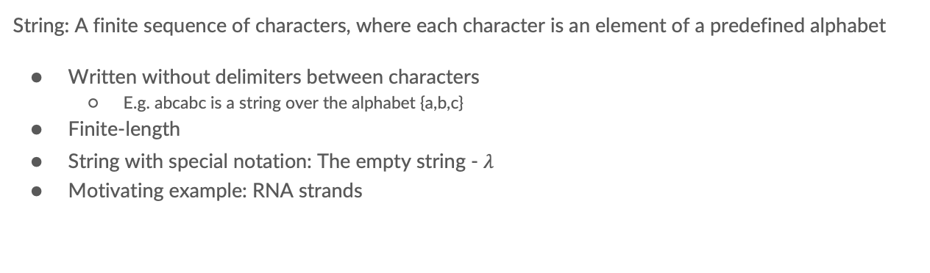
Strings
String: A finite sequence of characters, where each character is an element of a predefined alphabet
Written without delimiters between characters
E.g. abcabc is a string over the alphabet {a,b,c}
Finite-length
String with special notation: The empty string - $λ$
Motivating example: RNA strands

Slide 9
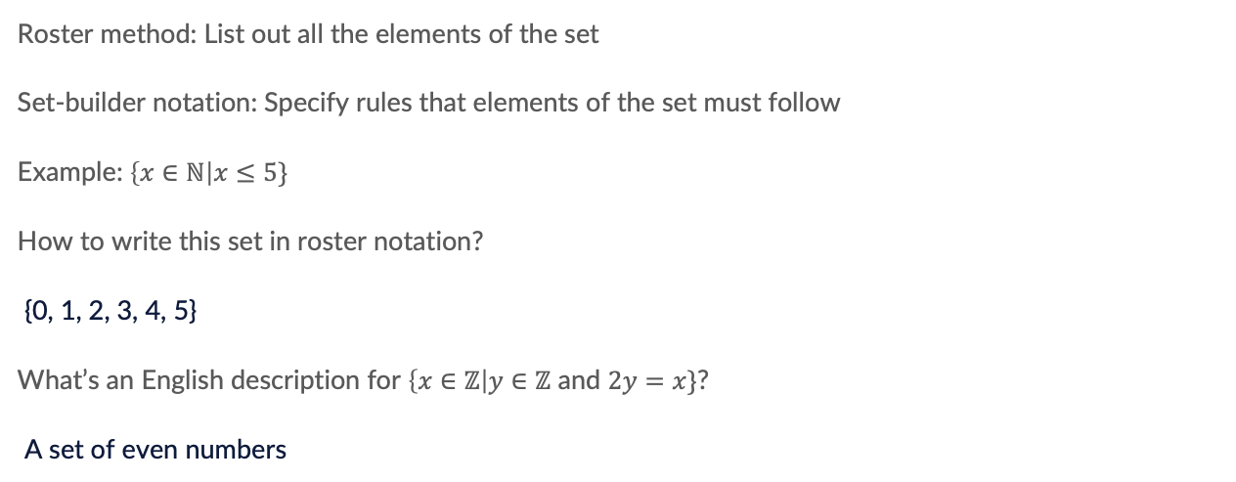
Representing Sets
Roster method: List out all the elements of the set
Set-builder notation: Specify rules that elements of the set must follow
Example: $\left\{x∈ℕ\right|x≤5\}$
How to write this set in roster notation?
{0, 1, 2, 3, 4, 5}
What’s an English description for $\left\{x∈ℤ\right|y∈ℤ$ and $2y=x\}$?
A set of even numbers

Slide 10
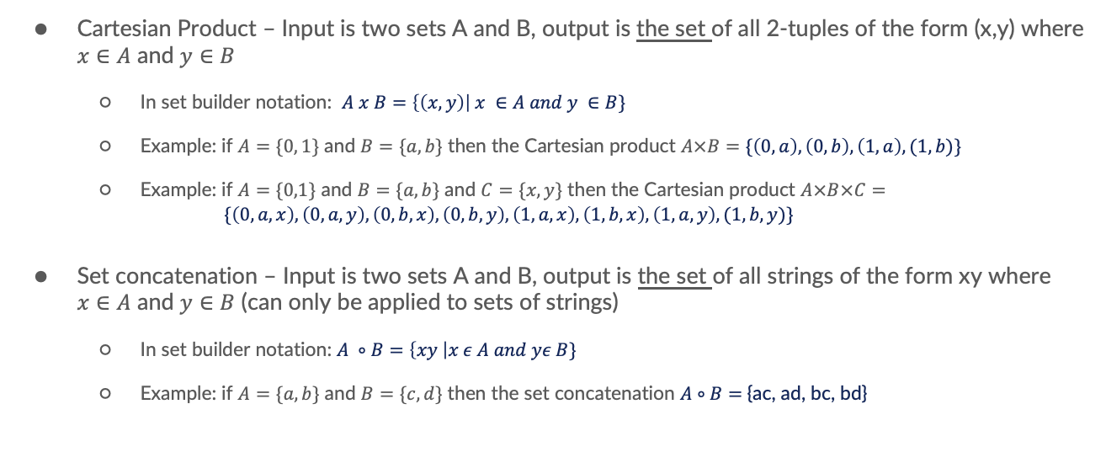
Operations on Sets
Cartesian Product – Input is two sets A and B, output is the set of all 2-tuples of the form (x,y) where $x∈A$ and $y∈B$
In set builder notation: $A x B=\left\{\left(x,y\right)\right| x ∈A and y ∈B\}$
Example: if $A=\{0, 1\}$ and $B=\{a, b\}$ then the Cartesian product $A×B=$ $\{\left(0,a\right), \left(0,b\right), \left(1,a\right), (1,b)\}$
Example: if $A=\{0,1\}$ and $B=\{a,b\}$ and $C=\{x, y\}$ then the Cartesian product $A×B×C=$
$$\{\left(0,a,x\right),\left(0,a,y\right),\left(0,b,x\right),\left(0,b,y\right),\left(1,a,x\right),\left(1,b,x\right),\left(1,a,y\right),(1,b,y)\}$$
Set concatenation – Input is two sets A and B, output is the set of all strings of the form xy where $x∈A$ and $y∈B$ (can only be applied to sets of strings)
In set builder notation: $A ∘B=\left\{xy \right|x ε A and yε B\}$
Example: if $A=\{a, b\}$ and $B=\{c, d\}$ then the set concatenation $A∘B=${ac, ad, bc, bd}

Slide 11
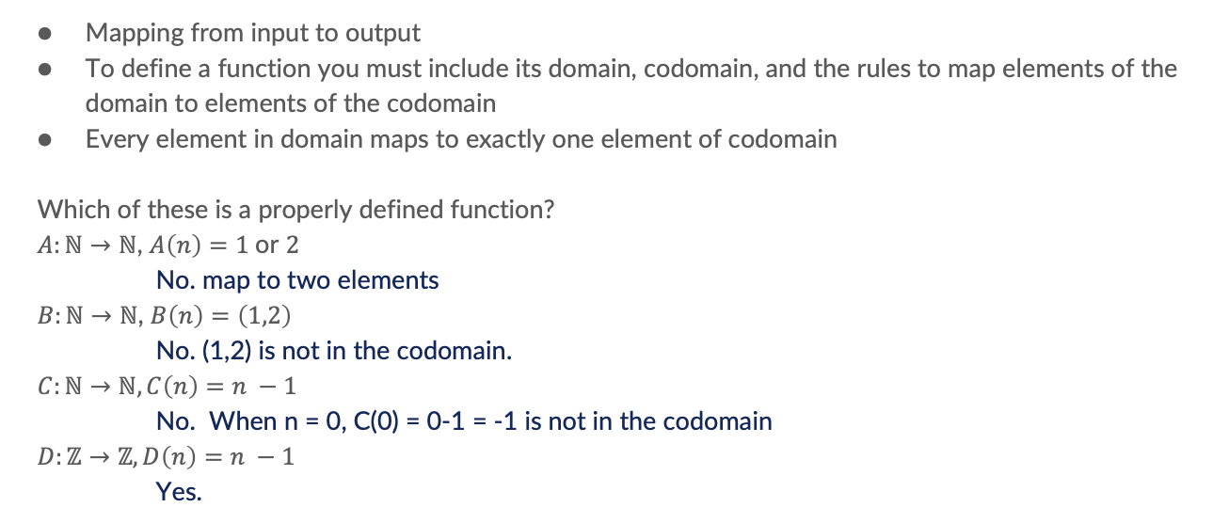
Functions
Mapping from input to output
To define a function you must include its domain, codomain, and the rules to map elements of the domain to elements of the codomain
Every element in domain maps to exactly one element of codomain
Which of these is a properly defined function?
$A:ℕ→ℕ$, $A\left(n\right)=1$or $2$
No. map to two elements
$B:ℕ→ℕ$, $B\left(n\right)=\left(1,2\right)$
No. (1,2) is not in the codomain.
$C:ℕ→ℕ, C\left(n\right)=n −1$
No. When n = 0, C(0) = 0-1 = -1 is not in the codomain
$D:ℤ→ℤ, D\left(n\right)=n −1$
Yes.

Slide 12
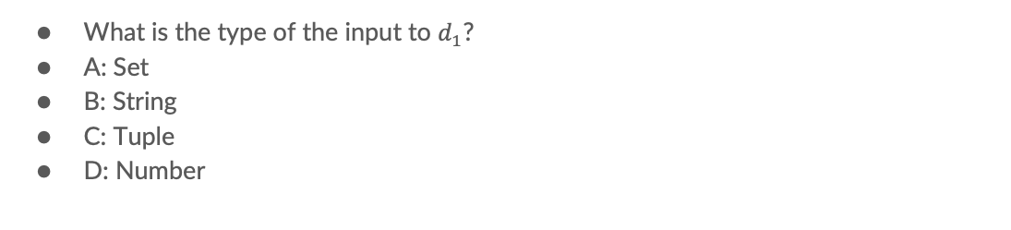
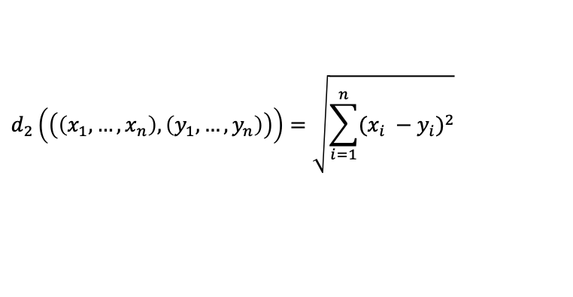
Distance Functions
$$d_{1}\left(\left(\left(x_{1},…,x_{n}\right), \left(y_{1}, …,y_{n}\right)\right)\right)=\max_{1 ≤i ≤n}|x_{i} −y_{i}|$$
$$d_{2}\left(\left(\left(x_{1},…,x_{n}\right), \left(y_{1}, …,y_{n}\right)\right)\right)=\sqrt{\sum_{i=1}^{n}{{(x_{i} −y_{i})}^{2}}}$$
What is the type of the input to $d_{1}$?
A: Set
B: String
C: Tuple
D: Number

Slide 13
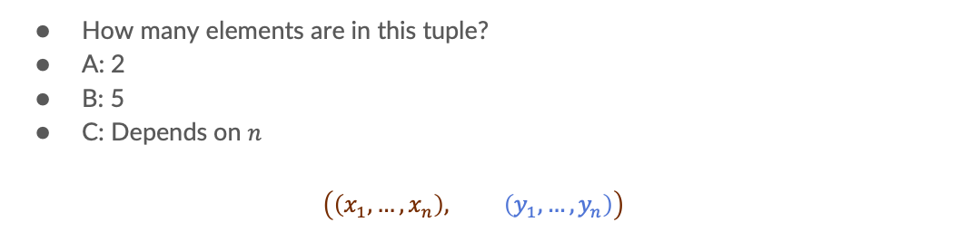
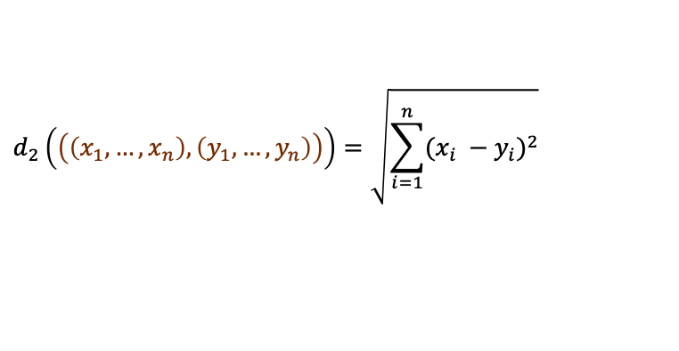
Distance Functions
$$d_{1}\left(\left(\left(x_{1},…,x_{n}\right), \left(y_{1}, …,y_{n}\right)\right)\right)=\max_{1 ≤i ≤n}|x_{i} −y_{i}|$$
$$d_{2}\left(\left(\left(x_{1},…,x_{n}\right), \left(y_{1}, …,y_{n}\right)\right)\right)=\sqrt{\sum_{i=1}^{n}{{(x_{i} −y_{i})}^{2}}}$$
How many elements are in this tuple?
A: 2
B: 5
C: Depends on $n$
$$\left(\left(x_{1},…,x_{n}\right), \left(y_{1}, …,y_{n}\right)\right)$$

Slide 14
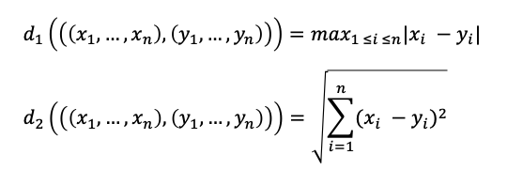
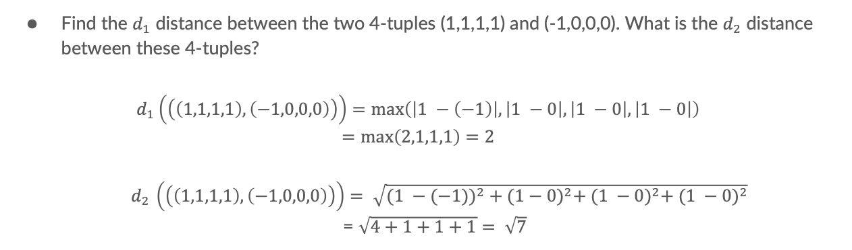
Distance Functions
Find the $d_{1}$ distance between the two 4-tuples (1,1,1,1) and (-1,0,0,0). What is the $d_{2}$ distance between these 4-tuples?
$$d_{1}\left(\left(\left(1,1,1,1\right), \left(−1,0,0,0\right)\right)\right)=\max\left(\left|1 −\left(−1\right)\right|, \left|1 −0\right|, \left|1 −0\right|, \left|1 −0\right|\right)$$
$$=\max\left(2,1,1,1\right)=2$$
$d_{2 }\left(\left(\left(1,1,1,1\right),\left(−1,0,0,0\right)\right)\right)= \sqrt{{(1 −(−1))}^{2} + {(1−0)}^{2}+ {(1 −0)}^{2}+ {(1 −0)}^{2}}$
= $\sqrt{4+1+1+1}= \sqrt{7}$

Slide 15
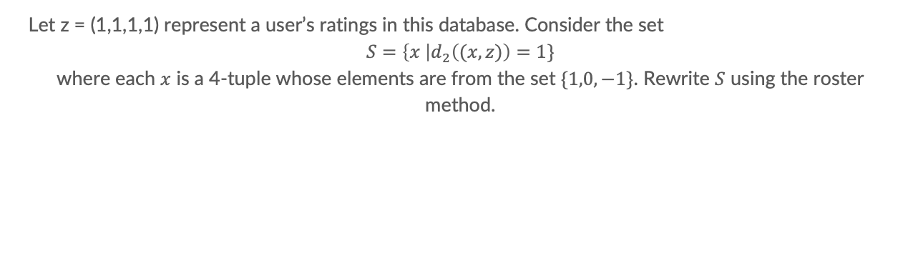
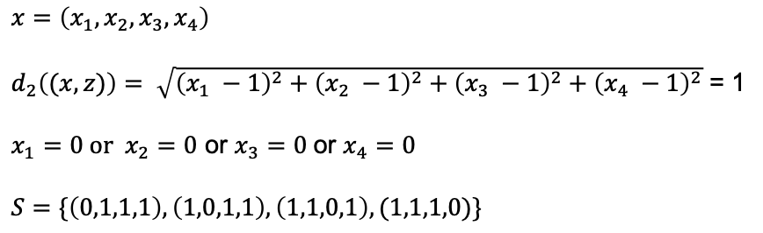
Distance Functions
Let z = (1,1,1,1) represent a user’s ratings in this database. Consider the set
$S=\left\{x \right|d_{2}\left((x,z)\right)=1\}$
where each $x$ is a 4-tuple whose elements are from the set $\{1,0,−1\}$. Rewrite $S$ using the roster method.
$$x=\left(x_{1},x_{2},x_{3},x_{4}\right)$$
$d_{2}\left((x,z)\right)= \sqrt{{\left(x_{1} −1\right)}^{2}+{\left(x_{2} −1\right)}^{2}+{\left(x_{3} −1\right)}^{2}+{\left(x_{4} −1\right)}^{2}}$ = 1
$x_{1}=0 or{ x}_{2}=0$ or $x_{3}=0$or $x_{4}=0$
$$S=\{\left(0,1,1,1\right), \left(1,0,1,1\right), \left(1,1,0,1\right), (1,1,1,0)\}$$

Slide 16
Recursion
We can use recursion to define sets and functions
General idea: Use the set / function in its own definition
Basis step defines the initial elements in the set / initial behavior of the function
Recursive step defines how to use smaller elements of the set to build new bigger elements in the set / how to compute the function on an input based on computing the function on a smaller input

Slide 17
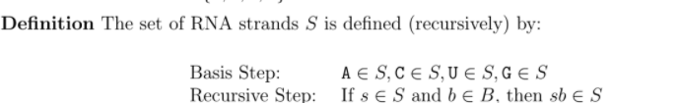
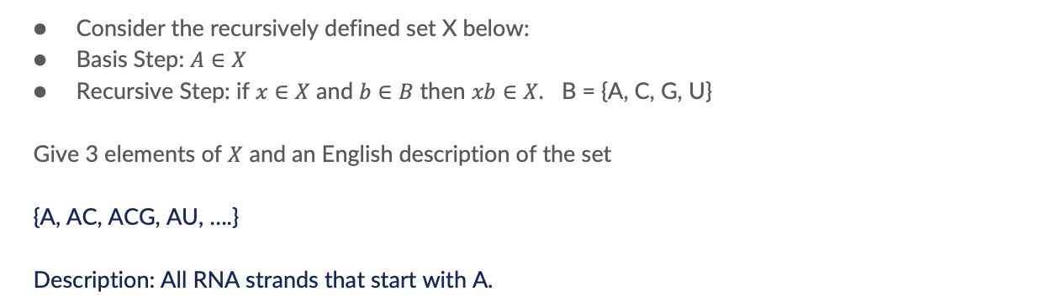
Recursive Definition of Sets – RNA strands
Consider the recursively defined set X below:
Basis Step: $A∈X$
Recursive Step: if $x∈X$ and $b∈B$ then $xb∈X$. B = {A, C, G, U}
Give 3 elements of $X$ and an English description of the set
{A, AC, ACG, AU, ….}
Description: All RNA strands that start with A.

Slide 18
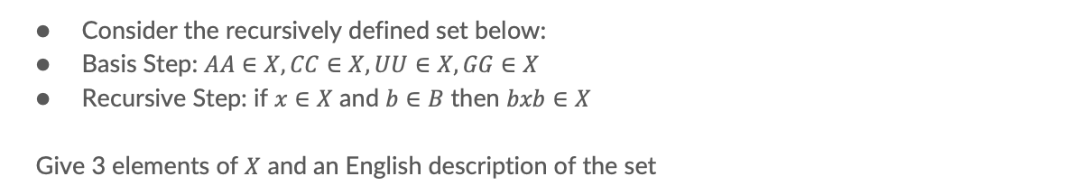
Recursive Definition of Sets – RNA strands
Consider the recursively defined set below:
Basis Step: $AA∈X, CC∈X, UU∈X, GG∈X$
Recursive Step: if $x∈X$ and $b∈B$ then $bxb∈X$
Give 3 elements of $X$ and an English description of the set
For example, x= AA b = G, bxb = GAAG …
{AA, CC, UU, GG, CAAC, GCAACG, …}
Description: even length palindrome: the same as its reverse

Slide 19
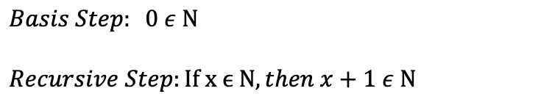
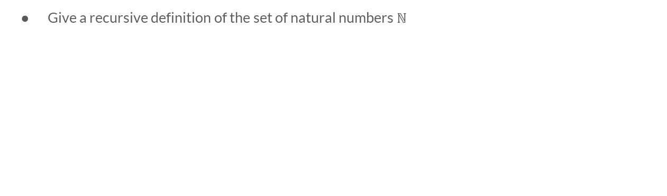
Recursive Definitions of Sets - Numbers
Give a recursive definition of the set of natural numbers $ℕ$
$$Basis Step: 0 ε Ν$$
$$Recursive Step:If x ϵ Ν, then x+1 ε Ν$$

