Slide 1
CSE 20 Discussion - Week 2
Representing Numbers

Slide 2
Administrative Stuff
Discussions are not mandatory
We have extended Homework submission deadline to tomorrow 8 am.
HW2 is due October 12th at 11pm.
Project Part 1 is due October 14th at 11pm..
See class website -> Assignments -> Project

Slide 3
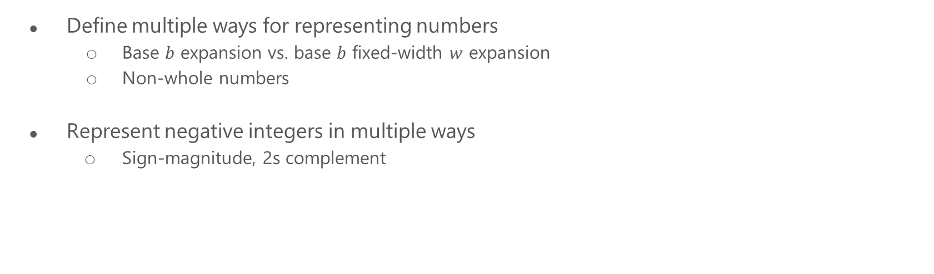
Agenda

Slide 4
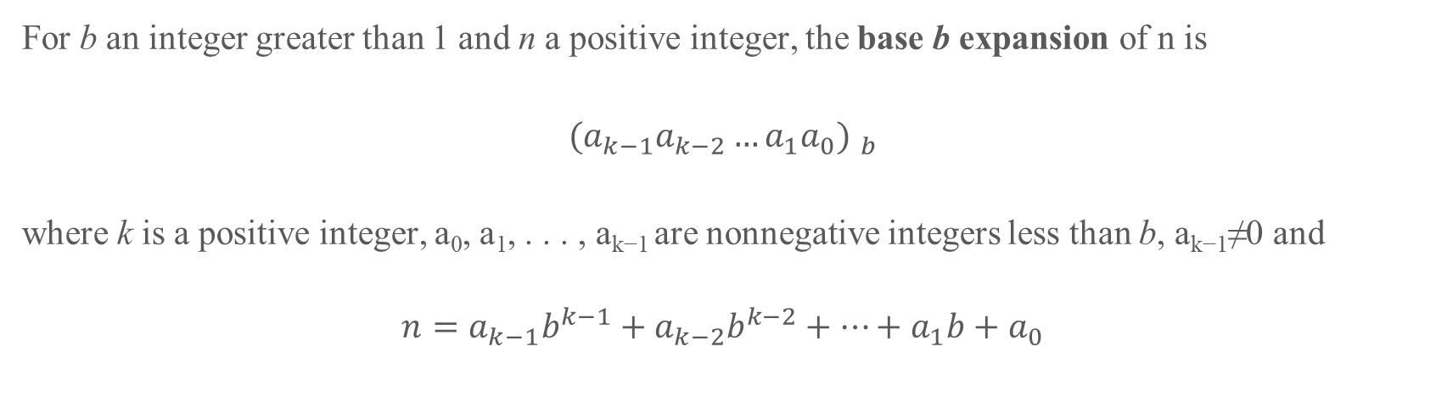


Slide 5
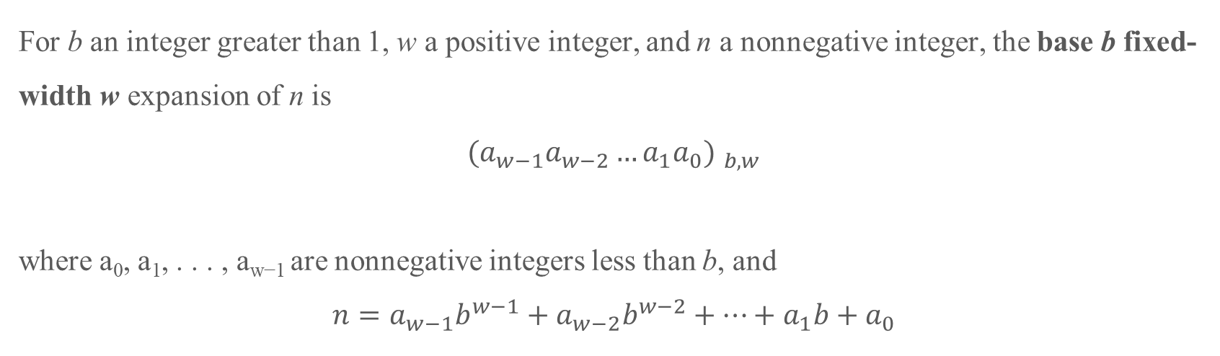


Slide 6
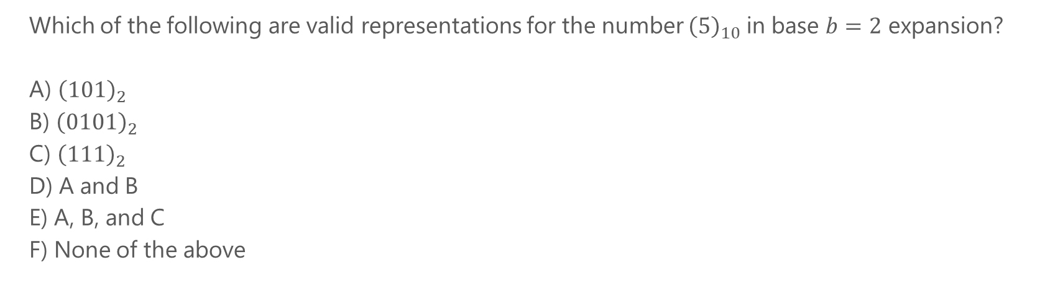
Problem 1

Slide 7
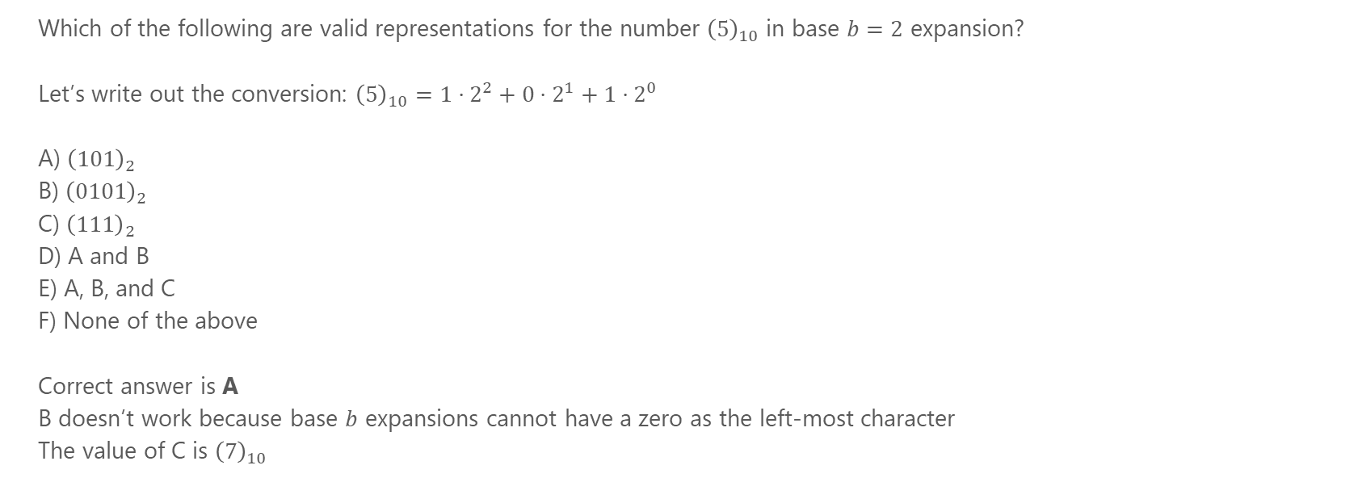
Problem 1

Slide 8
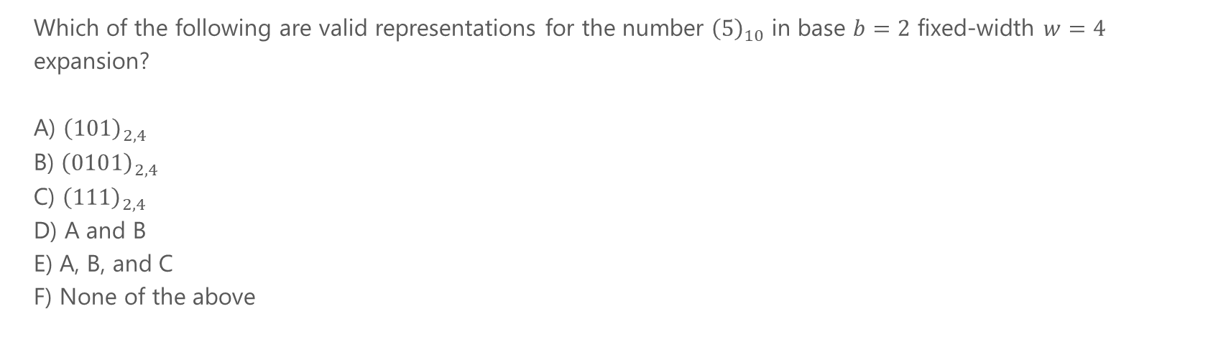
Problem 2

Slide 9
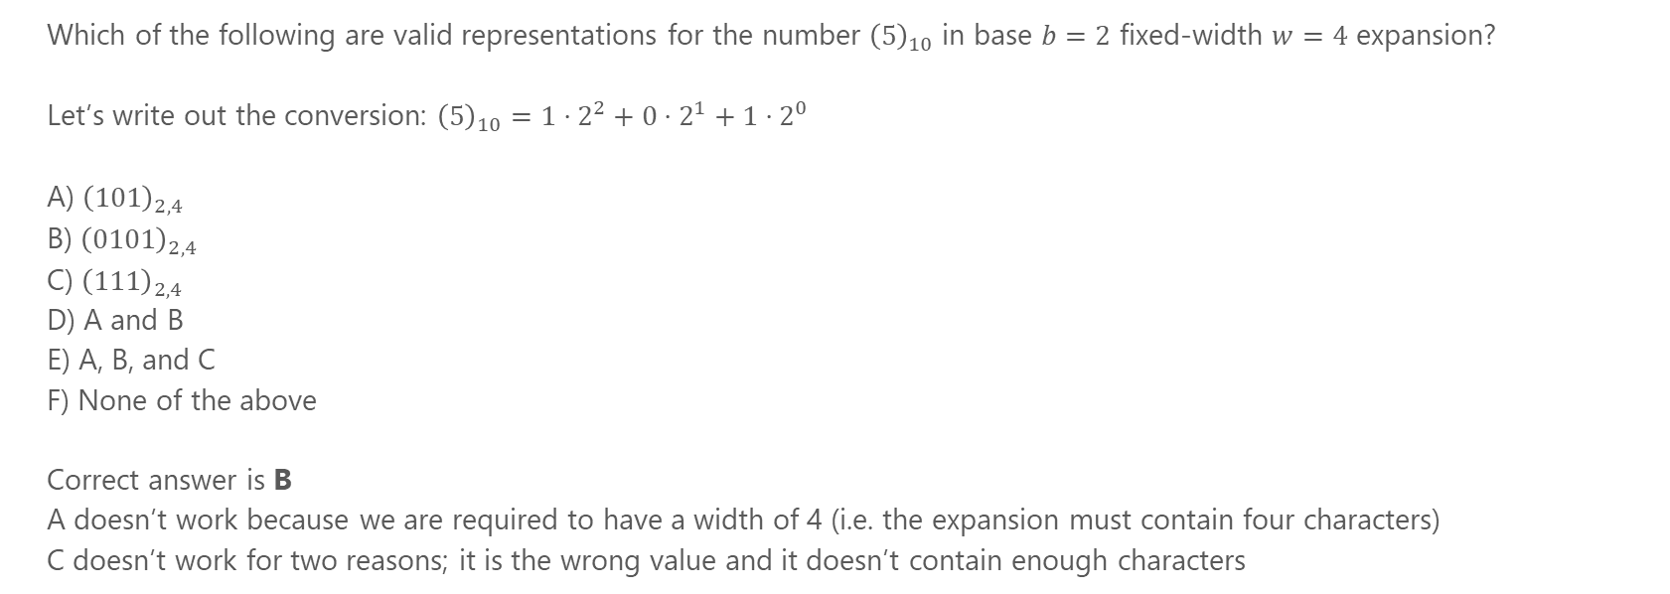
Problem 2

Slide 10
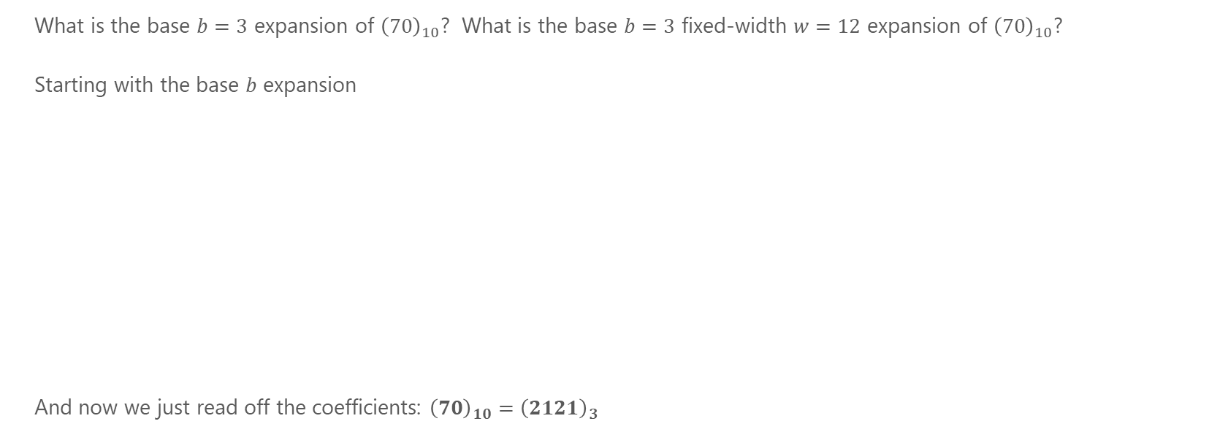
Problem 3

Slide 11
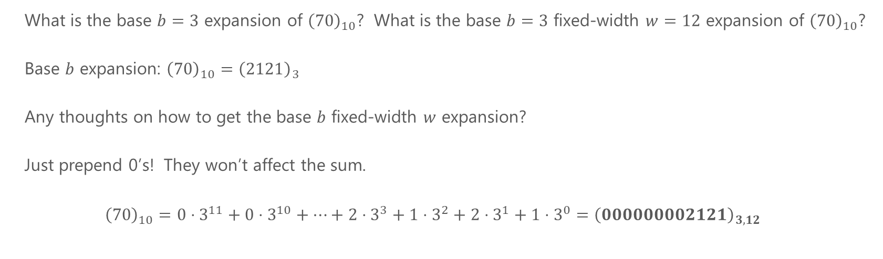
Problem 3

Slide 12
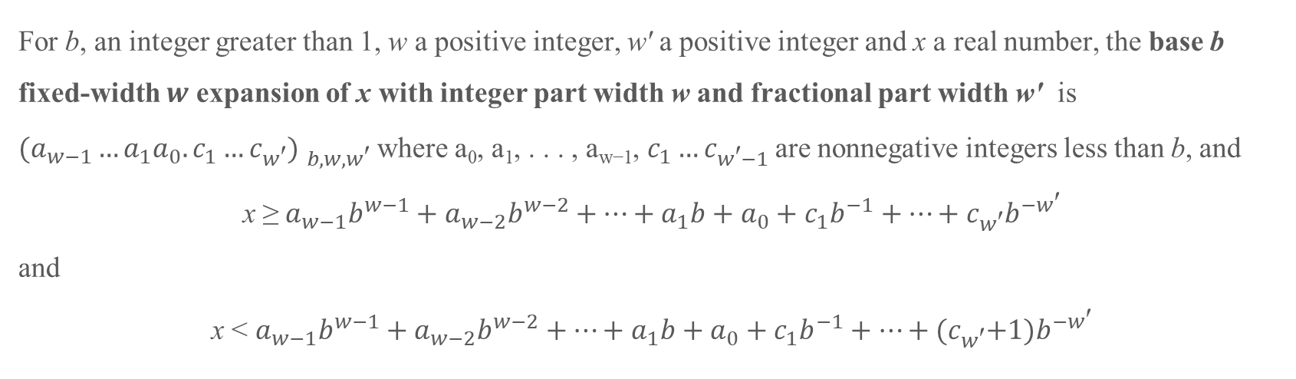
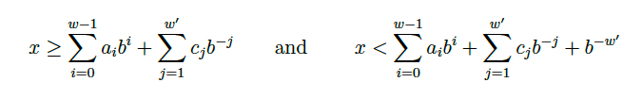
Non-Whole Numbers

Slide 13
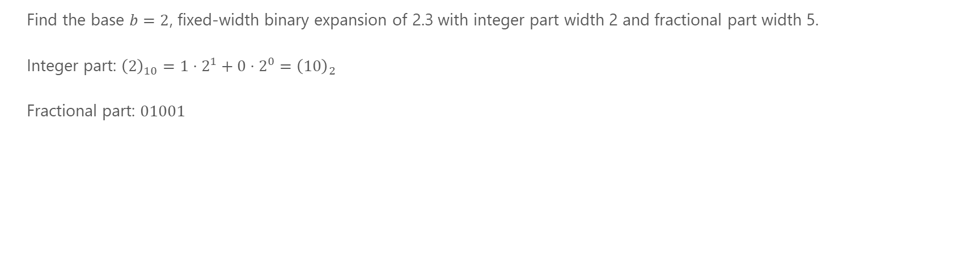
Problem 4

Slide 14
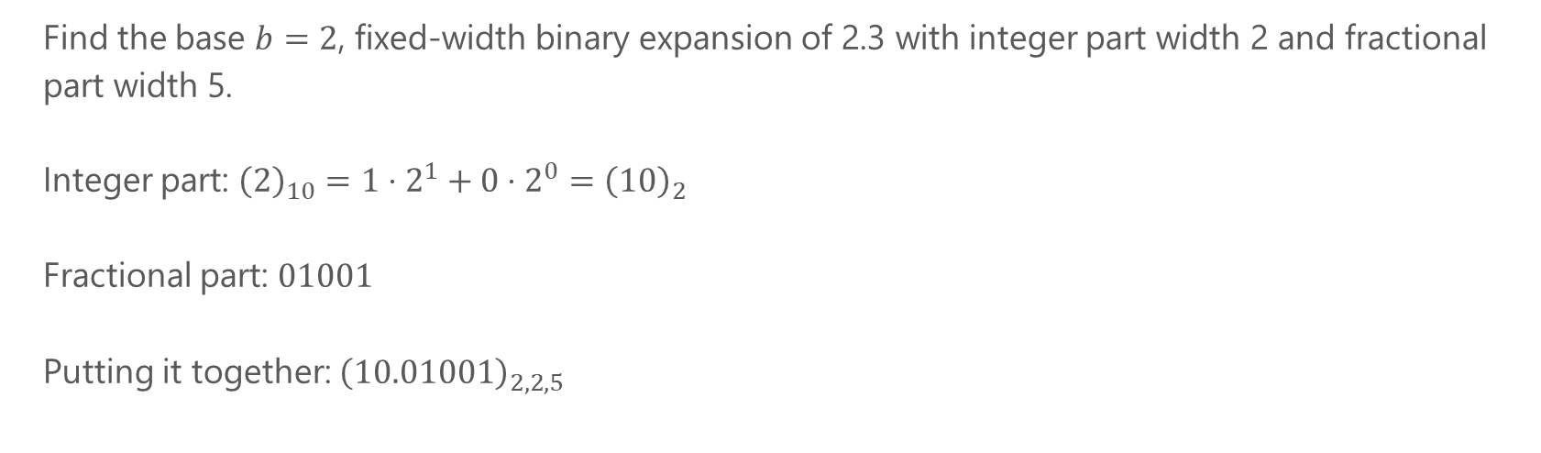
Problem 4

Slide 15
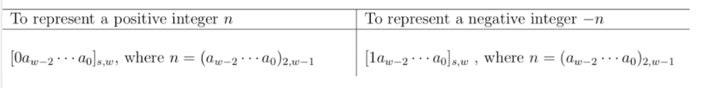
Signed Representations: Sign Magnitude

Slide 16
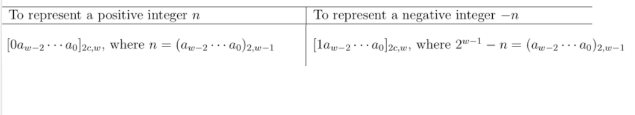
Signed Representations – 2’s Complement

Slide 17
Problem 5
For each of the numbers below, write the number in:
sign-magnitude width 4
2’s complement width 4
or determine that it is not possible.
(a) 5
(b) -7
(c) -8

Slide 18
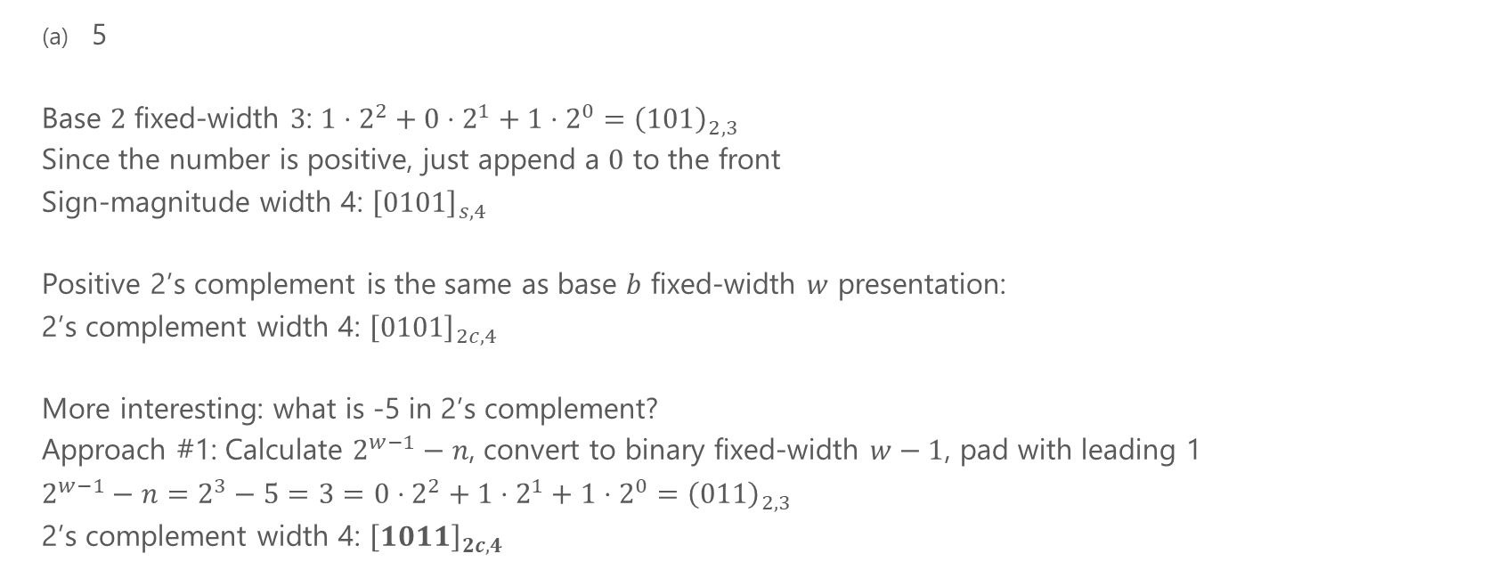
Problem 5a

Slide 19
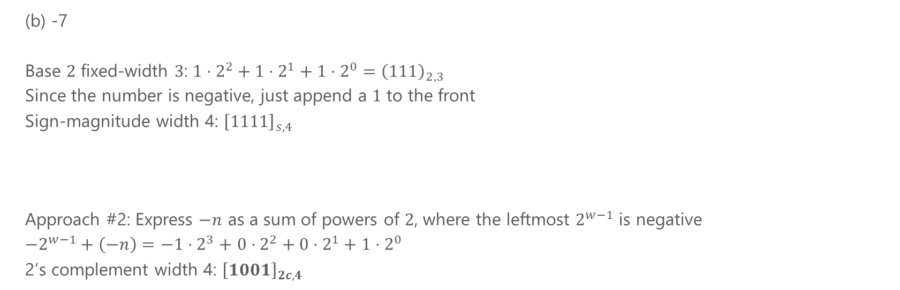
Problem 5b
2s Complement width 4: [1001]_{2c,4} Sign Magnitude width 4 of 7 is [0111]_{s,4}. From there flip the digits and add 1

Slide 20
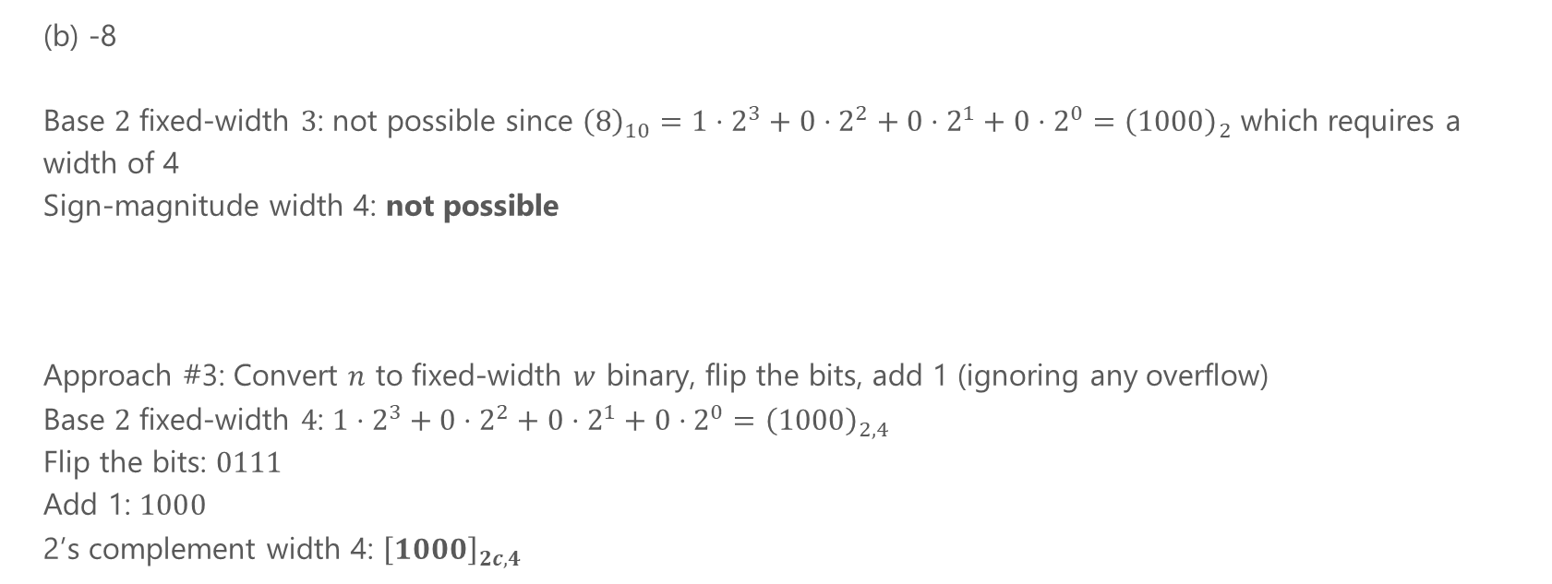
Problem 5c
2s Complement width 4: [1000]_{2c,4}

