Slide 1
CSE 20 Discussion - Week 4
Conditionals, Predicates and Quantifiers

Slide 2
Agenda
Conditional and Biconditional statements
Predicates and Truth Sets
Universal and Existential Quantifiers
Witnesses and Counterexamples

Slide 3
Conditionals Statements
Let p and q be propositions. The conditional statement p → q is the proposition “if p, then q.”
The statement p → q is called a conditional statement because p → q asserts that q is true on the condition that p holds. A conditional statement is also called an implication.
p is called the hypothesis/antecedent of p → q.
q is called the conclusion/consequent of p → q.

Slide 4
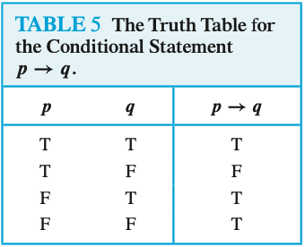
Truth table and example
Example:
If it is raining then there are clouds in the sky.
Let p be the statement “Maria learns subject x” and q the statement “Maria will find a good job.”
Express the statement p → q as a statement in English.

Slide 5
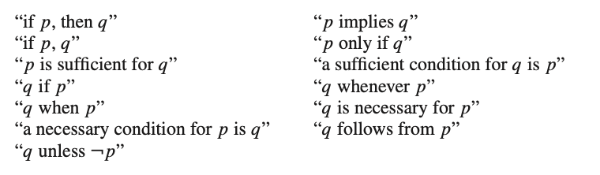
We have the statement p → q. Now,
Converse: The proposition q → p is called the converse of p → q.
Contrapositive: The contrapositive of p → q is the proposition ¬q → ¬p.
Inverse: The proposition ¬p → ¬q is called the inverse of p → q
Example:
What are the contrapositive, the converse, and the inverse of the conditional statement
“The home team wins whenever it is raining”

Slide 6
Example:
What are the contrapositive, the converse, and the inverse of the conditional statement
“The home team wins whenever it is raining”
q = The home team wins.
p = It is raining
if..then form: If it is raining, then the home team wins
Solution:
Contrapositive: “If the home team does not win, then it is not raining.”
Converse: “If the home team wins, then it is raining.”
Inverse: “If it is not raining, then the home team does not win.”

Slide 7
Biconditional Statements
Let p and q be propositions. The biconditional statement p ↔ q is the proposition “p if and only if q.”
The biconditional statement p ↔ q is true when p and q have the same truth values, and is false otherwise. Biconditional statements are also called bi-implications.

Slide 8
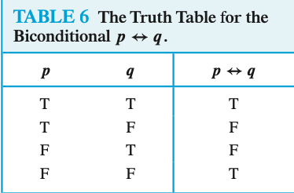
Truth table and example
Example:
Let p be the statement “You can take the flight,” and let q be the statement “You buy a ticket.” Then how do you express p ↔ q ?

Slide 9
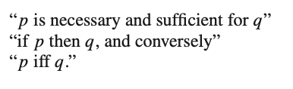
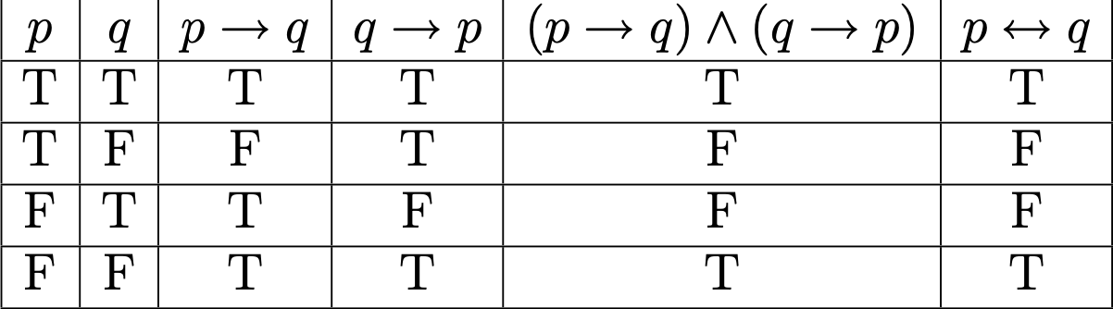
Example:
Let p be the statement “You can take the flight,” and let q be the statement “You buy a ticket.”
Then p ↔ q:
=> “You can take the flight if and only if you buy a ticket.”

Slide 10
Predicates
Definition: A predicate is a function from domain set, S to {T, F}.
predicate_function: S → {T, F}

Slide 11
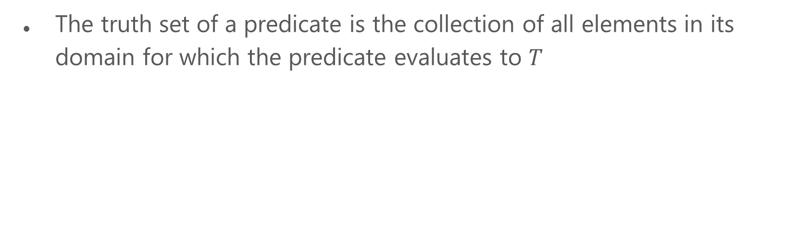
Truth Sets
{ s ∈ S | predicate_function(s) = T }

Slide 12
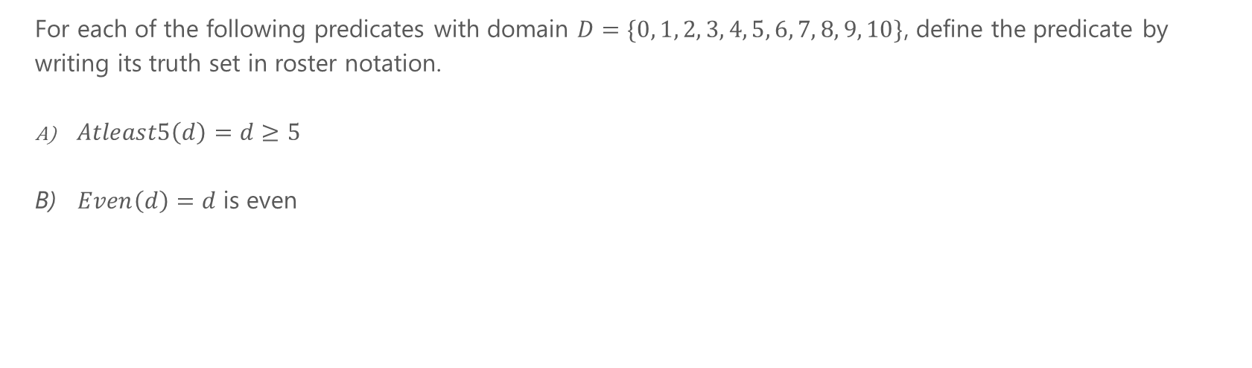
Problem 1 – Truth Sets

Slide 13
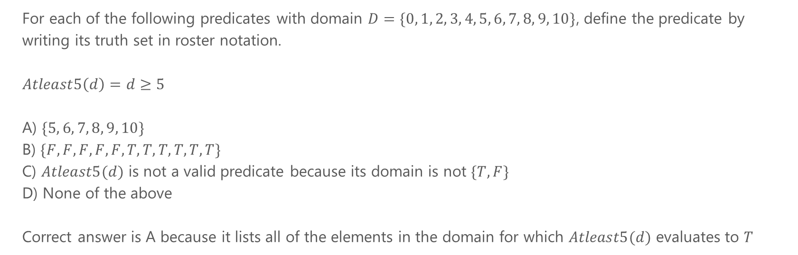
Problem 1a - Truth Sets

Slide 14
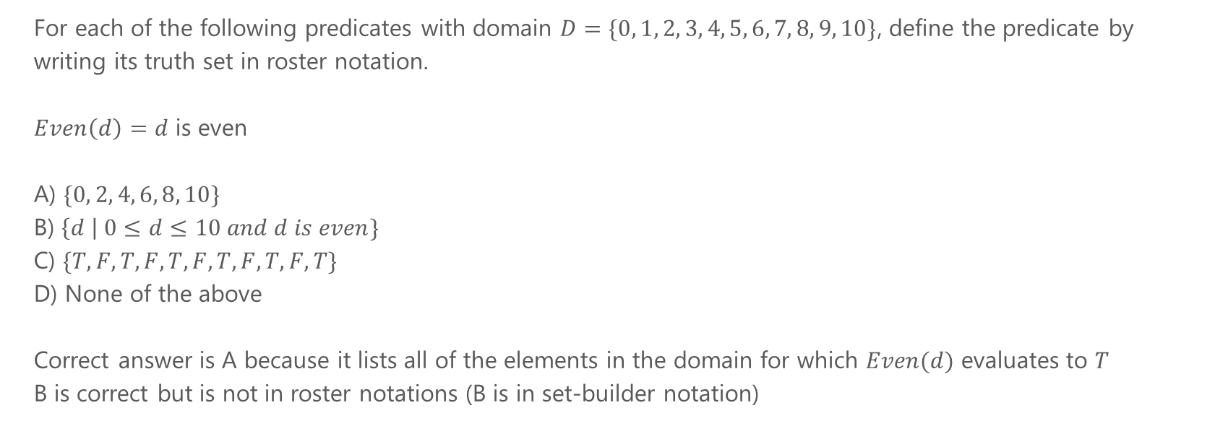
Problem 1b - Truth Sets

Slide 15
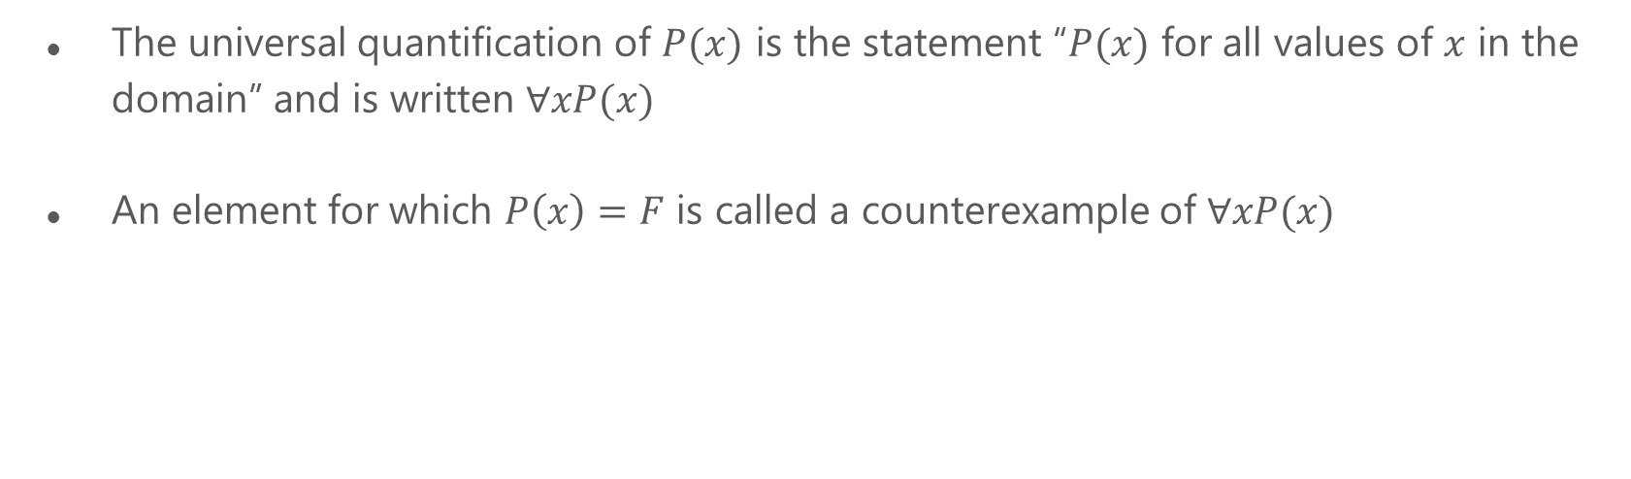
Universal Quantifiers and Counterexamples

Slide 16
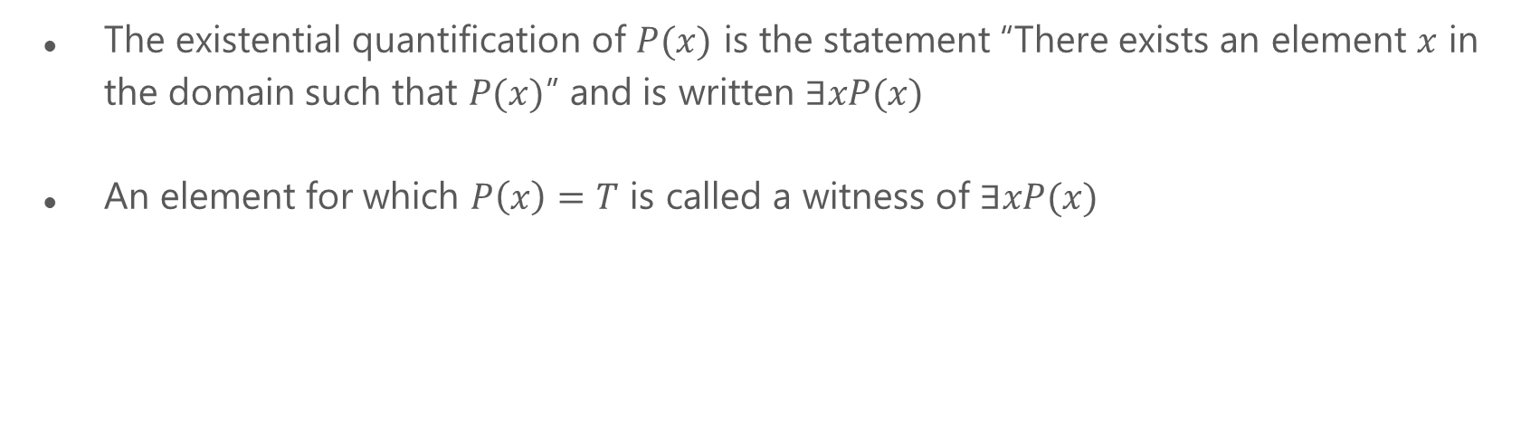
Existential Quantifiers and Witnesses

Slide 17
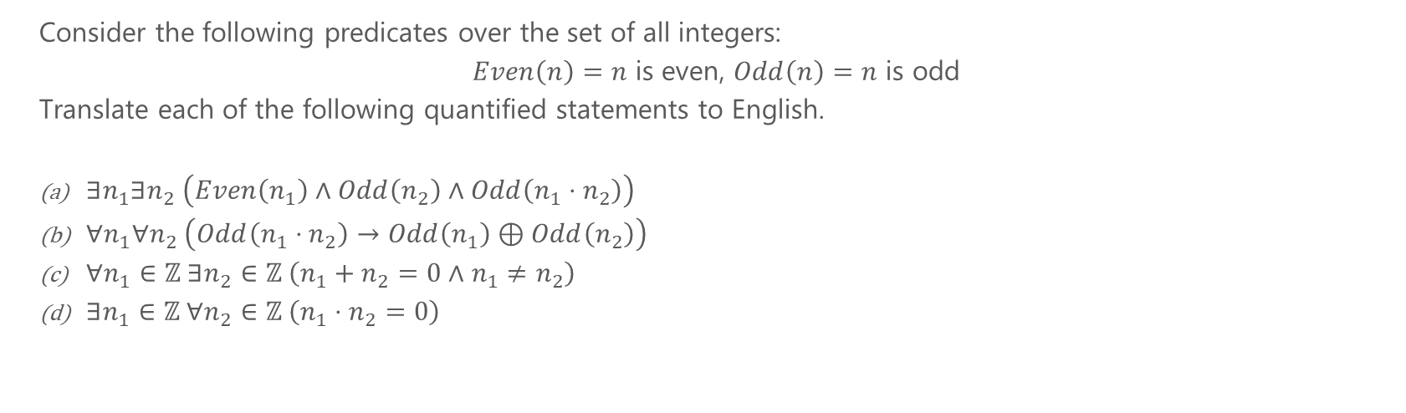
Problem 3 – Quantified Statements

Slide 18
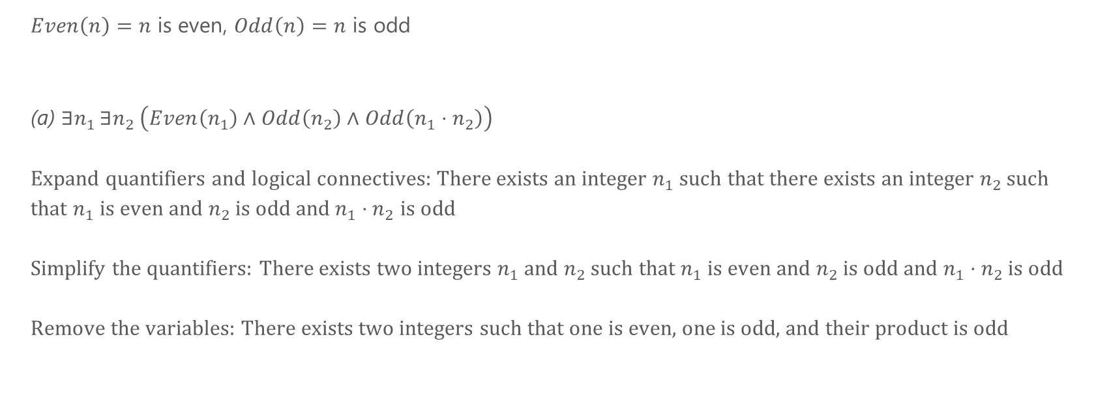
Problem 3a – Quantified Statements

Slide 19
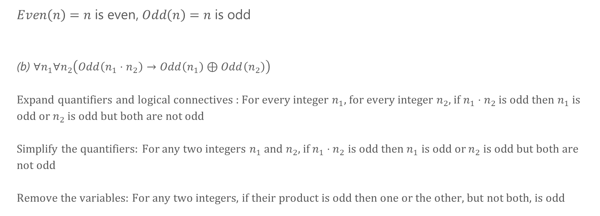
Problem 3b – Quantified Statements

Slide 20
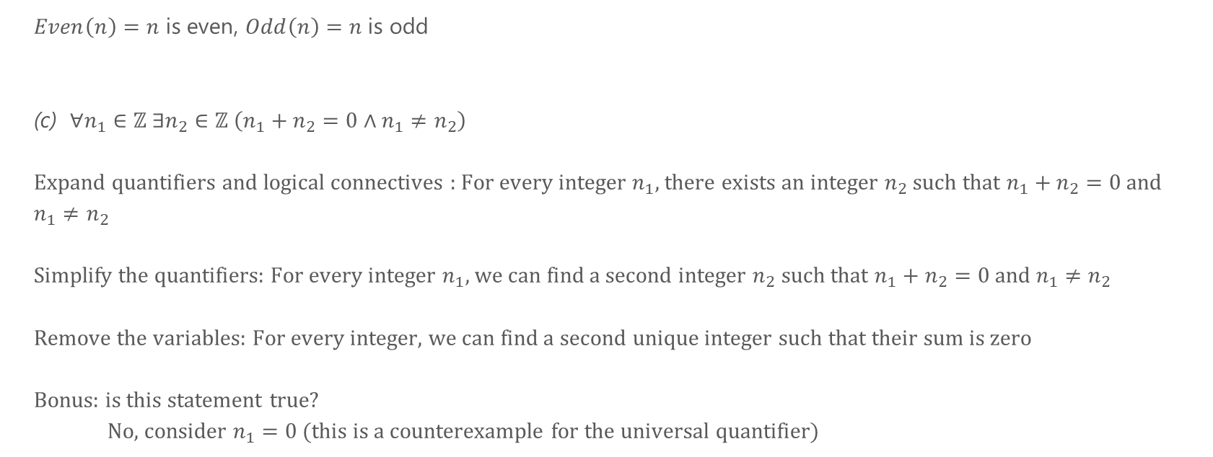
Problem 3c – Quantified Statements

Slide 21
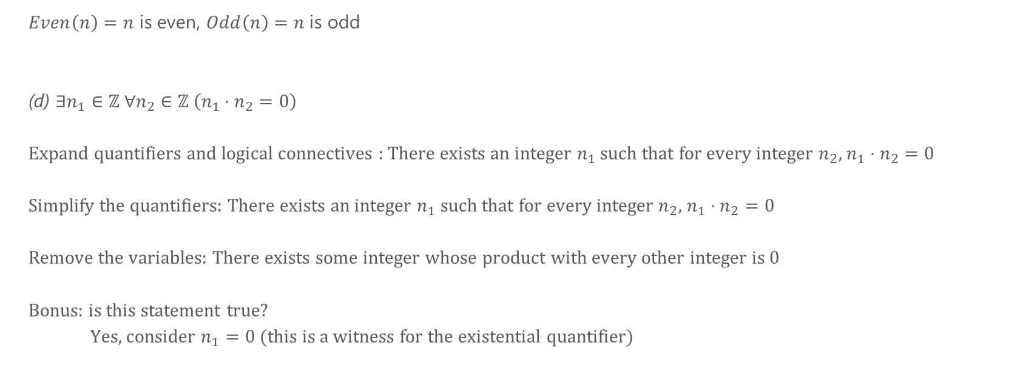
Problem 3d – Quantified Statements

