Slide 1
CSE 20 Discussion - Week 5
Quantifiers and Proofs

Slide 2
Administrative Stuff
Homework3 deadline is extended. It is due Tonight.
Week 5 (Monday, Wednesday, Friday) Review quiz “due” Friday
Hard due date is Sunday midnight - no penalty for submitting any time before then
Project Part 2 is due 11/4 at 11pm
See class website -> Assignments -> Project for more info

Slide 3
Agenda
De Morgan’s Laws for Quantified Statements and Quantified Statements (Review)
Proof Strategies
Proof of universal exhaustion
Proof by universal generalization
Proof of conditional by direct proof
Proof of conditional by contrapositive
Proof by Cases

Slide 4


De Morgan’s Laws
Below are the quantifier versions of De Morgan’s laws:

Slide 5
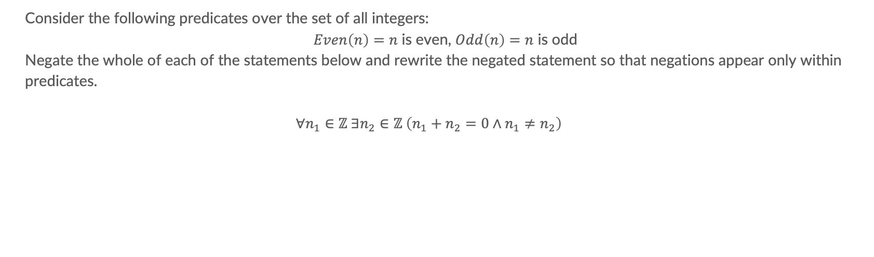
Problem 1 – De Morgan’s Laws
Consider the following predicates over the set of all integers:
$Even\left(n\right)=n$ is even, $Odd\left(n\right)=n$ is odd
Negate the whole of each of the statements below and rewrite the negated statement so that negations appear only within predicates.
$$∀n_{1}∈ℤ ∃n_{2}∈ℤ \left(n_{1}+n_{2}=0∧n_{1}≠n_{2}\right)$$

Slide 6
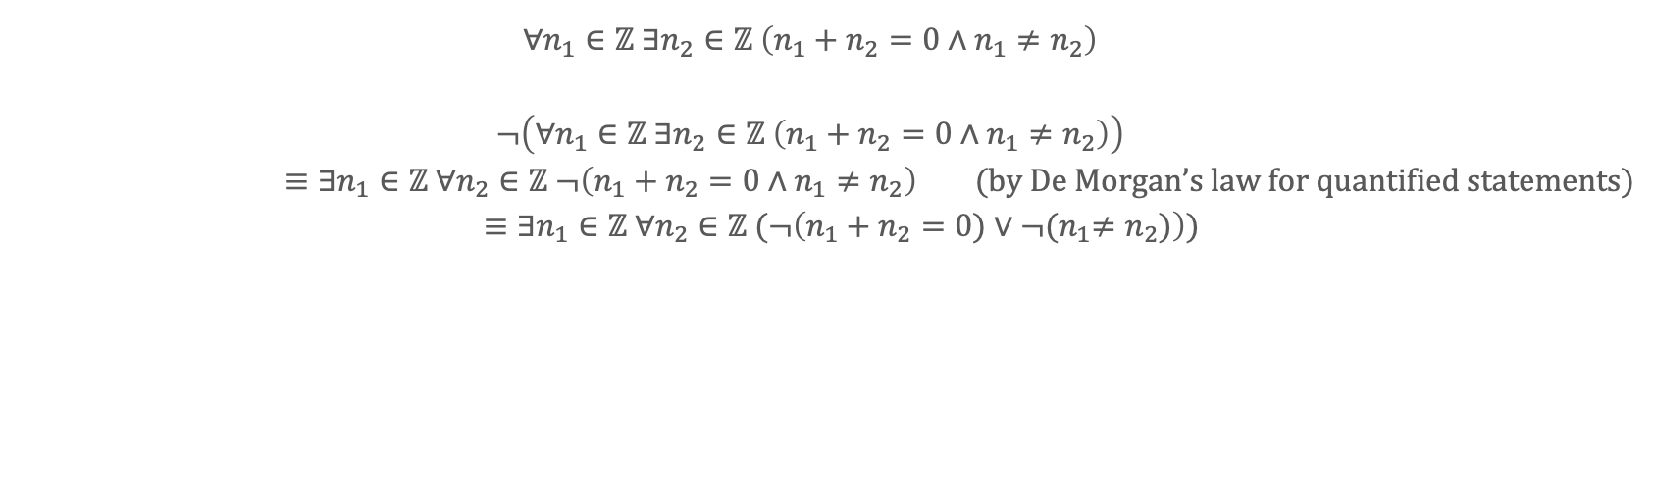
Problem 1 – De Morgan’s Laws
$$∀n_{1}∈ℤ ∃n_{2}∈ℤ \left(n_{1}+n_{2}=0∧n_{1}≠n_{2}\right)$$
$$¬\left(∀n_{1}∈ℤ ∃n_{2}∈ℤ \left(n_{1}+n_{2}=0∧n_{1}≠n_{2}\right)\right)$$
$≡∃n_{1}∈ℤ ∀n_{2}∈ℤ ¬\left(n_{1}+n_{2}=0∧n_{1}≠n_{2}\right)$ (by De Morgan’s law for quantified statements)
$≡∃n_{1}∈ℤ ∀n_{2}∈ℤ (¬\left(n_{1}+n_{2}=0)∨{¬(n}_{1}≠n_{2})\right)$)

Slide 7

Problem 2 - Quantified Statements
Suppose P(x) is a predicate over a domain D.
How many of the following statements can be used to express the fact that there is a unique element x such that P(x) is true.
1. $∃x∀y (P\left(y\right) ↔x=y )$
2. $∃xP\left(x\right) ∧∀x∀y(P\left(x\right)∧P\left(y\right)→x=y )$
3. $∃x(P\left(x\right)∧∀y\left(P\left(y\right)→x=y\right))$
A: 3
B: 2
C: 1
D: 0

Slide 8
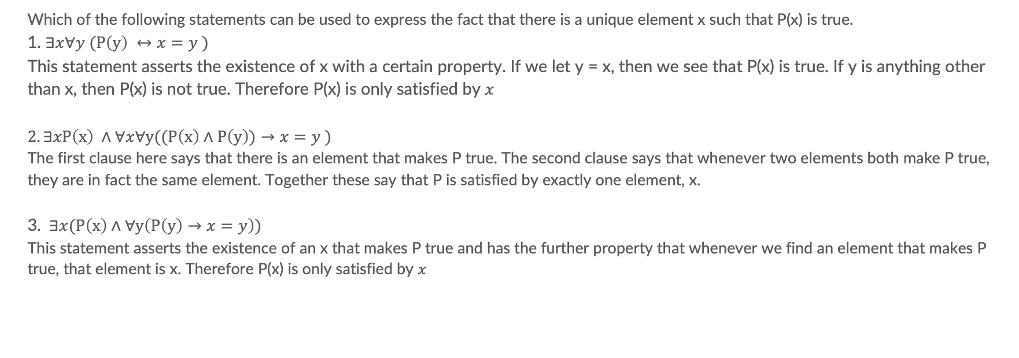
Problem 2 - Quantified Statements
Which of the following statements can be used to express the fact that there is a unique element x such that P(x) is true.
1. $∃x∀y (P\left(y\right) ↔x=y )$
This statement asserts the existence of x with a certain property. If we let y = x, then we see that P(x) is true. If y is anything other than x, then P(x) is not true. Therefore P(x) is only satisfied by $x$
$$2. ∃xP\left(x\right) ∧∀x∀y((P\left(x\right)∧P\left(y\right))→x=y )$$
The first clause here says that there is an element that makes P true. The second clause says that whenever two elements both make P true, they are in fact the same element. Together these say that P is satisfied by exactly one element, x.
3. $∃x(P\left(x\right)∧∀y\left(P\left(y\right)→x=y\right))$
This statement asserts the existence of an x that makes P true and has the further property that whenever we find an element that makes P true, that element is x. Therefore P(x) is only satisfied by $x$

Slide 9
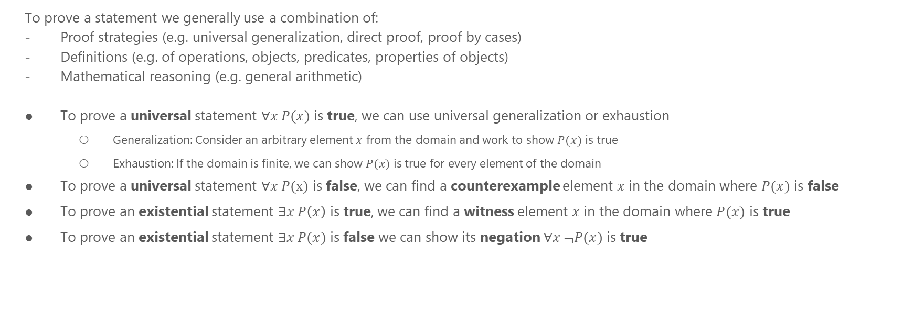
Proofs
To prove a statement we generally use a combination of:
Proof strategies (e.g. universal generalization, direct proof, proof by cases)
Definitions (e.g. of operations, objects, predicates, properties of objects)
Mathematical reasoning (e.g. general arithmetic)
To prove a universal statement $∀x P(x)$ is true, we can use universal generalization or exhaustion
Generalization: Consider an arbitrary element $x$ from the domain and work to show $P(x)$ is true
Exhaustion: If the domain is finite, we can show $P(x)$ is true for every element of the domain
To prove a universal statement $∀x P(x)$ is false, we can find a counterexample element $x$ in the domain where $P(x)$ is false
To prove an existential statement $∃x P\left(x\right)$ is true, we can find a witness element $x$ in the domain where $P(x)$ is true
To prove an existential statement $∃x P(x)$ is false we can show its negation $∀x ¬P(x)$ is true

Slide 10
Proof Tips
What if we don’t know whether the statement is true or false?
If it is a universal statement, first try to find a counterexample
If it is an existential statement, first try to find a witness
Consider the “extreme” elements of the domain
E.g. For integers, consider 1 and 0
For a domain that contains sets, consider the empty set and the power set
For a domain that contains strings, consider the empty string
If you are not able to find a counterexample / witness, try to prove the statement is true / false
If you get stuck, go back to thinking about counterexamples / witnesses
This process will often lead to insights that help you figure out if the statement is true or false

Slide 11

Problem 3a - proof
Suppose Smaller10(a) = $a<10$ is a predicate over the domain D = {0,1,2,3,4,5}.
Show that $∀$x $∈$D Smaller10(x).
Proof:

Slide 12

Problem 3a - proof
Suppose Smaller10(a) = $a<10$ is a predicate over the domain D = {0,1,2,3,4,5}.
Show that $∀$x $∈$D Smaller10(x).
Proof:
To show $∀$x $∈$D Smaller10(x), we proceed by universal exhaustion.
Smaller10(0) = 0 < 10, True
Smaller10(1) = 1 < 10, True
Smaller10(2) = 2 < 10, True
Smaller10(3) = 3 < 10, True
Smaller10(4) = 4 < 10, True
Smaller10(5) = 5 < 10, True
we have shown that Smaller10(x) is true for every element of the domain D.
Thus, $∀$x $∈$D Smaller10(x).

Slide 13

Problem 3b - proof
Consider the following predicates over the set of all integers:
Neg(n) = n is negative, Pos(n) = n is positive
Claim: Every negative integer has a positive integer where the sum of the two equals 0.
Express this claim as a quantified statement:
$∀$x $∈ℤ^{−} ∃y∈ℤ((Pos\left(y\right)∧(x+y=0))$
$∀$x $∈ℤ^{−} ∃y∈ℤ^{+}( x+y=0)$
$∀$x $∈ℤ ∃y∈ℤ(Neg\left(x\right)∧Pos\left(y\right) →(x+y=0))$. X

Slide 14
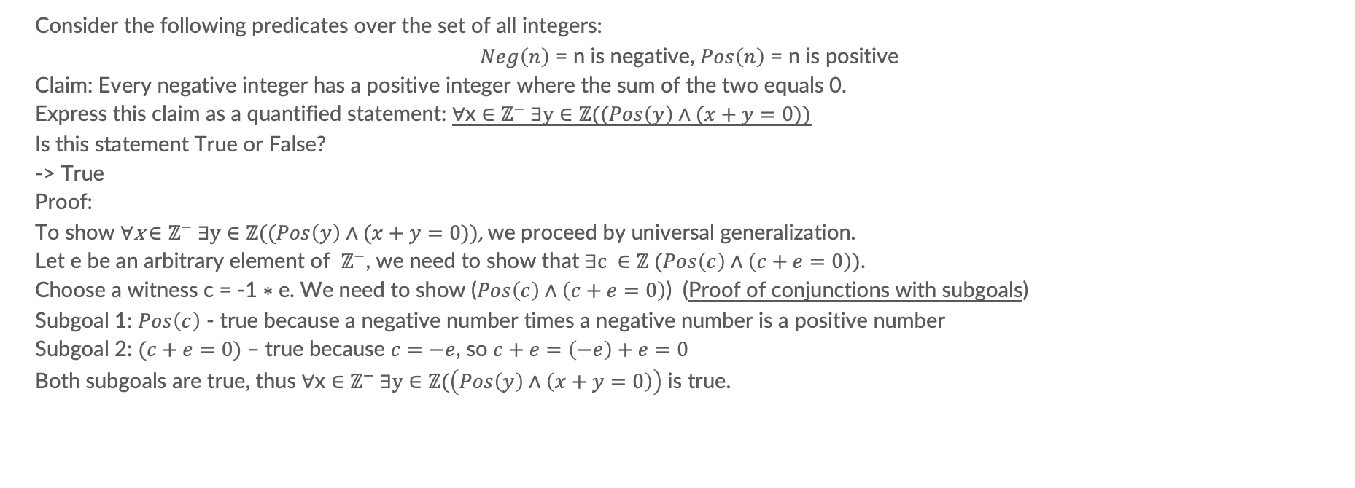
Problem 3b - proof
Consider the following predicates over the set of all integers:
$Neg\left(n\right)$ = n is negative, $Pos\left(n\right)$ = n is positive
Claim: Every negative integer has a positive integer where the sum of the two equals 0.
Express this claim as a quantified statement: $∀$x $∈ℤ^{−} ∃y∈ℤ((Pos\left(y\right)∧(x+y=0))$
Is this statement True or False?
-> True
Proof:
To show $∀$x $∈ℤ^{−} ∃y∈ℤ((Pos\left(y\right)∧(x+y=0))$, we proceed by universal generalization.
Let e be an arbitrary element of $ℤ^{−}$, we need to show that $∃c ∈ℤ (Pos\left(c\right)∧\left(c+e=0\right))$.
Choose a witness c = -1 $∗$ e. We need to show ($Pos\left(c\right)∧\left(c+e=0\right)$) (Proof of conjunctions with subgoals)
Subgoal 1: $Pos\left(c\right)$ - true because a negative number times a negative number is a positive number
Subgoal 2: $(c+e=0)$ – true because $c=−e$, so $c+e=\left(−e\right)+e=0$
Both subgoals are true, thus $∀$x $∈ℤ^{−} ∃y∈ℤ(\left(Pos\left(y\right)∧\left(x+y=0\right)\right)$ is true.

Slide 15
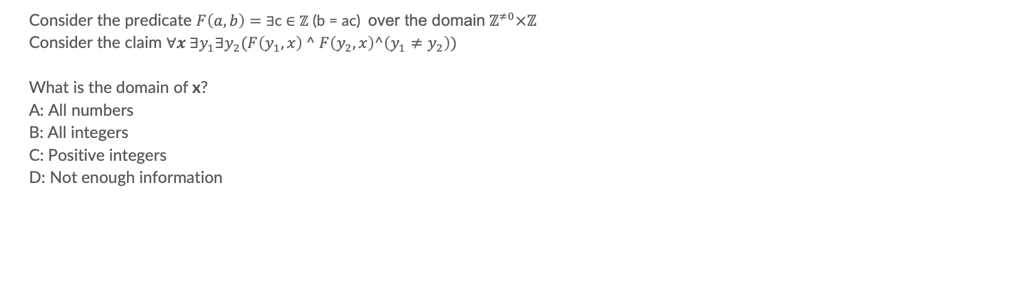
Problem 3c
Consider the predicate $F\left(a,b\right)=$ $∃$c $∈ℤ$ (b = ac) over the domain${ ℤ}^{≠0}×ℤ$
Consider the claim $∀x ∃y_{1}∃y_{2}(F\left(y_{1},x\right) ^ F\left(y_{2},x\right)^\left(y_{1}≠y_{2}\right))$
What is the domain of x?
A: All numbers
B: All integers
C: Positive integers
D: Not enough information

Slide 16
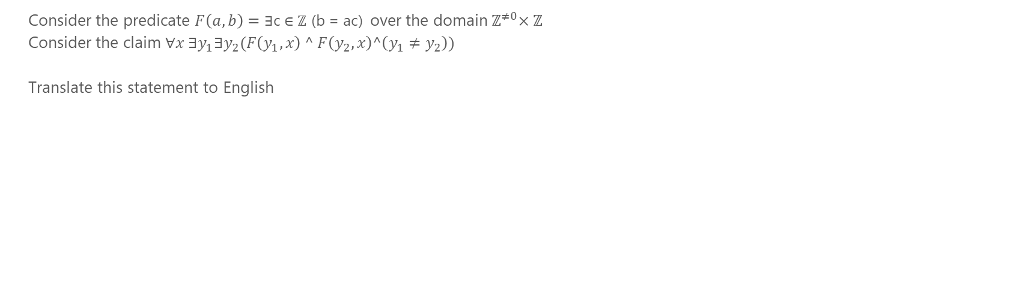
Problem 3c
Consider the predicate $F\left(a,b\right)=$ $∃$c $∈ℤ$ (b = ac) over the domain${ ℤ}^{≠0}×ℤ$
Consider the claim $∀x ∃y_{1}∃y_{2}(F\left(y_{1},x\right) ^ F\left(y_{2},x\right)^\left(y_{1}≠y_{2}\right))$
Translate this statement to English

Slide 17
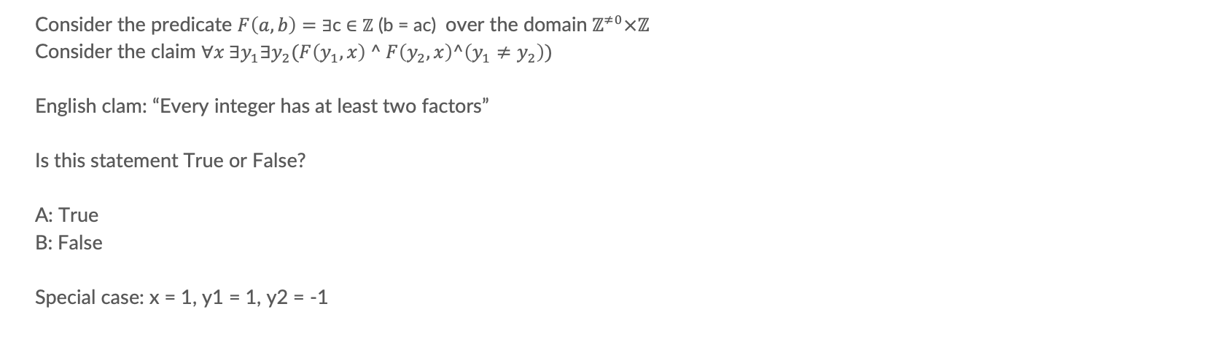
Problem 3c
Consider the predicate $F\left(a,b\right)=$ $∃$c $∈ℤ$ (b = ac) over the domain${ ℤ}^{≠0}×ℤ$
Consider the claim $∀x ∃y_{1}∃y_{2}(F\left(y_{1},x\right) ^ F\left(y_{2},x\right)^\left(y_{1}≠y_{2}\right))$
English clam: “Every integer has at least two factors”
Is this statement True or False?
A: True
B: False
Special case: x = 1, y1 = 1, y2 = -1

Slide 18
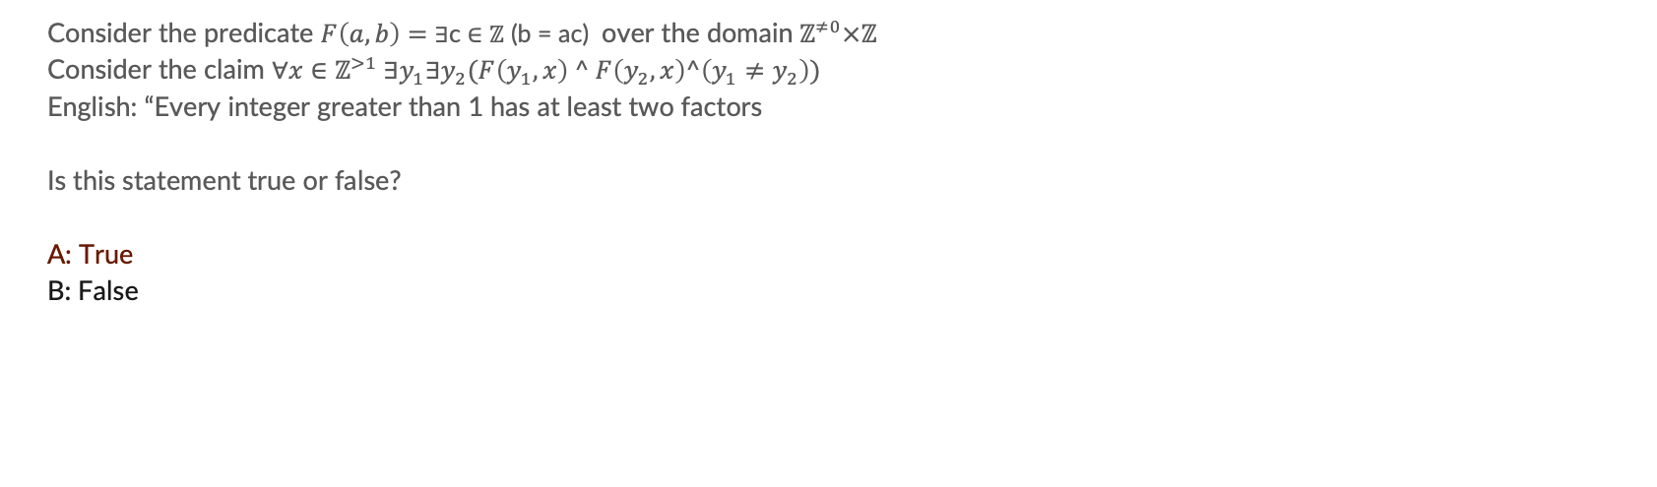
Problem 3c - exercise
Consider the predicate $F\left(a,b\right)=$ $∃$c $∈ℤ$ (b = ac) over the domain${ ℤ}^{≠0}×ℤ$
Consider the claim $∀x∈ℤ^{>1} ∃y_{1}∃y_{2}(F\left(y_{1},x\right) ^ F\left(y_{2},x\right)^\left(y_{1}≠y_{2}\right))$
English: “Every integer greater than 1 has at least two factors
Is this statement true or false?
A: True
B: False

Slide 19
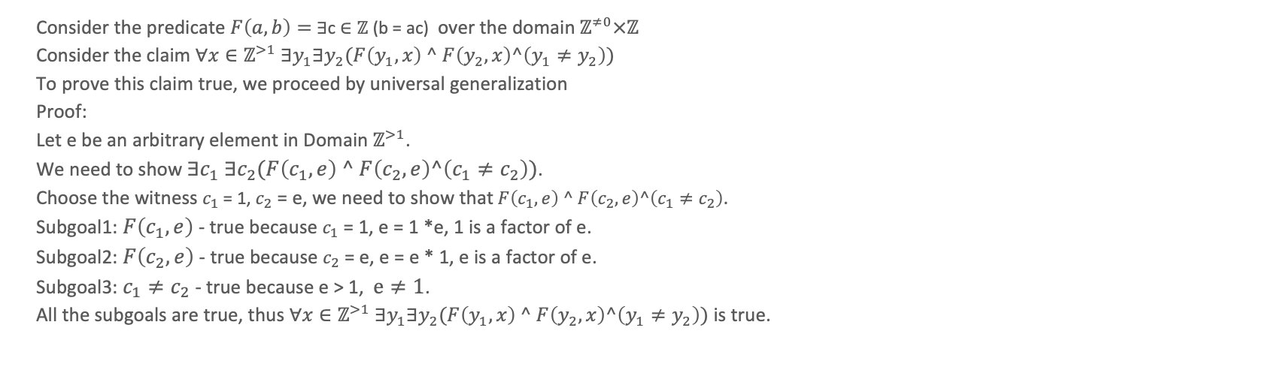
Problem 3c - exercise
Consider the predicate $F\left(a,b\right)=$ $∃$c $∈ℤ$ (b = ac) over the domain${ ℤ}^{≠0}×ℤ$
Consider the claim $∀x∈ℤ^{>1} ∃y_{1}∃y_{2}(F\left(y_{1},x\right) ^ F\left(y_{2},x\right)^\left(y_{1}≠y_{2}\right))$
To prove this claim true, we proceed by universal generalization
Proof:
Let e be an arbitrary element in Domain $ℤ^{>1}$.
We need to show $∃c_{1}$ $∃c_{2}(F\left(c_{1},e\right) ^ F\left(c_{2},e\right)^\left(c_{1}≠c_{2}\right))$.
Choose the witness $c_{1}$ = 1, $c_{2}$ = e, we need to show that$F\left(c_{1},e\right) ^ F\left(c_{2},e\right)^\left(c_{1}≠c_{2}\right)$.
Subgoal1: $F\left(c_{1},e\right)$- true because $c_{1}$ = 1, e = 1 *e, 1 is a factor of e.
Subgoal2: $F\left(c_{2},e\right)$- true because $c_{2}$ = e, e = e * 1, e is a factor of e.
Subgoal3: $c_{1}≠c_{2}$- true because e > 1, $e≠1$.
All the subgoals are true, thus $∀x∈ℤ^{>1} ∃y_{1}∃y_{2}(F\left(y_{1},x\right) ^ F\left(y_{2},x\right)^\left(y_{1}≠y_{2}\right))$ is true.

Slide 20
Problem 4a - proof
Using the definitions of even integer and odd integer, give a proof that this statement is true for all integers n:
If n is odd, then 5n+3 is even.
To prove this statement true, we use proof of conditional by direct proof.
Proof:
Assume n is odd, then n = 2k+1 for some integer k.
5n + 3 = 5* ( 2k + 1 ) + 3 = 10k + 8 = 2* (5k+4)
We can see that 5n+3 is a multiple of 2.
Therefore, if n is odd, 5n+3 is even.

Slide 21
Problem 4a - proof
Using the definitions of even integer and odd integer, give a proof that this statement is true for all integers n:
If 3n - 5 is even, then n is odd.
To prove this statement true, we use proof of conditional by contrapositive proof.
Proof:
Assume n is not odd, then n is even and n = 2k for some integer k.
3n – 5 = 3*2k – 5 = 6k – 5 = 2(3k - 3) +1
Therefore, 3n-5 is odd.
We have proven that If 3n - 5 is even, then n is odd.

Slide 22
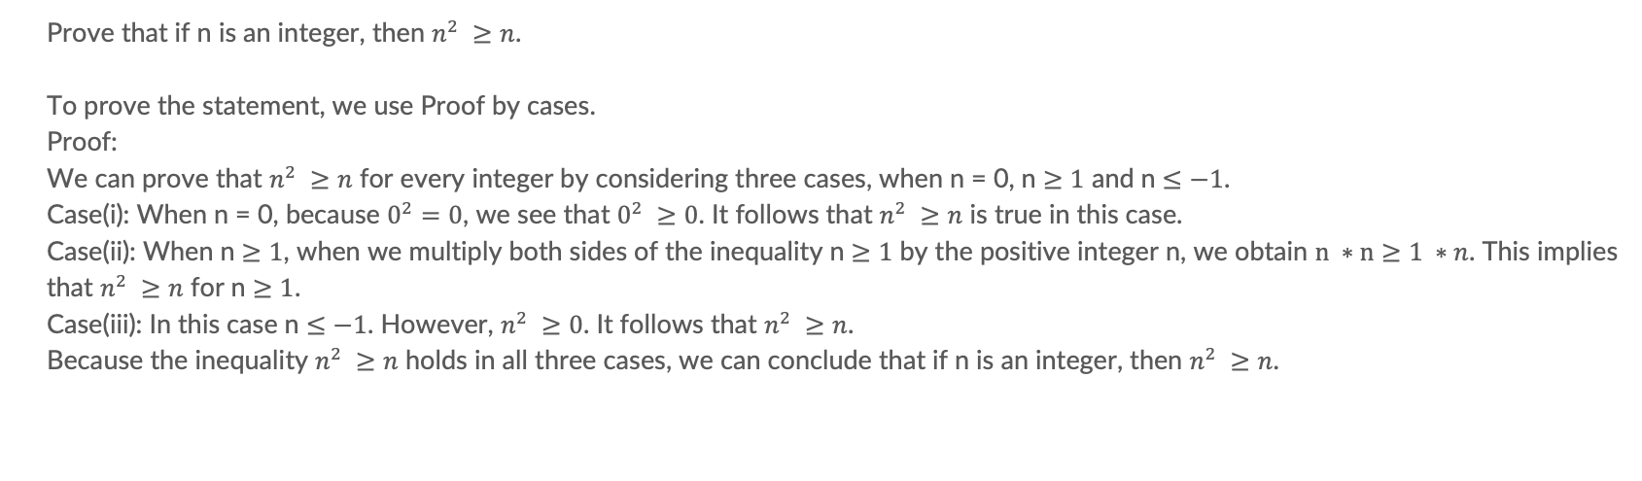
Problem 5 - proof
Prove that if n is an integer, then $n^{2} ≥n$.
To prove the statement, we use Proof by cases.
Proof:
We can prove that $n^{2} ≥n$ for every integer by considering three cases, when n = 0, n $≥1$ and n $≤−1$.
Case(i): When n = 0, because $0^{2}=0$, we see that $0^{2} ≥0$. It follows that $n^{2} ≥n$ is true in this case.
Case(ii): When n $≥1$, when we multiply both sides of the inequality n $≥1$ by the positive integer n, we obtain $n ∗n≥1 ∗n$. This implies that $n^{2} ≥n$ for n $≥1$.
Case(iii): In this case n $≤−1$. However, $n^{2} ≥0$. It follows that $n^{2} ≥n$.
Because the inequality $n^{2} ≥n$ holds in all three cases, we can conclude that if n is an integer, then $n^{2} ≥n$.

