Slide 1
CSE 20 Discussion - Week 9
Cardinality and Relations

Slide 2
Administrative Stuff
This discussion is being recorded – we will post the recording to class website
Week 9 (Monday Wednesday) Review quiz “due” Friday
Hard due date is Sunday midnight - no penalty for submitting any time before then
Project Part 3 is due Thursday 2nd !
See class website -> assignments -> Project for more info
Look at the checklist and make sure your submission checks all the boxes!

Slide 3
Agenda
Uncountable sets, Diagonalization
Binary Relation: definition, properties
Equivalence relation

Slide 4
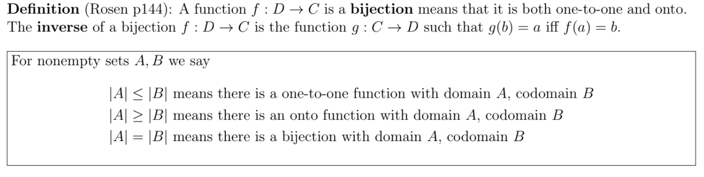
Cardinality Recap

Slide 5
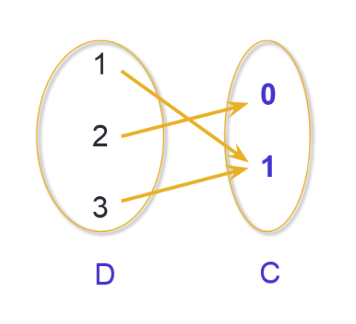
Onto functions, pictorially

Slide 6
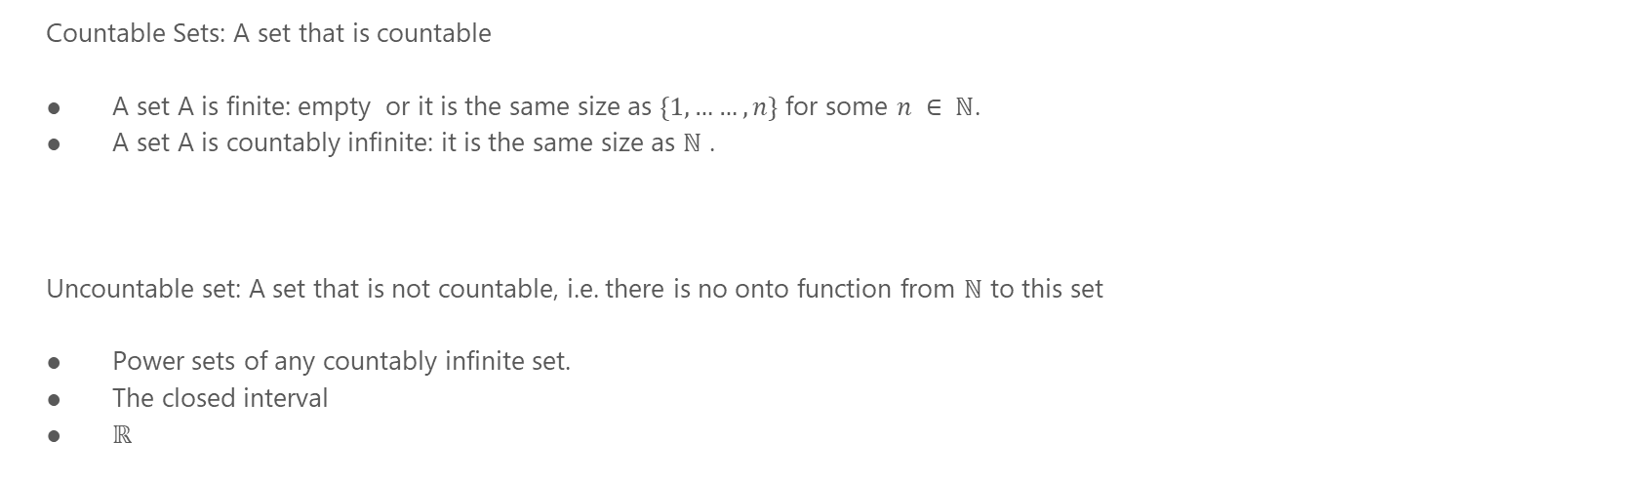
Cardinality of Sets
Countable Sets: A set that is countable
A set A is finite: empty or it is the same size as $\{1,……, n\}$ for some $n ∈ ℕ$.
A set A is countably infinite: it is the same size as $ℕ$ .
Uncountable set: A set that is not countable, i.e. there is no onto function from $ℕ$ to this set
Power sets of any countably infinite set.
The closed interval
$ℝ$

Slide 7
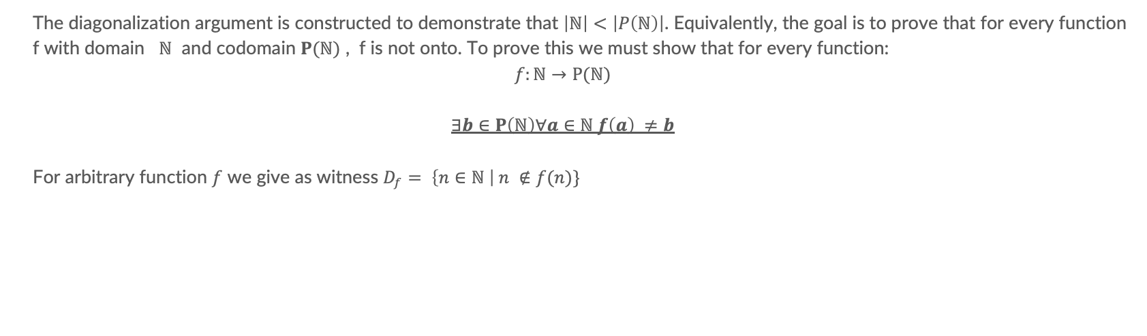
Diagonalization
The diagonalization argument is constructed to demonstrate that $\left|ℕ\right|<\left|P\left(ℕ\right)\right|$. Equivalently, the goal is to prove that for every function f with domain $ℕ$ and codomain $P(ℕ)$ , f is not onto. To prove this we must show that for every function:
$$f:ℕ→P(ℕ)$$
$$∃b∈P\left(ℕ\right)∀a∈ℕ f\left(a\right) ≠b$$
For arbitrary function $f$ we give as witness $D_{f}=$ $\left\{n∈ℕ \right| n ∉f(n)\}$

Slide 8
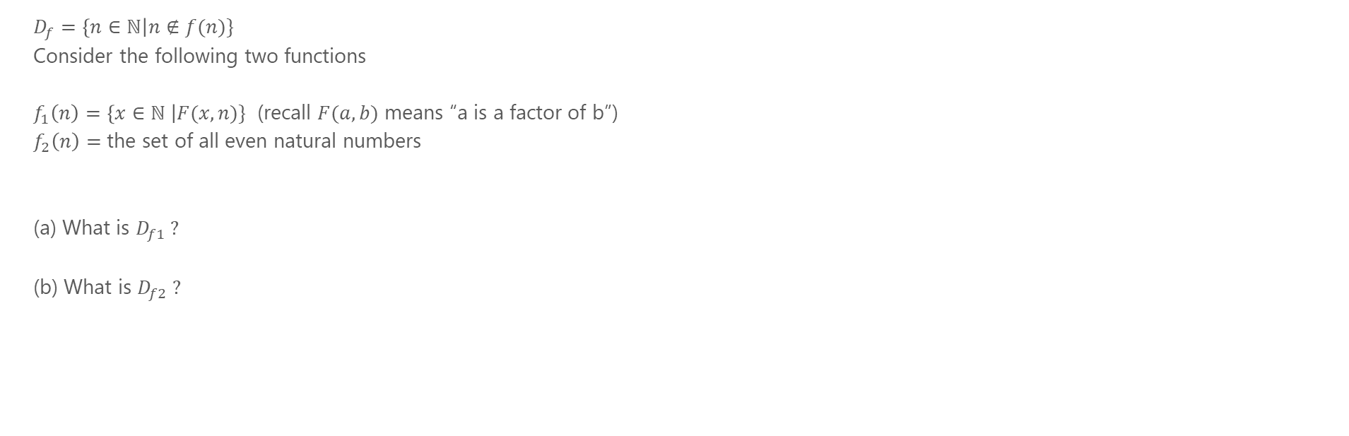
Problem 1
$D_{f}=\left\{n∈ℕ\right|n∉f(n)\}$
Consider the following two functions
$f_{1}\left(n\right)=\left\{x∈ℕ \right|F(x, n)\}$ (recall $F(a,b)$ means “a is a factor of b”)
$f_{2}\left(n\right)=$ the set of all even natural numbers
(a) What is $D_{f1} ?$
(b) What is $D_{f2} ?$

Slide 9
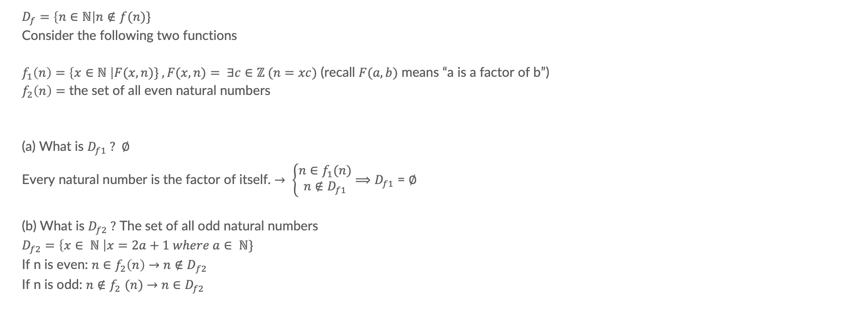
Problem 1
$D_{f}=\left\{n∈ℕ\right|n∉f(n)\}$
Consider the following two functions
$f_{1}\left(n\right)=\left\{x∈ℕ \right|F(x, n)\} ,F(x, n)= ∃c∈ℤ (n=xc)$ (recall $F(a,b)$ means “a is a factor of b”)
$f_{2}\left(n\right)=$ the set of all even natural numbers
(a) What is $D_{f1} ?$ $∅$
Every natural number is the factor of itself. $→ \left\{\begin{aligned}n∈f_{1}(n) \\ n∉D_{f1}\end{aligned}\right.$ $⟹D_{f1}$ = $∅$
(b) What is $D_{f2} ?$ The set of all odd natural numbers
$$D_{f2}=\left\{x∈ ℕ \right|x=2a+1 where a∈ ℕ\}$$
If n is even: $n∈f_{2}\left(n\right)$ $→$ $n{∉D}_{f2}$
If n is odd: $n{∉f}_{2}(n)$ $→$ $n∈D_{f2}$

Slide 10
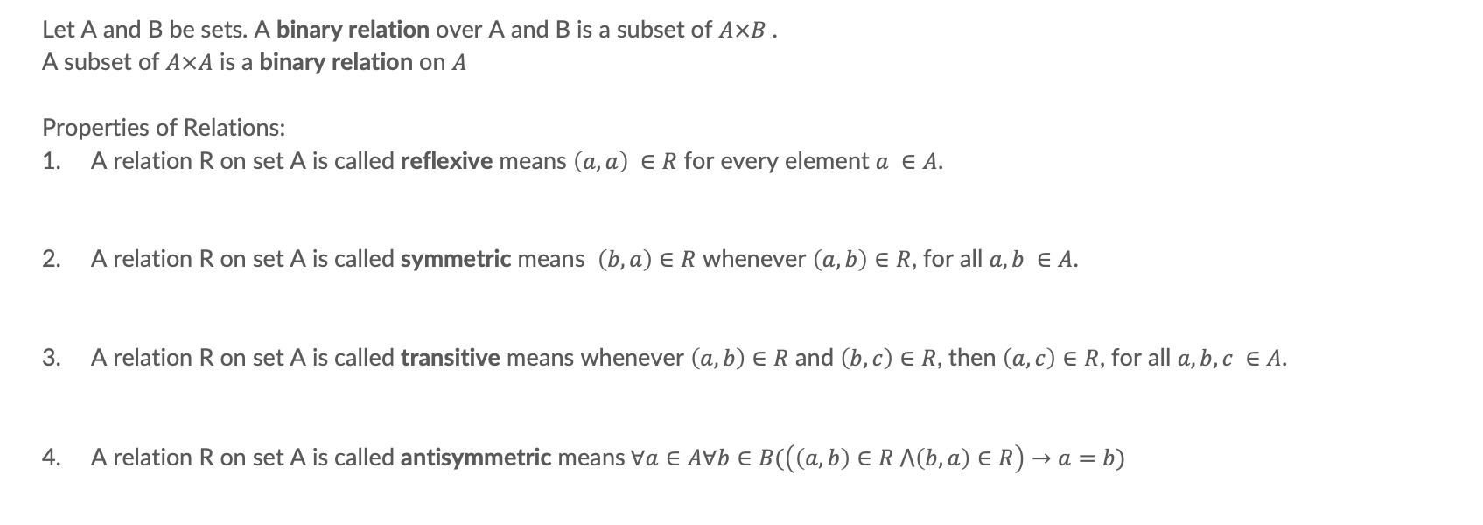
Binary Relation
Let A and B be sets. A binary relation over A and B is a subset of $A×B$.
A subset of $A×A$ is a binary relation on $A$
Properties of Relations:
A relation R on set A is called reflexive means $\left(a,a\right) ∈R$ for every element $a ∈A$.
A relation R on set A is called symmetric means $\left(b,a\right)∈R$ whenever $\left(a,b\right)∈R$, for all $a, b ∈A$.
A relation R on set A is called transitive means whenever $\left(a,b\right)∈R$ and $\left(b,c\right)∈R$, then $\left(a,c\right)∈R$, for all $a, b, c ∈A$.
A relation R on set A is called antisymmetric means$∀a∈A∀b∈B(\left(\left(a,b\right)∈R ⋀\left(b,a\right)∈R\right)→a=b)$

Slide 11

Problem2a
Consider the following relation on the set $P\left(ℕ\right):R=\left\{\left(a,b\right) \right| a⊊b\}$
Rewrite each of the following claims using quantifications then decide whether they are true or false.
R is reflexive
R is symmetric
R is transitive
R is antisymmetric

Slide 12
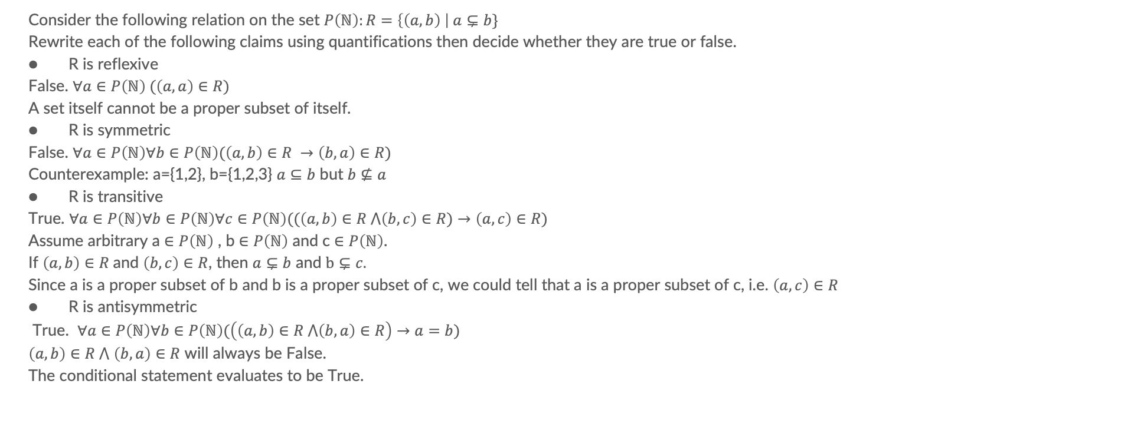
Problem2
Consider the following relation on the set $P\left(ℕ\right):R=\left\{\left(a,b\right) \right| a⊊b\}$
Rewrite each of the following claims using quantifications then decide whether they are true or false.
R is reflexive
False. $∀a∈P\left(ℕ\right) (\left(a,a\right)∈R)$
A set itself cannot be a proper subset of itself.
R is symmetric
False. $∀a∈P\left(ℕ\right)∀b∈P\left(ℕ\right)(\left(a,b\right)∈R →\left(b,a\right)∈R)$
Counterexample: a={1,2}, b={1,2,3} $a⊆b$ but $b⊈a$
R is transitive
True. $∀a∈P\left(ℕ\right)∀b∈P\left(ℕ\right)∀c∈P\left(ℕ\right)((\left(a,b\right)∈R ⋀\left(b,c\right)∈R)→\left(a,c\right)∈R)$
Assume arbitrary a $∈P\left(ℕ\right)$ , b $∈P\left(ℕ\right)$ and c $∈P\left(ℕ\right)$.
If $\left(a,b\right)∈R$and $\left(b,c\right)∈R$, then $a⊊b$ and $b⊊c.$
Since a is a proper subset of b and b is a proper subset of c, we could tell that a is a proper subset of c, i.e. $\left(a,c\right)∈R$
R is antisymmetric
True. $∀a∈P\left(ℕ\right)∀b∈P\left(ℕ\right)(\left(\left(a,b\right)∈R ⋀\left(b,a\right)∈R\right)→a=b)$
$\left(a,b\right)∈R ⋀$ $\left(b,a\right)∈R$ will always be False.
The conditional statement evaluates to be True.

Slide 13
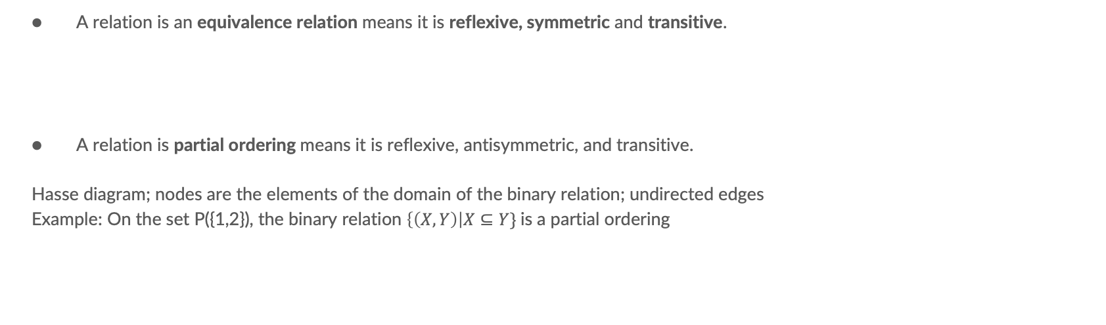
Equivalence Relation
A relation is an equivalence relation means it is reflexive, symmetric and transitive.
A relation is partial ordering means it is reflexive, antisymmetric, and transitive.
Hasse diagram; nodes are the elements of the domain of the binary relation; undirected edges
Example: On the set P({1,2}), the binary relation $\left\{\left(X,Y\right)\right|X⊆Y\}$is a partial ordering

Slide 14
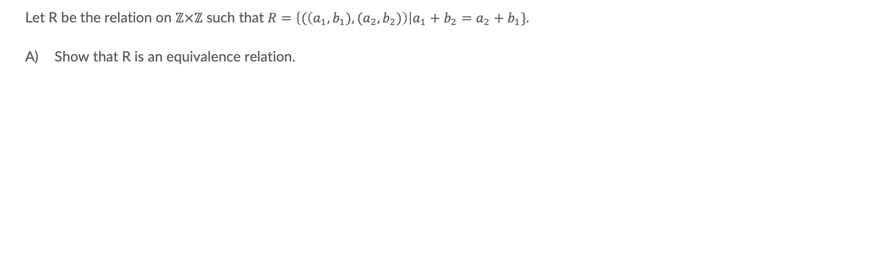
Problem 3
Let R be the relation on $ℤ×ℤ$ such that $R=\left\{(\left(a_{1},b_{1}), (a_{2},b_{2})\right)\right|a_{1}+b_{2}=a_{2}+b_{1}\}.$
Show that R is an equivalence relation.

Slide 15
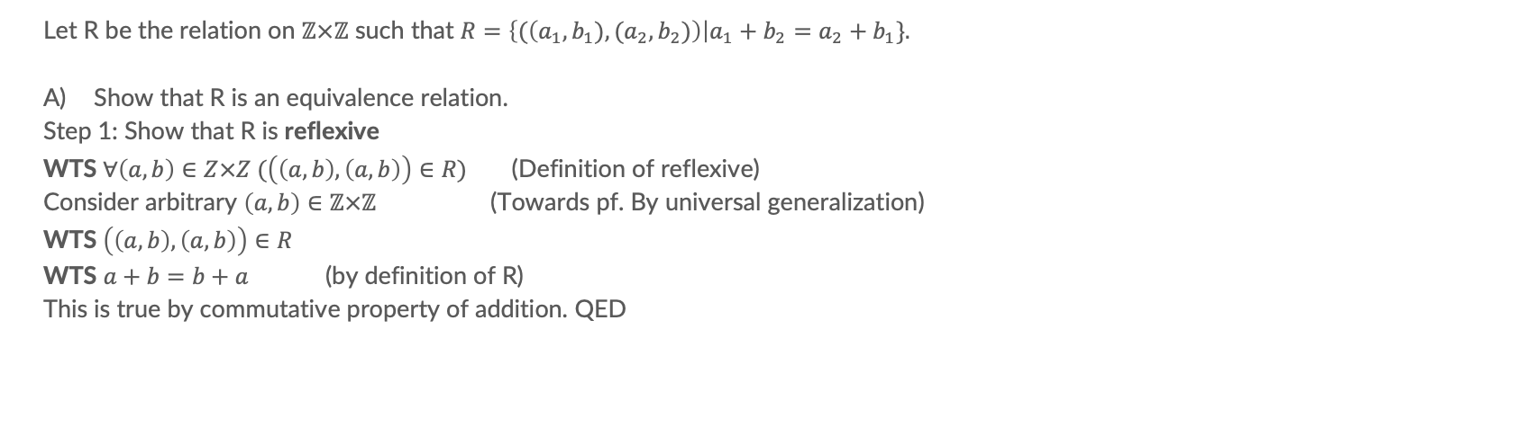
Problem 3a
Let R be the relation on $ℤ×ℤ$ such that $R=\left\{(\left(a_{1},b_{1}), (a_{2},b_{2})\right)\right|a_{1}+b_{2}=a_{2}+b_{1}\}.$
Show that R is an equivalence relation.
Step 1: Show that R is reflexive
WTS $∀\left(a, b\right)∈Z×Z (\left(\left(a,b\right),\left(a,b\right)\right)∈R)$ (Definition of reflexive)
Consider arbitrary $\left(a,b\right)∈ℤ×ℤ$ (Towards pf. By universal generalization)
WTS $\left(\left(a,b\right),\left(a,b\right)\right)∈R$
WTS $a+b=b+a$ (by definition of R)
This is true by commutative property of addition. QED

Slide 16
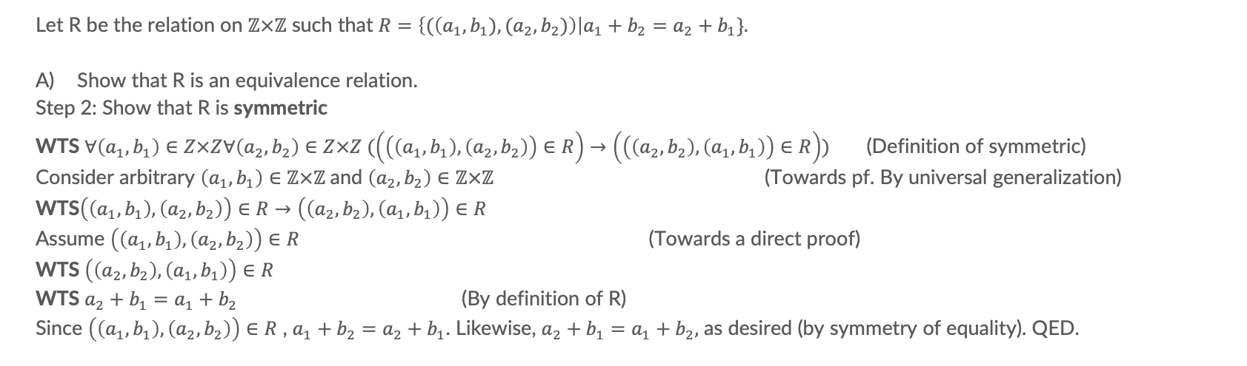
Problem 3a cont.
Let R be the relation on $ℤ×ℤ$ such that $R=\left\{(\left(a_{1},b_{1}), (a_{2},b_{2})\right)\right|a_{1}+b_{2}=a_{2}+b_{1}\}.$
Show that R is an equivalence relation.
Step 2: Show that R is symmetric
WTS $∀\left(a_{1}, b_{1}\right)∈Z×Z∀\left(a_{2}, b_{2}\right)∈Z×Z (\left(\left(\left(a_{1},b_{1}\right),\left(a_{2},b_{2}\right)\right)∈R\right)→\left(\left(\left(a_{2},b_{2}\right), \left(a_{1},b_{1}\right)\right)∈R\right))$ (Definition of symmetric)
Consider arbitrary $\left(a_{1},b_{1}\right)∈ℤ×ℤ$and $\left(a_{2},b_{2}\right)∈ℤ×ℤ$ (Towards pf. By universal generalization)
WTS$\left(\left(a_{1},b_{1}\right),\left(a_{2},b_{2}\right)\right)∈R→\left(\left(a_{2},b_{2}\right), \left(a_{1},b_{1}\right)\right)∈R$
Assume $\left(\left(a_{1},b_{1}\right),\left(a_{2},b_{2}\right)\right)∈R$ (Towards a direct proof)
WTS $\left(\left(a_{2},b_{2}\right), \left(a_{1},b_{1}\right)\right)∈R$
WTS $a_{2}+b_{1}=a_{1}+b_{2}$ (By definition of R)
Since $\left(\left(a_{1},b_{1}\right),\left(a_{2},b_{2}\right)\right)∈R$ , $a_{1}+b_{2}=a_{2}+b_{1}$. Likewise, $a_{2}+b_{1}=a_{1}+b_{2},$ as desired (by symmetry of equality). QED.

Slide 17
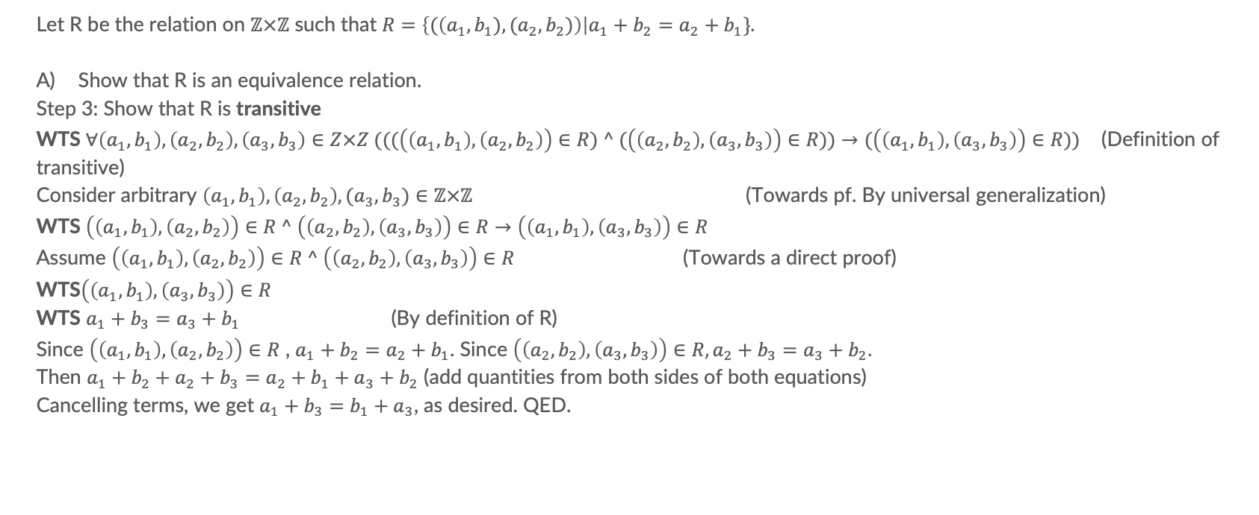
Problem 3a cont.
Let R be the relation on $ℤ×ℤ$ such that $R=\left\{(\left(a_{1},b_{1}), (a_{2},b_{2})\right)\right|a_{1}+b_{2}=a_{2}+b_{1}\}.$
Show that R is an equivalence relation.
Step 3: Show that R is transitive
WTS $∀\left(a_{1}, b_{1}\right),\left(a_{2},b_{2}\right),\left(a_{3},b_{3}\right)∈Z×Z (((\left(\left(a_{1},b_{1}\right),\left(a_{2},b_{2}\right)\right)∈R) ^ (\left(\left(a_{2},b_{2}\right),\left(a_{3},b_{3}\right)\right)∈R))→(\left(\left(a_{1},b_{1}\right), \left(a_{3},b_{3}\right)\right)∈R))$ (Definition of transitive)
Consider arbitrary $\left(a_{1},b_{1}\right),\left(a_{2},b_{2}\right),(a_{3},b_{3})∈ℤ×ℤ$ (Towards pf. By universal generalization)
WTS $\left(\left(a_{1},b_{1}\right),\left(a_{2},b_{2}\right)\right)∈R ^ \left(\left(a_{2},b_{2}\right),\left(a_{3},b_{3}\right)\right)∈R→\left(\left(a_{1},b_{1}\right), \left(a_{3},b_{3}\right)\right)∈R$
Assume $\left(\left(a_{1},b_{1}\right),\left(a_{2},b_{2}\right)\right)∈R ^ \left(\left(a_{2},b_{2}\right),\left(a_{3},b_{3}\right)\right)∈R$ (Towards a direct proof)
WTS$\left(\left(a_{1},b_{1}\right), \left(a_{3},b_{3}\right)\right)∈R$
WTS $a_{1}+b_{3}=a_{3}+b_{1}$ (By definition of R)
Since $\left(\left(a_{1},b_{1}\right),\left(a_{2},b_{2}\right)\right)∈R$ , $a_{1}+b_{2}=a_{2}+b_{1}$. Since $\left(\left(a_{2},b_{2}\right),\left(a_{3},b_{3}\right)\right)∈R, a_{2}+b_{3}=a_{3}+b_{2}.$
Then $a_{1}+b_{2}+a_{2}+b_{3}=a_{2}+b_{1}+a_{3}+b_{2}$ (add quantities from both sides of both equations)
Cancelling terms, we get $a_{1}+b_{3}=b_{1}+a_{3}$, as desired. QED.

Slide 18
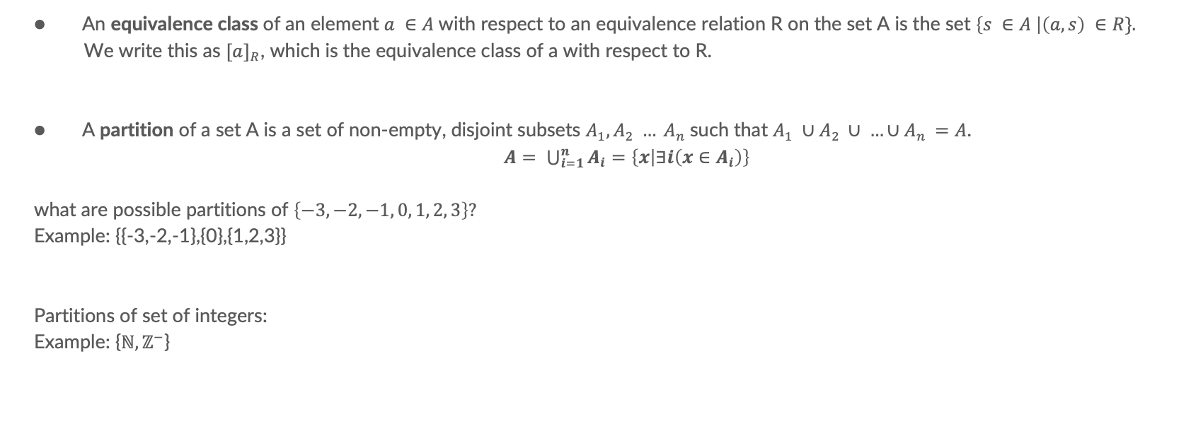
Equivalence Class
An equivalence class of an element $a ∈A$with respect to an equivalence relation R on the set A is the set $\left\{s ∈A \right|\left(a,s\right) ∈R\}.$
We write this as ${[a]}_{R}$, which is the equivalence class of a with respect to R.
A partition of a set A is a set of non-empty, disjoint subsets $A_{1}, A_{2} … A_{n}$such that $A_{1} ∪A_{2 }∪ …∪A_{n }=A$.
$A= \bigcup_{i=1}^{n}{A_{i}=\left\{x | ∃i\left(x∈A_{i}\right)\right\}}$
what are possible partitions of $\left\{−3, −2, −1, 0, 1, 2, 3\right\}?$
Example: {{-3,-2,-1},{0},{1,2,3}}
Partitions of set of integers:
Example: {$ℕ,ℤ^{−}$}

Slide 19
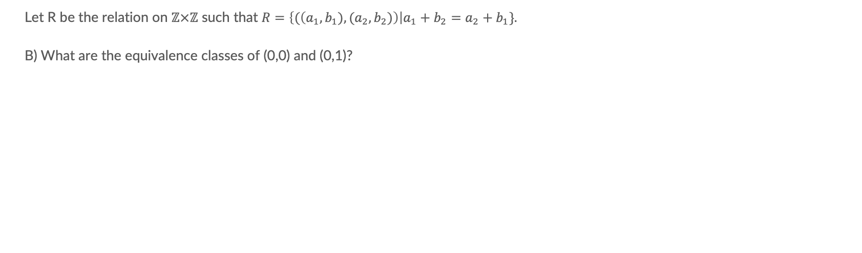
Problem 3b
Let R be the relation on $ℤ×ℤ$ such that $R=\left\{(\left(a_{1},b_{1}), (a_{2},b_{2})\right)\right|a_{1}+b_{2}=a_{2}+b_{1}\}.$
B) What are the equivalence classes of (0,0) and (0,1)?

Slide 20
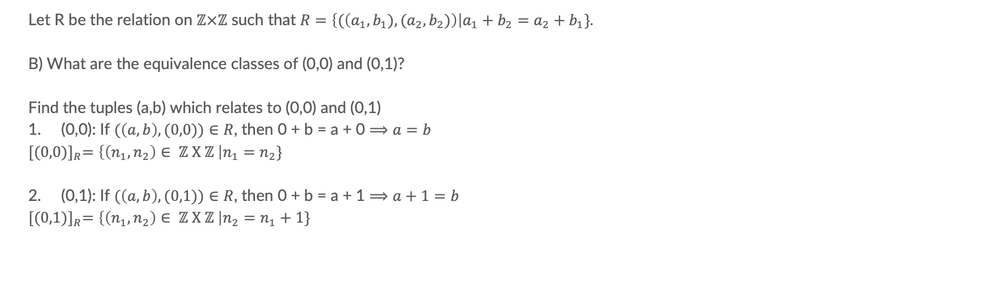
Problem 3b
Let R be the relation on $ℤ×ℤ$ such that $R=\left\{(\left(a_{1},b_{1}), (a_{2},b_{2})\right)\right|a_{1}+b_{2}=a_{2}+b_{1}\}.$
B) What are the equivalence classes of (0,0) and (0,1)?
Find the tuples (a,b) which relates to (0,0) and (0,1)
(0,0): If $(\left(a,b\right),(0,0))∈R$, then 0 + b = a + 0 $⟹a=b$
$${[(0,0)]}_{R}=\left\{\left(n_{1},n_{2}\right)∈ ℤ X ℤ \right|n_{1}=n_{2}\}$$
(0,1): If $(\left(a,b\right),(0,1))∈R$, then 0 + b = a + 1 $⟹a+1=b$
$${[(0,1)]}_{R}=\left\{\left(n_{1},n_{2}\right)∈ ℤ X ℤ \right|n_{2}=n_{1}+1\}$$

