Slide 1
CSE 20 Discussion - Week 3
Circuits and Logic

Slide 2
Administrative Stuff
Week 3 (Monday, Wednesday, Friday) Review quiz “due this Friday
Hard due date is Sunday
Project Part 1 is due Tomorrow at 11pm!
See class website -> assignments -> Project Part 1 for more info
Checklist is very useful

Slide 3
Agenda
Circuits
Review of gates, how to determine the output of a circuit
Propositional Logic
Key definitions
Logical equivalences and how to apply them
Normal Forms
Converting between circuits and propositional logic

Slide 4
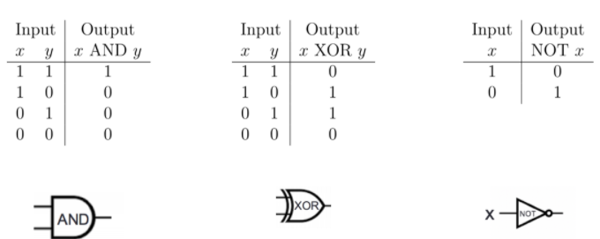

Logic Gates
Input / Output is expressed as 1/0 or T/F
Binary operators (AND, OR, XOR, etc) take 2 inputs, unary operators (NOT) take 1
Input / Output relationship is defined with truth tables
x | y | x OR y
0 | 0 | 0
0 | 1 | 1
1 | 0 | 1
1 | 1 | 1

Slide 5
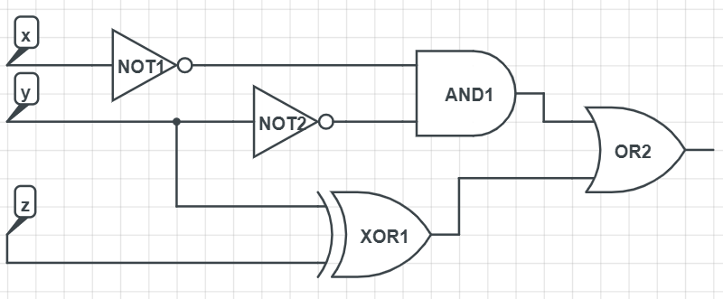
Logic Gates - practice
What will this circuit output when the inputs are x = 0, y = 1, and z = 0?
A: 1
B: 0
C: I don’t know
D: I really don’t know

Slide 6
Logic Gates - practice
What will this circuit output when the inputs are x = 0, y = 1, and z = 0?
A: 1
B: 0
C: I don’t know
D: I really don’t know
0
1
0
1
0
1
1
1
0
0

Slide 7
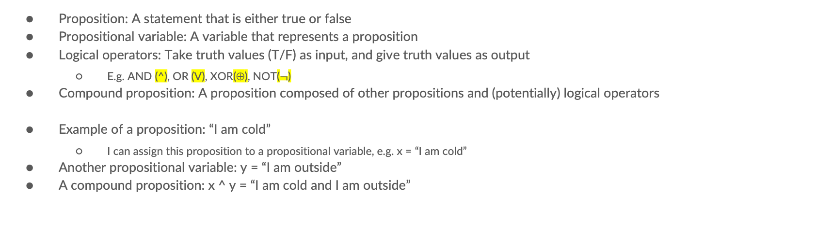
Propositional Logic
Proposition: A statement that is either true or false
Propositional variable: A variable that represents a proposition
Logical operators: Take truth values (T/F) as input, and give truth values as output
E.g. AND (^), OR (V), XOR(⊕), NOT($¬$)
Compound proposition: A proposition composed of other propositions and (potentially) logical operators
Example of a proposition: “I am cold”
I can assign this proposition to a propositional variable, e.g. x = “I am cold”
Another propositional variable: y = “I am outside”
A compound proposition: x ^ y = “I am cold and I am outside”

Slide 8
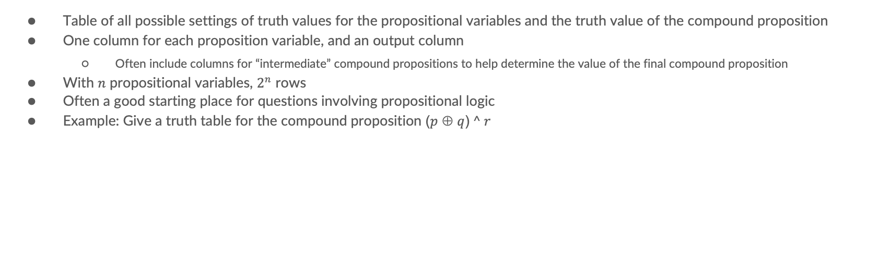
Truth Tables
Table of all possible settings of truth values for the propositional variables and the truth value of the compound proposition
One column for each proposition variable, and an output column
Often include columns for “intermediate” compound propositions to help determine the value of the final compound proposition
With $n$ propositional variables, $2^{n}$ rows
Often a good starting place for questions involving propositional logic
Example: Give a truth table for the compound proposition ($p$ ⊕ $q$)$^ r$

Slide 9
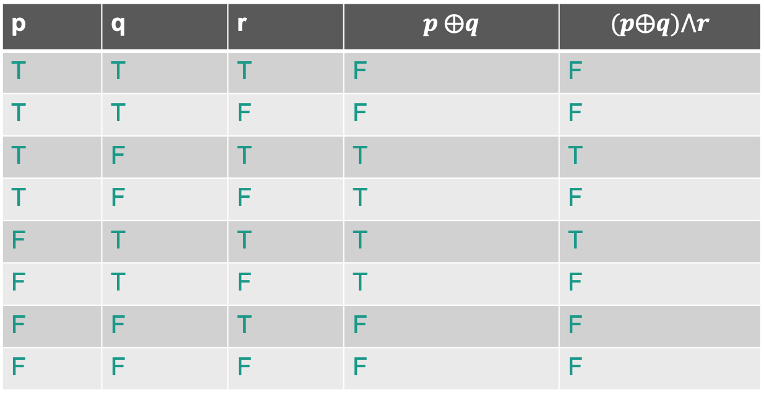

Example: Give a truth table for the compound proposition ($p$ ⊕ $q$)$^ r$
p | q | r | $$p ⨁q$$ | $$(p⨁q)⋀r$$
T | T | T | F | F
T | T | F | F | F
T | F | T | T | T
T | F | F | T | F
F | T | T | T | T
F | T | F | T | F
F | F | T | F | F
F | F | F | F | F

Slide 10







Logic Gates and Propositional Logic
We can translate circuits to compound propositions to help reason about their outputs
Inputs = propositional variables
Gates = logical operators
Give a compound proposition for the output of this circuit
$$¬x$$
$$¬x⋀¬y$$
$$¬y$$
$$(¬x⋀¬y)⋁(y⨁z)$$
$$y$$
$$z$$
$$y⨁z$$

Slide 11
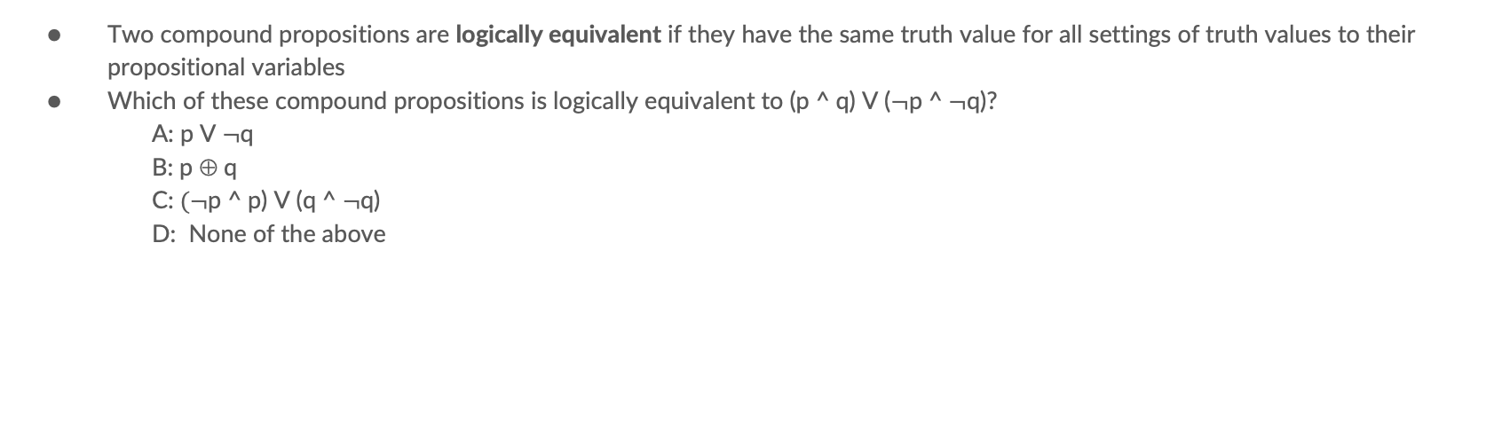
Logical equivalences
Two compound propositions are logically equivalent if they have the same truth value for all settings of truth values to their propositional variables
Which of these compound propositions is logically equivalent to (p ^ q) V ($¬$p ^ $¬$q)?
A: p V $¬$q
B: p $$ q
C: $(¬$p ^ p) V (q ^ $¬$q)
D: None of the above

Slide 12
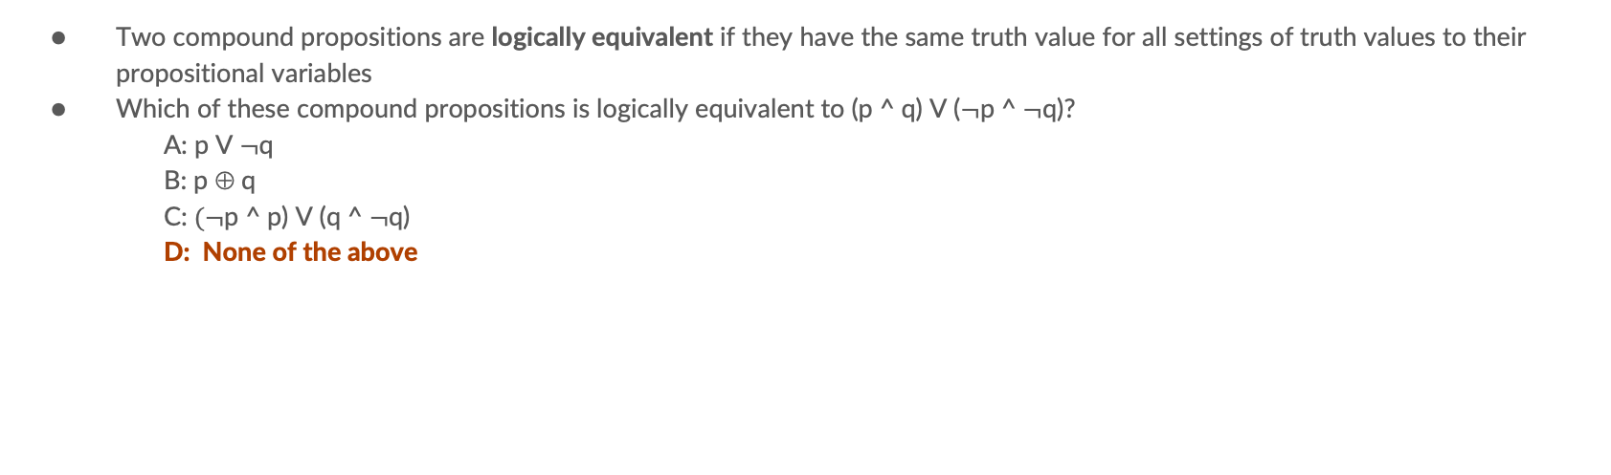
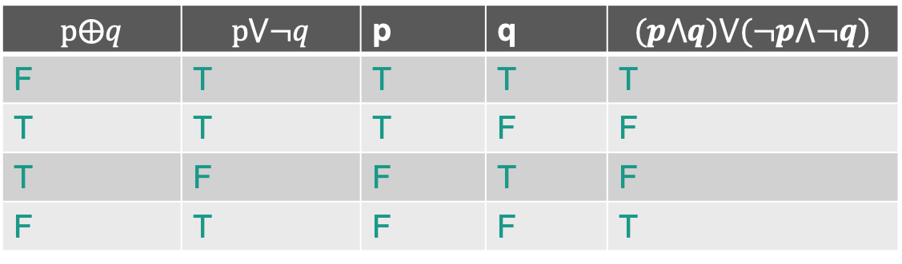
Logical equivalences
Two compound propositions are logically equivalent if they have the same truth value for all settings of truth values to their propositional variables
Which of these compound propositions is logically equivalent to (p ^ q) V ($¬$p ^ $¬$q)?
A: p V $¬$q
B: p $$ q
C: $(¬$p ^ p) V (q ^ $¬$q)
D: None of the above
$$p⨁q$$ | $$p⋁¬q$$ | p | q | $$(p⋀q)⋁(¬p⋀¬q)$$
F | T | T | T | T
T | T | T | F | F
T | F | F | T | F
F | T | F | F | T

Slide 13
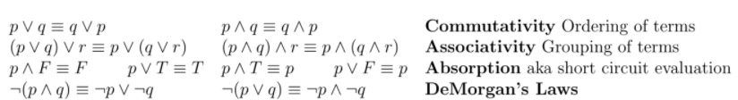
Common logical equivalences
Many others (see textbook for more)
DeMorgan’s Laws come up a lot!

Slide 14
Logic Gates and logical equivalence
Give a circuit that produces the same output as the circuit below but has only 4 gates
Can we use logical equivalences to help us?

Slide 15
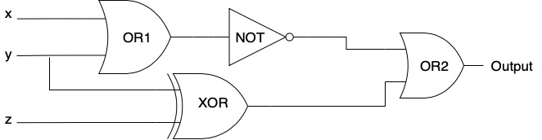


Can we use logical equivalences to help us? -> DeMorgan’s law
$$(¬x⋀¬y)⋁(y⨁z)$$
$$(¬x⋀¬y)≡¬(x⋁y)$$

Slide 16
Circuits and Propositional logic
We can convert between circuits and propositional logic in both directions
To get from a circuit to a compound proposition:
Create a propositional variable for each input to the circuit
Trace the circuit to determine how the output of the circuit depends on the inputs.
At the output of each gate, write the corresponding compound proposition based on the input wires and the logical operator for that gate
The compound proposition(s) at the output wire(s) is your answer
What about building a circuit from a compound proposition?
Similar process – each variable is an input to the circuit, build gates according to the logical operators in the proposition

Slide 17
Normal Forms
Normal Forms (DNF and CNF) give us ways to build a compound proposition that describes the input – output relationship of any truth table
Given a truth table:
DNF: Compound proposition should be “true” whenever the truth values of the input variables correspond to one of the “true” rows of the output column
CNF: Compound proposition should be “true” whenever the truth values of the input variables do not correspond to any of the “false” rows of the output column
A compound proposition in DNF is a compound proposition that is structured as an “OR” of “AND”s
Propositions in parentheses are “AND”s, with “OR”s between them
A compound proposition in CNF is a compound proposition that is structure as an “AND” of “OR”s
Propositions in parentheses are “OR”s with “AND”s between them

Slide 18
Normal Forms Practice
Consider the truth table below: Give a compound proposition that is logically equivalent to ?
X | Y | Z | ?
F | F | F | F
F | F | T | T
F | T | F | T
F | T | T | T
T | F | F | F
T | F | T | F
T | T | F | T
T | T | T | T
$$¬(¬x∧¬y∧¬z) ≡ (x∨y∨z)$$
CNF
$(x∨y∨z)∧$ $(¬x∨y∨z)∧(¬x∨y∨¬z)$
$$¬(x∧¬y∧¬z) ≡(¬x∨y∨z)$$
$$¬(x∧¬y∧z) ≡(¬x∨y∨¬z)$$

Slide 19
Putting it all together
To build a circuit that implements some operation:
Build an input/output table for that operation
Build compound propositions for the output column(s) using DNF / CNF
Build a circuit that implements those compound proposition(s)
This process probably won’t give the smallest circuit, but it will give a circuit that works

Slide 20

Putting it all together - example
Build a circuit that implements the operation ${\left(xyz\right)}_{2,3} mod 3=0$
Output of the circuit should be 1 when the number represented by ${\left(xyz\right)}_{2,3}$is divisible by 3, and $0$ otherwise
First step: Input / Output table

Slide 21

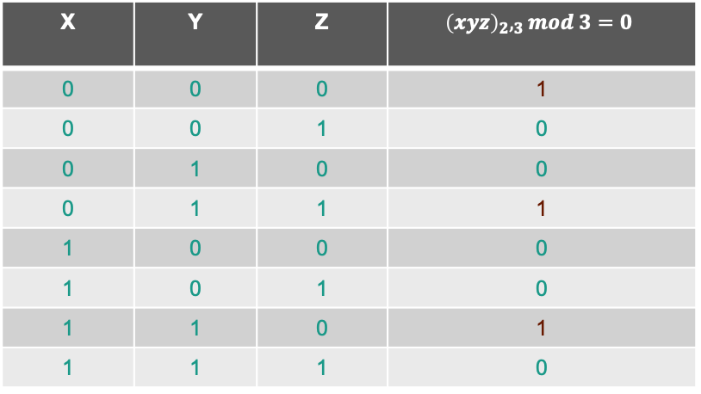
Putting it all together - example
Build a circuit that implements the operation ${\left(xyz\right)}_{2,3} mod 3=0$
Output of the circuit should be 1 when the number represented by ${\left(xyz\right)}_{2,3}$is divisible by 3, and $0$ otherwise
First step: Input / Output table
Next step: Compound proposition
X | Y | Z | $${\left(xyz\right)}_{2},_{3}mod 3=0$$
0 | 0 | 0 | 1
0 | 0 | 1 | 0
0 | 1 | 0 | 0
0 | 1 | 1 | 1
1 | 0 | 0 | 0
1 | 0 | 1 | 0
1 | 1 | 0 | 1
1 | 1 | 1 | 0
DNF
$(¬x⋀¬y⋀¬z)⋁(¬x⋀y⋀z)$ $⋁(x⋀y⋀¬z)$

Slide 22
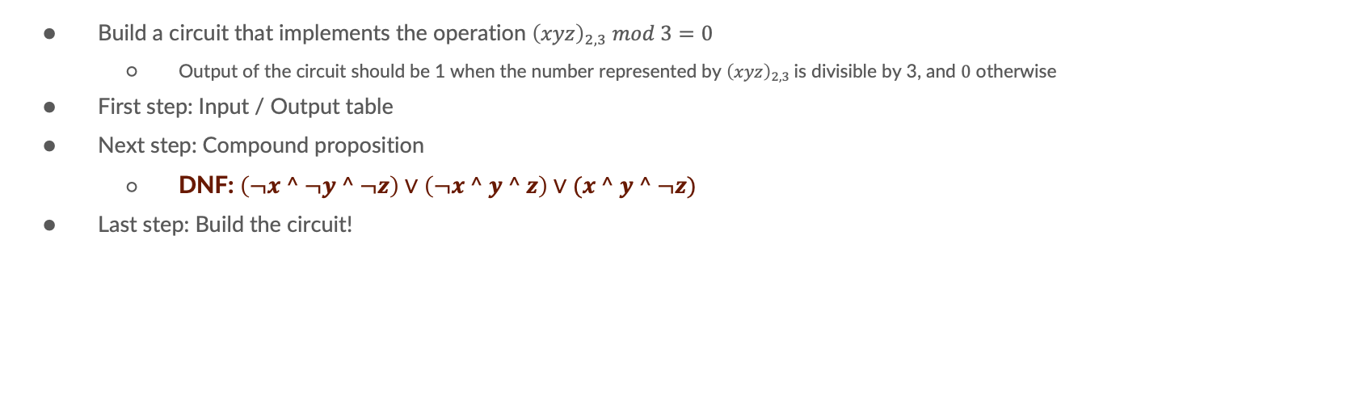
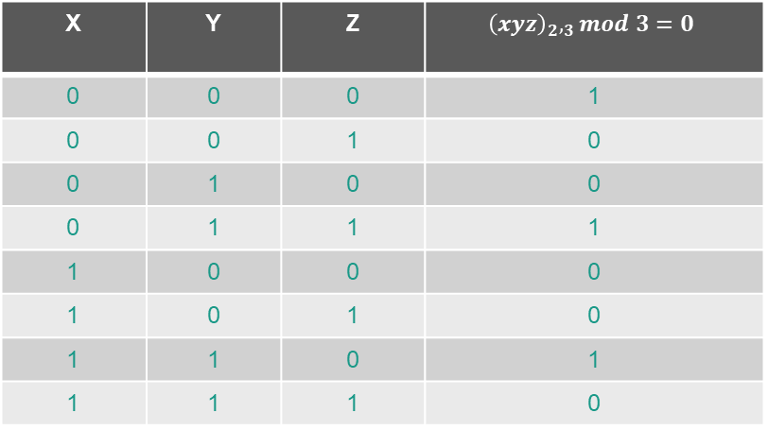
Putting it all together - example
Build a circuit that implements the operation ${\left(xyz\right)}_{2,3} mod 3=0$
Output of the circuit should be 1 when the number represented by ${\left(xyz\right)}_{2,3}$is divisible by 3, and $0$ otherwise
First step: Input / Output table
Next step: Compound proposition
DNF: $\left(¬x ^ ¬y ^ ¬z\right)∨\left(¬x ^ y ^ z\right)∨(x ^ y ^ ¬z)$
Last step: Build the circuit!
X | Y | Z | $${\left(xyz\right)}_{2},_{3}mod 3=0$$
0 | 0 | 0 | 1
0 | 0 | 1 | 0
0 | 1 | 0 | 0
0 | 1 | 1 | 1
1 | 0 | 0 | 0
1 | 0 | 1 | 0
1 | 1 | 0 | 1
1 | 1 | 1 | 0

Slide 23
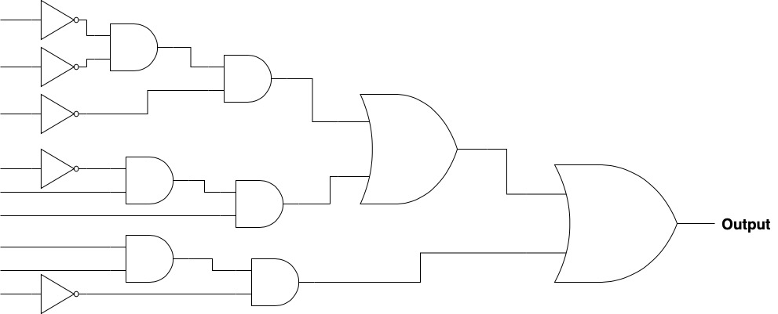

Putting it all together - example
Build a circuit that implements the operation ${\left(xyz\right)}_{2,3} mod 3=0$
Output of the circuit should be 1 when the number represented by ${\left(xyz\right)}_{2,3}$is divisible by 3, and $0$ otherwise
DNF: $\left(¬x ^ ¬y ^ ¬z\right)∨\left(¬x ^ y ^ z\right)∨(x ^ y ^ ¬z)$
Last step: Build the circuit!
x
y
z
x
y
z
x
y
z

