Slide 1
CSE 20 Discussion - Week 6
Sets and (More) Proofs

Slide 2
Administrative Stuff
HW 4 late submission for extenuating circumstances (no penalty and do not need to let us know): Thursday at 8 AM
Project Part 2 due at 11 PM on Thursday
Discussion is recorded and optional

Slide 3
Agenda
Sets
Properties of sets
Proof by Structural Induction

Slide 4
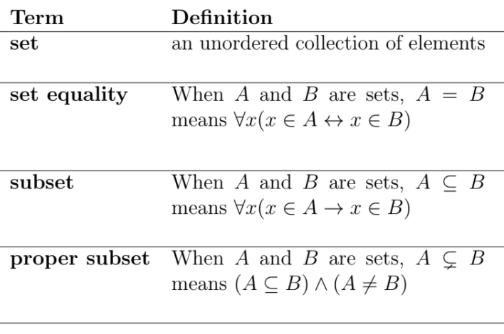
Sets and Related Definitions

Slide 5
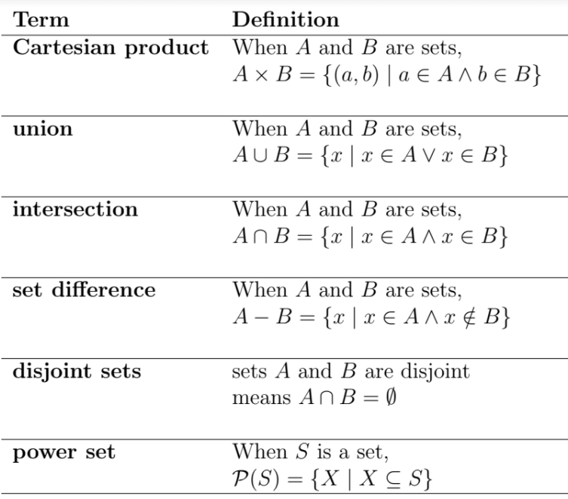
Definitions of Set Operations

Slide 6
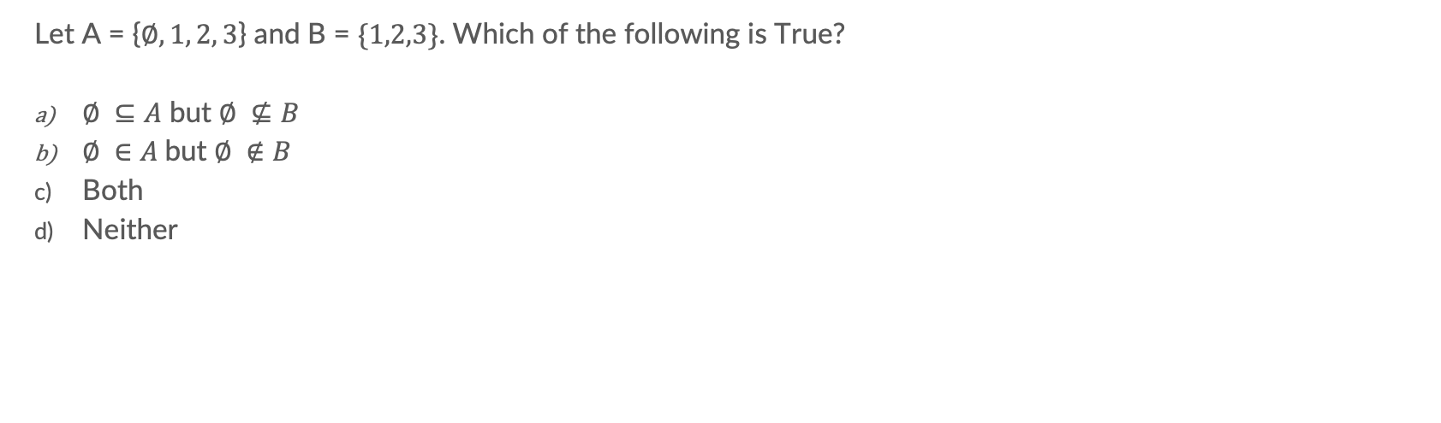
Problem 1a - Sets

Slide 7
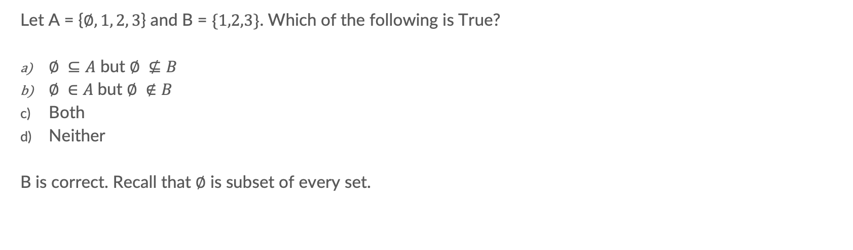
Problem 1a - Sets

Slide 8
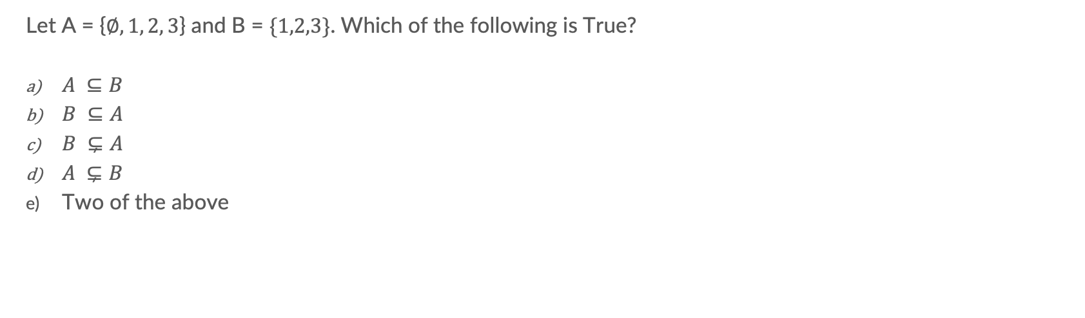
Problem 1b - Sets

Slide 9
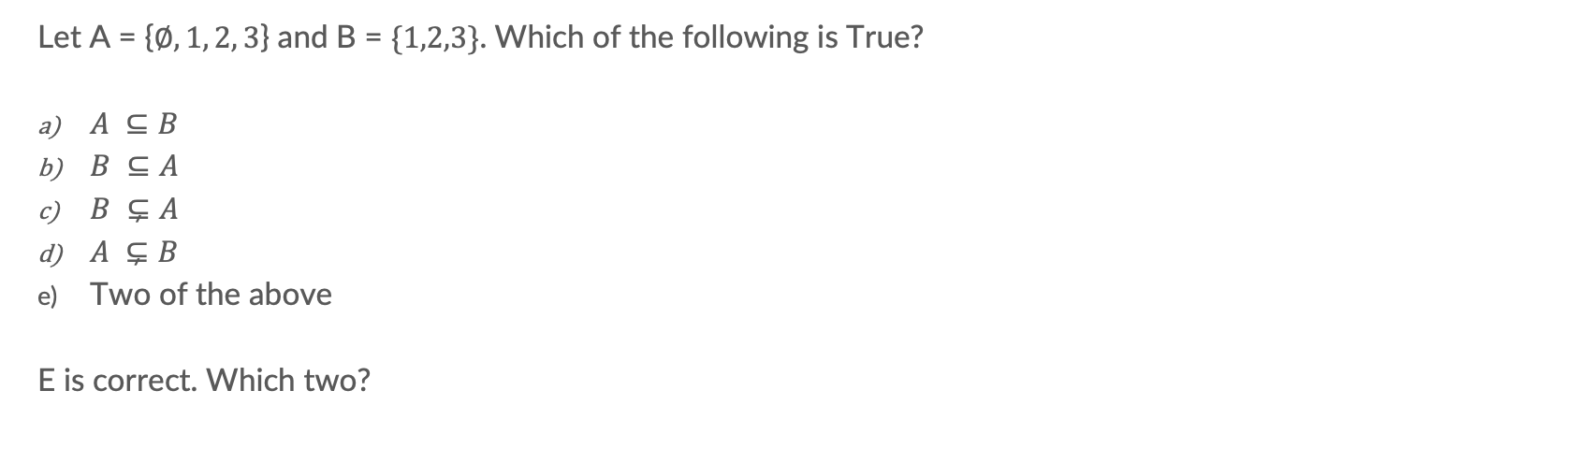
Problem 1b - Sets

Slide 10
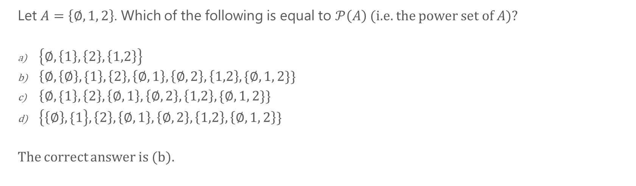
Problem 1c - Sets

Slide 11
Problem 1c - Sets

Slide 12
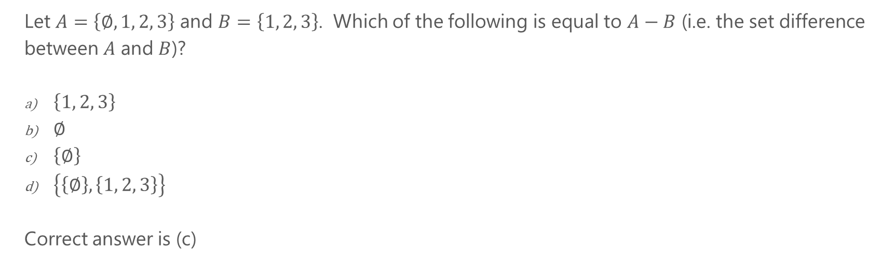
Problem 1d - Sets

Slide 13
Problem 1d - Sets

Slide 14
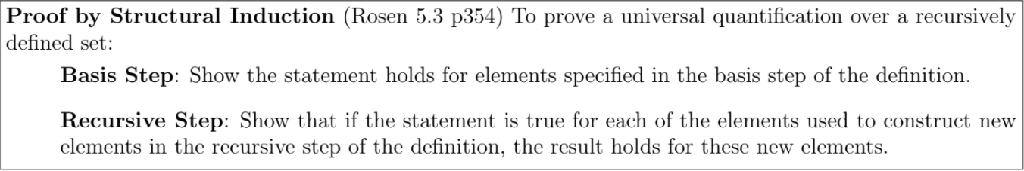
Structural Induction

Slide 15
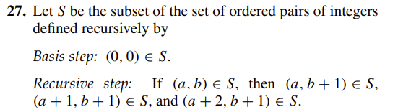
Problem 2 – Structural Induction
Textbook: page 358, problem 27
Use structural induction to show that a ≤ 2b whenever (a, b) ∈ S.

Slide 16
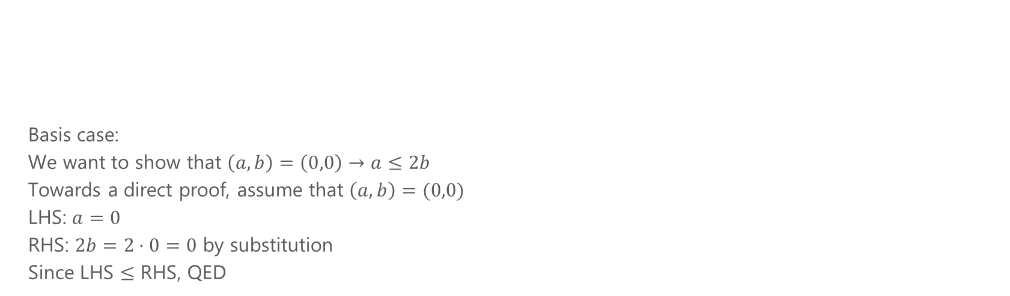
Problem 2 – Structural Induction

Slide 17
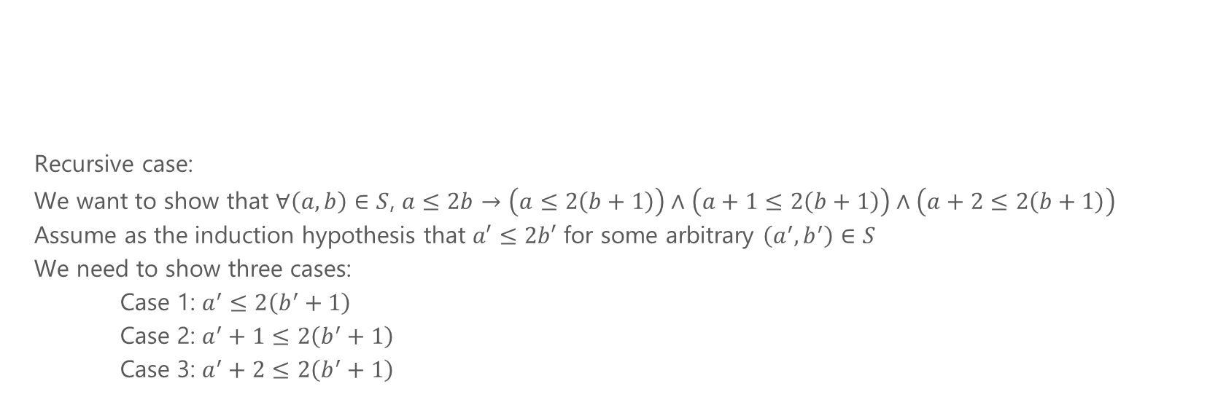
Problem 2 – Structural Induction

Slide 18
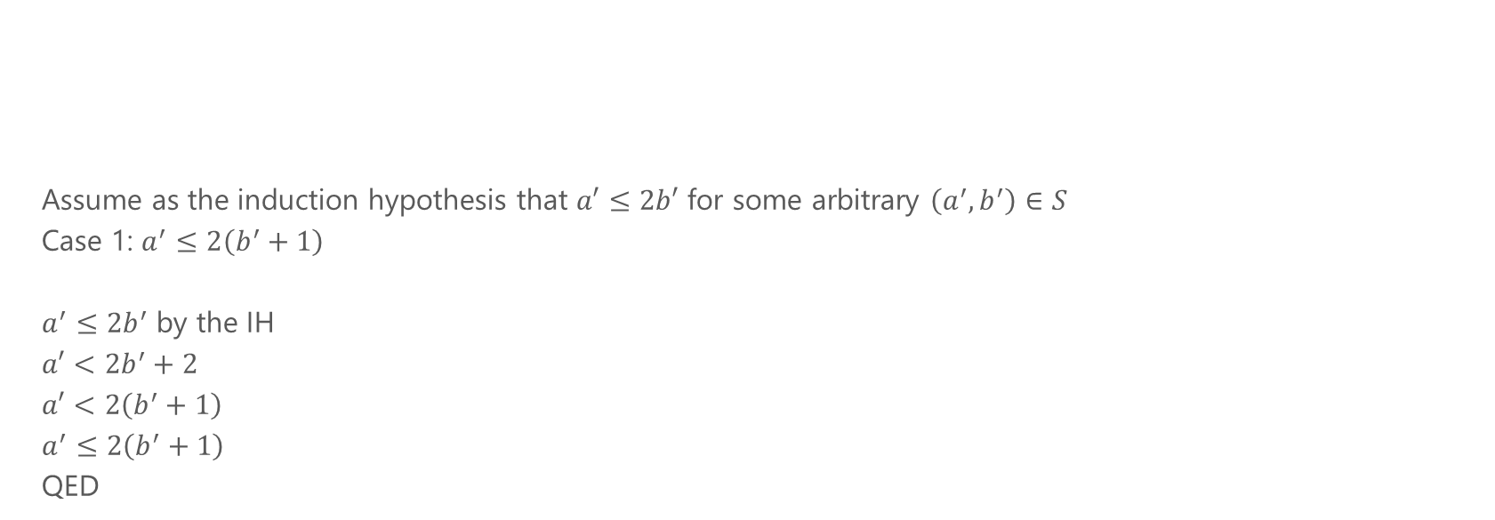
Problem 2 – Structural Induction

Slide 19
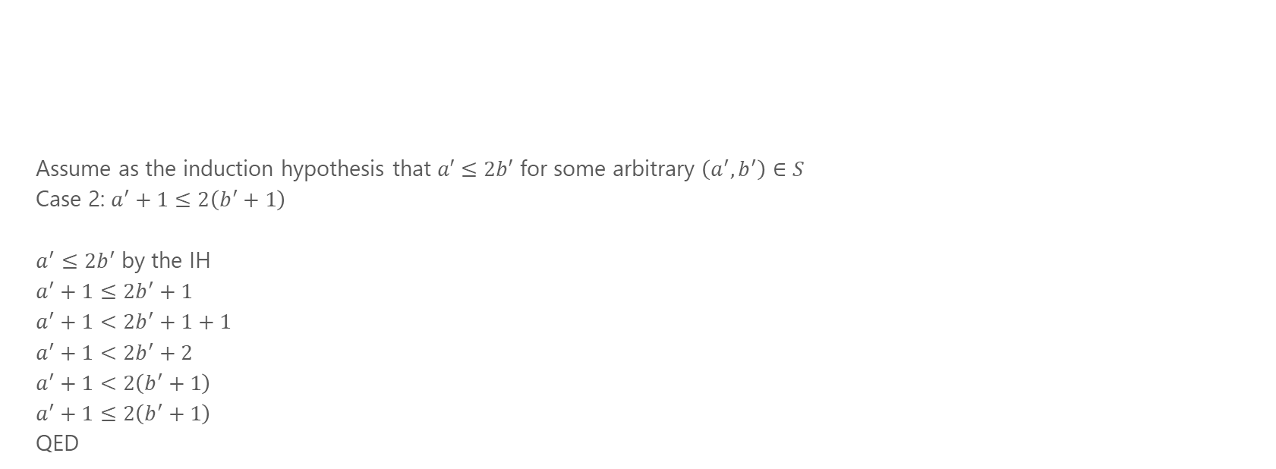
Problem 2 – Structural Induction

Slide 20
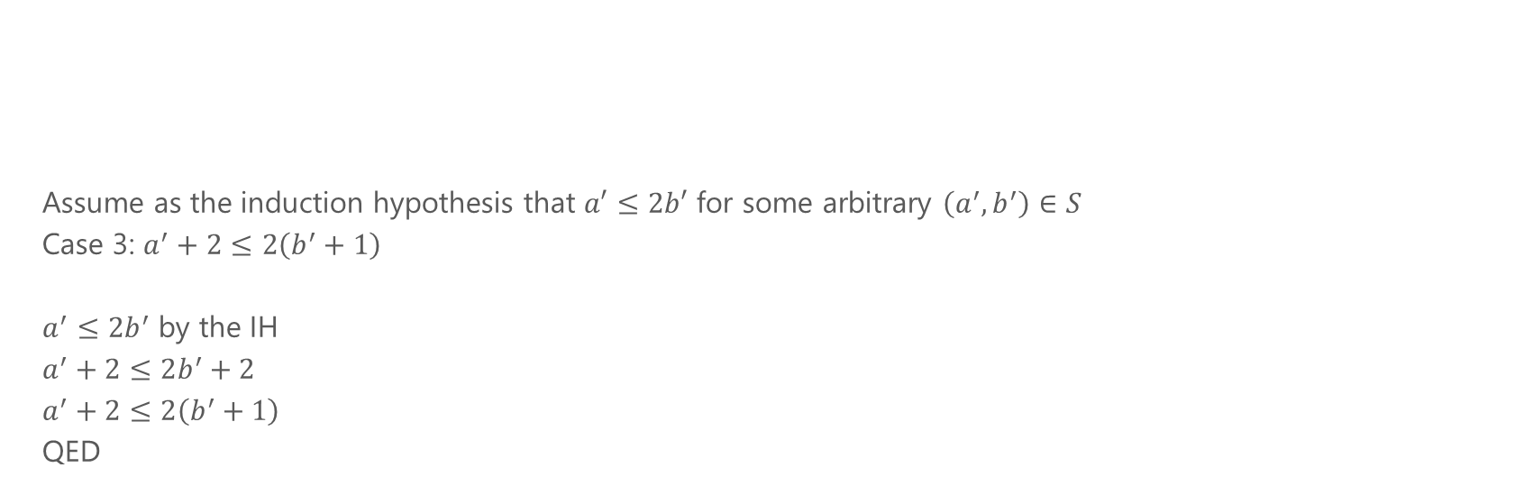
Problem 2 – Structural Induction

Slide 21
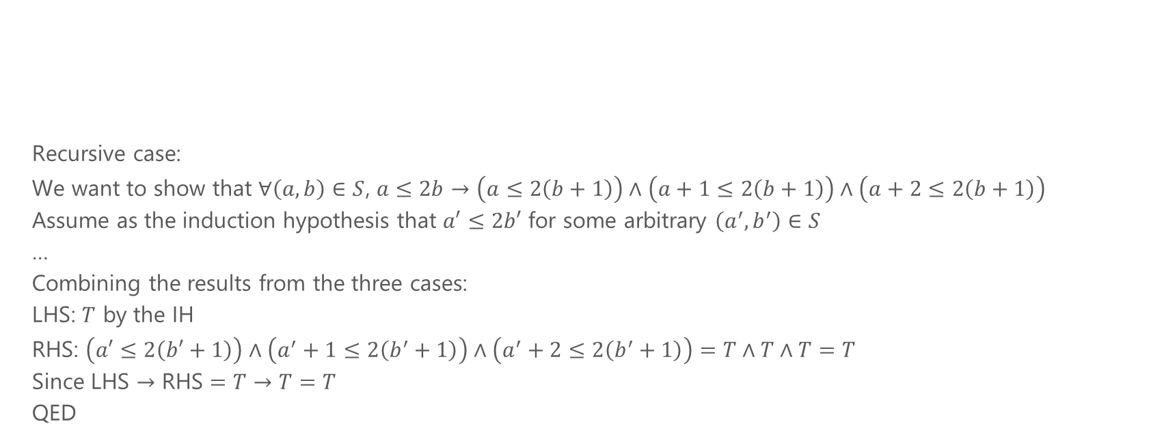
Problem 2 – Structural Induction

