Slide 1
CSE 20 Discussion - Week 7
Induction

Slide 2
Administrative Stuff
Homework 5 has been released - due Tuesday, November 16th at 11:00 pm PST
Week 7 (Monday, Wednesday, Friday) Review quiz “due” Friday
Hard due date is Sunday midnight - no penalty for submitting any time before then

Slide 3
Agenda
Linked List
Practice with all forms of induction!
Definitions and when to use each
Proofs using each type

Slide 4
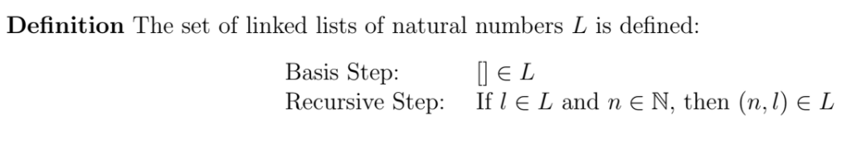
Recursive Definition of a Linked List
Examples: (2,(4,(8,[]))
(0,[])
(5,(4,(3,(2,(1,[])))))

Slide 5
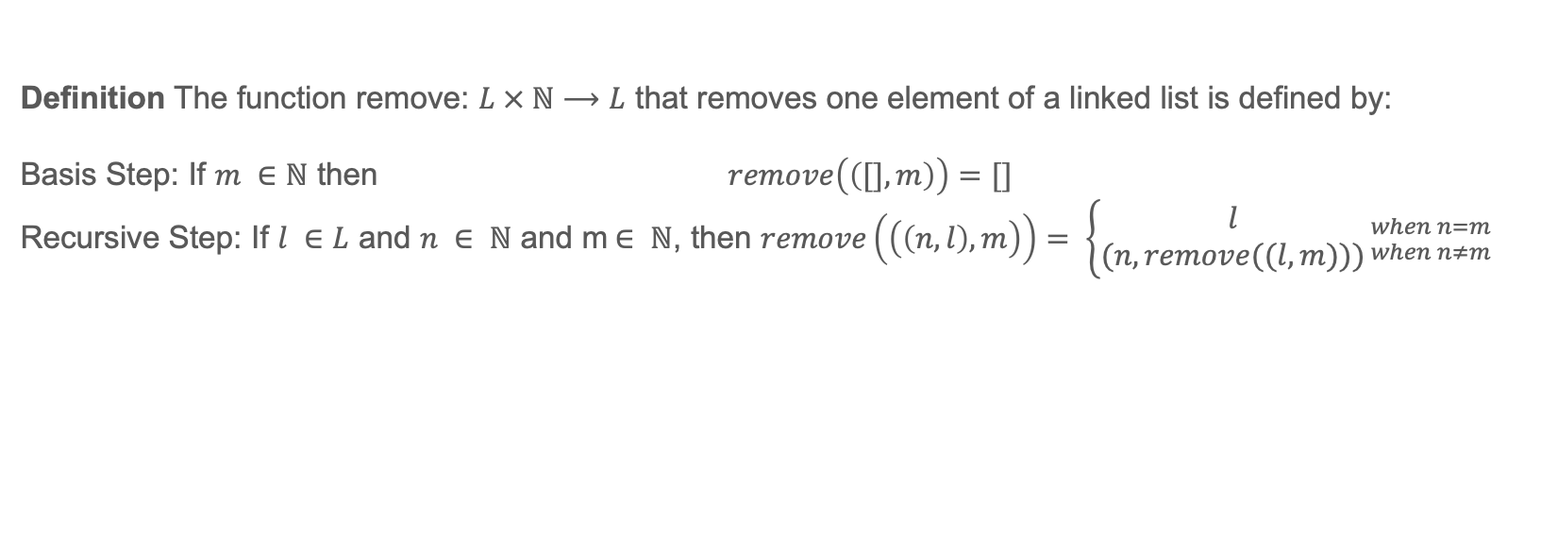
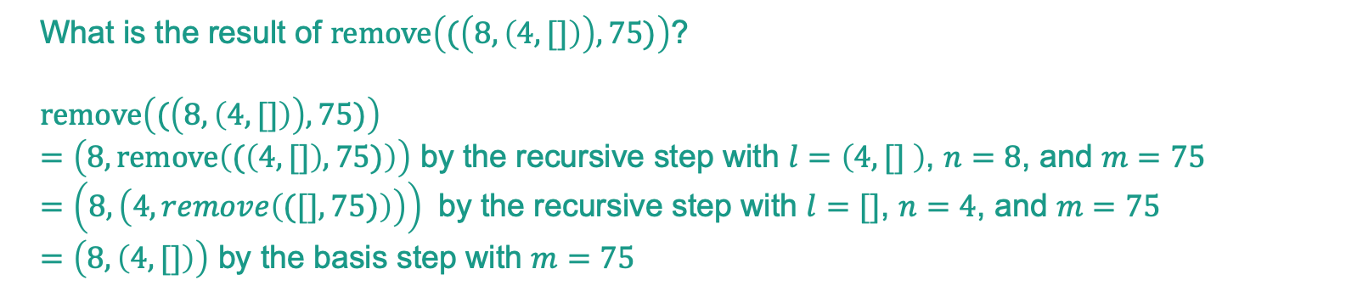
Practice – Linked List
Definition The function remove: $L × ℕ⟶L$ that removes one element of a linked list is defined by:
Basis Step: If $m ∈ℕ$ then $remove\left(\left([],m\right)\right)=[]$
Recursive Step: If $l ∈L$ and $n ∈ ℕ$ and m$∈ ℕ$, then $remove\left(\left(\left(n,l\right),m\right)\right)= \left\{\begin{aligned}l \\ (n,remove((l,m)))\end{aligned}\right.{when n=m \atop when n≠m}$
What is the result of $remove\left((\left(8, \left(4, []\right)\right), 75)\right)$?
$remove\left((\left(8, \left(4, []\right)\right), 75)\right)$
$=\left(8, remove\left((\left(4, []\right), 75)\right)\right)$ by the recursive step with $l=\left(4,[] \right)$, $n=8$, and $m=75$
$=\left(8, \left(4, remove\left(([],75)\right)\right)\right)$ by the recursive step with $l=[]$, $n=4$, and $m=75$
$=\left(8, \left(4, []\right)\right)$ by the basis step with $m=75$

Slide 6
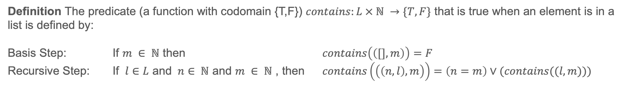
Problem 1a
Definition The predicate (a function with codomain {T,F}) $contains:L × ℕ →\{T, F\}$ that is true when an element is in a list is defined by:
Basis Step: If $m ∈ ℕ$ then $contains\left(\left([],m\right)\right)=F$
Recursive Step: If $l∈L$ and $n∈ ℕ$ and $m ∈ ℕ$ , then $contains\left(\left(\left(n,l\right),m\right)\right)=\left(n=m\right)∨(contains((l,m)))$
1. Compute $contains((\left(1,\left(2,\left(3,\left[ \right]\right)\right)\right), 3))$

Slide 7
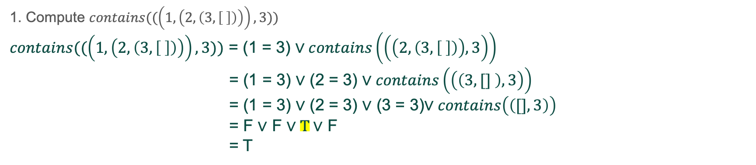
Problem 1a
Definition The predicate (a function with codomain {T,F}) $contains:L × ℕ →\{T, F\}$ that is true when an element is in a list is defined by:
Basis Step: If $m ∈ ℕ$ then $contains\left(\left([],m\right)\right)=F$
Recursive Step: If $l∈L$ and $n∈ ℕ$ and $m ∈ ℕ$ , then $contains\left(\left(\left(n,l\right),m\right)\right)=\left(n=m\right)∨(contains((l,m)))$
1. Compute $contains((\left(1,\left(2,\left(3,\left[ \right]\right)\right)\right), 3))$
$contains((\left(1,\left(2,\left(3,\left[ \right]\right)\right)\right), 3))$ = (1 = 3) $∨contains\left(\left(\left(2,\left(3,\left[ \right]\right)\right),3\right)\right)$
= (1 = 3) $∨$ (2 = 3) $∨contains\left(\left(\left(3,[] \right),3\right)\right)$
= (1 = 3) $∨$ (2 = 3) $∨$ (3 = 3)$∨contains\left(\left([],3\right)\right)$
= F $∨$ F $∨T∨$ F
= T

Slide 8
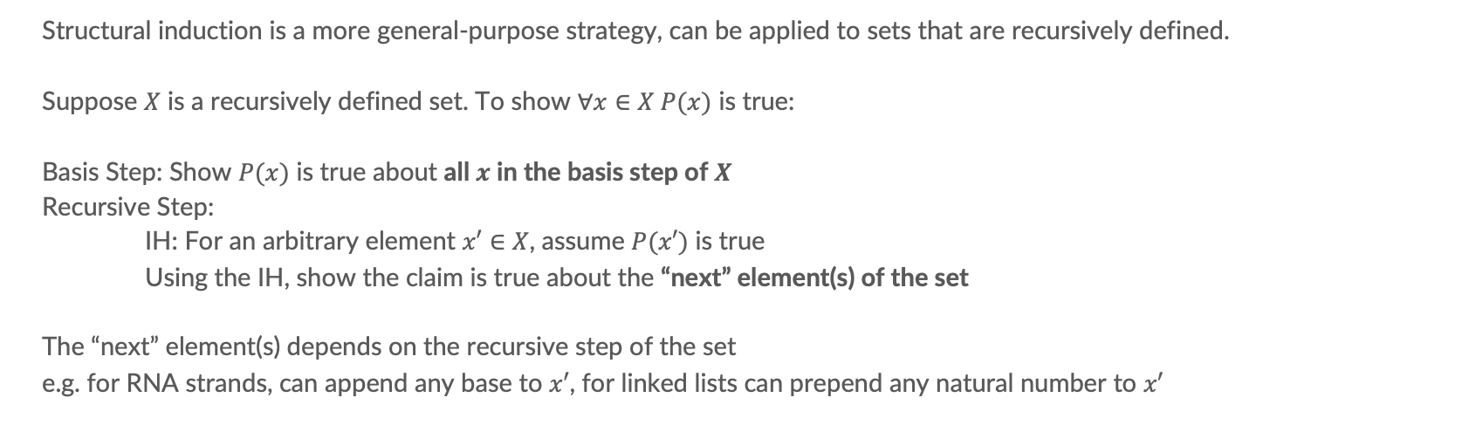
Structural Induction
Structural induction is a more general-purpose strategy, can be applied to sets that are recursively defined.
Suppose $X$ is a recursively defined set. To show $∀x∈X P(x)$ is true:
Basis Step: Show $P(x)$ is true about all $x$ in the basis step of $X$
Recursive Step:
IH: For an arbitrary element $x′∈X$, assume $P(x′)$ is true
Using the IH, show the claim is true about the “next” element(s) of the set
The “next” element(s) depends on the recursive step of the set
e.g. for RNA strands, can append any base to $x′$, for linked lists can prepend any natural number to $x′$

Slide 9
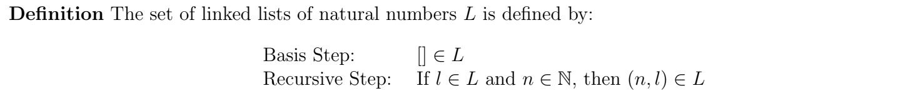
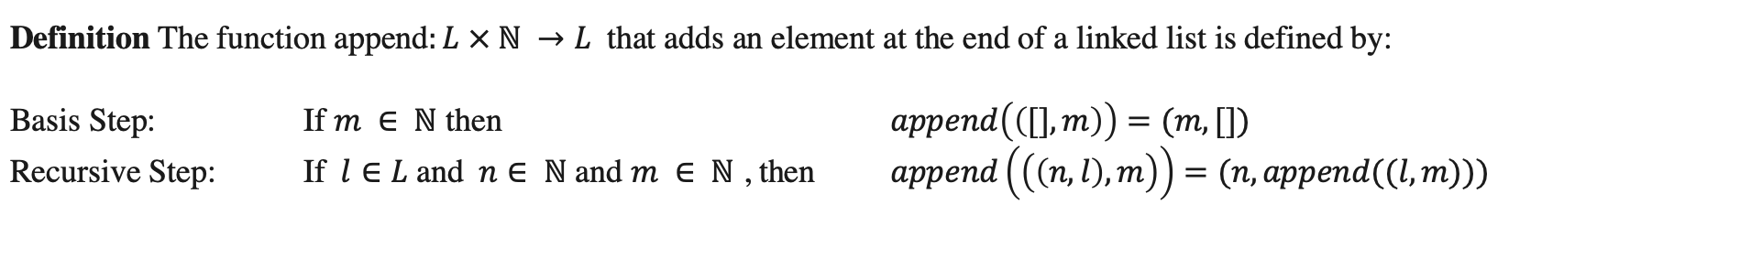
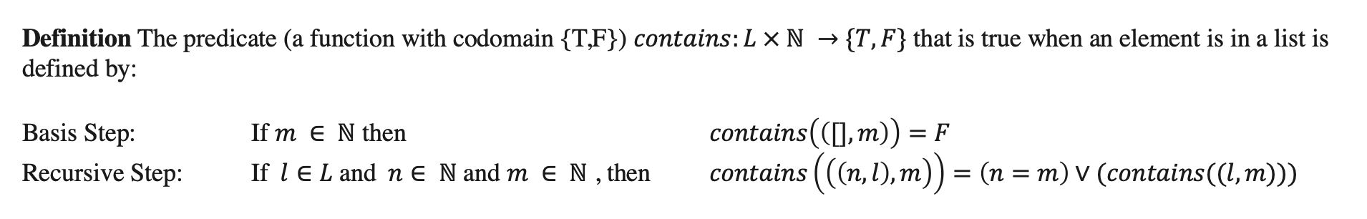
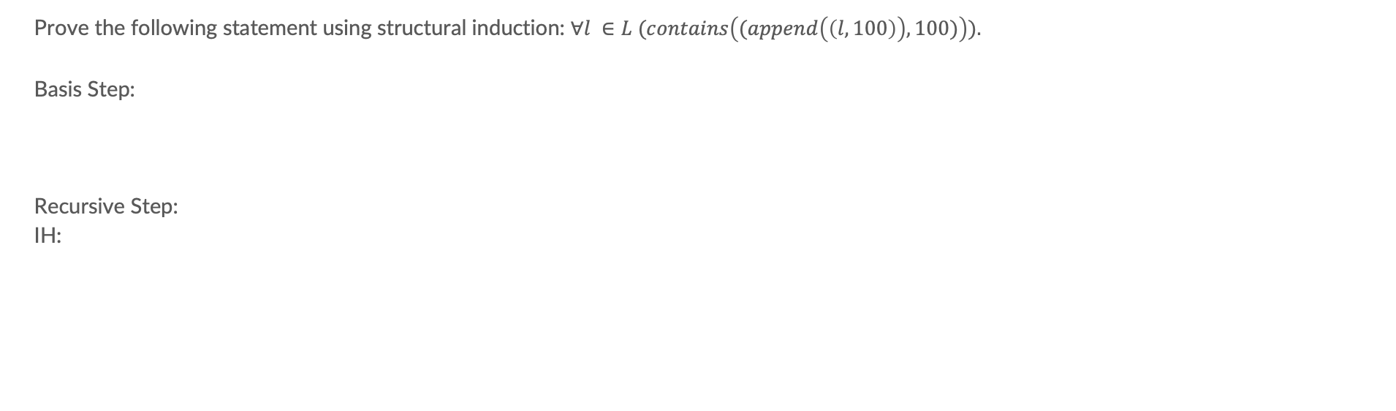
Problem 1b
Prove the following statement using structural induction: $∀l ∈L (contains\left((append\left(\left(l,100\right)\right),100)\right)).$
Basis Step:
Recursive Step:
IH:

Slide 10
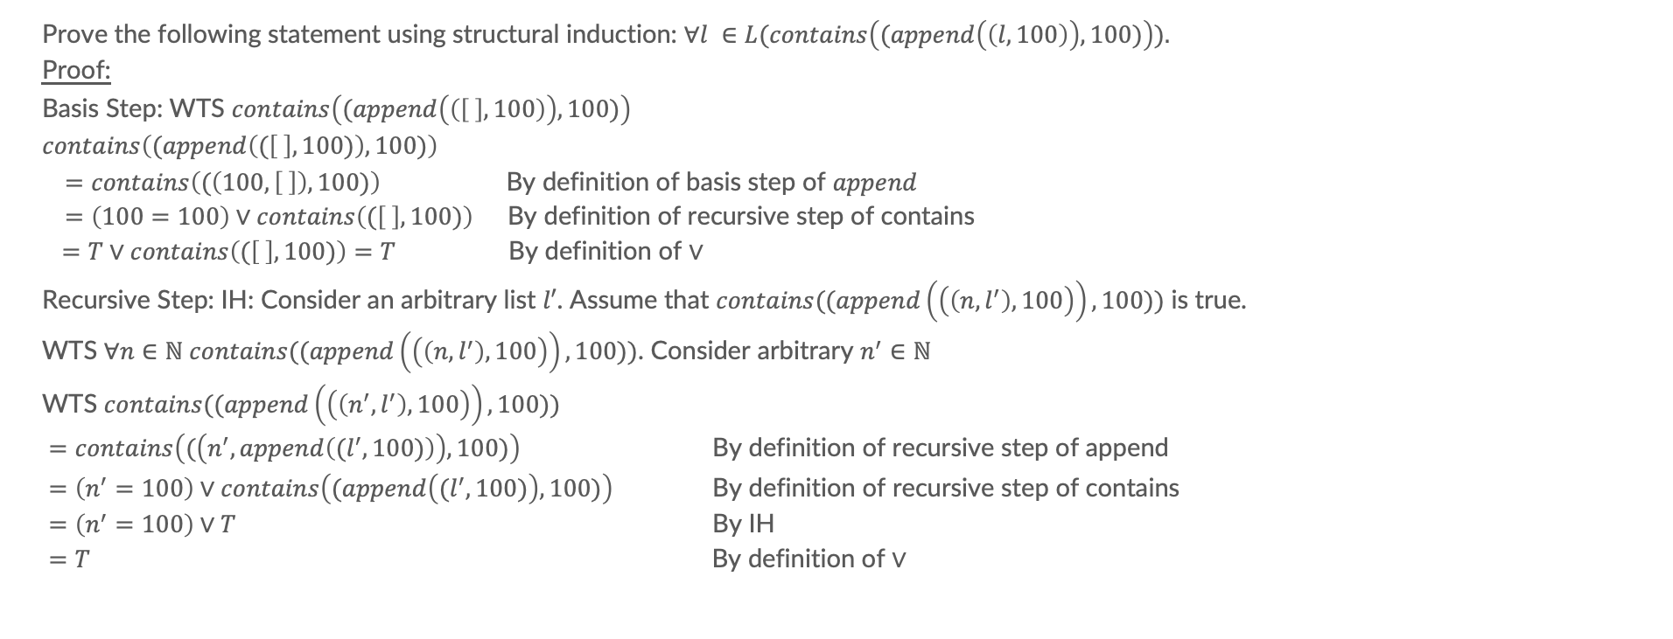
Problem 1b
Prove the following statement using structural induction: $∀l ∈L(contains\left((append\left(\left(l,100\right)\right),100)\right)).$
Proof:
Basis Step: WTS $contains\left((append\left(\left(\left[ \right], 100\right)\right),100)\right)$
$contains\left((append\left((\left[ \right],100)\right),100)\right)$ $=contains\left((\left(100,\left[ \right]\right),100)\right)$By definition of basis step of $append$ $=\left(100=100\right)∨contains\left((\left[ \right], 100)\right)$By definition of recursive step of contains
$=T∨contains\left((\left[ \right], 100)\right)=T$ By definition of $∨$
Recursive Step: IH: Consider an arbitrary list $l′$. Assume that $contains((append\left(\left(\left(n,l^{′}\right),100\right)\right),100))$ is true.
WTS $∀n∈ℕ contains((append\left(\left(\left(n,l^{′}\right),100\right)\right),100))$. Consider arbitrary $n^{′}∈ℕ$
WTS $contains((append\left(\left(\left(n^{′},l^{′}\right),100\right)\right),100))$
$=contains\left((\left(n^{′}, append\left((l^{′},100)\right)\right),100)\right)$ By definition of recursive step of append $=\left(n^{′}=100\right)∨contains\left((append\left({(l}^{′},100)\right),100)\right)$ By definition of recursive step of contains $=\left(n^{′}=100\right)∨T$ By IH $=T$ By definition of $∨$

Slide 11
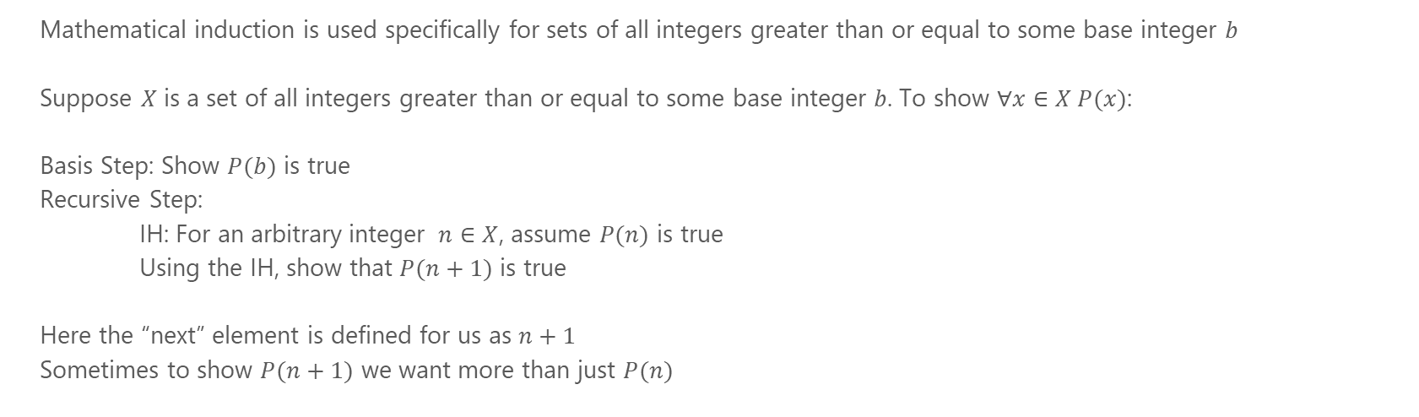
Mathematical Induction
Mathematical induction is used specifically for sets of all integers greater than or equal to some base integer $b$
Suppose $X$ is a set of all integers greater than or equal to some base integer $b$. To show $∀x∈X P(x)$:
Basis Step: Show $P(b)$ is true
Recursive Step:
IH: For an arbitrary integer $n∈X$, assume $P(n)$ is true
Using the IH, show that $P(n+1)$ is true
Here the “next” element is defined for us as $n+1$
Sometimes to show $P(n+1)$ we want more than just $P(n)$

Slide 12
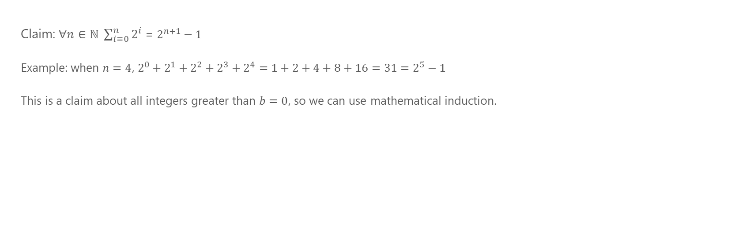
Problem 2
Claim: $∀n∈ℕ \sum_{i=0}^{n}{2^{i}}$ = $2^{n+1}−1$
Example: when $n=4$, $2^{0}+2^{1}+2^{2}+2^{3}+2^{4}=1+2+4+8+16=31=2^{5}−1$
This is a claim about all integers greater than $b=0$, so we can use mathematical induction.

Slide 13
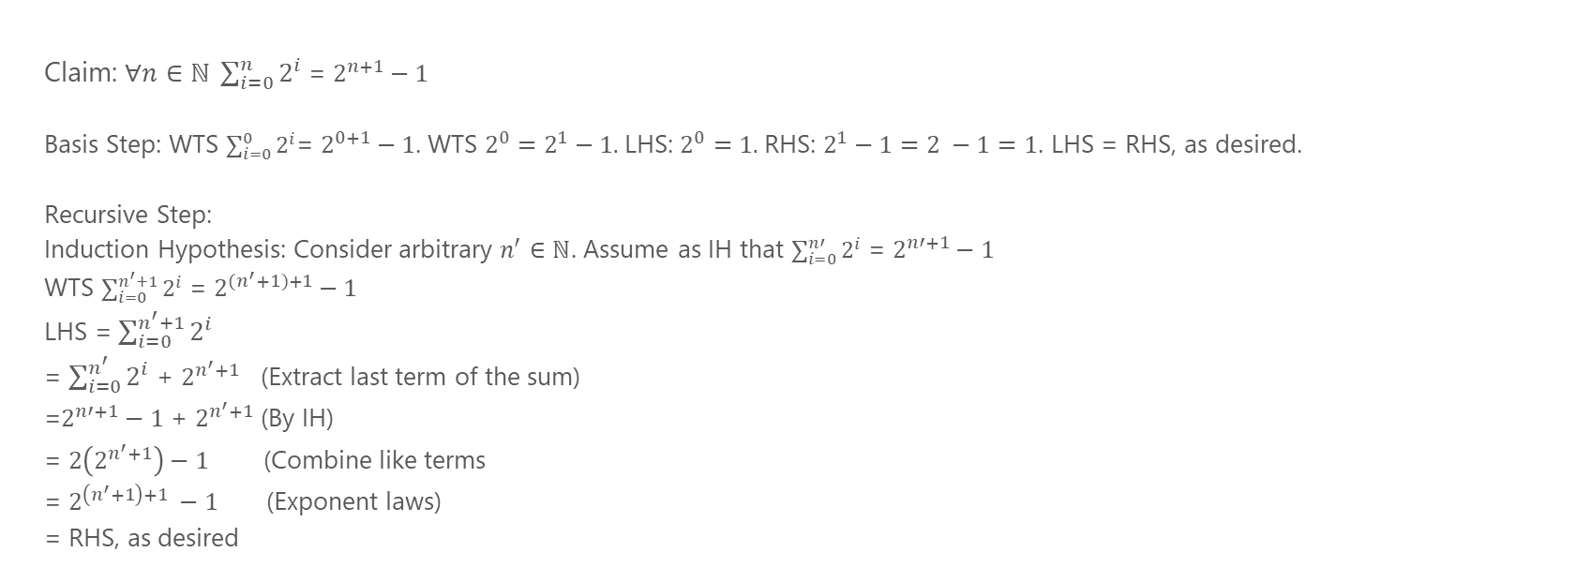
Problem 2
Claim: $∀n∈ℕ \sum_{i=0}^{n}{2^{i}}$ = $2^{n+1}−1$
Basis Step: WTS $\sum_{i=0}^{0}{2^{i}}$= $2^{0+1}−1$. WTS $2^{0}=2^{1}−1.$LHS: $2^{0}=1.$RHS: $2^{1}−1=2 −1=1$. LHS = RHS, as desired.
Recursive Step:
Induction Hypothesis: Consider arbitrary $n^{′}∈ℕ$. Assume as IH that $\sum_{i=0}^{n′}{2^{i}}$ = $2^{n′+1}−1$
WTS $\sum_{i=0}^{n^{′}+1}{2^{i}}$ = $2^{{(n}^{′}+1)+1}−1$
LHS = $\sum_{i=0}^{n^{′}+1}{2^{i}}$
= $\sum_{i=0}^{n^{′}}{2^{i}}$ + $2^{n^{′}+1}$ (Extract last term of the sum)
=$2^{n′+1}−1$ + $2^{n^{′}+1}$ (By IH)
= $2\left(2^{n^{′}+1}\right)−1$ (Combine like terms
= $2^{\left(n^{′}+1\right)+1} −1$ (Exponent laws)
= RHS, as desired

Slide 14
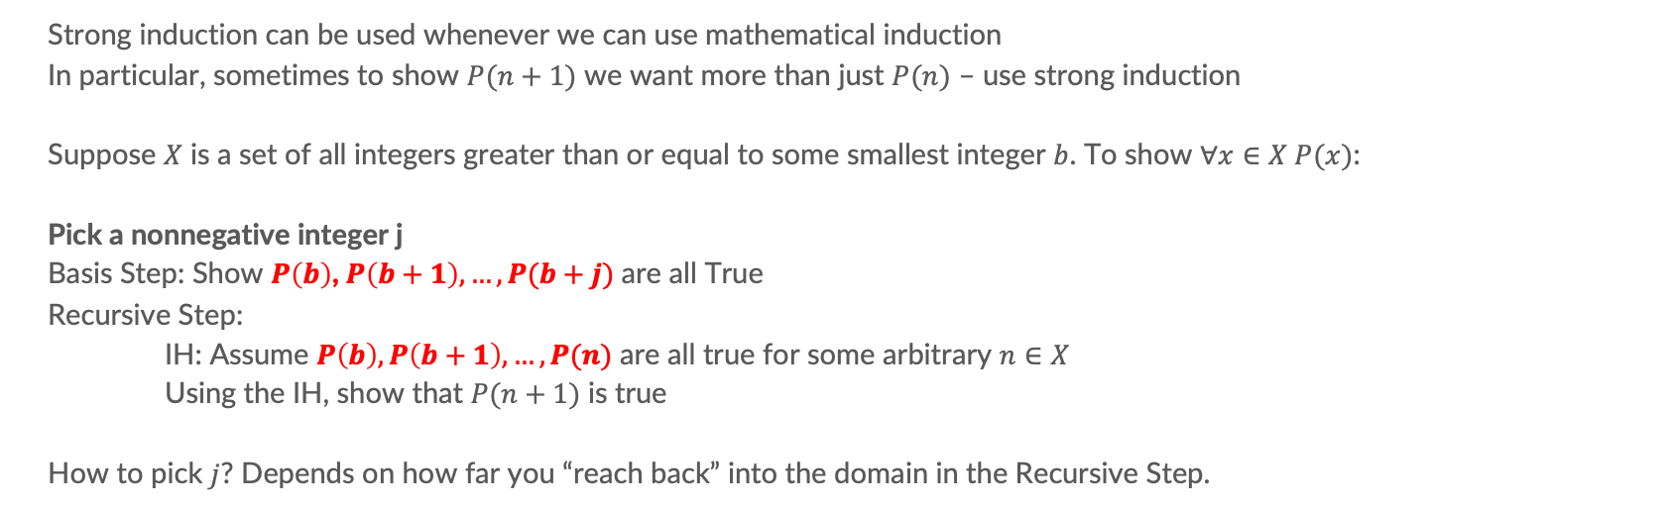
Strong Induction
Strong induction can be used whenever we can use mathematical induction
In particular, sometimes to show $P(n+1)$ we want more than just $P(n)$ – use strong induction
Suppose $X$ is a set of all integers greater than or equal to some smallest integer $b$. To show $∀x∈X P(x)$:
Pick a nonnegative integer j
Basis Step: Show $P\left(b\right)$, $P\left(b+1\right), …, P(b+j)$ are all True
Recursive Step:
IH: Assume $P\left(b\right), P\left(b+1\right), …, P(n)$ are all true for some arbitrary $n∈X$
Using the IH, show that $P(n+1)$ is true
How to pick $j$? Depends on how far you “reach back” into the domain in the Recursive Step.

Slide 15
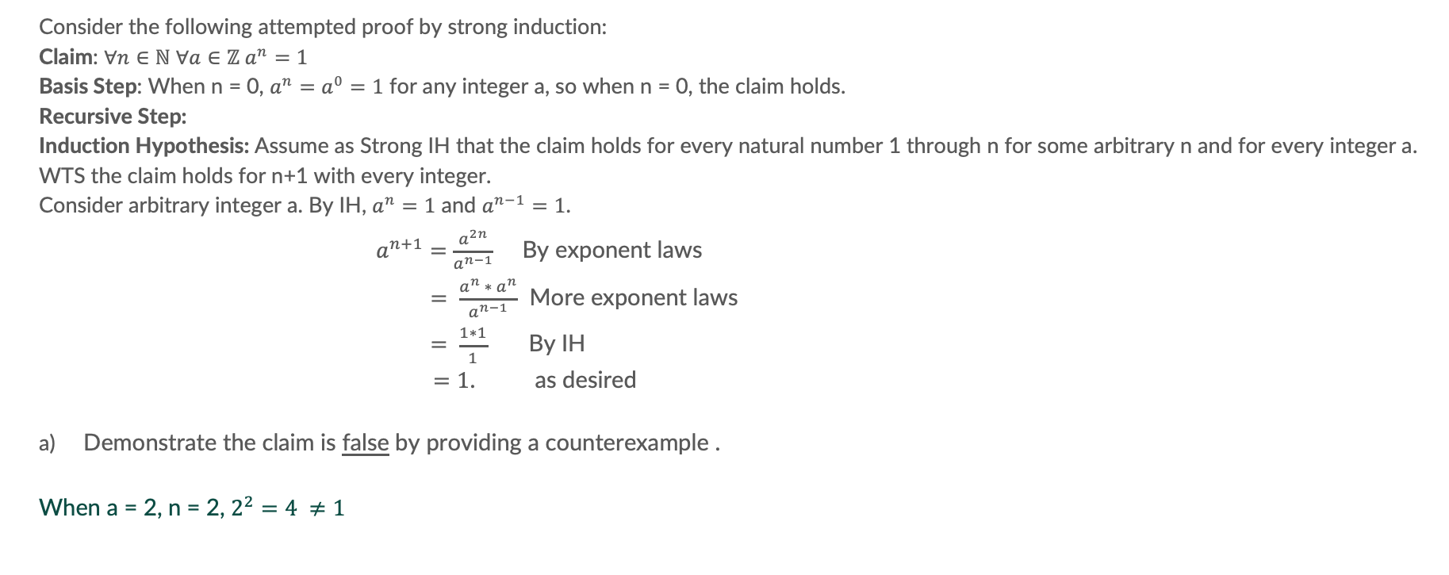
Problem 3a
Consider the following attempted proof by strong induction:
Claim: $∀n∈ℕ ∀a∈ℤ a^{n}=1$
Basis Step: When n = 0, $a^{n}=a^{0}=1$ for any integer a, so when n = 0, the claim holds.
Recursive Step:
Induction Hypothesis: Assume as Strong IH that the claim holds for every natural number 1 through n for some arbitrary n and for every integer a.
WTS the claim holds for n+1 with every integer.
Consider arbitrary integer a. By IH, $a^{n}=1$ and $a^{n−1}=1$.
$a^{n+1}=$ $\frac{a^{2n}}{a^{n−1}}$ By exponent laws
$= \frac{a^{n} ∗ a^{n}}{a^{n−1}}$ More exponent laws
$= \frac{1∗1}{1}$ By IH
$=1$. as desired
Demonstrate the claim is false by providing a counterexample .
When a = 2, n = 2, $2^{2}=4 ≠1$

Slide 16
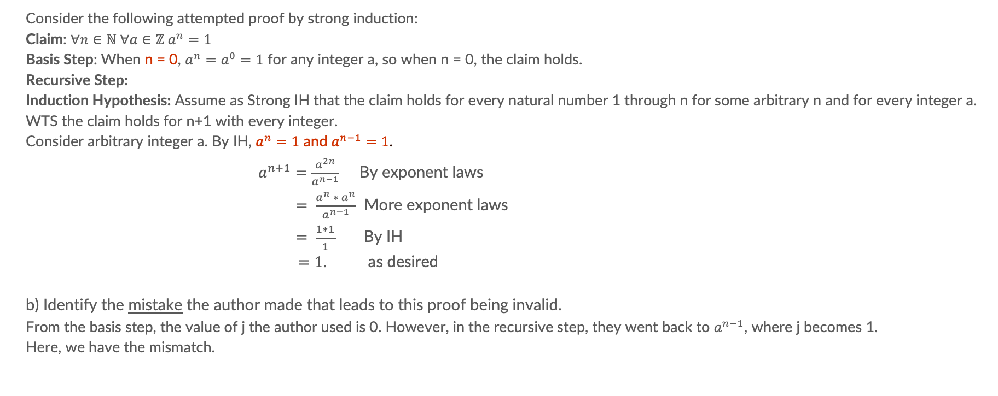
Problem 3b
Consider the following attempted proof by strong induction:
Claim: $∀n∈ℕ ∀a∈ℤ a^{n}=1$
Basis Step: When n = 0, $a^{n}=a^{0}=1$ for any integer a, so when n = 0, the claim holds.
Recursive Step:
Induction Hypothesis: Assume as Strong IH that the claim holds for every natural number 1 through n for some arbitrary n and for every integer a.
WTS the claim holds for n+1 with every integer.
Consider arbitrary integer a. By IH, $a^{n}=1$ and $a^{n−1}=1$.
$a^{n+1}=$ $\frac{a^{2n}}{a^{n−1}}$ By exponent laws
$= \frac{a^{n} ∗ a^{n}}{a^{n−1}}$ More exponent laws
$= \frac{1∗1}{1}$ By IH
$=1$. as desired
b) Identify the mistake the author made that leads to this proof being invalid.
From the basis step, the value of j the author used is 0. However, in the recursive step, they went back to $a^{n−1}$, where j becomes 1.
Here, we have the mismatch.

Slide 17
Problem 4a
Fill in the blank: Using 4- and 11-cent stamps we can create any postage value greater than or equal to ________

Slide 18
Problem 4b
Claim: We can create any postage value greater than or equal to 30 using 4- and 11-cent stamps.
Using strong induction:
What is the value of j and b?

Slide 19
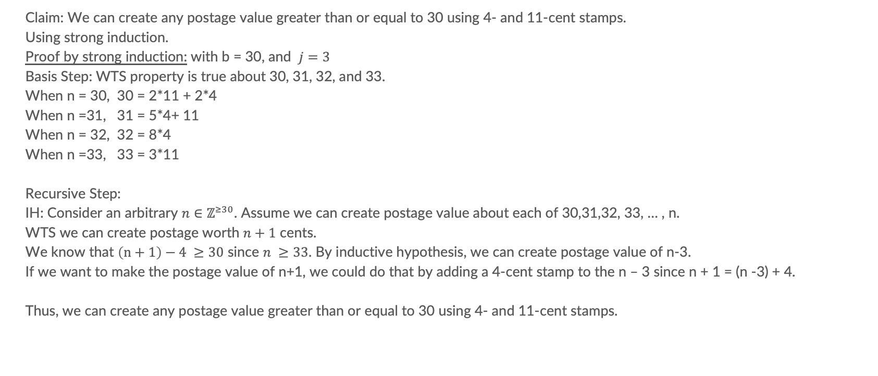
Problem 4b
Claim: We can create any postage value greater than or equal to 30 using 4- and 11-cent stamps.
Using strong induction.
Proof by strong induction: with b = 30, and $j=3$
Basis Step: WTS property is true about 30, 31, 32, and 33.
When n = 30, 30 = 2*11 + 2*4
When n =31, 31 = 5*4+ 11
When n = 32, 32 = 8*4
When n =33, 33 = 3*11
Recursive Step:
IH: Consider an arbitrary $n∈ℤ^{≥30}$. Assume we can create postage value about each of 30,31,32, 33, … , n.
WTS we can create postage worth $n+1$ cents.
We know that $\left(n+1\right)−4 ≥30$ since $n ≥33$. By inductive hypothesis, we can create postage value of n-3.
If we want to make the postage value of n+1, we could do that by adding a 4-cent stamp to the n – 3 since n + 1 = (n -3) + 4.
Thus, we can create any postage value greater than or equal to 30 using 4- and 11-cent stamps.

