Slide 1
CSE 20 Discussion - Week 8
Cardinality and Functions

Slide 2
Administrative Stuff
Homework 5 is due tomorrow 8 am.
Discussion is recorded and optional.

Slide 3
Agenda
Functions: Domain, Codomain
Functions: One-to-one, Onto, Bijections
Cardinality

Slide 4
Problem 1 – Domain and Co-domain
Find the domain and Codomain of these functions.
a) the function that assigns to each pair of positive integers the maximum of these two integers
b) the function that assigns to each positive integer the number of the digits 0, 1, 2, 3, 4, 5, 6, 7, 8, 9 that do not appear as decimal digits of the integer
c) the function that assigns to a bit string the number of times the block 11 appears

Slide 5
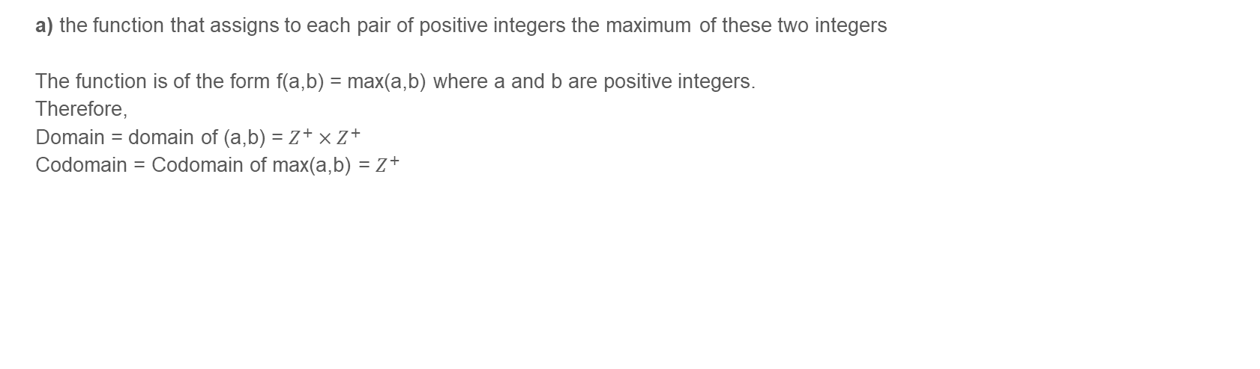
Problem 1 – Domain and Co-domain

Slide 6
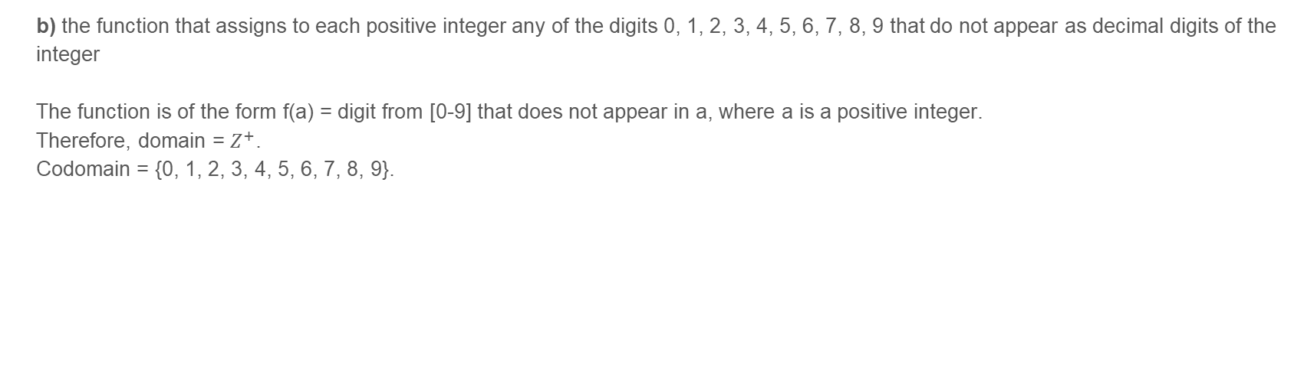
Problem 1 – Domain and Co-domain

Slide 7
Problem 1 – Domain and Co-domain
c) the function that assigns to a bit string the number of times the substring ’11’ appears
The function is of the form f(b) = number of occurrences of 11 where b is a bit string.
Therefore, Domain of f = domain of b i.e. the set of all bit strings.
Codomain = Ν

Slide 8
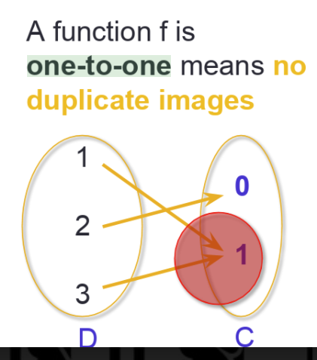
Functions: One-to-one

Slide 9
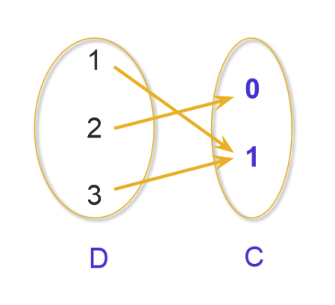
Functions: Onto

Slide 10
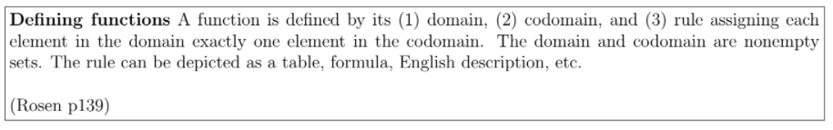
Well-Defined Functions

Slide 11
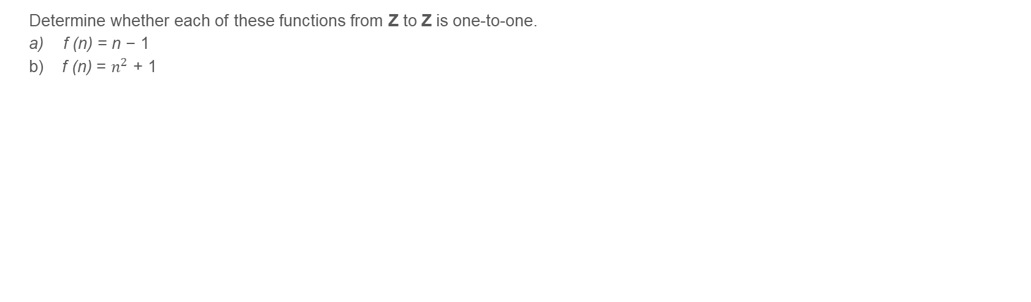
Problem 2 – One-to-one Functions

Slide 12
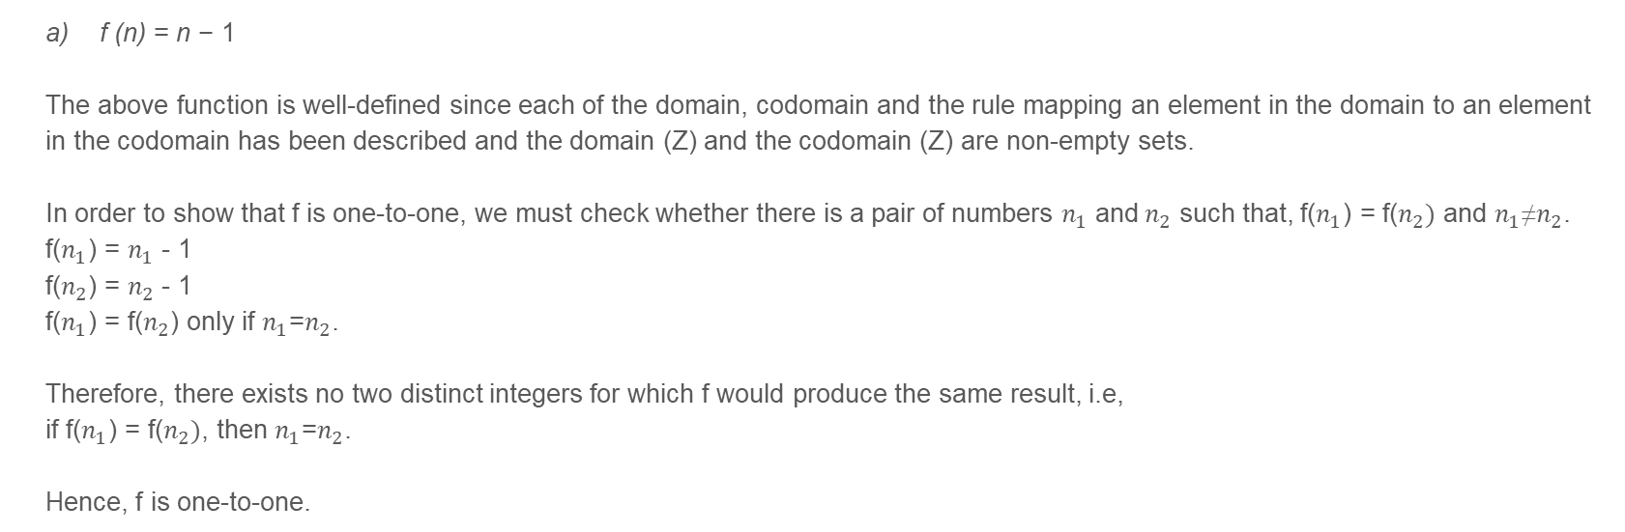
Problem 2 – One-to-one Functions

Slide 13
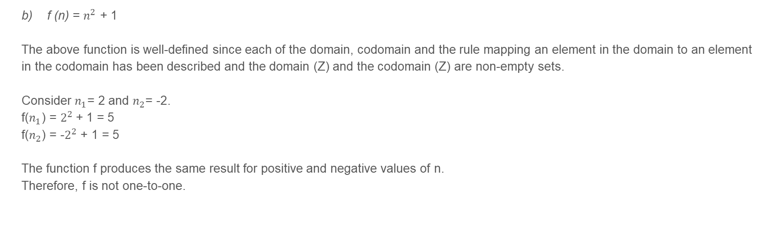
Problem 2 – One-to-one Functions

Slide 14
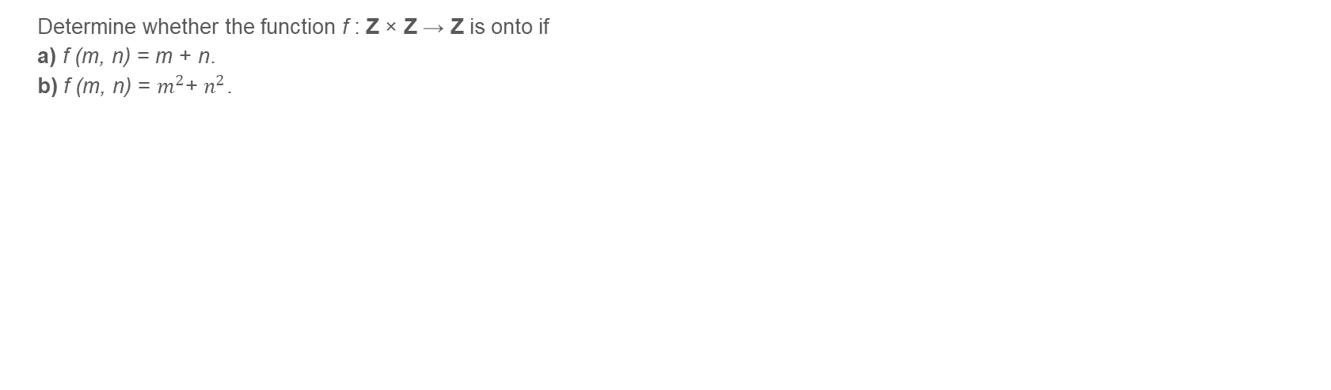
Problem 3 – Onto Functions

Slide 15
Problem 3 – Onto Functions
f (m, n) = m + n
The above function is well-defined since each of the domain, codomain and the rule mapping an element in the domain to an element in the codomain has been described and the domain (Z) and the codomain (Z) are non-empty sets.
The Codomain of f is the sum of two integers.
The question we need to ask is whether every integer can be expressed as a sum of pairs of integers and the answer is yes!
For example, 5 = 2+3, 5 = 1+4, 5 = -1+6 and so on.
Therefore, f is an onto function.
Proof by generalization:
Consider an arbitrary input – n,m which produce the result R, i.e.,
f(m,n) = m+n = R
Consider m = 0 and n = R. Then,
f(0,R) = 0+R = R
We could map every element in the codomain to a combination of inputs in the domain such that one of the inputs is 0.
Therefore, f is onto.

Slide 16
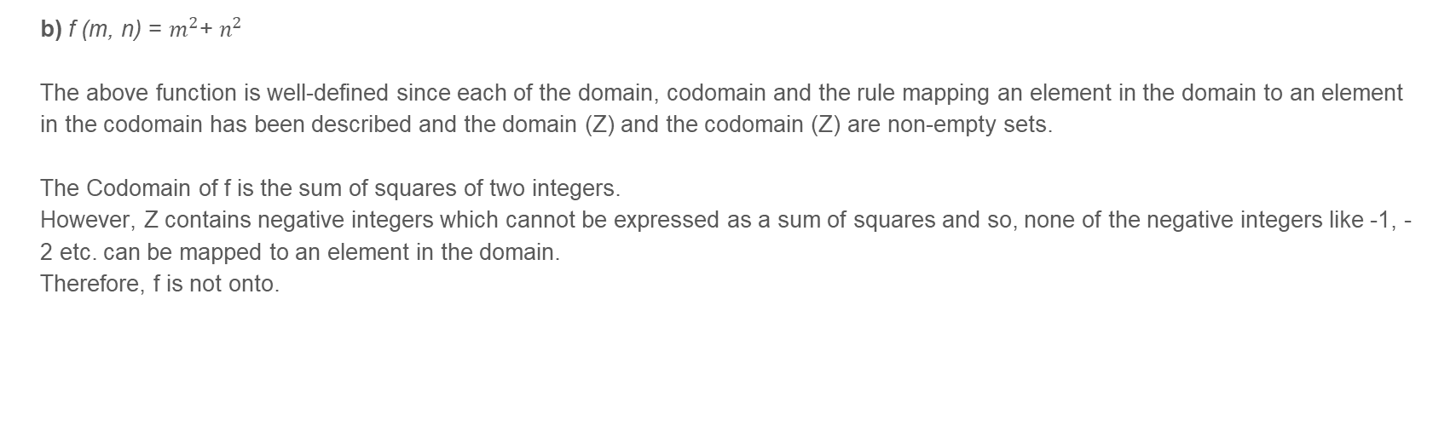
Problem 3 – Onto Functions

Slide 17
Cardinality

Slide 18
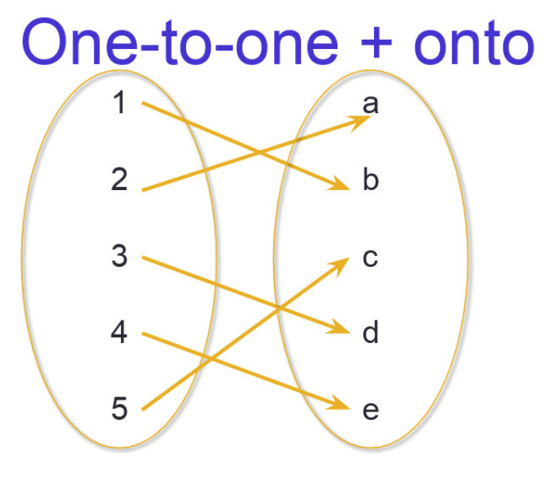
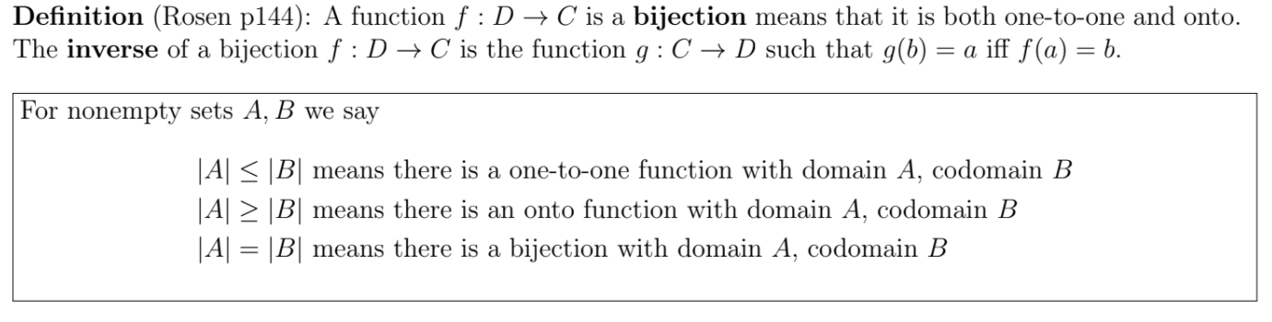
Functions: Bijection

Slide 19
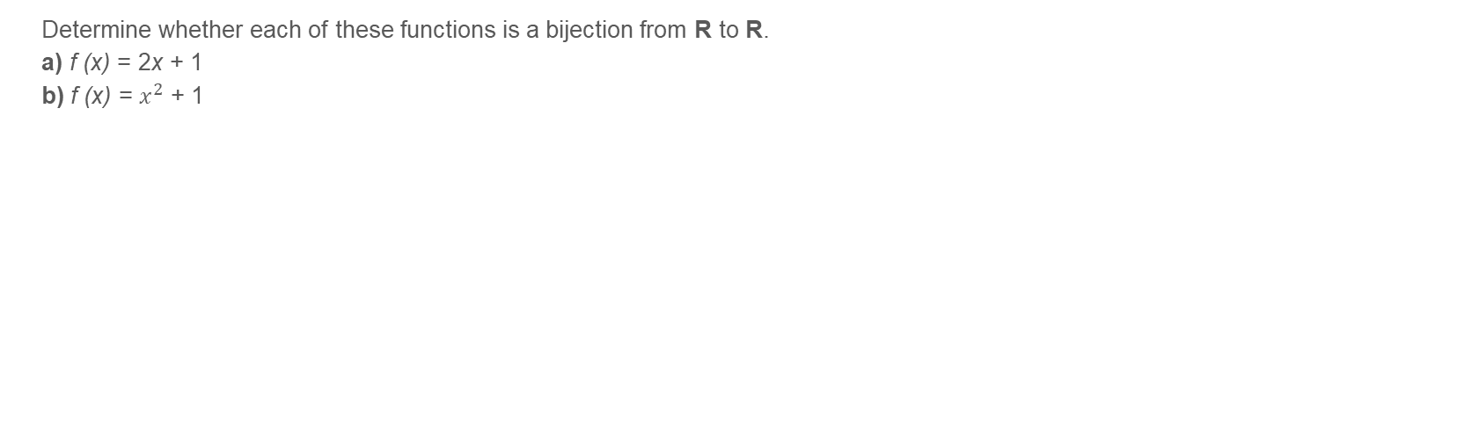
Problem 4 – Bijective Functions

Slide 20
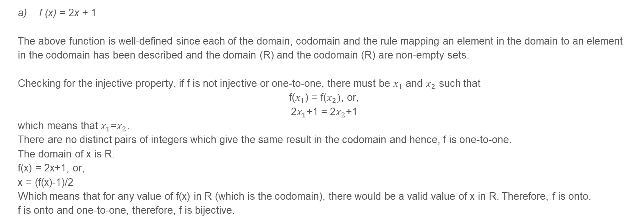
Problem 4 – Bijective Functions

Slide 21
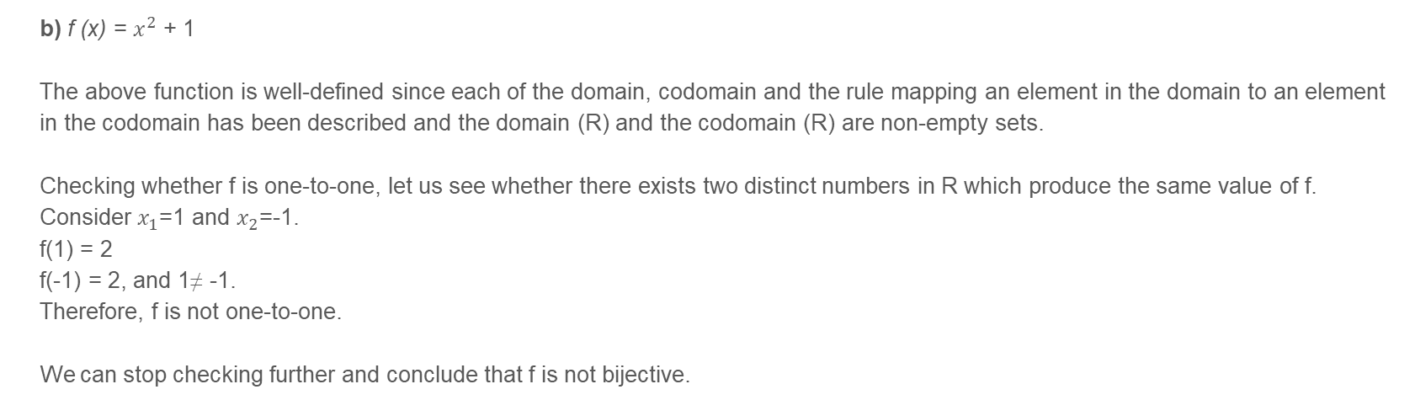
Problem 4 – Bijective Functions

Slide 22
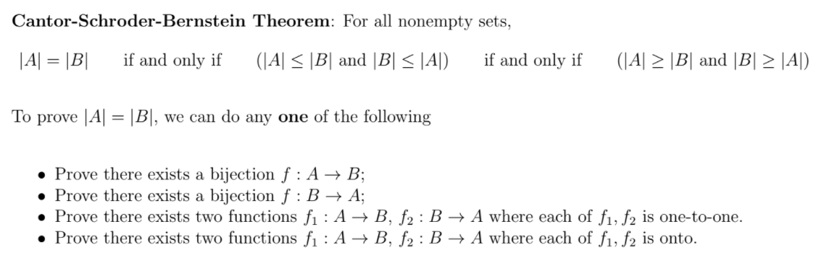
Cardinality + Bijections

Slide 23
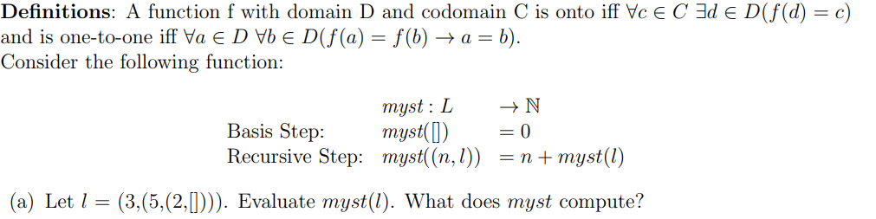


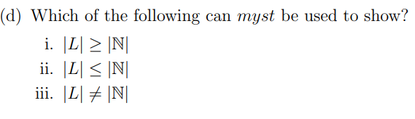
Problem 5

Slide 24
Problem 5
Recursively computing myst(l),
myst(3,(5,(2,[]))) = 3 + myst((5,(2,[]))), by the recursive step myst((n,l)) = n + myst(l)
= 3 + 5 + myst((2,[])), by the recursive step myst((n,l)) = n + myst(l)
= 3 + 5 + 2 + myst([]), by the recursive step myst((n,l)) = n + myst(l)
= 10, by the basis step
myst computes the sum of elements of a linked list.

Slide 25
Problem 5
The above function is well-defined since each of the domain, codomain and the rule mapping an element in the domain to an element in the codomain has been described and the domain (L) and the codomain (N) are non-empty sets.
For myst to be onto, it must be that every natural number is the sum of the elements of some linked list. Since we can find a linked list such that its elements sum to every non-negative (natural) number,
myst is onto.

Slide 26
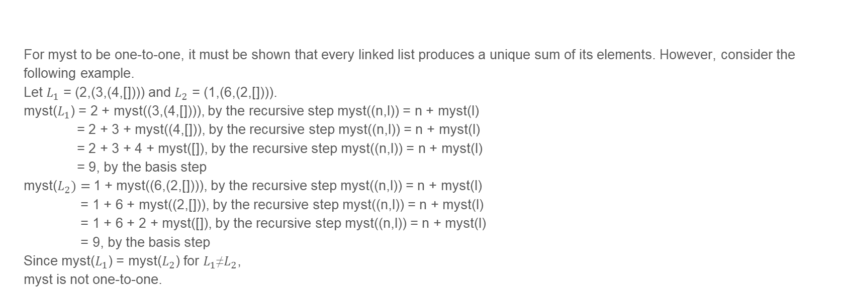
Problem 5

Slide 27
Problem 5
iv. None of the above.
Since myst is not one-to-one but is onto, it cannot be used to show ii but it can be used for i.
We would need to show that there exists some bijection to prove that |L| = |N|. Myst cannot be used since it is not a bijection as it is one-to-one.

Slide 28
THANK YOU!

