Slide 1
CocoSketch: High-Performance Sketch-based Measurement over Arbitrary Partial Key Query
Yinda Zhang^{1,3}, Zaoxing Liu², Ruixin Wang¹, Tong Yang¹, Jizhou Li¹,
Ruijie Miao¹, Peng Liu¹, Ruwen Zhang¹, Junchen Jiang³
¹Peking University, ²Boston University, ³University of Chicago

Slide 2


Applications need network measurement
Traffic Engineering?
Measurement
Data
(SrcIP, DstIP)?
Flow Scheduling?
5-tuple?
Key: combination of packet-header fields
5-tuple: {SrcIP, DstIP, SrcPort, DstPort, Protocol}

Slide 3
Applications need measurement over multiple keys
DDoS detection
How to locate the attack?
SrcIP? DstIP? 5-tuple?
Measurement
Data
(IP, port, protocol)?
(SrcIP/28, DstIP/24)?
Other applications:
rule management, rate limiting, …

Slide 4
Ideally, we want to support arbitrary partial key queries
Measurement
Data
After measurement:
query partial key of 5-tuple
Key benefit
e.g., (SrcIP/28, DstIP/16)
1. Support queries on
multiple keys
2. Without the need to predefine each key
Before measurement:
5-tuple is the full key

Slide 5
However, prior sketches focus on single keys (UnivMon [SIGCOMM‘16], Elastic Sketch [SIGCOMM‘18], NitroSketch [SIGCOMM’19])
Benefits of sketches
1. I need the statistics
over SrcIP
3. Provide approximate
statistics over SrcIP
1. bounded error rates
2. high throughput
3. small memory usage
2. Configure sketch to measure over SrcIP
Can we reuse them?

Slide 6
Strawman 1: one single-key sketch per key (SCREAM [CoNEXT‘15], UnivMon [SIGCOMM‘16], RHHH [SIGCOMM‘17])
Too many resources needed
I may need the
statistics over
SrcIP/16,
SrcIP/20,
SrcIP/24,
……
Resource Name | Percentage
Computing resource for one single-key sketch (Hash Distribution Unit) | 20.83%
Storage resource for one single-key sketch (Map RAM) | 7.11%
Configure
sketch1 for SrcIP/16,
sketch2 for SrcIP/20,
sketch3 for SrcIP/24,
……
Hardware platforms only support
limited single-key sketches

Slide 7
Strawman 2: one single-key sketch for full key
Low accuracy for partial keys
We can recover the statistics
of each key from that of the full key
Relative Error for SrcIP/24
0.94
SrcIP/24 | SrcIP (full key)
…… | ……
56.49.82.* | 56.49.82.0
 | ……
 | 56.49.82.255
…… | ……
0.13
Single-key
sketch
Recovered
from SrcIP

Slide 8
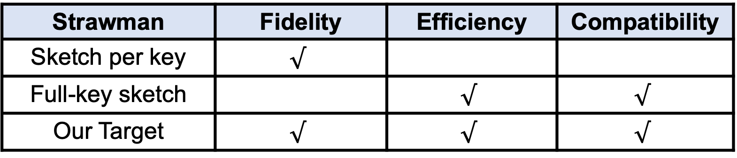
Reusing single-key sketches does not work
Fidelity: Accuracy guarantees over all partial key queries
Efficiency: High throughput using small memory footprints
Compatibility: Work on both software and hardware platforms
Strawman | Fidelity | Efficiency | Compatibility
Sketch per key | $$√$$
Full-key sketch |  | $$√$$ | $$√$$
Our Target | $$√$$ | $$√$$ | $$√$$
Any better solutions to achieve all requirements?

Slide 9
Subset Sum Estimation fits our goal of fidelity
The size of a partial-key flow $=$ the sum of a subset of full-key flows
SrcIP/24 (Partial Key)
SrcIP (Full Key)
56.49.82.0
56.49.82.1
56.49.82.*
……
56.49.82.254
56.49.82.255
To achieve fidelity, we should minimize the variance sum of all full-key flows

Slide 10

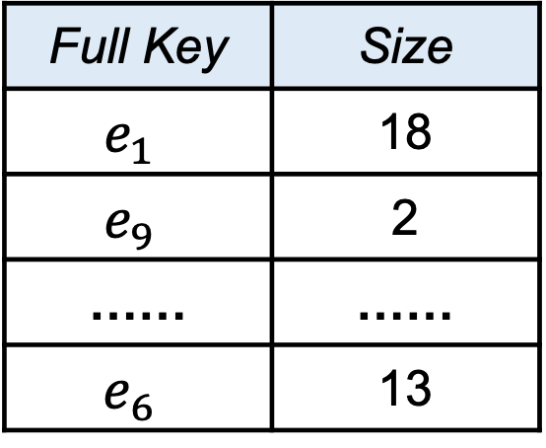
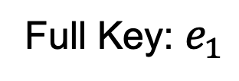
State-of-the-art of subset sum estimation (Unbiased SpaceSaving [SIGMOD’18])
Insert to the bucket with minimum collisions with other full-key flows
Unbiased SpaceSaving (USS)
Full Key | Size
$$e_{1}$$ | 18
$$e_{9}$$ | 2
…… | ……
$$e_{6}$$ | 13
Packet
$$+1$$
Full Key: $e_{1}$
If the full key is recorded,
insert to the corresponding bucket

Slide 11

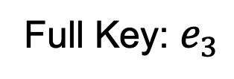

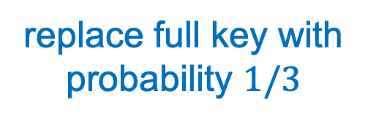
State-of-the-art of subset sum estimation (Unbiased SpaceSaving [SIGMOD’18])
Insert to the bucket with minimum collisions with other full-key flows
Unbiased SpaceSaving (USS)
Full Key | Size
$$e_{1}$$ | 19
$$e_{9}$$ | 2
…… | ……
$$e_{6}$$ | 13
Packet
Full Key: $e_{3}$
$$+1$$
If the full key is not recorded,
insert to the bucket with minimum size
replace full key with probability $1/3$

Slide 12
Can we reuse USS for arbitrary partial key queries?
No, USS falls short on system performance.
Our approach (CocoSketch¹) aims to achieve
good system performance while keeping fidelity.
¹ Cornucopia Sketch

Slide 13
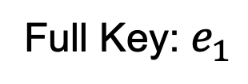
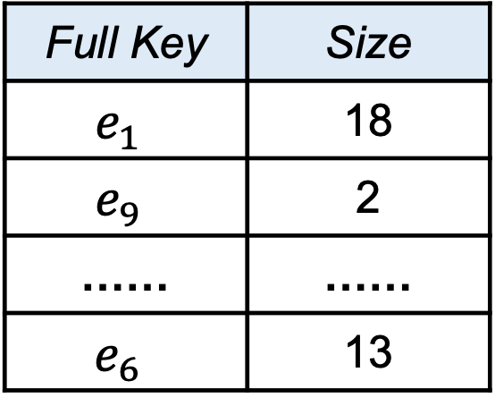
1st Limitation of USS: It needs too many memory accesses
Check all buckets to find the one with minimum collisions $(N≈{10}^{4})$
USS with N buckets
Full Key | Size
$$e_{1}$$ | 18
$$e_{9}$$ | 2
…… | ……
$$e_{6}$$ | 13
Check/Update
Packet
Check/Update
Full Key: $e_{1}$
……
Check/Update

Slide 14




Technique 1: Stochastic Variance Minimization
$d$ hash-indexed
Insert to the bucket with minimum collisions among all buckets
Packet
$$e_{1}$$
$$h_{1}(e_{1})$$
$$h_{2}(e_{1})$$
Map $e_{1}$ to $d$ buckets by $d$ hash functions ($d=2$)

Slide 15





Setting $d$ to 2 or 3 is sufficient
Insight: 2 or 3 accesses can retain similar accuracy
under heavily skewed flow distribution
$$d=1$$
$$d=2$$
Throughput
$$d=3$$
Better
USS $(d=N)$
Relative Error

Slide 16

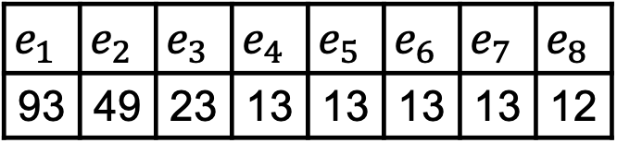
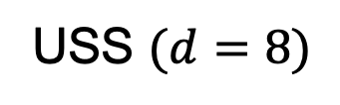
Why is $d=2$ sufficient?
USS $(d=8)$
Distribution of size in the bucket
Update the bucket with minimum collisions
Key
$$e_{1}$$ | $$e_{2}$$ | $$e_{3}$$ | $$e_{4}$$ | $$e_{5}$$ | $$e_{6}$$ | $$e_{7}$$ | $$e_{8}$$
93 | 49 | 23 | 13 | 13 | 13 | 13 | 12
Size
Size
Large flows: low collision rates
Small flows: collisions are balanced
Rank of size

Slide 17




Why is $d=2$ sufficient?
Avoid collisions
with large flows
$d=2$
Distribution of size in the bucket
$$e_{11}$$
$$h_{1}(e_{11})$$
$$h_{2}(e_{11})$$
Key
$$e_{1}$$ | $$e_{2}$$ | $$e_{3}$$ | $$e_{4}$$ | $$e_{5}$$ | $$e_{6}$$ | $$e_{7}$$ | $$e_{8}$$
93 | 49 | 23 | 13 | 13 | 13 | 13 | 12
Size
Size
Large flows: low collision rates
Small flows: collisions are balanced
Rank of size
Power of two choices: In two accesses, we can also balance the collisions well
(DRILL [SIGCOMM’17], DistCache [FAST’19], CHEETAH [NSDI’20])

Slide 18
2nd Limitation of USS: We cannot implement USS efficiently in hardware platforms
Circular dependencies: the update of variables depends on each other
Flow A: (Full Key, Size)
A<B?
B<A?
Flow B: (Full Key, Size)
Circular dependencies are incompatible with
the pipeline workflow of hardware platforms
FPGA: low clock frequency
Tofino switch: not feasible

Slide 19
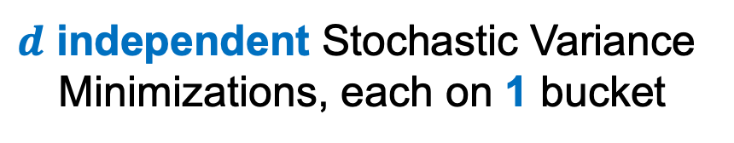
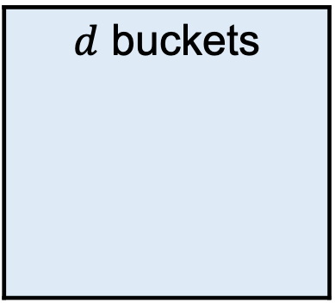
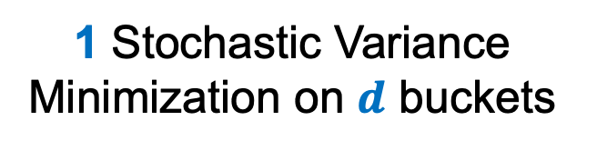


Technique 2: Removing Circular Dependencies
Packet
Packet
Packet
$d$ buckets
1 buckets
……
1 buckets
Flow A
Flow A
Flow B
Flow B
$d$ independent Stochastic Variance
Minimizations, each on 1 bucket
1 Stochastic Variance
Minimization on $d$ buckets
$$+$$
Report the median result
among $d$ buckets

Slide 20
Summary of CocoSketch
Stochastic Variance Minimization
Basic CocoSketch: for software platforms (CPU, Open vSwitch)
+ Circular Dependency Removal
Hardware-friendly CocoSketch: for hardware platforms (FPGA, Tofino switch)
CocoSketch also achieves fidelity as that of USS:
all partial keys share the same accuracy guarantee

Slide 21
Evaluation Setup
Real-world traces: CAIDA, MAWI
Tasks: heavy hitters, heavy changes, hierarchical heavy hitters
Platforms: Intel CPU, OVS with DPDK, Xilinx FPGA, Barefoot Tofino

Slide 22
CocoSketch estimates flow size more accurately
Heavy hitter detection in 500KB memory
 | SpaceSaving | UnivMon | Elastic Sketch | CocoSketch (Ours)
Recall rate for single key | 0.935 | 0.987 | 0.984 | 0.985
Recall rate for multiple keys¹ | 0.337 | 0.167 | 0.683 | 0.964
¹ We measure six different keys and report the average recall rate

Slide 23
CocoSketch achieves higher throughput
Single-thread throughput in CPU (Mpps)
 | SpaceSaving | UnivMon | Elastic Sketch | CocoSketch (Ours)
Throughput for single key | 5.25 | 2.39 | 23.04 | 23.71
Throughput for multiple keys¹ | 1.10 | 0.50 | 5.12 | 23.71²
¹ We report the throughput of measuring six different keys
² The insertion of CocoSketch is not influenced by the number of keys queried

Slide 24
CocoSketch uses less resource in hardware platforms
Heavy hitter detection to guarantee 90% F1 Score in Tofino switch
 | Elastic Sketch for 4 keys* | CocoSketch (Ours)
SRAM | 18.33% | 3.75%
Map RAM | 30.56% | 6.25%
Stateful ALU | 75.00% | 6.25%
*We can implement at most 4 Elastic sketches
in the data plane of Tofino switch

Slide 25
Conclusions
Arbitrary partial key query is needed
Existing single-key sketches are ill-suited
Arbitrary partial key query is a kind of subset sum estimation
Key idea of CocoSketch
Stochastic Variance Minimization
Circular Dependency Removal
Source code: https://github.com/yindazhang/CocoSketch

