Slide 1



Precise Error Estimation for Sketch-based Flow Measurement
Peiqing Chen*, Yuhan Wu*, Tong Yang, Junchen Jiang, Zaoxing Liu

Slide 2


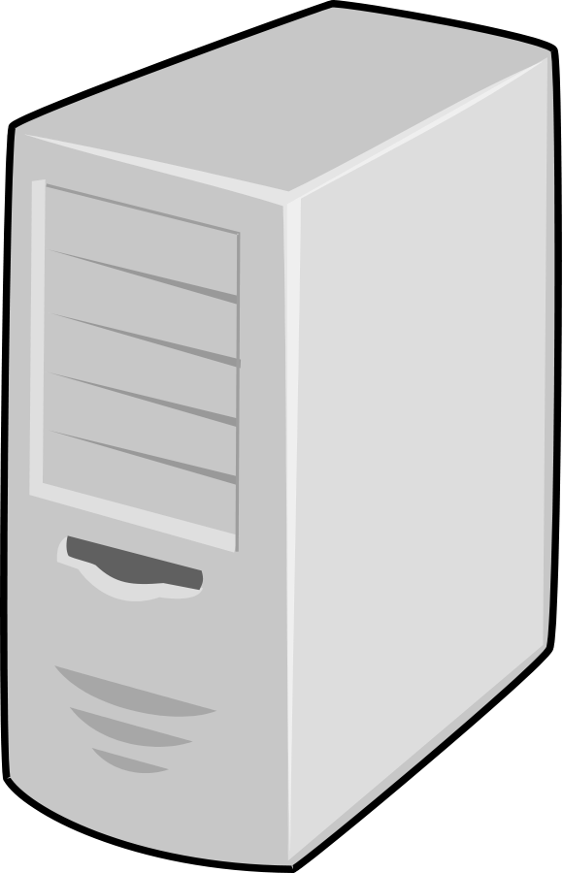
Sketch is an approximation method for network telemetry
Popular sketches:
Count-Min Sketch (CM-Sketch), Count-Sketch, CU-Sketch…
Supported tasks:
Heavy hitter, heavy changes, burst detection
Flow size, flowlet measurement
……
Notes:
这样说mis judge large flows够了吗？
We have less confidence

Slide 3
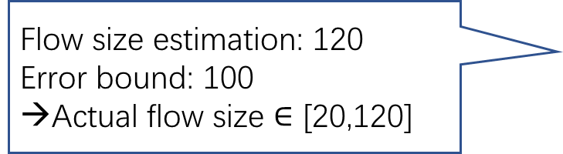
Sketch errors are hard to predict
Currently, the analysis of sketches provides loose error bounds
E.g. Error in large flow detection
Large flow threshold: 100
Flow size estimation: 120
Error bound: 100
→Actual flow size $∈$ [20,120]
Whether large flow or not?
Notes:
这样说mis judge large flows够了吗？
We have less confidence

Slide 4
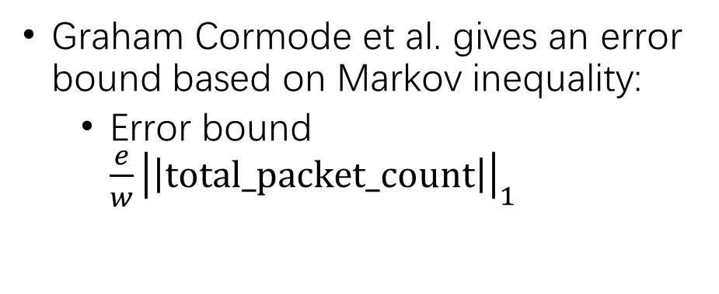


CM-Sketch and the original error bound
Hash collision
+1
+1
Graham Cormode et al. gives an error bound based on Markov inequality:
Error bound $\frac{e}{w}{\left|\left|total_packet_count\right|\right|}_{1}$
$$e_{a}$$
+1
+1
d rows
$$e_{b}$$
+1
+1
w counters
A CM-Sketch example
Notes:
CM-Sketch has error： Due to hash collisions (say it)

Slide 5

How loose the original bound is
Error bound $\frac{e}{w}{\left|\left|total_packet_count\right|\right|}_{1}$
This error bound is too loose in practice:
Example:
Ground truth error bound: 785
Original error bound: 2750
Notes:
CM-Sketch has error： Due to hash collisions (say it)

Slide 6
Can we precisely estimate the error bounds at the query time?
What does “precise” mean:
1. Tighter than the original bound
2. Near optimal (close to ground truth)
YES
Notes:
Say “Yes”

Slide 7

Our insight for one-row sketch
Counter value distribution reveals error distribution
Intuition:
One-row CM-Sketch
Non-existent flow
(Actual size = 0)
F(X)
F(Y)
100%
100%
0
12
0
10
5
56
0
7
25
CDF
CDF
Sketch returns 10
Error is 10
0%
X
0%
Y
0
∞
0
∞
Error
Counter value
Non-existent flow
error distribution
Counter value
distribution
Notes:
竖过来的文字真的好么

Slide 8

Our approach for one-row CM-Sketch
One-row CM-Sketch
(Shade indicating counter value)
F(Y)
d=1 row
100%
w=8 counters
CDF
0%
Y
0
∞
Counter value
The largest $\left[\frac{w}{e}\right]$ fractile as our error bound
Counter value distribution
Notes:
Input and output 写下来

Slide 9

Our insight for multi-row CM-Sketch
Counter value distribution reveals error distribution
We extend it into multi-row scenario:
Multi-row CM-Sketch
F(X)
F(Y)
100%
100%
CDF
Unknown
CDF
Easy to find
0%
X
0%
Y
0
∞
0
∞
Error
Counter value (any row)
Arbitrary flow error distribution
Counter value distribution
Notes:
在这一页需要口述一下，每一行的counter value distribution很接近，还是等到第9页
要不要写one-row

Slide 10

Our approach for multi-row CM-Sketch
Multi-row CM-Sketch
(Shade indicating counter value)
F(Y)
d=3 rows
100%
CDF
w=8 counters per row
0%
Y
0
∞
Counter value (any row)
The counter value distributions in any two rows are close
The largest $\left[\frac{w}{e}\right]$ fractile as our error bound

Slide 11

Summary of our approach
At query time, our error estimator is simple to just look to the largest $\left[\frac{w}{e}\right]$-fractile in an arbitrary row of the CM-Sketch.
Our error estimator can extend to other sketch algorithms (Count-Sketch, CU-Sketch etc.)

Slide 12
Experimental results
Traces: Internet trace (CAIDA), Data center trace, DDoS attack trace, synthetic traces
Metrics: Original bound, our bound, ground truth
Changing sketch memory
Changing trace size
Changing trace skewness
Result:
Our bound is far tighter than the original bound
Our bound is very close to the ground truth (near optimal)

Slide 13
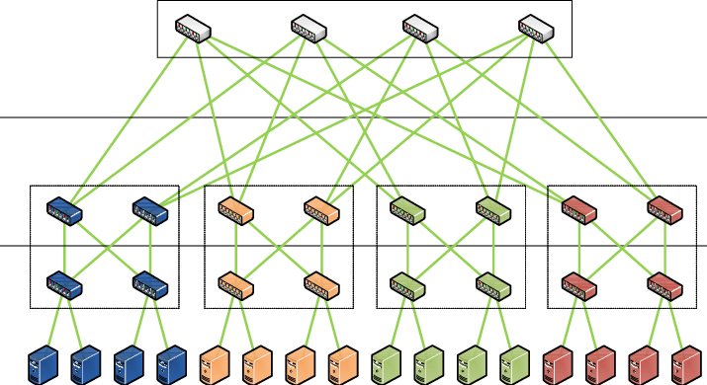
Potential applications of precise error bounds
Better detecting the hot items
Using more precise error estimation
1. Dynamic resource allocation for sketch based measurement to achieve targeted accuracy
2. Improve load balancing

Slide 14
Conclusions
The original error estimation of CM-Sketch is imprecise.
We design an error estimator that generates a near optimal error bound for sketch algorithms (CM-Sketch, Count-Sketch, CU-Sketch, etc.) under all circumstances.
A more precise error estimation can help network resource allocation, load balancing, etc.

