Slide 1
Testing and Inspecting to Ensure High Quality
Adapted from :
Timothy Lethbridge and Robert Laganiere,
Object-Oriented Software Engineering –
Practical Software Development using UML and Java, 2005
(chapter 10)

Slide 2
10.1 Basic definitions
  A failure is an unacceptable behaviour exhibited by a system
    Any violation of a functional or a non-functional (explicit or implicit) requirement should be considered a failure.
      Examples:
        an outright crash,
        the production of incorrect output,
        the system running too slowly,
        the user having trouble finding online help, etc.
    The frequency of failures measures the reliability.
    Important objective: maximize reliability ⇔ minimize the failure rate
  A defect is a flaw in any aspect of the system that contributes, or may potentially contribute, to the occurrence of one or more failures
    could be in the requirements, the design or the code
    It might take several defects to cause a particular failure
  An error is an omission or an inappropriate decision by a software developer that leads to the introduction of a defect
© Lethbridge/Laganière 2005
Chapter 10: Testing and Inspecting for High Quality

Slide 3
Testing is the process of executing a program with the intent of finding any defect that might be present.
  We emphasize that
    program testing can only demonstrate the presence of defects not their absence!
© Lethbridge/Laganière 2005
Chapter 10: Testing and Inspecting for High Quality

Slide 4
10.2 Effective and efficient testing
To test effectively, you must use a strategy that uncovers as many defects as possible
To test efficiently, you must find the largest possible number of defects using the fewest possible tests
  Testing is like detective work:
    The tester must try to understand how programmers and designers think, so as to better find defects.
    The tester must not leave anything uncovered, and must be suspicious of everything.
    It does not pay to take an excessive amount of time; the tester has to be efficient.
© Lethbridge/Laganière 2005
Chapter 10: Testing and Inspecting for High Quality

Slide 5
Basic testing techniques
We consider two basic testing techniques:
  Path testing (applicable in ‘white-box’ testing)
  Equivalence partitioning (applicable in both ‘white-box’ and ‘black-box’ testing)
© Lethbridge/Laganière 2005
Chapter 10: Testing and Inspecting for High Quality

Slide 6
White-box testing
Also called ‘glass-box’ or ‘structural’ testing
Testers have access to the system design
  They can
    Examine the design documents
    View the code
    Observe at run time the steps taken by algorithms and their internal data
  Individual programmers often informally employ white-box testing to verify their own code
© Lethbridge/Laganière 2005
Chapter 10: Testing and Inspecting for High Quality

Slide 7
Control flow graph for white-box testing
A well-known structural testing technique is path testing.
  Path testing is effective at method (procedure, function) level and it is based on the control flow graph (CFG) of the method.
It helps the programmer to systematically test the code
  Each branch in the code (such as an if or a while statement) creates a node in the CFG
  The testing strategy has to reach a targeted coverage of statements and branches. The objective can be to design tests for:
    covering all possible paths (most often unfeasible)
    covering all possible edges (each statement is executed at least once)
      The cyclomatic complexity (cc) of the CFG gives the maximum number of independent paths that must be tested in order to cover all possible edges [MCC76]:
        cc(CFG) = noEdges – noNodes + 2
  = noBinaryDecisionPredicates +1
      It is preferable to limit cc to 10 (11-20 moderate risk, 21-50 high risk, > 50 untestable / very high risk)
© Lethbridge/Laganière 2005
Chapter 10: Testing and Inspecting for High Quality

Slide 8
Control flow graph for white-box testing
  The CFG of a structured program can be built as a combination of CFGs for the basic structured constructs.
Sequence
If
While
  The CFG
    is a directed graph
    with single entry & single exit points
© Lethbridge/Laganière 2005
Chapter 10: Testing and Inspecting for High Quality

Slide 9
Example: CFG of a binary search routine ([Som00], ch. 20)
1
class BinSearch {
…
public static void search (int key, int[] a,Rez r)
{
int mid; int bottom = 0;
int top = a.length – 1;
r.found = false; r.index = -1;
while (bottom <= top) {
mid = (top + bottom) / 2;
if (a[mid] == key) {
r.index = mid;
r.found = true;
return;
} else {
if (a[mid] < key)
bottom = mid + 1;
else
top = mid - 1;
}
}
}
}
while (bottom <= top)
2
3
if (a[mid] == key)
4
if (a[mid] < key)
8
5
6
9
7
A set of independent
paths:
1,2,8,9
1,2,3,8,9
1,2,3,4,5,7,2,8,9
1,2,3,4,6,7,2,8,9
cc(CFG)
= noEdges – noNodes + 2
= noBinaryDecisionPredicates + 1
= 4
© Lethbridge/Laganière 2005
Chapter 10: Testing and Inspecting for High Quality

Slide 10
Black-box testing
Testers provide the system with inputs and observe the outputs
  They can see none of:
    The source code
    The internal data
    Any of the design documentation describing the system’s internals
© Lethbridge/Laganière 2005
Chapter 10: Testing and Inspecting for High Quality

Slide 11
Equivalence classes
  It is inappropriate to test by brute force, using every possible input value
    Takes a huge amount of time
    Is impractical
    Is pointless!
  You should divide the possible inputs into groups which you believe will be treated similarly by all algorithms.
    Such a group is called an equivalence class (EC)
    A tester needs only to run one test per EC
    The tester has to
      understand the required input,
      appreciate how the software may have been designed
© Lethbridge/Laganière 2005
Chapter 10: Testing and Inspecting for High Quality

Slide 12
Examples of equivalence classes
  Valid input is a month number (1-12)
    3 ECs: [-∞..0], [1..12], [13.. ∞]
  Valid input is one of ten (10) strings representing a type of fuel
    11 ECs:
      10 classes, one for each string
      1 class representing all other strings
© Lethbridge/Laganière 2005
Chapter 10: Testing and Inspecting for High Quality

Slide 13
Combinations of equivalence classes
  Combinatorial explosion means that you cannot realistically test every possible system-wide EC.
      For example, if there are 4 different inputs, each with 5 ECs, then there are 5×5×5×5 = 5⁴ (=625) possible system-wide ECs.
      It is impractical to design 625 different test cases.
  In practice, the number of tests must be kept in reasonable limits !
© Lethbridge/Laganière 2005
Chapter 10: Testing and Inspecting for High Quality

Slide 14
Example equivalence class combinations
Example: a system that contains information about all kinds of land vehicles (e.g. passenger, racing, etc). Five types of input:
  Type of unit: ‘Metric’ (km/h), or ‘Imperial or US’ (mph)
    By using ‘radio buttons’ there is no possibility of an invalid input
    2 ECs: Metric, US/Imperial
  Maximum speed (integer): 1-750 km/h, or 1-500 mph
    Validity depends on the type of unit (metric or US/Imperial)
    4 ECs: [-∞..0], [1..500], [501..750], [751.. ∞]
  Type of fuel (string): one of 10 possible strings
    11 ECs (10 plus 1 class for any invalid string)
  Time to accelerate to 100km/h or 60 mph (integer): 1-100s
    3 ECs: [-∞..0], [1..100],[101..∞]
  Range (integer): 1-5000 km, or 1-3000 miles.
    Validity depends on the the type of unit (metric or US/Imperial)
    4 ECs: [-∞..0], [1..3000],[3001..5000],[5001.. ∞]
© Lethbridge/Laganière 2005
Chapter 10: Testing and Inspecting for High Quality

Slide 15
Example equivalence class combinations
Total number of ECs: 2 × 4 × 11 × 3 × 4 = 1056 (!!)
A reasonable strategy for reducing the number of tests:
    You should first make sure that at least one test is run with every EC of every individual input.
    You should test all combinations where an input is likely to affect the interpretation of another.
      You should also test a few other random combinations of ECs.
By using this strategy the number of tests for the vehicles example can be reduced from 1056 to 11:
    You run one test for each EC of input 3 (11 tests)
    While doing this you vary (in parallel)
      the 8 possible combinations of ECs of inputs 1 and 2
      the 8 possible combinations of ECs of inputs 1 and 5
      the 3 possible ECs of input 4
© Lethbridge/Laganière 2005
Chapter 10: Testing and Inspecting for High Quality

Slide 16
Testing at the boundaries of equivalence classes
  More errors in software occur at the boundaries of equivalence classes
  The idea of ECs testing should be expanded to specifically test values at the extremes of each EC.
    E.g. The number 0 often causes problems
  E.g.: If the valid input is a month number (1-12)
    Test the ECs as before
    Test 0, 1, 12 and 13 as well as very large positive and negative values
© Lethbridge/Laganière 2005
Chapter 10: Testing and Inspecting for High Quality

Slide 17
Detecting specific categories of defects
A tester must try to uncover any defects the other software engineers might have introduced.
  This means designing tests that explicitly try to catch a range of specific types of defects that commonly occur
© Lethbridge/Laganière 2005
Chapter 10: Testing and Inspecting for High Quality

Slide 18
10.3 Defects in Ordinary Algorithms
Incorrect logical conditions
  Defect:
    The logical conditions that govern looping and if-then-else statements are wrongly formulated.
  Testing strategy:
    Use equivalence class and boundary testing.
    Consider as an input each variable used in a rule or logical condition.
© Lethbridge/Laganière 2005
Chapter 10: Testing and Inspecting for High Quality

Slide 19
Example of incorrect logical conditions defect (in software for an aircraft landing gear system)
  Specification:
    The landing gear must be deployed whenever the plane is within 2 minutes from landing or takeoff, or within 2000 feet from the ground. If visibility is less than 1000 feet, then the landing gear must be deployed whenever the plane is within 3 minutes from landing or lower than 2500 feet.
      (Otherwise, the aircraft’s alarm is supposed to sound !)
  What is the hard-to-find defect in the following implementation ?
if(!landingGearDeployed &&
(min(now-takeoffTime,estLandTime-now))<
(visibility < 1000 ? 180 :120) ||
relativeAltitude <
(visibility < 1000 ? 2500 :2000)
)
{
throw
new LandingGearException();
}
© Lethbridge/Laganière 2005
Chapter 10: Testing and Inspecting for High Quality

Slide 20
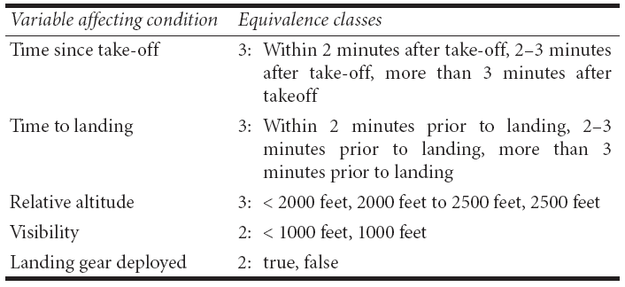
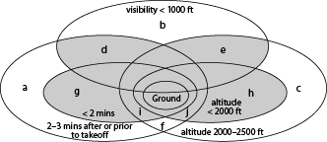
Example of incorrect logical conditions defect
Total number of system ECs: 108
For such a critical system all the 108 ECs (plus their boundaries) should be tested (in a simulated environment).
Venn diagram: the gray area indicates the ECs where the alarm should sound if the landing gear is not deployed.
© Lethbridge/Laganière 2005
Chapter 10: Testing and Inspecting for High Quality

Slide 21
Defects in Ordinary Algorithms
Not setting up the correct preconditions for an algorithm
  Defect:
    Preconditions state what must be true before the algorithm should be executed.
    A defect would exist if a program proceeds to do its work, even when the preconditions are not satisfied.
  Testing strategy:
    Run test cases in which each precondition is not satisfied.
© Lethbridge/Laganière 2005
Chapter 10: Testing and Inspecting for High Quality

Slide 22
Defects in Ordinary Algorithms
Not handling null conditions
  Defect:
    A null condition is a situation where there normally are one or more data items to process, but sometimes there are none.
    It is a defect when a program behaves abnormally when a null condition is encountered.
  Testing strategy:
    Determine the null conditions and run appropriate tests.
  Example:
    A program that calculates the average sales of the members of each division in an organization.
      Null condition: a division that has no members
      Typical defect: the program attempts to divide by zero (zero sales divided by zero members)
    Test the behavior of the program for a division with zero members.
© Lethbridge/Laganière 2005
Chapter 10: Testing and Inspecting for High Quality

Slide 23
Defects in Ordinary Algorithms
Not handling singleton or non-singleton conditions
  Defect:
    A singleton condition is similar to a null condition. It occurs when there is normally more than one of something, but sometimes there is only one.
    A non-singleton condition is the inverse (there is normally exactly one, but occasionally there is more than one).
    Defects occur when the unusual case is not properly handled.
  Testing strategy:
    Determine unusual conditions and run appropriate tests.
© Lethbridge/Laganière 2005
Chapter 10: Testing and Inspecting for High Quality

Slide 24
Defects in Ordinary Algorithms
Off-by-one errors
  Defect:
    A program loops one too many times or one too few times.
    Or a program inappropriately adds or subtracts one
      E.g. by using ++v instead of v++ (or vice versa)
    This is a particularly common type of defect.
  Testing strategy:
    Develop boundary tests in which you verify that the program:
      performs the correct number of iterations
      computes the correct numerical answer
© Lethbridge/Laganière 2005
Chapter 10: Testing and Inspecting for High Quality

Slide 25
Defects in Ordinary Algorithms
  Example: Assuming Java-like 0-based indexing, the following loop always skips the first element:
      for (i=1; i < arrayname.length; i++)
      {
      /* do something */
      }
  The problem can easily be avoided by the designer by using the concept of an Iterator (in Java the Iterator class).
  But the tester must assume the worst and design boundary tests.
© Lethbridge/Laganière 2005
Chapter 10: Testing and Inspecting for High Quality

Slide 26
Defects in Ordinary Algorithms
Not terminating a loop or recursion
  Defect:
    A loop or a recursion does not always terminate, i.e. in some conditions it is ‘infinite’.
      It is the responsibility of the programmer to avoid (undesirable) infinite behaviour, but the tester must assume the worst and design appropriate test cases.
  Testing strategies:
    Analyse what causes a repetitive action to be stopped.
    Run test cases that you anticipate might not be handled correctly.
© Lethbridge/Laganière 2005
Chapter 10: Testing and Inspecting for High Quality

Slide 27
Defects in Ordinary Algorithms
Use of inappropriate standard algorithms
  Defect:
    An inappropriate standard algorithm is one that is unnecessarily inefficient or has some other property that is widely recognized as being bad.
  Testing strategies:
    The tester has to know the properties of algorithms and design tests that will determine whether any undesirable algorithms have been implemented.
  Example: The designer uses a ‘bubble sort’ instead of ‘quick sort’.
    The tester can increase (e.g. double) the number of items being sorted and observe how execution time is affected.
© Lethbridge/Laganière 2005
Chapter 10: Testing and Inspecting for High Quality

Slide 28
10.4 Defects in Numerical Algorithms
Not using enough bits or digits to store maximum values
  Testing strategies: Test using very large numbers
  Example: In 5 June 1996 the first test flight of the French Ariane-5 Launcher ended in failure.
    The failure was caused by a software error: an attempt to convert a (too large) 64-bit floating point number to a 16-bit signed integer.
    It was one of the most expensive computer bugs in history (causing a loss of approx. $500 million).
© Lethbridge/Laganière 2005
Chapter 10: Testing and Inspecting for High Quality

Slide 29
Defects in Numerical Algorithms
Assuming a floating point value will be exactly equal to some other value
  Defect:
    If you perform an arithmetic calculation on a floating point value, then the result will very rarely be computed exactly.
    It is a defect to test if a floating point value is exactly equal to some other value.
    To test equality, you should always test if it is within a small range around that value.
  Testing strategies:
    Standard boundary testing should detect this type of defect.
© Lethbridge/Laganière 2005
Chapter 10: Testing and Inspecting for High Quality

Slide 30
Example of defect in testing floating value equality:
Defects in Numerical Algorithms
Bad:
for (double d = 0.0; d != 10.0; d+=2.0) {...}
Better:
for (double d = 0.0; d < 10.0; d+=2.0) {...}
© Lethbridge/Laganière 2005
Chapter 10: Testing and Inspecting for High Quality

Slide 31
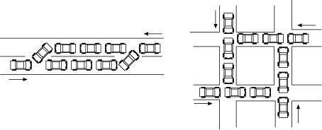
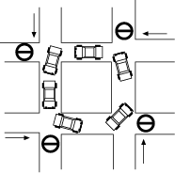
10.5 Defects in Timing and Co-ordination
Deadlock and livelock
  Defects:
    A deadlock is a situation where two or more threads are stopped, waiting for each other to do something before either can proceed.
      The system is hung
    Livelock is similar, but now the system can do some computations, but can never get out of some states.
© Lethbridge/Laganière 2005
Chapter 10: Testing and Inspecting for High Quality

Slide 32
Defects in Timing and Co-ordination
Deadlock and livelock
  Testing strategies:
    Deadlocks and livelocks occur due to unusual combinations of conditions that are hard to anticipate or reproduce.
    If black box testing is the only possibility you can:
      Run a large number of threads concurrently.
      Deliberately deny resources to one or more threads (e.g. by cutting network connections, or by locking input files).
      Vary the relative speed of the different threads
    However, the deadlock problem is difficult. Expensive white-box testing and inspections may be necessary.
      Formal verification techniques have been successful in producing concurrent systems that have a high level of reliability.
© Lethbridge/Laganière 2005
Chapter 10: Testing and Inspecting for High Quality

Slide 33
Defects in Timing and Co-ordination
Critical races
  Defect:
    One thread experiences a failure because another thread interferes with the ‘normal’ (or ‘expected’) sequence of events. The defect is not that the other thread tries to do something, but that the program allows the (‘abnormal’) interference to occur.
  Testing strategies:
    Same as for deadlock and livelock.
      Testing for deadlock or critical races is generally ineffective, since they are produced by particular chains of events.
      It is particularly hard to test for critical races by using black-box testing alone.
    Once again, inspection is often a better solution.
© Lethbridge/Laganière 2005
Chapter 10: Testing and Inspecting for High Quality

Slide 34
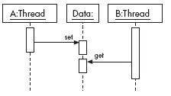
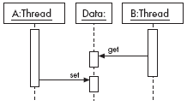
Example of critical race
a) Normal
b) Abnormal due to delay in thread A
© Lethbridge/Laganière 2005
Chapter 10: Testing and Inspecting for High Quality

Slide 35
Synchronization
  The easiest way to deal with deadlocks and critical races is to avoid them at design time !
  Critical races can be prevented by locking data so that they cannot be accessed by other threads when they are not ready.
    In Java, the synchronized keyword can be used.
      It ensures that no other thread can access an object until the synchronized method terminates.
© Lethbridge/Laganière 2005
Chapter 10: Testing and Inspecting for High Quality

Slide 36
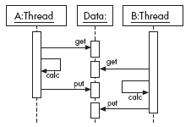
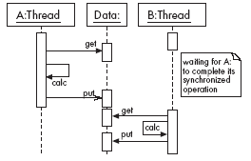
Example of a synchronized method
a) Abnormal: The value put by thread A is immediately overwritten by the value put by thread B.
b) The problem has been solved by accessing the data using synchronized methods.
© Lethbridge/Laganière 2005
Chapter 10: Testing and Inspecting for High Quality

Slide 37
10.9 Strategies for Testing Large Systems
Integration testing: big bang versus incremental testing
  In big bang testing, you take the entire system and test it all at once.
    Impractical for most nontrivial systems.
    Errors resulting from modules interactions are difficult to locate.
  A better strategy in most cases is incremental testing.
    When you encounter a failure you can locate the defect more easily.
    Unfortunately, there is a high probability that efforts to remove defects will actually add new ones. This phenomenon is called the ripple effect.
    After a defect is located and fixed you may have to perform regression testing.
      Regression testing is the process of retesting (parts of) a system that was previously built and tested when new functionality is added.
© Lethbridge/Laganière 2005
Chapter 10: Testing and Inspecting for High Quality

Slide 38
Strategies for Testing Large Systems
Incremental testing can be performed horizontally or vertically.
  Horizontal testing can only be applied when the system is divided into separate subsystems.
  The basic strategies for vertical incremental testing are:
    Top-down
      In this approach you have to design stubs (i.e. modules with the same interface but very limited functionality) that simulate lower-level modules.
    Bottom-up
      In this approach you have to design test drivers for the lower-level modules.
        A test driver is a module designed specifically for testing by making calls to the lower layers.
    Sandwich
© Lethbridge/Laganière 2005
Chapter 10: Testing and Inspecting for High Quality

Slide 39
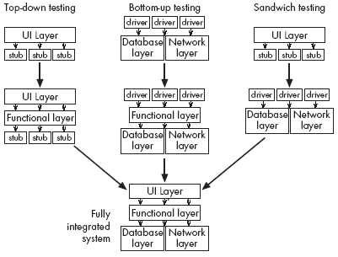
Vertical strategies for incremental integration testing
© Lethbridge/Laganière 2005
Chapter 10: Testing and Inspecting for High Quality

Slide 40
Most of the testing techniques and strategies given in this chapter work just as well for OO software as for non-OO software.
In an OO system method and class testing correspond to unit testing.
  An OO class is a unit of protection.
    You can write special methods within each class to act as test drivers for the methods of that class.
      In Java, you can create a main() method (to act as a test driver) in each class in order to exercise the other methods.
  JUnit [Bec04] is a professional unit testing tool for Java classes:
  http://www.junit.org
However, in an OO system there is no obvious ‘top’ to the system.
    Neither top-down, nor bottom-up integration are really appropriate for OO systems [Som00].
© Lethbridge/Laganière 2005
Chapter 10: Testing and Inspecting for High Quality

Slide 41
Use case integration testing
Use-case or scenario-based testing is often the most effective integration testing strategy for OO systems [JBR99,Som00].
  Black-box tests can be derived directly from the use case model.
    Each use case can give rise to a number of test cases.
  White-box tests are based on the use case realizations in the design model.
    Interaction diagrams (e.g. sequence diagrams) provide essential information for test cases design.
© Lethbridge/Laganière 2005
Chapter 10: Testing and Inspecting for High Quality

Slide 42
Test Cases
A test case is an explicit set of instructions designed to detect a particular class of defect in a software system.
Each test case should include the following information:
  what to test (identification information),
  with which input,
  (expected) result,
  and under which conditions.
The specification may also include
  detailed instructions on how to perform the test case (the test procedure)
  cleanup instructions (when needed)
    Example: instructions to remove erroneous test data (added during the execution of the test case) from some external database.
© Lethbridge/Laganière 2005
Chapter 10: Testing and Inspecting for High Quality

Slide 43
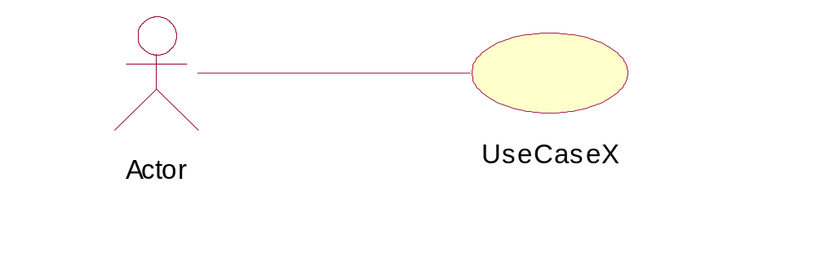
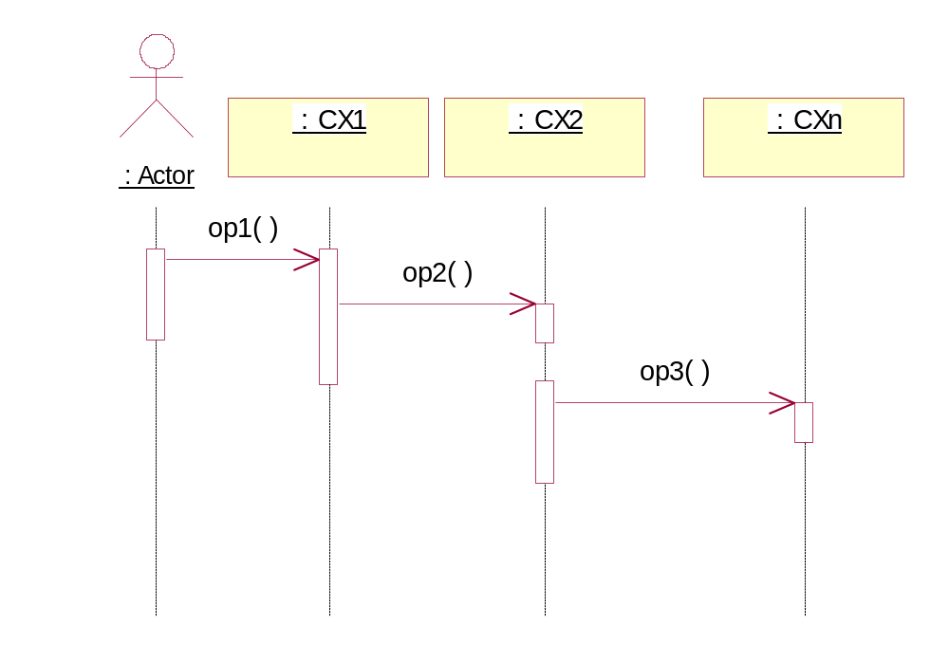
Designing integration test cases based on sequence diagrams
Assume that:
  CX1, CX2, …, CXn are the classes that participate the design of UseCaseX.
  The sequence diagram describes a use scenario for UseCaseX.
Based on such an interaction (sequence) diagram, you can design an integration test case by specifying the conditions (start state, input from the actor, etc) that make the sequence happen [JBR99].
  A defect is identified if the actual interaction (captured during the execution of the test case) and the interaction specified by the sequence diagram are not the same.
The actual interaction can be captured
  by running a debugger
  by using print statements (e.g. in Java System.out.println() ), etc.
© Lethbridge/Laganière 2005
Chapter 10: Testing and Inspecting for High Quality

Slide 44
10.10 Inspections
An inspection is an activity in which one or more people systematically
  Examine source code or documentation, looking for defects.
  Normally, inspection involves a meeting...
    Although participants can also inspect alone at their desks.
© Lethbridge/Laganière 2005
Chapter 10: Testing and Inspecting for High Quality

Slide 45
Roles on inspection teams
  The author
  The moderator.
    Calls and runs the meeting.
    Makes sure that the general principles of inspection are adhered to.
  The secretary.
    Responsible for recording the defects when they are found.
    Must have a thorough knowledge of software engineering.
  Paraphrasers.
    Step through the document explaining it in their own words.
© Lethbridge/Laganière 2005
Chapter 10: Testing and Inspecting for High Quality

Slide 46
Principles of inspecting
  Inspect the most important documents of all types
    code, design documents, test plans and requirements
  Choose an effective and efficient inspection team
    between two and five people
    Including experienced software engineers
  Require that participants prepare for inspections
    They should study the documents prior to the meeting and come prepared with a list of defects
  Only inspect documents that are ready
    Attempting to inspect a very poor document will result in defects being missed
© Lethbridge/Laganière 2005
Chapter 10: Testing and Inspecting for High Quality

Slide 47
Principles of inspecting
  Avoid discussing how to fix defects
    Fixing defects can be left to the author
  Avoid discussing style issues
    Issues like are important, but should be discussed separately
  Do not rush the inspection process
    A good speed to inspect is
      200 lines of code per hour (including comments)
      or ten pages of text per hour
© Lethbridge/Laganière 2005
Chapter 10: Testing and Inspecting for High Quality

Slide 48
Principles of inspecting
  Avoid making participants tired
    It is best not to inspect for more than two hours at a time, or for more than four hours a day
  Keep and use logs of inspections
    You can also use the logs to track the quality of the design process
  Re-inspect when changes are made
    You should re-inspect any document or code that is changed more than 20%
© Lethbridge/Laganière 2005
Chapter 10: Testing and Inspecting for High Quality

Slide 49
A peer-review process
Managers are normally not involved
  This allows the participants to express their criticisms more openly, not fearing repercussions
  The members of an inspection team should feel they are all working together to create a better document
  Nobody should be blamed
© Lethbridge/Laganière 2005
Chapter 10: Testing and Inspecting for High Quality

Slide 50
Conducting an inspection meeting
1. The moderator calls the meeting and distributes the documents.
2. The participants prepare for the meeting in advance.
3. At the start of the meeting, the moderator explains the procedures and verifies that everybody has prepared.
4. Paraphrasers take turns explaining the contents of the document or code, without reading it verbatim.
  Requiring that the paraphraser not be the author ensures that the paraphraser say what he or she sees, not what the author intended to say.
5. Everybody speaks up when they notice a defect.
© Lethbridge/Laganière 2005
Chapter 10: Testing and Inspecting for High Quality

Slide 51
Inspecting compared to testing
  Both testing and inspection rely on different aspects of human intelligence.
  Testing can find defects whose consequences are obvious but which are buried in complex code.
  Inspecting can find defects that relate to maintainability or efficiency.
  The chances of mistakes are reduced if both activities are performed.
© Lethbridge/Laganière 2005
Chapter 10: Testing and Inspecting for High Quality

Slide 52
Testing or inspecting, which comes first?
  It is important to inspect software before extensively testing it.
  The reason for this is that inspecting allows you to quickly get rid of many defects.
  If you test first, and inspectors recommend that redesign is needed, the testing work has been wasted.
    There is a growing consensus that it is most efficient to inspect software before any testing is done.
  Even before developer testing
© Lethbridge/Laganière 2005
Chapter 10: Testing and Inspecting for High Quality

Slide 53
Additional references
[Bec04] K. Beck. JUnit pocket guide. O’Reilly, 2004.
[BB99] W. Boggs, M. Boggs. Mastering UML with Rational Rose (1st edition), Sybex, 1999.
[JBR99] I. Jacobson, G. Booch and J. Rumbaugh. The Unified Software Development Process. Addison-Wesley, 1999.
[MCC76] T. McCabe. A software complexity measure. IEEE Trans. Software Engineering, 2:308-320, 1976.
[Som00] I. Sommerville. Software Engineering (6th edition), Addison-Wesley, 2000.
[Som04] I. Sommerville. Software Engineering (7th edition), Addison-Wesley, 2004.
© Lethbridge/Laganière 2005
Chapter 10: Testing and Inspecting for High Quality

