Slide 1
Use-case-driven development
Use-case-driven development is a key feature of the unified process [BRJ99,JBR99,Kru03].
  For large projects, it is usually employed as part of an iterative process.
The use-case-driven development methodology comprises the following basic (activities or) workflows, each producing a corresponding model described by using the UML:
  Requirements
  Analysis
  Design
  Implementation
  Test
Adapted with permission from © I. Jacobson, G. Booch and J. Rumbaugh. The Unified Software Development Process. Addison-Wesley, 1999

Slide 2
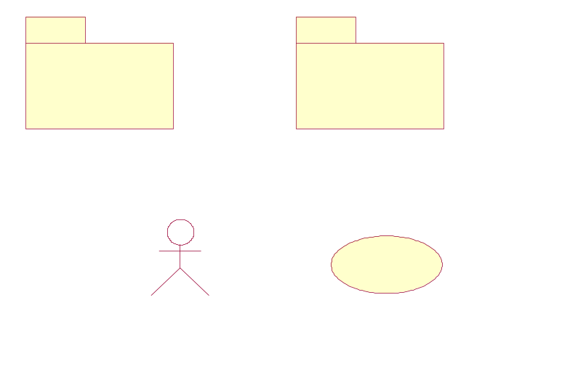
Use-case-driven development
Workflows & models [BRJ99,JBR99,Kru03]:
Analysis stereotypes
Use Case
Model
1
Use Case
System
Analysis
Model
1
Analysis
System
*
*
Analysis
Package
Boundary class – used to model interactions between the system and its actors
*
*
*
*
*
*
Control class – used to coordinate (or control) the activities of other classes
Analysis Class
Use-Case
Realization in Analysis
Actor
Use Case
Requirements
Typically, there is one control class per use case realization.
Communication diagrams are primarily used to model the interactions between analysis objects.
Entity class – used to model long-lived (often persistent) information
Analysis
Adapted with permission from © I. Jacobson, G. Booch and J. Rumbaugh. The Unified Software Development Process. Addison-Wesley, 1999

Slide 3


Use-case-driven development
Workflows & models [BRJ99,JBR99,Kru03]:
Implem
Model
1
Implem
System
*
*
Implem
Package
Design
Model
1
Design
System
*
*
Design
Package
The implementation workflow involves unit testing
*
*
*
*
Deployment
Model
*
*
*
Component
Interface
*
*
*
Implementation
Test
Model
1
Test components may be used to automate the test procedures
Test
System
*
Interface
Design
Class
Use-Case
Realization in Design
*
*
*
Node
Sequence diagrams are primarily used to model the interactions between design objects.
Test Case
Test
Procedure
Test
Component
Design
Test
Adapted with permission from © I. Jacobson, G. Booch and J. Rumbaugh. The Unified Software Development Process. Addison-Wesley, 1999

Slide 4
Use-case-driven development
Workflow | Description
Requirements | Actors who interact with the system are identified and use cases are developed to model the system requirements. The use-case model captures the functional requirements. Specific non-functional requirements can be attached to each use case.
Analysis | A conceptual model of the system based on analysis classes and use-case realizations is created. Conceptual classes are analyzed based on the roles (responsibilities, attributes) they play in the various use-case realizations. An analysis class is an abstraction of a number of design classes.
Design | The design model consists of design classes and sub-systems, use-case realizations, and deployment architectural models. The design model is developed based on the analysis model, but it is also adapted to the implementation environment (GUI kits, architectural frameworks, etc.).
Implementation | The components in the system (that implement design classes and may refine the deployment model) are structured into implementation sub-systems.
Test | System testing follows the completion of the implementation. The test model comprises test cases that can be derived directly from the use case model, test procedures and test components.
Adapted from slide created by © Ian Sommerville, 2007, Software Engineering 7th edition (also based on [Som16, JBR99])

Slide 5
References
[BRJ99] G. Booch, J. Rumbaugh and I. Jacobson. The Unified Modeling Language User Guide. Addison-Wesley, 1999.
[JBR99] I. Jacobson, G. Booch and J. Rumbaugh. The Unified Software Development Process. Addison-Wesley, 1999.
[Kru03] P. Kruchten. The Rational Unified Process: An Introduction (3rd edition). Addison-Wesley, 2003.
[RS13] D. Rosenberg, M. Stephens, Use Case Driven Object Modeling with UML: Theory and Practice, Apress, 2013.
[Som16] I. Sommerville. Software Engineering, (10th edition). Addison-Wesley, 2016.

