Slide 1
Developing Requirements
Adapted from:
Timothy Lethbridge and Robert Laganiere,
Object-Oriented Software Engineering –
Practical Software Development using UML and Java, 2005
(chapter 4)

Slide 2
4.1 Domain Analysis
Domain analysis is the process by which a software engineer learns about the application domain to better understand the problem.
  The domain is the general field of business or technology in which the clients will use the software
  A domain expert is a person who has a deep knowledge of the domain
Benefits of performing domain analysis:
  Faster development
  Better system
  Anticipation of extensions
© Lethbridge/Laganière 2005
Chapter 4: Developing requirements

Slide 3
Suggested Structure of a
Domain Analysis document
  A. Introduction
  B. Glossary
  C. General knowledge about the domain
  D. Customers and users
  E. The environment
  F. Tasks and procedures currently performed
  G. Competing software
  H. Similarities to other domains
© Lethbridge/Laganière 2005
Chapter 4: Developing requirements

Slide 4
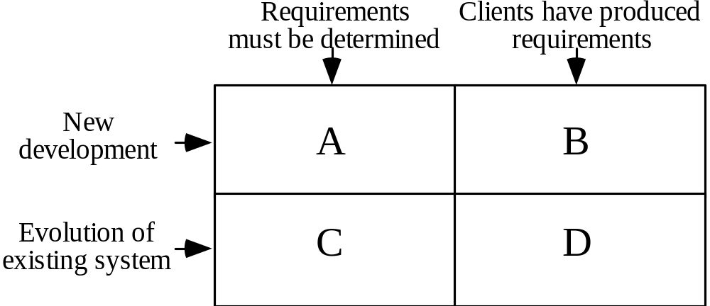
4.2 The Starting Point for Software Projects
Four broad categories of software projects:
(green field project)
© Lethbridge/Laganière 2005
Chapter 4: Developing requirements

Slide 5
4.3 Defining the Problem and the Scope
In order to determine the requirements, the first step is to work out an initial definition of the problem to be solved.
A problem can be expressed as:
  A difficulty the users or customers are facing,
  Or as an opportunity that will result in some benefit such as improved productivity or sales.
The solution to the problem normally will entail developing software.
A good problem statement is short and succinct - one or two sentences is best.
  Example - a new student registration system:
    “The system will allow students to register for courses, and change their registration, as simply ad rapidly as possible. It will help students achieve their personal goals of obtaining their degree in the shortest reasonable time while taking courses that they find most interesting and fulfilling.”
© Lethbridge/Laganière 2005
Chapter 4: Developing requirements

Slide 6
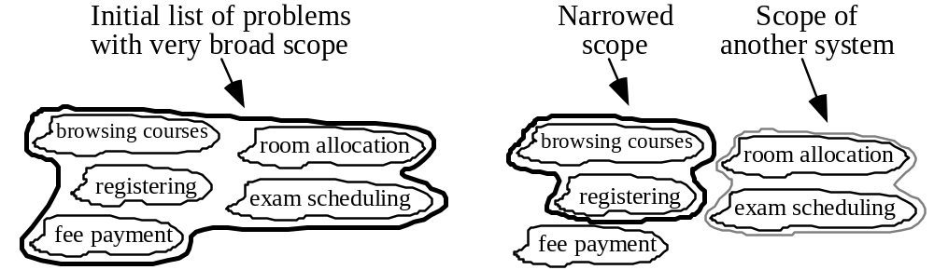
Defining the Scope
An important objective is to narrow the scope by defining a more precise problem
  List all the things you might imagine the system doing
    Exclude some of these things if too broad
    Determine high-level goals (of the user / customer) if too narrow
Example: A university registration system
© Lethbridge/Laganière 2005
Chapter 4: Developing requirements

Slide 7
4.4 What is a Requirement
A requirement is a statement describing either 1) an aspect of what the proposed system must do, or 2) a constraint on the system’s development. In either case, it must contribute in some way towards adequately solving the customer’s problem; the set of requirements as a whole represents a negotiated agreement among all stakeholders.
  A requirement is a short and concise piece of information
A collection of requirements is a requirements document.
© Lethbridge/Laganière 2005
Chapter 4: Developing requirements

Slide 8
4.5 Types of Requirements
Functional requirements
  Describe what the system should do
Non-functional requirements
  Constraints that must be adhered to during development
© Lethbridge/Laganière 2005
Chapter 4: Developing requirements

Slide 9
Functional requirements
Functional requirements describe the services provided for the users and for other systems.
Functional requirements can describe:
  What inputs the system should accept
  What outputs the system should produce
  What data the system should store that other systems might use
  What computations the system should perform
  The timing and synchronization of the above
© Lethbridge/Laganière 2005
Chapter 4: Developing requirements

Slide 10
Non-functional requirements
All must be verifiable
Three main types
  1. Categories reflecting quality attributes:
    Response time
    Resource usage
    Reliability
    Availability
    Recovery from failure
    Maintainability
    Reusability
© Lethbridge/Laganière 2005
Chapter 4: Developing requirements

Slide 11
Non-functional requirements
  2. Categories constraining the environment and technology of the system:
    Platform
    Technology to be used
  3. Categories constraining the project plan and development methods:
    Development process (methodology) to be used
    Cost and delivery date
      Often put in contract or project plan instead
© Lethbridge/Laganière 2005
Chapter 4: Developing requirements

Slide 12
4.6 Use-Cases describing how the user will use the system
A use case is a description of a set of sequences of actions, including variants, that a system performs that yields an observable result of value to a particular actor [BRJ99].
  The objective of use case analysis is to model the system
    … from the point of view of how users interact with this system
    … when trying to achieve their objectives.
  A use case model consists of
    a set of use cases
    a set of actors (an actor is a coherent set of roles that users of use cases play when interacting with the use cases [BRJ99])
    an optional description or diagram indicating how they are related
  To make a use case model understandable, you should group similar variant sequences of actions into one use case.
© Lethbridge/Laganière 2005
Chapter 4: Developing requirements

Slide 13
Use cases
  In general, a use case should cover the full sequence of steps from the beginning of a task until the end.
  A use case should describe the user’s interaction with the system ...
    not the computations the system performs.
  A use case should be written so as to be as independent as possible from any particular user interface design.
  A use case should only include actions in which the actor interacts with the computer.
© Lethbridge/Laganière 2005
Chapter 4: Developing requirements

Slide 14
Scenarios
A scenario is an instance of a use case, involving
    a specific actor instance,
    at a specific time and
    using specific data.
© Lethbridge/Laganière 2005
Chapter 4: Developing requirements

Slide 15
How to describe a single use case
A. Name: Give a short, descriptive name to the use case.
B. Actors: List the actors who can perform this use case.
C. Goals: Explain what the actor or actors are trying to achieve.
D. Preconditions: State of the system before the use case.
E. Description: Give a short informal description.
F. Related use cases
G. Steps: Describe each step (using a 2-column format: actor actions, system responses)
H. Post-conditions: What state is the system in following the completion of the use case.
Only the name (A) and the steps (G) are essential
    In a simplified description you may omit the other components.
© Lethbridge/Laganière 2005
Chapter 4: Developing requirements

Slide 16
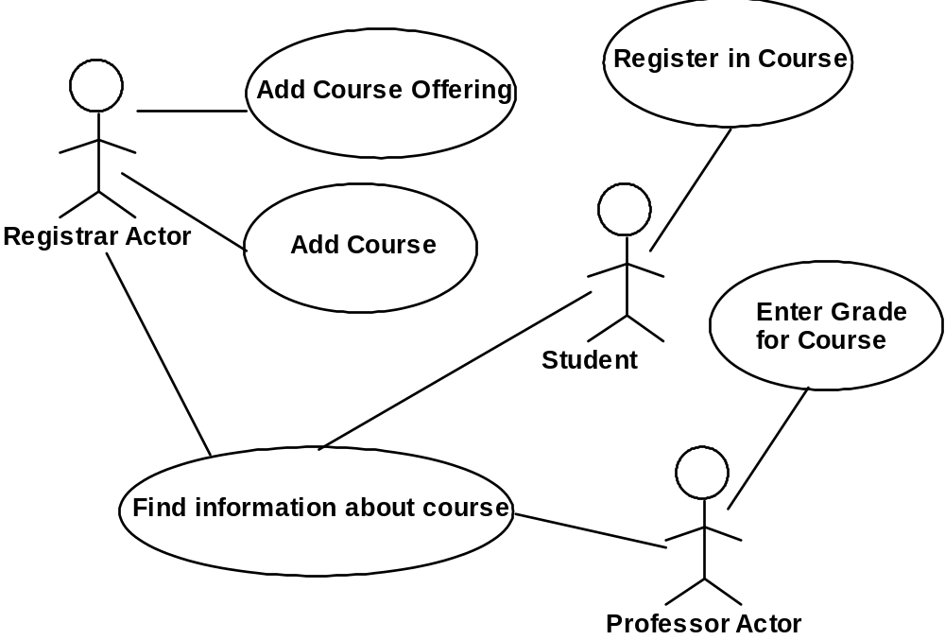
A simple use case diagram
Graphically
a use case is rendered as an ellipse,
an actor is rendered as a stick person.
Use case diagrams commonly contain [BRJ99]:
actors,
use cases,
associations, generalizations and dependencies.
© Lethbridge/Laganière 2005
Chapter 4: Developing requirements

Slide 17
Extensions
  Used to make optional interactions explicit or to handle exceptional cases.
    By creating separate use case extensions, the description of the basic use case remains simple.
    In the use case extension you must
      either list all the steps from the beginning of the use case to the end, including the handling of the unusual situation,
      or indicate which step is the extension point (the point at which the extension changes the basic sequence).
© Lethbridge/Laganière 2005
Chapter 4: Developing requirements

Slide 18
Generalizations
  Generalizations (/ specializations) work the same way as in a class diagram, and use the same triangle symbol.
    A generalized use case represents several similar use cases.
    One or more specializations provides details of the similar use cases.
© Lethbridge/Laganière 2005
Chapter 4: Developing requirements

Slide 19
Inclusions
  Allow one to express commonality between several different use cases.
  Are included in other use cases
    Even very different use cases can share sequence of actions.
    Enable you to avoid repeating details in multiple use cases.
  Represent the performing of a lower-level task with a lower-level goal.
© Lethbridge/Laganière 2005
Chapter 4: Developing requirements

Slide 20
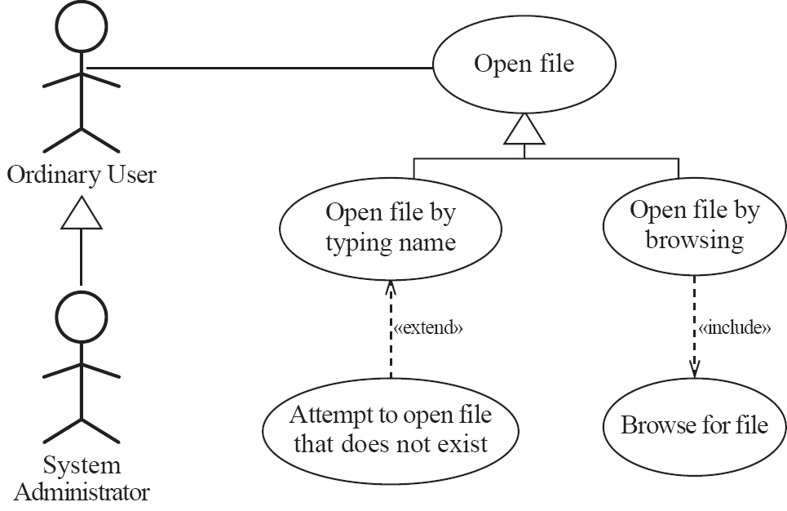
Example of generalization, extension and inclusion
© Lethbridge/Laganière 2005
Chapter 4: Developing requirements

Slide 21
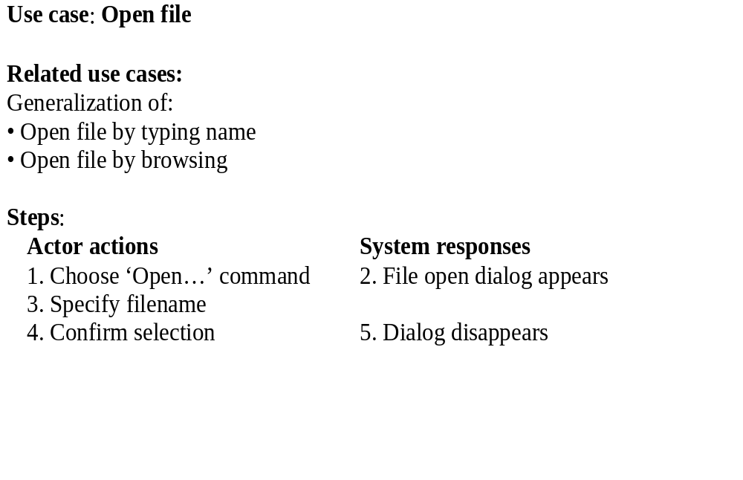
Example description of a use case diagram
© Lethbridge/Laganière 2005
Chapter 4: Developing requirements

Slide 22
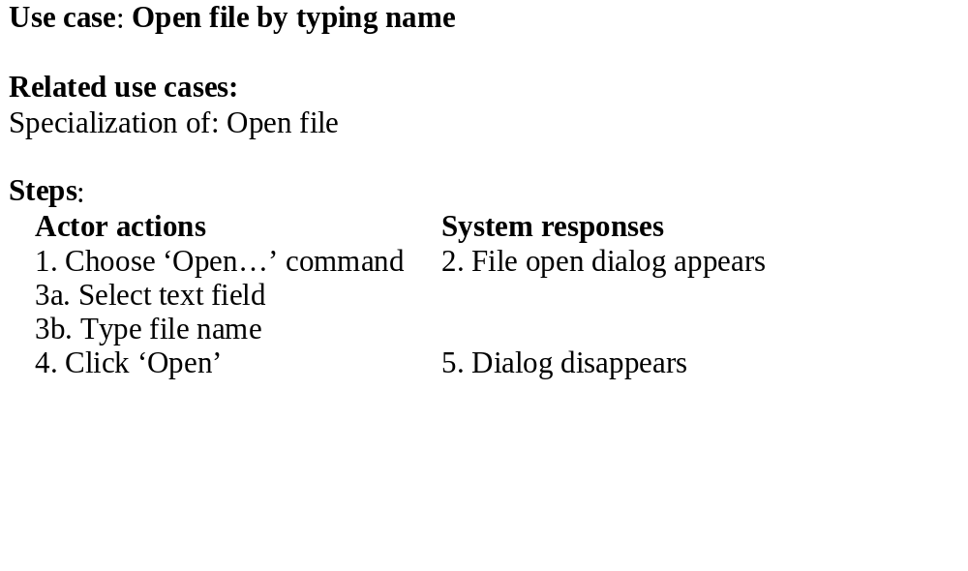
Example (continued)
© Lethbridge/Laganière 2005
Chapter 4: Developing requirements

Slide 23
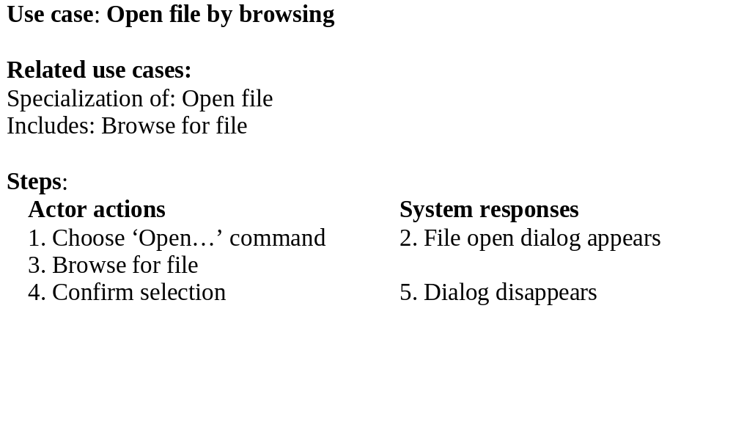
Example (continued)
© Lethbridge/Laganière 2005
Chapter 4: Developing requirements

Slide 24
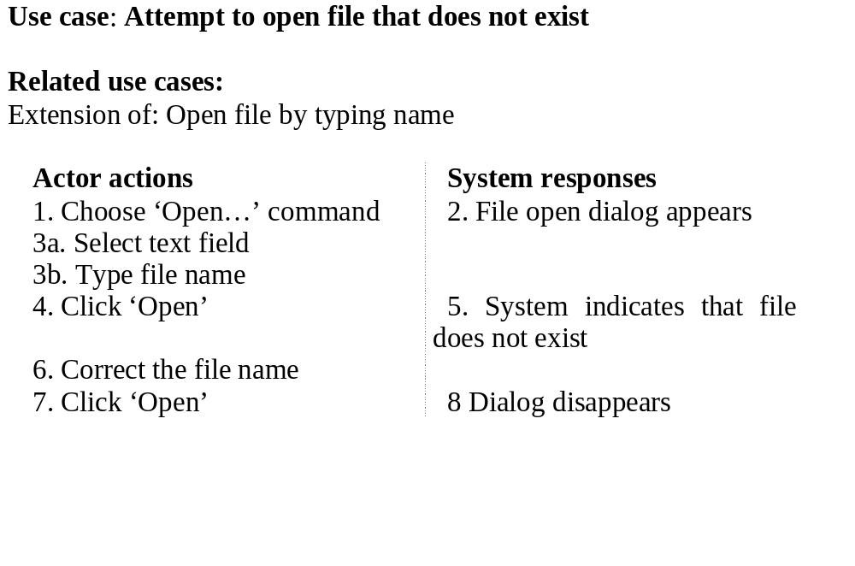
Example (continued)
© Lethbridge/Laganière 2005
Chapter 4: Developing requirements

Slide 25
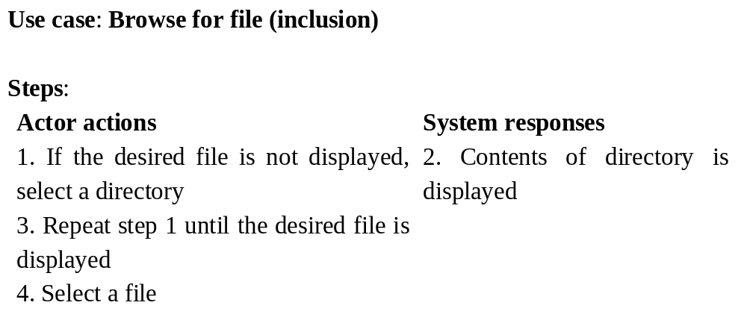
Example (continued)
© Lethbridge/Laganière 2005
Chapter 4: Developing requirements

Slide 26
The modeling processes: Choosing use cases on which to focus
  Often one use case (or a very small number) can be identified as central to the system
      For example, in an airline reservation system the central use case will be ‘Reserve a seat on a flight’
        The entire system can be built around this particular use case
  There are also other reasons for focusing on particular use cases:
    Some use cases will represent a high risk because for some reason their implementation is problematic
    Some use cases will have high political or commercial value
© Lethbridge/Laganière 2005
Chapter 4: Developing requirements

Slide 27
The benefits of basing software development on use cases
  Use cases can help to define the scope of the system.
  Use cases are often used to plan the development process.
  Use cases are used to both develop and validate the requirements.
  Use cases can form the basis for the definition of test cases.
    A test case is a specification of one case to test the system, including what to test, with which input, expected result, and under which conditions [JBR99].
      A test case specifies a testing scenario.
  Use cases can be used to structure user manuals.
© Lethbridge/Laganière 2005
Chapter 4: Developing requirements

Slide 28
The benefits of basing software development on use cases
  The basic integration testing strategies (top-down and bottom-up) are applicable where the design is a hierarchy of modules or subsystems.
    In an OO system the basic modules to be tested are object classes that are instantiated as objects.
    However, in general, in an OO system there is no obvious ‘top’ to the system [Som01].
  Use case or scenario based testing is often the most effective integration testing strategy for OO systems [JBR99,Som01,Som16].
  In this approach the software engineer identifies testing scenarios from use cases.
    A set of test cases can be identified for each use case.
© Lethbridge/Laganière 2005
Chapter 4: Developing requirements

Slide 29
4.7 Some Techniques for Gathering Requirements
Observation
  Read documents and discuss requirements with users
  Shadowing important potential users as they do their work
    ask the user to explain everything he or she is doing
  Session videotaping
Interviewing
  Conduct a series of interviews
    Ask about specific details
    Ask about the stakeholder’s vision for the future
    Ask if they have alternative ideas
    Ask for other sources of information
    Ask them to draw diagrams
© Lethbridge/Laganière 2005
Chapter 4: Developing requirements

Slide 30
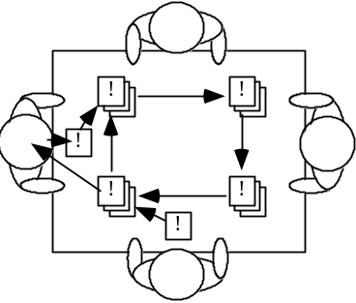
Gathering Requirements...
Brainstorming
  Appoint an experienced moderator
  Arrange the attendees around a table
  Decide on a ‘trigger question’. Examples of trigger questions:
    What features are important in the system?
    What future sources of data should we anticipate?
    What outputs should be produced by the system?
    What classes do we need in our domain model?
  Ask each participant to write an answer and pass the paper to its neighbour
Joint Application Development (JAD) is a technique based on intensive brainstorming sessions
© Lethbridge/Laganière 2005
Chapter 4: Developing requirements

Slide 31
Gathering Requirements...
Prototyping
  The simplest kind: paper prototype.
    a set of pictures of the system that are shown to users in sequence to explain what would happen
  The most common: a mock-up of the system’s UI
    Written in a rapid prototyping language
    Does not normally perform any computations, access any databases or interact with any other systems
    May prototype a particular aspect of the system
© Lethbridge/Laganière 2005
Chapter 4: Developing requirements

Slide 32
4.8 Types of Requirements Document
  Requirements documents for large systems are normally arranged in a hierarchy
Two extremes which should be avoided:
An informal outline of the requirements using a few paragraphs or simple diagrams
A long list of specifications that contain thousands of pages of intricate detail
Requirements
xxxx
xxxxxxx
xxx
xxxxxxxxxxx
xxxxx
xxxxxxxxxxxxx
xxxxxxx
xxx
xxxxxxxxxxxxxxx
subsystem 1
subsystem 2
The term requirements definition normally refers to a less detailed, higher-level document.
A requirements specification is a more detailed and precise document.
Requirements
Requirements
xxxx
Definition
xxxxxxx
xxxx
xxx
xxxxxxx
Requirements
xxxxxxxxxxx
xxx
xxxxx
xxxxxxxxxxx
Specification
xxxxxxxxxxxxx
xxxxx
xxxxxxx
xxxxxxxxxxxxx
xxxx
xxx
xxxxxxx
xxxxxxx
xxxxxxxxxxxxxxx
xxx
xxx
xxxxxxxxxxxxxxx
xxxxxxxxxxx
xxxxx
xxxxxxxxxxxxx
sub-subsystems
xxxxxxx
xxx
Requirements
Requirements
Requirements
xxxxxxxxxxxxxxx
Requirements
Definition
Definition
Definition
Definition
xxxx
xxxx
xxxx
sub-subsystems
xxxx
xxxxxxx
xxxxxxx
xxxxxxx
Requirements
xxxxxxx
xxx
Requirements
xxx
Requirements
xxx
xxx
Requirements
xxxxxxxxxxx
xxxxxxxxxxx
xxxxxxxxxxx
Specification
xxxxxxxxxxx
Specification
xxxxx
Specification
xxxxx
Specification
xxxxx
xxxx
xxxxx
xxxxxxxxxxxxx
xxxxxxxxxxxxx
xxxx
xxxx
xxxxxxx
xxxxxxxxxxxxx
xxxxxxxxxxxxx
xxxxxxx
Requirements
xxxxxxx
xxxx
xxxxxxx
xxxxxxx
xxxxxxx
xxxxxxx
xxx
xxx
Requirements
xxxxxxx
xxx
xxx
xxx
xxx
xxxxxxxxxxx
Definition
xxx
xxx
xxxxxxxxxxxxxxx
xxxxxxxxxxxxxxx
Definition
xxxxxxxxxxx
xxxxxxxxxxx
xxxxx
xxxxxxxxxxxxxxx
xxxxxxxxxxxxxxx
xxxx
xxxxxxxxxxx
xxxxx
xxxxx
xxxxxxxxxxxxx
xxxx
xxxxxxx
xxxxx
xxxxxxxxxxxxx
xxxxxxxxxxxxx
xxxxxxx
xxxxxxx
xxx
xxxxxxxxxxxxx
xxxxxxx
xxxxxxx
xxx
xxx
Requirements
xxxxxxxxxxx
xxxxxxx
xxx
xxx
xxxxxxxxxxxxxxx
xxxxxxxxxxx
Specification
xxxxx
Requirements
Requirements
xxx
xxxxxxxxxxxxxxx
xxxxxxxxxxxxxxx
xxxxx
xxxxxxxxxxxxx
Definition
xxxxxxxxxxxxxxx
xxxxxxxxxxxxx
xxxxxxx
xxxx
xxxxxxx
Definition
xxxx
xxx
xxxxxxx
xxx
xxxx
xxxxxxx
xxx
xxxxxxxxxxxxxxx
xxxxxxx
xxx
Requirements
xxxxxxxxxxxxxxx
xxx
Requirements
xxxxxxxxxxx
Requirements
xxxxxxxxxxx
xxxxxxxxxxx
Specification
xxxxx
xxxxx
Specification
Specification
xxxxx
xxxx
xxxxxxxxxxxxx
xxxxxxxxxxxxx
xxxxxxxxxxxxx
xxxx
xxxxxxx
xxxx
xxxxxxx
xxxxxxx
xxxxxxx
xxxxxxx
xxx
xxxxxxx
xxx
xxx
xxx
xxx
xxx
xxxxxxxxxxx
xxxxxxxxxxxxxxx
xxxxxxxxxxxxxxx
xxxxxxxxxxxxxxx
xxxxxxxxxxx
xxxxxxxxxxx
xxxxx
xxxxx
xxxxx
xxxxxxxxxxxxx
xxxxxxxxxxxxx
xxxxxxxxxxxxx
xxxxxxx
xxxxxxx
xxxxxxx
xxx
xxx
xxx
xxxxxxxxxxxxxxx
xxxxxxxxxxxxxxx
xxxxxxxxxxxxxxx
© Lethbridge/Laganière 2005
Chapter 4: Developing requirements

Slide 33
Level of detail required in a requirements document
  How much detail should be provided depends on:
    The size of the system
    The need to interface to other systems
    The readership
    The stage in requirements gathering
    The level of experience with the domain and the technology
    The cost that would be incurred if the requirements were faulty
© Lethbridge/Laganière 2005
Chapter 4: Developing requirements

Slide 34
4.9 Reviewing Requirements
  Each individual requirement should be carefully reviewed. In order to be acceptable each individual requirement should:
    Have benefits that outweigh the costs of development
    Be important for the solution of the current problem
    Be expressed using a clear and consistent notation
    Be unambiguous
    Be logically consistent
    Lead to a system of sufficient quality
    Be realistic with available resources
    Be verifiable
    Be uniquely identifiable
    Does not over-constrain the design of the system
© Lethbridge/Laganière 2005
Chapter 4: Developing requirements

Slide 35
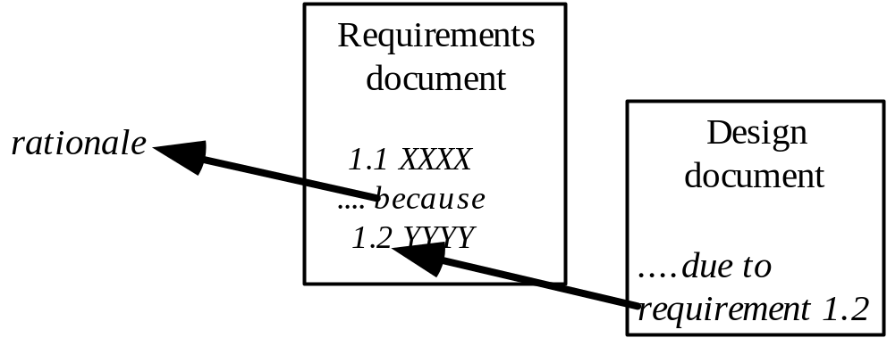
Requirements documents...
  The requirements document should be:
    sufficiently complete
    well organized
    clear
    agreed to by all the stakeholders
  In a design document it should be possible to say which requirement is being implemented by a given aspect of the design.
    This quality is called traceability.
© Lethbridge/Laganière 2005
Chapter 4: Developing requirements

Slide 36
Suggested structure of a requirements document
  Problem
    A succinct description of the problem to be solved
  Background information
    References to domain analysis documents, standards, related systems
  Environment and system models
    The context in which the system runs, a global overview of the subsystems, the hardware support, etc.
  D. Functional Requirements
  E. Non-functional requirements
© Lethbridge/Laganière 2005
Chapter 4: Developing requirements

Slide 37
Additional references
[BRJ99] G. Booch, J. Rumbaugh and I. Jacobson. The Unified Modeling Language User Guide. Addison-Wesley, 1999.
[JBR99] I. Jacobson, G. Booch and J. Rumbaugh. The Unified Software Development Process. Addison-Wesley, 1999.
[Som01] I. Sommerville. Software Engineering (6th edition). Addison-Wesley, 2001.
[Som16] I. Sommerville. Software Engineering (10th edition). Addison-Wesley, 2016.
© Lethbridge/Laganière 2005
Chapter 4: Developing requirements

