Slide 1
Forward and Reverse Engineering

Slide 2
Forward and Reverse Engineering
The UML is not just an OO modeling language. It also permits forward engineering (FE) and reverse engineering (RE).
FE and RE [Som04] are engineering processes.
  The objective of FE is to produce an implementation starting with a specification or a design.
  The objective of RE is to recover a design or a specification from an implementation.

Slide 3
Forward and Reverse Engineering
There are various CASE tools (e.g. Rational tools [IBM07]) which provide support for automatic FE and / or RE with the UML and various industrial-strength OO programming languages, such as Java or C++ [BB99,BB02,IBM07].
  The support is limited but, in general, at least class diagrams can be handled automatically.
  By combining automatic FE and RE, the UML models can be maintained in sync with the implementation at minimal costs.

Slide 4
Forward and Reverse Engineering
In this section FE and RE experiments with UML & Java are presented. The presentation is essentially based on [BB99,BB02,BRJ99].
Only class diagrams will be considered.
  The experiments will help you to understand better
    the semantics of UML class diagrams and
    the relationship between UML class diagrams and an actual OO implementation.
  This is important because class diagrams are the core of UML-based design models.

Slide 5
Forward and Reverse Engineering
The FE and RE processes that we explain in this section are represented diagrammatically below.
UML class diagram
Forward engineering
Java (skeleton)
source code
UML class diagram
Reverse engineering
Java
source code
We begin with FE and then continue with RE.

Slide 6
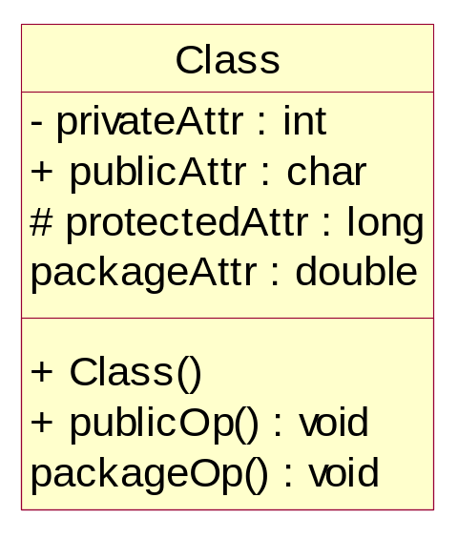
Forward Engineering
UML → Java
Class
public class Class
{
private int privateAttr;
public char publicAttr;
protected long protectedAttr;
double packageAttr;
public Class() {}
public void publicOp() {}
void packageOp() {}
}
- UML model -
- Java code generated by FE -

Slide 7
Forward Engineering
UML → Java
To support an association relationship attributes have to be generated in the code [BB99,BB02].
  Role names can be used to specify association attributes (alternatively, association attribute names might be generated automatically by the FE tool).
  Role names support visibility specifications (public,private,protected,package) but, for simplicity, in the sequel all attributes supporting associations will be public. We also assume that the FE tool automatically generates constructors.

Slide 8
Forward Engineering
UML → Java
In case of a unidirectional association from class A to class B, an attribute of type B must be generated in the body of class A.
In case of a bi-directional association attributes must be generated in the both classes participating in the relationship.
To support one-to-many or many-to-many relationships, arrays or other container classes are employed.

Slide 9
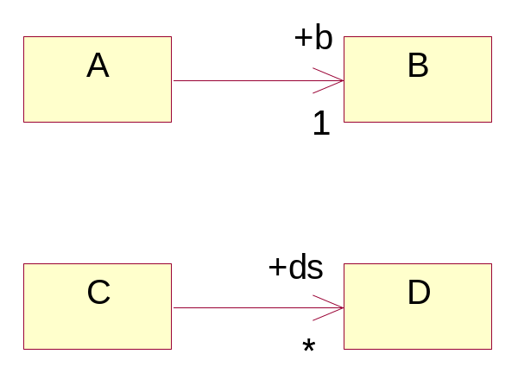
Forward Engineering
UML → Java
Unidirectional association
public class A {
public B b;
public A() {}
}
public class B {
public B() {}
}
public class D {
public D() {}
}
public class C {
public D ds[];
public C() {}
}
The FE tool might generate an array [BB02].
Alternatively, the FE tool might give you the option to specify a Container class.
There are many (*) instances of class D for each instance of class C.
public class C {
public Container ds;
public C() {}
}
- UML model -
- Java code generated by FE -

Slide 10
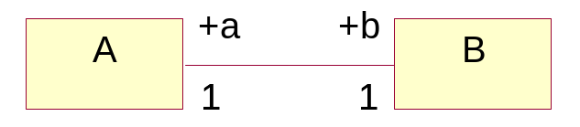
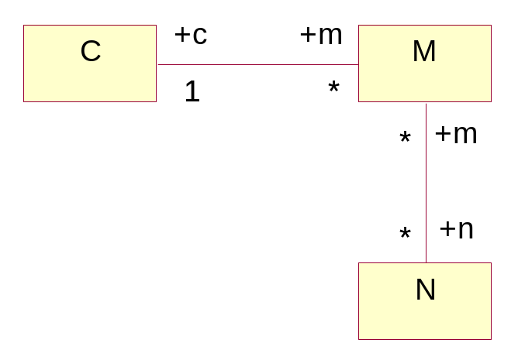
Forward Engineering
UML → Java
Bi-directional association
public class A {
public B b;
public A() {}
}
public class B {
public A a;
public B() {}
}
public class C {
public M m[];
public C() {}
}
public class M {
public C c;
public N n[];
public M() {}
}
one-to-many
public class N {
public M m[];
public N() {}
}
many-to-many
- UML model -
- Java code generated by FE -

Slide 11
Forward Engineering
UML → Java
Generalizations are implemented using the extends keyword in Java.
In UML class diagrams, the realization relationship can be used to specify the relationship between an interface and a class that implements operations for it; in Java, this relationship is expressed using the implements keyword.

Slide 12
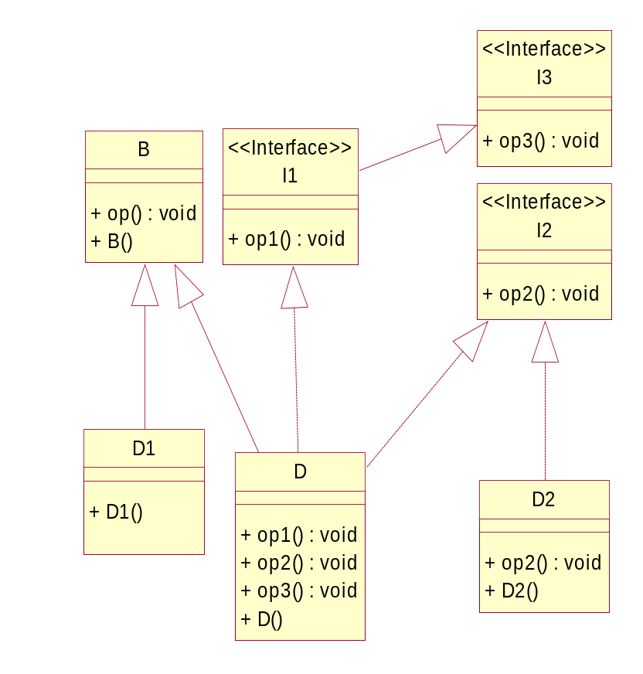
Forward Engineering
UML → Java
Generalization and realization
public interface I1 extends I3 {
public void op1();
}
public interface I3 {
public void op3();
}
public class B {
public B() {}
public void op() {}
}
public interface I2 {
public void op2();
}
public class D2 implements I2 {
public D2() {}
public void op2() {}
}
public class D1 extends B {
public D1() {}
}
public class D extends B implements I1, I2 {
public D() {}
public void op1() {}
public void op2() {}
public void op3() {}
}
- UML model -
- Java code generated by FE -

Slide 13
Forward Engineering
UML → Java
There are four kinds of relationships in the UML: dependency, association, generalization, and realization.
The dependency is the most general relationship in UML diagrams.
A dependency is a semantic relationship between two things in which a change to one thing (the independent thing) may affect the semantics of the other thing (the dependent thing) [BRJ99].
A dependency is rendered as a dashed directed line, pointing to the thing being dependent on.

Slide 14
Forward Engineering
UML → Java
You will use a dependency between class A and class B if [BB99,BB02]:
  Class B is “global” (e.g., in Java, it has a public static attribute used by A)
  Class A uses class B as an argument type in the signature of an operation.
  Class B is instantiated as a local variable inside an operation of class A.

Slide 15
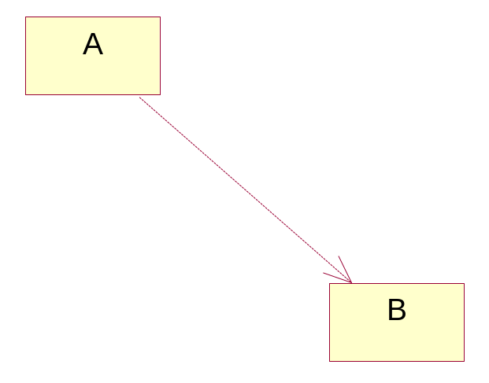
Forward Engineering
UML → Java
Dependency
public class A {
public A() {}
}
public class B {
public B() {}
}
The dependency is the most general relationship in UML diagrams.
In this case the FE tool does not know what kind of dependency is assumed. Therefore, it generates no support for the relationship (this is the approach considered in [BB02]).
- UML model -
- Java code generated by FE -

Slide 16
Reverse Engineering
Java → UML
UML models can be recovered from Java code by reverse engineering (RE).
  Each Java class will be represented as a class in the UML model.
  The relationships between classes can always be inferred from the source code.

Slide 17
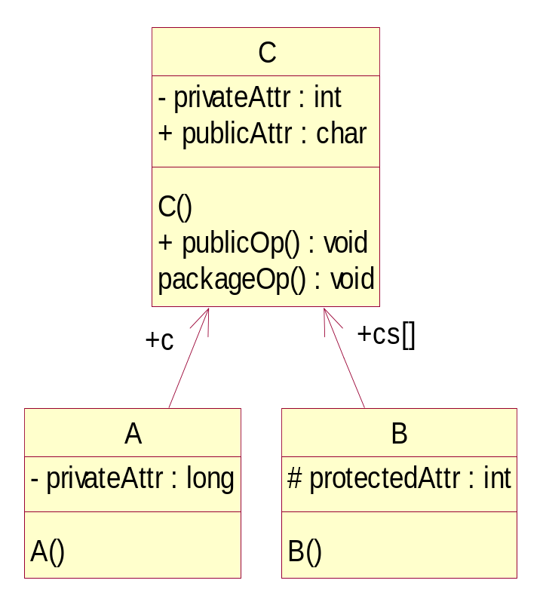
Reverse Engineering
Java → UML
Classes and associations
public class C
{
private int privateAttr;
public char publicAttr;
C() {}
public void publicOp() {}
void packageOp() {}
}
Each attribute will
be represented as
an association if its
class is represented
in the model.
class A {
private long privateAttr;
public C c;
A() {}
}
class B {
protected int protectedAttr;
public C[] cs;
B() {}
}
- Java source code -
- UML model generated by RE -

Slide 18
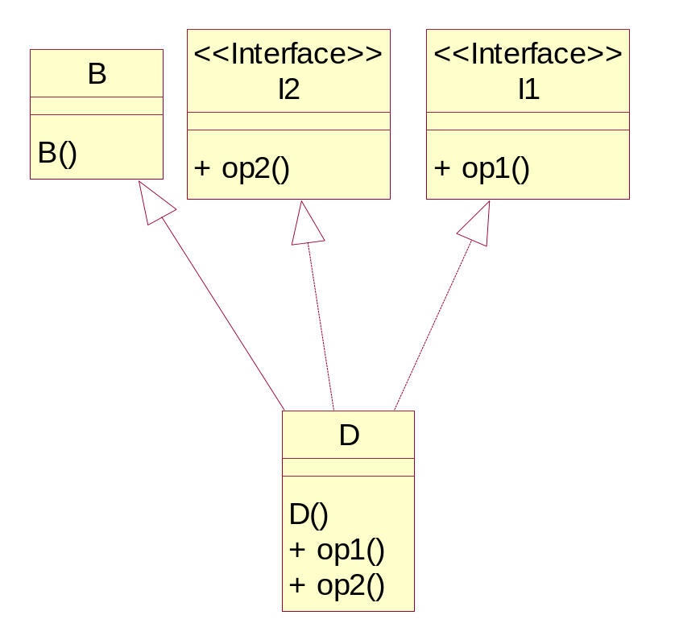
Reverse Engineering
Java → UML
Generalization and realization
class B {
B() {}
}
interface I1 {
void op1();
}
interface I2 {
void op2();
}
public class D extends B implements I1,I2 {
D() {}
public void op1() {}
public void op2() {}
}
- Java source code -
- UML model generated by RE -

Slide 19
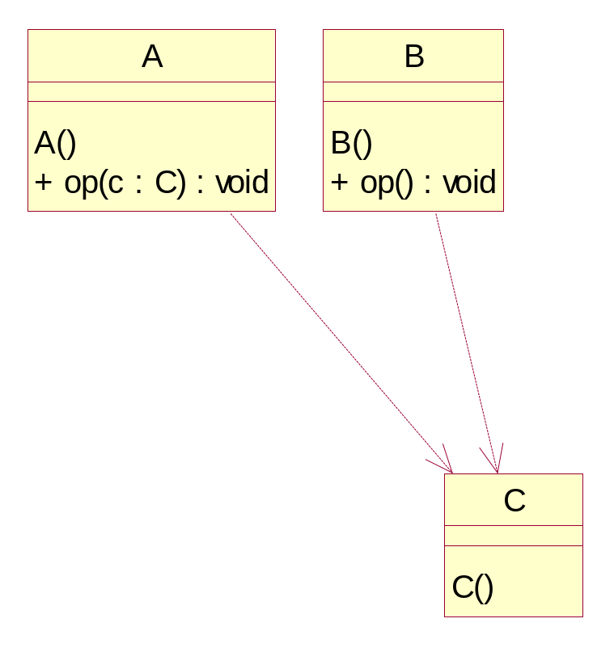
Reverse Engineering
Java → UML
Dependency
class A {
A() {}
public void op(C c) {}
}
class B {
B() {}
public void op() {
C c = new C();
}
}
A RE tool can infer class dependencies from the source code.
For example, the UML browser in Java Builder (6.0 and subsequent) shows class dependencies.
public class C {
C() {}
}
- Java source code -
- UML model generated by RE -

Slide 20
Reverse Engineering
Java → UML
A larger example
L
class L {
private N head;
public L() {…}
public void empty() {…}
public LI first() {…}
public LI find(Object x) {…}
public void insert(Object x,LI p) {…}
public void remove(Object x) {…}
}
class N {
Object element;
N next;
N(Object e,N n) {…}
}
+ L()
-head
N
+ empty()
<<Interface>>
+ first()
next
I
+ find()
N()
+ insert()
current
+ remove()
+ op()
interface I {
void op();
}
element
class B extends Object
implements I {
public void op() {}
public String toString() {…}
}
Object
class LI {
N current;
LI(N n) {}
public Object retrieve() {…}
public void advance() {…}
}
LI
D
B
class D extends B {
public String toString() {…}
}
LI()
+ retrieve()
+ toString()
+ op()
+ advance()
+ toString()
- Java source code -
- UML model generated by RE -

Slide 21
References
[BB99] W. Boggs, M. Boggs. Mastering UML with Rational Rose. Sybex, 1999.
[BB02] W. Boggs, M. Boggs. Mastering UML with Rational Rose (2nd edition). Sybex, 2002.
[BRJ99] G. Booch, J. Rumbaugh, I. Jacobson. The Unified Modeling Language User Guide. Addison-Wesley, 1999.
[Som04] J. Sommerville. Software Engineering (7th edition). Addison-Wesley, 2004.
[IBM07] http://www-306.ibm.com/software/rational/

