Slide 1
Modelling with Classes
Adapted from:
Timothy Lethbridge and Robert Laganiere,
Object-Oriented Software Engineering –
Practical Software Development using UML and Java, 2005
(chapter 5)

Slide 2
5.1 What is UML?
The Unified Modelling Language is a standard graphical language for modelling object oriented software [BRJ99,JBR99,RJB99]
  At the end of the 1980s and the beginning of 1990s, the first object-oriented development processes appeared
  The proliferation of methods and notations tended to cause considerable confusion
  Two important methodologists Rumbaugh and Booch decided to merge their approaches in 1994.
    They worked together at the Rational Software Corporation
  In 1995, another methodologist, Jacobson, joined the team
    His work focused on use cases
  In 1997 the Object Management Group (OMG) started the process of UML standardization
© Lethbridge/Laganière 2005
Chapter 5: Modelling with classes

Slide 3
UML diagrams
  Class diagrams
    describe classes and their relationships
  Object diagrams
    show sets of objects and their relationships
  Use case diagrams
    show sets of use cases and actors and their relationships
  Interaction (sequence and communication) diagrams
    show the behaviour of systems in terms of how objects interact with each other
  State diagrams and activity diagrams
    show how systems behave internally
  Component and deployment diagrams
    show how the various components of systems are arranged logically and physically
© Lethbridge/Laganière 2005
Chapter 5: Modelling with classes

Slide 4
What constitutes a good model?
Ideally, a model should
  use a standard notation
  be understandable by clients and users
  lead software engineers to have insights about the system
  provide abstraction
Models are used:
  to help create designs
  to permit analysis and review of those designs
  as the core documentation describing the system.
The UML provides a standard notation for OOSE models.
  The UML models permit you to specify the structure and (to a lesser extend) the behaviour of an OO system.
© Lethbridge/Laganière 2005
Chapter 5: Modelling with classes

Slide 5
5.2 Essentials of UML Class Diagrams
The main symbols shown on class diagrams are:
  Classes
      represent the types of objects
  Associations
      describe linkages between instances of classes (objects)
  Attributes
      are simple data found in classes and their instances
  Operations
      represent the functions performed by the classes and their instances
  Generalizations
      group classes into inheritance hierarchies
© Lethbridge/Laganière 2005
Chapter 5: Modelling with classes

Slide 6
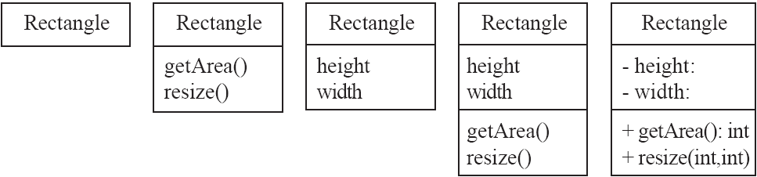
Classes
A class is simply represented as a box with the name of the class inside
  The diagram may also show the attributes and operations
  The complete signature of an operation is:
    operationName(parameterName: parameterType …): returnType
© Lethbridge/Laganière 2005
Chapter 5: Modelling with classes

Slide 7
Class attributes and operations
Visibility options for attributes and operations:
private (-)
public (+)
protected (#)
package or implementation (no icon)
An abstract class is rendered with its name in italics.
Abstract operations names are also shown in italics.
ClassName
- privateAttr : int = 0
# protectedAttr : String
+ publicAttr : Long
implAttr : String
op1(param : String)
+ op2()
AbstractClassName
© Lethbridge/Laganière 2005
Chapter 5: Modelling with classes

Slide 8
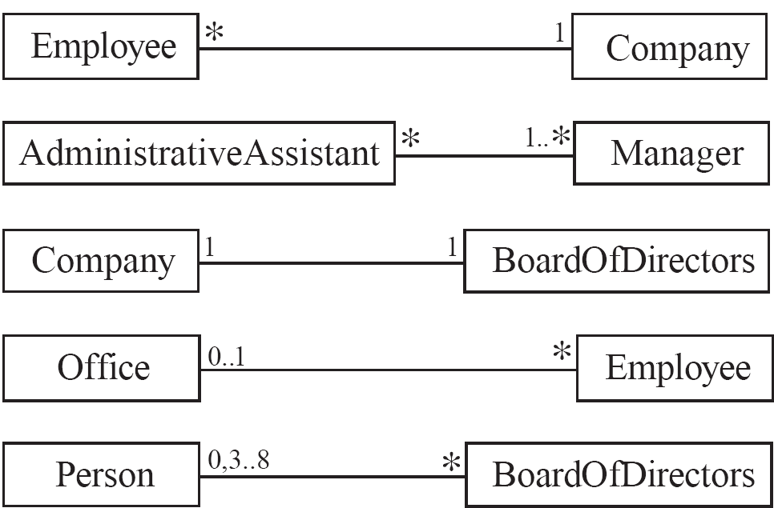
5.3 Associations and Multiplicity
An association is a structural relationship; it is used to show how two classes are related to each other
  An association is rendered as a solid line (possibly directed).
  Symbols indicating multiplicity can be shown at each end of the association.
  It is possible but not recommended to leave multiplicities undefined.
© Lethbridge/Laganière 2005
Chapter 5: Modelling with classes

Slide 9
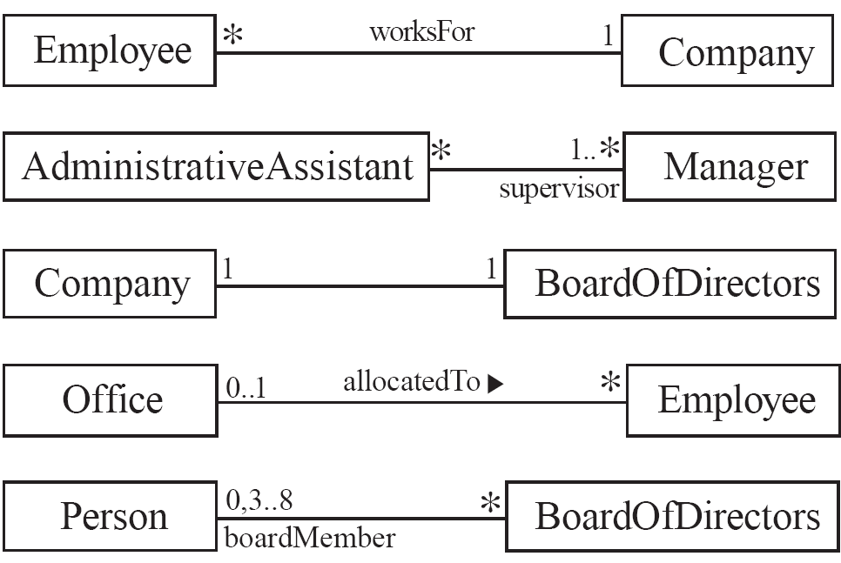
Labelling associations
  Each association can be labelled, to make explicit the nature of the association
association name
Two types of (optional)
labels:
association names
  placed near the
  middle of the
  association
  expressed as verbs
  or verb phrases
  ‘’ can clarify
  the ‘direction’ of
  an association
role names
  attached to either
  or both ends of
  the association
role name
© Lethbridge/Laganière 2005
Chapter 5: Modelling with classes

Slide 10
Analyzing and validating associations
  Many-to-one
    A company has many employees,
    An employee can only work for one company.
      This company will not store data about the moonlighting activities of employees!
    A company can have zero employees
      E.g. a ‘shell’ company
    It is not possible to be an employee unless you work for a company
Employee
*
worksFor
1
Company
© Lethbridge/Laganière 2005
Chapter 5: Modelling with classes

Slide 11
Analyzing and validating associations
  Many-to-many
    A secretary can work for many managers
    A manager can have many secretaries
    Managers can have a group of secretaries
    Some managers might have zero secretaries
© Lethbridge/Laganière 2005
Chapter 5: Modelling with classes

Slide 12
Analyzing and validating associations
  One-to-one (less common)
    For each company, there is exactly one board of directors
    A board is the board of only one company
    A company must always have a board
    A board must always be of some company
1
1
© Lethbridge/Laganière 2005
Chapter 5: Modelling with classes

Slide 13
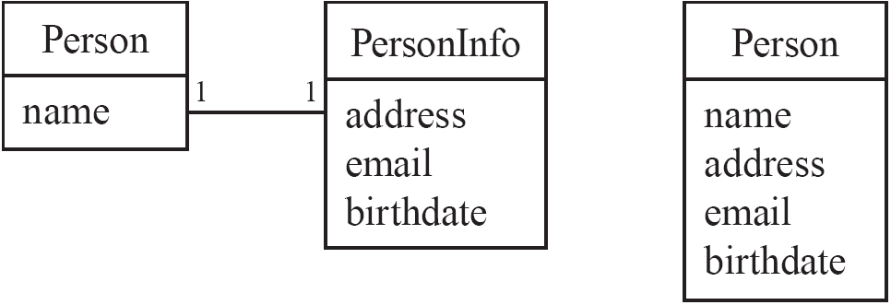
Analyzing and validating associations
Avoid unnecessary one-to-one associations
Avoid this do this
© Lethbridge/Laganière 2005
Chapter 5: Modelling with classes

Slide 14
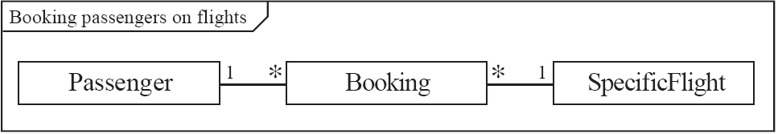
A more complex example
  A booking is always for exactly one passenger
    no booking with zero passengers
    a booking could never involve more than one passenger.
  A Passenger can have any number of Bookings
    a passenger could have no bookings at all
    a passenger could have more than one booking
This diagram has a frame around it (with a label ‘Booking passengers on flights’)
This is an UML 2.0 feature
Any UML 2.0 diagram may use frames
© Lethbridge/Laganière 2005
Chapter 5: Modelling with classes

Slide 15
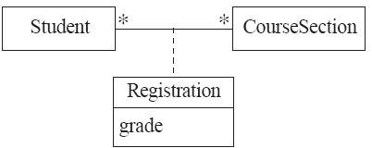

Association classes
  Sometimes, an attribute that concerns two associated classes cannot be placed in either of the classes. The solution is to create an association class (e.g. Registration) to hold that attribute (e.g. grade).
  The following two diagrams are semantically equivalent:
Registration is an association class.
Aside from being attached to an association, an association class is no different from any other class.
© Lethbridge/Laganière 2005
Chapter 5: Modelling with classes

Slide 16
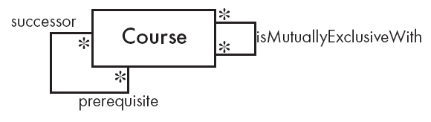
Reflexive associations
  It is possible for an association to connect a class to itself.
    A course can require prerequisite courses.
    Two courses are mutually exclusive if they cover (nearly) the same material.
© Lethbridge/Laganière 2005
Chapter 5: Modelling with classes

Slide 17

Directionality in associations
Associations are by default bi-directional.
It is possible to limit the navigability of an association – to make it unidirectional - by adding an arrow at one end.
  For example, the diagram given below (taken from a calendar application) is designed based on the following assumptions:
    the user can associate any number of notes with any day;
    there is no need to determine the day to which a given note belongs.
© Lethbridge/Laganière 2005
Chapter 5: Modelling with classes

Slide 18
5.4 Generalization
Person
A generalization / specialization hierarchy.
The generalization (is-a / is-a-kind-of) relationship, shows an inheritance relationship.
With inheritance
  you avoid duplication of attributes and operations by creating a separate super-class that contains common behavior.
  you can add or change behavior in more specialized derived classes, which “inherit” from the base class.
The generalization relationship is rendered as a solid line with a small triangle pointing to the super-class.
Polimorphic behavior:
  An operation of a sub-class with the same signature as an operation of the super-class overrides the operation of the super-class.
+ show()
show() is polymorphic
An OO system figures out at run time which type of Person is being shown
Employee
Student
+ show()
+ show()
Undergrad
Master
PhD
+ show()
+ show()
+ show()
One of the most important rules to adhere is the is-a rule:
Class A can only be a valid sub-class of class B if it makes sense, in English, to say ‘an A is a B’.
© Lethbridge/Laganière 2005
Chapter 5: Modelling with classes

Slide 19
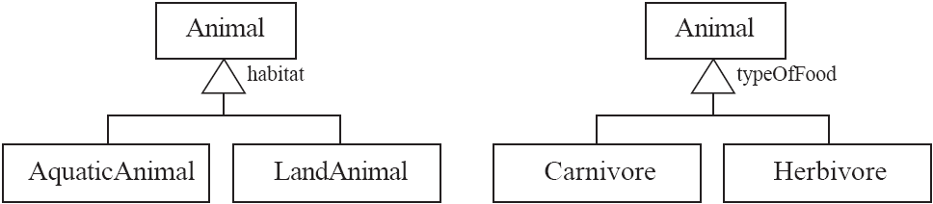
Generalization sets
A generalization set is a labeled group of generalizations with a common super-class.
The label (called discriminator in earlier versions of UML) describes the criteria used to specialize the super-class into two or more sub-classes.
The label of a generalization set (e.g. habitat, or typeOfFood) will typically be an attribute that has a different value in each sub-class.
© Lethbridge/Laganière 2005
Chapter 5: Modelling with classes

Slide 20
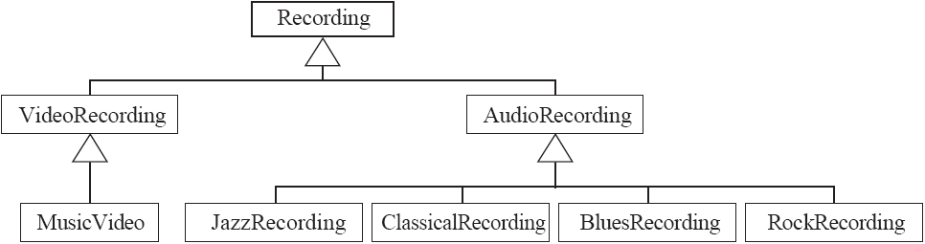
Avoiding unnecessary generalizations
Inappropriate hierarchy of
classes, which should be instances
It makes sense to say ‘an AudioRecording is a Recording’, etc
However, to justify the existence of each class there must be some operation that will be done
differently in that class.
Most of the classes in this hierarchy behave the same. For example, JazzRecording,
ClassicalRecording, BluesRecording and RockRecording would not differ with regard to
how they are sold, nor with regard to what kind of information clients can find
about them.
© Lethbridge/Laganière 2005
Chapter 5: Modelling with classes

Slide 21
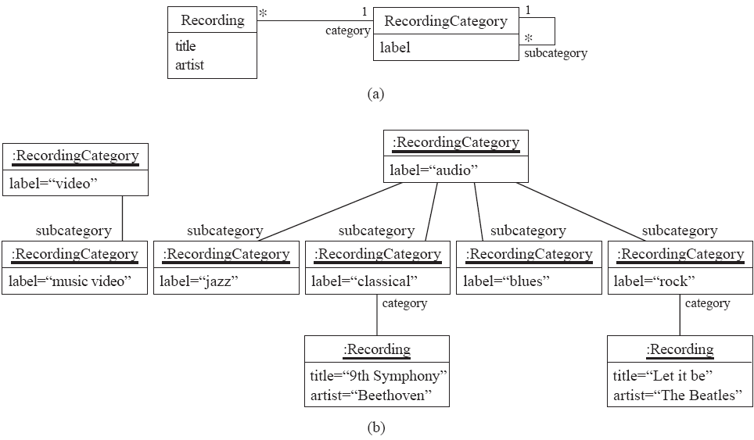
Avoiding unnecessary generalizations (cont)
Improved class diagram (a), with a corresponding object (instance) diagram (b)
© Lethbridge/Laganière 2005
Chapter 5: Modelling with classes

Slide 22
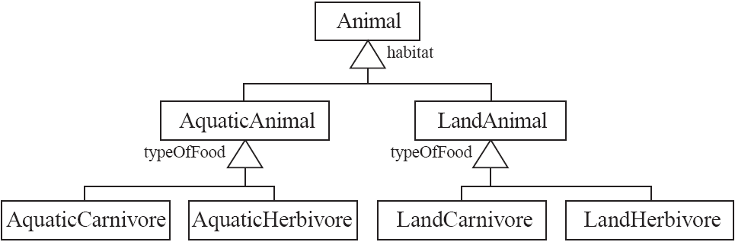
Handling multiple generalization sets
  Modeling problem:
    You want to find a way to enable animals to have all possible combinations of habitat and type of food (e.g., you want to represent aquatic carnivores such as sharks)
One possible solution is to create a higher-level generalization (habitat), and then have generalization sets with duplicate labels at a lower level in the hierarchy
Drawback: all features associated with the second generalization level would also have to be duplicated. For example:
  prey of an AquaticCarnivore
  prey of a LandCarnivore
© Lethbridge/Laganière 2005
Chapter 5: Modelling with classes

Slide 23
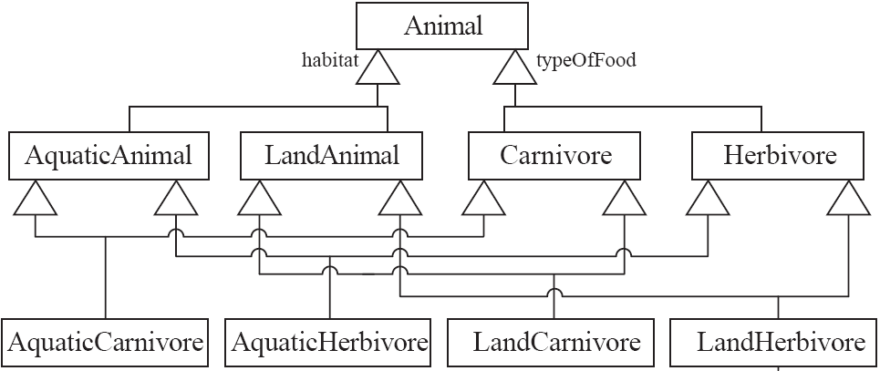
Handling multiple generalization sets
  Solution based on multiple inheritance
    Advantage: avoids duplication of features (e.g. prey only associated to Carnivore)
    Disadvantages:
      even more classes and generalizations
      multiple inheritance generally
      adds too much complexity
      (name clashes,
      diamond inheritance)
© Lethbridge/Laganière 2005
Chapter 5: Modelling with classes

Slide 24
Handling multiple generalization sets
  A superior solution (based on the Player-Role design pattern)
In the UML:
An abstract class is
rendered with its
name in italics.
Abstract operations
names are also
shown in italics.
Animal
1
0..2
HabitatRole
typeOfFood
habitat
Carnivore
Herbivore
AquaticAnimal
LandAnimal
The template of the Player-Role design pattern consists of a Player class associated with an abstract Role class; the Role class is the super-class of a set of possible concrete roles.
  A role is a particular set of features associated with an object in a particular context
  An object may play different roles in different contexts
In the diagram given above the roles (AquaticAnimal, LandAnimal) are unlikely to change.
© Lethbridge/Laganière 2005
Chapter 5: Modelling with classes

Slide 25
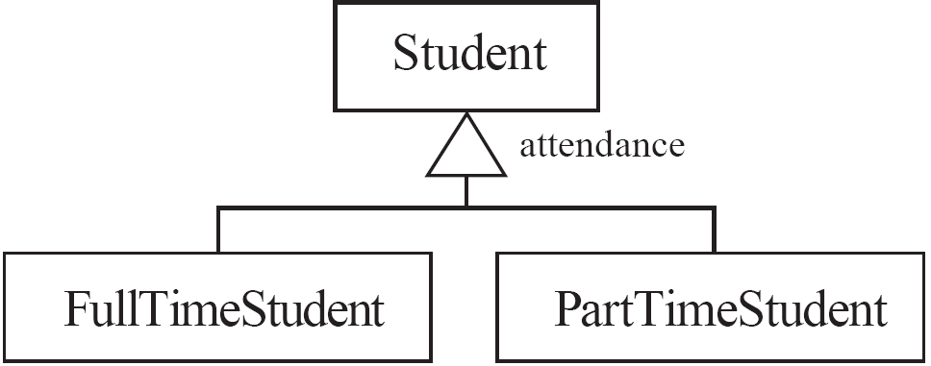
Avoiding having instances change class
  An instance should never need to change class !
    During his/her studies, the attendance status of a student can change from full-time to part-time and vice versa.
    You do not want to model this by destroying an instance of PartTimeStudent (FullTimeStudent) and creating an instance of FullTimeStudent (PartTimeStudent). The diagram given below is a poor model !
© Lethbridge/Laganière 2005
Chapter 5: Modelling with classes

Slide 26
Avoiding having instances change class
  A superior solution (again based on the Player-Role pattern)
1
1
Student
AttendanceRole
attendance
FullTimeStudent
PartTimeStudent
© Lethbridge/Laganière 2005
Chapter 5: Modelling with classes

Slide 27
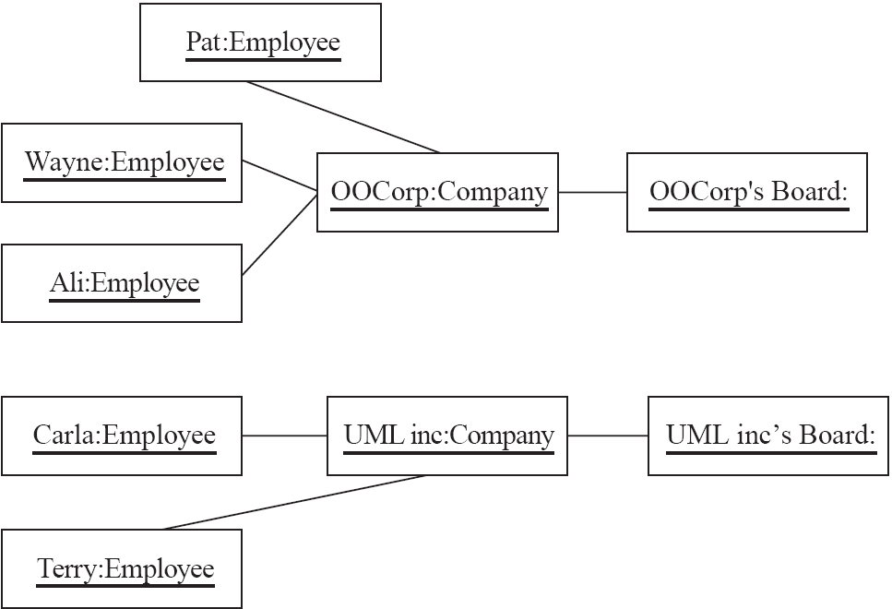
5.5 Object Diagrams
In the UML an object is shown as a rectangle (just like a class), but the name of the object is underlined. You ca represent:
named objects:
  objectName : ClassName
anonymous objects:
  : ClassName
  A link is an instance of an association
    in the same way that we say an object is an instance of a class
links
Object diagram for
the one-to-many association between Employee and Company, and
the one-to-one association between Company and BoardOfDirectors
© Lethbridge/Laganière 2005
Chapter 5: Modelling with classes

Slide 28
Associations versus generalizations in object diagrams
  Associations describe the relationships that will exist between instances at run time.
    When you show an instance diagram generated from a class diagram, there will be an instance of both classes joined by an association
  Generalizations describe relationships between classes in class diagrams.
    They do not appear in instance diagrams at all.
    An instance of any class should also be considered to be an instance of each of that class’s super-classes
© Lethbridge/Laganière 2005
Chapter 5: Modelling with classes

Slide 29
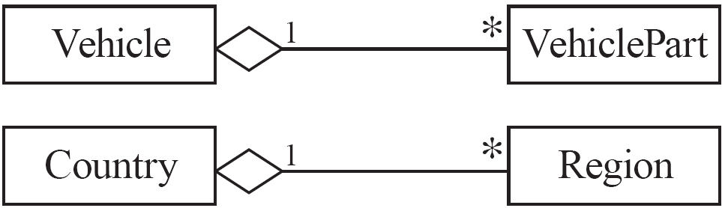
5.6 More Advanced Features: Aggregation
  Aggregations are special associations that represent ‘part-whole’ relationships (the hasA or isPartOf relationship ).
    The ‘whole’ side is often called the assembly or the aggregate
    Graphically, an aggregation is rendered as an association adorned with an open diamond at the ‘whole’ end.
© Lethbridge/Laganière 2005
Chapter 5: Modelling with classes

Slide 30
When to use an aggregation
As a general rule, you can mark an association as an aggregation if the following are true:
  You can state that
    the parts ‘are part of’ the aggregate
    or the aggregate ‘is composed of’ the parts
  When something owns or controls the aggregate, then they also own or control the parts
© Lethbridge/Laganière 2005
Chapter 5: Modelling with classes

Slide 31

Composition
  A composition is a strong kind of aggregation
    if the aggregate is destroyed, then the parts are destroyed as well
© Lethbridge/Laganière 2005
Chapter 5: Modelling with classes

Slide 32
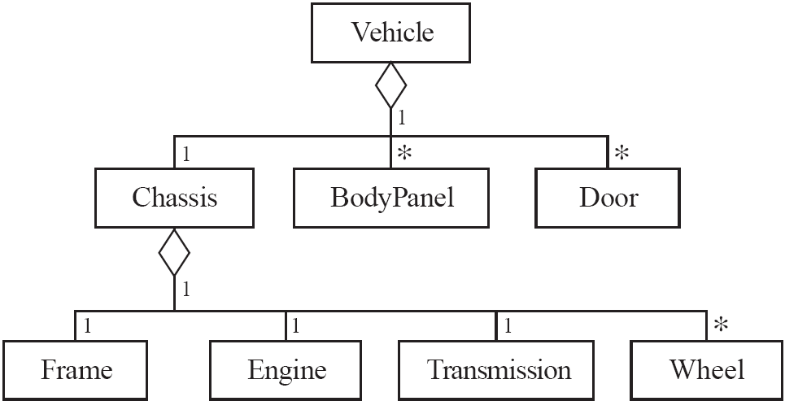
Aggregation hierarchy
This is more flexible a representation. It can easily accommodate new types of vehicles that have different
configurations of parts.
Vehicle
*
VehiclePart
*
© Lethbridge/Laganière 2005
Chapter 5: Modelling with classes

Slide 33
Propagation
  A mechanism where an operation in an aggregate is implemented by having the aggregate perform that operation on its parts
  At the same time, properties of the parts are often propagated back to the aggregate
    For example, the weight of an aggregate (e.g. a vehicle) could be obtained by summing the weights of its parts.
  Propagation is to aggregation as inheritance is to generalization.
    The major difference is:
      inheritance is an implicit mechanism
      propagation has to be programmed when required
© Lethbridge/Laganière 2005
Chapter 5: Modelling with classes

Slide 34
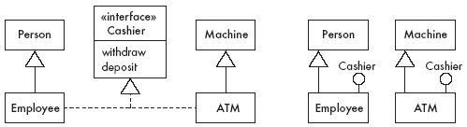
Interfaces
An interface describes a portion of the visible behaviour of a set of objects.
  An interface is similar to a class, except it lacks instance variables and implemented methods
  In the UML, the relationship between an interface and the class (or the component) which implements (realizes) it is called a realization.
    A realization is rendered as a dashed line with a small triangle.
  In the UML there are two ways to specify interfaces, both of which are shown in the figure below (where the Cashier interface is implemented by the classes Employee and ATM).
© Lethbridge/Laganière 2005
Chapter 5: Modelling with classes

Slide 35
5.9 The Process of Developing Class Diagrams
You can create UML models at different stages and with different purposes and levels of details
  Exploratory domain model:
    Developed in domain analysis to learn about the domain
    It normally has some classes, associations and attributes that are outside the scope of the system (which are only needed to understand the domain).
    At this stage you are not concerned with model optimization techniques, such as avoiding multiple inheritance.
  System domain model:
    Models aspects of the domain represented by the system
    The classes in this model become real software modules and the instances of many of these classes end up being stored persistently in some kind of database.
    This model can contain less than half the classes of the complete system model.
    Should be developed to be used independently of particular sets of user interface classes or architectural classes.
  (Complete) System model:
    Includes the system domain model, and it also
    Adds classes used to build the user interface, the system architecture (clients, servers, layer protocols, etc.), as well as utility classes (that make the system more reusable, more maintainable, etc.)
© Lethbridge/Laganière 2005
Chapter 5: Modelling with classes

Slide 36
Suggested sequence of analysis & design activities
  Identify a first set of candidate classes
  Add associations and attributes
  Find generalizations
  List the main responsibilities of each class
  Decide on specific operations that are needed to realize each responsibility
  Iterate over the entire process until the model is satisfactory
    Add or delete classes, associations, attributes, generalizations, responsibilities or operations
    Identify interfaces, apply design patterns and principles
Don’t be disorganized. Don’t be too rigid either.
© Lethbridge/Laganière 2005
Chapter 5: Modelling with classes

Slide 37
Identifying classes
  When developing a domain model you tend to discover classes (based on requirements descriptions, interview notes, or results of brainstorming sessions)
    Sometimes you may have to invent elements of a domain model: for example you may have to invent a super-class (whose name is not in the domain) in order to obtain a generalization hierarchy.
  When you work on the user interface or the system architecture, you tend to invent classes
    Such classes are needed to solve a particular design problem
  When identifying classes reuse should always be a concern; you can
    reuse frameworks
    extend existing systems
    look at similar systems to obtain useful insights.
© Lethbridge/Laganière 2005
Chapter 5: Modelling with classes

Slide 38
A simple technique for discovering domain classes
  Look at a source material such as a description of requirements
  Extract the nouns and noun phrases
  Eliminate nouns that:
    are redundant (two names for the same class)
    represent instances
    are vague or highly general (for example: ‘the user’s goal’, or ‘the information this application will represent’)
    not needed in the application
  Pay attention to classes in a domain model that represent types of users or other actors
  Make a clear distinction between classes and class attributes
© Lethbridge/Laganière 2005
Chapter 5: Modelling with classes

Slide 39
A simple technique for discovering domain classes
  Example: Using the description of the Airlines system
  given below, list the nouns and noun phrases that might
  end up being classes in a system domain model.
  Ootumlia Airlines runs sightseeing flights from Java Valey, the
  capital of Ootumlia. The reservation system keeps track of
  passengers who will be flying in specific seats on various flights, as
  well as people who will form the crew. For the crew, the system
  needs to track what everyone does, and who supervises whom.
  Ootumlia Airlines runs several daily numbered flights on a regular
  schedule. Ootumlia Airlines expects to expand in the future,
  therefore the system needs to be flexible; in particular, it will be
  adding a frequent-flier plan.
© Lethbridge/Laganière 2005
Chapter 5: Modelling with classes

Slide 40
A simple technique for discovering domain classes
  Solution:
  Nouns that are put in the initial list of classes include: Flight, Passenger, Employee.
  We choose not to include the other nouns or noun phrases because:
    ‘Ootumlia Airlines’, ‘Java Valey’, ‘Ootumlia’ are instances
    ‘Reservation system’ is the name of the system itself
    ‘SeightSeeing Flight’ rejected in favor of Flight
    ‘Seat’ appears to be an attribute of Flight
    ‘Crew’ - this implies the entire crew; we could have created a class ‘CrewMember’, but ‘Employee’ is more flexible
    ‘Schedule’ describes complex information that is best represented using classes such as Flight, with its associations and attributes.
    ‘Future’ – this is a noun but is not part of the system to be developed
    ‘Frequent-flier plan’ is not part of the current scope
© Lethbridge/Laganière 2005
Chapter 5: Modelling with classes

Slide 41
Identifying associations and attributes
  Start with classes you think are most central and important
  For each of these classes, decide on the clear and obvious data it must contain and its relationships to other classes.
  Work outwards towards the classes that are less important.
  Avoid adding many associations and attributes to a class
    A system is simpler if it manipulates less information
    As you add an association or an attribute, make sure it is relevant to the application – that it will be needed to implement some requirement
© Lethbridge/Laganière 2005
Chapter 5: Modelling with classes

Slide 42
Tips about identifying and specifying valid associations
  An association should exist if a class
      possesses
      controls
      is connected to
      is related to
      is a part of
      has as part
      is a member of, or
      has as member
  some other class in your model (such information can often be extracted from the requirements document)
  Specify the multiplicity at both ends
  Label it clearly.
© Lethbridge/Laganière 2005
Chapter 5: Modelling with classes

Slide 43
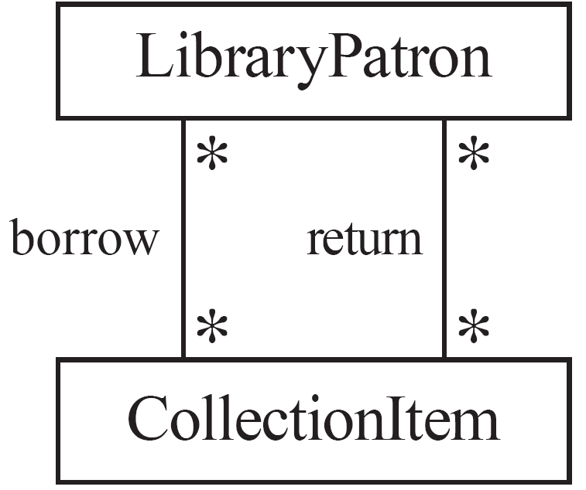
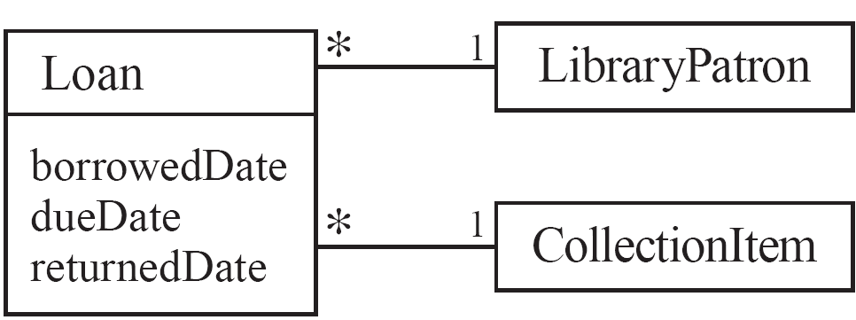
Actions versus associations
  A common mistake is to represent actions (or use cases) as if they were associations
Bad, due to the use of associations
that are actions.
Better: the borrow operation creates
a Loan and the return operation sets
the returnDate attribute
© Lethbridge/Laganière 2005
Chapter 5: Modelling with classes

Slide 44
Identifying attributes
  Look for information that must be maintained about each class
  Several nouns rejected as classes, may now become attributes
  An attribute should generally contain a simple value
    E.g. string, number
© Lethbridge/Laganière 2005
Chapter 5: Modelling with classes

Slide 45
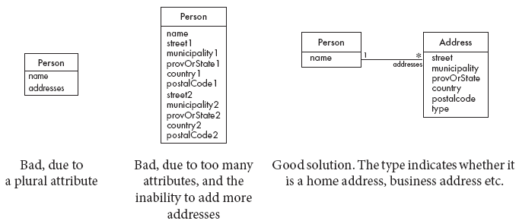
Tips about identifying and specifying valid attributes
  It is not good to have many duplicate attributes
  If a subset of a class’s attributes form a coherent group, then create a distinct class containing these attributes
© Lethbridge/Laganière 2005
Chapter 5: Modelling with classes

Slide 46
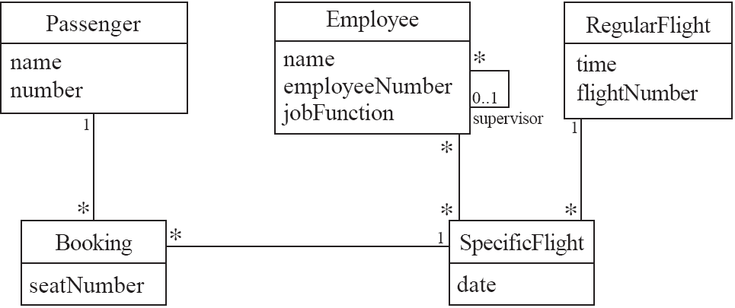
Example: attributes and associations for the Airline system
A central class at which to start identifying associations and attributes is Flight. To avoid redundancy, this is split into: RegularFlight, and SpecificFlight.
Next it can be studied how the passengers are booked.
© Lethbridge/Laganière 2005
Chapter 5: Modelling with classes

Slide 47
Identifying generalizations and interfaces
  There are two ways to identify generalizations:
    bottom-up
      Group together two or more classes that share some common behaviour (attributes, associations or operations) by creating a new super-class (that represents the common behavior)
    top-down
      Look for more general classes first, specialize them if needed
  Create an interface, instead of a super-class if
    The classes are very dissimilar except for having a few operations in common
    One or more of the classes already have their own super-classes
    You want to limit the operations that can be performed on a variable to just those available in the interface
© Lethbridge/Laganière 2005
Chapter 5: Modelling with classes

Slide 48
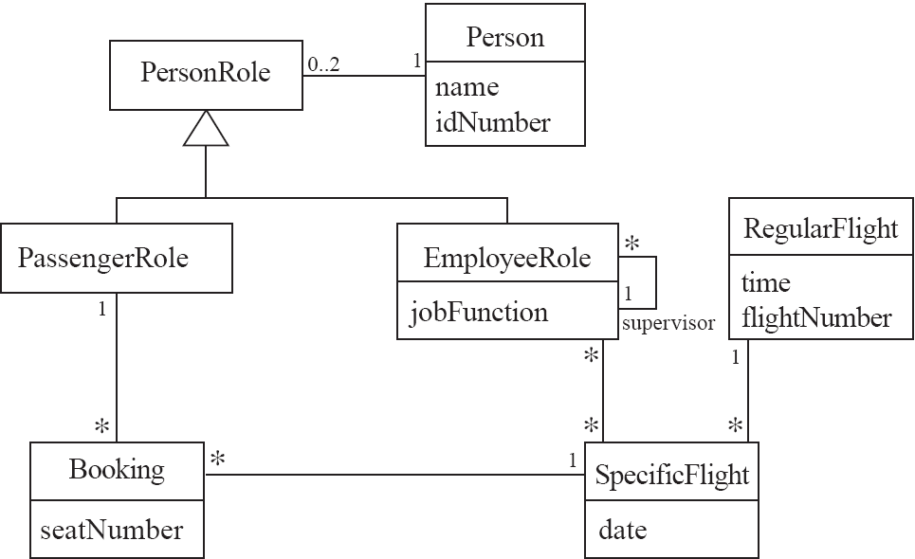
An example (generalization)
In the Airline example, the
classes Passenger and Employee
share the attributes for name and
identification number.
However, it would not suffice
simply to abstract out the common
behavior in a super-class Person,
because a Person can play both the
role of a Passenger and the role of
an Employee.
© Lethbridge/Laganière 2005
Chapter 5: Modelling with classes

Slide 49
Allocating responsibilities to classes
A responsibility is something that the system is required to do
  The main responsibilities are given by the functional requirements.
  Each responsibility must be attributed to one of the classes, although other classes will likely collaborate with it to help perform the task.
    All the responsibilities of a given class should be clearly related.
    If a class has too many responsibilities, consider splitting it into distinct classes
    If a class has no responsibilities attached to it, then it is probably useless
    When a responsibility cannot be attributed to any of the existing classes, then a new class should be created
  To determine responsibilities
    Perform use case analysis
    Look for verbs and nouns describing actions in the system description
© Lethbridge/Laganière 2005
Chapter 5: Modelling with classes

Slide 50
Categories of responsibilities
  Setting and getting the values of attributes
  Creating and initializing new instances
  Loading to and saving from persistent storage
  Destroying instances
  Adding and deleting links of associations
  Copying, converting, transforming, transmitting or outputting
  Computing numerical results
  Navigating and searching
  Other specialized work
© Lethbridge/Laganière 2005
Chapter 5: Modelling with classes

Slide 51
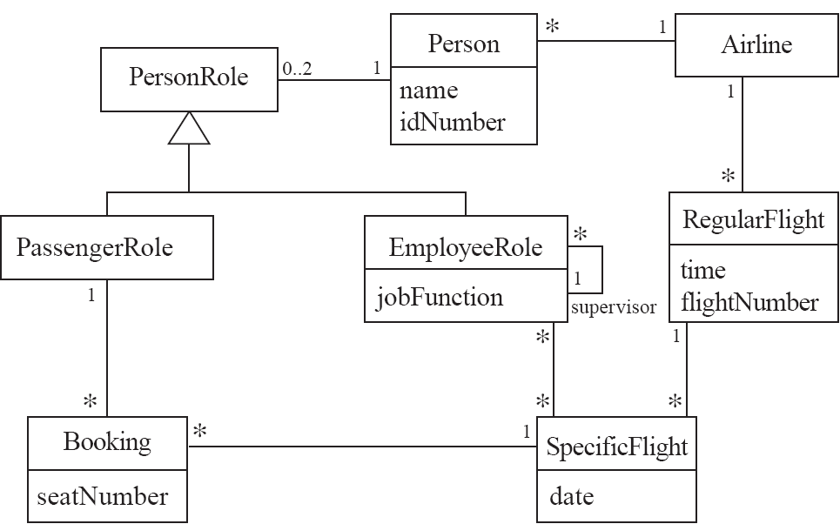
An example (responsibilities)
Creating a new regular flight
Searching for a flight
Modifying attributes of a flight
Creating a specific flight
Booking a passenger
© Lethbridge/Laganière 2005
Chapter 5: Modelling with classes

Slide 52
Prototyping a class diagram on paper: CRC (Class-Responsibility-Collaboration) cards
  As you identify classes, you write their names on small cards
  As you identify attributes and responsibilities, you list them on the cards
    If you cannot fit all the responsibilities on one card:
      this suggests you should split the class into two related classes.
  Move the cards around on a whiteboard to arrange them into a class diagram.
  Draw lines among the cards to represent associations and generalizations.
© Lethbridge/Laganière 2005
Chapter 5: Modelling with classes

Slide 53
Identifying operations
Operations are needed to realize the responsibilities of each class
  There may be several operations per responsibility
  The main operation that implements a responsibility is normally declared public; it becomes part of the interface of the entire system.
  Other methods that collaborate to perform the responsibility must be as private as possible
© Lethbridge/Laganière 2005
Chapter 5: Modelling with classes

Slide 54
Example: operations for the Airline system
© Lethbridge/Laganière 2005
Chapter 5: Modelling with classes

Slide 55
Creating an object and linking it to an existing object (with a bi-directional link)
Example: Creating a SpecificFlight and linking it to a RegularFlight. This responsibility can be accomplished by two operations (the Java implementation is given in section 5.10).
1. (public) The instance of RegularFlight
    calls the constructor of SpecificFlight; then, when it is complete, makes a unidirectional link to the new instance of SpecificFlight (each instance of RegularFlight actually maintains a list of SpecificFlight instances; the list is needed to implement the one-to-many relationship).
2. (non-public) Class SpecificFlight’s constructor (among its other actions)
    makes a one-directional link back to the instance of RegularFlight.
SpecificFlight
1
RegularFlight
*
SpecificFlight()
+ addSpecificFlight()
© Lethbridge/Laganière 2005
Chapter 5: Modelling with classes

Slide 56
Creating an association class, given two existing objects
Example: creating an instance of Booking, which will link a SpecificFlight to a PassengerRole. This responsibility can be accomplished in four steps (we want bi-directional associations):
1. (public) The instance of PassengerRole
    calls the constructor of Booking (operation 2).
2. (non-public) Class Booking’s constructor, among its other actions
    makes a one-directional link back to the instance of PassengerRole
    makes a one-directional link to the instance of SpecificFlight
    calls operations 3 and 4.
3. (non-public) The instance of SpecificFlight
    makes a one-directional link to the instance of Booking.
4. (non-public) The instance of PassengerRole
    makes a one-directional link to the instance of Booking.
PassengerRole
Booking
1
SpecificFlight
1
*
*
+ makeBooking()
addLinkToBooking()
Booking()
addLinkToBooking()
© Lethbridge/Laganière 2005
Chapter 5: Modelling with classes

Slide 57
5.10 Implementing Class Diagrams in Java
  Attributes are implemented as instance variables
  Generalizations are implemented using extends
  Interfaces are implemented using implements
  Associations are normally implemented using instance variables
    Divide each two-way association into two one-way associations
      so that each associated class has an instance variable representing the other end of the association
    For a one-way association where the multiplicity at the other end is ‘one’ or ‘optional’
      declare a variable of that class (a reference)
    For a one-way association where the multiplicity at the other end is ‘many’:
      use a collection class implementing List, such as ArrayList, or LinkedList.
© Lethbridge/Laganière 2005
Chapter 5: Modelling with classes

Slide 58
Example: SpecificFlight
class SpecificFlight
{
private Calendar date;
private RegularFlight regularFlight;
...
// Constructor that should only be called from
// addSpecificFlight
SpecificFlight( Calendar aDate, RegularFlight aRegularFlight)
{
date = aDate;
regularFlight = aRegularFlight;
}
}
© Lethbridge/Laganière 2005
Chapter 5: Modelling with classes

Slide 59
Example: RegularFlight
class RegularFlight
{
private List specificFlights;
...
// Method that has primary responsibility
public void addSpecificFlight(Calendar aDate)
{
SpecificFlight newSpecificFlight;
newSpecificFlight = new SpecificFlight(aDate, this);
specificFlights.add(newSpecificFlight);
}
...
}
© Lethbridge/Laganière 2005
Chapter 5: Modelling with classes

Slide 60
Additional references
[BRJ99] G. Booch, J. Rumbaugh and I. Jacobson. The Unified Modeling Language user guide. Addison-Wesley, 1999.
[JBR99] I. Jacobson, G. Booch and J. Rumbaugh. The Unified Software Development Process. Addison-Wesley, 1999.
[RJB99] J. Rumbaugh, I. Jacobson and G. Booch. The Unified Modeling Language reference manual. Addison-Wesley, 1999.
© Lethbridge/Laganière 2005
Chapter 5: Modelling with classes

