Slide 1
Modelling
interactions and behaviour
Adapted from:
Timothy Lethbridge and Robert Laganiere,
Object-Oriented Software Engineering –
Practical Software Development using UML and Java, 2005
(chapter 8)

Slide 2
8.1 Interaction Diagrams
Interaction diagrams are used to model dynamic aspects of a software system
  They help you to visualize how the system runs.
  An interaction diagram is often built from a use case and a class diagram.
    An interaction model shows a set of actors and objects interacting by exchanging messages.
© Lethbridge/Laganière 2005
Chapter 8: Modelling Interactions and Behaviour

Slide 3
Interactions and messages
  Interaction diagrams show how a set of actors and objects communicate with each other to perform:
    The steps of a use case, or
    The steps of some other piece of functionality.
  The set of steps, taken together, is called an interaction.
  Interaction diagrams can show various types of messages exchanged between objects, including:
        Simple procedure calls,
        Commands issued by an actor through the user interface,
        Messages exchanged over a network.
  One of the main objectives of drawing interaction diagrams is to better understand the sequence of messages.
© Lethbridge/Laganière 2005
Chapter 8: Modelling Interactions and Behaviour

Slide 4
Elements found in interaction diagrams
  Instances of classes (objects)
    Shown as boxes with the class and object identifier underlined
  Actors
    Shown using the same stick-person symbol as in use case diagrams
  Messages
    Shown as arrows from actor to object, or from object to object
© Lethbridge/Laganière 2005
Chapter 8: Modelling Interactions and Behaviour

Slide 5
Creating interaction diagrams
  Since you need to know the actors and objects involved in the interaction, you should normally develop a class diagram and a use case model before starting to create an interaction diagram.
  Two kinds of diagrams are used to show interactions:
    Sequence diagrams
    Communication diagrams
© Lethbridge/Laganière 2005
Chapter 8: Modelling Interactions and Behaviour

Slide 6
Sequence diagrams
A sequence diagram shows the sequence of messages exchanged by the set of objects performing a certain task.
  The objects are arranged horizontally across the diagram.
  An actor that initiates the interaction is often shown on the left.
  The vertical dimension represents time; the top of the diagram is the starting point and time progresses downwards towards the bottom of the diagram.
  A vertical dashed line, called a lifeline, is attached to each object or actor.
  The lifeline becomes a box, called an activation box, during the period of time (called live activation period) when the object is performing computations.
  A message is represented as an arrow between activation boxes of the sender and receiver.
    You give each message a label; it can optionally have an argument list and a response (return value). The complete syntax is as follows:
    response := message(arg,…)
    A creation message is shown using a dashed line with the label ‘create’.
© Lethbridge/Laganière 2005
Chapter 8: Modelling Interactions and Behaviour

Slide 7
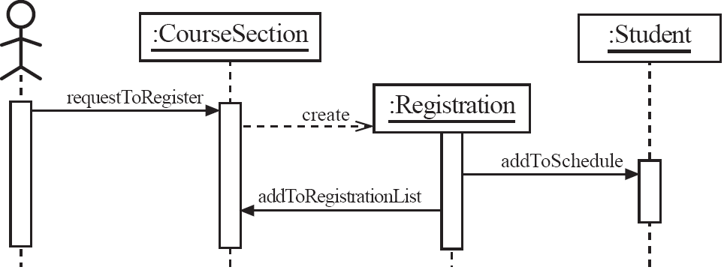
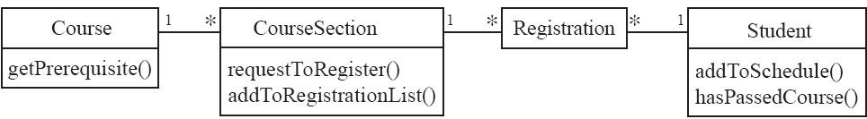
Sequence diagrams – an example
Sequence diagram showing a student registration process:
The labels on the messages in the sequence diagram correspond to operations in the
corresponding class diagram (given below).
The reception of a message by an object causes one of its methods to be run.
Sequence diagrams are useful for identifying the operations that have to be included in each class.
© Lethbridge/Laganière 2005
Chapter 8: Modelling Interactions and Behaviour

Slide 8
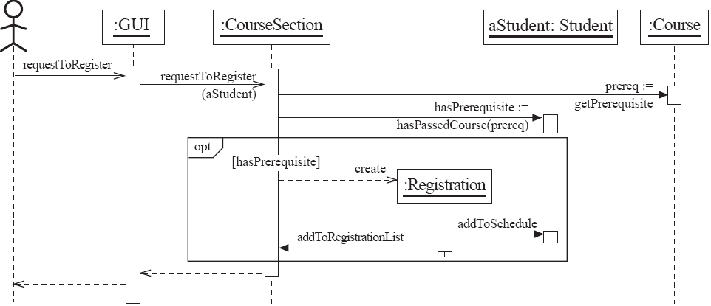
Sequence diagrams – same example, more details
This is a combined fragment (a UML 2.0 feature)
It shows a subsequence of an interaction.
‘opt’ is a label indicating that it may or may not occur.
[hasPrerequisite] is a Boolean condition which describes the circumstances when it will occur.
This is a return action, indicating
the moment when the computation
(the execution of requestToRegister)
ends. A return value can (optionally)
be shown as a label on a return action.
© Lethbridge/Laganière 2005
Chapter 8: Modelling Interactions and Behaviour

Slide 9
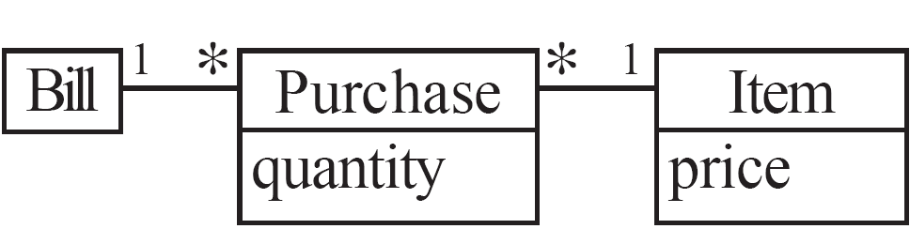
Sequence diagrams – an example with replicated messages
  In a sequence diagram you can show iteration using a combined fragment with label ‘loop’.
  The number of iterations is specified using the syntax: min .. max.
:Bill
Message sent to numPurchase different Purchase objects
loop
:Purchase
:Item
0 .. numPurchases
getSubtotal
getUnitPrice
computeTotal
Corresponding class diagram:
© Lethbridge/Laganière 2005
Chapter 8: Modelling Interactions and Behaviour

Slide 10
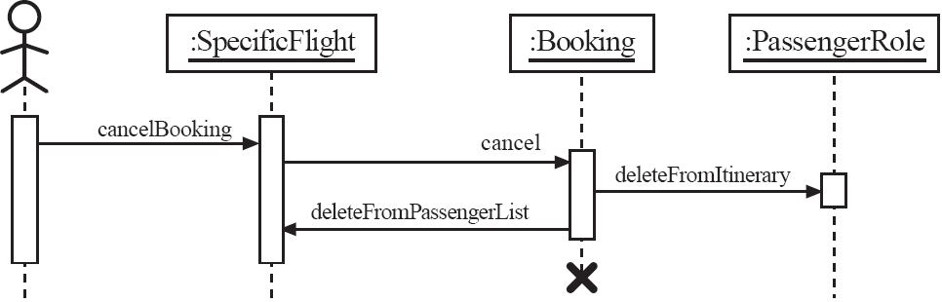
Sequence diagrams – an example with object deletion
  If an object’s life ends, this is shown with an X at the end of the lifeline
  This diagram describes a possible interaction for cancelling a Booking in the airline system introduced in chapter 5.
© Lethbridge/Laganière 2005
Chapter 8: Modelling Interactions and Behaviour

Slide 11
Communication diagrams
A communication diagram (known as a collaboration diagram
in UML 1.x) is an interaction diagram that:
  shows the objects in two dimensions (a graph with objects as vertices)
  uses sequence numbers to show the order of messages
Communication diagrams and sequence diagrams
  use different layouts,
  but are very similar (in UML 1.x they are semantically equivalent).
Communication diagrams are a bit less expressive than sequence diagrams.
  Combined fragments - introduced in UML 2.0 (2004) - are lacking in communication diagrams.
(communication) link
message
© Lethbridge/Laganière 2005
Chapter 8: Modelling Interactions and Behaviour

Slide 12
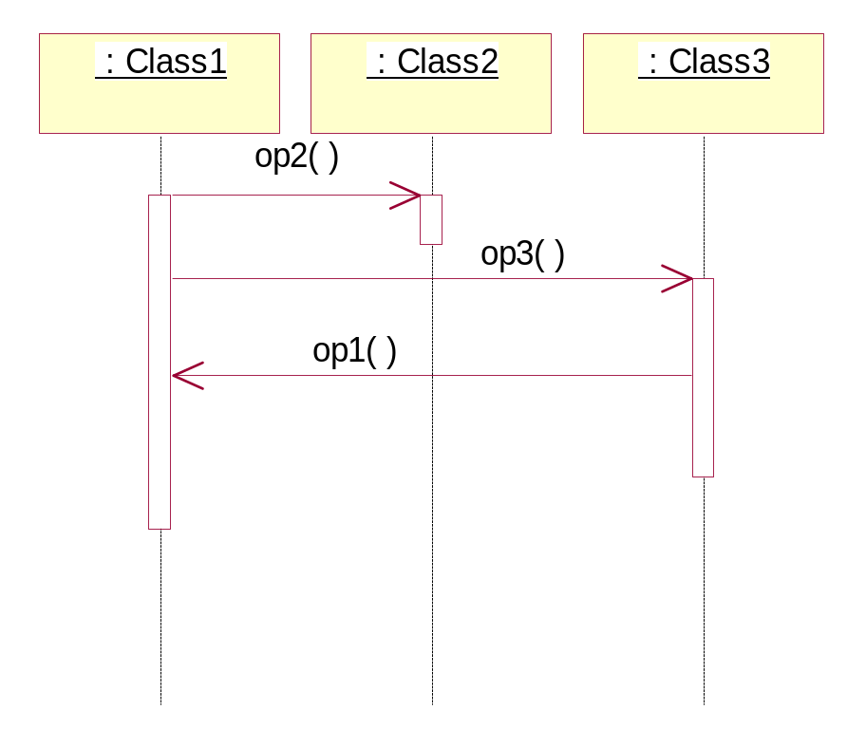
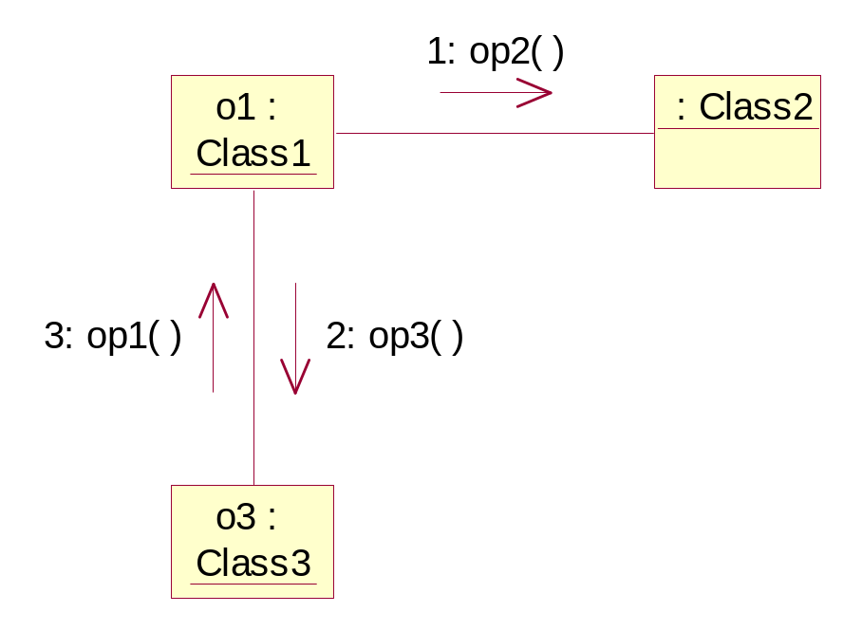
Communication and sequence diagrams
Remark: In Rational Rose 2002 (which is based on UML 1.x), you can
press F5 to switch between a communication diagram and a corresponding
sequence diagram; the two representations of the interaction are isomorphic.
© Lethbridge/Laganière 2005
Chapter 8: Modelling Interactions and Behaviour

Slide 13
Communication links
  A communication link (in a communication diagram) can exist between two objects whenever it is possible for one object to send a message to the other one.
  The classes of the two interacting objects can be connected by:
    an association, or
    a dependency.
© Lethbridge/Laganière 2005
Chapter 8: Modelling Interactions and Behaviour

Slide 14
8.2 State Diagrams
A state diagram describes the behaviour of a (sub)system, or an individual object.
  At any given point in time, the system or object is in a certain state.
    Being in a state means that it will behave in a specific way in response to any events that occur.
  Some events will cause the system to change state.
    In the new state, the system will behave in a different way to events.
  A state diagram is a directed graph where the nodes are states and the arcs are (labelled) transitions.
  A transition represents a change of state in response to an event, and is considered to occur instantaneously (that is, to take no time).
    The label of a transition represents the event that causes the change of state.
© Lethbridge/Laganière 2005
Chapter 8: Modelling Interactions and Behaviour

Slide 15
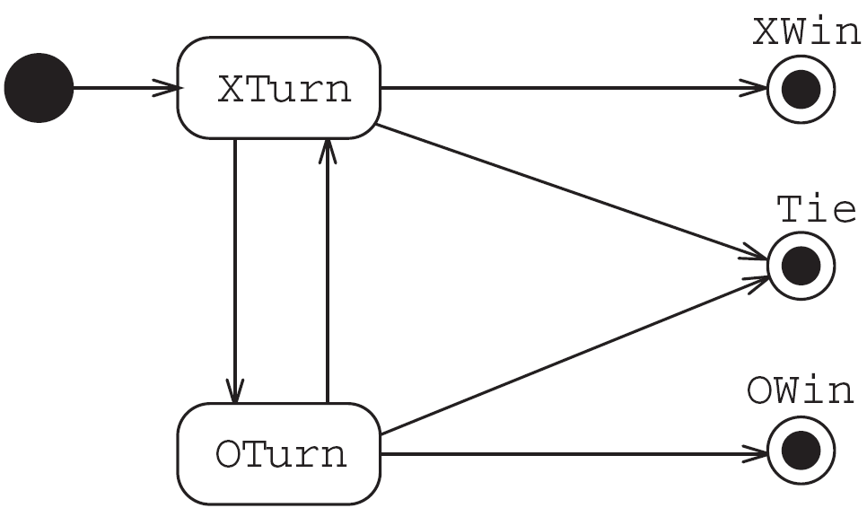
State diagrams – a first example
  State diagram of a tic-tac-toe (noughts and crosses) game:
A state is rendered as a rectangle with rounded corners containing the name of the state
A transition is rendered as a (solid) arrow connecting two states (in this first example all transitions are unlabelled)
A final state is represented as a filled black circle surrounded by an unfilled circle
The initial state is represented as a filled black circle
© Lethbridge/Laganière 2005
Chapter 8: Modelling Interactions and Behaviour

Slide 16
Overview of state diagram
In general, a State Transition Diagram (STD) includes:
states
transitions; the specification of a transition can (optionally) include:
  an event that causes the transition (with optional arguments),
  a guard condition given between square brackets (if there is more than one transition out of a state there must be mutually exclusive guard conditions on each transition), and
  an action, which is a non-interruptible behavior that occurs as part of a transition.
event(args) [guard condition] / action
AState
AnotherState
© Lethbridge/Laganière 2005
Chapter 8: Modelling Interactions and Behaviour

Slide 17
Example: STD specification of a one-bit buffer
B
A one-bit buffer is a (software or hardware) component which may hold a single bit.
  A one-bit buffer B may accept a bit at the input port (1); when holding a bit it may deliver it at the output port (2).
1
2
In the STD specification we use the following conventions:
  r1(b) = receive bit b at port 1
  s2(b) = send bit b at port 2
The STD describes a finite state machine.
B
r1(0)
r1(1)
s2(0)
s2(1)
B(0)
B(1)
© Lethbridge/Laganière 2005
Chapter 8: Modelling Interactions and Behaviour

Slide 18
State diagrams and formal specification
A State Transition Diagram (STD) gives an accurate description of the system’s behavior.
B
r1(0)
r1(1)
s2(0)
s2(1)
B(0)
B(1)
The behavior of the one-bit buffer can be specified by the following process algebra equation [BW90]:
B = r1(0) . s2(0) . B + r1(1) . s2(1) . B
Here
  ‘.’ is the operator for sequential composition
  ‘+’ is the operator for non-deterministic choice.
In case not just bits, but more generally, elements of some finite data set
(d∈)D are buffered we get the following equation:
B = ∑ d∈D r1(d) . s2(d) . B
© Lethbridge/Laganière 2005
Chapter 8: Modelling Interactions and Behaviour

Slide 19
State diagrams with elapsed-time transitions
The event that triggers a transition can be a certain amount of elapsed time.
The STD given below illustrates the use of elapsed-time transitions to model the behavior of a simple traffic light.
GreenLight
after(25s)
YellowLight
after(30s)
after(5s)
RedLight
© Lethbridge/Laganière 2005
Chapter 8: Modelling Interactions and Behaviour

Slide 20
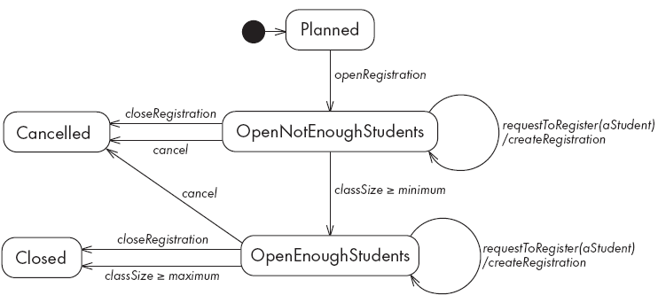
State diagrams – an example with conditional transitions
This STD describes the behavior of instances of the CourseSection class.
  It includes two transitions triggered by conditions becoming true.
  For example, in the OpenNotEnoughStudents state a CourseSection object makes a transition to the OpenEnoughStudents state (in which the course can actually be taught) as soon as the (classSize >= minimum) condition becomes true.
Remark: createRegistration is
an action attached to the requestToRegister(...) event.
© Lethbridge/Laganière 2005
Chapter 8: Modelling Interactions and Behaviour

Slide 21
Activities in state diagrams
  An activity is something that takes place while the system is in a state.
    It takes a period of time.
    An activity is shown inside the state itself, preceded by the string “do /” .
    The system takes a transition out of the state in response to completion of the activity (if no other transition is triggered before by some event).
© Lethbridge/Laganière 2005
Chapter 8: Modelling Interactions and Behaviour

Slide 22
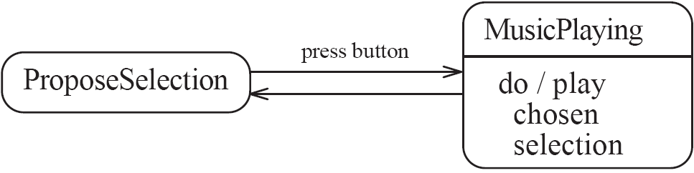
State diagram – an example with activity
State diagram for a jukebox illustrating an activity in a state.
In the ProposeSelection state the system waits for the user to press a button, selecting some music.
In the MusicPlay state the system plays the chosen music until it comes to an end.
  The system then takes a transition back to the ProposeSelection state.
© Lethbridge/Laganière 2005
Chapter 8: Modelling Interactions and Behaviour

Slide 23
Actions in state diagrams
  An action is something that takes place effectively instantaneously
    When a particular transition is taken (in this case the action is attached to an event)
    Upon entry into a particular state
      An entry action is shown inside the state, preceded by the string “entry /”
    Upon exit from a particular state
      An exit action is shown inside the state, preceded by the string “exit /”
  An action should consume no noticeable amount of time
© Lethbridge/Laganière 2005
Chapter 8: Modelling Interactions and Behaviour

Slide 24
State diagram – an example with actions
State diagram for a garage door opener
pressButton
Opening
enter / start motor forwards
do / run motor forwards
Closed
enter / stop motor
closingCompleted
openingCompleted
pressButton
Closing
enter / start motor in reverse
do / run motor in reverse
Open
enter / stop motor
pressButton
© Lethbridge/Laganière 2005
Chapter 8: Modelling Interactions and Behaviour

Slide 25
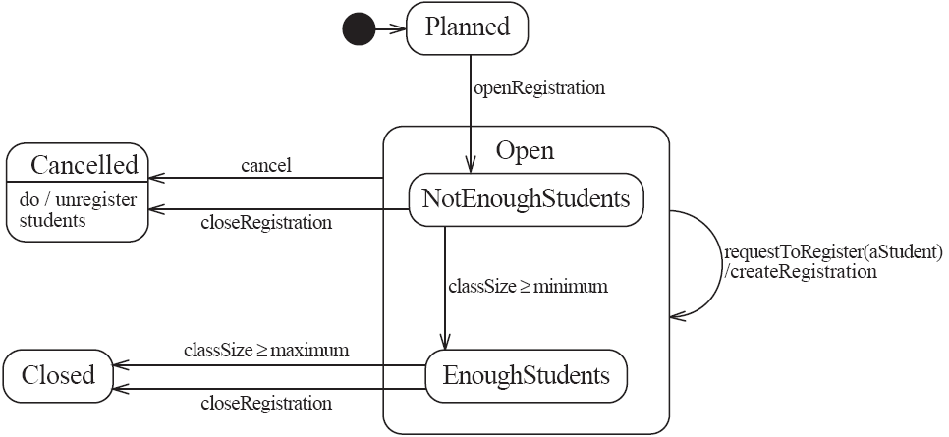
State diagram – an example with substates
A state diagram can be nested inside a state. The states of the inner diagram are called substates.
  If two or more states have an identical transition, they can be grouped together in a
  superstate. Then, rather than maintaining two identical transitions (one for each substate)
  the transition can be moved to the superstate.
The figure shows the behavior of instances of the CourseSection class, converted to use nested
substates. It is now enough to show only one ‘cancel’ transition and one ‘requestToRegister’
transition.
© Lethbridge/Laganière 2005
Chapter 8: Modelling Interactions and Behaviour

Slide 26
8.3. Activity diagrams
An activity diagram is used to understand the flow of work that an object or a system performs.
An activity diagram is a special kind of a state transition diagram, that shows the flow from activity to activity within a system. In an activity diagram the states are activity states and the flow of control passes immediately to the next state when the activity (of the current state) completes [BRJ99].
  An activity state represents the performance of a non-atomic task within a state machine.
  An action state is a special kind of an activity state that cannot be further decomposed (the internal activity of an action state is a single atomic computation).
© Lethbridge/Laganière 2005
Chapter 8: Modelling Interactions and Behaviour

Slide 27
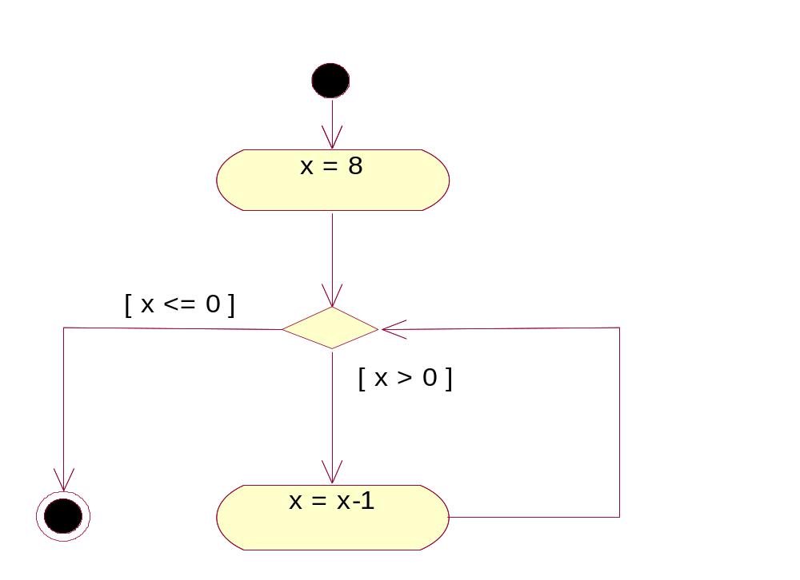
Activity diagram – an example with action states
An activity diagram can use action states to show the flowchart of an imperative program.
action state
initial state
guard
expression
branch
final state
© Lethbridge/Laganière 2005
Chapter 8: Modelling Interactions and Behaviour

Slide 28
Activity diagram – an example with activity states
An activity diagram can use activity states to show human activities, such as software processes.
The figure shows an activity diagram for throwaway prototyping [Bel05]:
Draw up an
outline specification
Construct
prototype
Check with
user
Deliver
specification
[User happy]
[User requires change]
Refine
prototype
© Lethbridge/Laganière 2005
Chapter 8: Modelling Interactions and Behaviour

Slide 29
Additional references
[BW90] J.C. Baeten, W.P. Weijland. Process algebra. Cambridge University Press, 1990.
[Bel05] D. Bell. Software Engineering for Students – a
Programming Approach (4th edition). Addison-Wesley, 2005.
[BRJ99] G. Booch, J.Rumbaugh, I. Jacobson. The Unified
Modeling Language User Guide. Addison Wesley, 1999.
© Lethbridge/Laganière 2005
Chapter 8: Modelling Interactions and Behaviour

