Slide 1
Matter

Slide 2
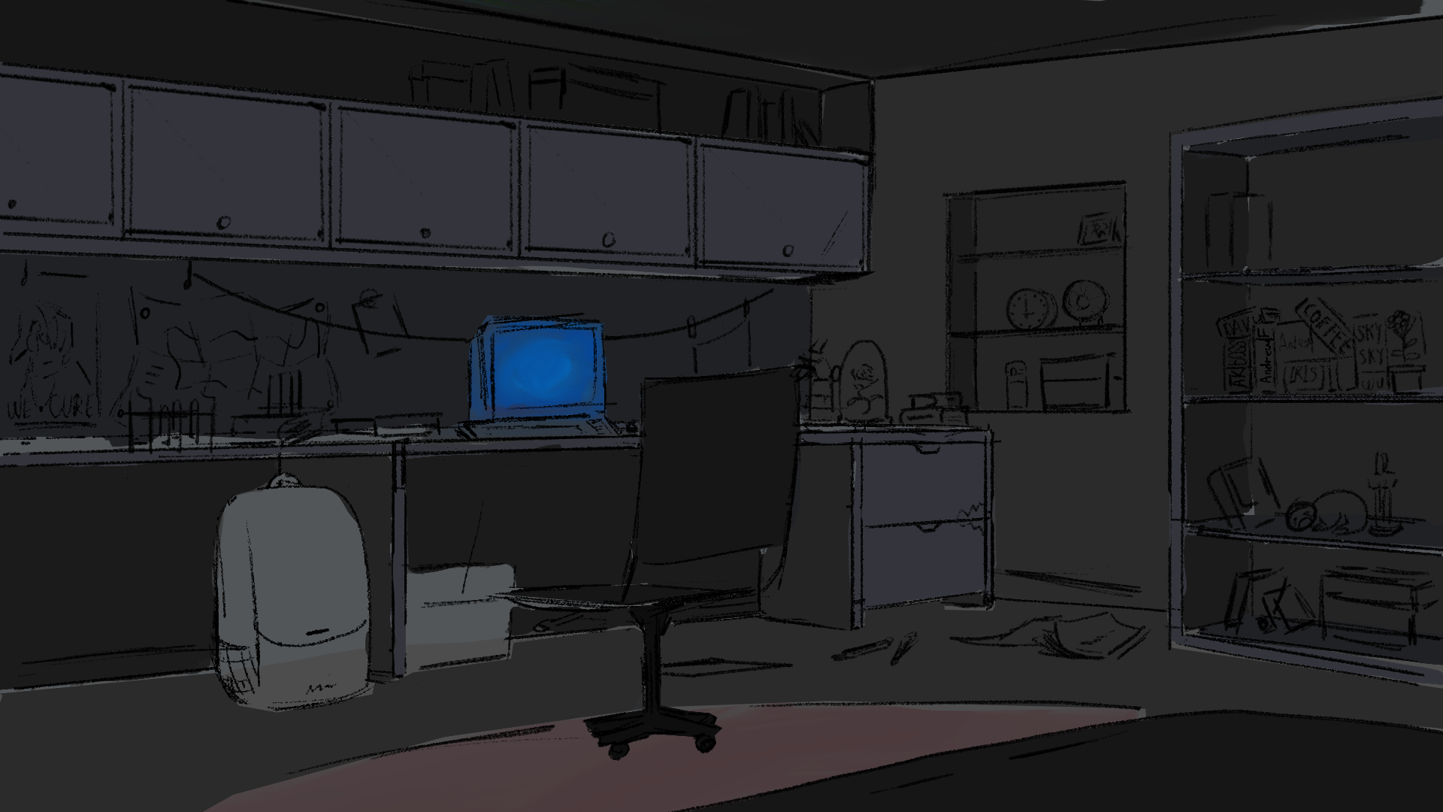

MATTER

