Slide 1
Summary: BIM Handbook
OK
Summary by Eng. Omar Khamis • Omar Khamis Library — 2026
A learning summary — not a substitute for the original book

Slide 2
What this deck covers
1
Introduction: why the BIM Handbook?
9
Level of Development (LOD)
2
From drawings to a model
10
Clash detection and coordination
3
Parametric modelling
11
Common data environment (CDE) and workflow
4
Interoperability (IFC and openBIM)
12
The BIM Execution Plan (BEP)
5
BIM for owners
13
Challenges and adoption in an office
6
BIM for designers
14
Case studies (general lessons)
7
BIM for contractors
15
Eng. Omar Khamis's takeaways
8
BIM for fabricators and suppliers

Slide 3
Introduction: why the BIM Handbook?
1
2
The BIM Handbook by Rafael Sacks, Chuck Eastman, Ghang Lee and Paul Teicholz (3rd edition, …
BIM is not software — it is a way of working: one digital model holding geometry (3D) and data (materials, quantities, cost, time, …
This summary is written by Eng. Omar Khamis in his own words and linked to day-to-day work in Revit and in offices in Egypt and Saudi Arabia.
Notes:
The BIM Handbook by Rafael Sacks, Chuck Eastman, Ghang Lee and Paul Teicholz (3rd edition, 2018) is the most complete academic and professional reference on Building Information Modelling. It explains BIM from the point of view of every party: owner, designer, contractor, fabricator and facility manager, and ends with case studies of real projects.
The idea in one sentence
BIM is not software — it is a way of working: one digital model holding geometry (3D) and data (materials, quantities, cost, time, maintenance) that everyone works on and uses over the building's life.

Slide 4
From drawings to a model
Level 0: paper or CAD without coordination.
Level 1: 2D/3D CAD with file-exchange standards.
Traditional drawing (CAD) | BIM
Lines with no meaning to the software | Smart elements (wall, door, column)
Every sheet on its own | All sheets from one model
Changing the plan does not change the section | Every change appears on all sheets and schedules
Manual take-off | Automatic quantities from the model
Clashes found on site | Clashes found on screen
Notes:
Maturity levels
Level 0: paper or CAD without coordination.
Level 1: 2D/3D CAD with file-exchange standards.
Level 2: a model per discipline exchanged in a common data environment (CDE) — the level most large public projects require.
Level 3: a fully integrated shared model (full openBIM).

Slide 5
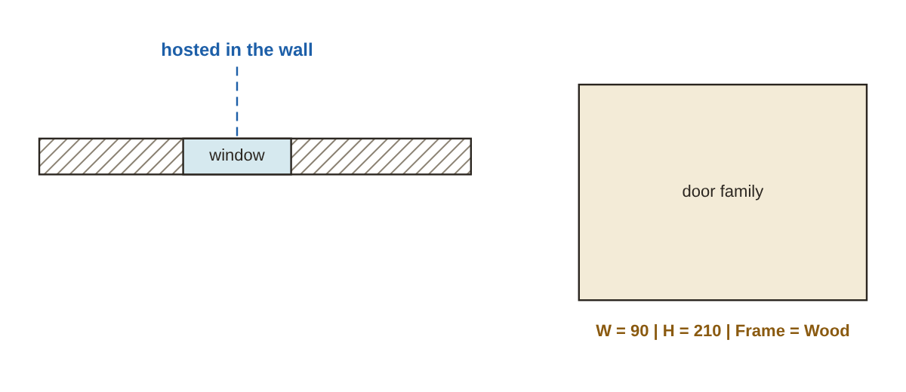
Parametric modelling
Elements are defined by rules and relationships: a window is "hosted" in a wall and moves with it; a slab sits on its level.
Change the storey height and walls, stairs and columns adjust themselves.
Revit families are the practical form: a door with width, height and frame type as parameters.
A hosted parametric element and family parameters
The same idea as the parametric blocks of Omar Khamis Library: change a parameter and the shape is rebuilt.
Notes:
Elements are defined by rules and relationships: a window is "hosted" in a wall and moves with it; a slab sits on its level.
Change the storey height and walls, stairs and columns adjust themselves.
Revit families are the practical form: a door with width, height and frame type as parameters.

Slide 6
Interoperability (IFC and openBIM)
IFC is an open international format (ISO 16739) for exchanging models between tools.
openBIM means a project is not locked into one program.
Item | Why it matters
Origin and coordinates | Models overlay correctly
Units | mm vs m — a mismatch breaks everything
Level and grid names | Coordination between disciplines
Classification (Uniclass / OmniClass) | Quantities, cost and specifications
File naming | The common data environment (CDE)
Notes:
IFC is an open international format (ISO 16739) for exchanging models between tools.
openBIM means a project is not locked into one program.
Not everything transfers perfectly: complex families and custom parameters can be lost — run an exchange test early.
COBie: a spreadsheet format for handing over operation and maintenance data.
Agreements to make early

Slide 7
BIM for owners
1
2
Better early decisions: design options with cost and energy performance before money is spent.
Cost and schedule control: 4D and 5D models.
3
4
Digital handover: an as-built model with equipment data for maintenance.
The owner's role is to state requirements in Employer's/Owner's Information Requirements (EIR / OIR) from day one.
Notes:
Better early decisions: design options with cost and energy performance before money is spent.
Cost and schedule control: 4D and 5D models.
Digital handover: an as-built model with equipment data for maintenance.
The owner's role is to state requirements in Employer's/Owner's Information Requirements (EIR / OIR) from day one.

Slide 8
BIM for designers
1
2
3
Conceptual design with masses, area, energy and solar analysis.
Coordinating disciplines: architecture, structure and MEP in linked models.
Sheets and schedules generated from the model (doors, windows, finishes, rooms).
4
5
6
Libraries and templates: the basis of an office's speed and quality.
Build an office template with wall, floor and ceiling types, line styles and schedules.
Keep an approved family library instead of everyone making their own.
Notes:
Conceptual design with masses, area, energy and solar analysis.
Coordinating disciplines: architecture, structure and MEP in linked models.
Sheets and schedules generated from the model (doors, windows, finishes, rooms).
Libraries and templates: the basis of an office's speed and quality.
Practical office tips
Build an office template with wall, floor and ceiling types, line styles and schedules.
Keep an approved family library instead of everyone making their own.
Set the level of detail for each stage so models do not grow heavy for nothing.

Slide 9
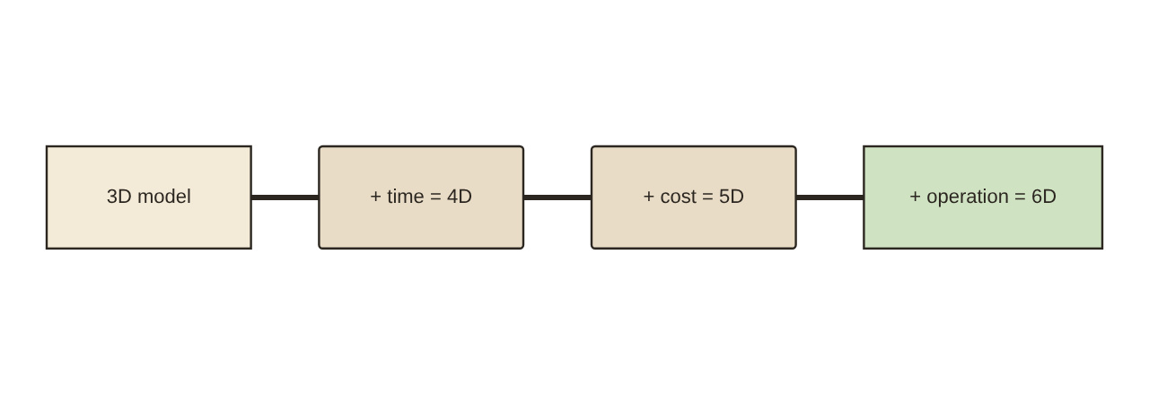
BIM for contractors
Quantity take-off from the model (concrete, masonry, tiles, paint).
4D: linking elements to the programme and simulating construction stages.
5D: linking quantities to rates and updating cost with every change.
Site planning: cranes, vehicle routes, laydown areas.
Shop drawings directly from the model.
BIM dimensions from 3D to 6D
Notes:
Quantity take-off from the model (concrete, masonry, tiles, paint).
4D: linking elements to the programme and simulating construction stages.
5D: linking quantities to rates and updating cost with every change.
Site planning: cranes, vehicle routes, laydown areas.
Shop drawings directly from the model.

Slide 10
BIM for fabricators and suppliers
1
2
Structural steel, façades, ductwork and built-in joinery are made directly from the model (CNC and automatic cutting).
Higher accuracy, less waste, faster installation on site.
3
Prefabrication and modular units are easier with BIM.
Notes:
Structural steel, façades, ductwork and built-in joinery are made directly from the model (CNC and automatic cutting).
Higher accuracy, less waste, faster installation on site.
Prefabrication and modular units are easier with BIM.

Slide 11
Level of Development (LOD)
LOD | Meaning | Use
100 | Mass or symbol | Early area and cost studies
200 | Generic element, approximate size and shape | Concept / schematic design
300 | Precise size, location and shape | Final design and tender drawings
350 | + connections to other elements | Coordination between disciplines
400 | Fabrication and installation detail | Shop drawings
500 | As-built, field-verified | Operation and maintenance

Slide 12
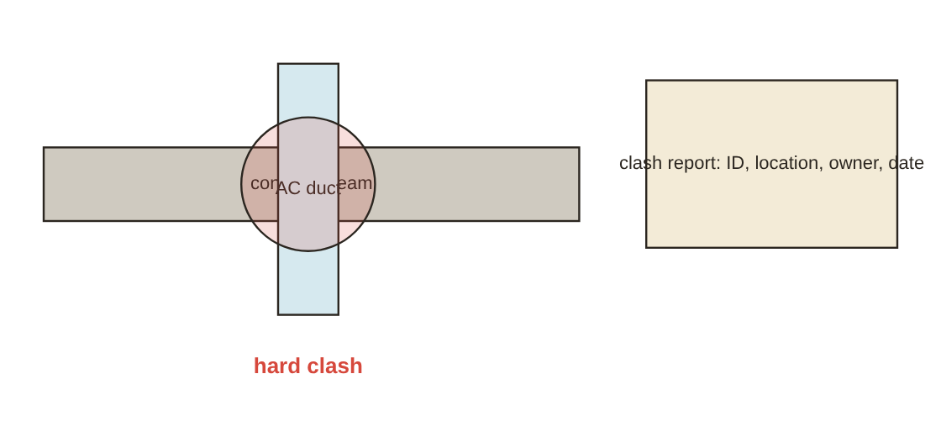
Clash detection and coordination
Combine discipline models in a coordination model (Navisworks, Solibri or similar).
Clash types: hard (pipe through beam), clearance (maintenance or insulation space), time (construction sequence).
Build a test matrix: architecture × structure, structure × mechanical, mechanical × electrical...
A weekly coordination meeting, with an owner and due date for every clash.
A hard clash between a duct and a beam, and the coordination report
Notes:
Combine discipline models in a coordination model (Navisworks, Solibri or similar).
Clash types: hard (pipe through beam), clearance (maintenance or insulation space), time (construction sequence).
Build a test matrix: architecture × structure, structure × mechanical, mechanical × electrical...
A weekly coordination meeting, with an owner and due date for every clash.

Slide 13
Common data environment (CDE) and workflow
1
2
CDE = one place for files with states: work in progress → shared → published → archived.
The international standard ISO 19650 sets out information management for BIM projects.
3
Every file has a standard name, revision and status.
Notes:
CDE = one place for files with states: work in progress → shared → published → archived.
The international standard ISO 19650 sets out information management for BIM projects.
Every file has a standard name, revision and status.

Slide 14
The BIM Execution Plan (BEP)
1
2
3
It usually contains:
The project's BIM goals (take-off? coordination? 4D? handover to FM?).
Parties and roles (BIM manager, coordinator, modellers).
4
5
6
Software, versions and exchange formats.
LOD per stage and per element.
Coordinates, units and naming.
Notes:
It usually contains:
The project's BIM goals (take-off? coordination? 4D? handover to FM?).
Parties and roles (BIM manager, coordinator, modellers).
Software, versions and exchange formats.
LOD per stage and per element.
Coordinates, units and naming.
Model exchange schedule and coordination meetings.
Model quality checking.
Final deliverables.

Slide 15
Challenges and adoption in an office
1
2
3
Up-front cost: licences, hardware, training.
Culture change: the work moves from "drawing" to "building a model".
IP and liability: who is responsible for the model? Set it in the contract.
4
5
6
A small pilot project.
An office template and family library.
Staged team training.
Notes:
Up-front cost: licences, hardware, training.
Culture change: the work moves from "drawing" to "building a model".
IP and liability: who is responsible for the model? Set it in the contract.
A plan to move an office to BIM
A small pilot project.
An office template and family library.
Staged team training.
Record lessons learned and roll out.

Slide 16
Case studies (general lessons)
1
2
Successful projects set clear BIM goals from the start.
Early contractor involvement reduces clashes and changes.
3
4
Prefabrication saved a lot of time on complex projects.
A handover model only helps the owner if it holds the data actually needed for maintenance.
Notes:
Successful projects set clear BIM goals from the start.
Early contractor involvement reduces clashes and changes.
Prefabrication saved a lot of time on complex projects.
A handover model only helps the owner if it holds the data actually needed for maintenance.

Slide 17
Eng. Omar Khamis's takeaways
1
2
3
BIM = model + information + collaboration, not a program.
Agree coordinates, units, naming and LOD on day one.
A clash on screen is far cheaper than a clash on site.
4
5
Start with a pilot and build an office template and library.
Hand the owner an as-built model with maintenance data.
Summary by Eng. Omar Khamis — Omar Khamis Library for SketchUp.
Notes:
BIM = model + information + collaboration, not a program.
Agree coordinates, units, naming and LOD on day one.
A clash on screen is far cheaper than a clash on site.
Start with a pilot and build an office template and library.
Hand the owner an as-built model with maintenance data.

Slide 18
Thank you
Summary by Eng. Omar Khamis • +20 100 543 3170
Omar Khamis Library for SketchUp

