Slide 1
Summary: Building Construction Illustrated — Ching
OK
Summary by Eng. Omar Khamis • Omar Khamis Library — 2026
A learning summary — not a substitute for the original book

Slide 2
What this deck covers
1
Introduction: a book that shows how buildings are built
8
Doors and windows
2
The site and the building
9
Stairs
3
Foundations
10
Finishes
4
Floor systems
11
Building services
5
Walls
12
Materials
6
Roofs
13
Eng. Omar Khamis's takeaways
7
Moisture and thermal protection

Slide 3
Introduction: a book that shows how buildings are built
1
2
3
Francis Ching's Building Construction Illustrated (6th edition, 2020) is one of the best-known books linking design to construction. …
It follows the building sequence: site → foundations → floors → walls → roofs → protection → openings → stairs → finishes → services → …
Understand why a detail is drawn the way it is, not just copy it.
4
5
Write correct construction notes on drawings.
Speak the site's language with contractors and supervisors.
This summary is written by Eng. Omar Khamis in his own words. The book is based on US practice (IBC and US materials); here we relate it to practice in Egypt and Saudi …
Notes:
Francis Ching's Building Construction Illustrated (6th edition, 2020) is one of the best-known books linking design to construction. Its strength is that it is entirely hand-drawn in clear 3D drawings that show every layer and every joint.
It follows the building sequence: site → foundations → floors → walls → roofs → protection → openings → stairs → finishes → services → materials.
What you gain
Understand why a detail is drawn the way it is, not just copy it.
Write correct construction notes on drawings.
Speak the site's language with contractors and supervisors.

Slide 4
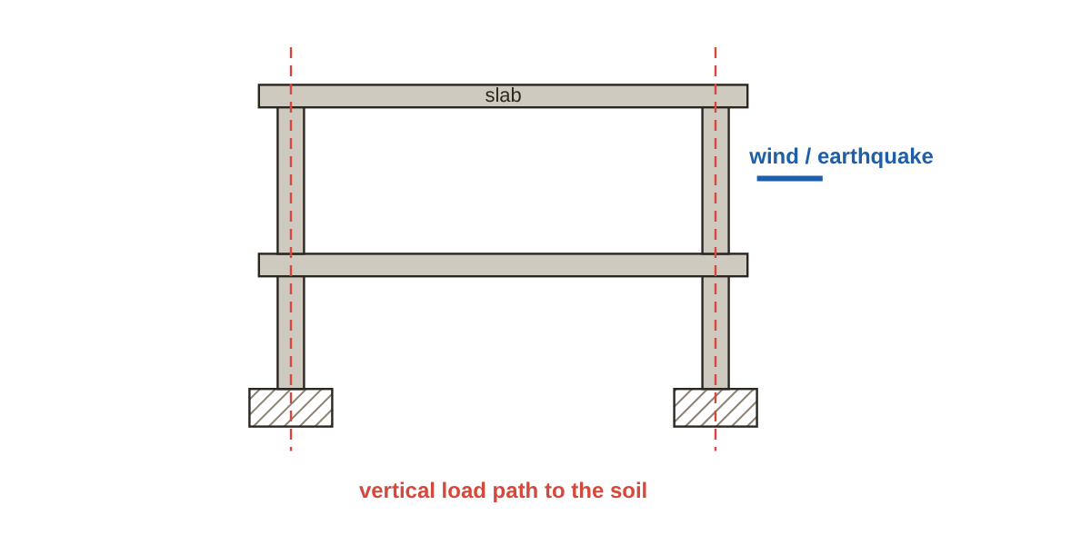
The site and the building
Site analysis: sun, wind, soil, groundwater, roads and utilities, before any design.
Orientation: in hot-dry climates (Egypt, Saudi Arabia) long façades face north and south, with the fewest openings to the west.
Surface drainage: ground falls away from the building (about 2–5% over the first 3 m).
Ching divides the building into systems: structure (what carries loads), enclosure (what keeps the weather out) and services (power, …
Load travels roof → beams → columns or bearing walls → foundations → soil.
Vertical and lateral load paths
Notes:
Site analysis: sun, wind, soil, groundwater, roads and utilities, before any design.
Orientation: in hot-dry climates (Egypt, Saudi Arabia) long façades face north and south, with the fewest openings to the west.
Surface drainage: ground falls away from the building (about 2–5% over the first 3 m).
The building as systems
Ching divides the building into systems: structure (what carries loads), enclosure (what keeps the weather out) and services (power, plumbing, HVAC). A good detail serves all three.
The load path
Load travels roof → beams → columns or bearing walls → foundations → soil.

Slide 5
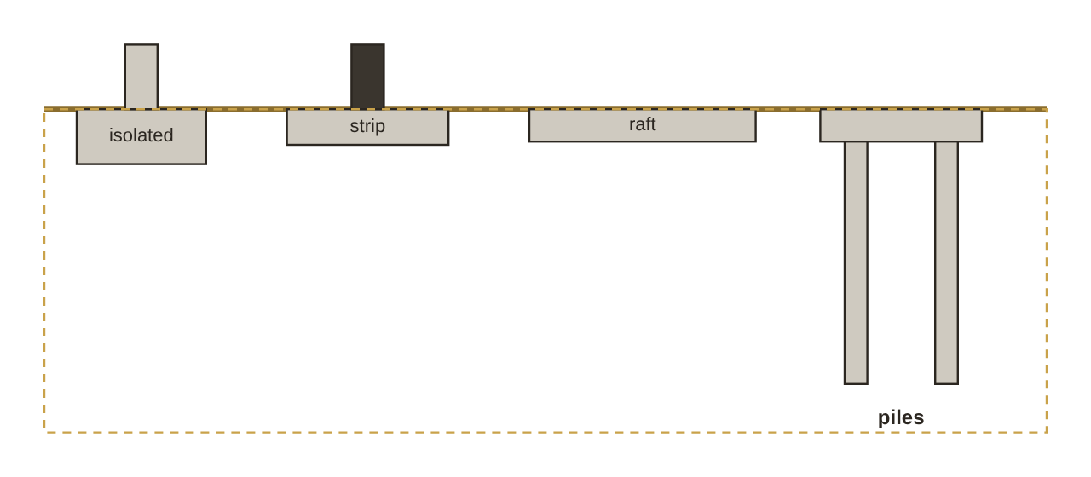
Foundations
Isolated footings under columns: the most common in housing.
Strip footings under bearing walls.
Raft: weak soil, heavy loads, or a basement with groundwater.
Piles: carry load to a stronger layer, by friction or end bearing.
Caissons: large-diameter piles.
Shallow and deep foundation types
Egypt: Egyptian code for soil mechanics and foundations. Saudi Arabia: SBC 303 (soils and foundations). Check the official text.
Notes:
Shallow foundations
Isolated footings under columns: the most common in housing.
Strip footings under bearing walls.
Raft: weak soil, heavy loads, or a basement with groundwater.
Deep foundations
Piles: carry load to a stronger layer, by friction or end bearing.
Caissons: large-diameter piles.
Key site points
The soil report decides the foundation type and level — never guess.
Blinding concrete about 10 cm under footings.
Waterproof footings, ground beams and below-grade walls before backfilling.
Backfill in 20–30 cm layers, wetted and compacted.

Slide 6
Floor systems
A slab is one-way when the long/short ratio exceeds 2, two-way below that.
Movement joints in long buildings at spacings set by the structural engineer.
System | Use
Solid slab on beams | The most common in housing
Flat slab | Flat soffits, easier finishes and HVAC
Ribbed / hollow block | Longer spans, less weight
Waffle | Long spans in both directions
Post-tensioned | Long spans with thinner slabs
Notes:
Reinforced concrete
A slab is one-way when the long/short ratio exceeds 2, two-way below that.
Movement joints in long buildings at spacings set by the structural engineer.
Ground-bearing floors
Compacted fill → polyethylene vapour barrier → concrete → finish.

Slide 7
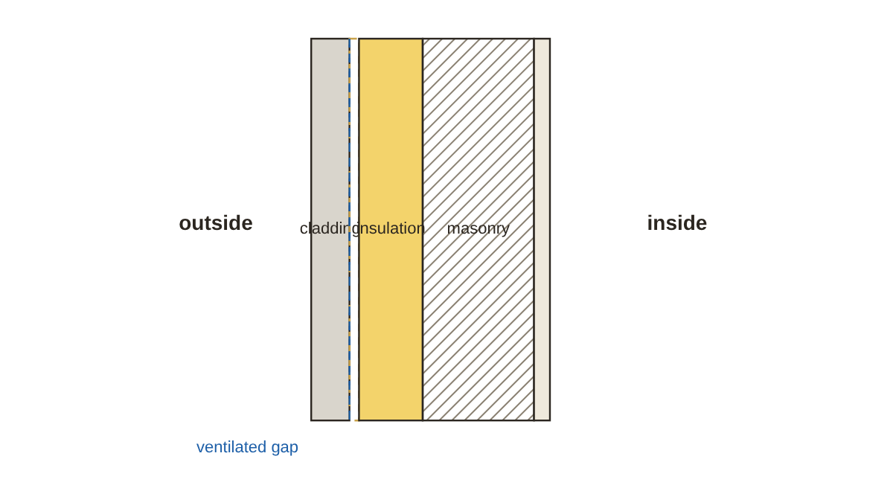
Walls
Load-bearing: carry the slabs (bearing masonry).
Non-load-bearing / infill: in framed buildings, they only enclose.
Cavity wall: two leaves with a cavity and insulation, better thermally and against damp.
Lintels bear at least 15–20 cm into the wall each side.
Bond: vertical joints never line up (half-brick offset).
Section through an insulated external cavity wall
Notes:
Wall types
Load-bearing: carry the slabs (bearing masonry).
Non-load-bearing / infill: in framed buildings, they only enclose.
Cavity wall: two leaves with a cavity and insulation, better thermally and against damp.
Key requirements
Lintels bear at least 15–20 cm into the wall each side.
Bond: vertical joints never line up (half-brick offset).
Tie walls to columns with starter bars or mesh every 3–4 courses.
Roof parapet about 100–120 cm high for safety.

Slide 8
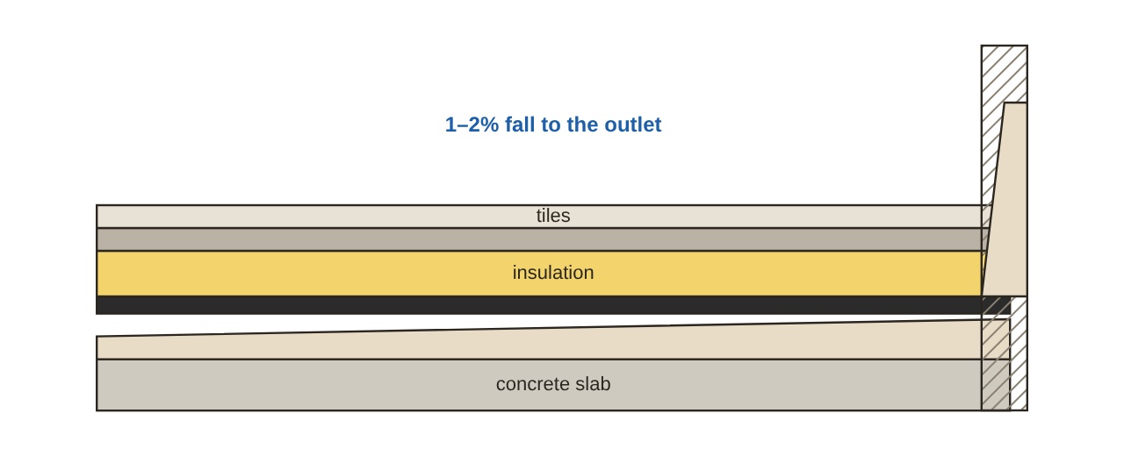
Roofs
Need a fall of at least 1–2%.
Inverted roof build-up: slab → screed to falls → waterproofing → insulation → protection/tiles.
The membrane turns up the parapet 20–30 cm and is fixed with a flashing or profile.
Outlets and downpipes sized for the roof area, plus an overflow.
Tiles: usually 22–45° depending on the tile.
Inverted roof build-up and membrane upstand at the parapet
Notes:
Flat roofs
Need a fall of at least 1–2%.
Inverted roof build-up: slab → screed to falls → waterproofing → insulation → protection/tiles.
The membrane turns up the parapet 20–30 cm and is fixed with a flashing or profile.
Outlets and downpipes sized for the roof area, plus an overflow.
Pitched roofs
Tiles: usually 22–45° depending on the tile.
Ventilation under the tiles and a secondary underlay.

Slide 9
Moisture and thermal protection
1
2
3
Bitumen membranes (torch-applied rolls), liquid membranes (polyurethane/acrylic), cementitious (bathrooms, tanks).
Bathrooms: the whole floor, turned up the walls 20–30 cm, and 180–200 cm in the shower.
Flood test for 24–48 hours before covering.
4
5
6
Best placed outside (protects the structure and keeps thermal mass inside).
Common materials: extruded polystyrene (XPS), mineral wool, sprayed polyurethane.
Vapour retarder on the warm side of the insulation.
Saudi Arabia: SBC 601/602 (energy conservation). Egypt: code for improving energy efficiency in buildings. Check the official text.
Notes:
Waterproofing
Bitumen membranes (torch-applied rolls), liquid membranes (polyurethane/acrylic), cementitious (bathrooms, tanks).
Bathrooms: the whole floor, turned up the walls 20–30 cm, and 180–200 cm in the shower.
Flood test for 24–48 hours before covering.
Thermal insulation
Best placed outside (protects the structure and keeps thermal mass inside).
Common materials: extruded polystyrene (XPS), mineral wool, sprayed polyurethane.
Vapour retarder on the warm side of the insulation.
Thermal bridges
Columns, beams and projecting slabs carry heat around the insulation — wrap or insulate them.

Slide 10
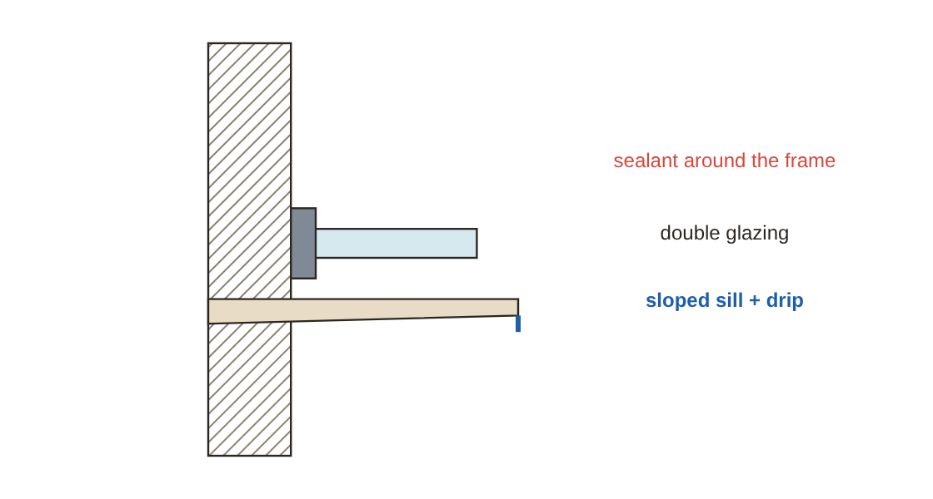
Doors and windows
Frames fixed into the wall with lugs or anchors, with a separation joint to the plaster.
External windows: sill sloping outwards and a drip under the sill.
Sealant around the frame outside and insulating fill in the gap behind it.
External window sill detail
Notes:
Frames fixed into the wall with lugs or anchors, with a separation joint to the plaster.
External windows: sill sloping outwards and a drip under the sill.
Sealant around the frame outside and insulating fill in the gap behind it.

Slide 11
Stairs
Step rule: 2 × riser + tread = 60–65 cm.
All steps in a flight the same size (a difference above about 1 cm causes trips).
Type | Note
Cast concrete | The most common in Egypt and Saudi Arabia
Steel with timber or marble treads | Villas and feature stairs
Spiral | Tight spaces, not a main escape route
Cantilevered | Needs special structural design
Notes:
Step rule: 2 × riser + tread = 60–65 cm.
All steps in a flight the same size (a difference above about 1 cm causes trips).
Nosing projecting 2–3 cm or an anti-slip strip.
Guard about 90 cm high, openings under 10–12 cm.

Slide 12
Finishes
1
2
3
Three coats: scratch (bond) → brown (levelled to screeds and dots) → finish (smooth), about 2–2.5 cm total.
Mesh where concrete meets masonry to prevent cracks.
Metal studs at 40 or 60 cm, board 12.5 mm.
4
5
6
Joints taped and filled in 3 coats.
Tiles on mortar or adhesive depending on type, with movement joints at walls and in large areas.
Timber: 1 cm gap at walls.
Notes:
Plaster
Three coats: scratch (bond) → brown (levelled to screeds and dots) → finish (smooth), about 2–2.5 cm total.
Mesh where concrete meets masonry to prevent cracks.
Drywall
Metal studs at 40 or 60 cm, board 12.5 mm.
Joints taped and filled in 3 coats.
Floors
Tiles on mortar or adhesive depending on type, with movement joints at walls and in large areas.
Timber: 1 cm gap at walls.
Paint
Dry, clean surface → primer/sealer → filler in coats → sanding → at least two finish coats.

Slide 13
Building services
1
2
Plumbing: supply under pressure; drainage by gravity at about 1–2% for horizontal pipes.
HVAC: duct routes need ceiling depth (often 40–60 cm).
3
4
Electrical: distribution boards, separate circuits for AC, heaters and kitchen, and earthing.
Coordination before casting: sleeves in beams and slabs are placed before the pour, not cut afterwards.
Any coring of concrete after casting needs the structural engineer's approval.
Notes:
Plumbing: supply under pressure; drainage by gravity at about 1–2% for horizontal pipes.
HVAC: duct routes need ceiling depth (often 40–60 cm).
Electrical: distribution boards, separate circuits for AC, heaters and kitchen, and earthing.
Coordination before casting: sleeves in beams and slabs are placed before the pour, not cut afterwards.

Slide 14
Materials
Material | Key property
Concrete | Strong in compression, weak in tension — steel takes the tension
Steel | Strong in tension, needs protection from rust and fire
Timber | Light and easy, needs protection from damp and insects
Clay / concrete blocks | Thermal mass, good fire resistance
Glass | Transparent, needs safety design (tempered / laminated)
Aluminium | Light, corrosion resistant, high thermal movement

Slide 15
Eng. Omar Khamis's takeaways
1
2
3
Understand the system (structure, enclosure, services) before the detail.
Water must always have a way out: falls, drips, flashings, outlets.
Waterproofing is tested before it is covered.
4
5
Insulation is better outside, the vapour retarder inside.
Coordinating disciplines before the pour saves money and time.
Summary by Eng. Omar Khamis — Omar Khamis Library for SketchUp.
Notes:
Understand the system (structure, enclosure, services) before the detail.
Water must always have a way out: falls, drips, flashings, outlets.
Waterproofing is tested before it is covered.
Insulation is better outside, the vapour retarder inside.
Coordinating disciplines before the pour saves money and time.

Slide 16
Thank you
Summary by Eng. Omar Khamis • +20 100 543 3170
Omar Khamis Library for SketchUp

