Slide 1
Summary: Architecture for the Poor — Hassan Fathy
OK
Summary by Eng. Omar Khamis • Omar Khamis Library — 2026
A learning summary — not a substitute for the original book

Slide 2
What this deck covers
1
Introduction: a book that changed how the world sees …
8
The mashrabiya
2
The problem: poverty and housing
9
Cooperative building and participation
3
The story of Gourna
10
Cost and economy
4
Mud brick
11
Criticism and lessons
5
The Nubian vault and dome
12
Hassan Fathy's influence
6
The courtyard
13
Eng. Omar Khamis's takeaways
7
The malqaf and natural ventilation

Slide 3
Introduction: a book that changed how the world sees climate-responsive architecture
1
2
Architecture for the Poor: An Experiment in Rural Egypt, by the Egyptian architect Hassan Fathy (1900–1989). …
One of the first Arab architecture books to reach the whole world and be translated into many languages.
3
4
It asks a question still open today: how do we build good homes people can afford?
An intellectual foundation for sustainable, climate-responsive architecture in the Arab world.
This summary is written by Eng. Omar Khamis for learning and is no substitute for reading the original.
Notes:
Architecture for the Poor: An Experiment in Rural Egypt, by the Egyptian architect Hassan Fathy (1900–1989). First published in Cairo in 1969 as "Gourna: A Tale of Two Villages", then in English by the University of Chicago Press in 1973. It tells the story of building New Gourna village west of Luxor between 1946 and 1952.
Why the book matters
One of the first Arab architecture books to reach the whole world and be translated into many languages.
It asks a question still open today: how do we build good homes people can afford?
An intellectual foundation for sustainable, climate-responsive architecture in the Arab world.

Slide 4
The problem: poverty and housing
1
2
In the 1940s millions of Egyptian farmers lived in poor, decaying houses.
"Modern" materials (cement, steel, imported timber) were too expensive for them.
3
4
The usual government answer: standard concrete buildings — costly and unsuited to the climate and way of life.
Fathy saw the answer in local materials, traditional craft and people's participation.
Notes:
In the 1940s millions of Egyptian farmers lived in poor, decaying houses.
"Modern" materials (cement, steel, imported timber) were too expensive for them.
The usual government answer: standard concrete buildings — costly and unsuited to the climate and way of life.
Fathy saw the answer in local materials, traditional craft and people's participation.

Slide 5
The story of Gourna
1
2
The people of Old Gourna lived on top of the ancient Theban tombs, and the government decided to move them to a new village.
Fathy was commissioned to design the new village in mud brick.
3
4
A large part was built: the market, mosque, khan, theatre, a school and a number of houses.
The project was never completed: administrative and funding problems, and some villagers refused to leave their old homes.
The lesson: a housing project does not succeed on design alone — it needs social acceptance and administrative support.
Notes:
The people of Old Gourna lived on top of the ancient Theban tombs, and the government decided to move them to a new village.
Fathy was commissioned to design the new village in mud brick.
A large part was built: the market, mosque, khan, theatre, a school and a number of houses.
The project was never completed: administrative and funding problems, and some villagers refused to leave their old homes.

Slide 6
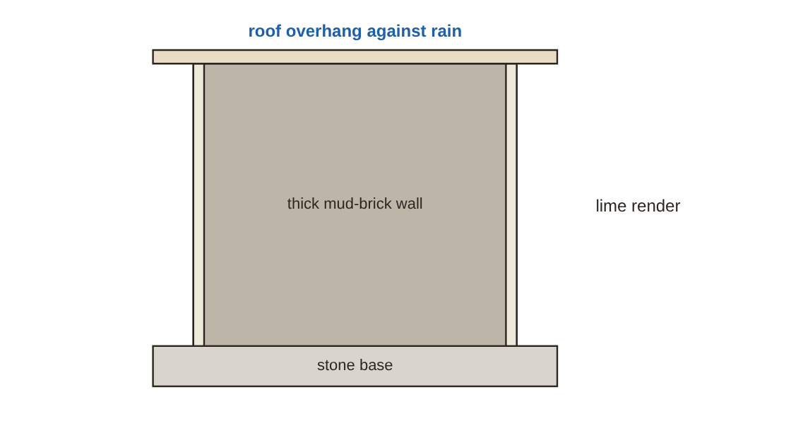
Mud brick
Mud + straw + water, mixed and left to mature, shaped in timber moulds and dried in the sun.
No firing = almost no energy and low cost.
Water is the enemy: a stone or fired-brick base, roof overhangs, lime render renewed regularly.
Lower compressive strength than fired brick — suited to low buildings (one or two storeys).
Protecting a mud-brick wall from water
Notes:
Ingredients and making
Mud + straw + water, mixed and left to mature, shaped in timber moulds and dried in the sun.
No firing = almost no energy and low cost.
Advantages
Weaknesses and protection
Water is the enemy: a stone or fired-brick base, roof overhangs, lime render renewed regularly.
Lower compressive strength than fired brick — suited to low buildings (one or two storeys).

Slide 7
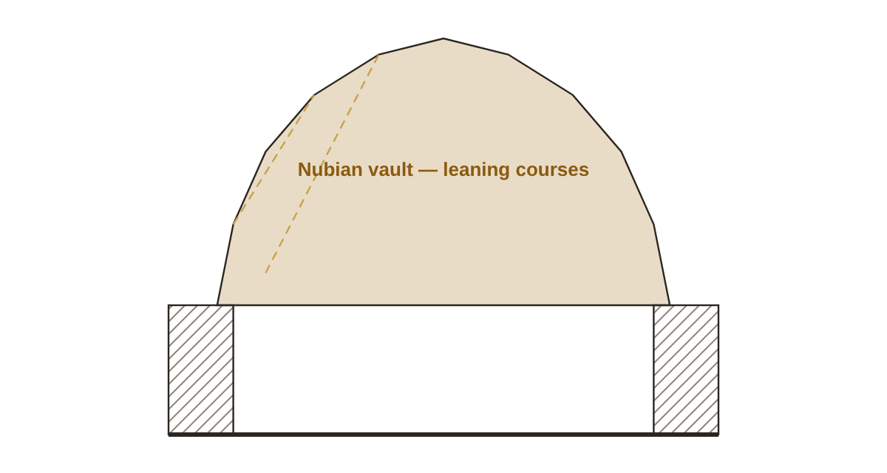
The Nubian vault and dome
Nubian masons near Aswan built vaults without timber centring: bricks are laid in leaning courses against an end wall, …
This solved the problem of expensive timber in Egypt (it was imported).
The curved shape (close to a parabola) keeps the load in compression only, where mud brick is strong.
A dome over a square room sits on pendentives in the corners.
A Nubian vault built in leaning courses without centring
Notes:
Nubian masons near Aswan built vaults without timber centring: bricks are laid in leaning courses against an end wall, each course holding the one before.
This solved the problem of expensive timber in Egypt (it was imported).
The curved shape (close to a parabola) keeps the load in compression only, where mud brick is strong.
A dome over a square room sits on pendentives in the corners.

Slide 8
The courtyard
1
2
The house is grouped around a courtyard open to the sky.
The courtyard stores cool night air and releases it to the rooms in the morning.
3
4
It gives shade and privacy to the family, and space for children and plants.
Proportion matters: a narrow, tall courtyard = more shade.
Notes:
The house is grouped around a courtyard open to the sky.
The courtyard stores cool night air and releases it to the rooms in the morning.
It gives shade and privacy to the family, and space for children and plants.
Proportion matters: a narrow, tall courtyard = more shade.

Slide 9
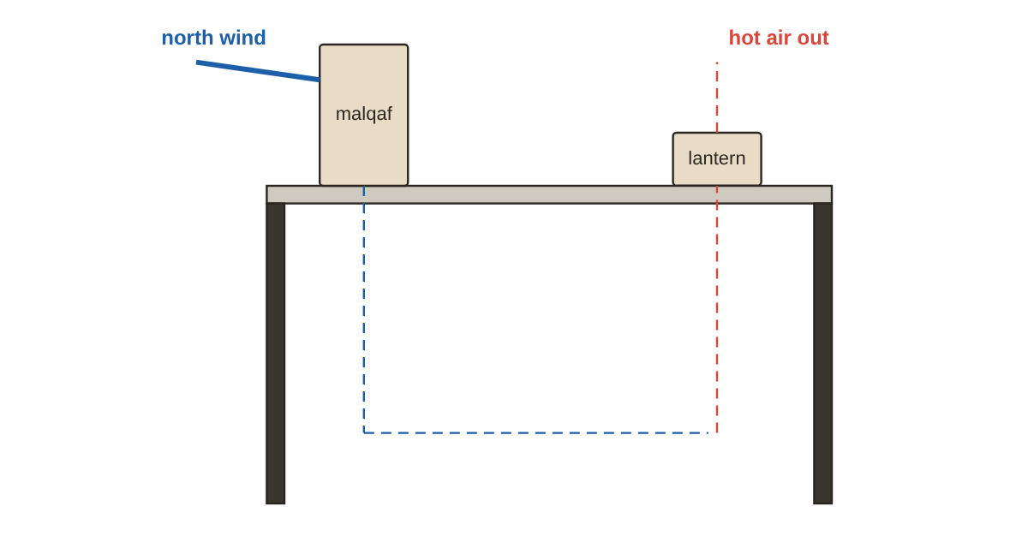
The malqaf and natural ventilation
The malqaf is a roof tower open to the prevailing wind (north-west in Egypt).
It catches cleaner air from above (cleaner and cooler than street air) and brings it down into rooms.
Wet pottery or charcoal placed in it cools the air by evaporation.
With the shukhshaykha (a roof lantern letting hot air out) it completes a ventilation cycle.
The ventilation cycle of the malqaf and the roof lantern
Notes:
The malqaf is a roof tower open to the prevailing wind (north-west in Egypt).
It catches cleaner air from above (cleaner and cooler than street air) and brings it down into rooms.
Wet pottery or charcoal placed in it cools the air by evaporation.
With the shukhshaykha (a roof lantern letting hot air out) it completes a ventilation cycle.

Slide 10
The mashrabiya
1
2
Turned timber lattice with small openings over windows.
Breaks direct sun and reduces glare.
3
4
Privacy: those inside can see out, not the other way round.
Lets air through; water jars were once placed behind it for cooling.
Notes:
Turned timber lattice with small openings over windows.
Breaks direct sun and reduces glare.
Privacy: those inside can see out, not the other way round.
Lets air through; water jars were once placed behind it for cooling.

Slide 11
Cooperative building and participation
1
2
Fathy believed people should take part in building their homes: learn the craft and work with their hands.
The architect's role is to understand each family's needs (size, work, animals, customs) and design for them.
3
4
Every house in Gourna was different for its family — against the idea of a repeated standard unit.
Training: passing the Nubian masons' craft on to the villagers.
Notes:
Fathy believed people should take part in building their homes: learn the craft and work with their hands.
The architect's role is to understand each family's needs (size, work, animals, customs) and design for them.
Every house in Gourna was different for its family — against the idea of a repeated standard unit.
Training: passing the Nubian masons' craft on to the villagers.

Slide 12
Cost and economy
1
2
Local earth and building without centring greatly reduced cost compared with concrete.
Labour from the villagers themselves = money stays in the village.
3
For Fathy, the true cost of a house is not only materials — it includes thermal comfort, building life and maintenance.
Notes:
Local earth and building without centring greatly reduced cost compared with concrete.
Labour from the villagers themselves = money stays in the village.
For Fathy, the true cost of a house is not only materials — it includes thermal comfort, building life and maintenance.

Slide 13
Criticism and lessons
1
2
3
Bureaucracy and changing officials.
Villagers were attached to their old place and livelihood.
Some saw mud brick as "poor people's architecture" and wanted "modern" concrete.
4
5
6
Design for climate first: orientation, shade, natural ventilation, thermal mass.
Local, low-energy materials where appropriate.
The user is a partner in design.
Notes:
Why the project did not fully succeed
Bureaucracy and changing officials.
Villagers were attached to their old place and livelihood.
Some saw mud brick as "poor people's architecture" and wanted "modern" concrete.
Lessons for today
Design for climate first: orientation, shade, natural ventilation, thermal mass.
Local, low-energy materials where appropriate.
The user is a partner in design.
Traditional crafts can be developed rather than discarded.
Low cost does not mean poor architecture.

Slide 14
Hassan Fathy's influence
1
2
He received the Right Livelihood Award ("Alternative Nobel") and an Aga Khan award for architecture.
New Gourna today receives international attention for heritage conservation.
3
4
His ideas influenced architects in Egypt, Saudi Arabia and worldwide, and the modern earth-architecture movement.
Projects such as New Baris village in the Kharga oasis and Dar al-Islam in New Mexico continue his ideas.
Notes:
He received the Right Livelihood Award ("Alternative Nobel") and an Aga Khan award for architecture.
New Gourna today receives international attention for heritage conservation.
His ideas influenced architects in Egypt, Saudi Arabia and worldwide, and the modern earth-architecture movement.
Projects such as New Baris village in the Kharga oasis and Dar al-Islam in New Mexico continue his ideas.

Slide 15
Eng. Omar Khamis's takeaways
1
2
3
Good architecture is not about expense — it is about understanding.
The hot climate of Egypt and Saudi Arabia calls for thick walls, courtyards, wind catchers, mashrabiyas and few west openings.
Every housing project must weigh the social factor, not just the structural one.
4
5
Traditional craft is a treasure — develop it with modern techniques.
Read the original book — it holds a spirit no summary can.
Summary by Eng. Omar Khamis — Omar Khamis Library for SketchUp.
Notes:
Good architecture is not about expense — it is about understanding.
The hot climate of Egypt and Saudi Arabia calls for thick walls, courtyards, wind catchers, mashrabiyas and few west openings.
Every housing project must weigh the social factor, not just the structural one.
Traditional craft is a treasure — develop it with modern techniques.
Read the original book — it holds a spirit no summary can.

Slide 16
Thank you
Summary by Eng. Omar Khamis • +20 100 543 3170
Omar Khamis Library for SketchUp

